Slide 1
In-situ Satellite Measurements
John Sample
Montana State University
7-27-19
Many thanks to: Mark Moldwin for slides on magnetometry
John Bonnell for Slides on Electric Field Measurements
Davin Larson for Slides on Particle measurements

Slide 2
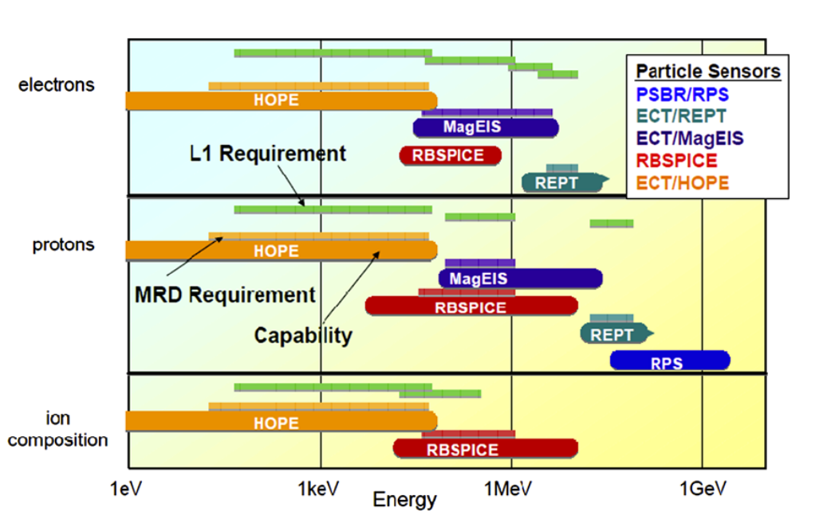
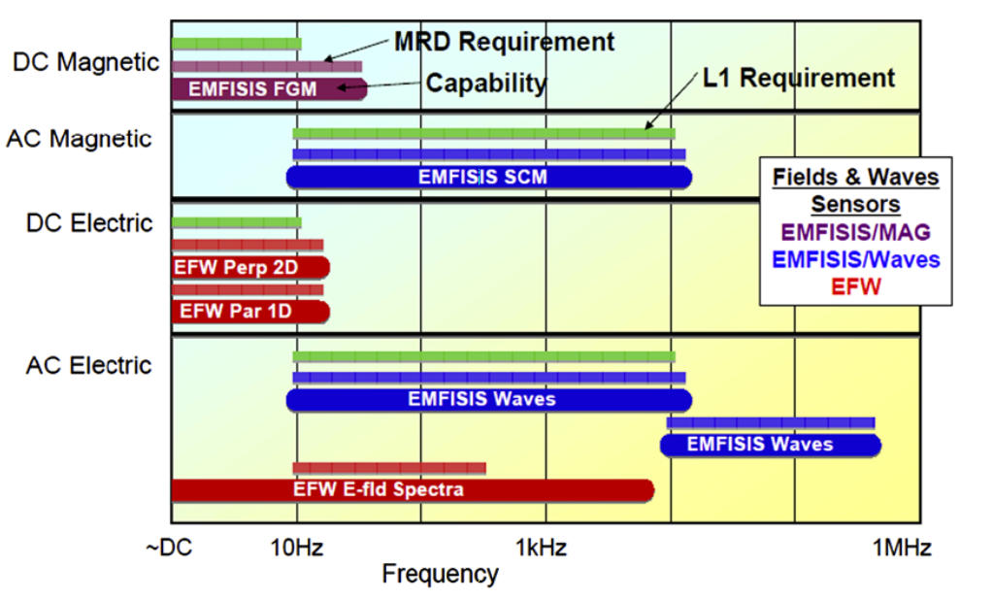
Outline
What do we want to measure?
  E, B, J (current or flux), n, T, v….
  Within each there are subdivisions
    frequency
    energy
    species
  Many different measurement techniques required
  Even these quantities sometimes require augmentation to get to relevant physics (e.g. PSD)
From Mauk et al., 2012
“Space plasma measurements are conducted in a hostile, remote environment. The art and science of measurements gathered in space depend therefore on unique instrument designs and fabrication methods to an extent perhaps unprecedented in experimental physics.” –Preface to “Measurement Techniques in Space Plasmas” -Pfaff, Borovsky, Young - editors

Slide 3
Outline
What do we want to measure?
  E, B, J, n, T, v….
  Within each there are subdivisions
    frequency
    energy
    species
  Many different measurement techniques required
  Even these quantities sometimes require augmentation to get to relevant physics (e.g. PSD)
From Mauk et al., 2012
“Space plasma measurements are conducted in a hostile, remote environment. The art and science of measurements gathered in space depend therefore on unique instrument designs and fabrication methods to an extent perhaps unprecedented in experimental physics.” –Preface to “Measurement Techniques in Space Plasmas” -Pfaff, Borovsky, Young - editors

Slide 4
Outline
Particle Detectors
Magnetic Field Sensors
Electric Field Sensors
Example instruments from (mostly) recent missions will be scattered throughout

Slide 5
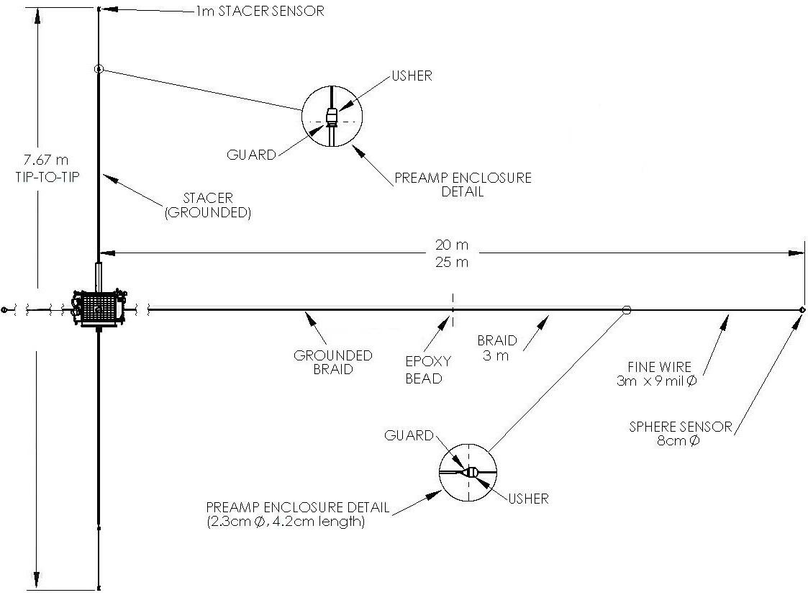
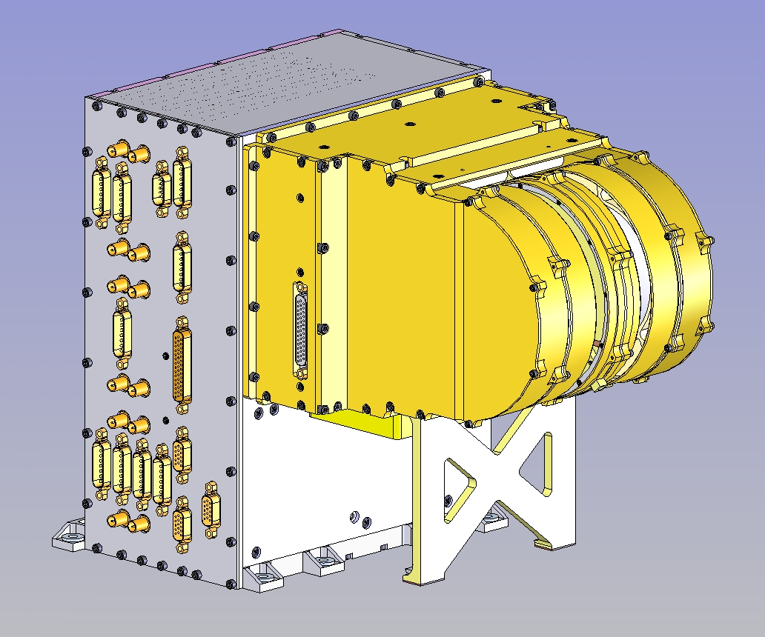
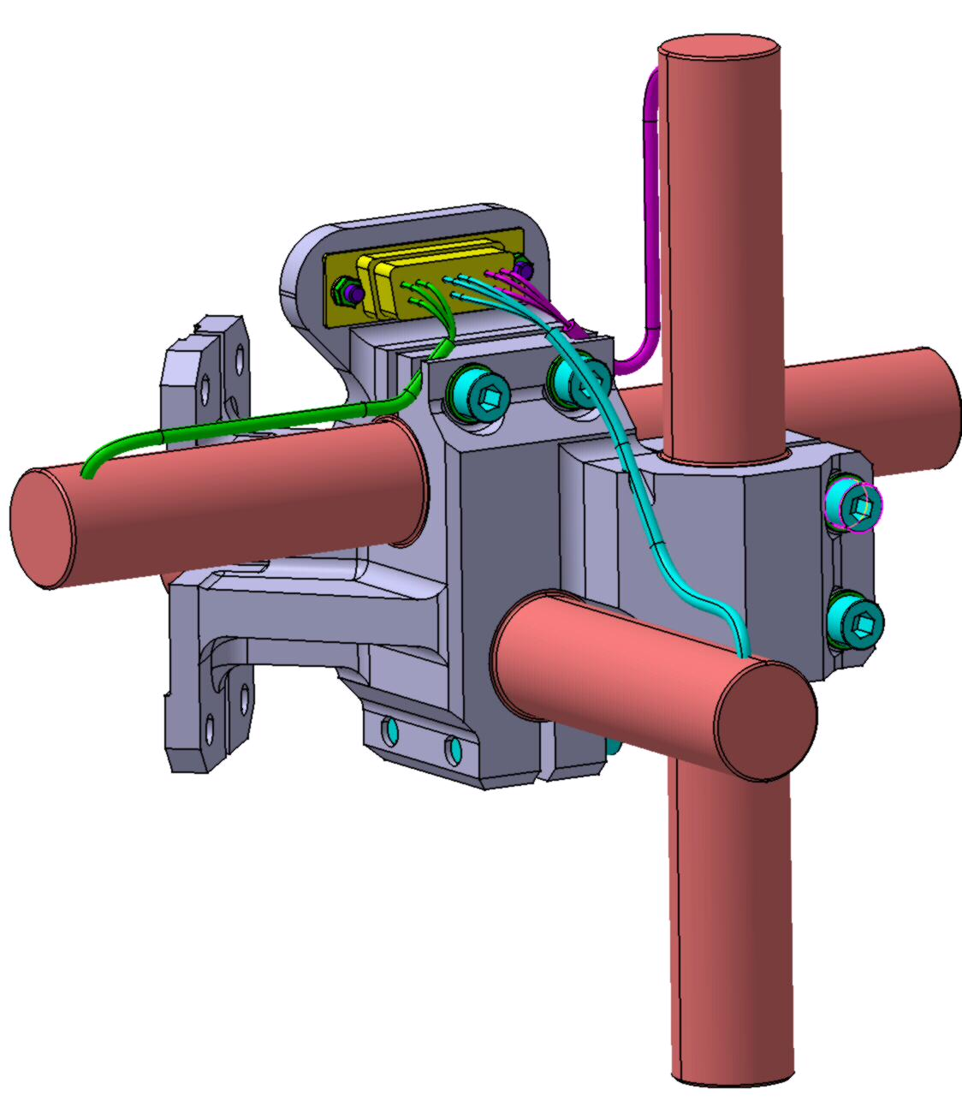
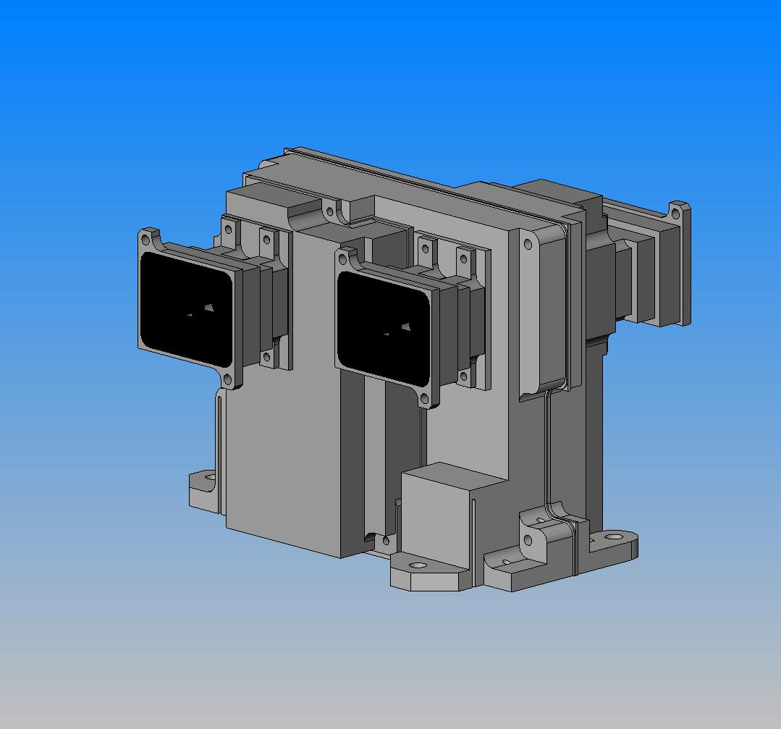
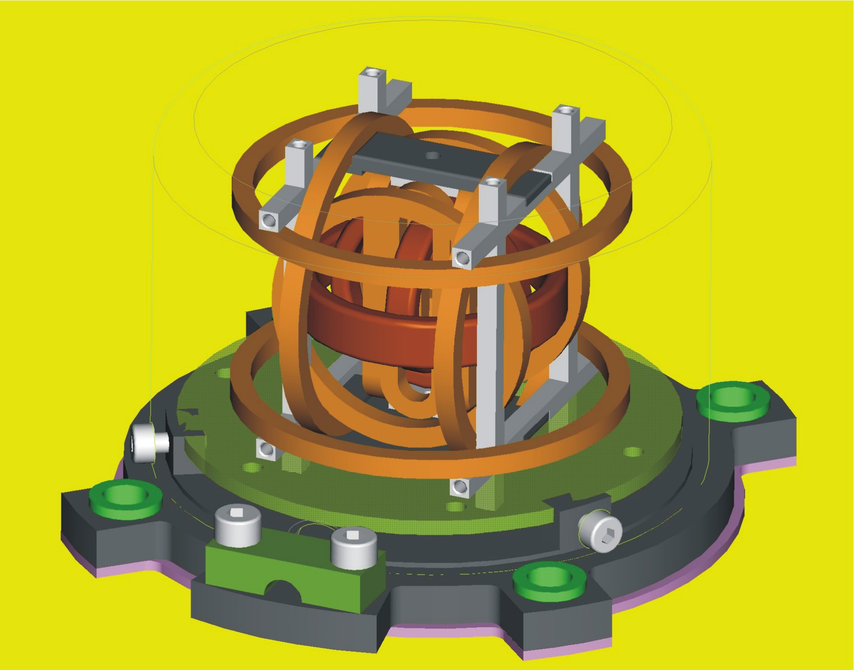
Typical Mission Objectives and Measurements
Electric Field Instrument (EFI)
3-axis E-Field
0-4000 Hz
Electrostatic Analyzer (ESA)
3D e- and i+ from 5-30,000 eV
Once per spin (3-s period)
Plasma Flows
Plasma Waves
Plasma
Heating
Magnetic Field Reconfiguration
(Reconnection, Current Diversion/Disruption)
Search Coil Magnetometer (SCM)
3-axis B-Field
10-4000 Hz
Solid State Telescope (SST)
3D e- 25-800 keV
3D i+ 25 keV- 6 MeV
Once per spin (3-s period)
Flux Gate Magnetometer (FGM)
3-axis B-Field
0-128 Hz

Slide 6
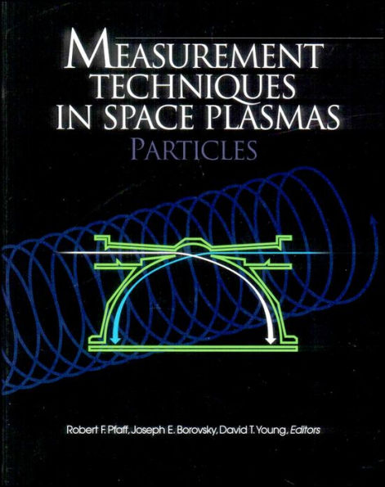
Particle Detectors
Outline:
  Energy loss in Matter
    Photons
    Charged Particles
      Ions
      Electrons
  Energetic Particle Detectors
  Also highly recommend “Radiation Detection and Measurement” by Knoll

Slide 7
Energy loss in Matter
The manner in which energetic particles interact with matter depends upon their mass and energy.
  Photons - have “infinite range”- Their interaction is “all-or-nothing” They don’t gradually lose energy, instead interact in discrete instances typically through 1 of 3 interactions:
    Photoelectric effect (Low energy: E<~50 keV
    Compton Scattering (50 keV ~< E < 1 MeV)
    Pair production ( E >2 x 511 keV).
  Particles with non-zero mass (Electrons and Ions) will slow down as they pass through matter.

Slide 8
Energy Loss in Matter – Particles with mass
Charged particles primarily interact with the electrons in a material. Typically the energetic particle suffers numerous, distant collisions with a Fermi sea of electrons losing a small amount of energy with each interaction (much like a plasma!).
The interaction is typically strongest when the velocity of the energetic particle is approximately the same as the Fermi speed.
Energetic neutral atoms ENAs are quickly ionized soon after entering the solid and then behave like an ion.
Neutrons are a different matter altogether

Slide 9
Energy Loss in Matter
The stopping power for heavy particles is well described by the Bethe-Bloch formula (1932):
Where:
Rate of energy loss is ~ inversely proportional to energy, and
proportional to z, (the effective charge)

Slide 10
The range is given by:
This formula is only useful for ions for reasons we will soon see.

Slide 11
Some Useful Software tools for determining /simulating the passage of particles through Matter (use google to find them)
  NIST – stopping power and range
    Estar - electrons
    Pstar - protons
    Astar - alphas
  CASINO – Electron propagation
  SRIM / TRIM – Ion Propagation
  GEANT –Does everything!

Slide 12
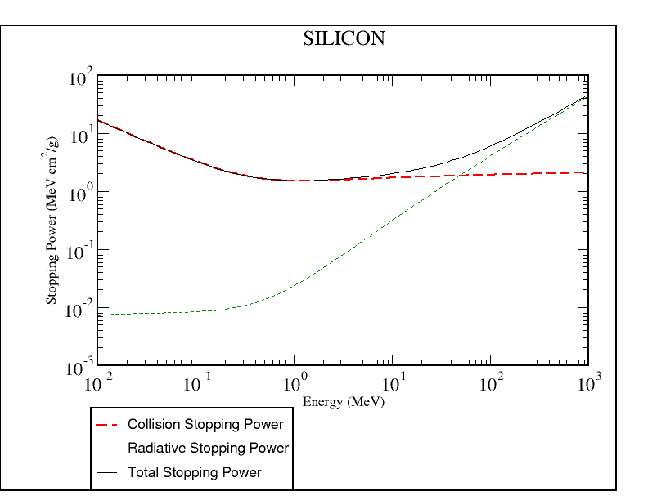
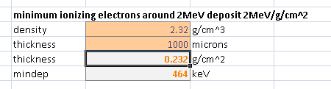
Energy Loss in Matter -Electrons
From the NIST website:
Electrons in
Note “minimum ionizing deposition above ~MeV where collected energy doesn’t change with electron energy
Example above, multi MeV electron into 1mm Si will deposit minimum of 464 keV (depending on path length)
The same detector will stop a 464 keV electron
Energy lost to photons (not always collectable)
Energy lost to primarily to ionization (collectable)

Slide 13
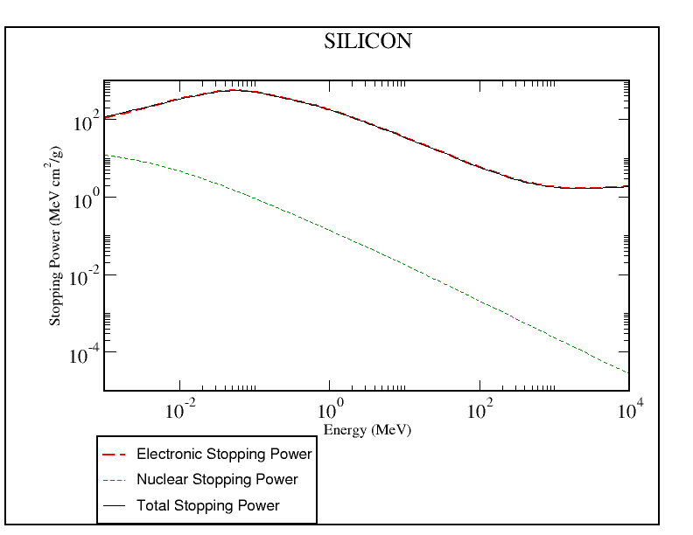
Energy Loss in Matter- Protons
Protons in
Stopping power is
high at lower energy
Stopping power is
Low at High energy

Slide 14
Energy Loss in MatTER
Protons in
Protons
Electrons
Cosmic rays
Radiation Belts
Ring Current
Auroral zone
1 keV
10 keV
100 keV
1 MeV

Slide 15
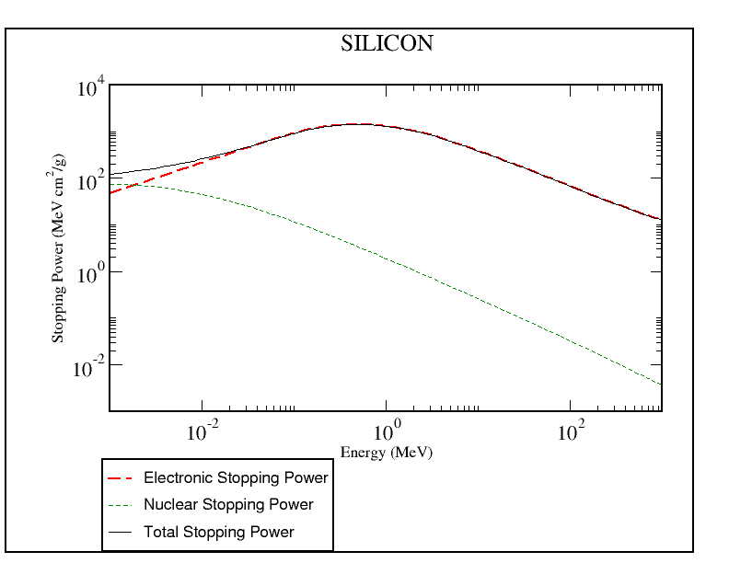
Energy Loss in Matter - Alphas
Alphas in:
As particle gets heavier, these curves continue to shift (up and to the right)
This allows for differentiating species by measuring dE/dx and E
Energy lost to ionization (collectable)
Energy lost to phonons (not collectable)

Slide 16
Energy Loss in Matter – Differences between electrons and ions
Electrons and Ions behave differently due to the different mass ratio
The primary interaction of all energetic particles is with the sea of electrons.
Ions interact with a series of distant collisions. Each interaction results in a small energy loss and very little angular scattering. – They travel in nearly straight lines as they slow down. The dispersion is small. (Imagine a fast bowling ball thrown into a sea of slow moving ping pong balls.)
Electrons can lose a large fraction of their energy and undergo large angle scattering with each interaction (Imagine a high speed ping pong ball thrown into the same sea of ping pong balls)

Slide 17
When an electron hits an atom it can undergo a very large angle deflection, often scattering it back out of the material.
Bremstrahlung (breaking) radiation is produced when electrons undergo extreme accelerations. X-rays are easily generated when energetic electrons strike high Z materials. These x-rays will easily penetrate instrument shields causing background counts (a good reason to avoid high Z materials on exposed surfaces)

Slide 18
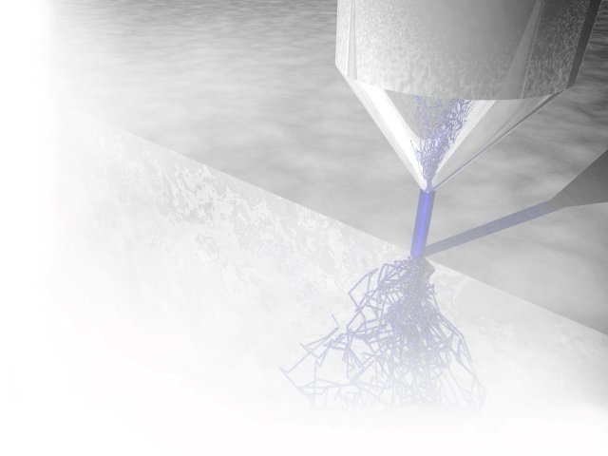
Simulation tools
CASINO - " monte CArlo SImulation of electroN trajectory in sOlids ".
  A very useful simple tool that simulates electron propagation within solids
  Developed for electron microscopy
  http://www.gel.usherbrooke.ca/casino/index.html
This program is a Monte Carlo simulation of electron trajectory in solids specially designed for low beam interaction in a bulk and thin foil.

Slide 19
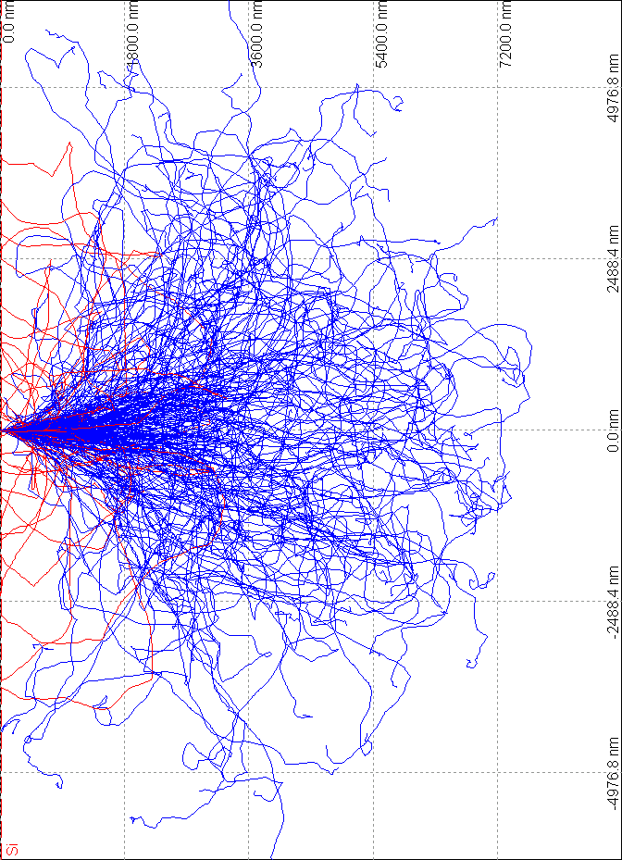
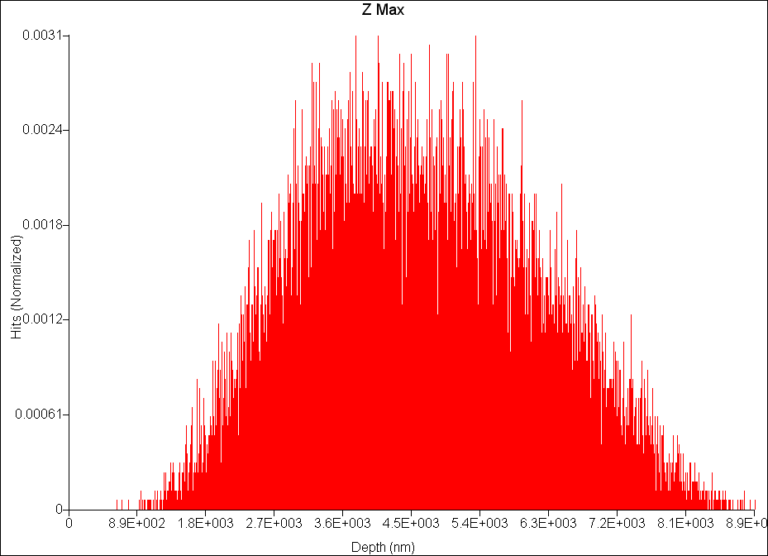
CASINO Simulation
Simulation of 30 keV electrons in Silicon
45 microns
Electron Trajectories
84% come to rest (in blue)
16 % backscattered (in red)
Distribution of Maximum Z value.
Mean: 45 microns

Slide 20
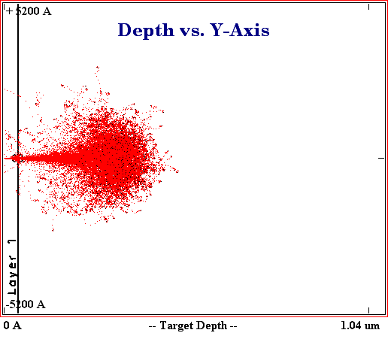
Ion simulation software
SRIM/TRIM “Stopping and Range in Matter”
Only for ions
Download from: http://www.srim.org/
Simple to use.
30 keV proton in Si
Range: 0.3 microns

Slide 21
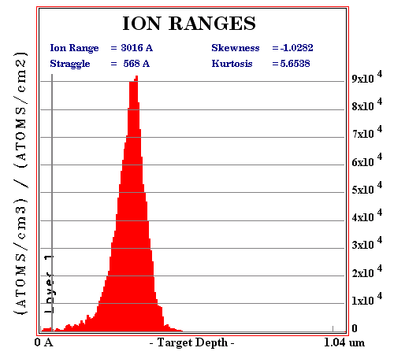
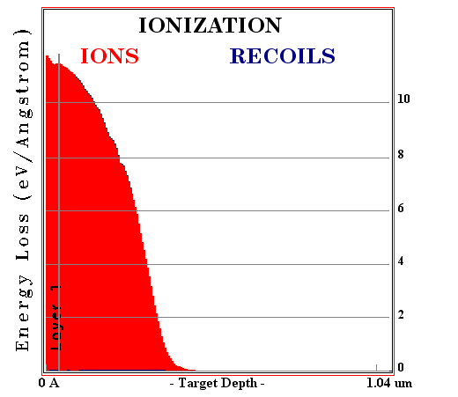
TRIM Simulation - 30 keV
Simulation results for 30 keV ions in Silicon detector
Ionization energy not collected in
400 Angstrom Dead layer
(No backscattered ions)
3000A

Slide 22
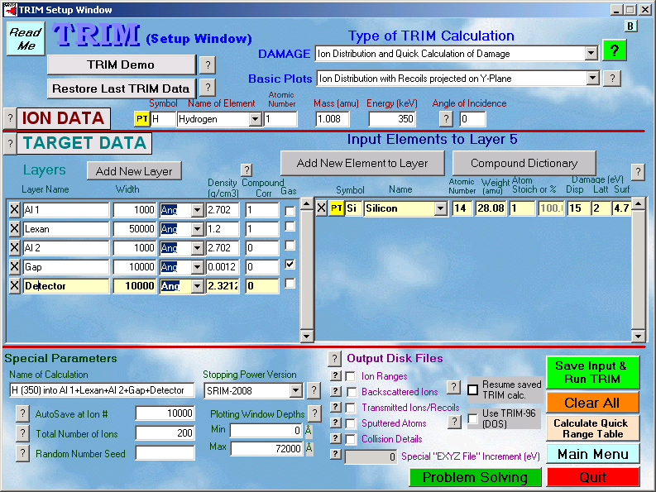
TRIM/ SRIM ion simulation
Define layers here

Slide 23
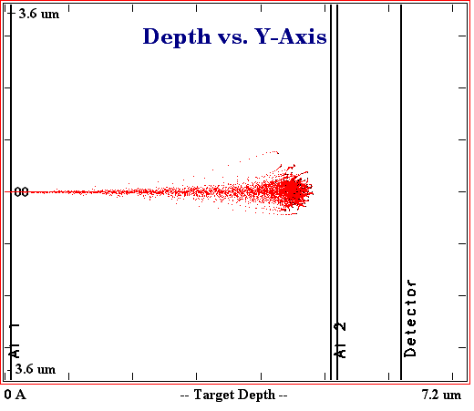
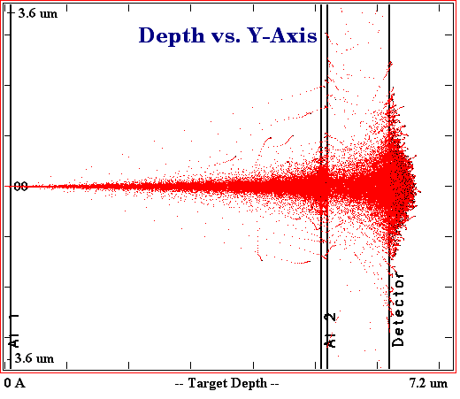
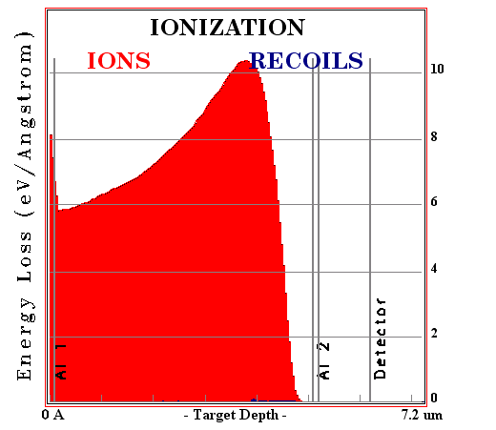
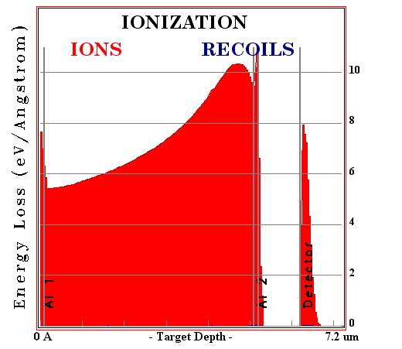
Simulation showing absorption in FOIL
350 keV protons
400 keV protons
Lexan
Si
Al

Slide 24

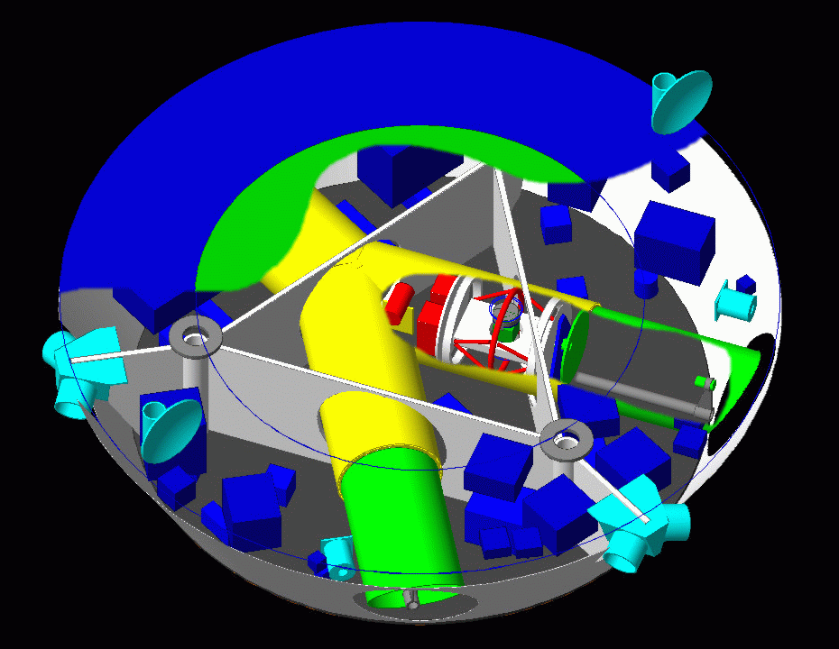
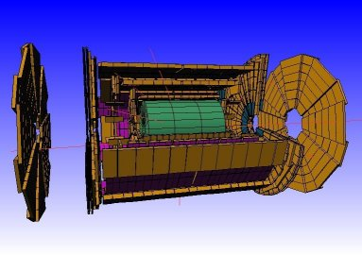
Energetic particle simulation tools
GEANT4 – GEometry ANd Tracking
  The ultimate simulation tool
  Developed at CERN for high energy particle accelerators and detectors
  Allows complex 3D geometries
  Simulates all particles (electrons/ion/photons) and recursively tracks all daughter products.
  Has a moderate learning curve, especially if you don’t know C++
  More info at: http://geant4.web.cern.ch/geant4/

Slide 25
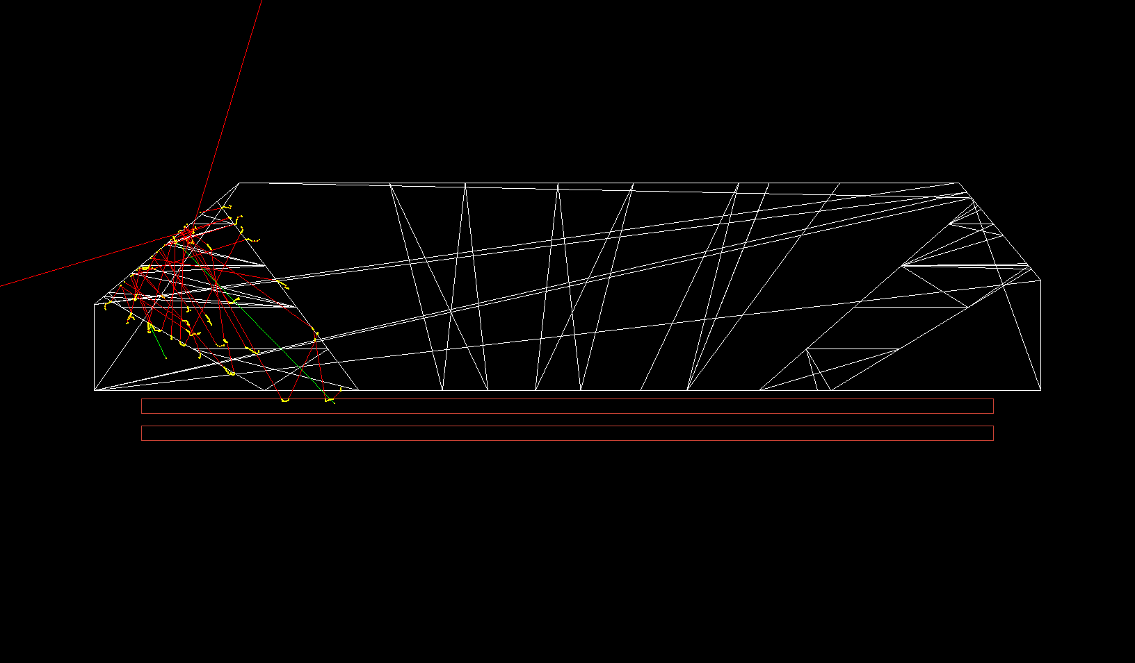
Energetic particle simulation tools
GEANT4 – GEometry ANd Tracking
  The ultimate simulation tool
  Developed at CERN for high energy particle accelerators and detectors
  Allows complex 3D geometries
  Simulates all particles (electrons/ion/photons) and recursively tracks all daughter products.
  Has a moderate learning curve, especially if you don’t know C++
  More info at: http://geant4.web.cern.ch/geant4/

Slide 26
Summary of Particle interaction with matter
Electrons typically:
  Penetrate deeply
  Scatter VERY easily (potentially causing unwanted contamination – in some cases this is beneficial)
  Strongly affected by magnetic fields
Ions typically
  Stop quickly in matter
  Don’t scatter easily
There are easy to use software tools to help model

Slide 27
Basic types of detectors
Low energy (<50 keV) (no energy determination)
  Current measuring:
    Faraday cup
    Langmuir probe
  Single particle detectors
    CEM
    MCP
High Energy (>2 keV) (energy determination)
  Solid State detectors
    Silicon
    Germanium
    Cad-Zinc-Telluride (CZT)
  Scintilators

Slide 28

Faraday Cups
A Faraday cup is fundamentall an electrode from which electrical current is measured while a charge particle beam (electrons or ions) impinges on it.

Slide 29
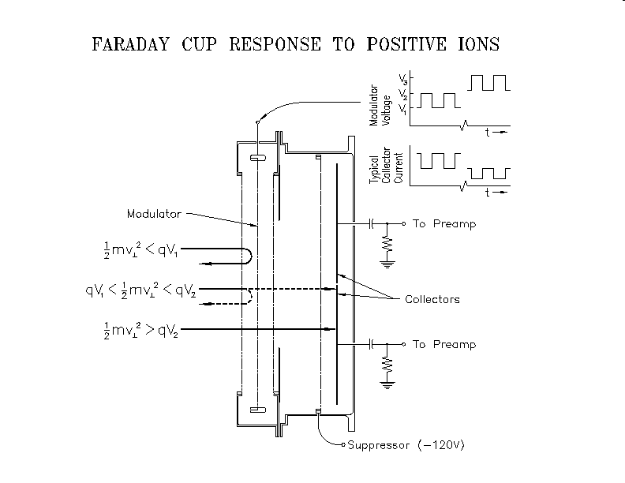
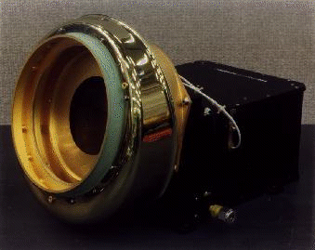
Faraday Cup to measure the Solar wind
Faraday cup still in use on WIND (launched 1994)
Drift estimated at 0.01% per year
Notes:
Figure Caption: How a Faraday Cup works. We show here a schematic cross section of a typical Faraday Cup sensor. It contains a series of wire-mesh, planar grids knitted from tungsten wire and one or more collector plates. The velocity distribution function of ions is measured by applying a sequence of voltages to the "modulator" grid. With voltage V applied to the grid, only particles having energy/charge, E/Q, greater than V will be able to pass through the grid and continue on to strike the collector plate where they produce a measurable current. As normally operated, the grid voltage is varied between two voltages, V1 and V2 at a frequency of a few hundred Hz. Thus particles normally incident on the grid and having E/Q between V1 and V2, will produce a current on the collector plate that varies at the modulation frequency and can easily be detected with an appropriate phase-sensitive measurement system. By choosing an increasing sequence of values for the modulation voltage, e.g. V2 and V3, the E/Q spectrum of the particles can be explored.

Slide 30
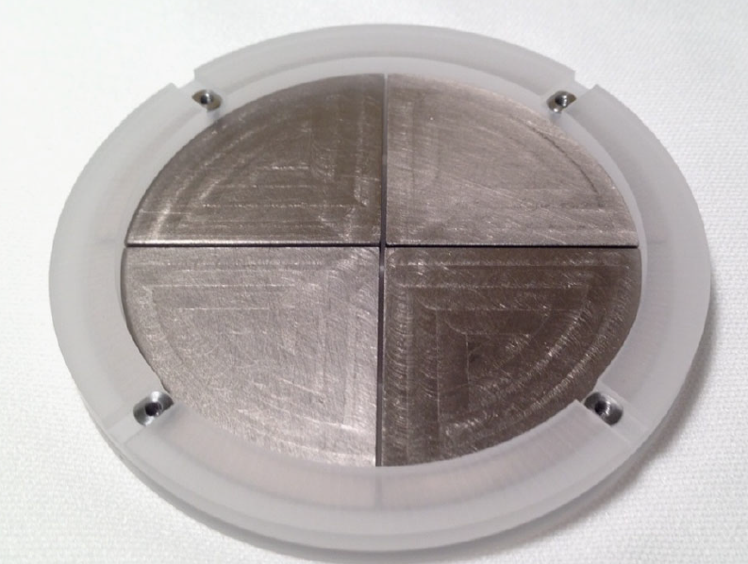
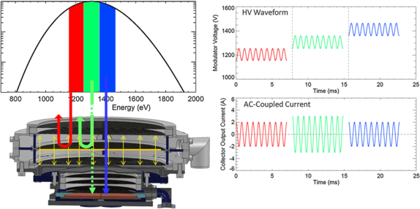
Faraday Cup for SPP
By comparing ratios of modulation on the four plates the incoming direction can be determined to high accuracy
From Kasper et. al 2016

Slide 31
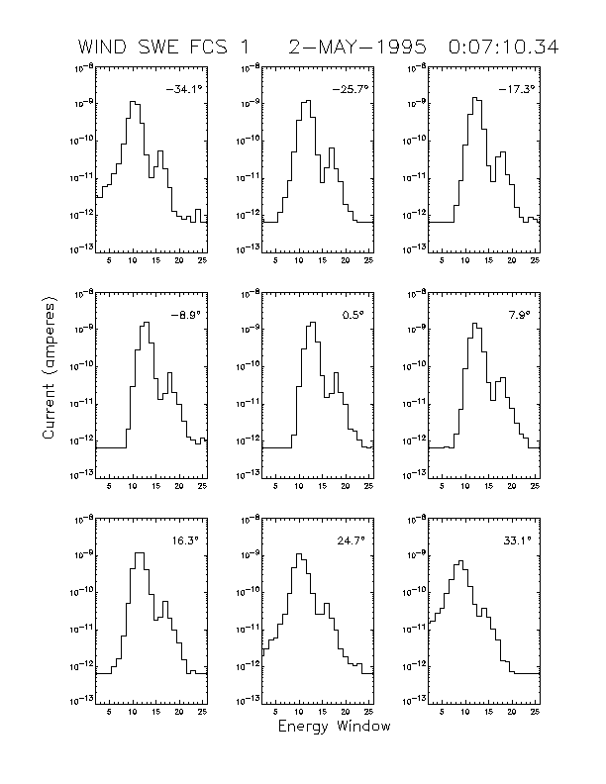
Faraday Cup
Simple, reliable and stable
Susceptible to micro-vibrations in the grid.
3 orders of magnitude less sensitive particle counters. Not suitable for low fluxes. (<10^7/cm2/s)

Slide 32
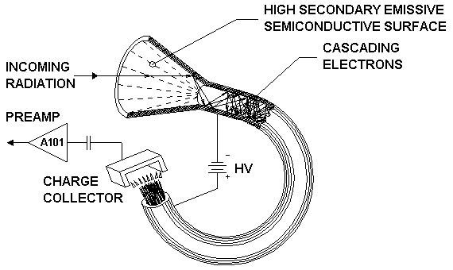
Channel Electron mulitipliers (CEMS)
Good for very high count rates (~10^7/sec)
Good radiation tolerance
Highly reliable

Slide 33
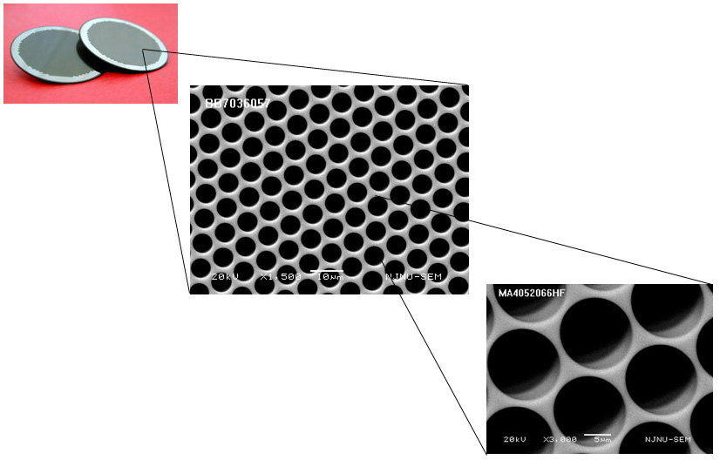
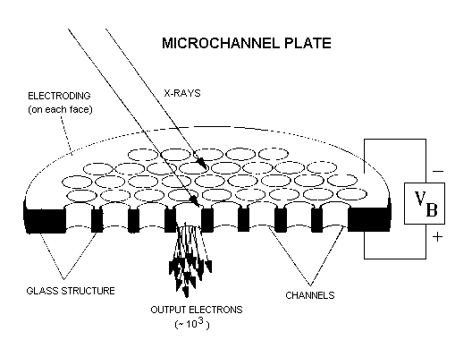
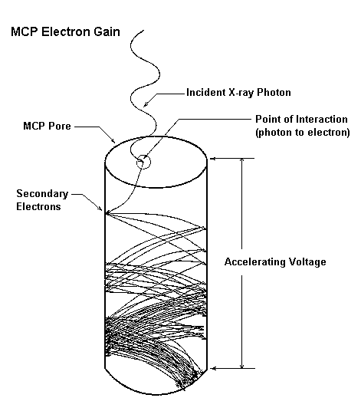
MicroChannel Plates
~5 micron
40:1 or greater is often the aspect ratio
Standard detector used for low energy particles – sensitive to all particles – photons, electrons, ions, neutrals

Slide 34
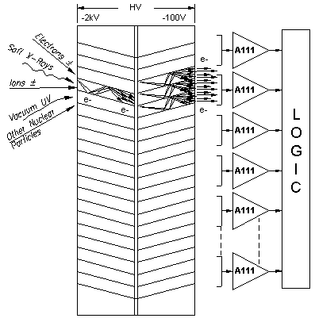
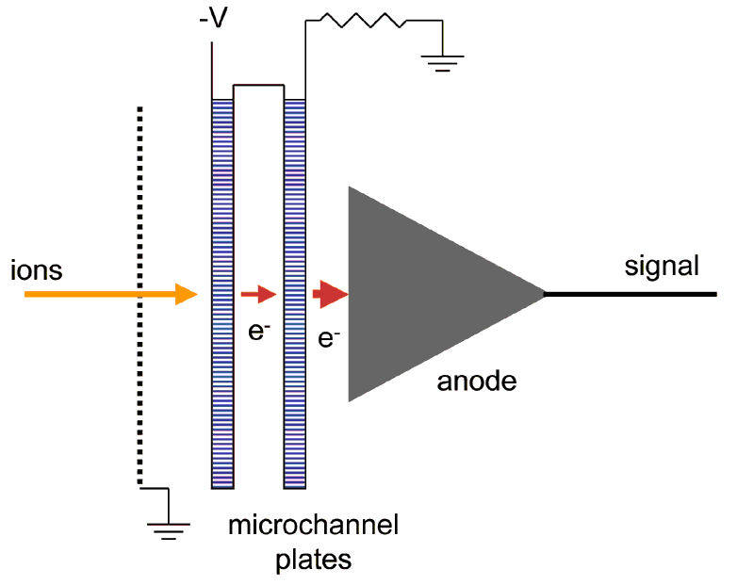

Slide 35
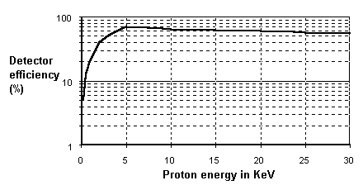
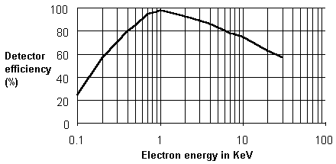
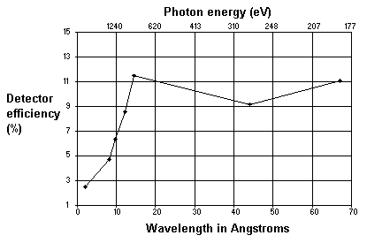
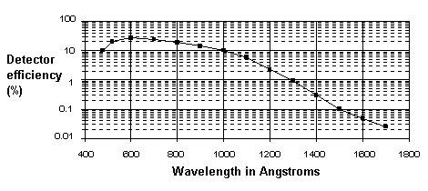
CEM (and MCP) efficiency
CEM Electron Response
From: Pashman, G., et al., Rev. of Sci. Inst., 41, 1706 (1970)
CEM Proton Efficiency
From: Egidi, Rev. of Sci. Inst., 40, 88 (1969)
CEM absolute vacuum ultraviolet response
From: Johnson, M.C., Rev. of Sci. Inst., 40, 311 (1969)
CEM x-ray response
From: Smith, D.G., et al., Trans. of the IEEE, NS-15, 541 (1968)

Slide 36
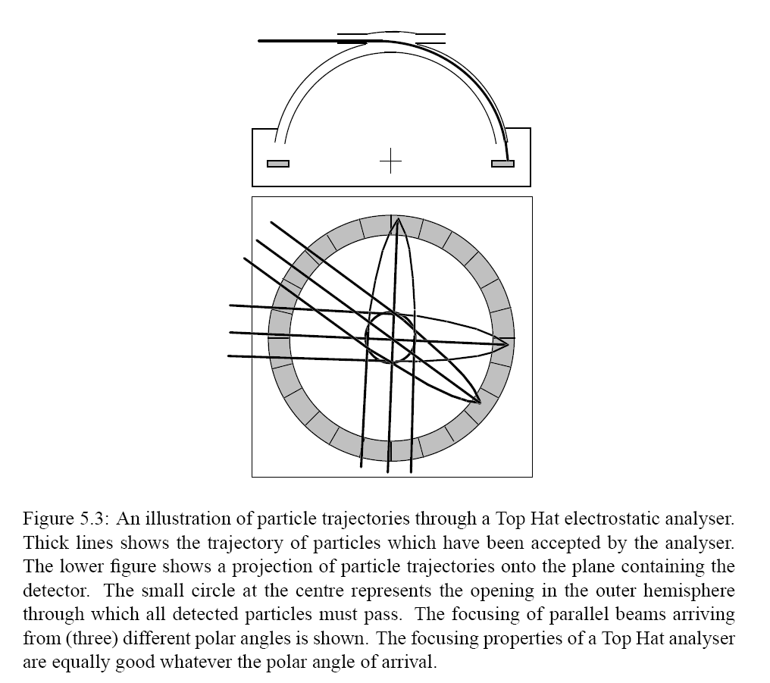
Electrostatic Analyzers
Top Hat analyzers
  Energy resolution: dE/E~0.1
  Angle resolution: ~7 degrees.
  Disk like field of view
  Uses Electrostatic deflection
    high energy limited to ~40 keV
    Low energy limit ~0 eV
    Samples phase space by sweeping voltage
  Rejects neutrals
  Discriminates electrons and ions

Slide 37
ESA – Energy angle response
Calibration of Particle Instruments in Space Physics – ISSI

Slide 38
ESA on a spinning spacecraft
Full 4Pi field of view can be obtained on a rotating spacecraft
When you can’t spin -> deflect

Slide 39
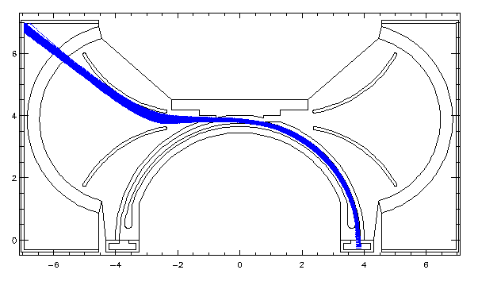
ESA with deflectors
By adding deflectors a large FOV can be obtained
Modelled using potential solving/particle tracing software i.e. (SIMION is a popular modeling package; we use)

Slide 40
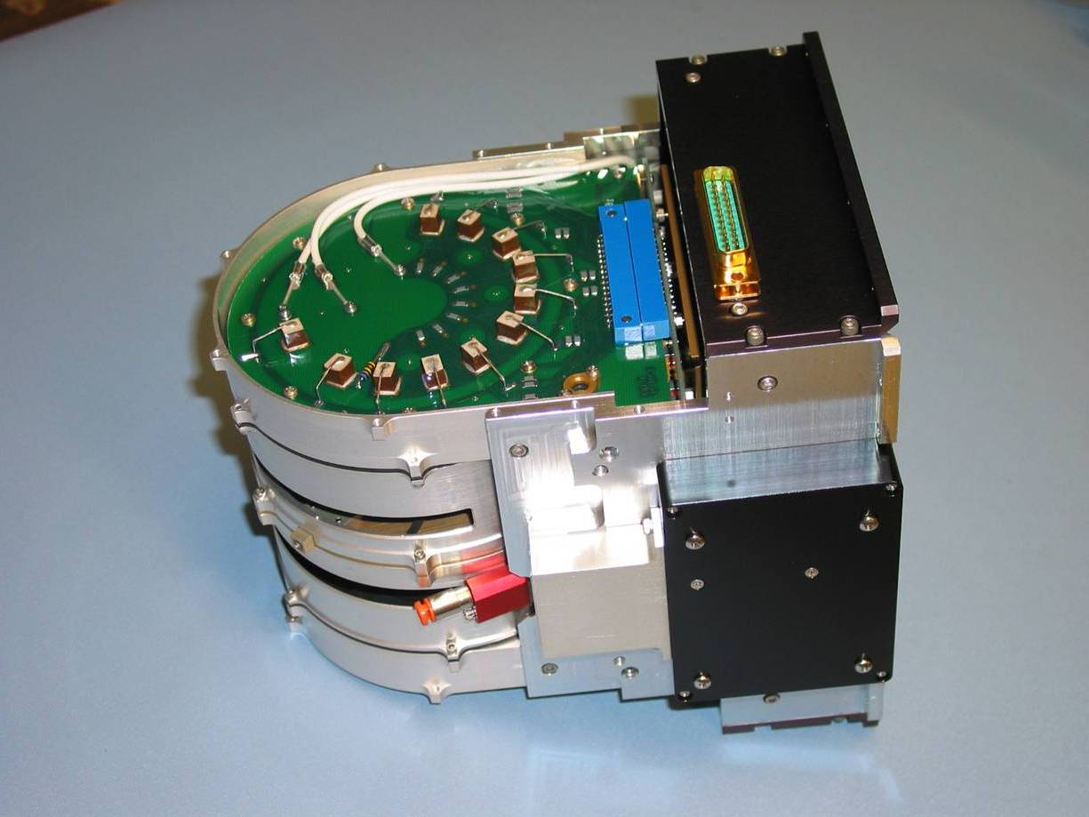
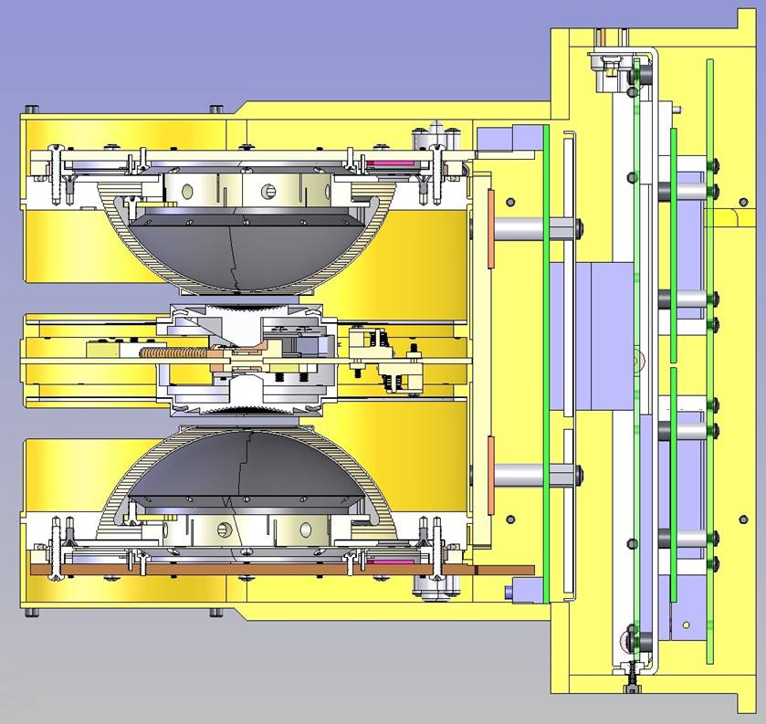
THEMIS Electrostatic AnalyzeR
The THEMIS ion and electron electrostatic analyzers (iESA and eESA) measure plasma over the energy range from a few eV up to 30 keV for electrons and 25 keV for ions.
The instrument consists of a pair of "top hat" electrostatic analyzers with common 180° by 6° fields-of-view that sweep out 4π steradians each 3s spin period. Particles are detected by MCP

Slide 41
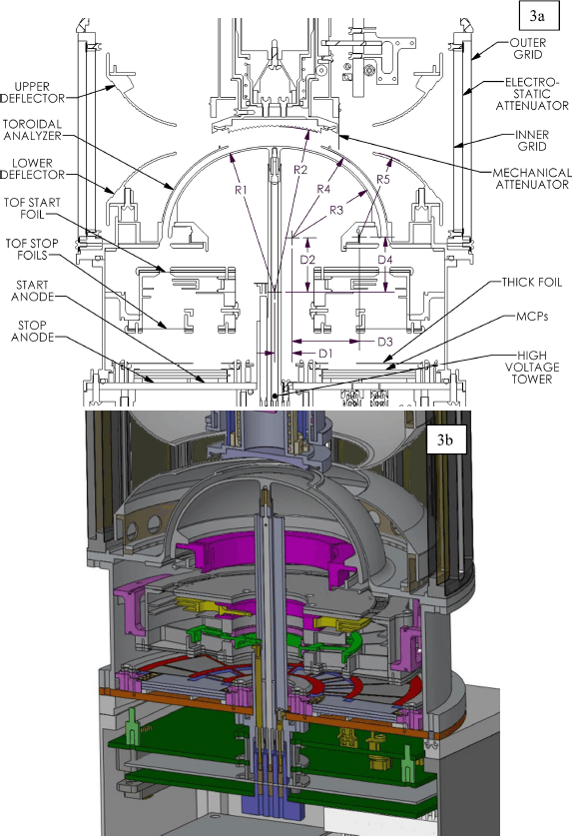
Combining ESA with TOF
ESA determines E/q
ions are accelerated by 15kV potential
Pass through a carbon foil for start pulse
2cm Time Of Flight (TOF) region
Strike a carbon foil for stop pulse to get velocity
Allows mass determination at low-moderate energies
Similar to SPAN on SPP (ion SPAN)
Note mechanical attenuator (similar to SPP)
MAVEN STATIC

Slide 42
Energetic Particle Detectors
Solid State Detectors (SSDs) not only detect individual particles, they can be used to measure particle energy with good energy resolution.
Typically only good for E>20 keV
Improvements in thin dead layer contacts and low noise electronics can push the limit to ~2 keV with penalty of increased susceptibility to UV
Typically run fully depleted (electric field extending throughout bulk of material)
Maximum thickness is ~1000 microns – defines max energy particle that can be stopped within the detector
Particles can be incident on either side of detector

Slide 43
Other Detectors Continued…
Lithium Drifted Silicon
  Requires (?) LN2 storage for stability
  Can be made in thicknesses up to 1 cm to stop very energetic ions (~100 meV)
  Reduced energy resolution for ion studies
HP (High Purity) Germanium
  Expensive!
  Large Z high stopping power
  Very large form factor are possible
  Generally used for x-rays, gamma-rays
CdZnTd (Cad Zinc Telluride)
  High Z
  Cheaper than Ge
  Good stopping Power

Slide 44
Solid State Detectors – Principle of operation
With the application of a (large enough) reverse bias voltage an electric field is established throughout the silicon.
An energetic charged particle will leave an ionization trail in its wake.
The electron hole pairs will separate and drift to opposite sides.
The total charge is proportional to the electronic energy deposited. (3.61 eV per pair for Silicon).
The signal contains only a few thousand electrons thus requiring sensitive electronics.
The trick is to collect and measure this small signal.
Energetic
Particle
E
Ionization trail
e-
h+

Slide 45
Solid State Detector Basics
Avg signal in black
Real signal in red
+35 V
Outside at bias Voltage
Charge
Voltage
Voltage
PH
2ns
2us
Time
Time
Time
Example:
3.6 keV
Particle strikes
detector
CSA
Shaper
n
p
-+
Minimize distance
The shaper circuit averages out the “noise”
guard ring
~200A Al
~200A Poly Si
It takes 3.6 eV to make one electron-hole pair
Total charge produced is:
N = 3600 eV /3.6eV = 1000 electrons = 1.6e-16C
Output PH is proportional to deposited energy!
300 micron
thick detector

Slide 46
Solid State Detector Basics (Cont)
DAC
Voltage
PH
2us
Thresh
FPGA
(logic)
Convert signal occurs
when THRESH is high and
PD passes through zero
Time
Comparator
Read
Shaper
Shaper
Signal
ADC
The shaper circuit averages out the “noise”
Convert
PD
Differentiator
Zero crossing
Comparator
Convert
Thresh
Memory
Signal
2us
Voltage
PD
300 micron
thick detector
Time

Slide 47
Techniques to discriminate species with Solid State detectors
Solid state detectors do not discriminate species but there are methods to filter out one or another species
  Broom Magnets can “sweep” electrons away leaving only ions and neutrals (with similar energies) to pass through
  Thin Foils can absorb lower energy ions (and neutrals) allowing electrons (with similar energy) to pass through with little degradation.
  Electrostatic deflection can be used to filter all charged species.
  Stacking multiple detectors to measure dE/dx

Slide 48
THEMIS SST Sensor Unit Schematic
Foil Detector
Al/Polyamide/Al Foil
Thick Detector
Open Detector
Foil
Collimator
Open Collimator
Attenuator
Attenuator
Sm-Co Magnet
Notes:
Foil chosen to stop up to 400keV ions

Slide 49
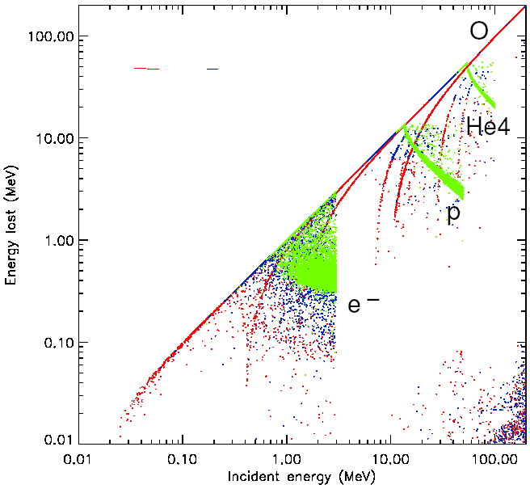
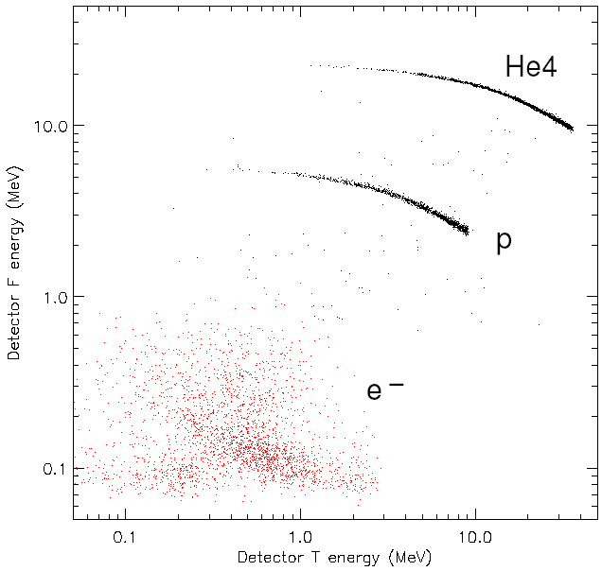
Detector System
Detectors stacked in “Triplet” sequence:
  Foil (F) | Thick (T) | Open (O)
  Area used 1.32 × 0.7 cm²
  Front detectors F and O are 300 μm thick while T is 600 μm (with two detectors back to back)
  Detectors associated with a system of coincidence/anticoincidence logic
F T O

Slide 50
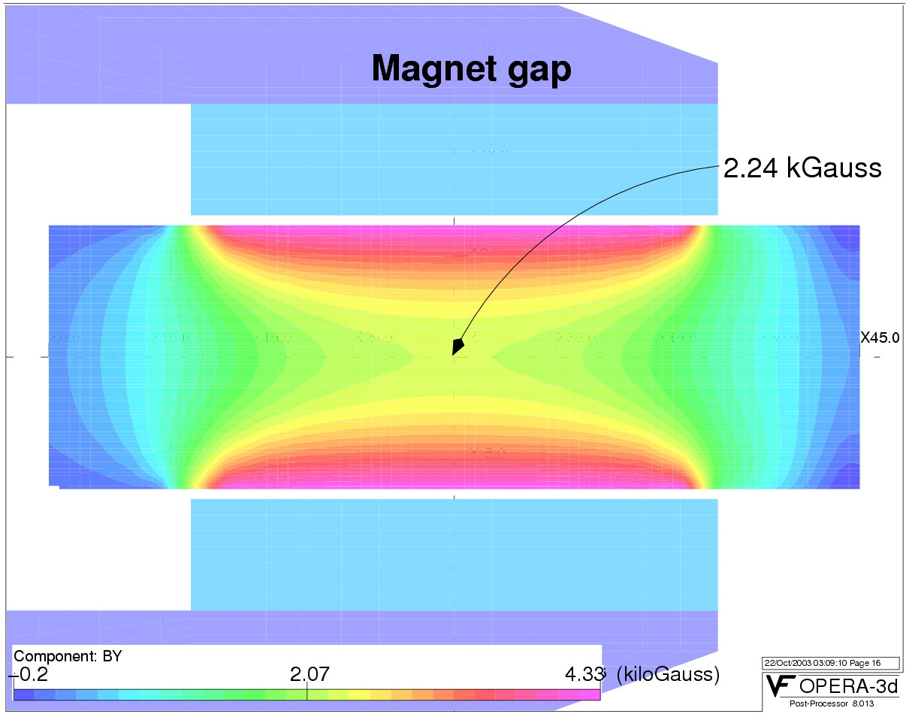
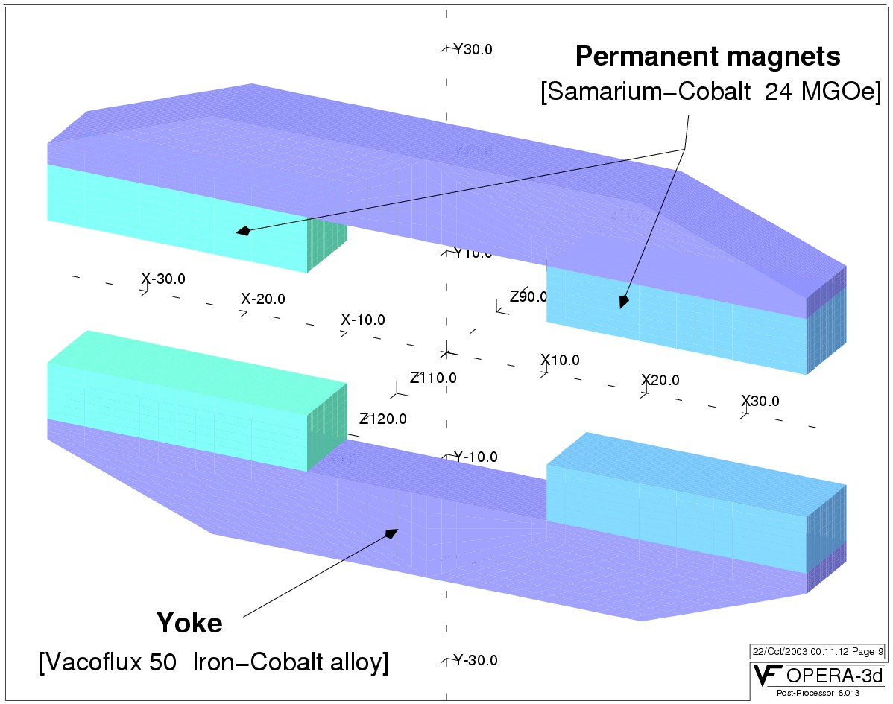

Magnet System to sweep electrons out
Magnetic circuit design
  4 permanent magnets (Dexter Magnetic Technologies) + 2 yokes (Vacuumschmelze, Germany)
  Two oppositely oriented dipoles
  Stray fields < 1.5 nT at 2m distance
Magnet gap

Slide 51

Magnetic spectrometers
A great way to sort electrons and ions at moderate energies
  Has sometimes been used with MCP image plane at even lower energies
MagEIS on Van Allen probes is a good example

Slide 52


MagEIS
Divided into Different energy ranges
By using both PHA to measure the energy and the larmor radius in the chamber field they get independent measurements of energy
  Especially good in the high penetrating radiation environment of the radiation belts

Slide 53

ISIS on SPP
Again divided into multiple instruments
Many look directions for EPI-LO
Stacked Si allows for high energies and species determination
EPI-LO also utilizes TOF and Energy deposited
From McComas, 2016

Slide 54


Combining SSD with TOF
2
5
SSD provides energy
Time of flight provides V hence mass determination

Slide 55

What stacked si looks like on SPP

Slide 56


LET
Measuring energy deposited in each layer and correcting (even roughly) for angled path lengths allows extensive energy range and mass resolution

Slide 57

E+B
Each of these deserves a talk in its own right
  I am not the person to give either talk
Read the instrument papers

Slide 58
Conceptual Understanding
Magnetic Fields play important role in structure, dynamics and processes in space plasma
Hierarchy of Structure (Cavities, current sheets and flux tubes)
Multiple ways to measure magnetic fields usually classified by in situ and remote sensing, DC or AC, scalar or vector, strong or weak fields
  Often need to worry about dynamic range, at earth we are in a 60000nT field and care about sub-nT fluctuations

Slide 59
Induction – Search Coil
Principle of Faraday’s Law of Magnetic Induction
With a loop of wire describing a closed path, the time rate of change of total magnetic flux threading the loop area (A) can be determined from the integrated electric field along the loop

Slide 60
Search Coil
If you use a solenoidal coil of N turns enclosing a ferromagnetic core (high mu increases magnetic flux threading the coil) you can calculate the integrated electric field (or Voltage)

Slide 61
What if search coil is on a spinning spacecraft?
First done on Pioneer 1 w/ Chuck Sonnett as PI in 1960
Need sophisticated time series analysis to separate effects of motion.
K=gain factor, S=sensor axis, F=magnetic field
1st term sensor motion, 2nd B Change, and 3rd plasma and s/c motion

Slide 62


Search Coils (cont.)
dB/dt makes search coils natural choice for higher frequencies
Choice of sensor R, L, C all affect the electronics design and result in the frequency response
Often data will be given to you with response removed, but you should try to know where limits/systematics are

Slide 63
Fluxgates
Is “simple” and has long heritage of spaceflight magnetometers
Principle of operation relies on concept of magnetic hysteresis.
Good from DC up to moderately low frequencies

Slide 64

Hysteresis Curve

Slide 65
Fluxgates
The sensor is a transformer wound around a high-permeability core (often ring core)
Permeability (mu) is the proportionality constant of applied field and magnetization of material (aligned dipoles/domains)

Slide 66


Slide 67
Fluxgate
Drive coil at known high frequency to drive sensor into saturation.
Time to saturation takes longer in opposite direction of external field
Look at 2nd harmonic of sense current/voltage. This is proportional to the strength of the background field.

Slide 68


Slide 69

Curlometery
Measure the curl of B to compute J (current density)
Cluster (shown)
MMS
From Dunlop et al., 2002

Slide 70

SPP FIELDS

Slide 71

Use multiple sensors to optimize over frequency range
Fluxgate covers low frequencies
LF –SCM covers mid ranges
HF-SCM covers high

Slide 72

Measuring E
One common way to measure E is with a spherical double probe
  This is the method I will choose to focus on but MMS also has an Electron Drift Instrument with some tradeoffs
  MMS, Van Allen Probes, SPP (not counting the spheres)
Total oversimplification: probe comes to local plasma potential
  Depends on illumination, bias currents, Debye length, electron and ion fluxes
  Interaction is through the plasma sheath which will affect design decisions
Voltage difference between probes/Separation = E component
Offsets in electronics or photocurrent or almost anything else can make this challenging-want same systematics at each probe

Slide 73
Why Use Wire Booms?
Signal-to-noise scales with boom length (L^{n}):
  Longer booms increase measured potential difference for a given E field strength.
  Longer booms decrease magnitude of SC-related noise sources.
  Longer booms decrease effective magnitude of sensor-related noise sources.
Mass and Moment of Inertia (MOI) of antenna scales directly with mass rate (g/m).
  more length/kg of boom unit (mass resources).
  more length/(MOI unit) of deployed antenna (propulsion resources).
  Even wire booms add significantly to MOI

Slide 74
Why Use Double Probes?
Class | Pros | Cons
Type of E-Field Measurement
Electron Drift | Less effect of SC potential, wake, etc. | Poor or no AC response in relevant regimes (temporal or spatial fluctuations). Instrument is more massive. 2D measurement.
Potential Difference | DC-MHz response. 3D measurement possible. | Impacted by SC potential, wake, photoelectrons, etc. Wire booms require spinner.
Type of Wire Boom Dipole
Bare Wire | Very good AC response (gain~1). | Large spin-dependent photo-emission signal ruins DC-100’s of Hz measurement.
Double Cyl. Probe | Same as Bare wire. | Same as Bare Wire, plus frequency-dependent effective boom length.
Double Spherical Probe | Easily symmetrized photo-emission improves DC measurement. | Often less AC response (gain~0.9 to 0.5).

Slide 75
Design Considerations: Sources of DC Errors
L
Spacecraft
photoelectrons
sensor
photoelectrons
d
a
Boom
photoelectrons
ambient e-, i+.
SC wake
Differential input bias currents and voltages (preamp).
Differential photoemission/collection (≈δI*R_{sheath}).
Displacement of charge center from boom system center (≈ 2ad/L³).
Differential charging of spacecraft surfaces (≈ VA/L³).
Electrostatic wakes (SC and Booms; ≈ 1 to 1/L³).

Slide 76
EFW Sensor Electronic Design Motivation
(in words)
Measuring 1.0 to 0.1 mV/m DC E-fields required accuracies of 0.1% in the magnetosphere:
  tens of mV of signal in the presence of tens to hundreds of mV/m of effective common-mode or systematic noise (photocurrents, SC charging), or tens of volts of common mode signal.
Non-linear coupling (I-V curve) of EFW sensors to E-field can be optimized through current biasing (factor of 100 decrease in susceptibility to systematic error sources and density fluctuations).
Current biasing of sensors drives volts to tens of volts floating potential differences between sensors and SC ground.
High effective source impedance (plasma sheath, ten of MΩ), and low-noise and low-leakage current requirements (systematic error reduction again) drive use of low-voltage preamps in floating ground configuration.
Deflection and collection of stray photoelectron currents prior to impingement upon sensor also reduces DC biases (WHIP/USHER and GUARD surfaces).
Different orthogonal boom lengths (130-, 160-m on Polar; 40-, 50-m on THEMIS; 80-, 100-m on RBSP) allow one to detect the presence of wake effect E-fields (data quality control).

Slide 77

Electrical Block Diagram
“A Trio of High-Input Impedance, Low-Noise Voltmeters in Space”
sheath
sensor
preamp
Floating ground
generation
BIAS
USHER
Bias channels
GUARD

Slide 78







Diagram of E-Field Instrument Elements (THEMIS-EFI)
AXB
Preamp
Enclosure
Preamp PWB
BEB
SPB
DFB

Slide 79



Spin Plane (Wire Boom) Deployment Mechanism
THEMIS-EFI SPB
( ~ 2 kg/boom; L = 20, 25 m; 40, 50 m tip-to-tip; ~380 kg-m2 MOI deployed (all booms))
RBSP-EFW SPB
(~2 kg/boom; L = 40, 50 m; 80, 100 m tip-to-tip; ~2000 kg-m2 MOI deployed (all booms))
DC Drive Motor
Sensor Housing w/ ‘Trap Doors’
Cable Spool
Spherical Sensor
w/ Fine Wire ‘Spring Reel’

Slide 80

Sheath Model: R and C
photo e-
Sensor
(Sphere)
Total current = 0.
Set BIAS to minimize dV/dI
plasma i+ (protons)
plasma e-
BIAS

Slide 81
Sensor-Preamp-Cable response
Measured signal reduced by voltage division between sheath and effective input impedance:
  at DC, (Vout/Vin) ≈ 1.
  above the sheath and input rolloff frequencies (1/2πRC ≈ 10 and 100 Hz), (Vout/Vin) ≈ Cs/(Cs + Ci) < 1 (0.5 to 0.9 typically).

Slide 82

Response vs. Frequency
7.5 pF input capacitance of preamp has significant effect on gain above 100 Hz:
  SPB AC gain is 0.65.
  AXB AC gain is 0.45.
Rolloff frequency from DC to AC gain (resistive to capacitive coupling) is predominantly controlled by sheath resistance, which is under direct control via sensor bias current.
AC gain in both cases is still sufficient to achieve required measurements over desired frequency interval.
Difference in DC and AC gain leads to uncertainty in phase and amplitude in crossover regime (100 Hz to 1 kHz).

Slide 83

What this looks like at SPP
Big changes in Rsheath across perihelion passes

Slide 84

E vs. –VxB (EFI/FGM/ESA Inter-Calibration)
This can only be done at select times
Can see that the double probes underestimate the field by 30%
May be due to “shorting” of the measurement by the support structures and charge clouds around the spacecraft

Slide 85

Vsc vs. Ambient Density
  Typical two-slope correlation between Vsc and ambient ion density estimate (iESA).
  Population of points below main curve probably represent presence of cold plasma, e.g. Scudder et al., [2000] result for Polar.

Slide 86
Thanks
Read instrument papers
  Feel free to skip some sections, but try to understand the limitations that affect you
Contact instrument PIs, teams, or colleagues who have worked with similar instruments, or similar data products. Most of the time they will be happy to help.
Range is important (dynamic range, energy range, frequency range) especially for something like SPP which is going to an environment we can only extrapolate to design for
Lots of the best science comes from combining instruments that are confined in some way. Think about:
  inter-callibration,
  contamination
  saturation and low counting statistics (if you only work in flux, Know the relevant Geometric Factors+ Sensitivity)
Many thanks to the instrument papers included here including Bale, McComas, Kasper, McFadden, probably others.
  Go read them

Slide 87

Spacecraft Wakes
Will affect particle and E-field measurements

Slide 88
Measurement Requirements
Science Requirements
  Consider the scope of the measurements
  Species discrimination / determination
  Energy range / resolution
  Differential flux (vs energy) - dynamic range of measurement
  Time resolution
  Angular resolution
  Trade off studies
Define Design constraints (The best particle detectors in the world weigh many tons, consume kilowatts of power, produce terabytes of data and cost Billions of dollars.)
  Mass
  Power
  Cost
  Telemetry
Convert Science requirements into measurement requirements
  Peak count rates / determined by Saturation (correcting for dead time corrections)
  Minimum (acceptable) count rates provides time resolution
  Contaminating sources
    Light – (visible, UV, x-ray etc)
    Other species of Charged particles
    Penetrating radiation.
    Neutrals
    Noise susceptibility

Slide 89
Know your geometric factors
  Know your 1-count level
  Know where saturation and deadtime/pileup occur

Slide 90
Solid State Telescope examples –WIND EPACT
Cross section of the EPACT isotope telescope on Wind. The first two detectors
are two-dimensional position sensitive strip detectors (PSD1, PSD2). They are required
so that path-length corrections may be made for the angle of incidence and for
non-uniformities in detector thickness. Tungsten rings are used to mask off circular areas
for each PSD. There are 6 solid-state detectors increasing in thickness with depth in the
stack in order to minimize Landau fluctuations. From von Rosenvinge et al. [1995].

Slide 91
Solid State Detector Basics (cont)
The FPGA is responsible for controlling:
  Threshold DAC
  ADC
    Wakeup signal
    Conversion pulse
    Readout of Pulse Height (PH)
  Use PH value to read Energy Bin (EB) from LUT
  Incrementing EB counter
  Interface to Space Craft
  Writing to Look Up Table (LUT)
  MUX control

Slide 92
Other detector types
Scintillators
  Emit light when charged particle traverses the material.
  Light output is approximately linear with deposited energy
  Light is typically collected with a photomultiplier
  Easily shaped to accommodate instrument requirements
  Relatively poor energy resolution
  Often used as active shielding (veto device) or as final stop for very energetic particles (cosmic rays)
  Two Classes:
    Inorganic (Ionic crystals, ie. NaI is very common)
      High stopping power (high Z)
    Organic (plastics)
      Generally have low stopping power
      Very fast (good for coincidence events)
Cherenkov Detectors
  Utilizes Cherenkov radiation emitted when a particle travels faster than speed of light in that medium (extremely relativistic particles only)

Slide 93





The AMPTEK preamplifier

Slide 94

Often tradeoffs in shaping time, capacitance, and other factors affecting noise performance

Slide 95

Instrument Electronics

Slide 96

Solar Wind Plasma Electron Analyzer (SWEA)
CESR, UC Berkeley
SWEA is designed to measure the distribution function of the solar wind core and halo electrons from below an eV to several keV, with high spectral and angular resolution over practically the full spherical range. This capability allows the distinction between these components in detail during both undisturbed periods and the passage of CME generated disturbances, when the interplanetary field rotates far out of the ecliptic plane. SWEA consists of a hemispherical top-hat electrostatic analyzer (ESA) that provides a 360 deg. field of view in a plane, combined with electrostatic deflectors to provide nearly 4 pi coverage when SWEA is mounted at the end of the STEREO boom. The inner plate radius is 3.75 cm and the plate separation is 0.28 cm. The resulting energy resolution dE/E is 18%, and the geometric factor is 0.01 cm2 ster E (eV). SWEA compensates for the effects of spacecraft potential on the lowest energy particles by having an outer hemisphere that can be biased according to the plasma density measured by the PLASTIC solar wind ion instrument.

Slide 97
Know your Plasma Environment
Environment | Electrons | Protons | Neutrals | Comments
Solar Wind (at 1 AU) | N ~0.1-100/cc | Mono-energetic Beam (~1 keV) | 0 (mostly) | Photo-electrons are important High charge state ions
Inner Magnetosphere (including plasmasphere) | Nc~10-1000/cc Tc< 1 eV Nh~1 /cc Th~100 keV | Nc~10-1000/cc Tc< 1 eV Nh~1 /cc Th~100 keV | N~10^4/cc T<<1eV | Multi temperature plasma
Tail | N~0.3/cc T~1-10 keV | N~0.3/cc T~6-60keV | N~0/cc | Multi temperature plasma
Low orbit | Energetic population is gone | Energetic population is gone | >10^4/cc (Ram velocity) ENA

