Slide 1
Observations and Instrumentations
for NWS Operations
Presented at:
Building a Weather-Ready Nation by Transitioning Academic Research to NOAA Operations Workshop
November 1, 2017
Joseph A. Pica
Director, NWS Office of Observations

Slide 2
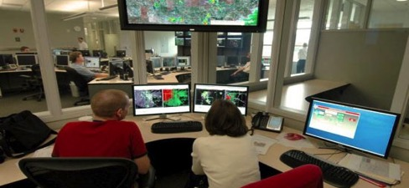
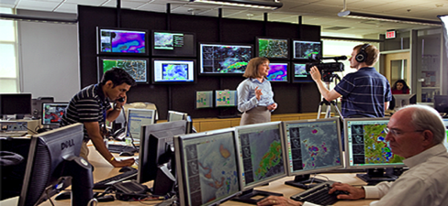
What NWS Does
Provide weather, water, and climate data, forecasts and warnings for the protection of life and property and the enhancement of the national economy.
MISSION
A Weather-Ready Nation where Society is prepared for and responds to Weather-Dependent Events.
VISION
“First, it should be understood that forecasts possess no intrinsic value.
They acquire value through their ability to influence the decisions made by users of the forecasts.”
What is a Good Forecast? An Essay on the Nature of Goodness in Weather Forecasting”
By Allan H. Murphy; Weather and Forecasting (June 1993)

Slide 3

NWS Strategic Outcome: A Weather- and Water-Ready Nation
“Ready, Responsive, Resilient”
Becoming a Weather-Ready Nation is about
building community resiliency in the face of increasing vulnerability to extreme weather, water and climate events
Better forecasts and warnings Actionable environmental intelligence
Consistent products and services
Connecting forecasts to decisions
Involves the entire US Weather, Water and Climate Enterprise WORKING TOGETHER
We have 6000+ WRN Ambassadors
3
Notes:
Strategic Outcome

Slide 4
Ready, Responsive, Resilient
Saving Lives and Property
4100+ WRN Ambassadors
Pulling it all together to build a Weather-Ready Nation and to accomplish
our mission to save lives and property
Multi-faceted Communication Strategy
Deep Relationships Core Partners
NWS Employees Providing Impact-Based
Decision Support Services (IDSS)
Accurate & Consistent
Forecasts/Warnings
Social Science
Fully-Integrated Field Structure through a Collaborative Forecast Process
National Blend of Models: Forecast starting point
One NWS, One Dissemination Network
4
Observations and Numerical Weather Prediction

Slide 5
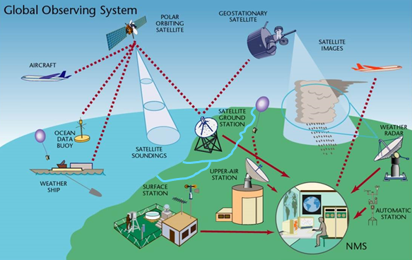

Observations Portfolio
Responsible for the collection of space, atmosphere, water, and
climate observational data owned or leveraged by the NWS
5
Notes:
NOAA PORTFOLIO MANAGEMENT GUIDING PRINCIPALS
VISION: Achieve and sustain an observing system portfolio which is mission-effective, integrated, adaptable, and affordable
SUPERIOR SERVICE and REPUTATION: Meet or exceed the requirements established to fulfill systems’ current and envisioned missions, and maintain NOAA’s standing as a preeminent leader in the global operational Earth observing enterprise
ADAPTABILITY: Portfolio must adapt to the rapidly-evolving variety of measurement and data sources
COST-EFFECTIVENESS and SUSTAINABILITY: NOAA must embrace cost-effective solutions, including the leveraging of domestic and international partnerships, to operate with its allocated budget
INTEGRATED: Manage the portfolio to make more holistic decisions about priorities and associated investments decisions within and across observing system domains, NOAA Line Offices, operational programs, and partners
GLOBAL CONTEXT AND COMMITMENTS: Uphold commitments to our partners and ensure access to global observations needed to generate accurate forecasts, warnings, and other services
IN-HOUSE EXPERTISE: NOAA must sustain the in-house expertise (including contracted) necessary to support well-managed integrated observing systems
WELL-GOVERNED, UNDERSTOOD & TRUSTED: Manage the integrated observing systems portfolio so that NOAA employees, key decision makers, Congressional resources, and external entities perceive our management system as well-governed, understood, and trusted

Slide 6
Observation Portfolio Management in NOAA
As our portfolio management matures, the following are guiding principles towards which we are striving:
Mission-Effective
Superior Service and Reputation
Adaptable
Cost-Effective, Affordable, and Sustainable
Integrated
Global Context and Commitments
In-House Expertise
Well-Governed, Understood, and Trusted
Notes:
VISION: Achieve and sustain an observing system portfolio which is mission-effective, integrated, adaptable, and affordable
SUPERIOR SERVICE and REPUTATION: Meet or exceed the requirements established to fulfill systems’ current and envisioned missions, and maintain NOAA’s standing as a preeminent leader in the global operational Earth observing enterprise
ADAPTABILITY: Portfolio must adapt to the rapidly-evolving variety of measurement and data sources
COST-EFFECTIVENESS and SUSTAINABILITY: NOAA must embrace cost-effective solutions, including the leveraging of domestic and international partnerships, to operate with its allocated budget
INTEGRATED: Manage the portfolio to make more holistic decisions about priorities and associated investments decisions within and across observing system domains, NOAA Line Offices, operational programs, and partners
GLOBAL CONTEXT AND COMMITMENTS: Uphold commitments to our partners and ensure access to global observations needed to generate accurate forecasts, warnings, and other services
IN-HOUSE EXPERTISE: NOAA must sustain the in-house expertise (including contracted) necessary to support well-managed integrated observing systems
WELL-GOVERNED, UNDERSTOOD & TRUSTED: Manage the integrated observing systems portfolio so that NOAA employees, key decision makers, Congressional resources, and external entities perceive our management system as well-governed, understood, and trusted

Slide 7

NOAA’s Second Emerging Technologies
for Observations Workshop - 2017
Theme: “Technology toward a mission-effective, integrated, adaptable and affordable
observation portfolio”
When: August 22-23, 2017
Where: NOAA Center for Weather and Climate Prediction (NCWCP), College Park, MD
Why: The NOAA Observing Systems Council is seeking to identify emerging technologies for Earth and space observation, and develop recommendations to help NOAA infuse new technology into the observing systems portfolio.
How: 5 Internal Sessions – Space, Atmosphere, Terrestrial, Oceans, and
Data Management/Analytics
2 External Requests for Information that was open to all
Inter-governmental / Partner Panel as the last session
Info: https://nosc.noaa.gov/emerging-tech-workshop.php
7
Notes:
A key element of the vision is to be adaptable, more specifically to “implement a systematic approach to infusing new technology into our observing systems” and included direction to “conduct an Emerging Technologies Workshop to better understand new and emerging technologies and their impacts on NOAA programs, products, and services.”1
First Workshop was successfully held in July 2016.

Slide 8
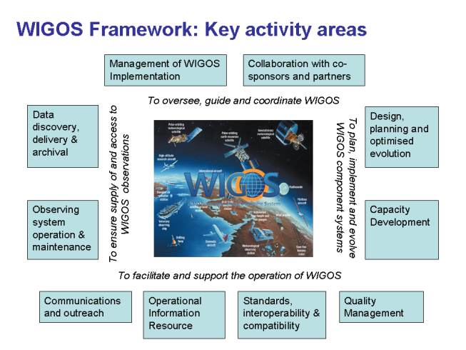
Observations Coordination & Collaboration
Agency
NOAA Observing Systems Council
Priority to Invest in Observational Infrastructure
Interagency
Federal Committee for Meteorological Services and Supporting Research
Strategic Plan for Federal Weather Enterprise Coordination in development
International
World Meteorological Organization (WMO)
WMO Integrated Global Observing System
(WIGOS) Vision 2040 in development
Coordination Group for Meteorological
Satellites (CGMS)
Notes:
Autonomous observing systems
Optimal mix of fixed and mobile platforms
Emerging crowd-sourced information
Miniaturization and commoditization of sensors
Efficient and new, novel uses of communications technologies
Expected roles and ownership of government and private sector observations

Slide 9
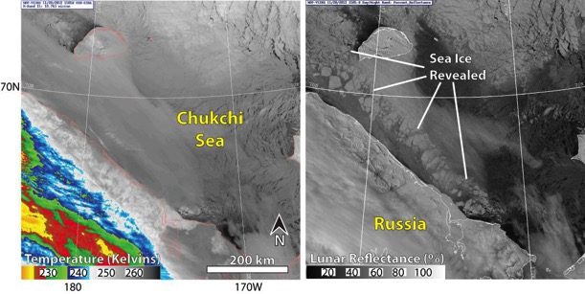
Investing in Observation Infrastructure: Satellites
GOES-16
On-orbit testing
Slated to become GOES-East in December
JPSS-1
Advanced Technology Microwave Sounder (ATMS) and Cross-track Infrared Sounder (CrIS) radiances in models
Day-Night Band applications --->
GOES-S
Revolutionary capability for Western U.S. and Pacific
COSMIC-2A
1800 soundings a day in the tropics is eagerly anticipated
Notes:
DSCOVR
Launched February 11, 2015
Jason-3
Launch Date: January 17, 2016
GOES-R
Launch Date: November 2016
JPSS-1
Launch Date: October 12, 2017
GOES-S
Launch Date: March 2018
COSMIC-2a
Launch Date: ILC April 30, 2018

Slide 10
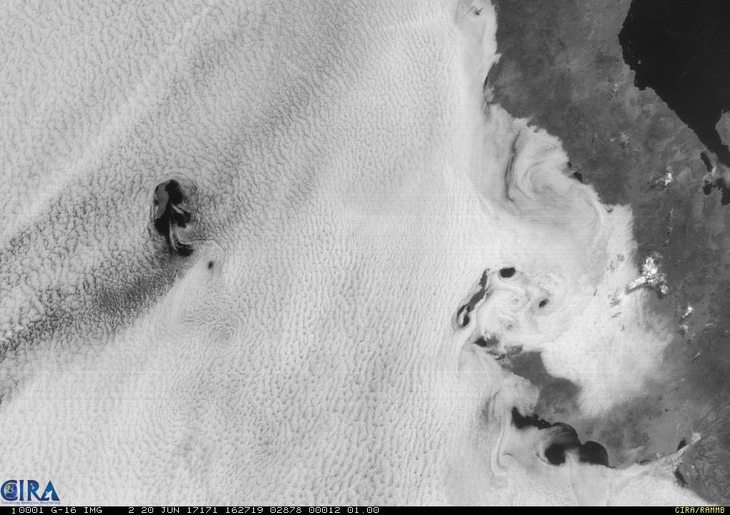
GOES-R Series Imagery
Courtesy of Dan Lindsey, NESDIS/RAMMB

Slide 11
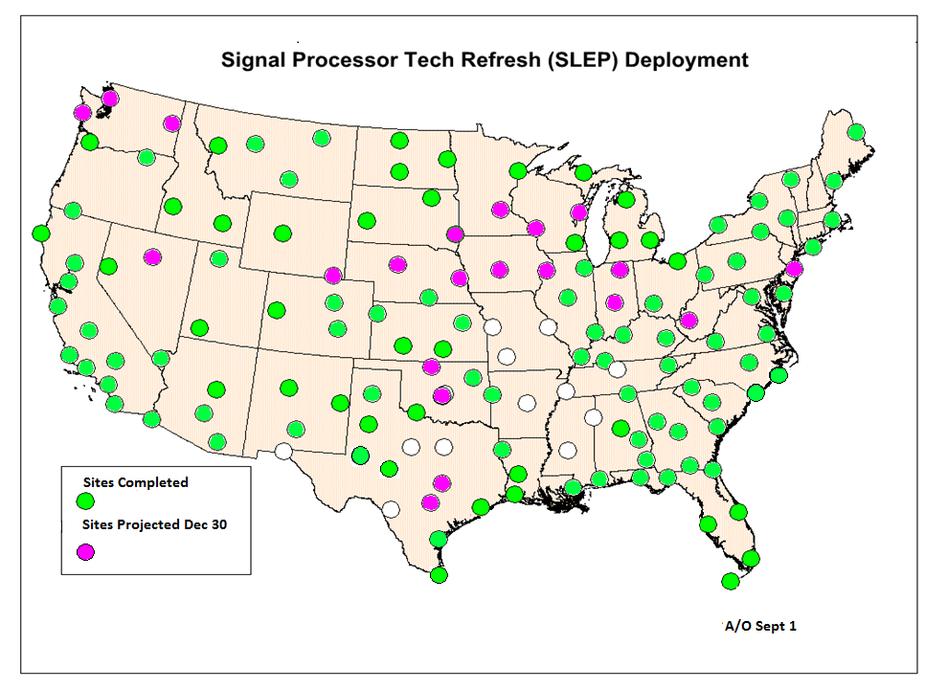
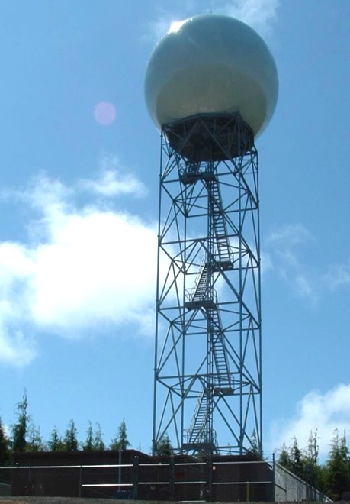
Investing in Observation Infrastructure:
NEXRAD SLEP
A/O Jan 6, 2017
A/O Sept 30
NEXRAD Service Life Extension Program (SLEP) ensures viability thru at least 2030
Signal Processor Suite Technology Refresh scheduled to be complete in 2017
Transmitter Refurbishment (second of 4 projects), first site completed all phases of refurbishment
Pedestal Refurbishment Request for Proposals issued
Overall, the project is ahead of schedule and within budget

Slide 12
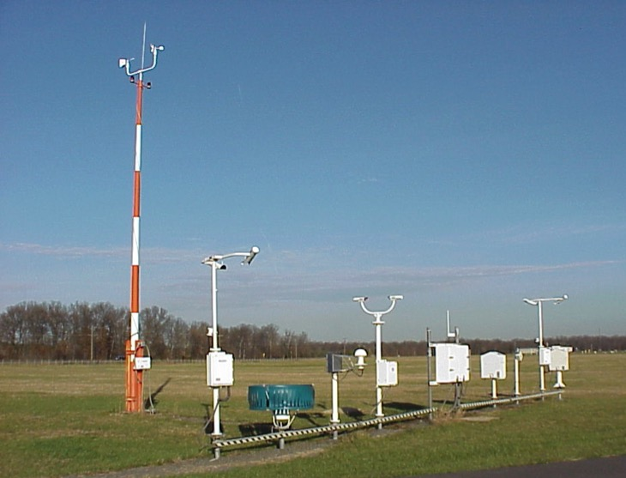
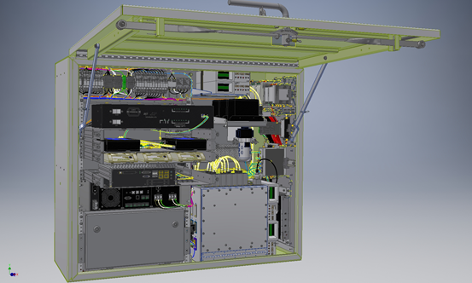
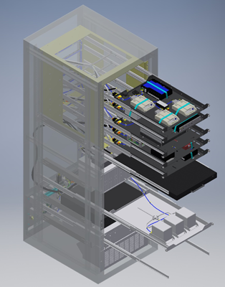
Investing in Observation Infrastructure:
ASOS SLEP
ASOS ACU/DCP Upgrade
Re-designed DCP
Re-designed ACU
Automated Surface Observing System (ASOS) SLEP aims to extend system viability thru 2040
Most critical components:
- Acquisition Control Unit / Data Collection Platform (ACU/DCP) replacement
- Telecommunications upgrade
Will facilitate cost-effective Commercial-off-the-Shelf meteorological sensor solutions, increased data flow, improved system security posture, and remote maintenance capabilities
Funded in the FY 2017 Omnibus Appropriation
Notes:
ASOS SLEP
Replacement of 3 sensors
All-Weather Precipitation Accumulation Gage
Wind sensor
Dew point sensor

Slide 13
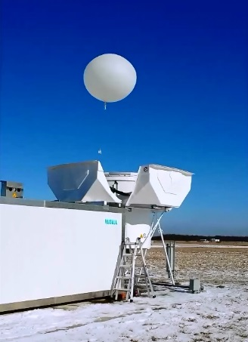
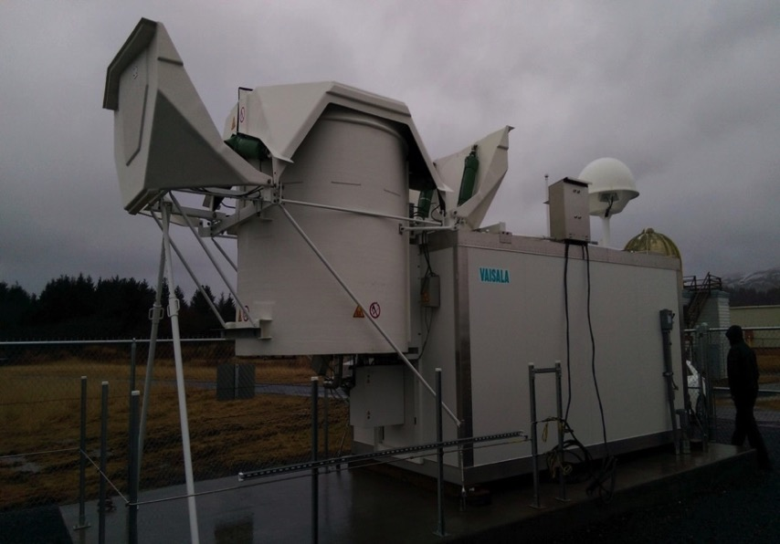
Investing in Observation Infrastructure:
Radiosonde Network
Radiosonde Autolauncher in Kodiak, AK
Sterling, VA
Due to sale of “spectrum,” the Radiosonde Frequency Migration Project will move radiosondes from the 1680 MHz band to the 403 MHz band. Funding from the spectrum sale is supporting this infrastructure investment.
While putting together the larger network acquisition, pursuing Demonstration Project in Alaska Region to install Autolaunchers at all AK Upper Air sites
Notes:
RFMP
Installed and evaluating autolaunching capabilities at the Observations test facility in Sterling, VA, and Kodiak, AK. By deploying new technologies like this, we would be able to provide flexibility in scheduling shifts to free up staff at upper air sites as part of our EvolveNWS initiative.
As a first step towards automation, autolaunchers will be deployed to 13 Upper Air sites in the Alaska Region over the next few years as part of a demonstration project of this capability.
Frequency spectrum is required to support observations; however, spectrum sales are providing a source of funding for observing infrastructure investment, including technology advancements.

Slide 14
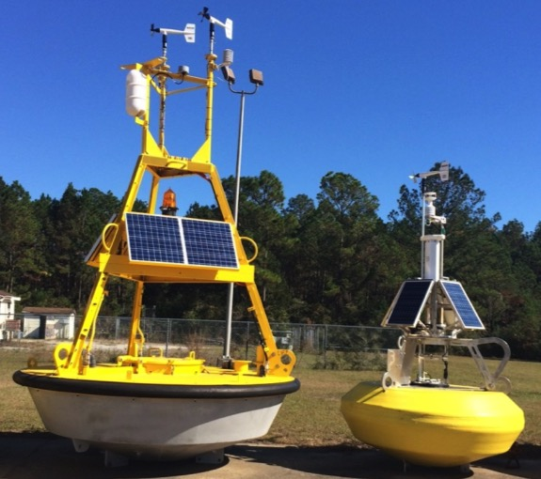

Recapitalizing WX Buoy Network with SCOOP at NDBC
106
Development ( 2.3 yrs)
OP Deployment ( 34% in 3 yrs)
100
HI LVL REQTS
90
PDR
SCOOP
Legacy
80
CDR
70
1st PROTOTYPE
60
1st DEPLOYMENT
# WX
Buoys
500 lb
Payload
Inside
50
Nothing
Inside
Much Lower Cost to Build & Maintain
Increased Reliability ( Never Open in Field)
Less Ship Time and Smaller Ships Required
Much Smaller Size & Easier Logistics
Accommodates Additional Sensors with no Impact on Software
Provides all MET & Ocean Measurements + Cameras & AIS
Step 1 Towards Robotic Manufacturing ( Water Jets & 3D Printers)
Significantly less Manufacturing Errors & Rebuilds
Provides 10 minute MET Data (Legacy provides hourly)
40
36 Operational
( 34% of WX Network)
30
20
10
Q1 Q2 Q3 Q4
Q1 Q2 Q3 Q4
Q1 Q2 Q3 Q4
Q1 Q2 Q3 Q4
Q1 Q2 Q3 Q4
2013 2014 2015 2016 2017
Notes:
Seed Funds from Sandy Supplemental: $xxxx for 1st 10 buoys deployed in 2015
Remaining deployment planned with annual Operations and Maintenance funding
Acronyms-
SCOOP: Self-Contained Ocean Observation Platform
NDBC: National Data Buoy Center….Division of NWS Office of Observations
PDR: Preliminary Design Review
CDR: Critical Design Review

Slide 15
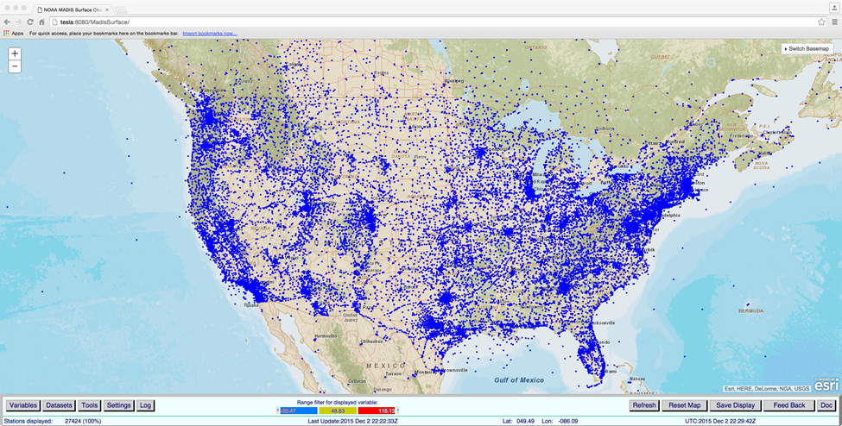
Leveraging Smart Data Buys
National Mesonet Program
Aircraft Based Observations (MDCRS, WVSS)
Lightning Data
GPS-Met
Commercial Weather Data Pilot – evaluating Radio Occultation data from commercial satellite providers
Notes:
As of FY15, National Mesonet supports 8000 surface observing sites, 4000 of which have soil moisture and 1400 have solar radiation measurements
National Mesonet now includes the TAMDAR data set, which provides approximately 3500 aircraft soundings per day in the vicinity of 300 regional airports
The program also supports 68 fixed location vertical profiling systems (mostly SODARS and radiometers), and the CASA network in the DFW region

Slide 16
Future Scenario: Holding Base Observations Steady While Increasing Leveraged Data
Observations Today
Observations in 5 years
Conceptual representation only, not based on actual numbers

Slide 17
Discussion
Given the scarce resources available, how do we determine the highest “value” observing capabilities to transition from research to operations?
Identify the most significant gaps or opportunities to improve the mission
Utilize tools to show actual or estimated impact of an observation on the mission
When determining costs, include consideration of the resources needed through the entire value chain
To the extent possible, represent the results in a consistent manner among observing capabilities

Slide 18
Thank You!
Contact: Joseph.A.Pica@noaa.gov
301-427-9778

