Slide 1



GAW Urban Research Meteorology and Environment Project (GURME)
V. Bouchet, Chair
Dir National operations, Meteorological Service of Canada, ECCC

Slide 2
GAW Urban Research Meteorology and Environment Project (GURME)
Created under GAW in 1995:
To enhance the capabilities of NMHSs in providing urban-environmental forecasting and air quality services of high quality, illustrating the linkages between meteorology and air quality;
In collaboration with other WMO programmes, WHO and environmental agencies, to better define meteorological and air quality measurements focusing specifically on those that support urban forecasting;
To provide NMHSs with easy access to information on measurement and modeling techniques;
To promote a series of pilot projects to demonstrate how NMHSs can successfully expand their activities into urban environment issues.
mce2.org/wmogurme.org/ (hosted by L. Molina)

Slide 3
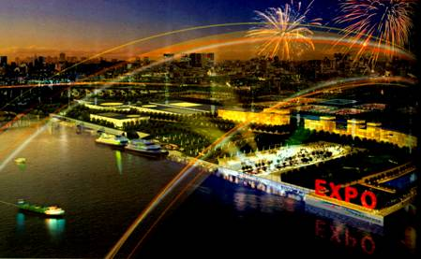
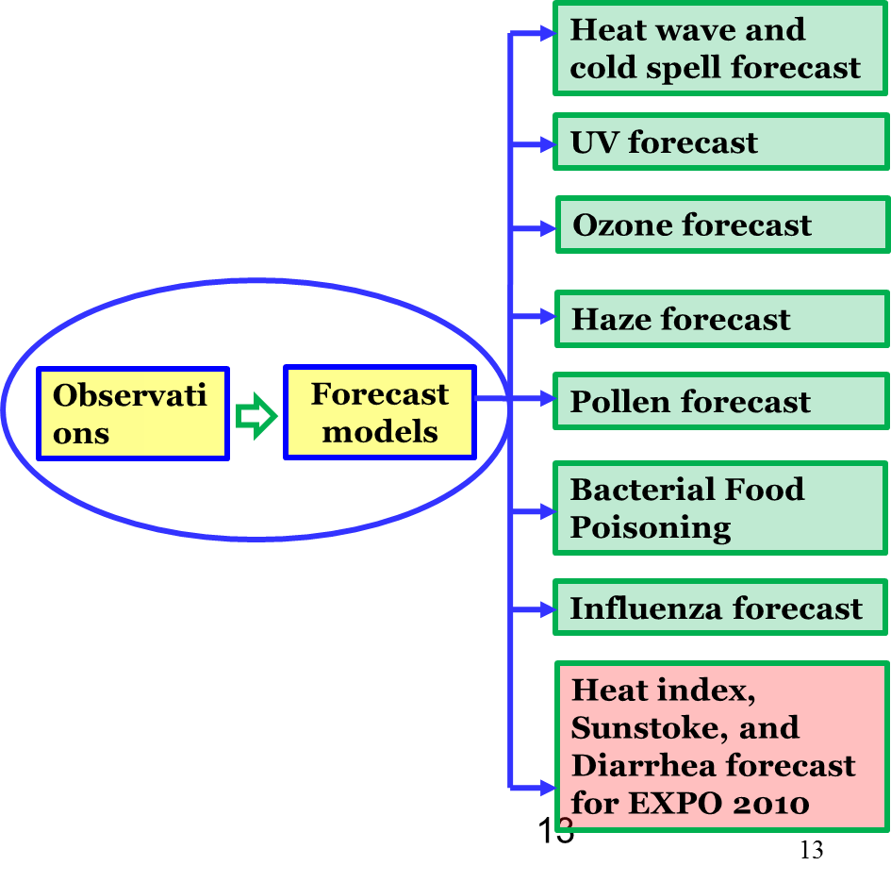
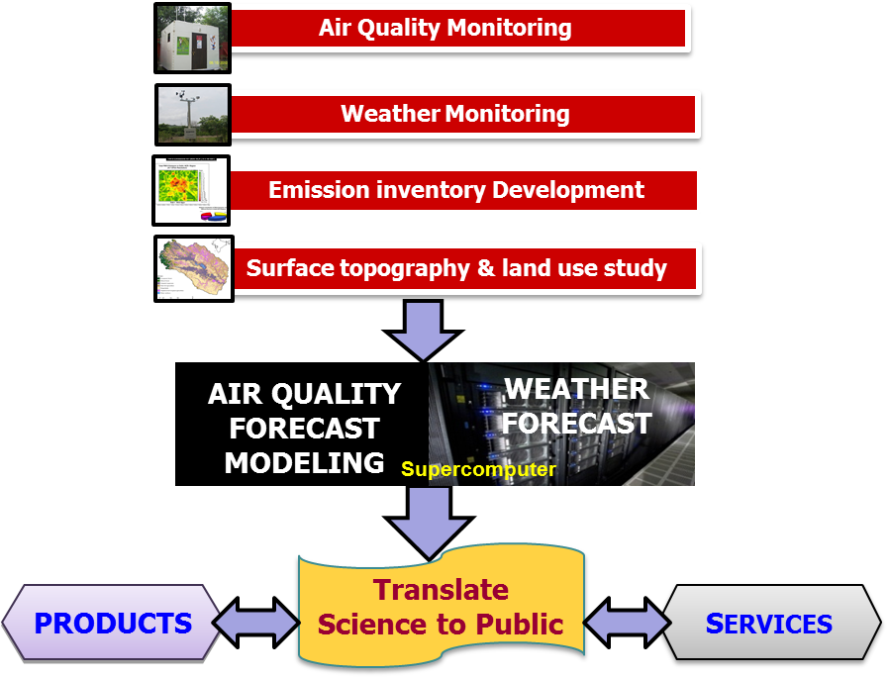
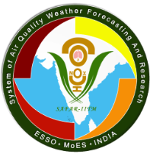

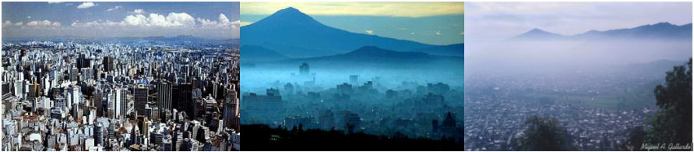
GURME pilot projects
1st AQ Forecasting System in India: Forecasting Air Quality of tomorrow SAFAR (G. Beig, IITM)
Shanghai Expo: multi-hazards forecast system
(Lead by Tang Xu, SMB)
Sao Paulo, Brazil
Mexico City, Mexico
Santiago, Chile
Latin American cities
Signature of MOU between Chilean
Meteorological Office and UNAB to transfer
AQ forecasting model to the Met Office.

Slide 4
A ‘NEW’ ORIENTATION FOR GURME
WMO Commission for Atmospheric Sciences (CAS16) - 2013: inclusion of “Urbanization: research and services for megacities and large urban complexes” among the six emerging challenges and opportunities for the decades to come.
WMO 17 Congress (May 2015):
  Congress stressed that WMO and its Members can make a tangible positive impact on the urban environment by providing forecasts and integrated services that are targeted to the wide-ranging needs of urban authorities and population
  Emphasized that integrated urban services will be relevant for urban resilience and sustainable development…
GURME is shifting its focus from regional AQ forecasting systems to the modelling of the urban atmosphere environment to address related health impacts.
  Given the scale of megacities, GURME’s area of focus spans from regional to high-resolution sub-km scales and how these environments interact with the regional and global scales

Slide 5
GURME SAG Composition
GURME- Science Advisory Group
Gufran Beig - Indian Institute of Tropical Meteorology, India
Veronique Bouchet (Chair) – Environment and Climate Change Canada, Montreal
Sue Grimmond – Department of Meteorology, University of Reading, UK
Jhoon Kim – Yonsei University, Seoul, Korea
Louisa Molina – Molina Center for Energy and Environment
Jianguo Tan – Chinese Meteorological Administration, Shanghai, China
Pablo Saide – Chile curently at NCAR, Boulder, USA
Paulo Saldiva – University of Sao Paulo, Faculty of Medicine, Sao Paulo, Brazil
Heinke Schuenzen – University of Hamburg, Germany
Ex-officio: Greg Carmichael, representatives from JWGMNR (WWRP), APP SAG and CBS
Collaboration at chair level between GURME and HIWeather (WWRP)

Slide 6

Highlights of GURME Objectives
Address the research barriers to advance the predictive capacity at increasing resolutions, and in the urban context in particular: through the coordination of reviews in the current state of science in urban-scale forecasting and associated monitoring, establish activities where gaps exist.
Develop activities on those research questions/issues that transcend disciplines and require leveraging a broader community to develop improved forecasting concepts and tools to resolve complex urban environments at increasing scales; facilitate data sharing and establishment of test beds.
              Release of the PanAm2015 Legacy Database as a test bed for the development of other user efforts worldwide
              Establishing a network of urban scale modelling and monitoring initiatives as being discussed here

Slide 7

Surface characteristics workshop
Approach to urban processes representation depends on the primary objective of the modelling, computational resources, and modelling design.
To date there are ranges of ways to characterize the urban surface.
  Some developed specifically for modelling urban land-atmosphere interactions
  others intended for a variety of different purposes but now commonly used for atmospheric modelling.
  Efforts include WUDAPT, NCAR, U. Reading…
Objective of workshop:
  Understand the current ways for characterizing the urban land surface (modelling/observations; application/objective, scale)
  How data are currently obtained and what limitations they present
  Define future efforts needed in order to make improvements, including with need to have regular and rapid updates to the urban characteristic data
Picture from boston.com

Slide 8
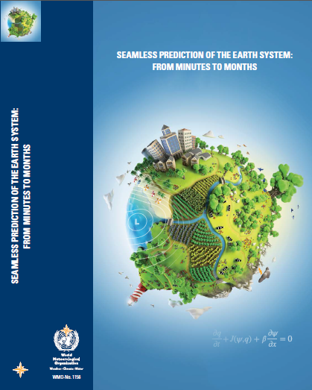
Highlights of GURME Objectives
Given the integrative nature of modelling, the on-going scientific trend towards seamless predictions and the evolution of technology, actively engage other WMO advisory and working groups within WWRP, GAW and the rest of its organisation, to address this complex and multidisciplinary challenge.
Participating in and sponsoring expert meetings
  EX: WWOSC2014 - Seamless prediction of the Earth system: from minutes to months (Available online at: http://library.wmo.int/pmb_ged/wmo_1156_en.pdf)
  Co-Sponsoring of the IWAQFR series
  Participation in CCMM Symposium in 2015
  Part of the High Impact Weather Project

Slide 9


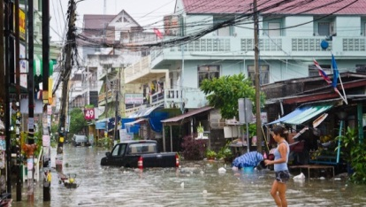
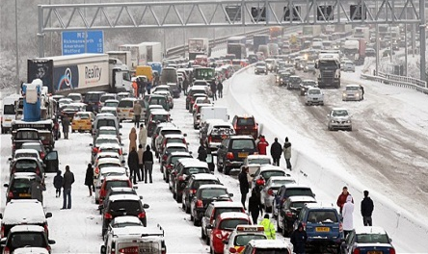
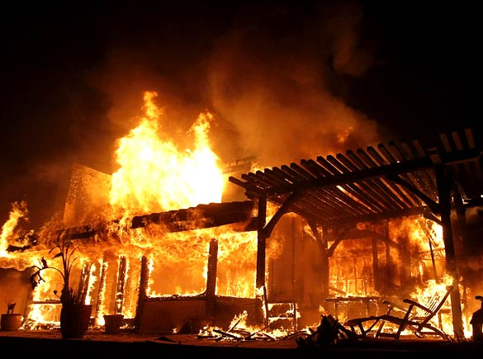
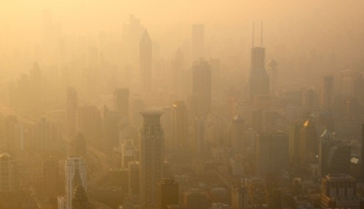
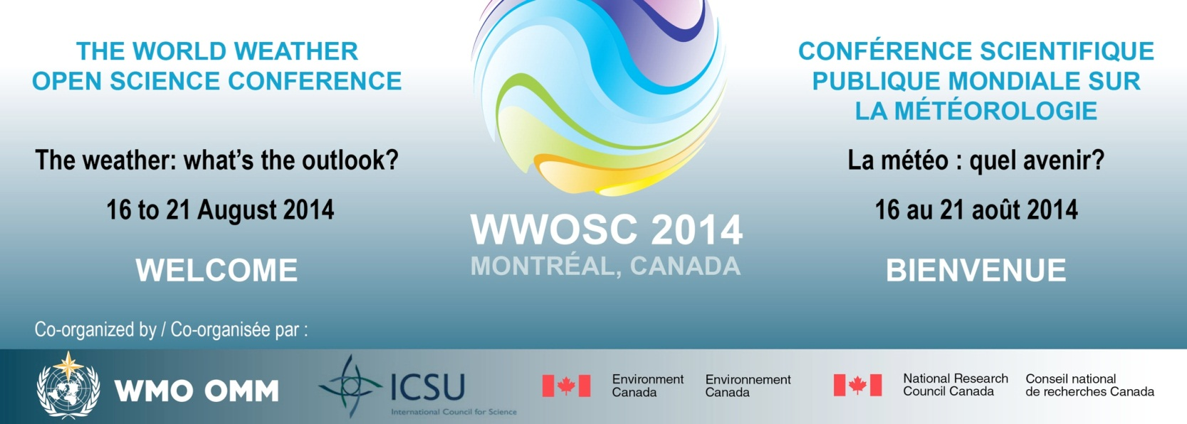
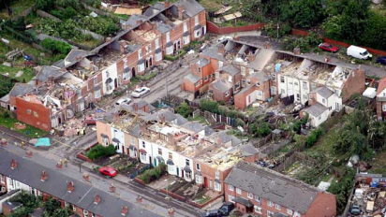
High Impact Weather Project
Urban Flood: Reducing mortality, morbidity, damage and disruption from flood inundation by intense rain.
© www.thamai.net
Disruptive Winter Weather: Reducing mortality, morbidity, damage and disruption from snow, ice and fog to transport, power & communications infrastructure.
Wildfire: Reducing mortality, morbidity, damage and disruption from wildfires & their smoke.
© Tommy Hindley/ Professional Sport
MALAO@pictzz.blogspot.com
Urban Heat Waves & Air Pollution: Reducing mortality, morbidity and disruption from extreme heat & pollution in the megacities of the developing and newly developed world.
Extreme Local Wind: Reducing mortality, morbidity, damage and disruption from wind & wind blown debris in tropical & extra-tropical cyclones, downslope windstorms & convective storms, including tornadoes.
© www.energydigital.com
© Adrian Pearman/Caters
9
2

Slide 10

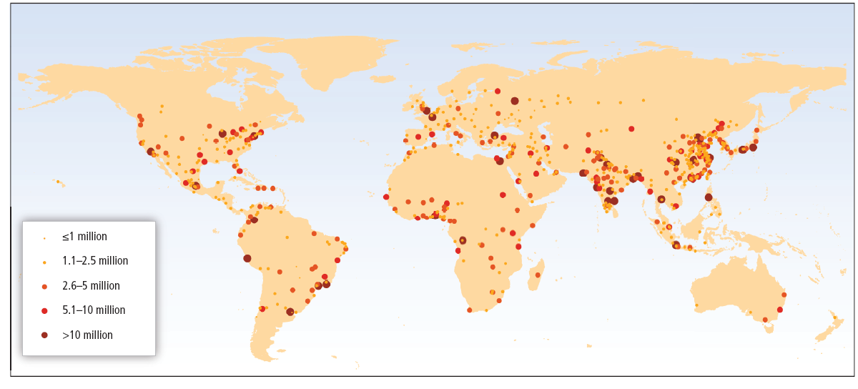
Risks in the urban environment:
flooding;
poor air quality;
sea-level rise;
extreme heat/cold and human thermal stress;
energy and water sustainability;
public health problems caused by the previous.
WMO Cg-17 Resolution 9.8 :
Establishing WMO Cross-cutting Urban Focus
Global map showing the location of urban agglomerations with 750,000-plus inhabitants projected for 2025 (derived from statistics in UN DESA Population Division, 2012).[IPCC AR5 WGII, Fig. 8-2]
Notes:
Increasing exposure due to convergence of livelihood and properties into coastal megacities.
Urbanization and the growing needs of urban dwellers for new and improved climate, weather, water and related environmental services
The particular vulnerabilities of the urban setting
Acknowledging the wide range of urban relevant past and present initiatives within WMO and among Members
The need for an integrated approach for all weather, climate, water and related environmental components as also promoted in Doc 4.3(5) on joint research activities.
New UN Urban Agenda: UNHABITAT-III (2016)

Slide 11
GURME Terms of Reference – cont’
Build capacity through its research projects, identifying those environments that constitute gaps in the overall directions of the GURME program and Encourage in its projects the development and testing of derived services. The products themselves would take the form of forecasts, alerts and warnings and/or real-time/NRT maps or databases.
Chilean Pilot:
  Transitioning the forecasting system to the Chilean Ministry of Environment and facilitating the development of a window for a city in the southern most part of Chile
  Improving the existing system to function at higher resolution with urban canopy module and unresolved topography parameterization
  Development of a land cover dataset for Santiago for the urban canopy module.
Mexico City Pilot:
  Development of air quality forecast model for the Government of Mexico City
  Develop the database for the quantitative assessment of public exposure to air pollutants
  Improve and expand the atmospheric monitoring system, including testing of low-cost sensors in the city environment.

Slide 12
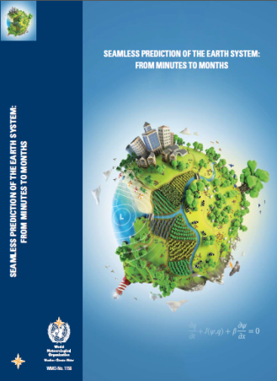
GURME Research Priorities
Chapter 18: Urban-scale environmental prediction systems (C.S. Grimmond et al, 2015, WWOSC2014 - Seamless prediction of the Earth system: from minutes to months - Available online at: http://library.wmo.int/pmb_ged/wmo_1156_en.pdf)
    Resolution to describe urban effects for different applications
    Methods to routinely gather and continuously update dynamically changing land cover
    Advance coupled models that simulate the feedback between human activities and urban environmental conditions
    Data assimilation methods to support coupled prediction systems
Panel discussion this afternoon on ‘Knowledge gaps in the development of coupled urban environmental prediction systems”

Slide 13
Questions ?

