Slide 1
London 2012 and Air Quality Forecasting Developments at the UK Met Office
Matthew Hort and Paul Agnew
12/01/17
Notes:
In UK responsibilities are divided up differently to Canada. The Met Office is not the ‘environment agency’ and so has limited mandated remit in the are of air quality.
However the obvious close link with the weather and also our strong climate role, where composition is key, mean that there are strong synergies.

Slide 2
Atmospheric Dispersion and
Air Quality Group
Biological
Biomass burning
Volcanic
Industrial
Radiological
Air Quality
Dust Storms
Routine, Response & Research
Weather Feedbacks
Atmospheric Process
GHG
Impacts
Notes:
As for many Met Services the Met Office has a long history of composition modelling for a range of tasks.

Slide 3
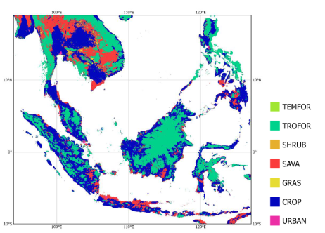
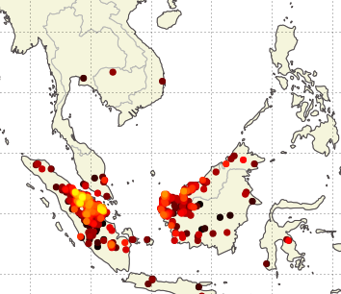
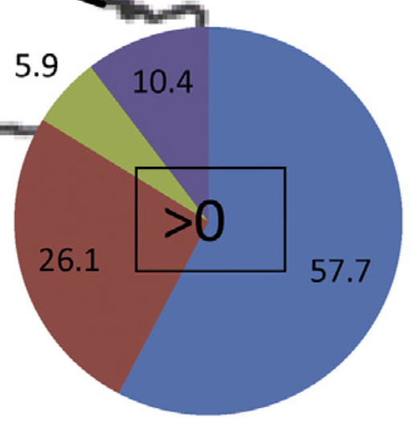

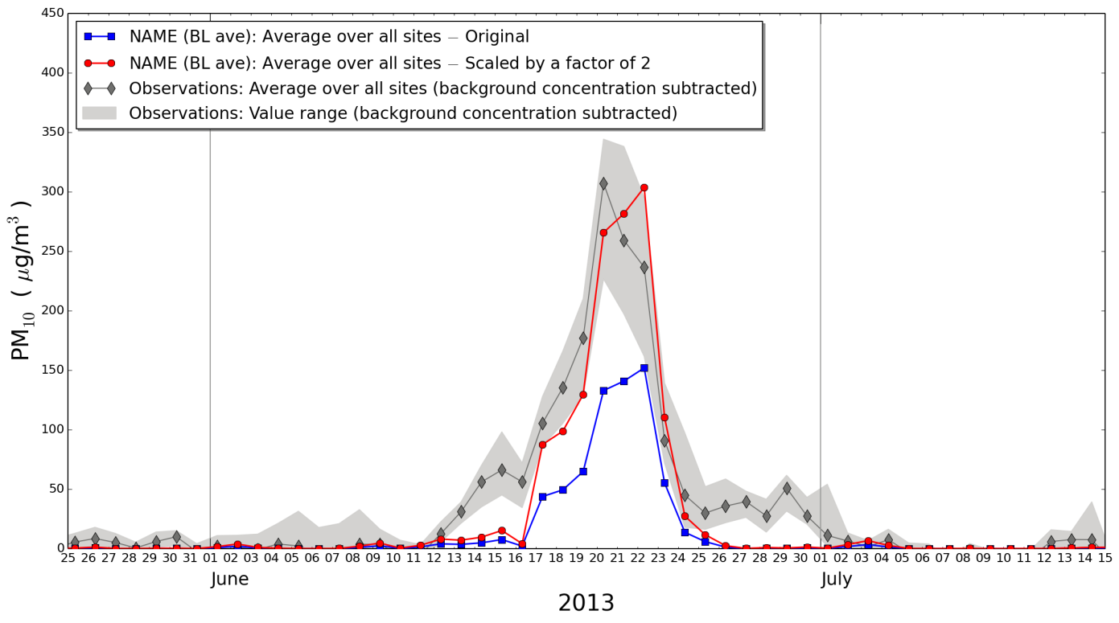
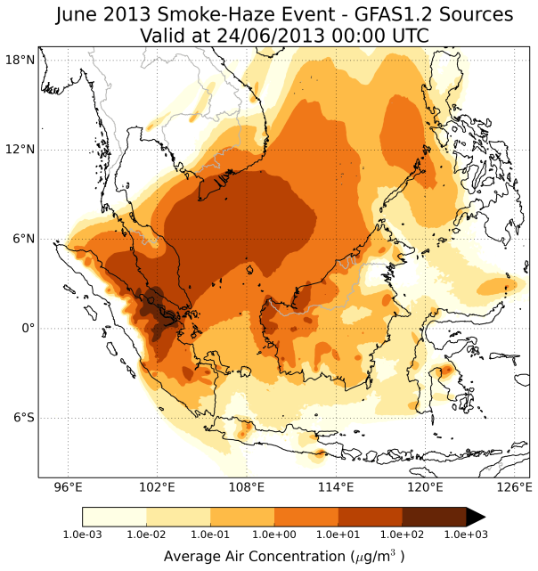
Wider air quality activities
Biomass Burning PM Forecast
Attribution
Land use & type
London Bloomsbury Sources of PM₁₀ for:
FRP
Annual average
During Episodes
Redington et al. [AE, 2016]
Hertwig et al. [JGR, 2015]
Notes:
Other ‘AQ’ activities
One slide covering attribution, biomass burning etc….

Slide 4
Air Quality Forecasting Evolution
Late 1990’s - Operational UK AQ forecast delivered using NAME.
AQUM:
2005 - Model development started
July 2010 - Operational 2 day forecast
(Taking over from NAME)
January 2012 - Operational 5 day forecast
Summer 2012 - Olympics demonstration
April 2014 - Met Office regain official UK AQ forecast

Slide 5
AQUM
Air Quality in the Unified Model
Limited area 2-way coupled configuration of the:
  Met Office Unified Model (UM)
  +
  UK community atmospheric Chemistry-Aerosol
  model (UKCA)
Flexible and seamless framework
Used across Global and UK Weather forecasting; Ensembles; Climate; Earth System and Air Quality configurations

Slide 6
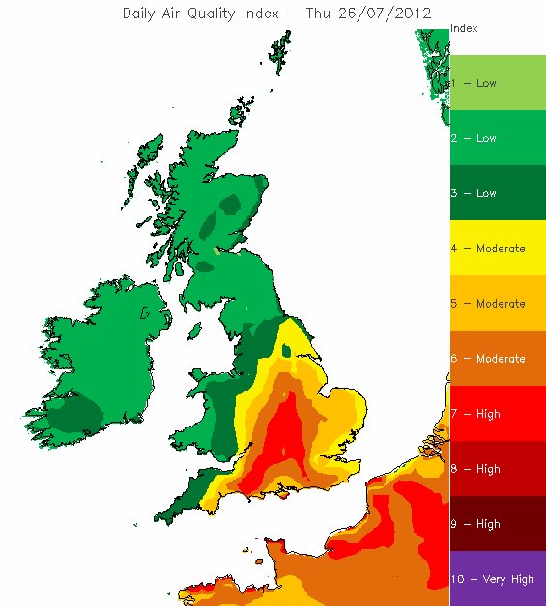
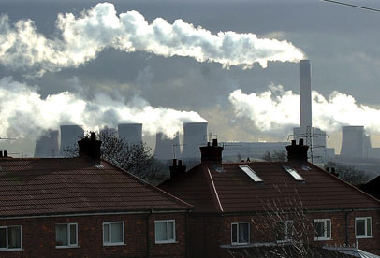
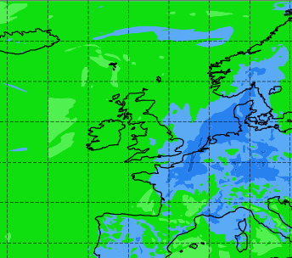
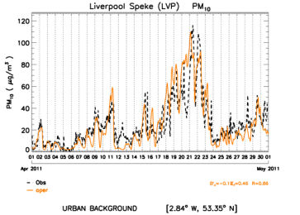
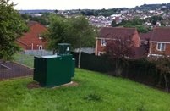
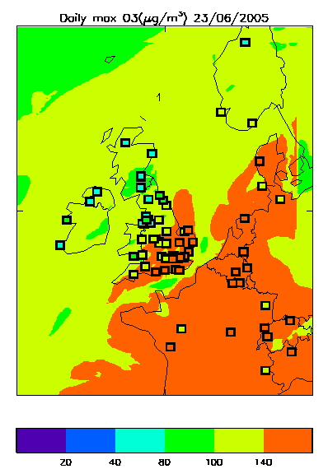
Operational Forecast System
NWP+ Composition LBC
Forecast
AQUM
Emissions
SPPO
Observations
NRT Verification
Notes:
O₃, NO₂, SO₂, PM_{2.5} and PM₁₀

Slide 7
AQUM
12 km horizontal resolution
38 (63) model levels (surface-39 km)
LBCs
  NWP from UM global model
  Composition from Copernicus/MACC global
  model (forecasts or reanalysis)
Emissions
  UK (NAIE); Shipping (ENTEC); Europe (EMEP and MACC)
  Updated annual, with ~ 3 years delay
2.0
SNAP sectors
traffic
Emission Factor
1.0
non-traffic
0.0
18
0
6
12
Hour

Slide 8
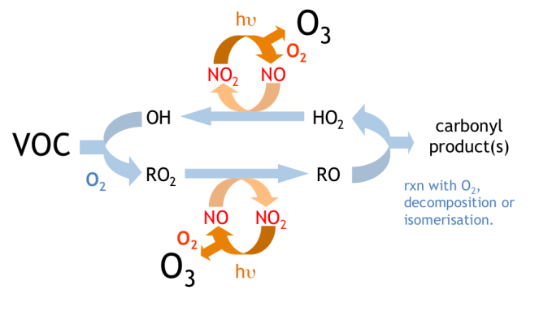
AQUM
Physics: UM
  Non-hydrostatic and fully compressible with semi-implicit, semi-Lagrangian time integration
Chemistry: UKCA with RAQ mechanism
  40 transported species (16 emitted)
  18 non-advected species
  116 gas-phase reactions + 23 photolysis reactions
Aerosol: Classic
  Sulphate, Black Carbon, Organic Carbon, Sea Salt, Dust (2 or 6 bins), Nitrate
  Single moment, fixed mode scheme
Savage et al. [GMD, 2013]

Slide 9
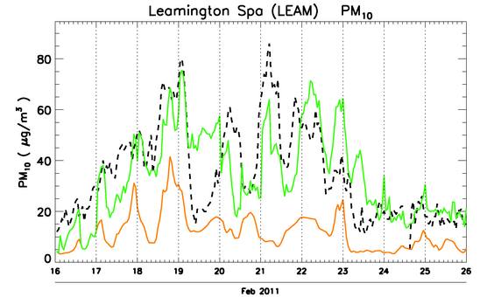
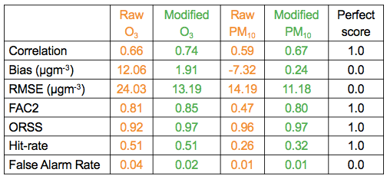
Statistical post-processing using observations
SPPO
Using recent observations to improve AQ forecast
SPPO
  Post-processing bias correction scheme
  Based on the short-term persistence
  of model bias with respect to recent surface pollutant concentrations
  Kriging of residual field
Largest improvements in forecast
skill for PM and O₃
- Observed PM₁₀
- Raw model forecast
- Adjusted forecast
Neal et al. [AE, 2014]
March 2011 – Feb 2012

Slide 10
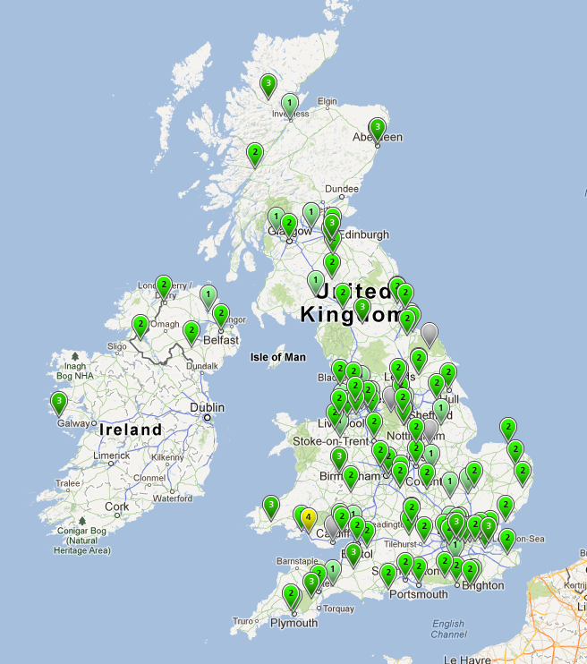
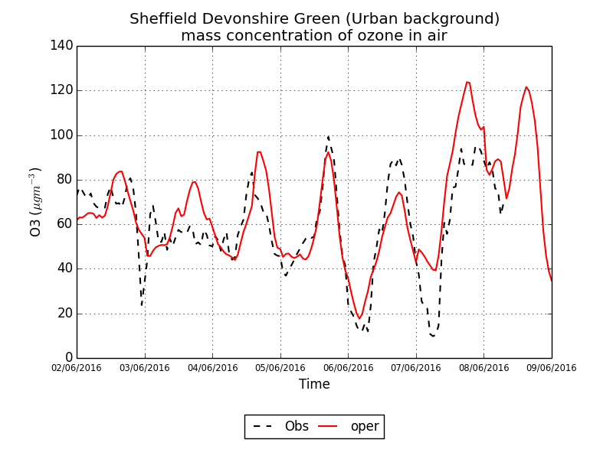
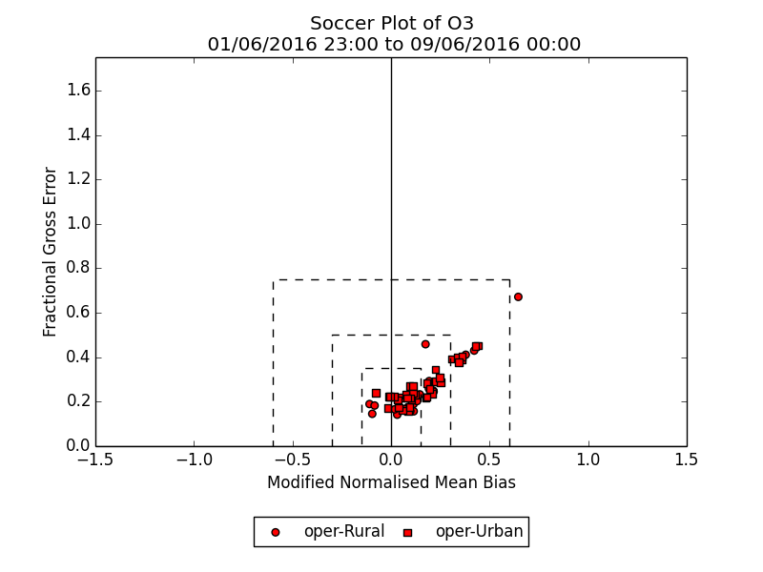
Near Real Time Verification
Routine verification against surface observations from the UK national network (AURN)
  O₃, NO₂, NO, SO₂, CO, PM_{2.5} and PM₁₀
Daily forecast evaluation
Constant objective evaluation aids services and model development
Obs
Forecast
Notes:
What metrics do we evaluate against?
Mean bias, fractional gross error, rmse, factor 2, hit rate, false alarm rate,
Time series mass

Slide 11
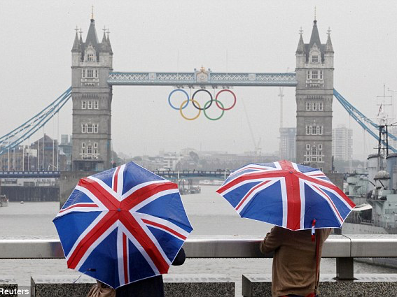

Enhanced weather capability for the 2012 Olympic and Paralympic games

Slide 12
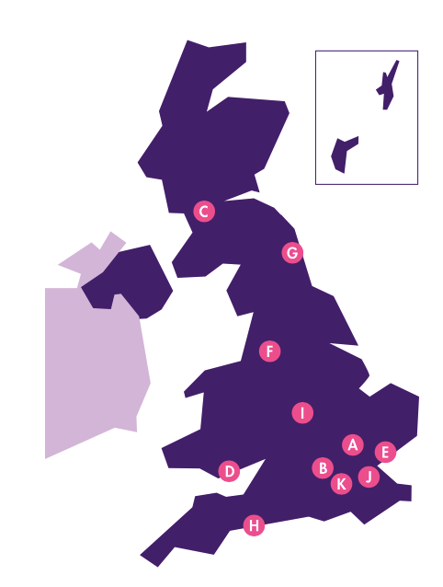
London 2012
Infrastructure cost of FDP not justified by benefits to UK
Met Office science showcased
Tailored forecast services & imbedded staff
Out reach, engagement, education
Olympic Site Locations
Notes:
Olympic sites spread across the country

Slide 13




Demonstration Products
Air Quality
Convective Scale Ensemble
NWP Hourly 1.5 km Nowcasting
T+1
Hourly 4D-Var DA. 12 hr forecast
12 members, 2.2. km, run 6 hourly
Wind (333m) and Wave (250 m)
Additional Observations
Local wind probabilities
Notes:
Met Office not UK air quality forecast provide
Comms channels ‘hit’ more than 118 million people over 2 months

Slide 14
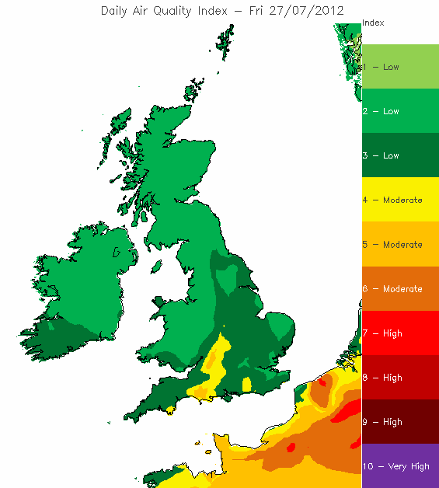
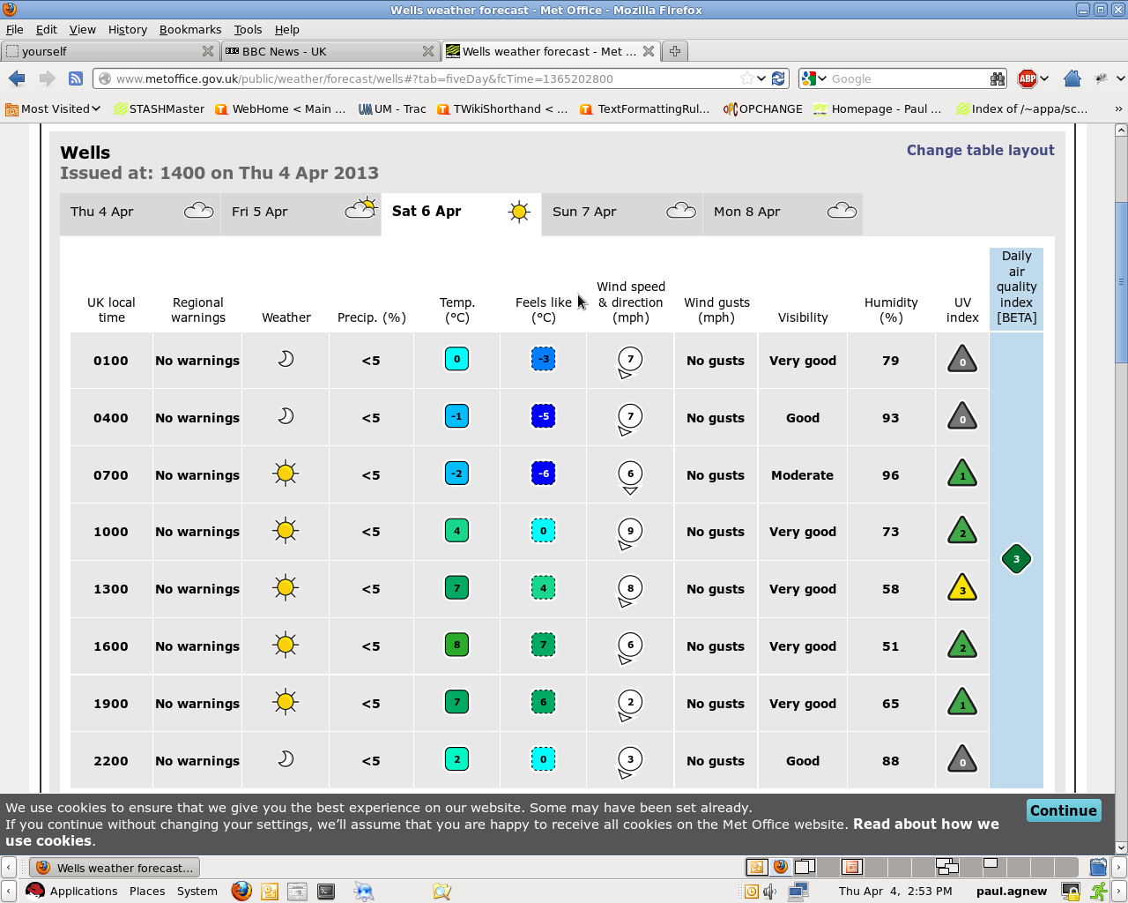
Air Quality During the Olympics
Friday 27th July 2012 Opening Ceremony
AQUM run once per day
at ~ midnight
5 day forecast
  Products available at 0200
  Disseminated to customers before 0400
UK maps of daily air quality index (DAQI)
Site specific forecasts for 5000 sites

Slide 15
Air Quality During the Olympics
Air quality was generally good during the Olympics
Pollution levels did increase in the few days prior to the opening ceremony
  Event driven by Ozone

Slide 16
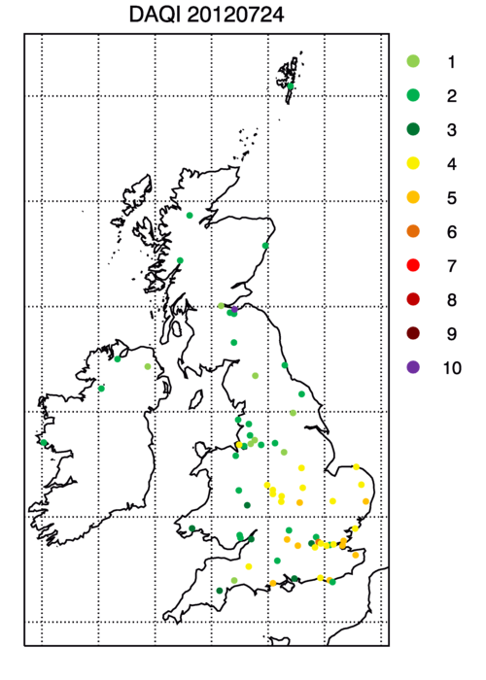
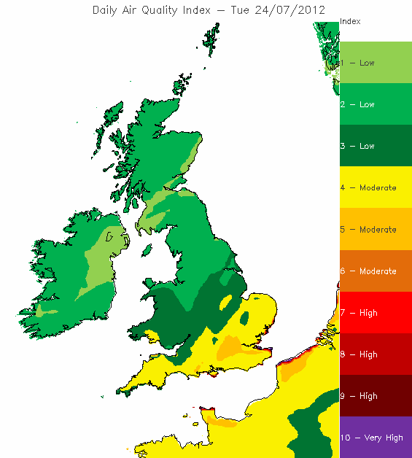
Air Quality During the Olympics
Tuesday 24th July

Slide 17
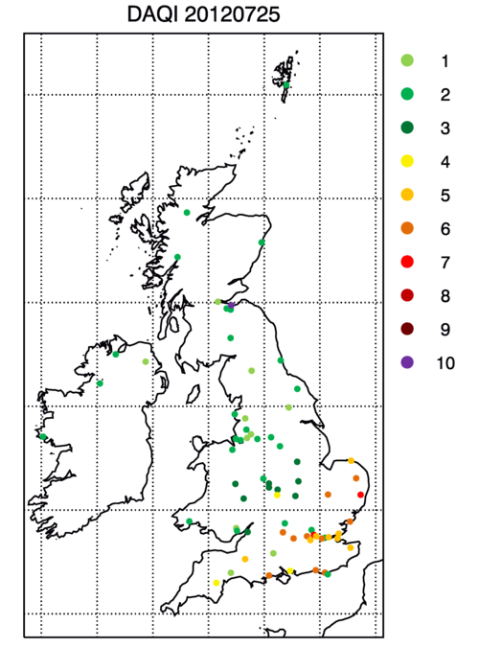
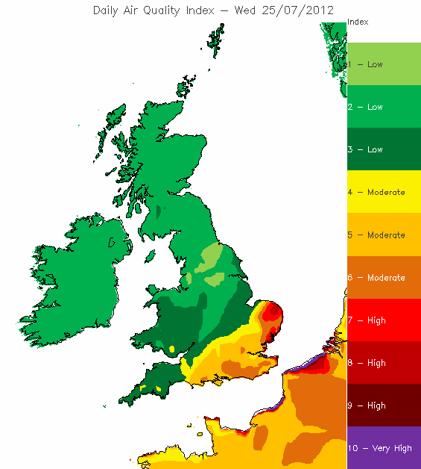
Air Quality During the Olympics
Wednesday 25th July

Slide 18
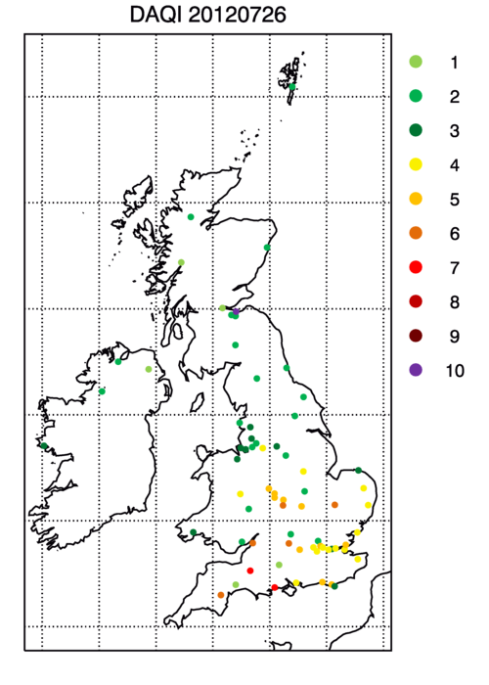
Air Quality During the Olympics
Thursday 26th July

Slide 19
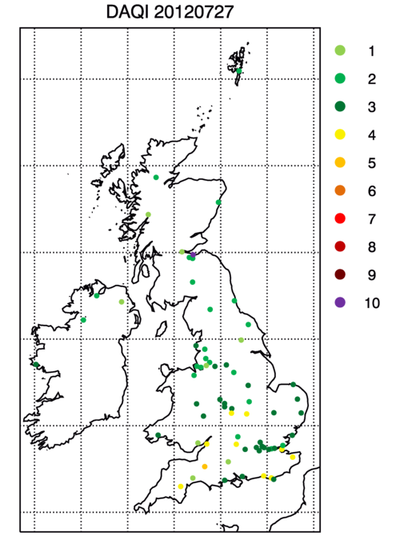
Air Quality During the Olympics
Friday 27th July - Olympics Opening Ceremony

Slide 20
Outcomes
Motivation to enhance offering
Provided useful ‘vehicle’ for stakeholder engagement and discussion
Good air quality ‘limited’ role
Olympic sites distributed, but local/urban factors still present challenges of representivity
A useful ‘step’ in developing the service

Slide 21
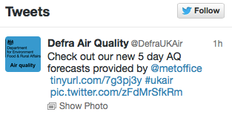
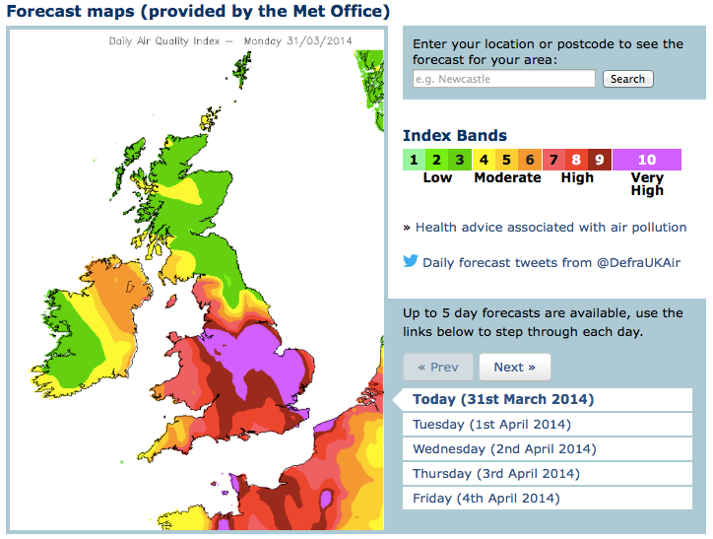
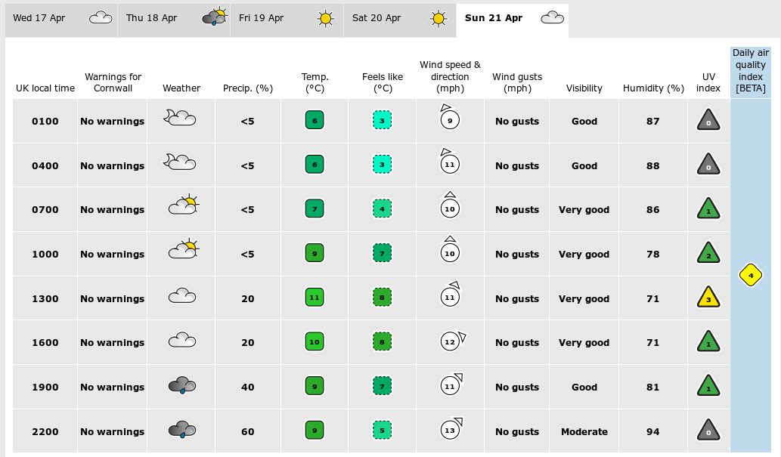
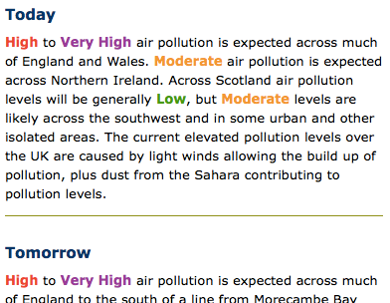
UK AQ Forecast Provider
April 2014 Met Office became UK AQ forecast provider
Communication enhanced:
  Forecaster written web content and tweets (https://uk-air.defra.gov.uk/forecasting/)
  Inclusion in daily UK hazard assessment
  Teleconferences during episodes
Notes:
~38 air pollution episode

Slide 22
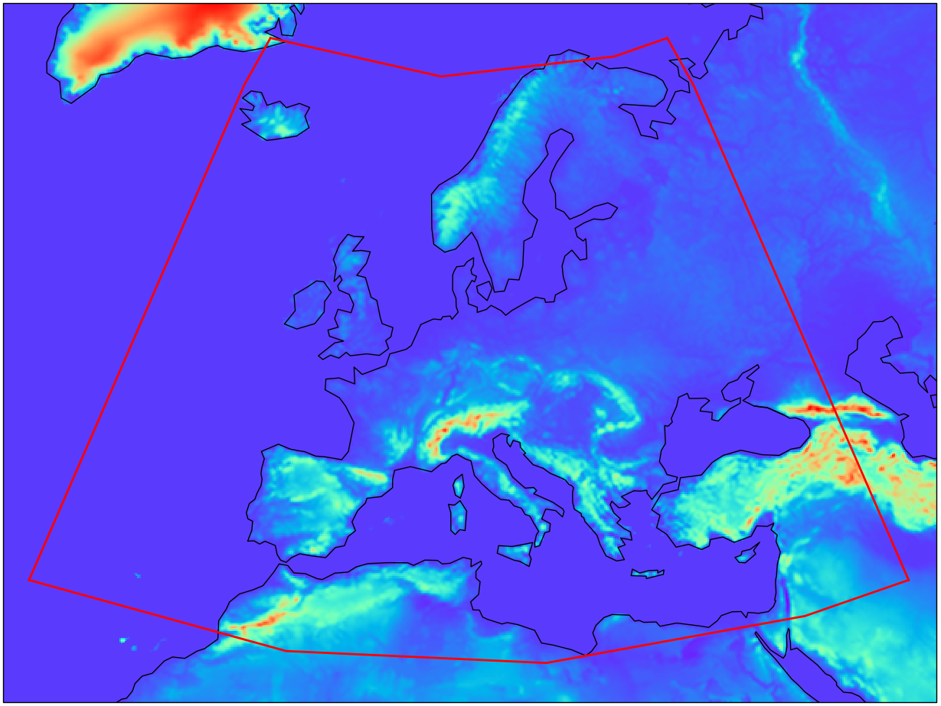
Some Recent/Ongoing Developments
Enhanced anthropogenic emissions scheme
Interactive biogenic emissions
New UM configuration including 63 vertical levels
Improved mineral dust
Copernicus - Regional air quality ensemble – requiring development of:
  Composition DA – 3d VAR of
  surface observations; European
  verification; Pollen (Birch) forecast;
  Dynamic bio-mass burning
CAMS Domain
EU wide PM_{2.5} evaluation
Hindcast: June 2015 – May 2016
Bias (µg/m3) | CAMS Ensemble | AQUM Day 1 | AQM Day2
Summer | -3.57 | 2.29 | 2.22
Autumn | -2.71 | 1.16 | 0.80
Winter | -3.52 | -2.20 | -2.63
Spring | -2.27 | 0.23 | -0.09

Slide 23
The Future
Improved mechanism:
  Heterogeneous & aqueous phase chemistry
  HONO, oxidation of SO2 and terpenes (needed for coupling to GLOMAP-mode aerosols in UKCA), …
Move to GLOMAP-mode – two moment modal scheme
Higher resolution ~ 1.5 km
DA of satellite composition observations
Continued work on emissions, SPPO, etc…

Slide 24
Thank you

