Slide 1
Resolution of Local and Regional Sources Using Near Road and Background Measurement Sites
Yushan Su
Environmental Monitoring and Reporting Branch
Ontario Ministry of the Environment and Climate Change
8th IWAQFR, Toronto | January 12, 2017

Slide 2
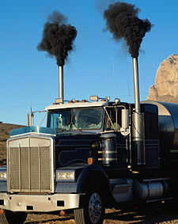
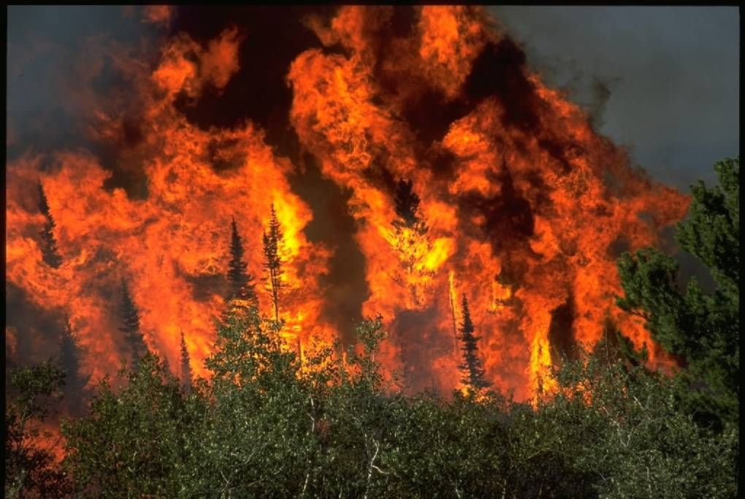
Case Study 1:
Local and Regional Contribution of Fossil Fuel and Biomass Burning Black Carbon in Ontario
Acknowledgement:
Robert Healy, Yemi Sofowote, Mike Noble, Jerzy Debosz and Tony Munoz
Ontario Ministry of the Environment and Climate Change
Cheol-Heon Jeong, Greg Evans, Jon Wang and Nathan Hilker
University of Toronto
Luc White, Celine Audette and Dennis Herod
Environment and Climate Change Canada

Slide 3
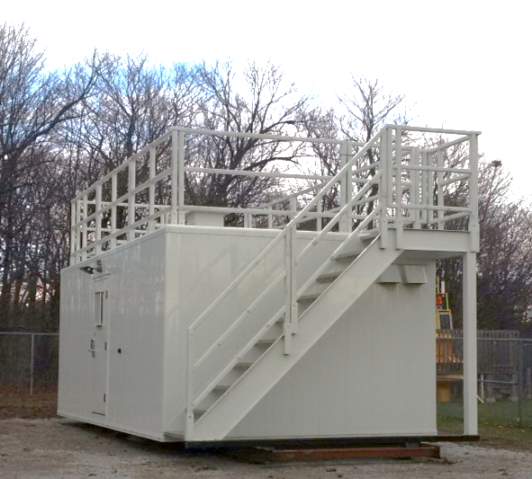
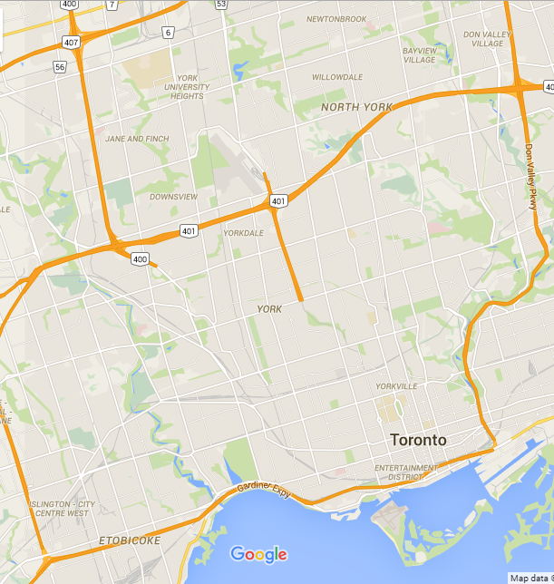




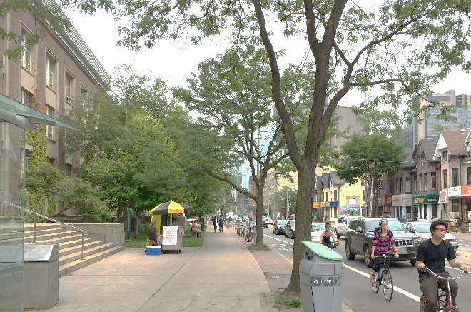
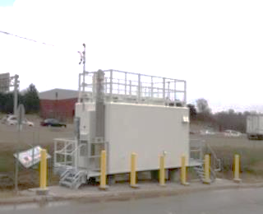
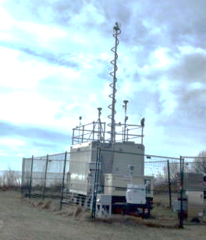
Near Road Air Monitoring in Toronto
● Downsview
● Hwy 401
● U of T
Hanlan’s Point 

Slide 4
Black Carbon (BC)
BC is emitted from incomplete combustion processes including fossil fuels (vehicles, industry) and biomass (residential wood burning, wildfires).
BC exerts a positive direct radiative forcing (warming effect) on global climate.
BC absorbs light efficiently across a broad wavelength range.
BC is monitored with the Magee Scientific Aethalometer®.
An optical model based on differences in absorption efficiency of aerosol is used to estimate relative contribution of fossil fuel and biomass burning.

Slide 5
Aethalometer Measurements of BC in Ontario
(June 2015 – May 2016)

Slide 6
Annual Mean Concentrations of BC in Ontario
BC_{ff} = BC from fossil fuels
BC_{bb} = BC from biomass
Fossil fuels are the dominant BC source at every site, with the highest fossil fuel contributions (>80%) observed at near-road sites

Slide 7
Seasonal Mean Concentrations
Summer-Winter difference for BC_{ff} is much higher at HWY 401
4 sites have peak biomass burning BC contributions in the winter months most likely due to residential wood combustion, although this is a minor source overall relative to fossil fuels

Slide 8
Potential Source Regions for Fossil Fuel BC
The transboundary influence of fossil fuel BC (BC_{ff}) from the US is highest in the summer, although HWY 401 also exhibits higher local fossil fuel BC during this period

Slide 9
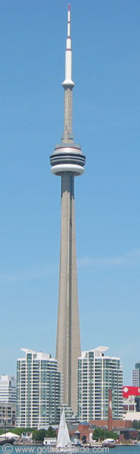
Case Study 2:
Influence of Lake Breeze on Regional Ozone Levels
CN Tower
(444m intake + 84m ASL)
Acknowledgement:
Stephanie Pugliese and Jennifer Murphy
Department of Chemistry, University of Toronto
Ryerson University
(65m intake + 96m ASL)
Toronto Downtown
(10m intake + 105m ASL)

Slide 10
Background
Ozone (O₃) and nitrogen oxides (NO_{x}) were monitored from January – December, 2010 at three levels in Toronto:
CN Tower (444m intake height + 84m above the sea level or ASL)
Ryerson University (65m intake height + 96m ASL)
Toronto Downtown (10m intake height + 105m ASL)
Local emissions of NO_{x} may mix up and impact regional O₃ levels measured at the CN Tower. Lake breeze may also impact air pollutants levels in Toronto.
In summer 2010 from May to September, 110 lake breeze days (72% summertime) were manually identified for the Greater Toronto Area (Wentworth et al., 2015).

Slide 11
NO₂ Diurnal Profile on Lake Breeze and Non-Lake Breeze Days

Slide 12
NO Diurnal Profile on Lake Breeze and Non-Lake Breeze Days

Slide 13
O₃ Diurnal Profile on Lake Breeze and Non-Lake Breeze Days

Slide 14
Summer 8-hr O₃ Average Vertical Profile on Lake Breeze and Non-Lake Breeze Days

Slide 15
O₃ Average Vertical Profile on Lake Breeze and Non-Lake Breeze Days at 14:00 EST

Slide 16
O_{x} Average Vertical Profile on Lake Breeze and Non-Lake Breeze Days at 14:00 EST
O_{x} = O₃ + NO₂

Slide 17
Identification of Local and Regional Sources using Near Road Measurement Sites
Cheol -H. Jeong¹, Jon M. Wang¹, Nathan Hilker¹, Jerzy Debosz², Uwayemi Sofowote², Yushan Su², Michael Noble², Rob Healy², Tony Munoz², Luc White³, Celine Audette³, Dennis Herod³, Ewa Dabek-Zlotorzynska³, Greg Evans¹
¹Southern Ontario Centre for Atmospheric Aerosol Research, University of Toronto, Toronto, Ontario
²Air Monitoring and Transboundary Air Sciences Section, Ministry of the Environment and Climate Change, Toronto, Ontario
³Analysis and Air Quality Section, Science and Technology Branch, Environment and Climate Change Canada, Ottawa, Ontario

Slide 18
Background and Objectives
The spatial variability of traffic-related pollutants are of great interest as these may disproportionately mediate health outcomes arising from PM_{2.5} exposures across metropolitan areas.
The spatial and temporal variations of PM_{2.5} chemical speciation data (i.e., trace metals, organics, inorganic ions) were examined at two near-road sites (i.e., Downtown and Highway).
The hourly continuous chemical speciation data at the near-road sites were analyzed using positive matrix factorization (PMF) to identify local and regional scale PM_{2.5} sources.

Slide 19
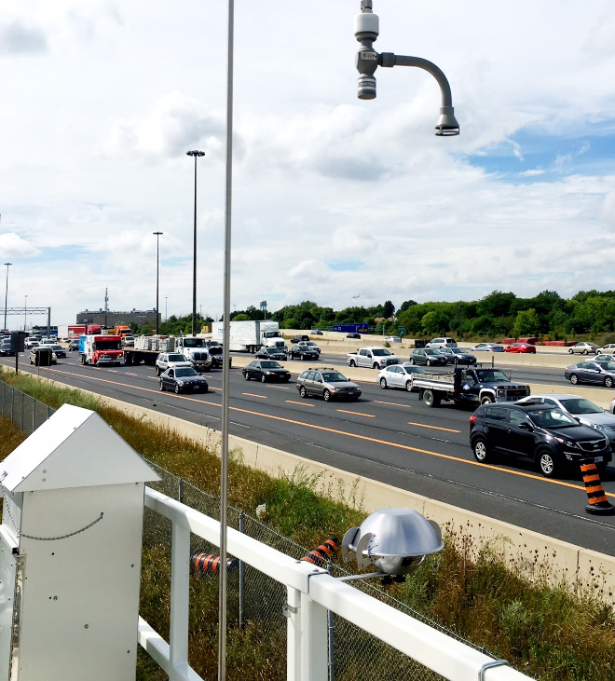
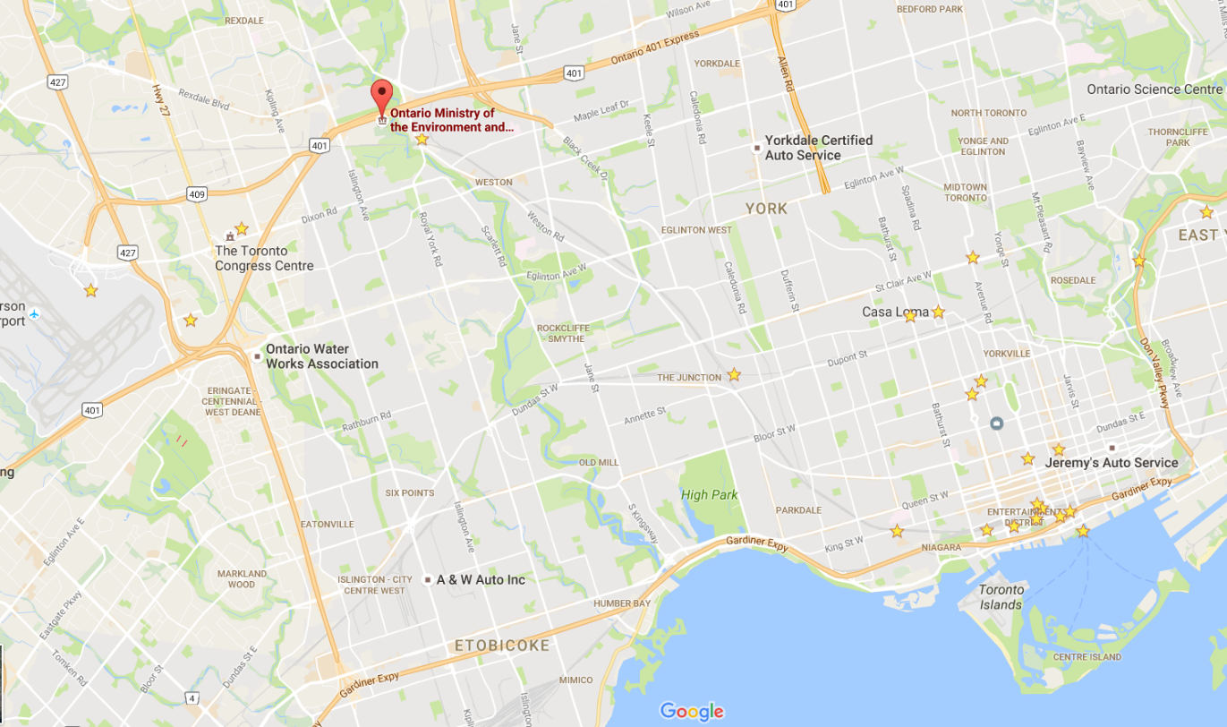
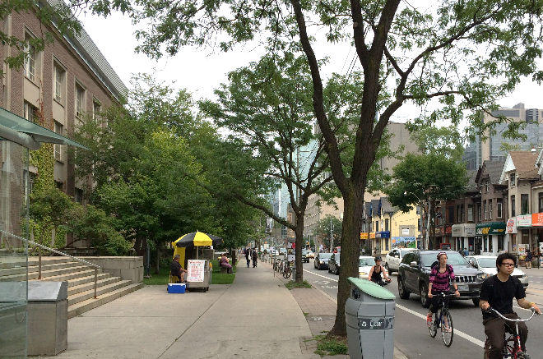
Near-Road Monitoring Sites : Downtown vs. Highway
Highway
13 km
May 10 –Aug. 31, 2016
Hourly Organics, Sulphate, Nitrate, Ammonium
Aerosol Chemical Speciation Monitor (ACSM) w. PM2.5 inlet
Hourly Trace Metals
Xact 625 (Copper Environ.)
Black Carbon & PM2.5
Aethalometer (AE-33), SHARP
Data Analysis
Positive Matrix Factorization (PMF)
Downtown
Notes:
Simultaneous measurements at two near-road (NR-HWY and NR) and two urban background sites (UB) in Toronto as part of the Near-Road Monitoring pilot study
Wind roses for each site

Slide 20
Spatial Variations of PM_{2.5} Chemical Species
Organic Aerosol
Downtown
Highway
Downtown
Highway
Downtown
Highway
Downtown
Highway
No consistent trends in the spatial variations of major organic/inorganic ions
High spatial difference between the downtown and highway sites
3-fold higher transition metal concentrations (Ti, Mn, Fe, Cu)
7-fold higher Ba at Highway
Notes:
SO4: 0.52 for NR vs. 0.51 for NR-H
OA: 4.0 vs. 4.3
Ba: 9 times
Cu: 4 times higher
No strong differences for major organic and inorganics ions
Significant differences in the concentrations of trace metals, implying the impact of traffic emissions (tailpipe/non-tailpipe)

Slide 21
Diurnal Trends of Organic Aerosol (OA)
Downtown
Highway
Differences in the weekends/weekdays ratio and diurnal patterns
Various OA sources (i.e., industrial, traffic, cooking)

Slide 22
Diurnal Trends of Trace Metals
Downtown
Highway
Strong weekday/weekends differences during the morning rush-hour: anthropogenic sources
Morning rush-hour peaks : Ba, Cu, Fe, Ca, Mn
Notes:
Highway sites

Slide 23
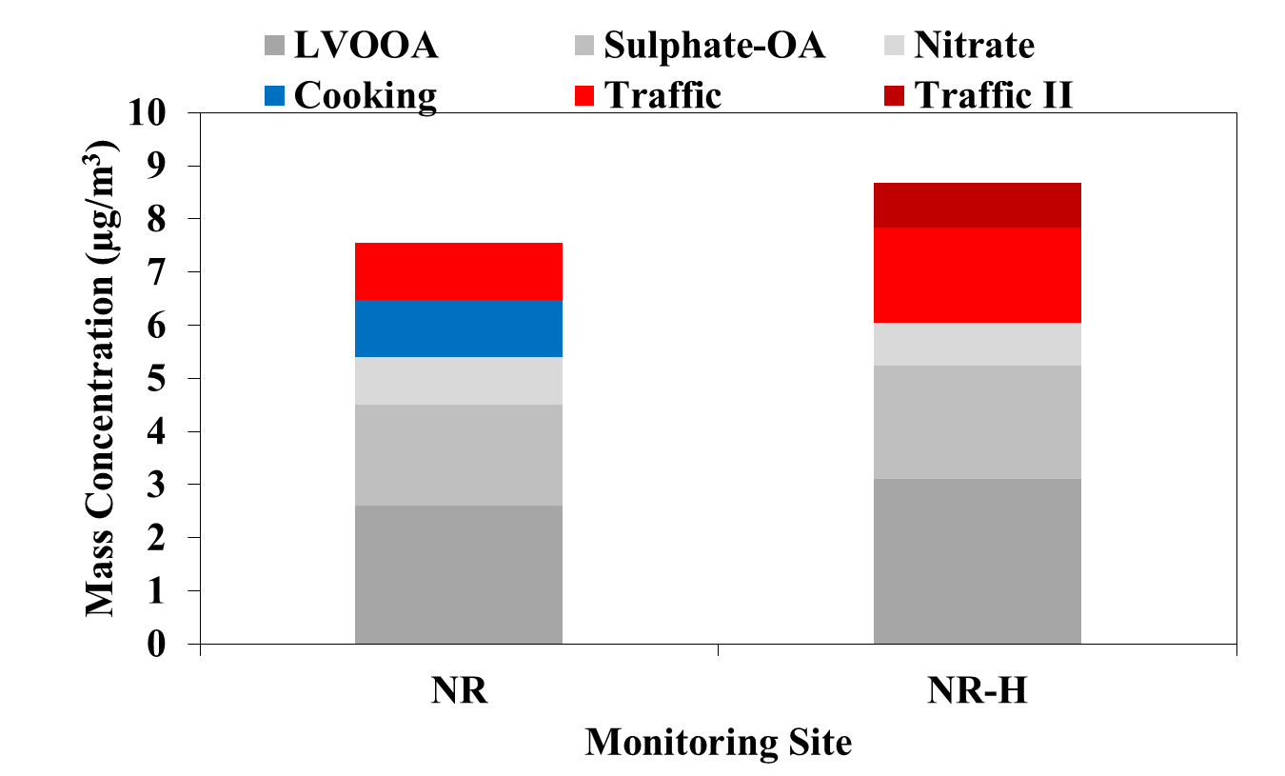
Source Apportionment of PM_{2.5}
*
PM_{2.5}: 7.5±5.0 µg/m³
PM_{2.5}: 8.6±4.8 µg/m³
14%
30%
Downtown
Highway
Downtown
Highway
May 10-Aug 31, 2016
*LVOOA: Low-volatility Oxygenated Organic Aerosol
Notes:
there is a statistically significant difference (P = <0.001) for PM2.5 mass between the two sites from May 10-Aug 31, 2016
PMF analysis using ACSM+Xact+BC
Regional scale sources: LVOOA, sulphate, nitrate having very high correlations in their temporal variations (r= 0.89 for Sulphate, 0.81 for LVOOA, 0.60 for Nitrate)
Cooking factor was only found at WB, while two traffic-related sources were observed for HWY401.
NR traffic: 0.8 ug/m3, NR-H traffic : 1.8 ~ 2times higher (on the median basis)

Slide 24
Local (traffic-related) Sources at Highway
Traffic Factor I (tailpipe emissions)
Hydrocarbon-like Organic Aerosols (HOA, m/z 57, 71, 85, 97) with trace metals (Ca, Fe, Mn) and black carbon
Early morning rush-hour peaks
Stronger weekend/weekday (WE/WD) difference
Stronger correlations with NOx (r=0.85) and particle number (r=0.75)
Traffic Factor II (non-tailpipe)
More aged and metal-rich (Ba, Cu, Ti, Fe)
No strong WE/WD difference
Inverse correlation with RH
Resuspended road dust caused by the movement of traffic on dry highway.
Notes:
Stronger weekend/weekday (WE/WD) difference (WE/WD=0.73)

Slide 25
Local PM2.5 Sources at Downtown
Downtown Traffic Factor
Stronger weekend/weekday ratio (WE/WD=0.56 vs. 0.73 at HWY)
Morning rush hour peaks (7 am vs. 4 am)
Downtown Cooking Factor
Only in Downtown
Peaks at noon and evening
No weekend/weekday difference (except for lunch hours)
Notes:
Very clear diurnal patterns at the downtown site, weekends/weekday difference for the traffic factor, lunch and dinner time at noon and 6-8 pm for the COA factor

Slide 26
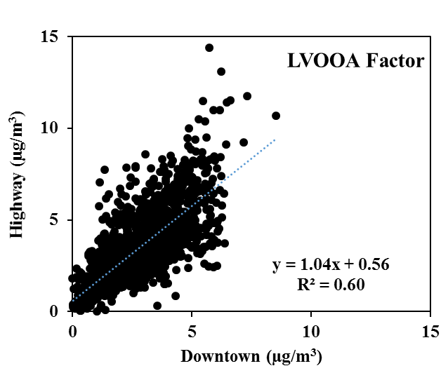
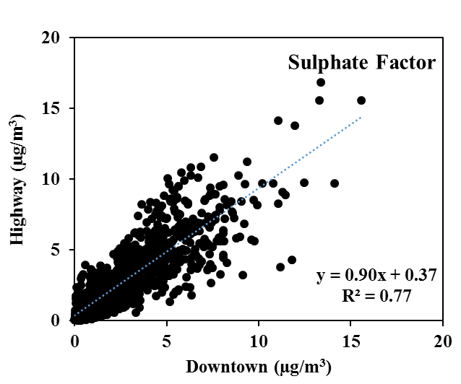
Regional PM2.5 Sources at Downtown and Highway Sites
Low-volatility Oxygenated OA (LVOOA) Factor
Sulphate Factor
Notes:
There is a statistically significant difference (p <0.05)

Slide 27
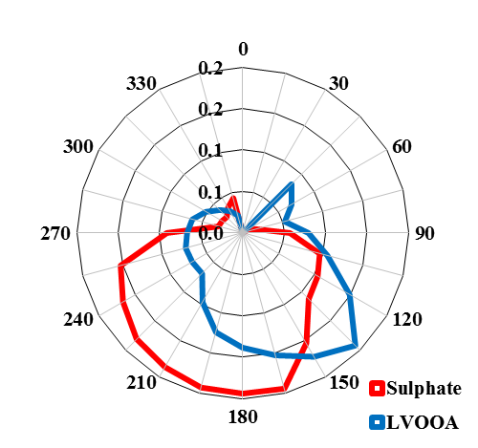
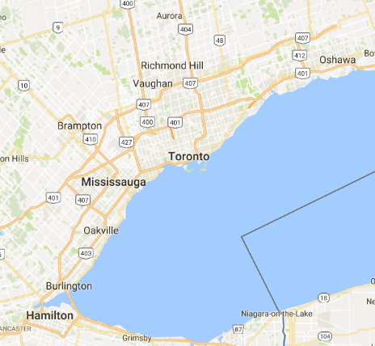
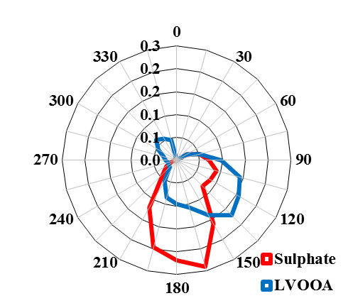
Probable Locations of Regional Sources
Conditional Probability Function (CPF) Plots
Highway
Downtown
Canada
Canada
USA
USA
Regional sources : Sulphate and LVOOA sources accounting for ~60% of the total PM2.5 mass

Slide 28
Summary
Regional scale PM_{2.5} sources (i.e., Sulphate and oxygenated OA) were found to be major PM_{2.5} sources (>60%) identified using PMF at both locations and exhibited high similarities in their temporal and spatial variations.
Traffic related PM_{2.5} sources were characterized by strong hydrocarbon fragments (i.e., m/z 57, 71, 85), trace metals (i.e., Ba, Cu, Fe), and black carbon.
The overall concentration of trace metals in PM_{2.5} at the near-highway was considerably higher than the level at near-roadway in downtown by a factor of 3 (i.e., max.16 times higher for Ba).
The traffic sources accounted for 14% and 30% of the total PM_{2.5} mass at the Downtown and Highway sites, respectively, with a strong spatial heterogeneity (i.e., 2-fold higher at Highway) between two sites.

Slide 29
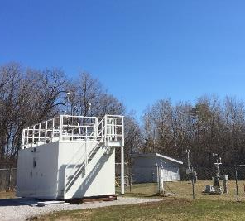

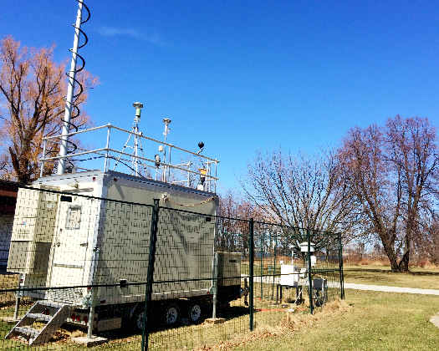
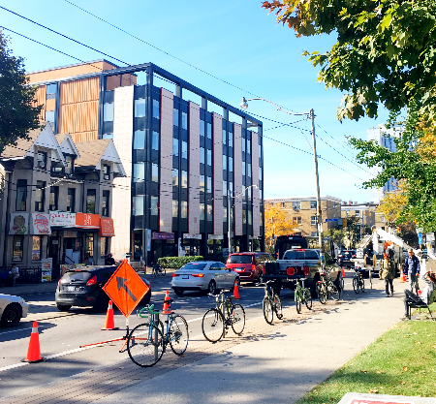
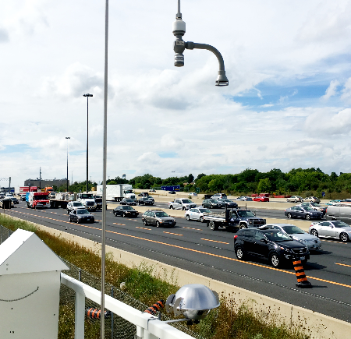
Thank you for your attention!
Questions and Comments?

Slide 31
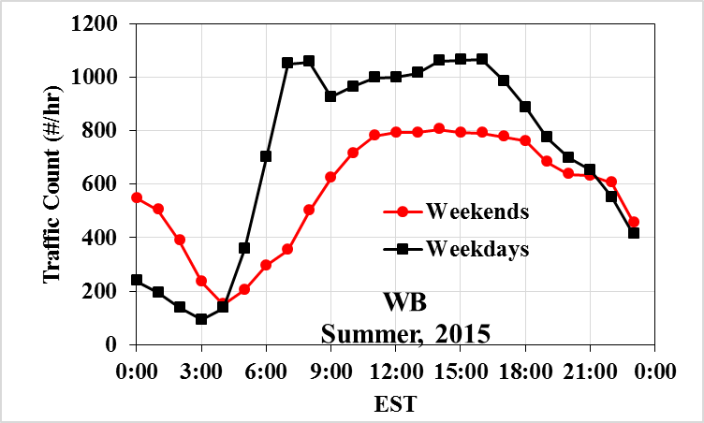
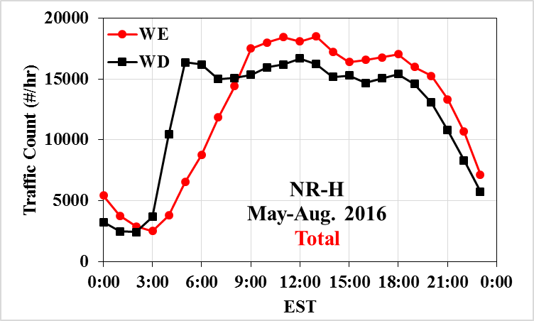
Traffic Volume: Downtown (WB) vs. Highway
Highway
Downtown
15,000 veh/day
300,000 veh/day
~20-fold higher traffic volume at the Highway site
But, no weekday/weekend differences in total traffic volume at the Highway site
Notes:
Hwy 401: 13 lanes, May, august, 2016
WB: 4 lanes: June-Aug, 2015
Annual Average Daily Traffic volume (AADT) for HWY 401: ~300,000/day

