Slide 1
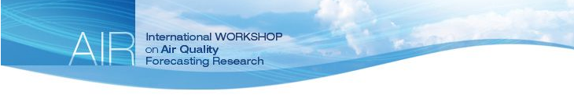
Dissecting the Multiple Scales of Urban Air Pollutant Variability using a Mobile Lab
J. Brook, S. Wren, C. Mihele, E. Seed*, J. Zhang, D. Sills, C. Stroud
8th International Workshop on Air Quality Forecasting Research and 2015 Pan American/ParaPan American Games Legacy Data Workshop Toronto, Ontario January 10 - 12, 2017
*CANUE, U. of Toronto
Notes:
As an environmental health risk, air pollution has been the subject of study and an active focus of regulatory measures for many decades

Slide 2
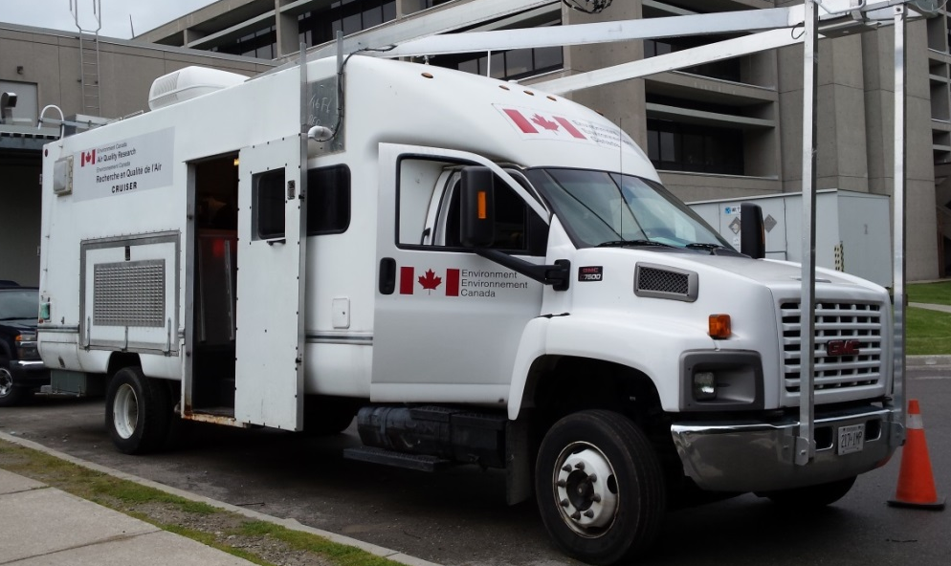
Mobile Lab Deployment
High time resolution mobile measurements
(1 – 5 second data)
Measurements
Black Carbon (new HS-LII)
NO₂ (true NO₂ using LGR-CRD)
Toxics such as HCN (HR-CIMS)
Ultrafine particle counts (CPC)
VOCs such as benzene, toluene, xylenes (PTR-TOF-MS)
NO (TECO), CO, CO₂, CH₄ (Picarro-CRD), O₃ (2B)
PM_{2.5} (SHARP), optical particle counts (UHSAS)
Meteorology and turbulence, GPS
CRUISER

Slide 3
Mobile Lab Deployment
High time resolution mobile measurements
(1 – 5 second data)
Measurements
Black Carbon (new HS-LII)
NO₂ (true NO₂ using LGR-CRD)
Toxics such as HCN (HR-CIMS)
Ultrafine particle counts (CPC)
VOCs such as benzene, toluene, xylenes (PTR-TOF-MS)
NO (TECO), CO, CO₂, CH₄ (Picarro-CRD), O₃ (2B)
PM_{2.5} (SHARP), optical particle counts (UHSAS)
Meteorology and turbulence, GPS
CRUISER

Slide 4
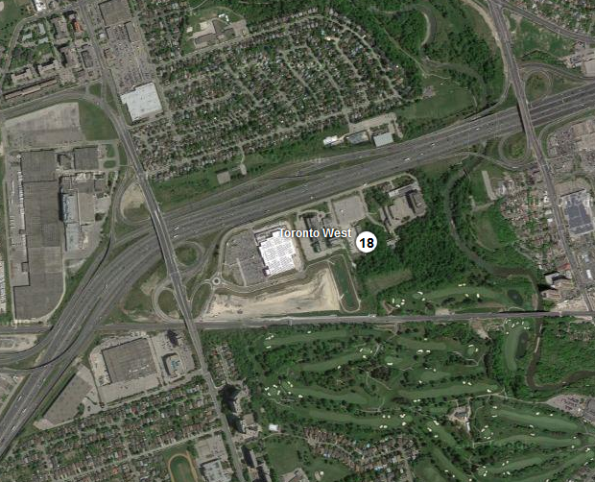
PanAm Games CRUISER deployment to study Air Quality
Mobile measurements in urban area to study spatial and temporal patterns of pollutants and their relationship to urban area meteorology
3-4 case studies
Develop and implement a strategy for mapping of spatial exposure patterns air pollutants
Regional and urban background
Local-scale, including sub-grid variation
Multi-scale evaluation of high-resolution (2.5 km) GEM-MACH v2
point-to-grid comparisons,
Mobile measurements near routine monitoring sites (e.g., Resources Rd., Downtown T.O., Downsview)
Assess representativeness, extrapolate
401
New ‘near-road’ site
Notes:
Take advantage of enhanced meteorological and air quality forecasting during the Toronto Pan Am Games 2015
MOECC Toronto West site – 125 Resources Rd.
NAPS – National Air Pollution Surveillance
Gage Institute – Site 60427 – 223 College St.
125 Resources Road – Site 60430
Downsview – Site 60431
Play up FTIR site – located at key site in near-road network MOECC/NAPS near road network site at Resources Rd.
And our CRUISER measurements can help link what they see at that site to other regions (remember MOECC people will be at meeting)
MAPPING
Building on CRUISER work in Montreal
Scoping out driving routes
Get a feel for how long it takes to do routes, what can be reasonably accomplished in a day
Test some instrumentation

Slide 5
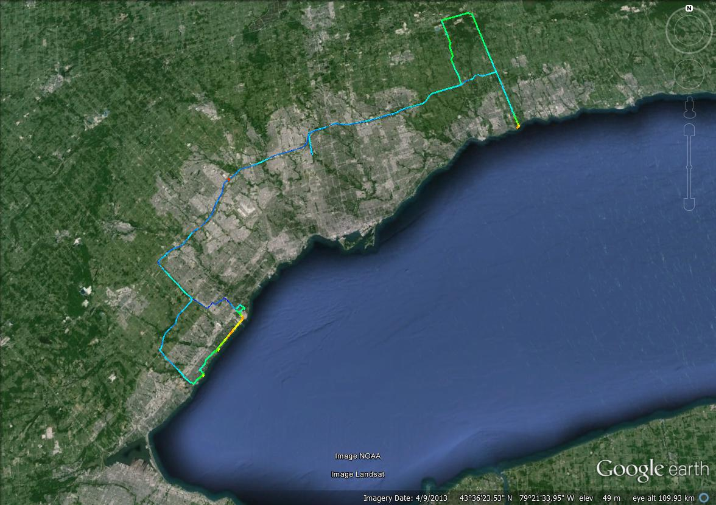
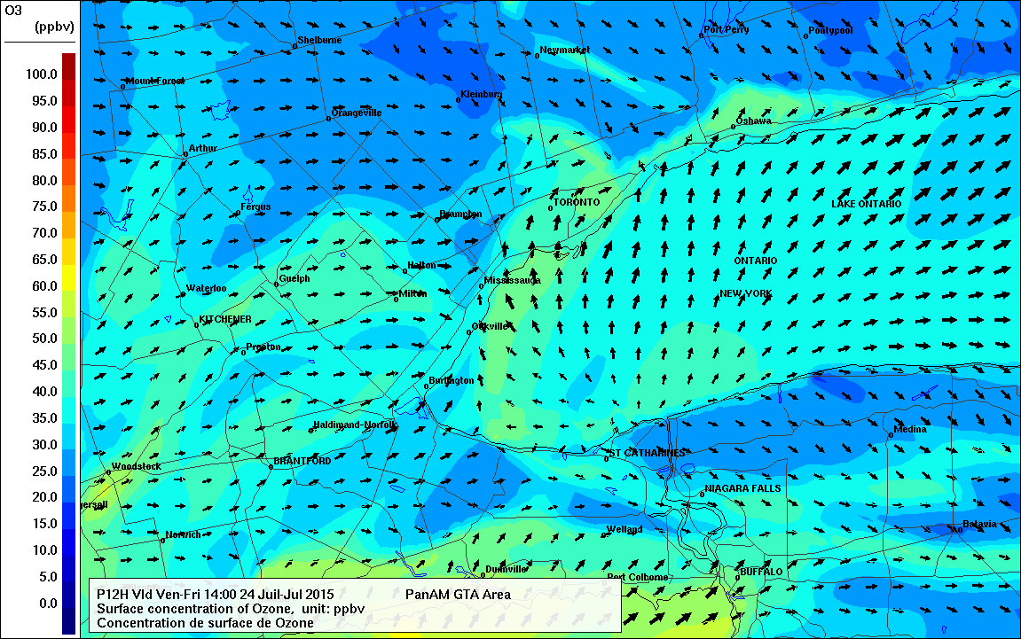
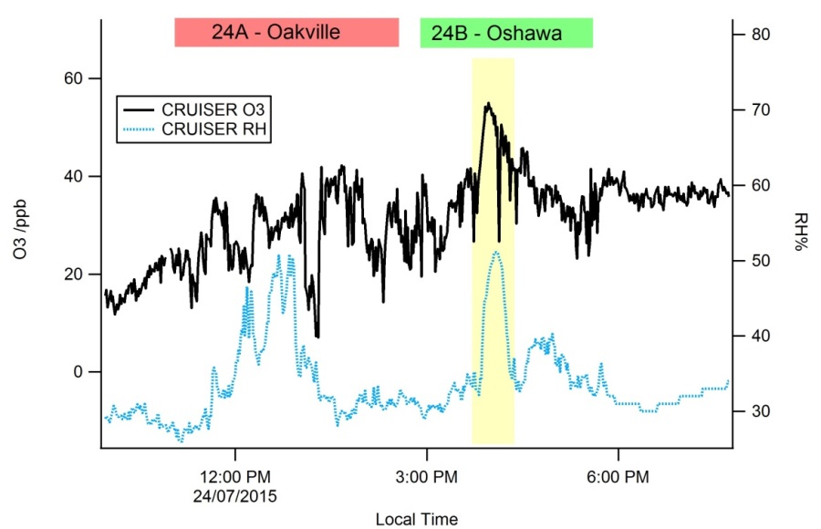
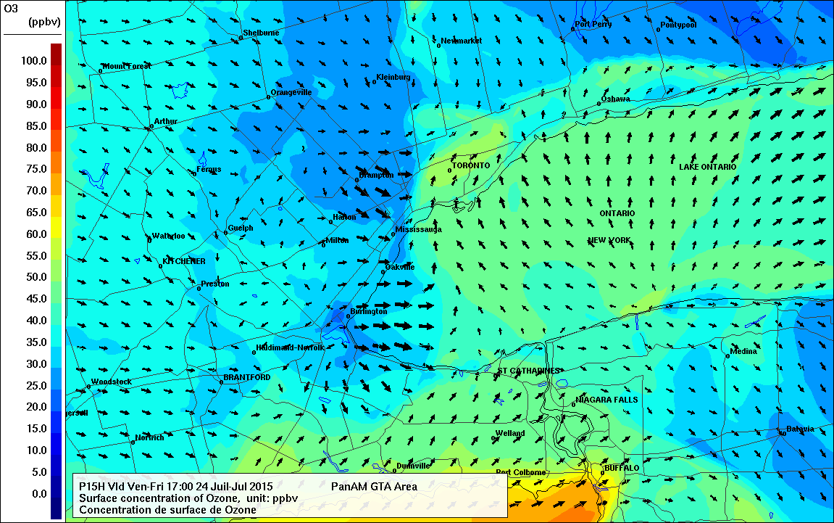
Lake Breeze Case: July 24 Ozone not exceptionally high but lake-related spatial variability was expected
CRUISER
Deployment
10:00 EDT
Oshawa
Oakville
RH%
13:00 EDT

Slide 6
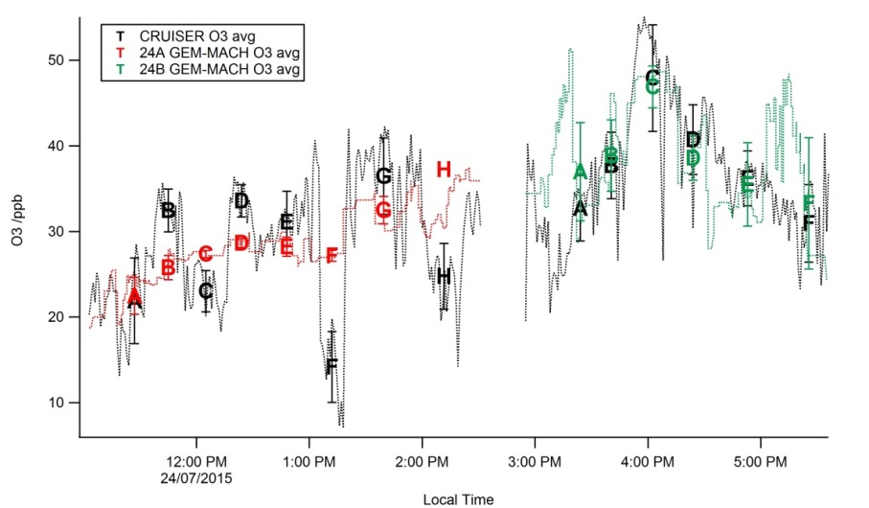
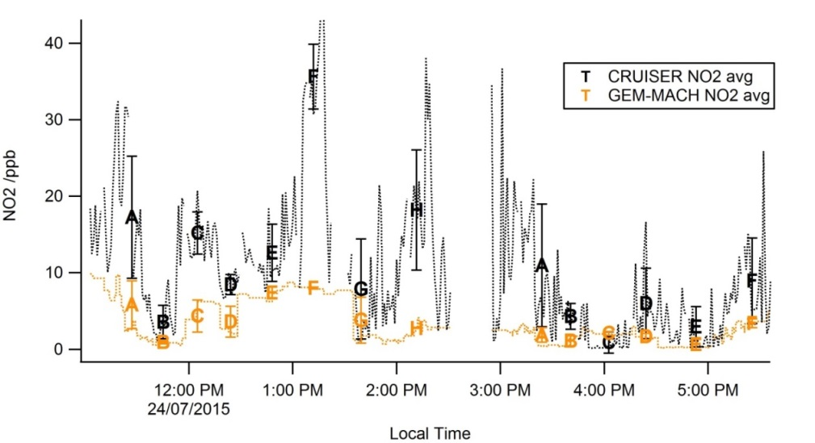
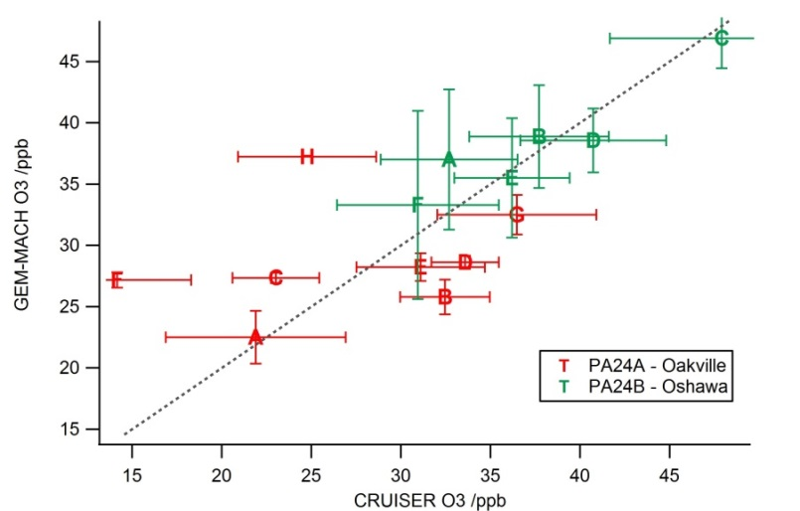
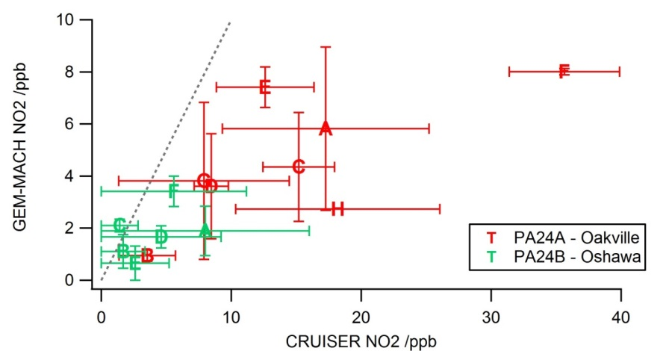
GEM-MACH v2 Performance July 24 Lake Breeze Case Study
Model predicts heterogeneity
Industrial hotspot
Obs support this but locations differ
Notes:
NO2 too low due to too much vertical mixing ???
O3 seems less sensitive to the vertical mixing given large contribution from regional O3 from above the surface layer(s).
But not really a great case for testing O3 due to the relatively low O3.

Slide 7
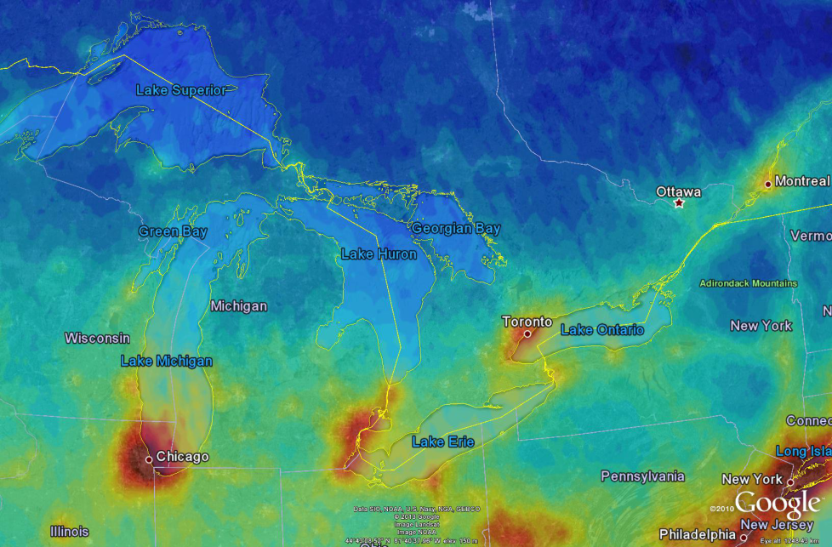
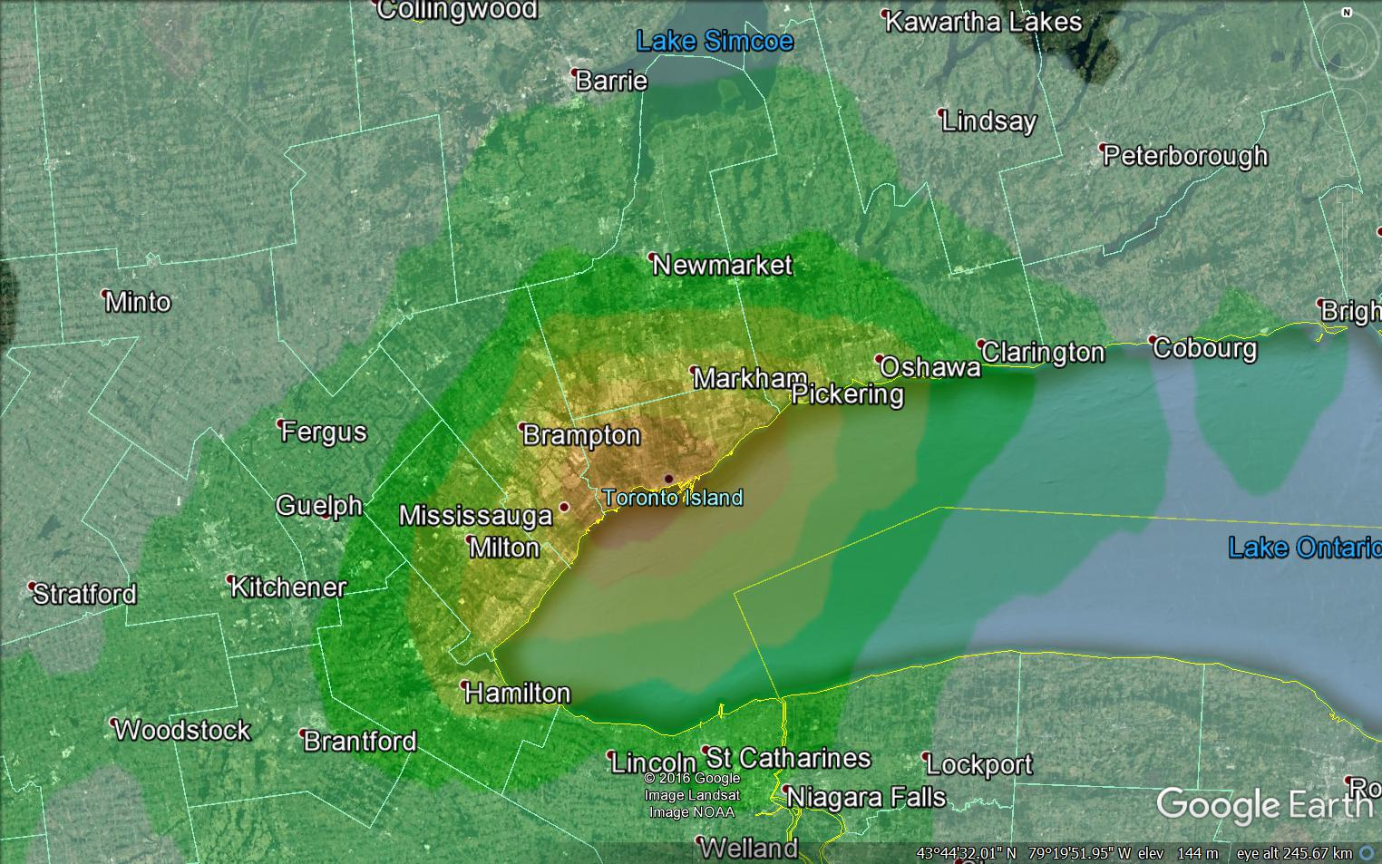
Multiple Scales of NO₂ Variability
Land-Use Regression
OMI Satellite

Slide 8
Conceptual pattern across a city
Hypotheses:
Mobile lab measurements can be used to isolate and quantify these different scales or ‘components’ of the total concentration leading to new approaches for model evaluation
Empirical models for chronic exposure can be improved by isolating the components

Slide 9
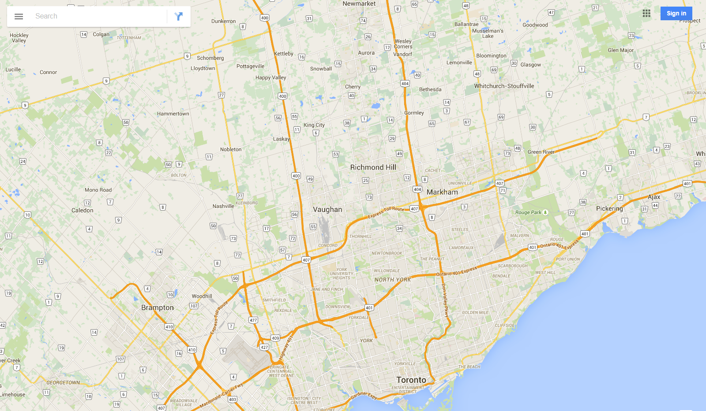
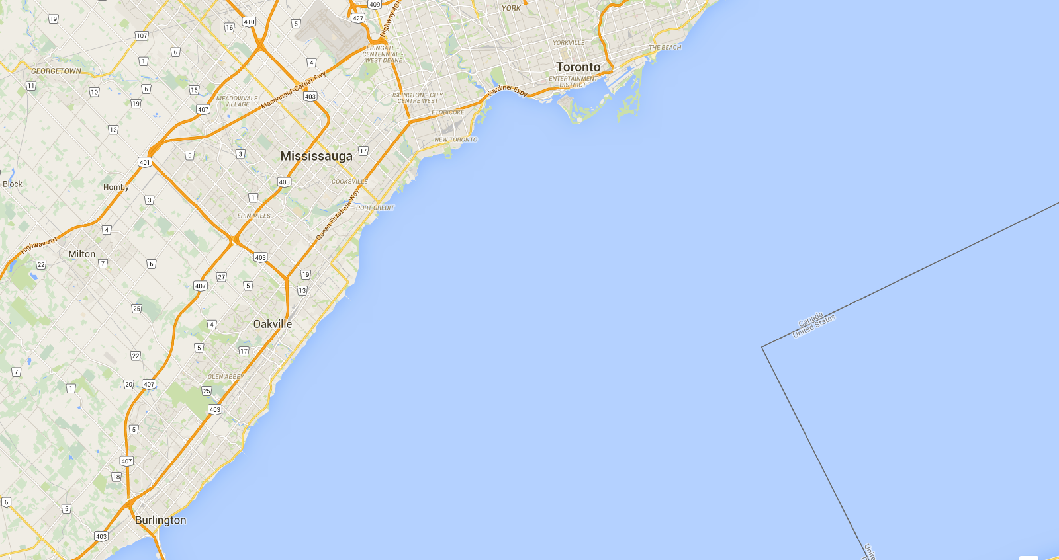
Toronto and Area
Exposure Mapping
J
Three Regions.
Visit one of each on a driving day. The order of visit should be randomized.
N & E Region
K
A, B, C, D
west
I
E, F, G, H
central
I, J, K, L
north
H
east
L
F
G
Central Region
Four driving routes within each Region.
Visit one Region on a driving day, also selected randomly.
West Region
D
E
B
MOECC Site
Goal over 20 driving days:
Each sub-area visited 20 times
Each driving route visited 5 times
C
Common route to/from 4905 Dufferin St
Providing frequent coverage of different road
and land-use types
Common connecting routes (highways) between
sub-areas followed to also provide frequent coverage
A
The common routes, the daily sub-area background concentrations and the MOECC data will provide information to adjust for meteorological variations

Slide 10
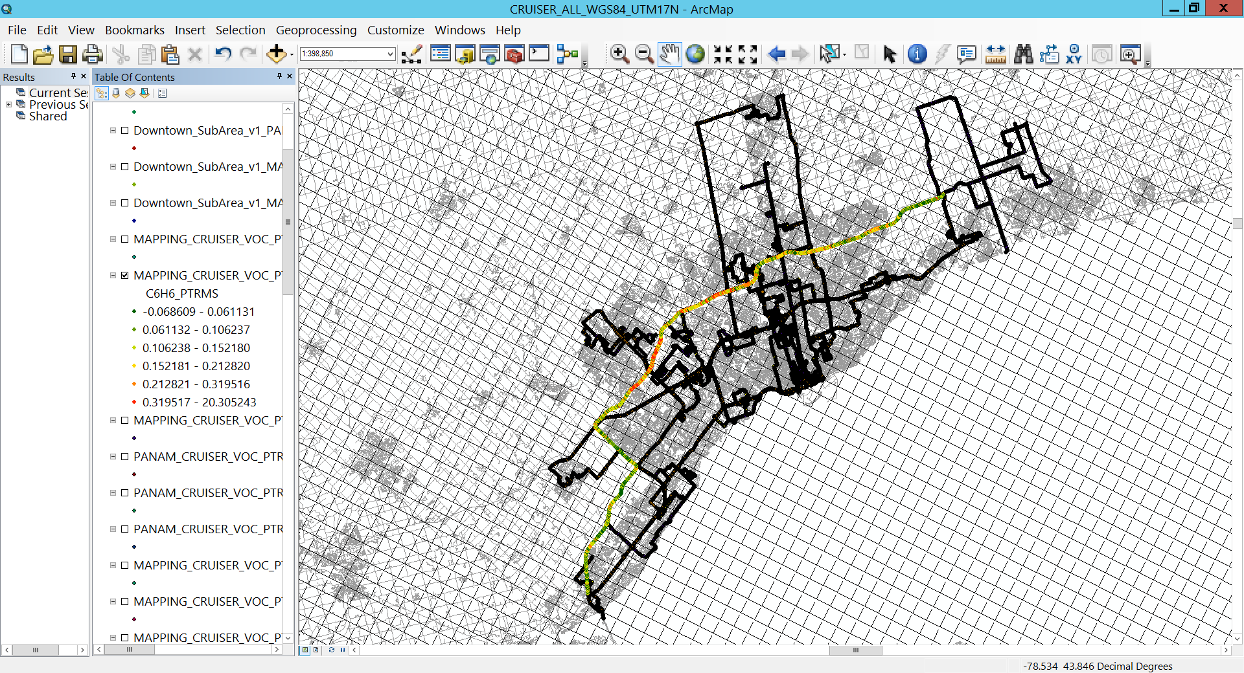
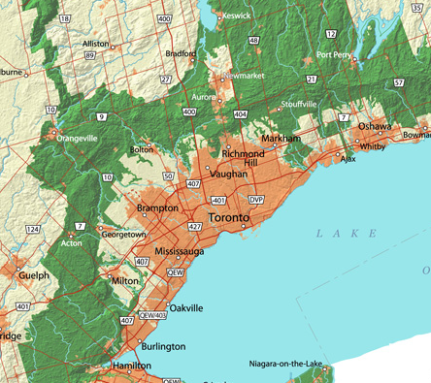
Overview of spatial coverage
Greenbelt
Airport – industrial
Downtown – Commercial
Downtown – Residential
Greenbelt

Slide 11
Summary of the number of visits
N
19
21
20

Slide 12
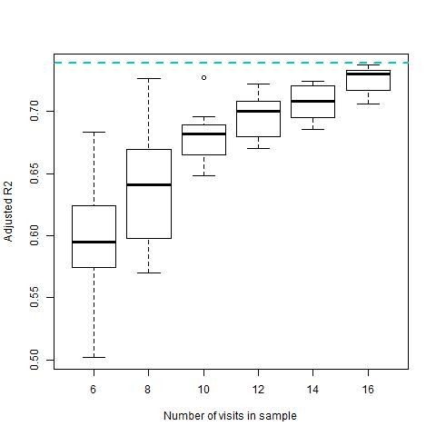
Mobile Sampling - Optimizing the number of visits
Montréal UFP
LUR Model goodness of fit improves and is less variable with larger N_{vis}
Rate of improvement is smaller beyond ~15 visits
Hatzopoulou et al., 2016 ES&T in revision
Notes:
Average concentrations determined from small number independent CRUISER visits (i.e., driving across a road segment) are less likely to be representative of the true average concentration. The number of ufp models developed form mobile/portable measurements is increasing worldwide. The base model R2 here (0.74) is better than the other three models thus far developed in Canada (2 for Toronto and 1 for Vancouver) and at the to end of values for all those developed worldwide. Many of the other models were developed after a limited number of visits, in some cases only 3.
Here we show that the goodness of fit (R2) of a model developed with <10 visits can be highly variable. With more than 10 visits the range of resulting R2 values is near 5% and clearly within 5% for more than ~15 visits.

Slide 13
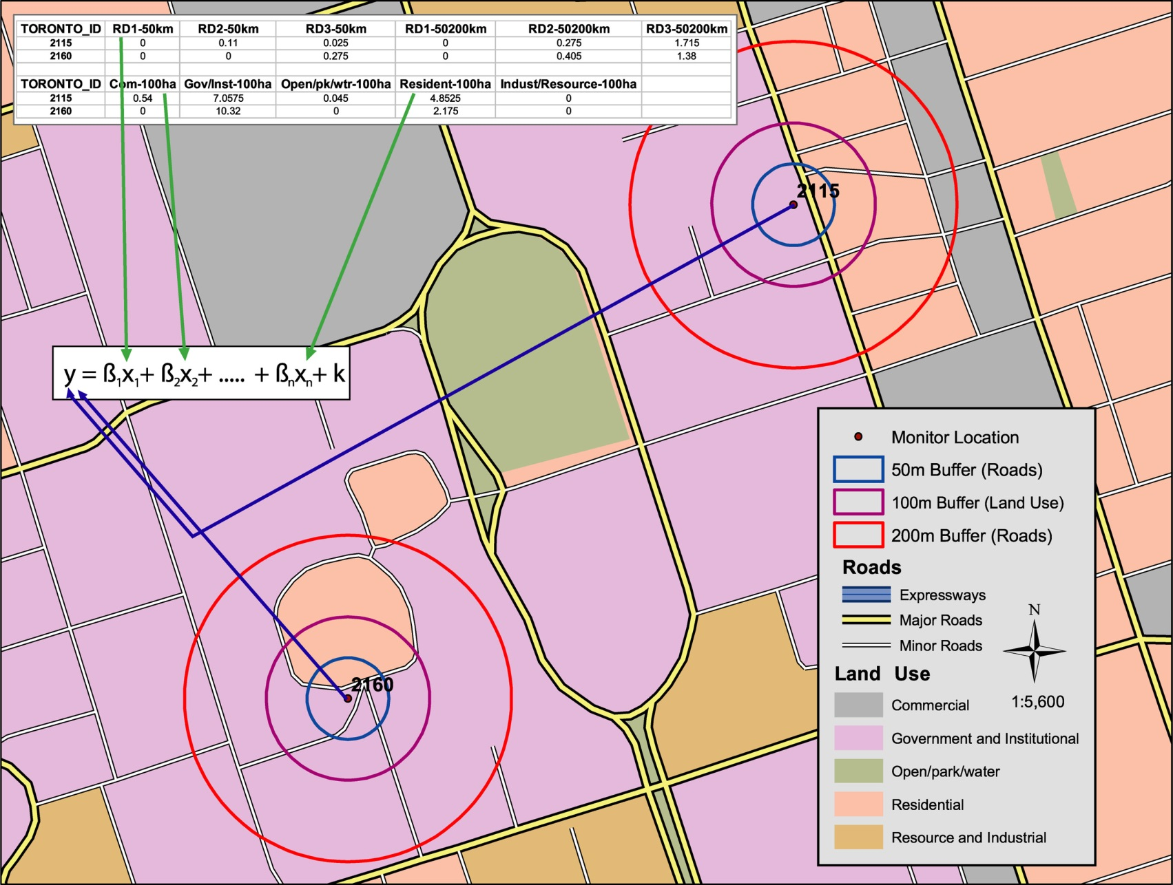
Land-Use Regression – deriving predictors

Slide 14
Proof of Concept: Uncovering systematic patterns
Identify ‘long drives’ that provide urban transects within short time periods
Focus on highways (e.g., 407)
Bin 1 sec observations into 5 km sections
1 transect at a time
Determine percentiles in the distribution
Pool among transects
Compare spatial changes in pooled statistics

Slide 15
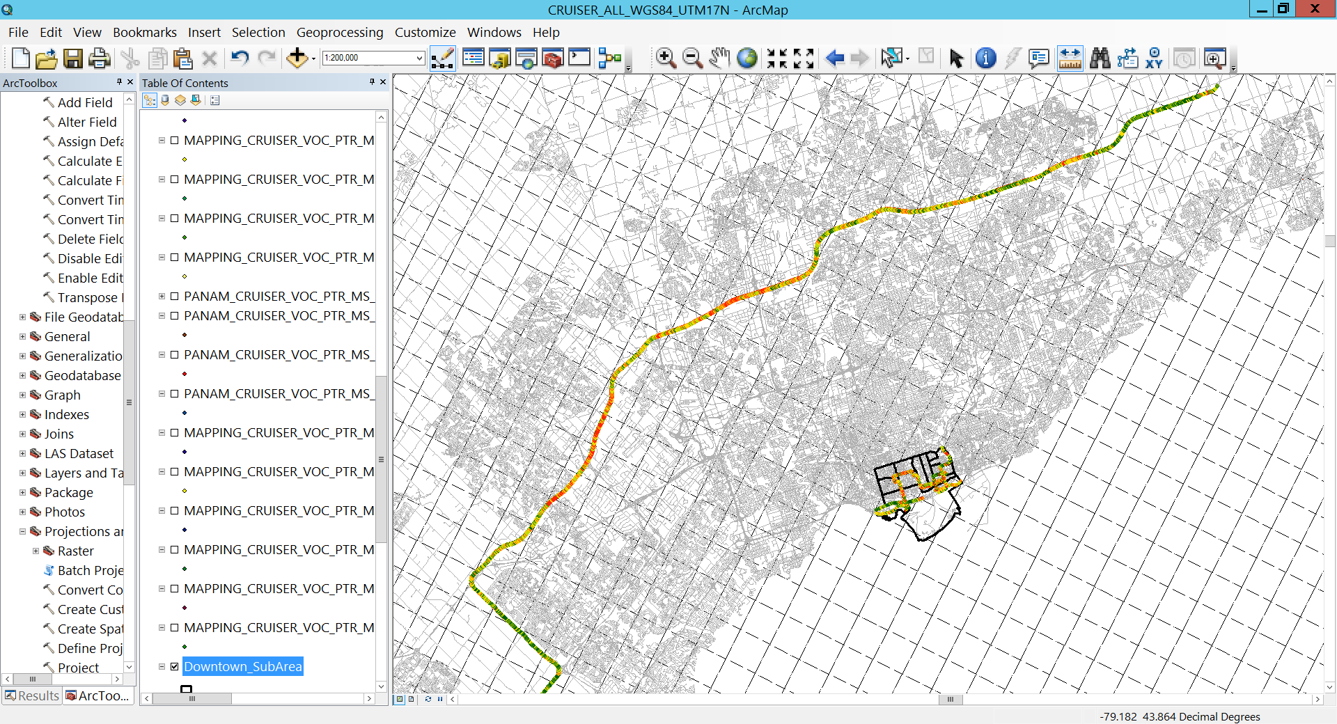

Slide 16
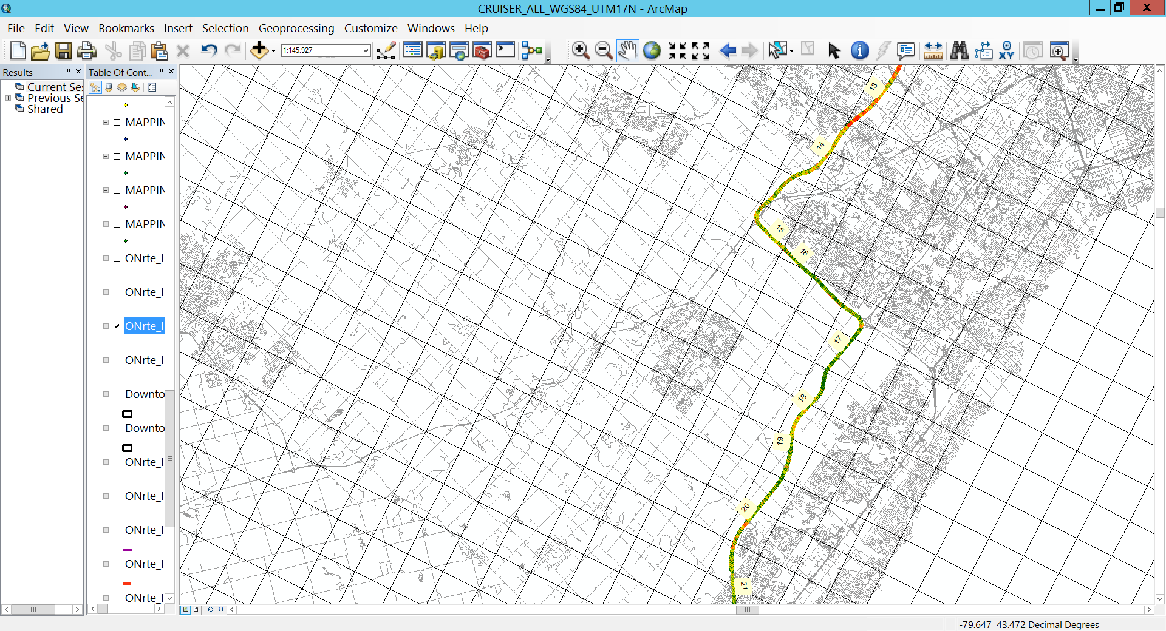
Spatial variability of Benzene along 5 km segments of HWY 407: hotspot (95th percentile) and background pollution (5th percentile)
Segment ID

Slide 17
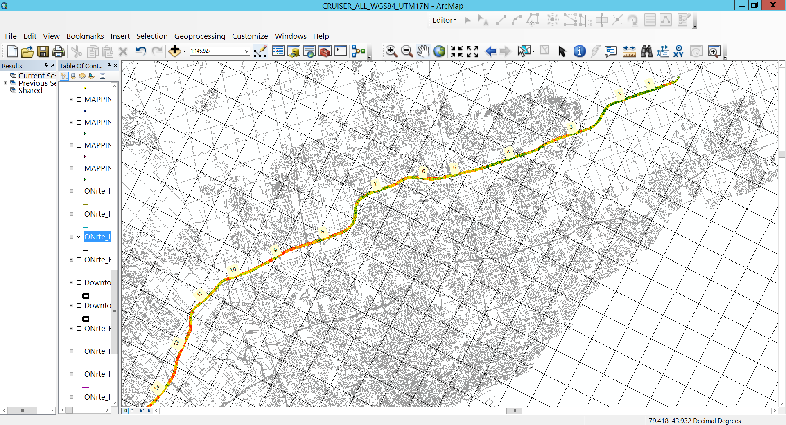
Spatial variability of Benzene along 5k segments of HWY 407: hotspot (95th percentile) and background pollution (5th percentile)
Segment ID

Slide 18
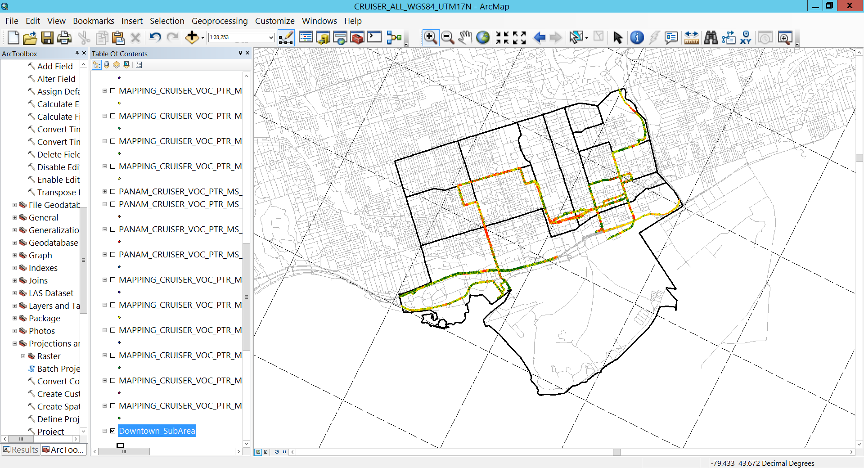
Downtown Sub-Grid Variability
North
East
West

Slide 19
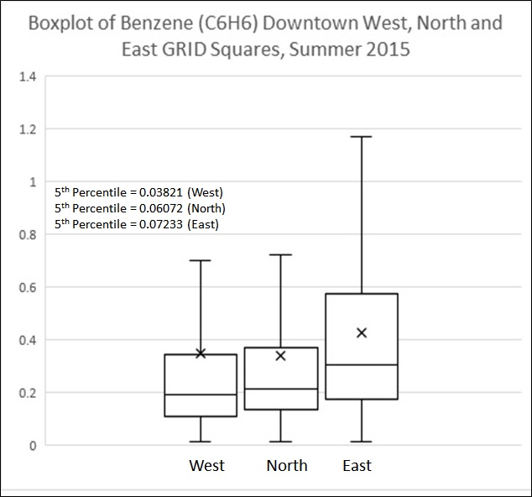
Benzene between and within grid

Slide 20
Conclusions and Next Steps
A well-designed mobile measurement approach can be used for detailed AQ model evaluation, to quantify the different scales/components contributing to urban air pollutant levels and sub-grid variability
Use mobile measurement data to help improve emissions and AQ model performance
Develop methodology to adjust for day to day (meteorological) and diurnal variability in CRUISER data
Develop new Land-Use Regression models with greater coverage
Apply in epidemiological studies

Slide 21
Acknowledgements
Yuemei Han, Ralf Staebler, Kathy Hayden, Richard Mittermeier, Gang Lu, John Liggio, Jeremy Wentzell, Peter Liu, Amy Leithead – EC Measurement team
Andrew Sheppard, Raj Santhaneswaran, Raymon Atienza, Andrew Budden – EC Technical (and driving) team
Andrew Elford, Andrea Darlington, Julie Narayan – EC data team
MOECC – Toronto and area O₃ data
CANUE – Analysis support

