Slide 1

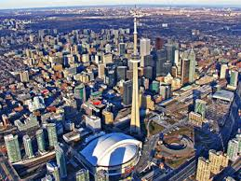
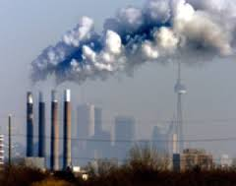
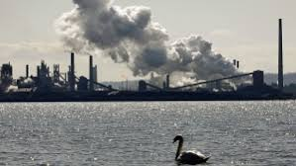
Lessons Learned from High Resolution Air Quality Forecasting for the 2015 Pan Am Games
Craig Stroud, Balbir Pabla, Sylvie Gravel, Shuzhan Ren
Alain Robichaud, Junhua Zhang, Philip Cheung
Air Quality Modelling and Integration (ARQI)
Air Quality Research Division
Science and Technology Branch, ECCC
IWAQFR 2017
Notes:
Today, I am going to highlight the results from the high res demonstration air quality model that was developed for the PanAm Games.
Acknowledge coauthors

Slide 2
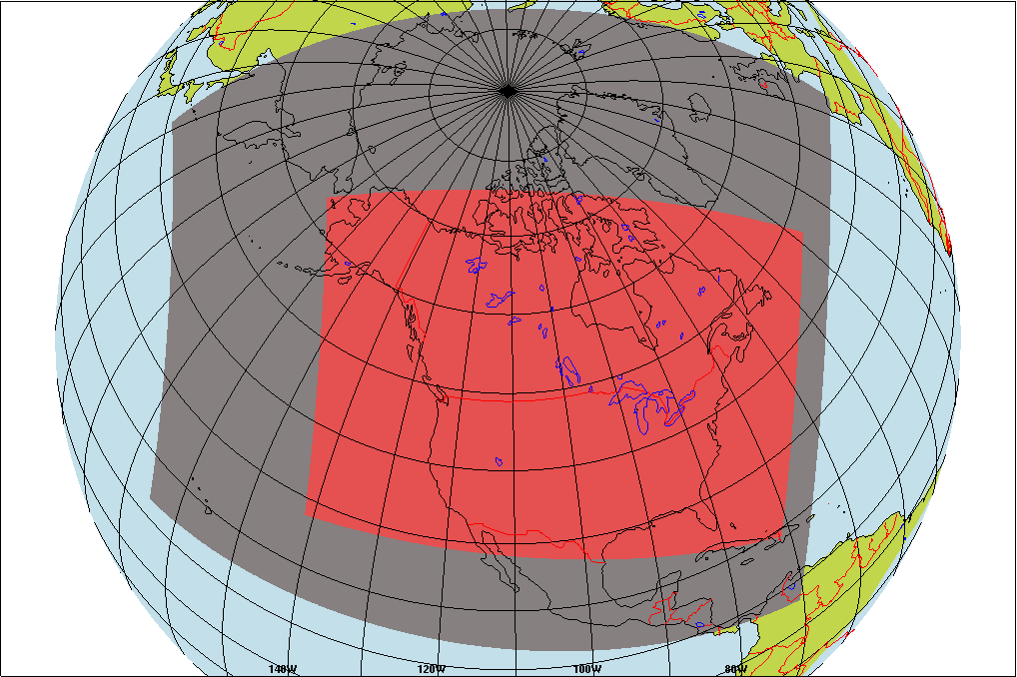
Nested GEM-MACH Model Domain Configuration
GEM v3 – Regional Operational
10-km grid spacing
GEM-MACH v1.5.1 Operational
10-km grid spacing
80 levels, 0.1hPa, ~60km
High Resolution
GEM-MACH v2, 581x418
62 levels, ~40-km
2.5-km grid spacing
06Z, 24-hr forecast
Daily
Notes:
This slide details the nested domain configuration that was used for the PanAm demonstration forecasting. GEMv3 was run in limited area mode for entire N. America at 10km grid spacing. This provided the met boundary conditions for the regional GEM-MACH model. GEM-MACH v1.5.1 is the operational version of GEM-MACH and provided the boundary conditions for the high res GEM-MACH model. The high res GEM-MACH model was run at 2.5km grid spacing, daily for a 24-hr forecast. The domain included most of the Great Lakes and major cities including Chicago, New York, Toronto, Detroit, Pittsburgh, Montreal. The domain size is 581x418. Daily forecasts were started at 06Z and were available at the forecast desk at 09Z.

Slide 3
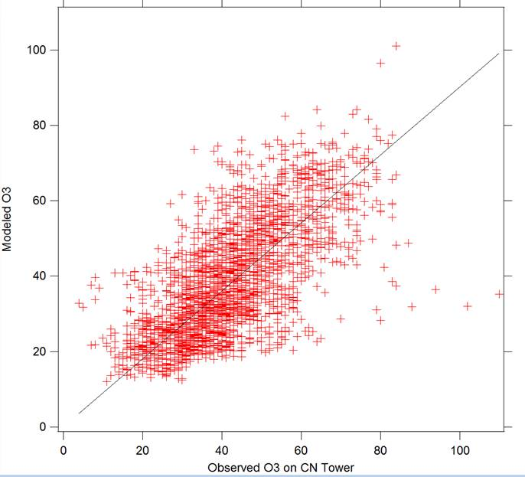
CN Tower Ozone Observations (data collected by MOECC)
1-hr Data, Summer 2015
R=0.7 (Good correlation)
m= 0.9 (Good slope)
Model is capturing the O₃ above surface layer quite well (at 444-magl).
Notes:
I am going to start out by showing the model evaluation for O3 from data atop the CN tower. The height of the meas was 444m, so above the urban surface layer. The model captures the O3 observations quite well, with little bias and decent correlation. This suggests that the O3 is captured well when the boundary layer is mixed during the day and at night when regional O3 is transported aloft to CN tower.

Slide 4
Lessons Learned
1) Operational Evaluation: High resolution GEM-MACH v2 scored better than the operational GEM-MACH v1.5.1 for 7 out of the 9 scores. The scores for NO2 and O3 had a diurnal behavior. Daytime scores were much better than nighttime scores.

Slide 5
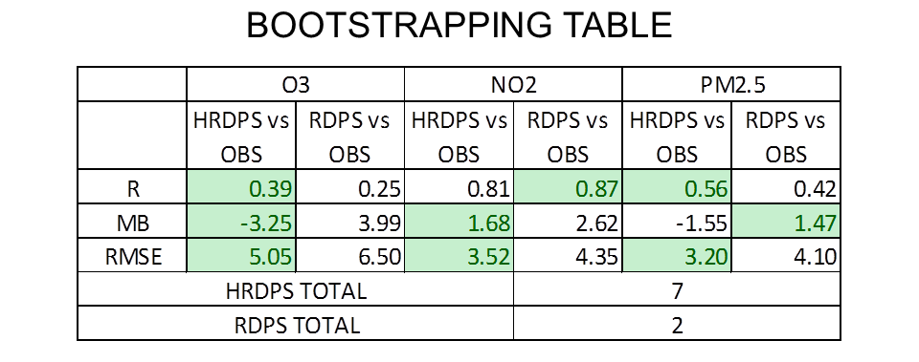
Operational GEM-MACH Evaluation
July 2015 Surface
High Res
GEM-MACH
v2
Operational
Regional
GEM-MACH
V1.5.1
R: Correlation Coefficient
MB: Mean Bias
RMSE: Root Mean Square Error
Note that GEM-MACH 2.5-km performed better than operational 10-km model in 7 of 9 scores. Same for June and August 2015 scoring.

Slide 6
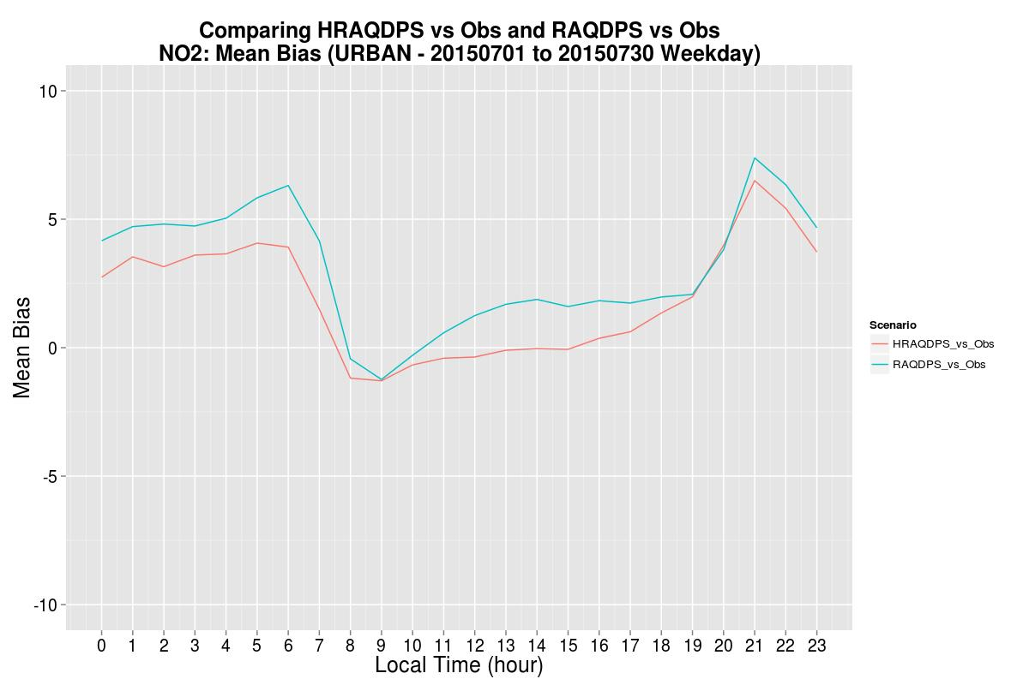
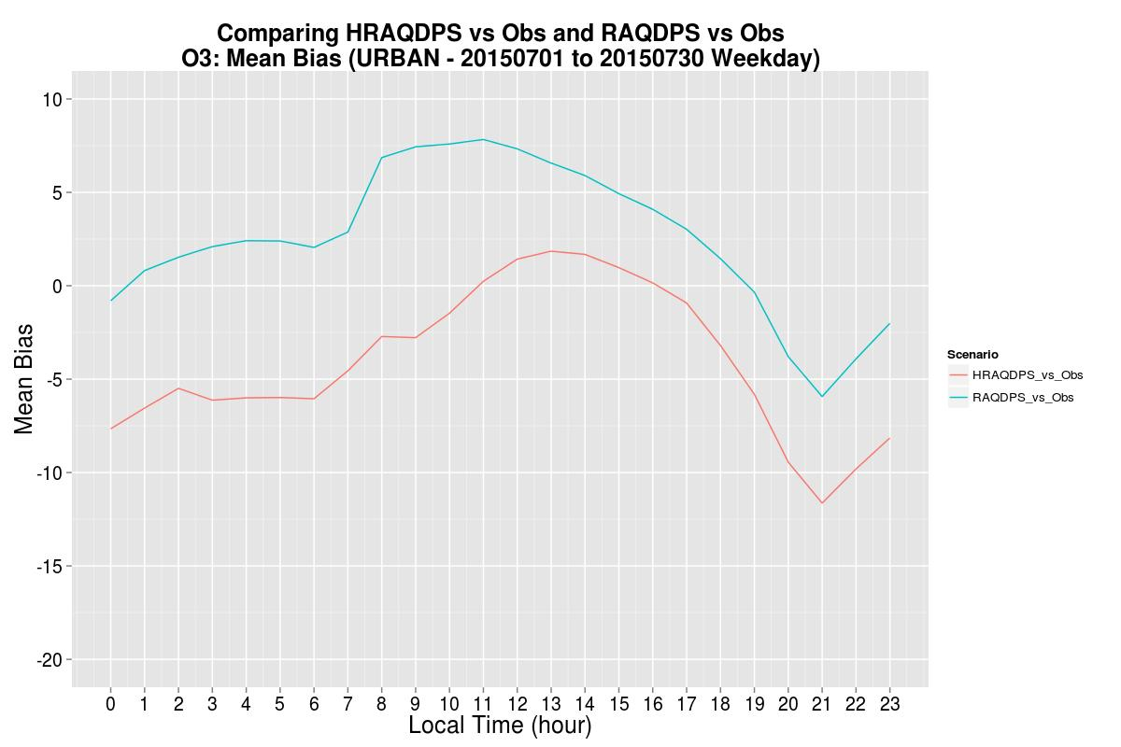
Mean Bias Average Diurnal Plots
Urban Sites
NO₂
MB in ppbv
O₃
Positive NO₂ bias at night and
Negative O₃ bias at night.
Too much titration at night
in urban surface layer?
MB in ppbv

Slide 7
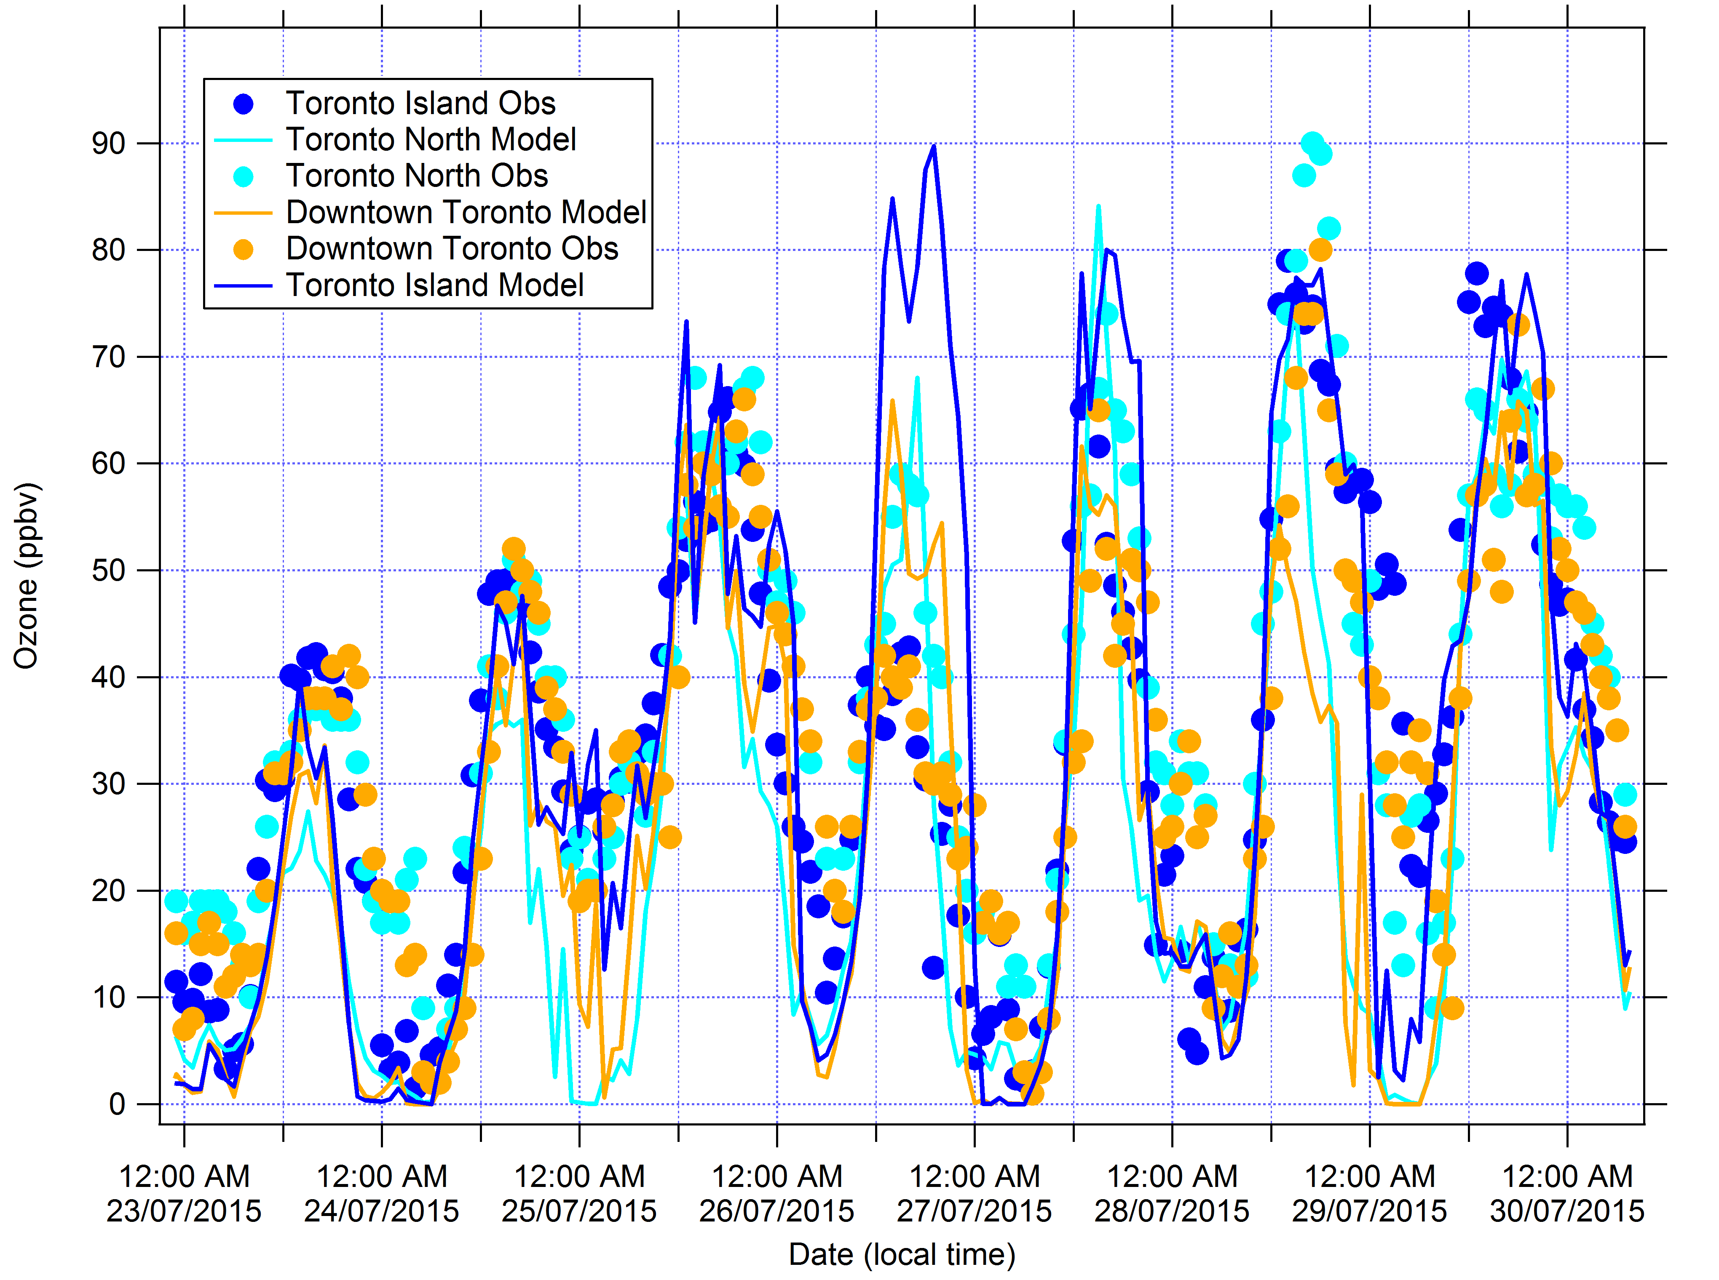
Week 3: Ozone model and observations
Measured ozone about 90 ppbv on July 28, highest levels observed in recent years.
Max predictions generally good for July 27.
Model max over-prediction on July 26 for TO Island.
Model over-titration often for Toronto North site.
Model drops off too quickly and remain too low throughout night.
Notes:
Focus on pollution episode from July 27-29. Ozone over 90 ppbv on July 28 at Toronto North site.

Slide 8
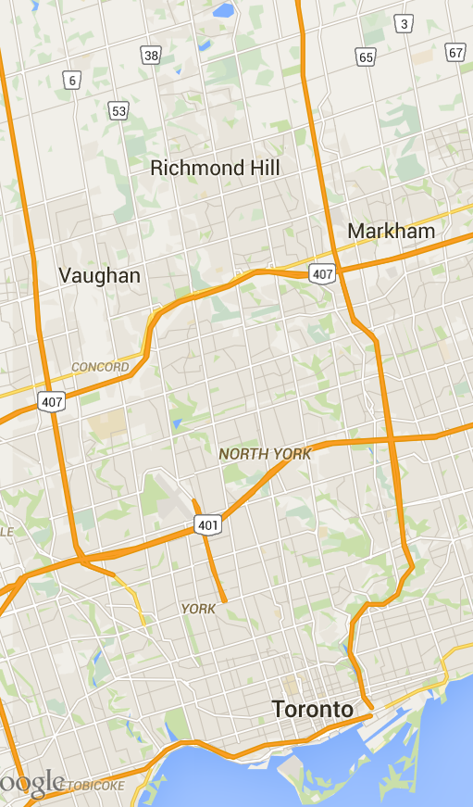
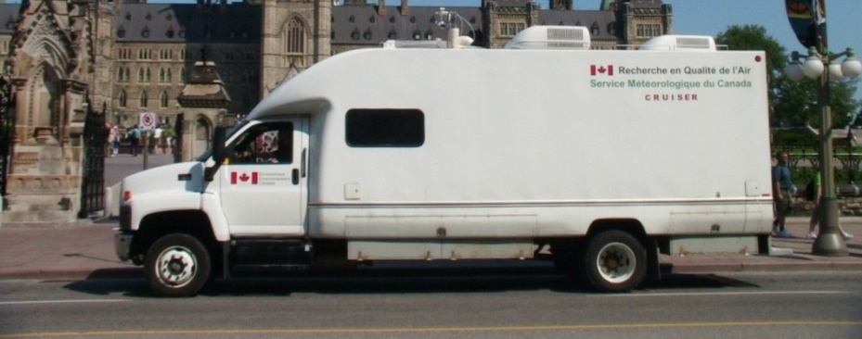
CRUISER
July 29, 2015
Yonge Transect
Jeff Brook, lead PI
Observations:
O3, PM2.5, NO, NO2, SO2, CO
PTR-MS for VOCs
CIMS for Acids
Black Carbon aerosol
Particle Size distribution

Slide 9
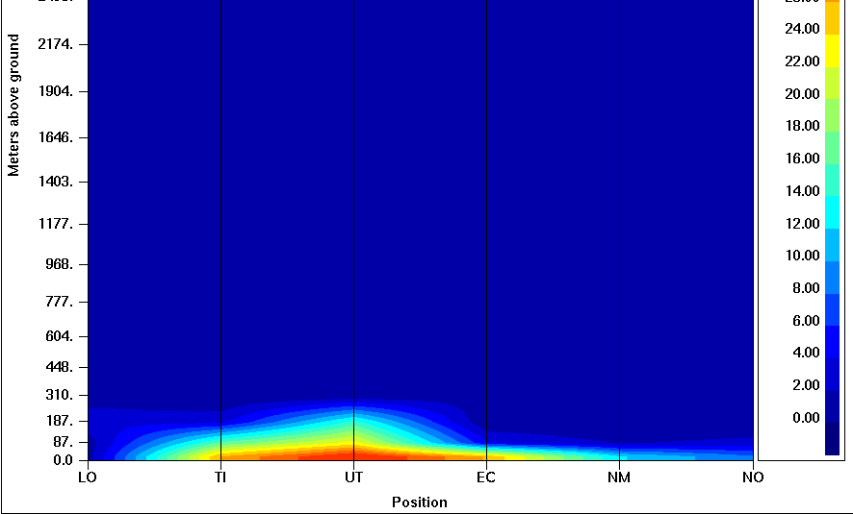
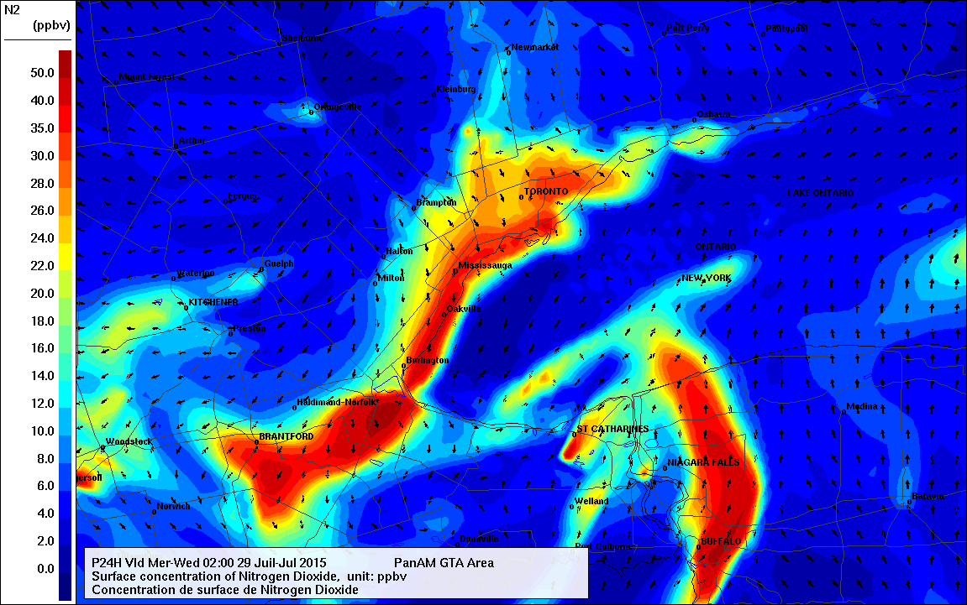
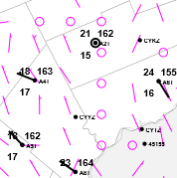
GEM-MACH NO2 Urban Heat Island Case Strongest at Night
NO₂ Vertical Cross Section
From Lake Ont to Newmarket
Notice the stable conditions
NO₂
Toronto South NO₂ predictions are twice as large as obs!
NO
Notice the warmer temps near lakeshore compared to suburbs (3 to 5 degree diff).
LO
GEM-250m

Slide 10
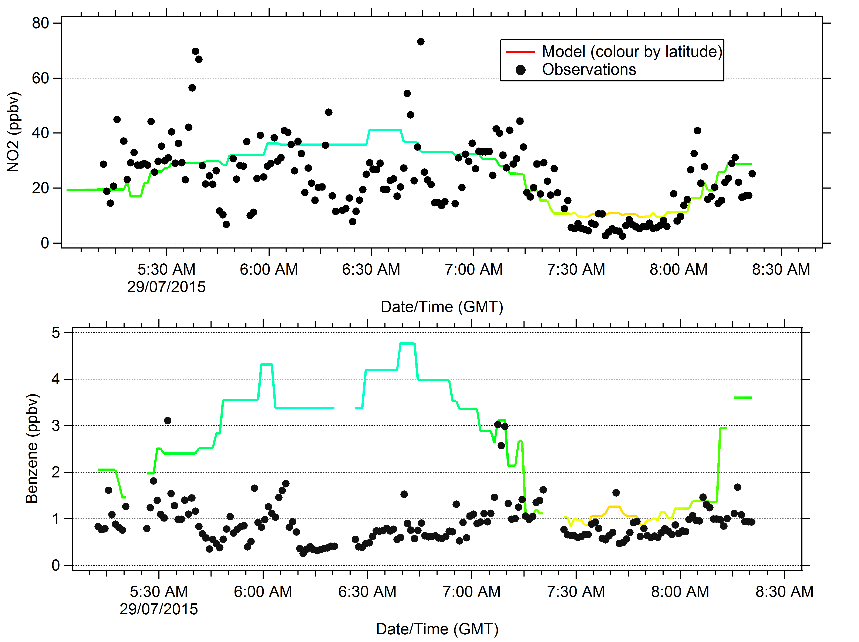
July 29, CRUISER Drive, Yonge Street
Data courtesy of Jeff Brook
Sumi Wren,
For downtown TO (blue),
the model overpredicted
both NO₂ and Benzene.
More model surface
vertical mixing would
help these biases?

Slide 11
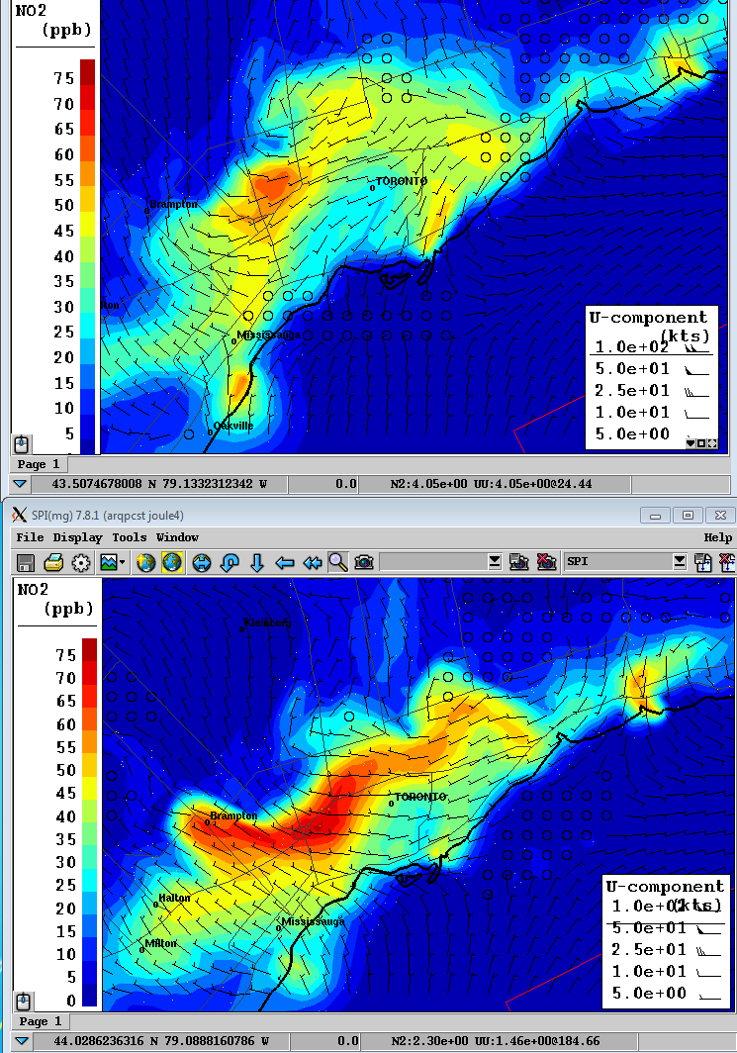
July 29, 2am local time
With Town Energy
Balance
Without Town Energy
Balance
NO₂ generally higher without TEB
- hot spots
- downtown core

Slide 12
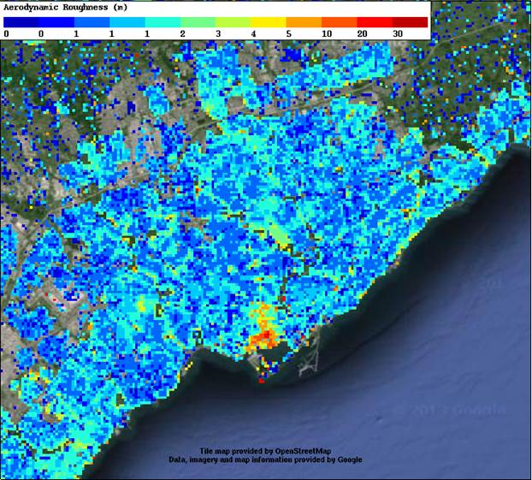
Lessons Learned
For calm nighttime conditions, the model under-predicted O₃ and over-predicted NO₂ over the urban area. We are exploring whether the urban albedo, urban emissivity, urban heat fluxes and enhanced roughness can provide enhanced surface mixing at night to help these biases.
Implementing Town Energy Balance module into GEM-MACH (Shuzhan Ren, Rodrigo Munoz-Alpizar, help from Stephane Belair’s group).
Aerodynamic
Roughness

Slide 13
Lessons Learned
2) Several cases of very high O₃ predicted over Lake Ontario and along shoreline. Several possible factors:
Photolysis rate over reflective water surface – new MESSy JVAL module - actually increased O3 predictions slightly over lake.
Dry deposition to water surface is too slow - some sensitivity, but not nearly enough.
Enhanced vertical stability over cooler lake water
Water vapour may also be enhanced in model over lake – some evidence for this in boat RH and T measurements
concentration of O₃ precursors results in large model O₃ production rates

Slide 14
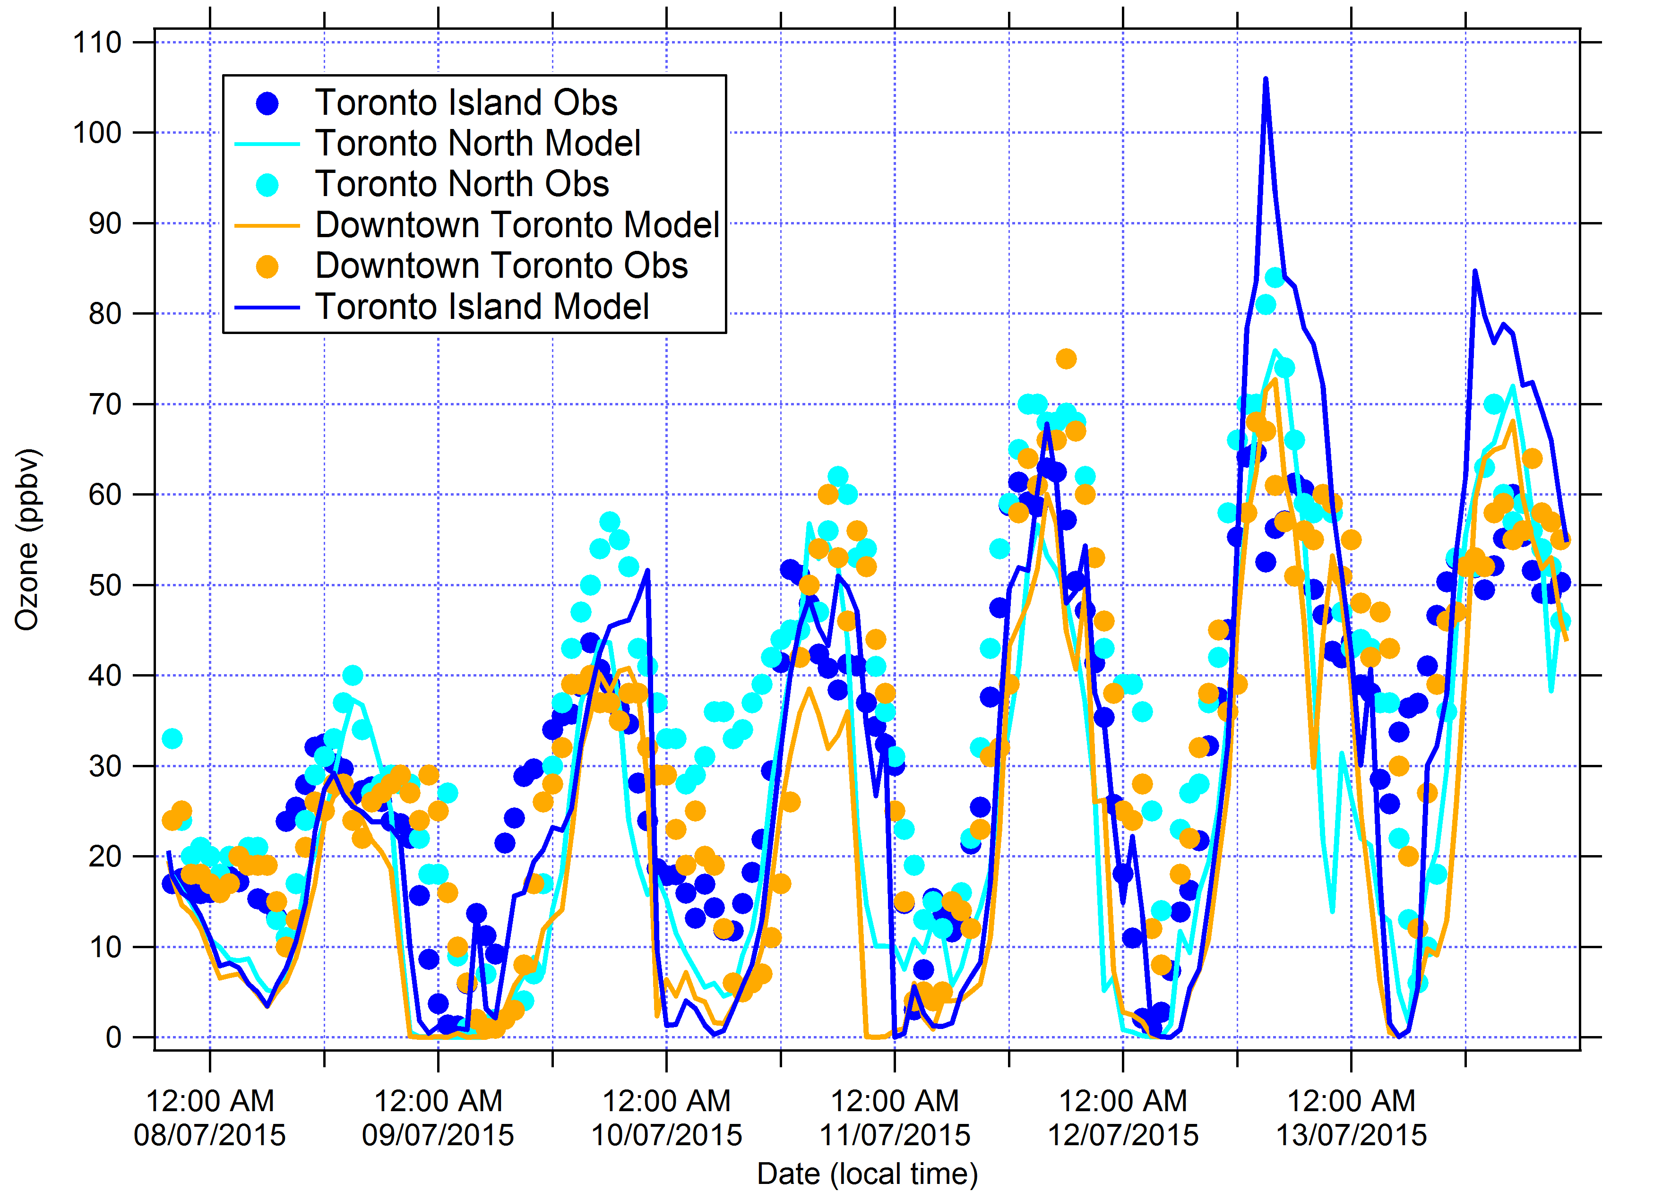
Week 1: Ozone model and observations
Toronto Island ozone over-prediction on July 12 is a bust forecast. Model under-predicts at Toronto North.
Daytime predictions on July 8-11 and 13 are generally good for Toronto sites.
Model ozone titration at night can be too strong (July 10).

Slide 15
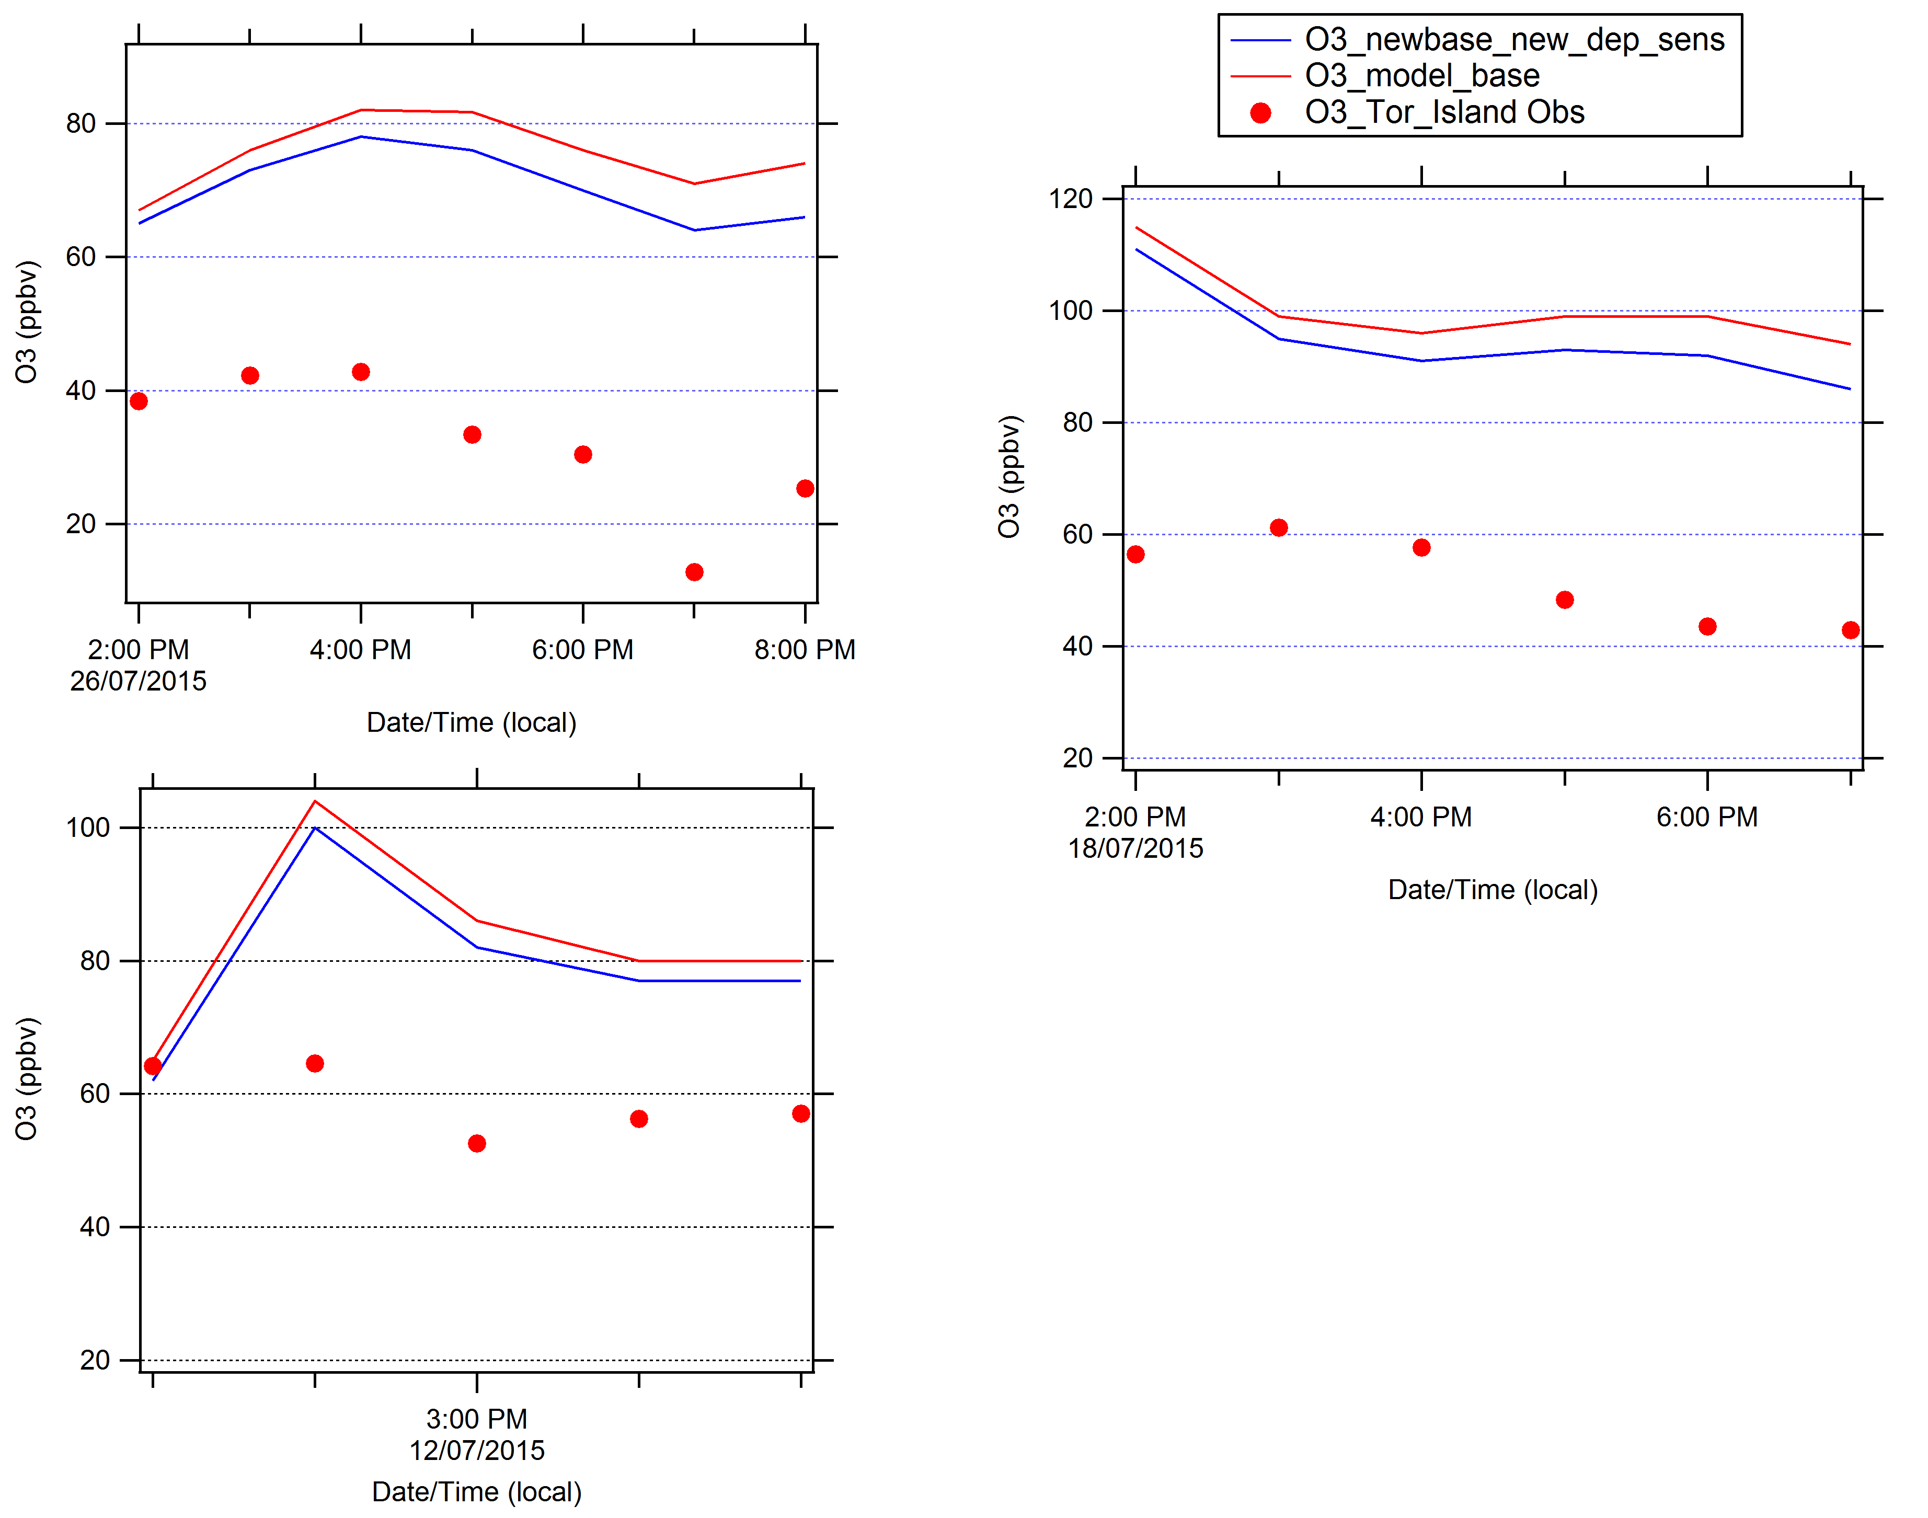
O₃ Time Series for Toronto Island for Periods of Over-prediction:
Impact of Factor of 2 Increase in O₃ Deposition Velocity to Lake
A doubling of the O₃ deposition velocity resulted in a 3-5 ppbv decrease in ozone modelled at Toronto Island for time periods with significant ozone over-prediction.

Slide 16
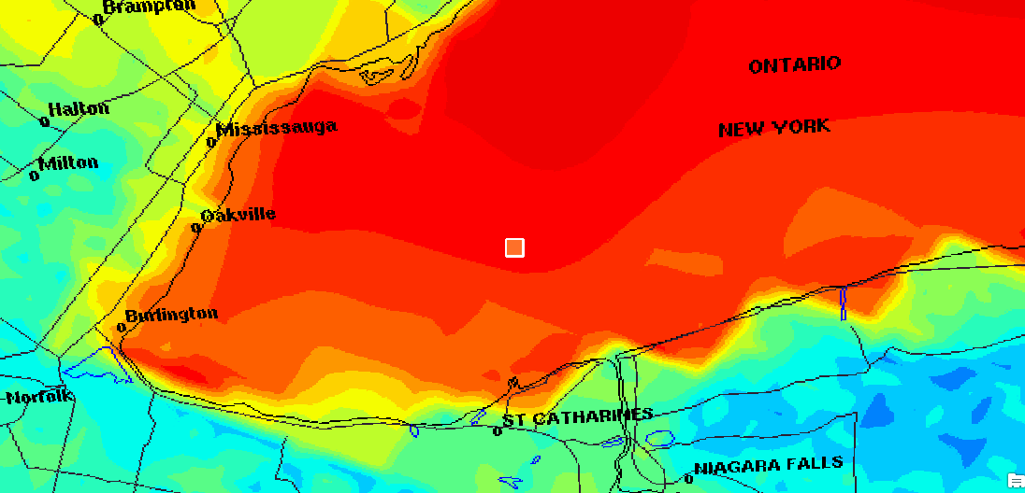
Humidity - July 12/2015 – 14:00
Actual HR = 75.18, Model HR = 85-90
Notes:
Actual HR = 75.18, Model HR = 85-90

Slide 17
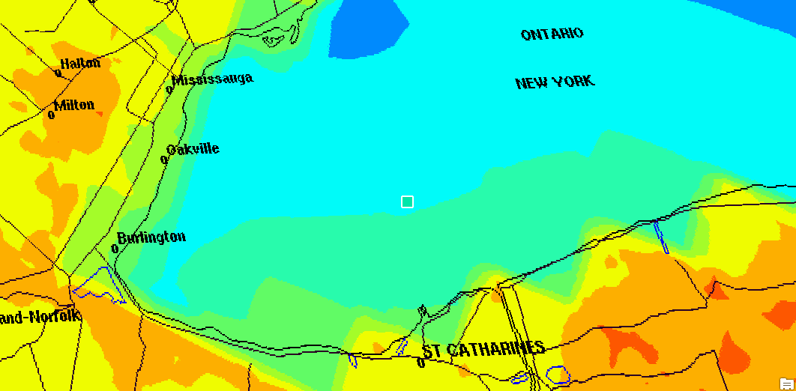
Temperature - July 12/2015 – 14:00
Actual Temp = 21.03, Model Temp = 18-20
Notes:
Actual Temp = 21.03, Model Temp = 18-20

Slide 18
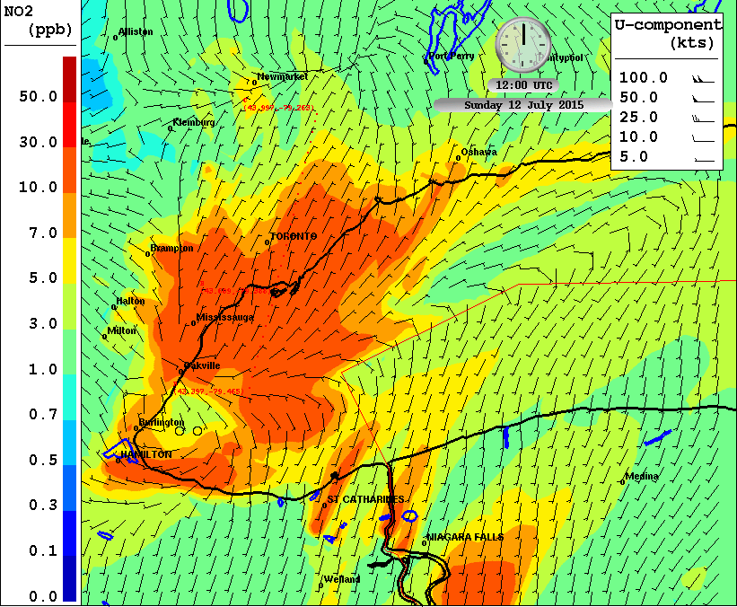
July 12 Case Study: Morning Rush Hour, NO2
C
Local flow over Toronto
in the morning was from north to south.
Line is for vertical cross
section from A to B to C.
B
A

Slide 19
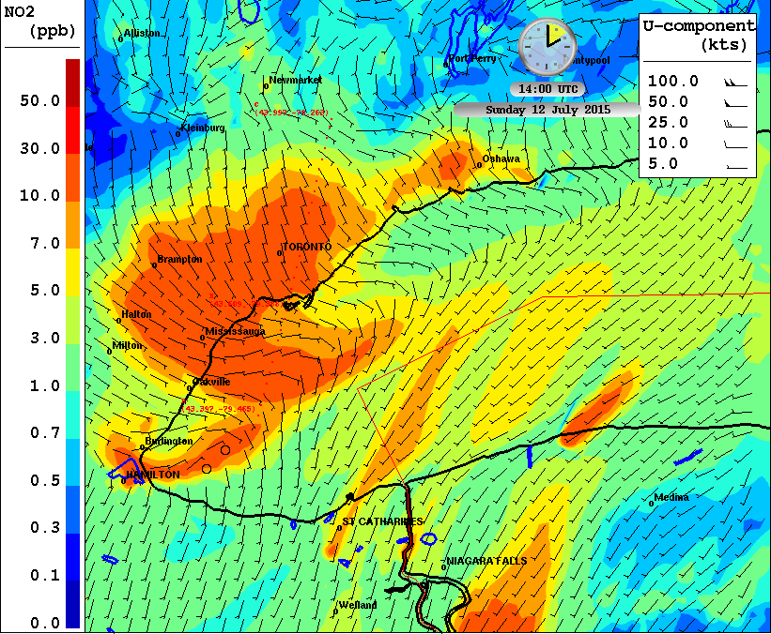
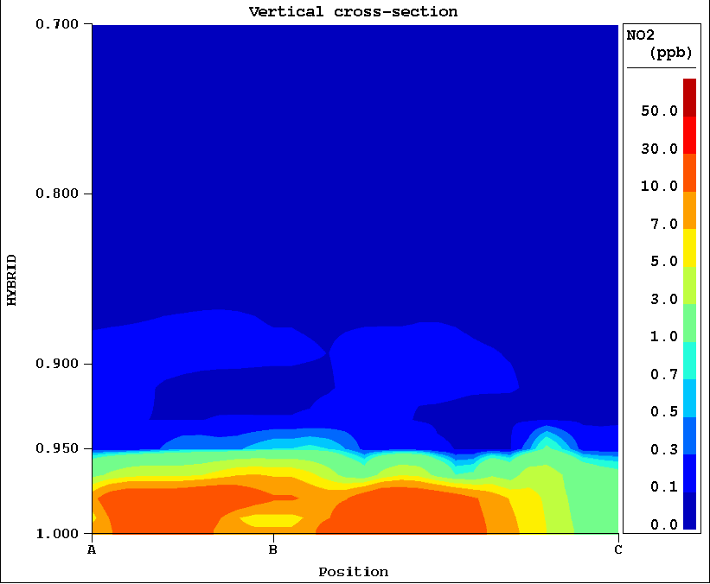
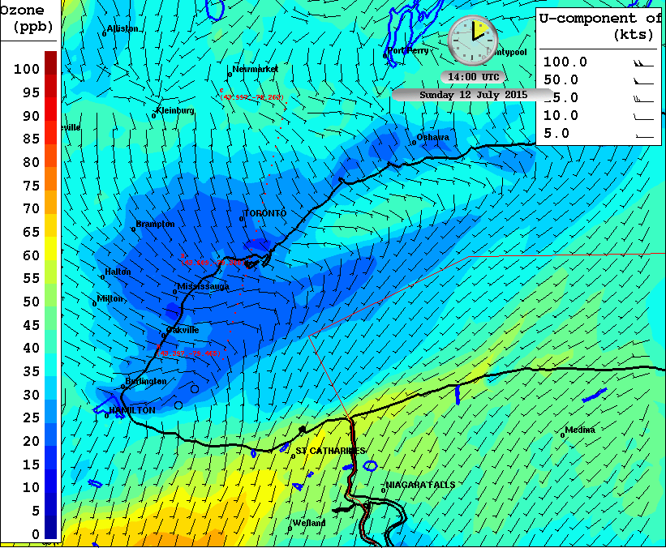
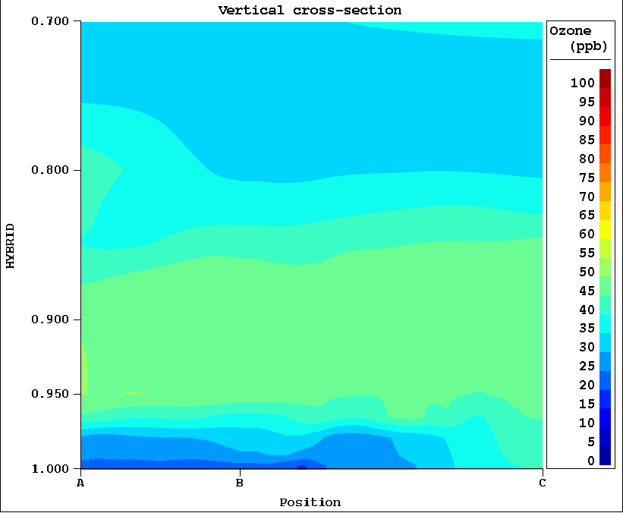
July 12, 14Z, NO₂ and O₃
At 10 LDT, winds shift more easterly for Toronto plume
over lake.
Mixing height looks pretty uniform over lake and land, about 500-m.
O3 titration is evident

Slide 20
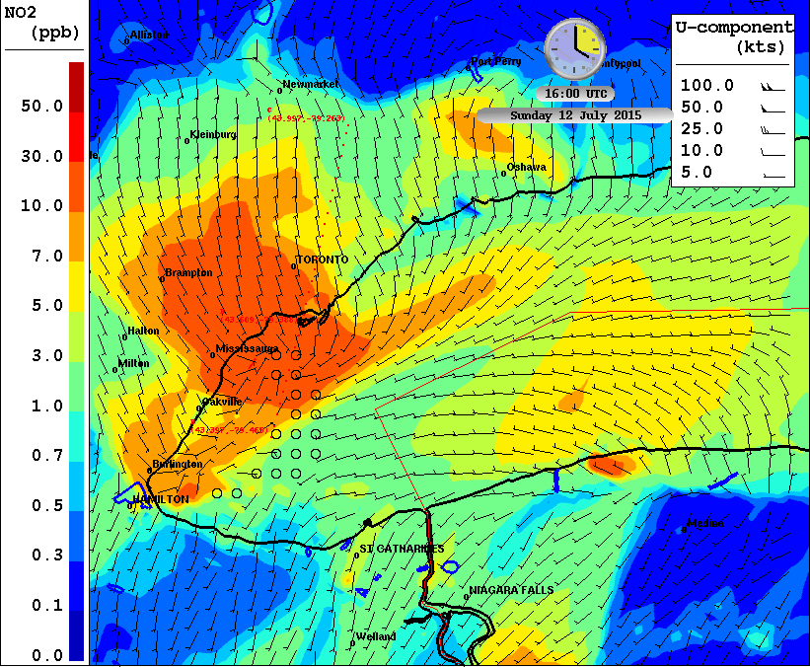
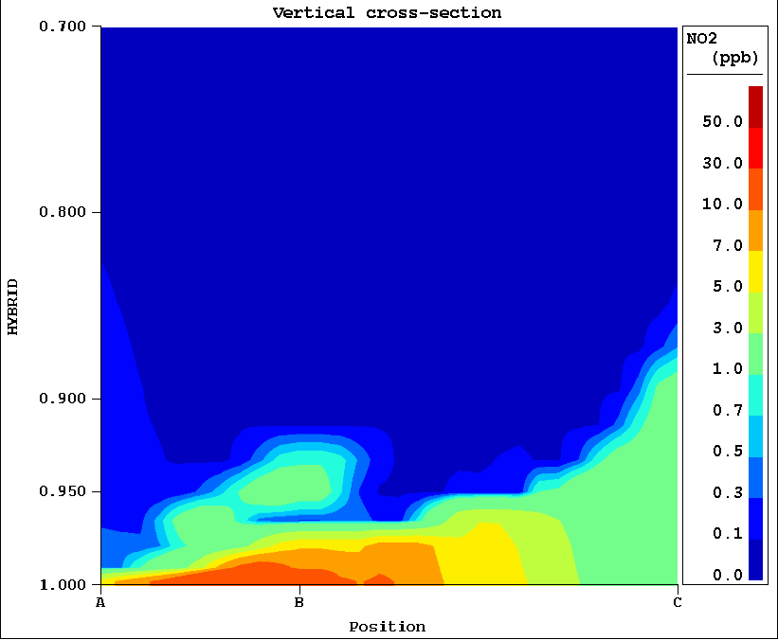
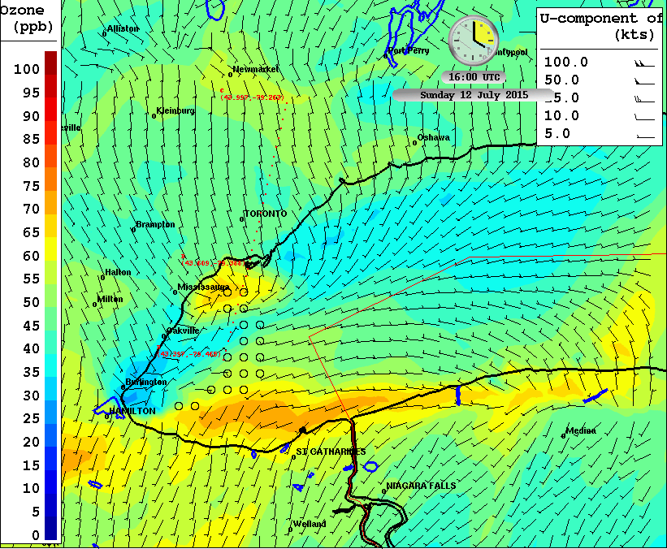
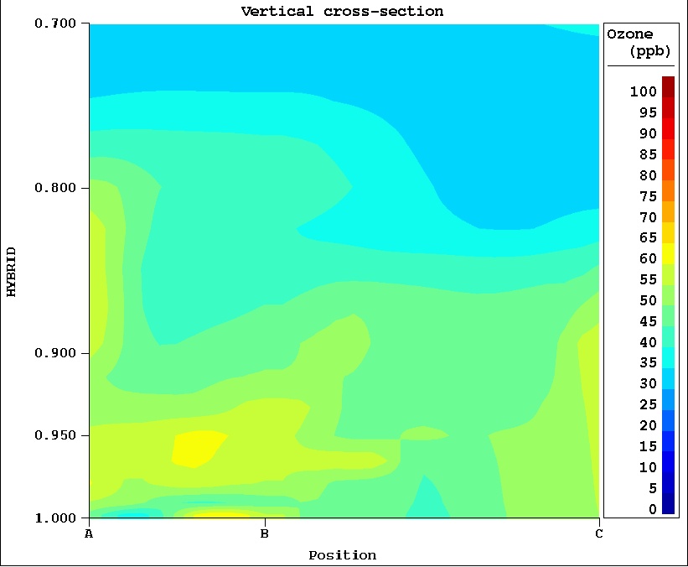
July 12, 16Z, NO₂ and O₃
At noon, winds shift from south for Toronto plume. Shallow layer of high NO2 over lake.
Mixing inland up to 1.2 km
(at point C).

Slide 21
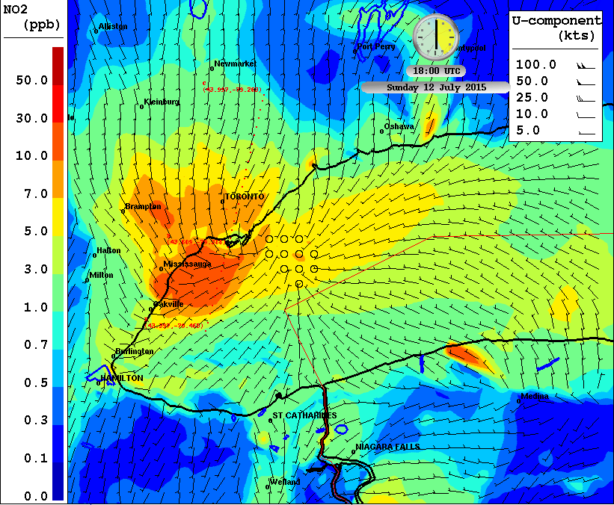
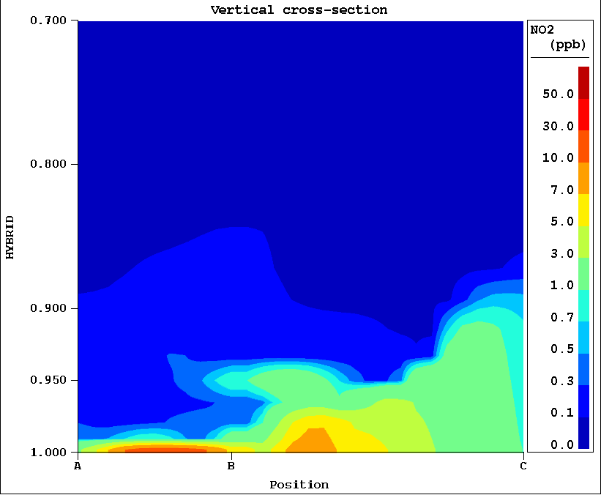
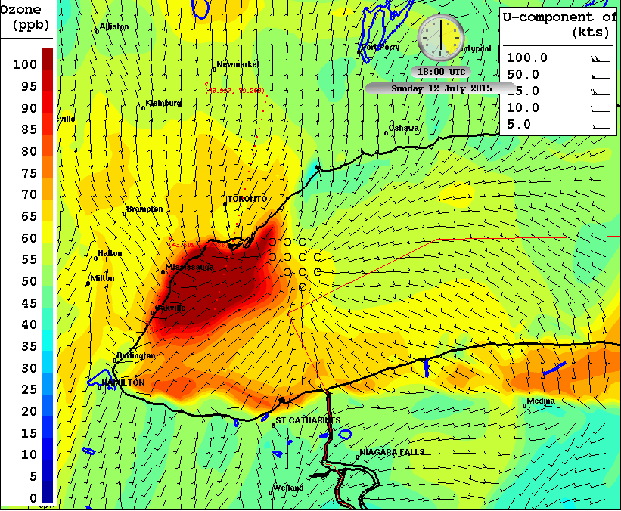
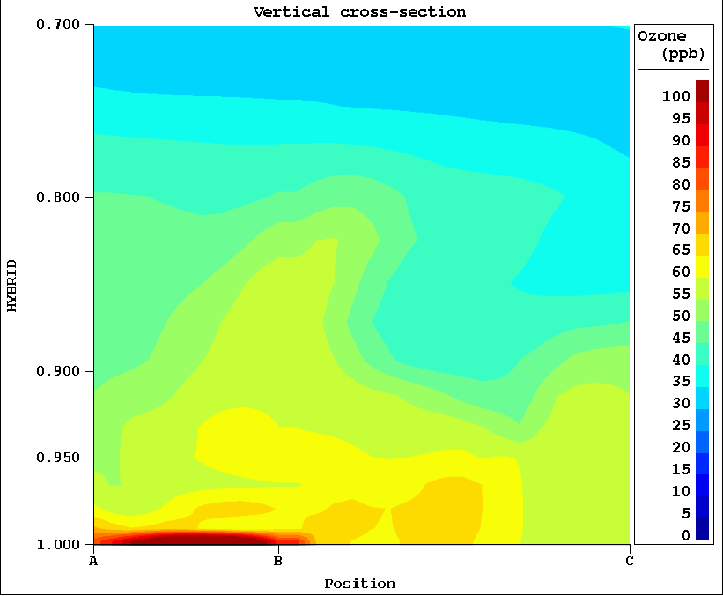
July 12, 18Z, NO₂ and O₃
At 2pm local time,
NO₂ remains in a shallow layer over lake (even more so than noon time)
Burst of O₃ formed over lake
in a shallow layer (some conversion of NO₂ to O₃, but also a lot of new odd oxygen formation).
Lake breeze circulation just forming and evident in O₃
distribution.

Slide 22
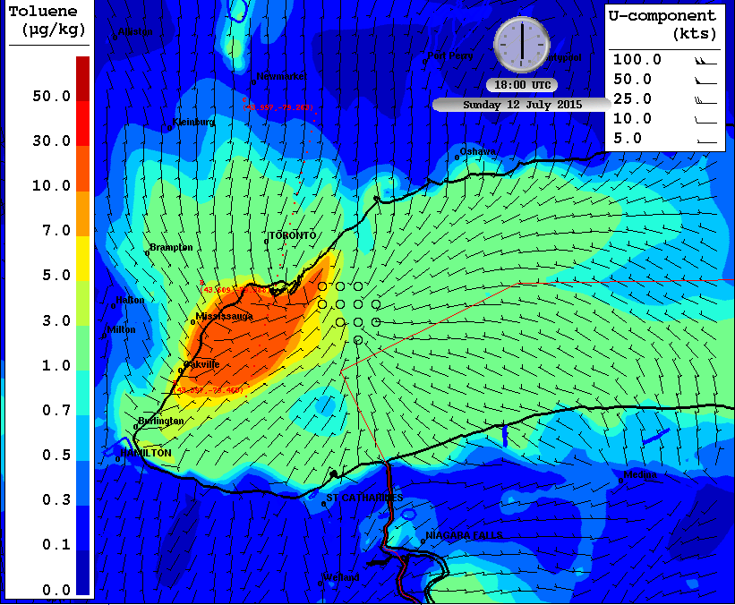
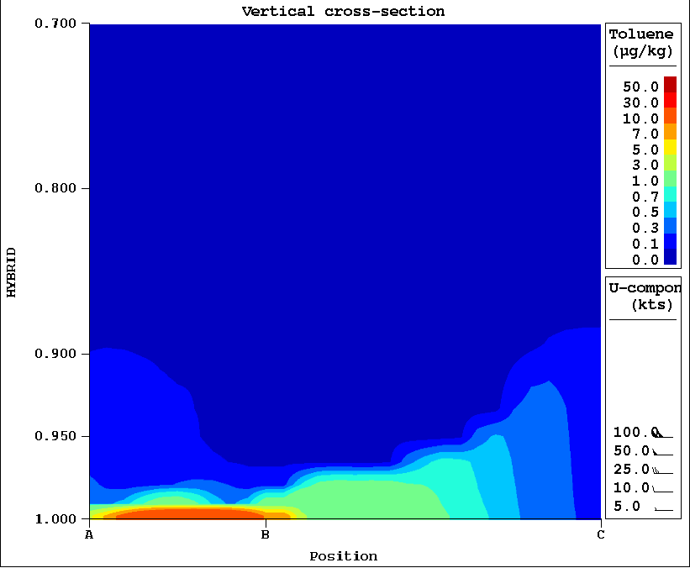
July 12, 18Z, Toluene
At 2pm LDT, O₃ precursors, such as toluene, are also concentrated in the shallow surface layer over lake. These precursors likely play a role in the rapid O₃ formation in model.
Modeled O₃ is very sensitive to stable surface layer conditions over lake.

Slide 23
Lessons Learned
3) For high O₃ days over Greater Toronto Area, the position of lake breeze fronts was better predicted by GEM-250m with Town Energy Balance than by GEM-MACH. The urban surface may limit the inland penetration of the lake breeze front which changes the location of the O₃ maximum.

Slide 24
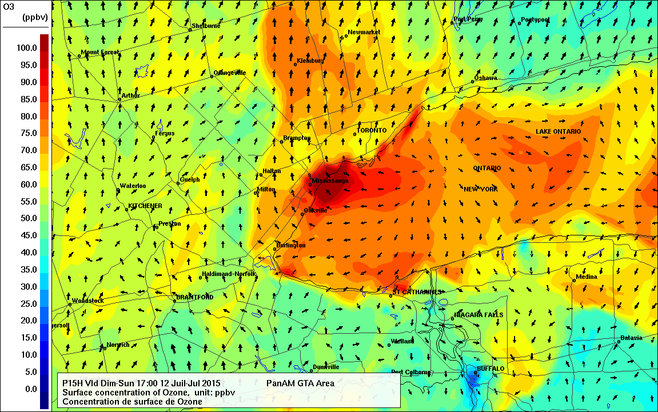
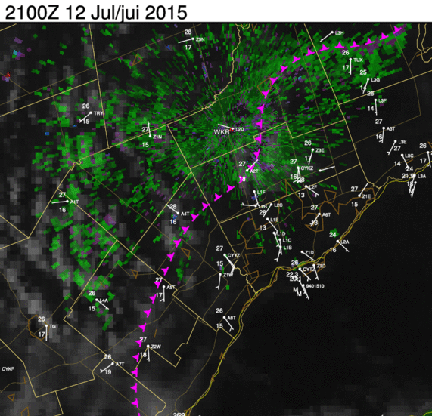
Bust Forecast
July 12
Actual front position
diagnosed from
wind observations.
Maximum over Toronto Island is evident.
Summary of observed meteorology:
Light synoptic southerly flow, ~55ppbv
Model lake breeze front runs south to north (black), while diagnosed front is more parallel to lakeshore (pink).
Max ozone may be too far north in model, along model front.
ICAST
Observations

Slide 25
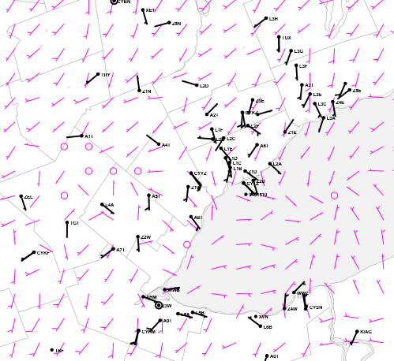
Bust Forecast
July 12
Diagnosed from
wind obs.
Max over Toronto Island is evident.
GEM-URBAN-250-m
GEM-URBAN (Belair)
GEM-MACH
GEM-URBAN 250-m predicts a much improved wind field and location for lake breeze (blue line) compared to GEM-MACH.

Slide 26
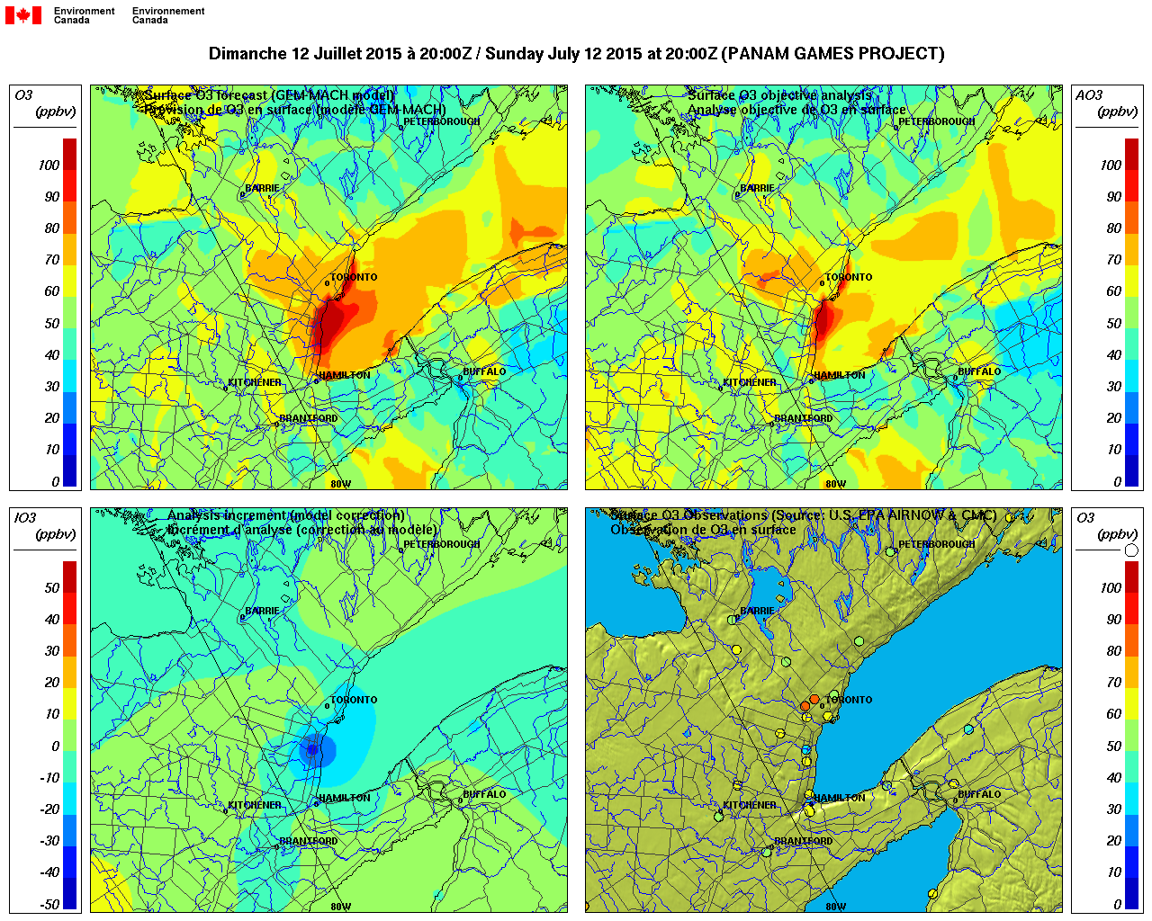
Chemical Objective Analysis at High Resolution (Ozone)
GEM-MACH Prediction
July 12, 20Z
Improved Concentration Map
Analysis Increment
Observations (NAPS, MOECC)
Note the correction
over lakeshore, common feature
Notes:
Improvement in predictions along lake shore from chemical objective analysis. Courtesy of Alain Robichaud.

Slide 27
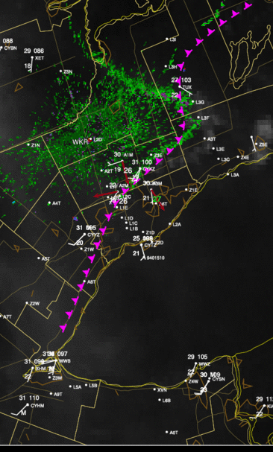
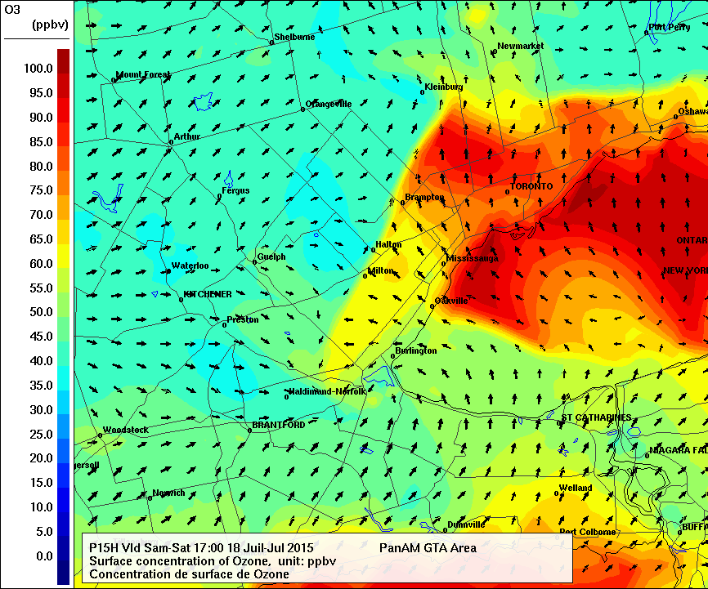
July 18 Ozone Forecast Bust for Toronto North
Southwest synoptic flow, ~ 45 ppbv
Model lake breeze front too far north and west compared to observations (pink).
21Z

Slide 28
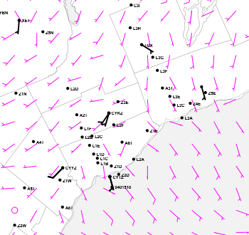
July 18 Ozone Forecast Bust for Toronto North
GEM-URBAN 250-m lake breeze front location is much better compared to GEM-MACH.
21Z
GEM-URBAN more
consistent with
ICAST analysis

Slide 29
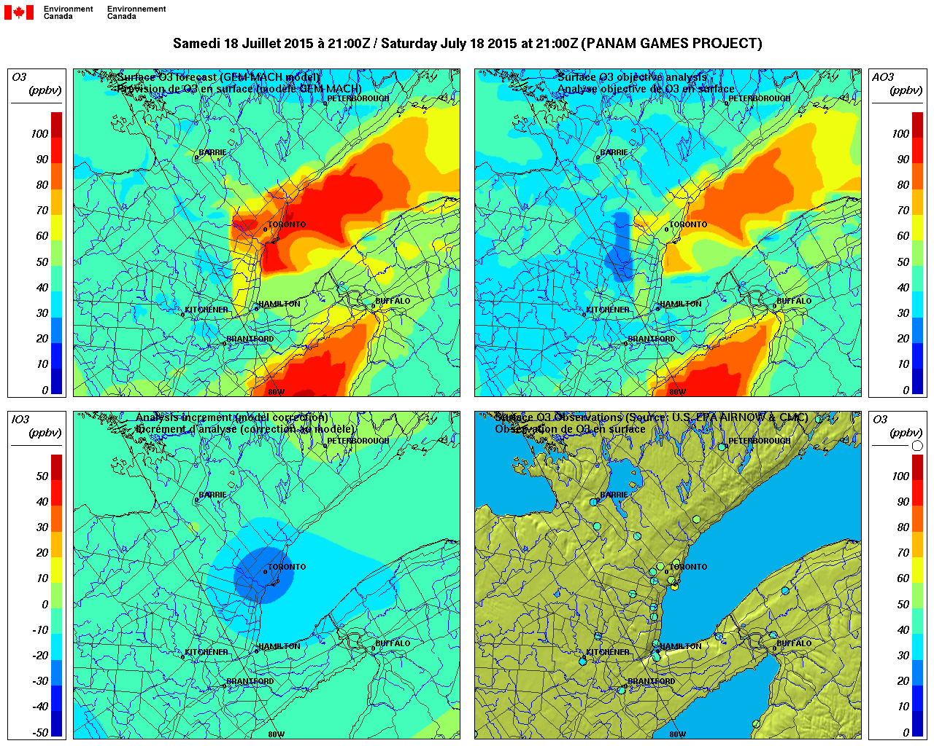
GEM-MACH Prediction
July 18, 20Z
Improved Concentration Map
Analysis Increment
Observations (NAPS, MOECC)
Notes:
Objective analysis improves forecasts.

Slide 30
Lessons Learned
4) We kept the high resolution GEM-MACH v2 system running over January 2016. High resolution system performed much better for all PM_{2.5} statistical comparisons, but results were mixed for O₃ and NO₂ statistics.

Slide 31
Future Work
Working towards implementation of an operational HRAQDPS at 2.5-km grid spacing for year 2020.
Other Projects under Pan Am Umbrella
2-way feedbacks of chemistry and weather in GEM-MACH (Paul Makar, Wanmin Gong, Ayodeji Akingunola)
PM_{2.5} composition evaluation, as data sets become available
Benzene source apportionment for Toronto
Biodiesel Fuel Scenarios at high resolution
Oil Refinery Scenarios at high resolution
Questions/Comments? Craig.Stroud@canada.ca

Slide 32
Acknowledgements
ARQI Team: Sylvie Gravel, Balbir Pabla, Alain Robichaud, Paul Makar, Mike Moran, Philip Cheung, Junhua Zhang, Heather Morrison
MSC AQMAS Team: Paul-Andre Beaulieu, Sophie Cousineau et al.
ARQP: Jeff Brook et al.
AAQS and ARQM: J. P. Charland, Rosa Wu et al.
MSC AQHI Team: Dave Henderson et al.
MRD: Paul Joe, Dave Sills, Joan Klaason, John McPhee et al.
MRD: Stephane Belair, Sylvie Leroyer
XM-Tools MSC: Andrew Teakles, Jonathan Baik
ECCC PIRD: Canadian pollutant release inventory
UofTChemical Eng: Prof Arthur Chan group, Prof Greg Evans group
US EPA: SMOKE program and US emissions inventory

Slide 33
Week 3: Ozone model and observations
Measured ozone about 90 ppbv on July 28, highest levels observed in recent years.
Max predictions generally good for July 27.
Model max over-prediction on July 26 for TO Island.
Model over-titration often for Toronto North site.
Notes:
Focus on pollution episode from July 27-29. Ozone over 90 ppbv on July 28 at Toronto North site.

Slide 34
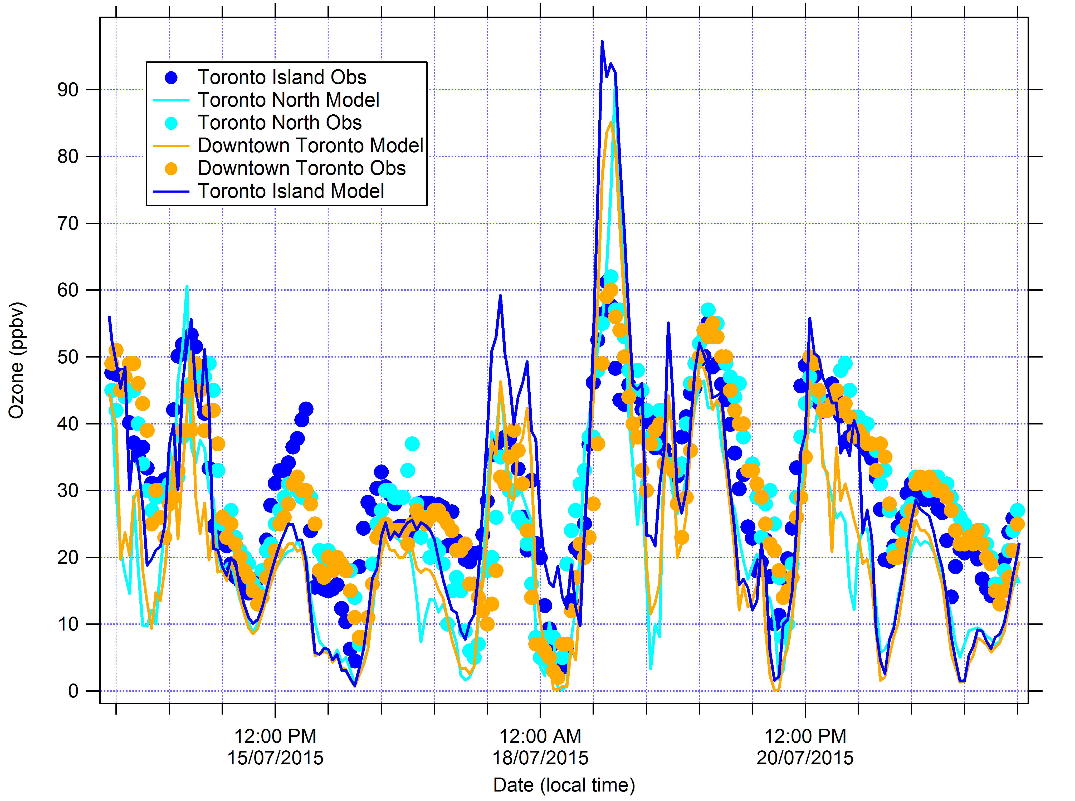
Week 2: Ozone model and observations
Huge model over-prediction for July 18
Model ozone over-prediction at Toronto Island on July 17 because of high ozone predictions over lake.

