Slide 1
Recent Upgrades to the Chemical Transport Model Used in the Canadian Operational Regional Air Quality Deterministic Prediction System (RAQDPS)
Michael Moran, Sylvie Gravel, Verica Savic-Jovcic, Radenko Pavlovic, Hugo Landry, Alexandru Lupu, Sylvain Ménard, Sophie Cousineau, and Didier Davignon
10 Jan. 2017 8th IWAQFR Toronto, Canada

Slide 2
Talk Outline
Background
Description of Recent Upgrades
Model emissions inputs
Meteorological host model
AQ science modules
Impact of Recent Upgrades
Next Steps

Slide 3
Background
The Canadian Air Quality Prediction Program at Environment and Climate Change Canada (ECCC) is an 18-year-old program that has evolved from issuing O₃-only forecasts for eastern Canada to issuing O₃, NO₂, and PM_{2.5} forecasts for all of Canada (+ the continental U.S. and Alaska)
The ECCC operational AQ forecast system is called the Regional Air Quality Deterministic Prediction System (RAQDPS)
The GEM-MACH in-line meteorology/chemistry model has been used in the RAQDPS since Nov. 2009 to produce twice-daily, 48-hour, continental-scale forecasts of O₃, NO₂, PM_{2.5}, and Air Quality Health Index (AQHI)

Slide 4
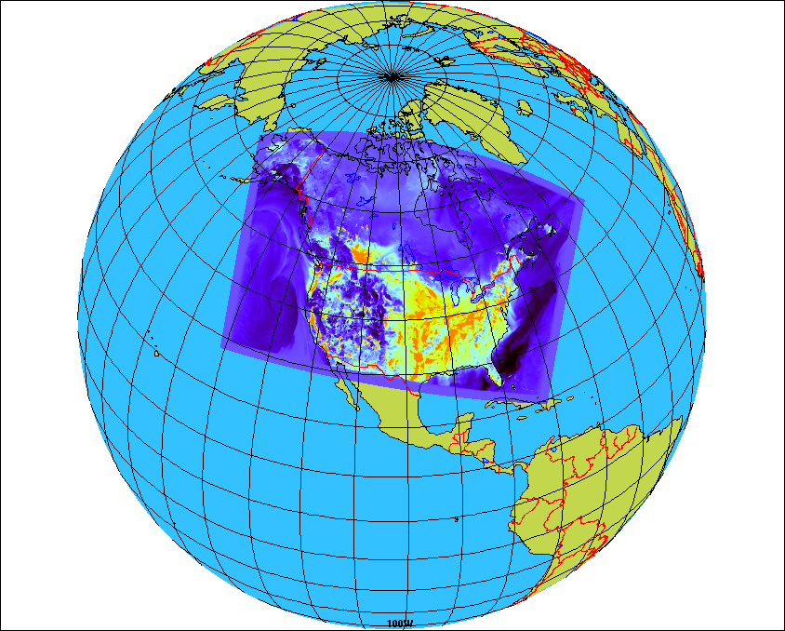
Overview of Regional GEM-MACH
GEM = Global Environmental Multiscale
MACH = Modelling Air quality & CHemistry
GEM-MACH version 1 in operation since 2009; replaced by version 2 in 2016
Regional grid covers much of North America
10 km horizontal grid spacing
80 vertical levels with lid at 0.1 hPa (~10 levels in 1st km above surface)
GEM-MACH is also the FireWork base model
One-way coupling (meteorology affects chemistry) for operational version
Full representation of oxidant and aerosol chemistry processes:
gas-, aqueous- & heterogeneous chemistry mechanisms
aerosol dynamics, microphysics, and SOA formation
dry and wet deposition (including in- and below-cloud scavenging)
2-bin sectional representation of PM size distribution (i.e., 0-2.5 μm and 2.5-10 μm); each size bin has 8 chemical components
Notes:
4
Regional yet more than 37 million sq km

Slide 5
Recent Upgrades to the RAQDPS
There have been 17 upgrades to the RAQDPS since 2009 (from RAQDPS001 to 018); some upgrades were major while others were minor; each upgrade must be shown to improve (or maintain) model performance and each must be approved by an ECCC internal committee
One important recent update was the release in June 2015 of RAQDPS013, which introduced a new set of emissions files [see weblink http://collaboration.cmc.ec.gc.ca/cmc/cmoi/product_guide/docs/changes_e.html#20150611_raqdps]
A second set of significant releases (RAQDPS015, RAQPS016, RAQDPS017) was made in 2016 to upgrade to the next generation of the GEM-MACH model [see http://collaboration.cmc.ec.gc.ca/cmc/cmoi/product_guide/docs/changes_e.html#20160907_raqdps016]

Slide 6
2015 Update to RAQDPS013 Emissions
Inventory representativeness is an issue: Newer emissions inventories were used
Previous emissions (SET0)
Canada: 2006 v1 (without construction sector)
USA: 2012 projection (based on 2005 NEI v1)
Mexico: 1999
Updated emissions (SET2.1.1)
Canada: 2010 v1
USA: 2011 v1
Mexico: 1999 (no change)

Slide 7
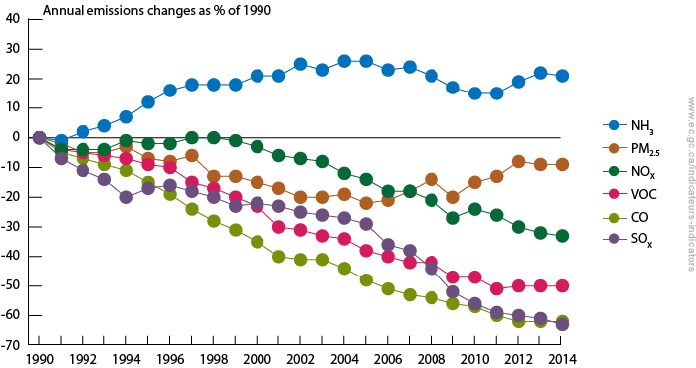
Air Pollutant Emissions Trends, Canada, 1990-2014
2006
2010
2015
[From http://ec.gc.ca/indicateurs-indicators/default.asp?lang=en&n=E79F4C12-1]

Slide 8
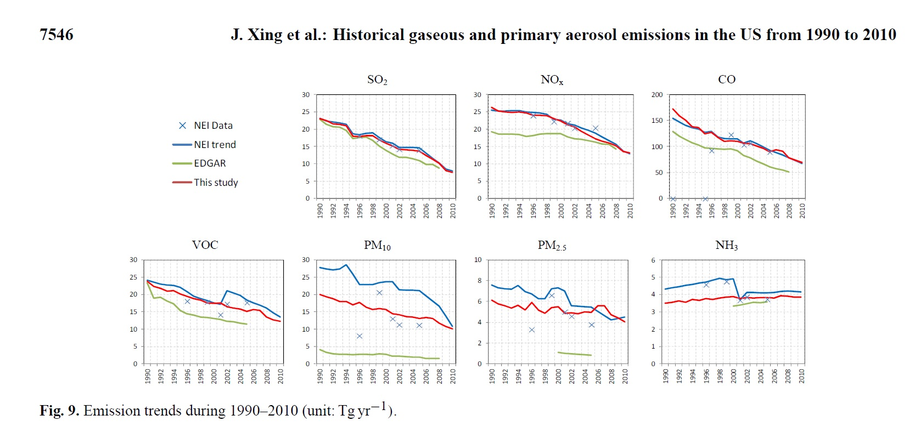
Air Pollutant Emissions Trends, U.S., 1990-2010
[From Xing et al., 2013, Atmos. Chem. Phys., 13, 7531-7549]

Slide 9
Many Improvements to Emissions Processing Treatment for Canada
New Canadian population and dwelling spatial surrogates based on 2011 census replaced older versions based on 2006 census
New Canadian spatial surrogates for residential wood combustion, on-road mobile sources, airports, marine pleasure craft, and others
Land-use-dependent transportable fraction used to scale fugitive dust emissions for near-source capture in place of simple 0.25 factor
New temporal profiles for major point sources
New library of PM speciation profiles and addition of some VOC speciation profiles
Removal of emissions from closed facilities

Slide 10
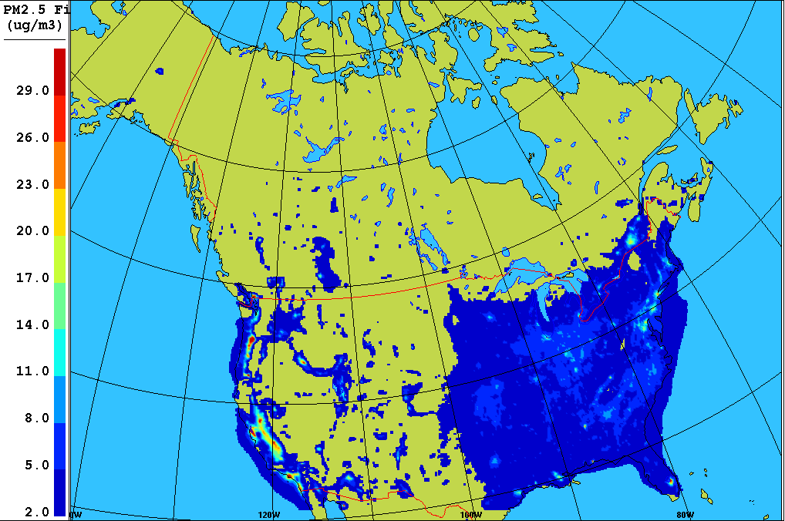
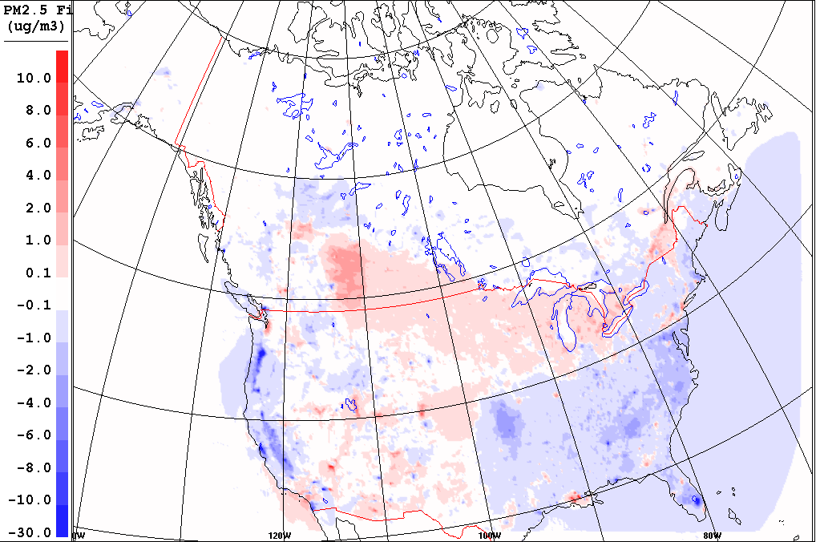
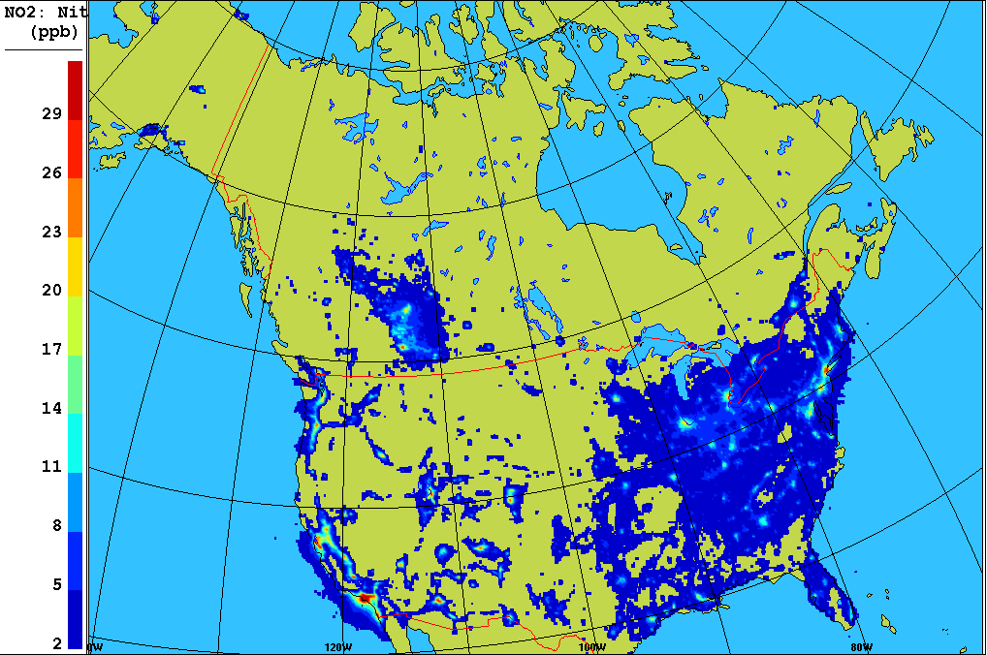
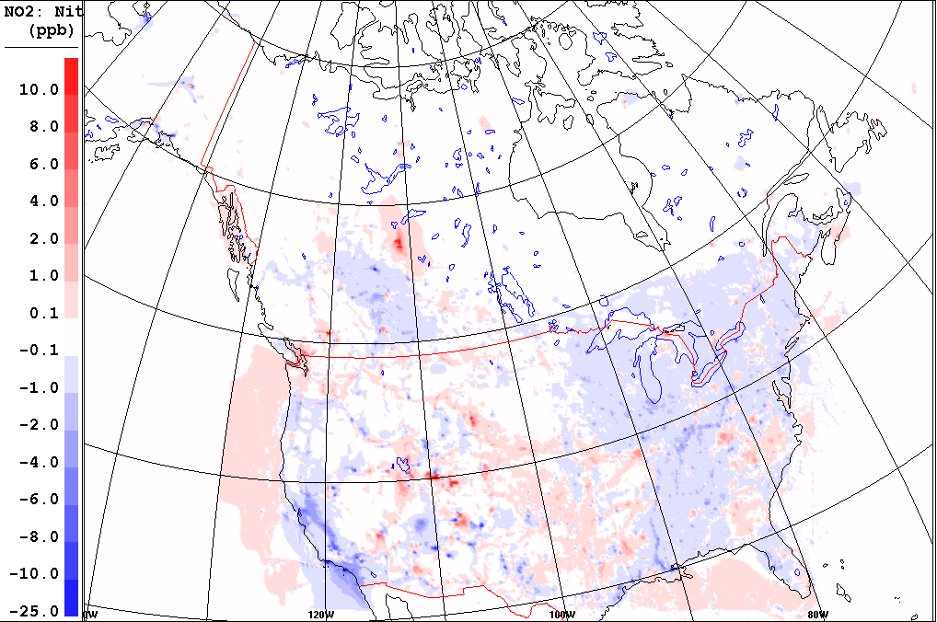
Impact of Revised Emissions on Winter 2014 Mean PM_{2.5} (µg/m³) and NO₂ (ppbv) Concentrations
SRPDQA (OPS)
DIFF =SRPDQA(SET2.1.1) – SRPDQA(OPS)
PM_{2.5}
NO₂

Slide 11
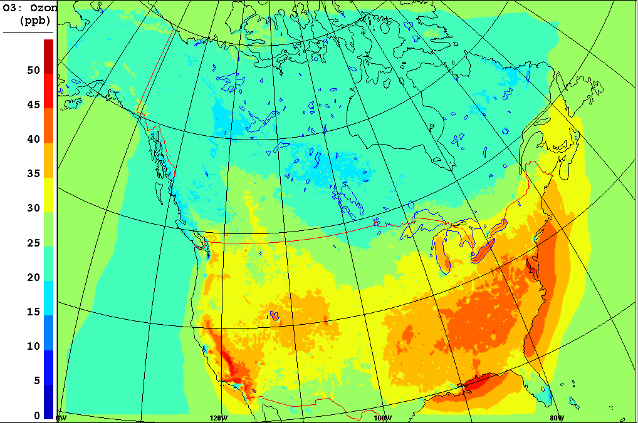
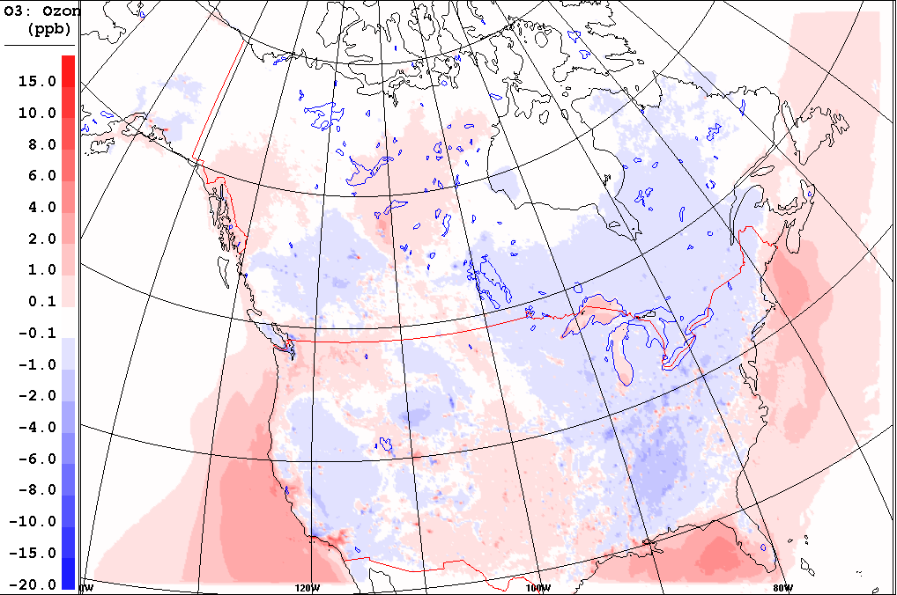
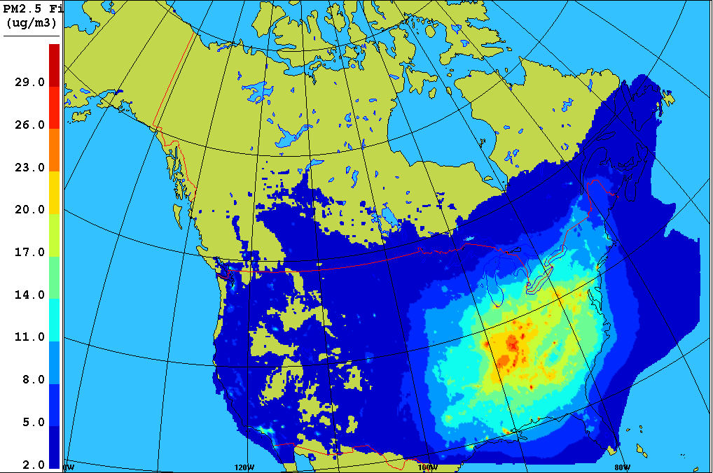
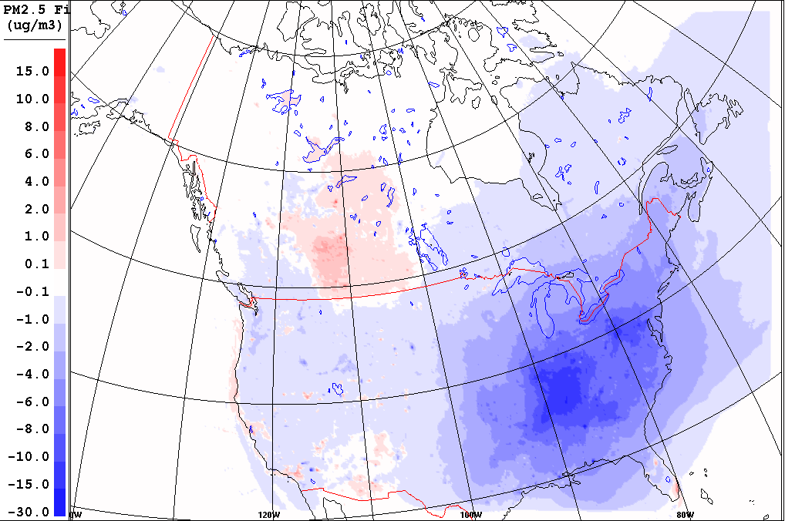
Impact of Revised Emissions on Summer 2014 Mean O₃ (ppbv) and PM_{2.5} (µg/m³) Concentrations
SRPDQA (OPS)
DIFF =SRPDQA(SET2.1.1) – SRPDQA(OPS)
O₃
PM_{2.5}

Slide 12
2016 Updates to AQ Forecast Model: GEM-MACH v2 vs. GEM-MACH v1 (1)
With respect to the GEM host model, G-M v2
Is based on GEMv4 (new version of NWP model) vs. GEMv3
Uses new GEM vertical coordinate (log-hydrostatic-pressure)
Uses new GEM staggered vertical discretization (next slide)
Uses different model level for surface concentrations (level 80 at 20 m for G-Mv2 vs. surface for G-Mv1)
Has different thickness of lowest model layer (40 m for G-Mv2 vs. 20 m for G-Mv1)
Uses GEM “native” vertical diffusion scheme for chemical tracers (changed from a different scheme for harmonization)
Uses new horizontal grid (Yin10 vs. RLL10)

Slide 13
New Vertical Discretization
GEM-MACH v1
GEM-MACH v2
T, φ, u, v, w, tracers
Τ, q, w, tracers
T, φ, u, v, w, tracers
φ, u, v
T, φ, u, v, w, tracers
Τ, q, w, tracers
φ, u, v
T, φ, u, v, w, tracers
Τ, q, w, tracers
Τ, q, w, tracers
T, φ, u, v, w, tracers
φ, u, v
φ, u, v
T, φ, u, v, w, tracers
Τ, q, w, tracers
T, φ, u, v, w, tracers
φ, u, v
Τ, q, w, tracers
T, u, v, w, tracers
Τ_{s}, q_{s}
Regular Grid
Charney-Phillips Grid
Notes:
13

Slide 14
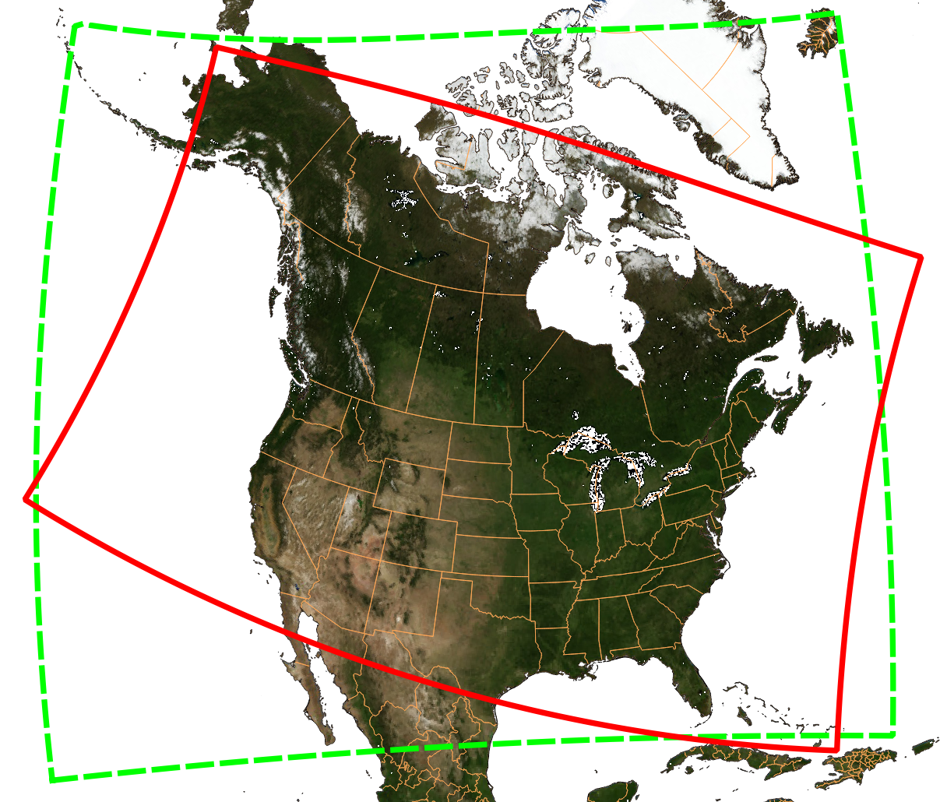
Change in Forecast Domain from GEM-MACHv1 to GEM-MACHv2

Slide 15
GEM-MACH v2 vs. GEM-MACH v1 (2)
Fixes to two major (and compensating) bugs in surface emissions and gas-phase dry deposition plus a number of minor corrections
Corrections to gas-phase dry deposition scheme to include leaf-area-index (LAI) scaling in some surface resistance terms
Adoption of limited-area version of new GEM mass-conserving semi-Lagrangian advection scheme for tracers
New set of climatological chemical lateral boundary conditions (seasonal 3D mean fields in G-Mv2 from MOZART4 vs. seasonal 1D vertical profiles in G-Mv1 )
Call to sea-salt emissions operator moved in operator sequence

Slide 16
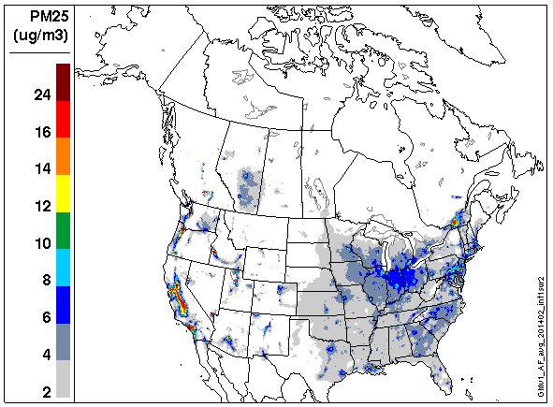
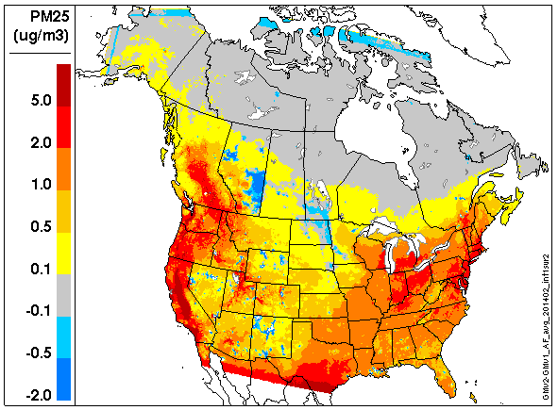
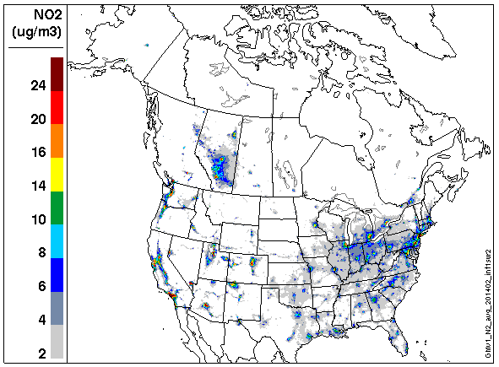
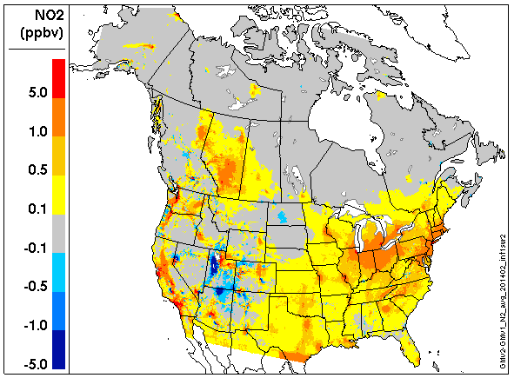
Impact of New Model Version on Winter 2014 Mean PM_{2.5} and NO₂ Concentrations
GMv1 (OPS)
DIFF =GMv2 – GMv1(OPS)
PM_{2.5}
(ppbv)
NO₂

Slide 17
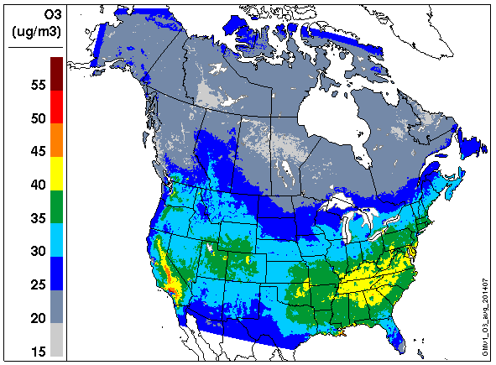
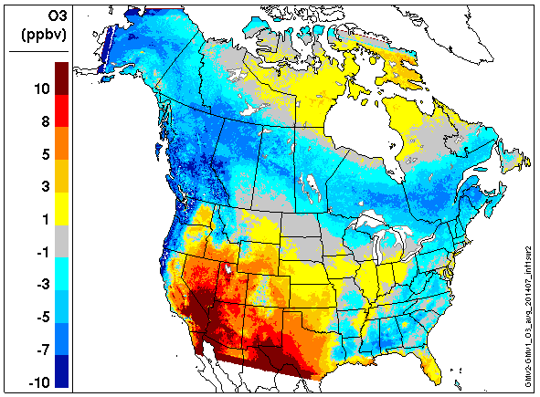
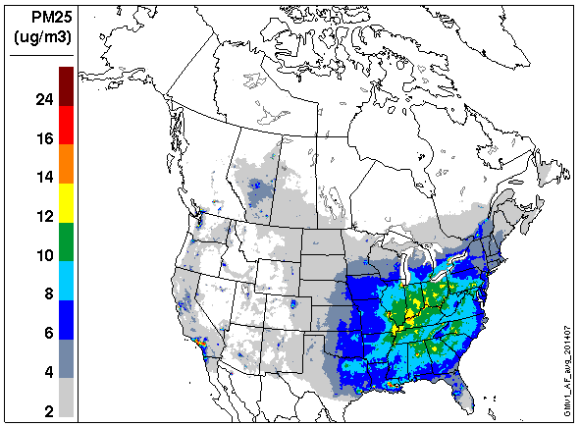
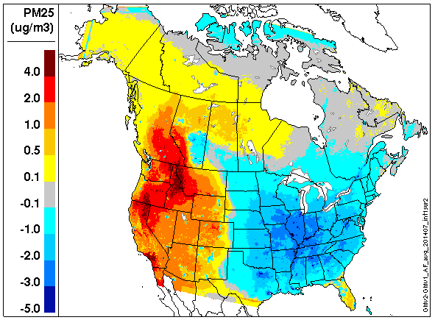
Impact of New Model Version on Summer 2014 Mean O₃ and PM_{2.5} Concentrations
GMv1 (OPS)
DIFF =GMv2 – GMv1(OPS)
(ppbv)
O₃
PM_{2.5}

Slide 18
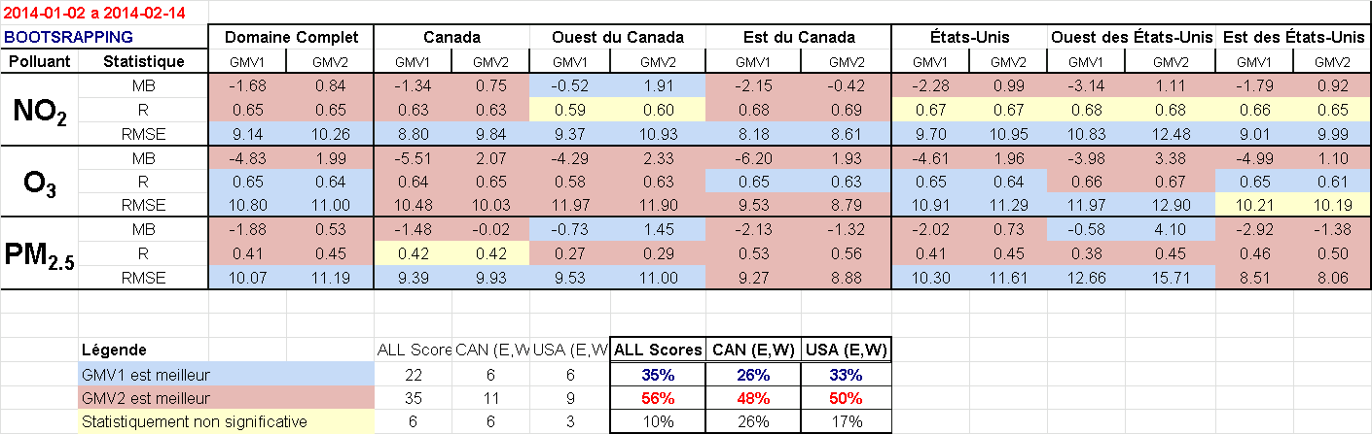
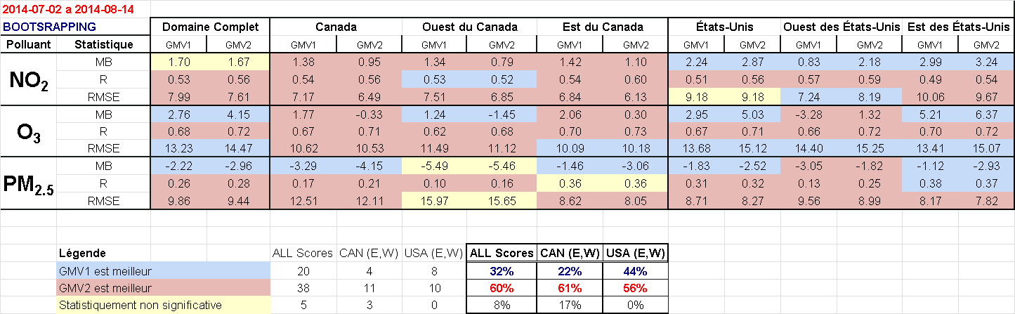
Objective Scores (MB, R, URMSE) for Hourly Forecasts (NO₂, O₃, PM_{2.5})
WINTER 2014
SUMMER 2014
Notes:
REDONE

Slide 19
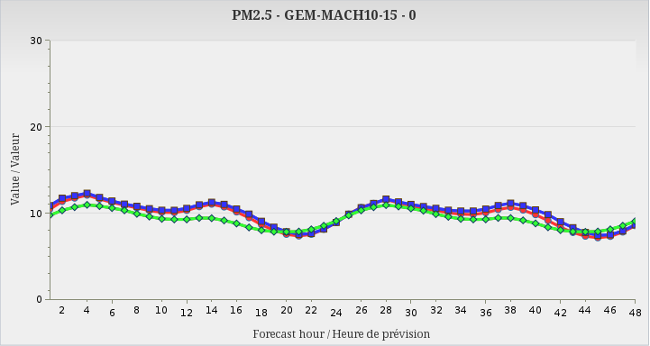
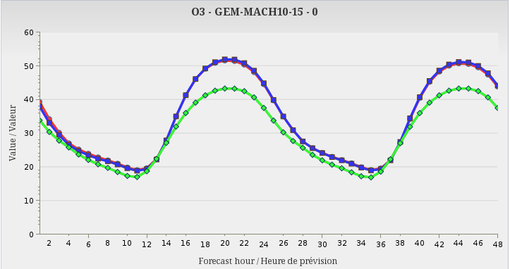
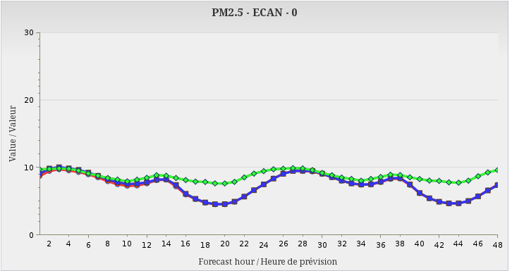
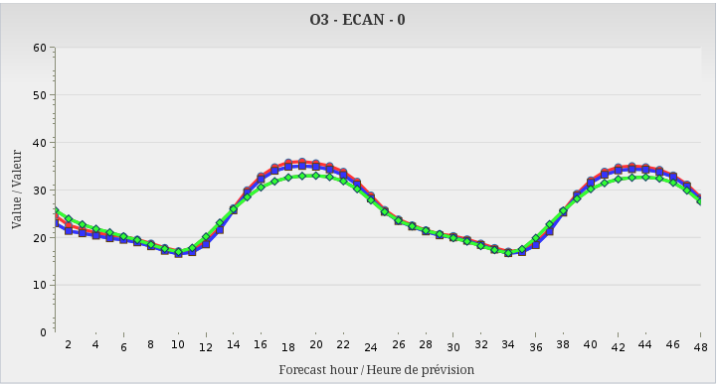
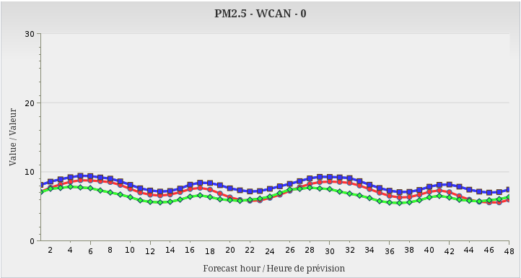
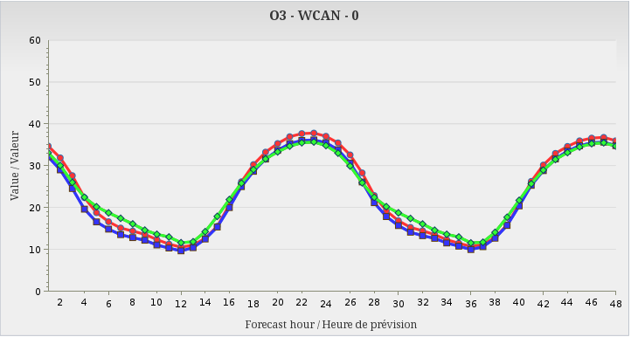
48-hour Season-Mean Hour-of-Day Concentrations
SRPDQA015
SRPDQA016
Observed
Winter – PM_{2.5}
Summer – O₃
G-M Domain
G-M Domain
Eastern Canada
Eastern Canada
Western Canada
Western Canada
Notes:
REDONE

Slide 20
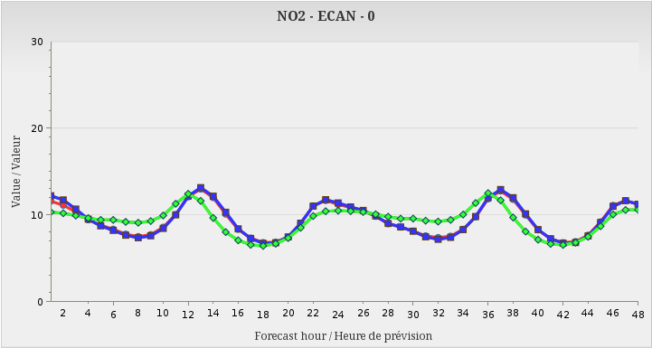
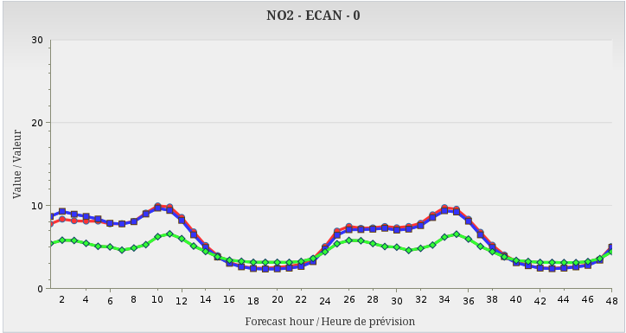
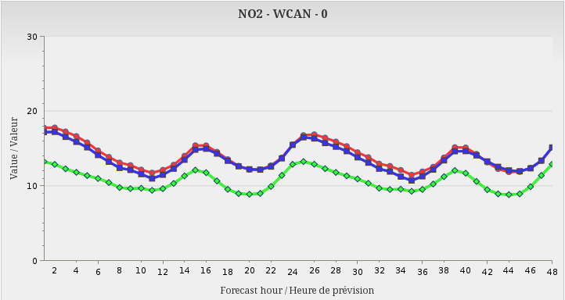
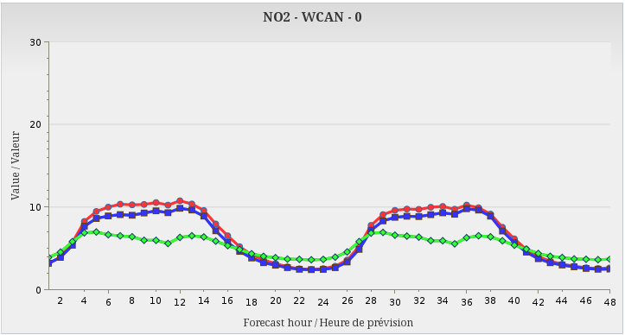
48-hour Season-Mean Hour-of-Day Concentrations
SRPDQA015
SRPDQA016
Observed
Winter – NO₂
Summer – NO₂
Eastern Canada
Eastern Canada
Western Canada
Western Canada
Notes:
REDONE

Slide 21
Next Steps in 2017-2018
Migrate to new CMC supercomputer
Extend RAQDPS forecasts from 2 to 3 days
(see poster tonight by Sylvain Ménard)
Upgrade model emissions inputs
(see talk this afternoon by Junhua Zhang)
Improve computational efficiency
Take first step to chemical data assimilation with new objective analysis (OA) scheme
(see talk tomorrow by Richard Ménard)
Implement AQ science upgrades
(e.g., see poster tonight by Diane Pendlebury)

Slide 22
Summary
The ECCC operational Regional Air Quality Deterministic Prediction System (RAQDPS) has been updated 17 times since 2009
One major update in 2015 introduced new input emissions based on newer inventories (2010 Cdn, 2011v1 U.S.) and improved emissions processing methodology
Another major update in 2016 upgraded the GEM-MACH chemical weather model from version 1 to version 2: changes included (1) new vertical discretization, (2) new mass-conserving semi-Lagrangian advection scheme, (3) updated gas-phase dry deposition scheme, (4) new tracer vertical diffusion, (5) new chemical lateral boundary conditions, and (6) correction of surface emissions error

Slide 23
Thank you for your attention!

Slide 24
Percentage Differences in National Annual Emissions Of Criteria Air Contaminants Between SET2.1.1 and SET0
Country | SO₂ | NO_{x} | VOC | NH₃ | CO | PM_{2.5} | PM₁₀
Canada | -30 | -9 | -6 | -15 | -6 | -4 | 16
U.S. | -48 | 8 | -1 | -3 | -6 | -5 | -11
Notes:
http://iweb.cmc.ec.gc.ca/~arqpmik/Emissions/Inventories/2010_Canadian_CAC_EI/Canada2006_2009_2010_4July2012.xls

