Slide 1
Use of observations by the Copernicus Atmosphere Monitoring Service for data assimilation and product evaluation over Europe
IWAQFR, Toronto, 11th January 2017
Plu, M.¹, S. Guidotti¹, J. Arteta¹, M. Joly¹, J. Parmentier¹, L. Rouïl², F. Meleux², R. Engelen³, V.-H. Peuch³, A. M. Benedictow⁴, J. Douros⁵, H. Elbern⁶, H. Eskes⁵, E. Friese⁶, M. Gauss⁴, L. Robertson⁷, A. Segers⁸, M. Sofiev⁹, A. Valdebenito⁴
1: Meteo-France, France ; 2: INERIS, France ; 3: ECMWF, United Kingdom ; 4: MET Norway, Norway ; 5: KNMI, the Netherlands ; 6: RIU, Germany ; 7: SMHI, Sweden ; 8: TNO, the Netherlands ; 9: FMI, Finland.

Slide 2
Plan
The Regional CAMS over Europe
Surface observations for CAMS over Europe
CAMS assimilation over Europe
Conclusion and perspectives

Slide 3

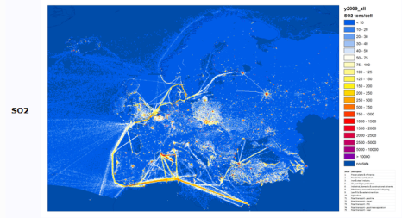

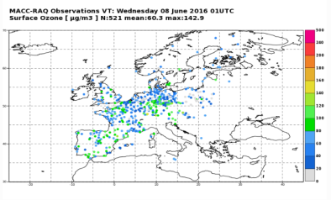




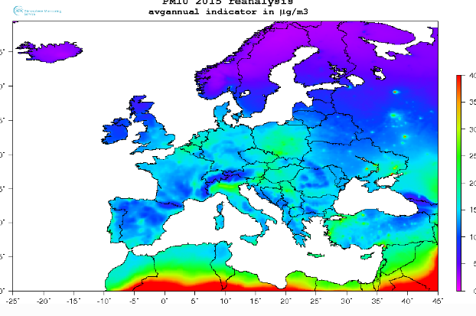
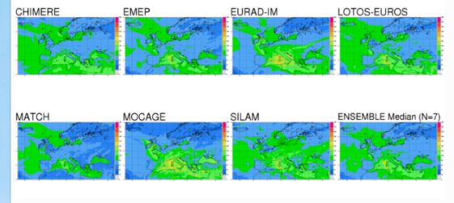



The Regional CAMS over Europe
7 operational models
(see M. Pithon’s presentation yesterday)
CHIMERE (INERIS)
Global model products
Regional emissions
Observations
EMEP (MET Norway)
EURAD-IM (RIUUK)
LOTOS-EUROS (KNMI/TNO)
MATCH (SMHI)
Daily production
of air quality
forecasts and
Analyses (7 models & Ensemble)
Annual production of
air quality reanalyses
Interim (YY-1) & Validated (YY-2)
MOCAGE (Meteo-France)
SILAM (FMI)
3 models under development
AQUM (Met Office)
DEHM (Aarhus Univ.)
USERS
GEM-AQ (Warsaw Univ.)

Slide 4
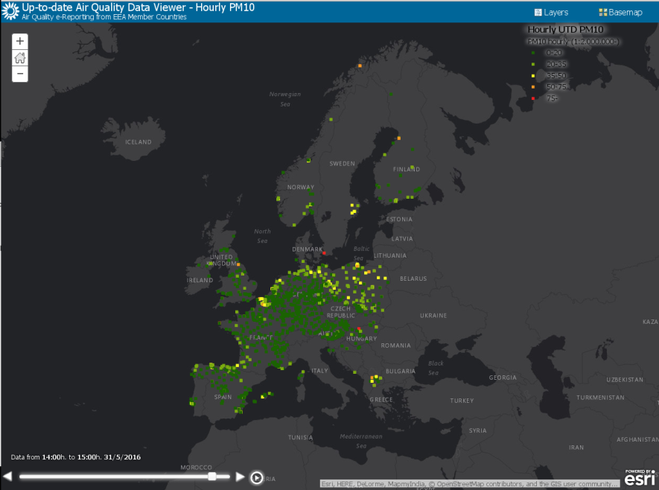

Surface observations for CAMS over Europe
How are surface observations used?
Surface observations from EIONET
- « Near-Real time » (NRT) dataflow
- A posteriori validated dataflow
Data assimilation
in regional models
(NRT analyses,
re-analyses)
Monitoring
Filtering
Ozone
NO₂
SO₂
CO
PM10
PM2.5
Verification
of regional CAMS products
(NRT forecasts, analyses,
re-analyses)

Slide 5
Surface observations for CAMS over Europe
Selection of stations: use of an objective, homogeneous, and pollutant-specific classification (Joly and Peuch, 2012, Atmos. Env.):
  Based on the past hourly time series only,
  For each station and pollutant, 8 indicators are defined that cover the main features of the measured pollutant behaviour (diurnal cycle, week-end effect, winter/summer ratios...),
  Classification relies on a Linear Discriminant Analysis,
  → 10 classes are defined, and the stations classified as 1-5 are kept (background) for assimilation and evaluation in CAMS-Regional.

Slide 6
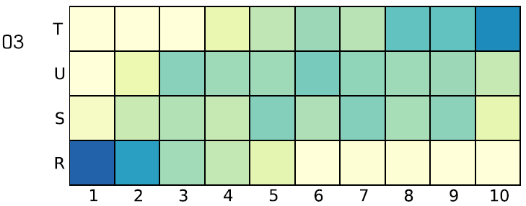
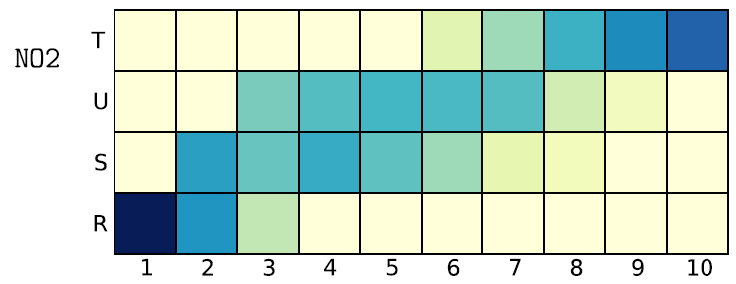
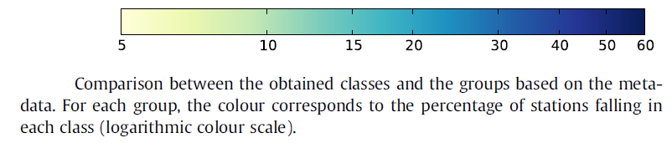
Surface observations for CAMS over Europe
Cross-validation with meta-data (Joly and Peuch, 2012):
T: Traffic – U: Urban – S: Suburban – R: Rural
Notes:
Correspondance between station type and class.
Higher correspondance for NO2 than for ozone

Slide 7
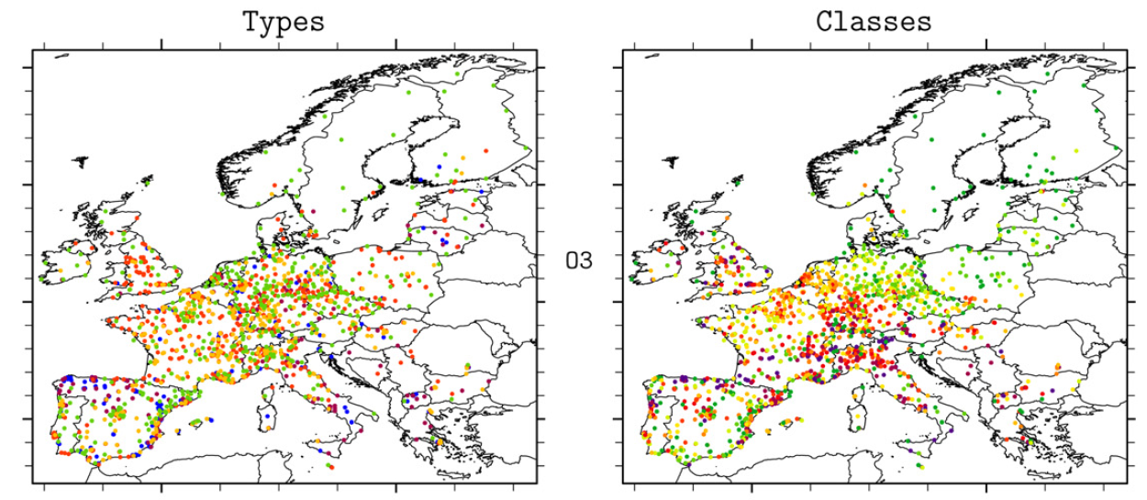
Surface observations for CAMS over Europe
Ozone: Cross-validation with meta-data (Joly and Peuch, 2012)
T: Traffic – U: Urban – S: Suburban – R: Rural
Notes:
Northern part of France, Germany, Poland: some U sites are now classified as bkground.
Suggests that the classification acts as a re-calibration.

Slide 8
Surface observations for CAMS over Europe
The classification that is used in CAMS-Regional is being revised in order to:
  Update with regards to the surface measurements available (→2014),
  Classify the stations for all the pollutants evaluated in CAMS-Regional: O₃, NO₂, PM10, PM2.5, SO₂, CO (in test),
  Investigate some refinements of the method:
    Indicators: improvement of the definition/computation, addition of 6 new indicators, transformation of asymmetric distributions using a Box-Cox procedure, refinement of the detection of outliers (using a learning method),
    A Principal Component Analysis is now used,
    The LDA is multiple in order to separate the 4 groups of stations,
    New procedure to affect each station in its class.

Slide 9
Plan
The Regional CAMS over Europe
Surface observations for CAMS over Europe
CAMS assimilation over Europe
Conclusion and perspectives

Slide 10
CAMS assimilation over Europe
Assimilation systems
  Each of the 7 operational models have their own assimilation system, that can at least assimilate in-situ surface observations,
  Developments are on-going to assimilate more species and also to assimilate upper-level observations (satellite, profilers, etc),
  ~15% of the stations are kept for independent evaluation of the analyses,
  CAMS-Regional is a relevant test bed to evaluate:
    The added-value of assimilation with regards to free model forecasts,
    The benefit of satellite observations on surface analyses,
    The impact of assimilation on non-assimilated species,
    The impact of initializing forecasts by analyses.
  The 3 models “under development” will develop establish their assimilation system this year.

Slide 11
CAMS assimilation over Europe
Assimilated species by each model (as of January 2017):
 | _{Method} | O₃ | NO₂ | PM10 | PM2.5 | SO₂ | CO
CHIMERE | O.I. | EEA | EEA | EEA | EEA | - | -
EMEP | 3D-VAR | EEA | EEA, OMI | - | - | EEA | -
EURAD-IM | 3D-VAR | EEA | EEA, OMI, GOME-2 | EEA | EEA | EEA | MOPITT
LOTOS-EUROS | EnKF | EEA | - | - | - | - | -
MATCH | 3D-VAR | EEA | EEA | EEA | EEA | EEA | EEA
MOCAGE | 3D-VAR | EEA | EEA | EEA | - | - | -
SILAM | 3D-VAR | EEA | EEA | - | EEA | - | -
Total assim. |  | 7 | 6 | 4 | 4 | 3 | 2
EEA: surface in-situ distributed by Meteo-France (NRT) or INERIS (reanalyses)
after retrieval from the EEA

Slide 12
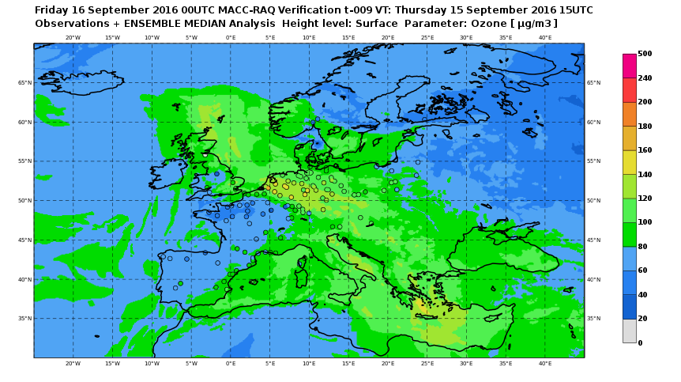
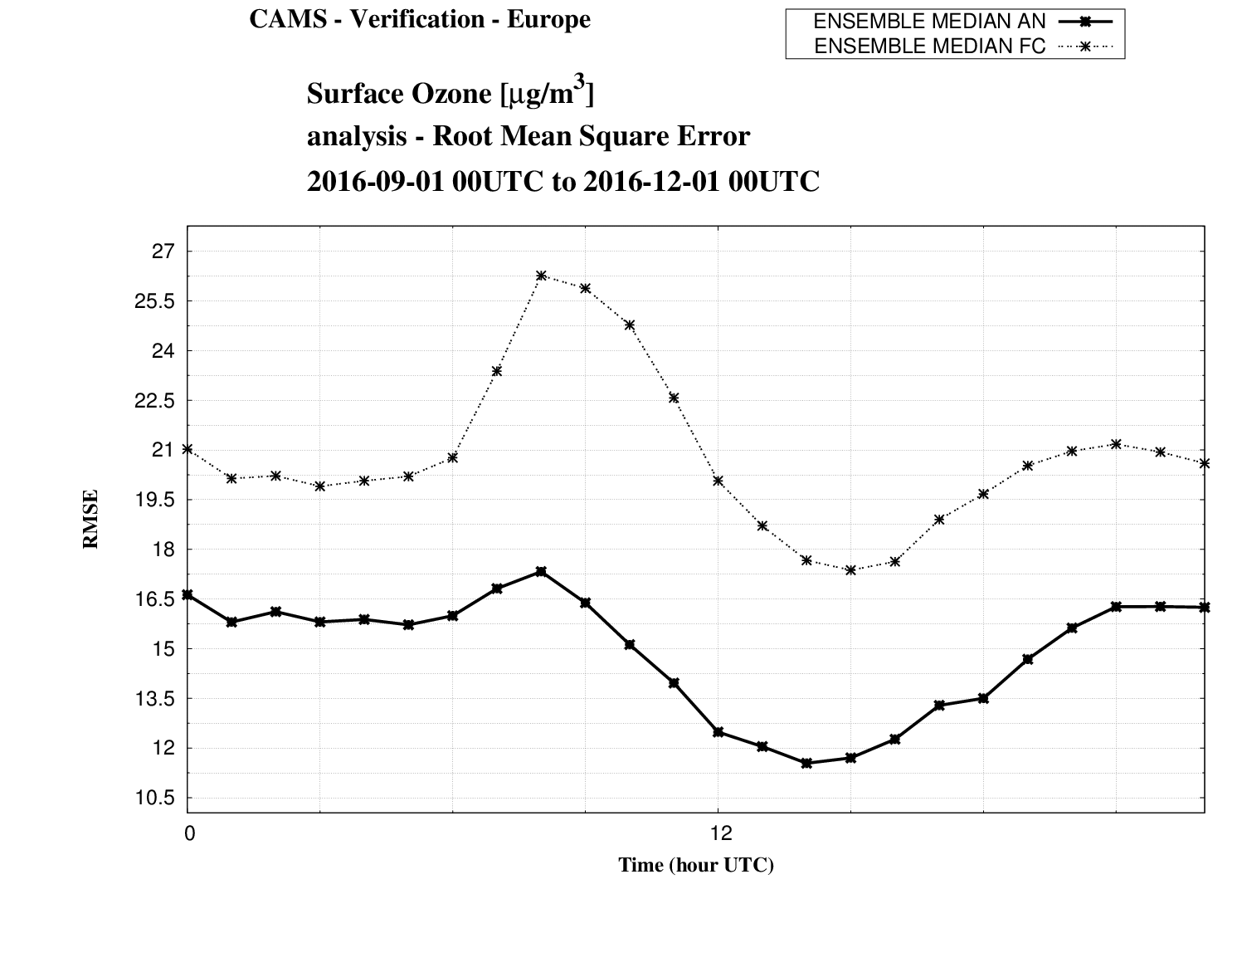
CAMS assimilation over Europe
How much better are the surface analyses compared to the surface forecasts?
RMSE of O3 forecasts
RMSE of O3 analyses

Slide 13
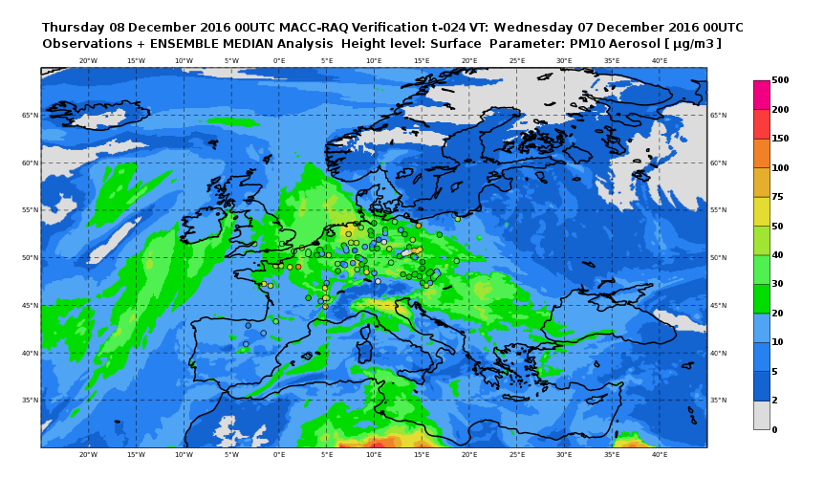
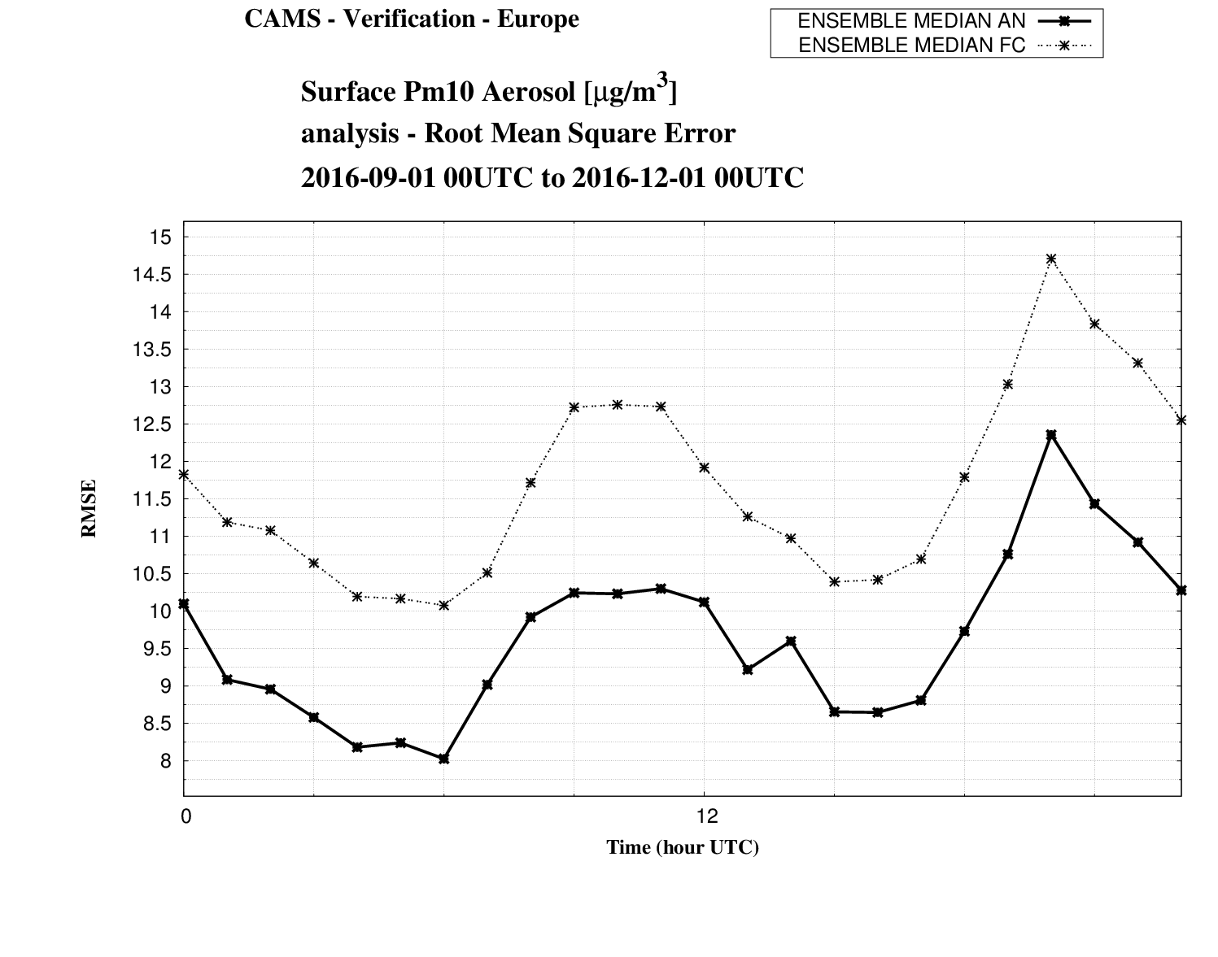
CAMS assimilation over Europe
How much better are the surface analyses compared to the surface forecasts?
RMSE of PM10 forecasts
RMSE of PM10 analyses

Slide 14
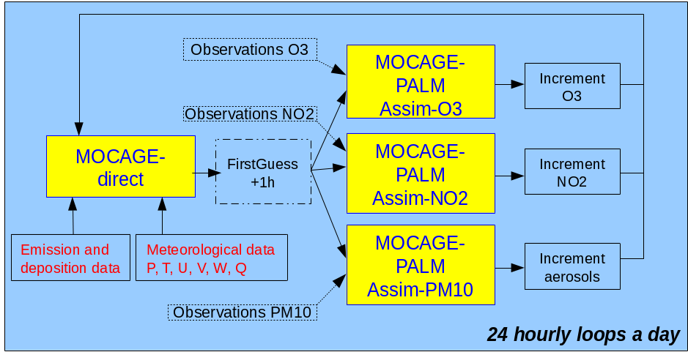
CAMS assimilation over Europe
On the impact of assimilation on non-assimilated species: effect of assimilating PM10 surface observations on PM2.5 with MOCAGE (Météo-France)
Parmentier, Arteta, Plu (CNRM, Météo-France/CNRS)

Slide 15
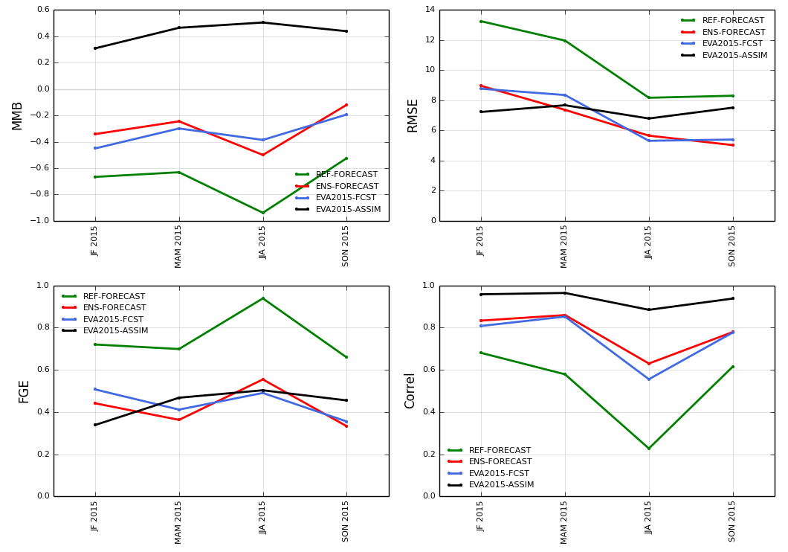
CAMS assimilation over Europe
On the impact of assimilation on non-assimilated species: effect of assimilating PM10 surface observations on PM2.5 with MOCAGE
MOCAGE ASSIM PM10
MOCAGE FORECAST
ENSEMBLE
PM2.5 scores
Parmentier, Arteta, Plu (CNRM, Météo-France/CNRS)

Slide 16
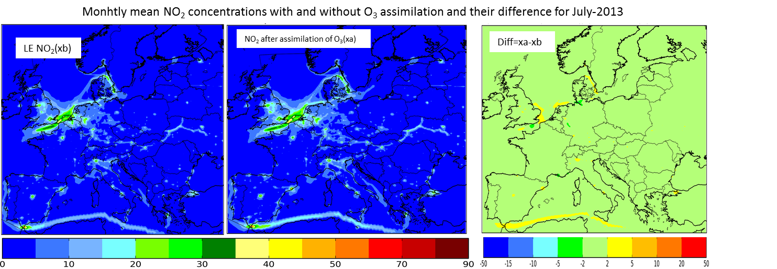
CAMS assimilation over Europe
On the impact of assimilation on non-assimilated species: effect of assimilating ozone surface observations on other species with LOTOS-EUROS (KNMI, TNO)
NO₂ - Free run
NO₂ – Assimilation O₃
Difference
μg.m⁻³
Douros, Segers, Eskes (KNMI and TNO)

Slide 17
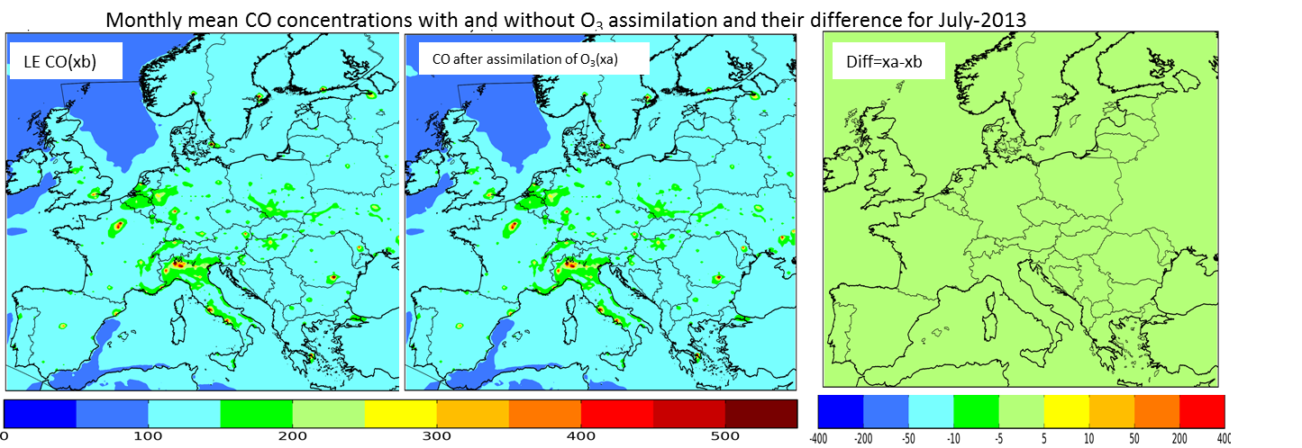
CAMS assimilation over Europe
On the impact of assimilation on non-assimilated species: effect of assimilating ozone surface observations on other species with LOTOS-EUROS (KNMI, TNO)
CO - Free run
CO₂ – Assimilation O₃
Difference
μg.m⁻³
Douros, Segers, Eskes (KNMI and TNO)

Slide 18
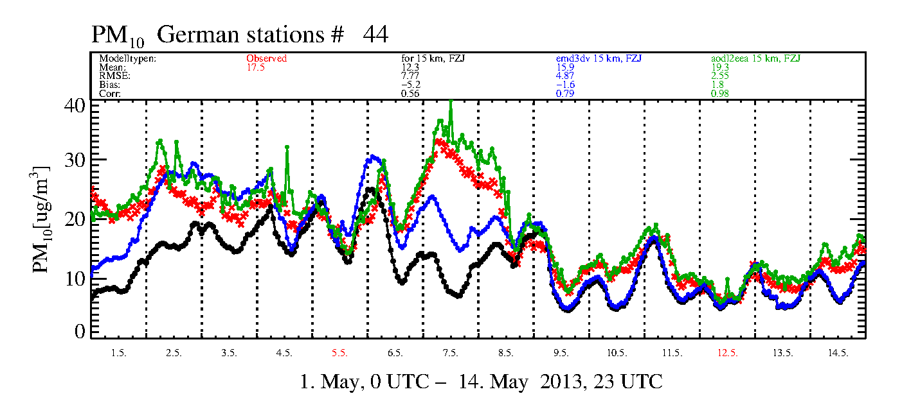
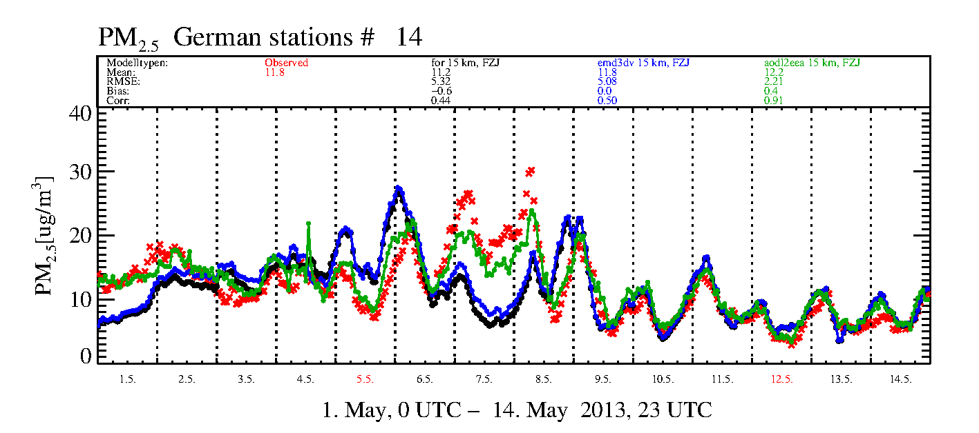
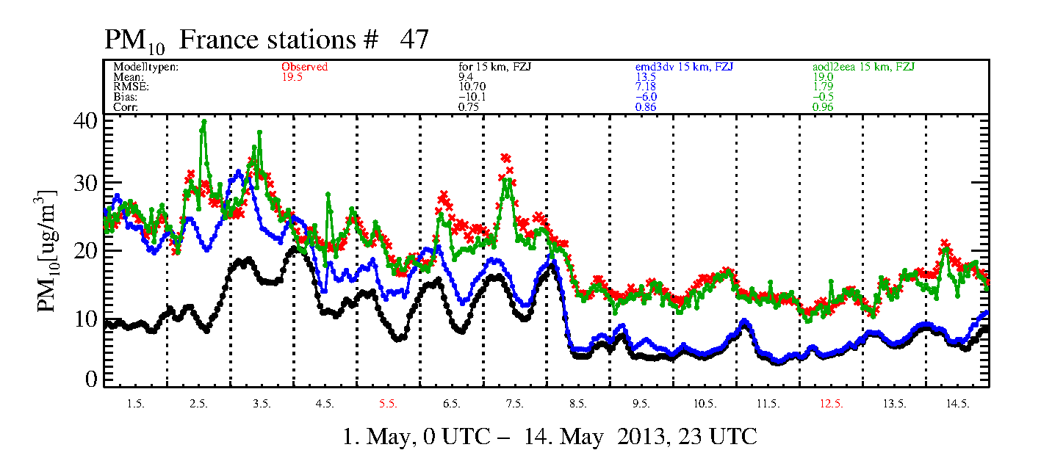
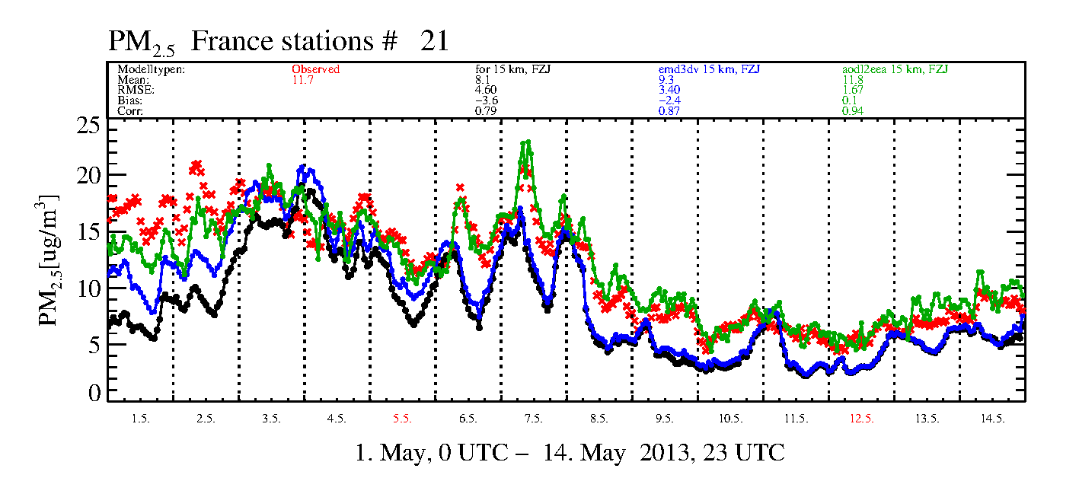
CAMS assimilation over Europe
On the benefit of assimilating upper-air observations for surface products: effect of assimilating MODIS AOD on PM surface analyses with EURAD-IM (RIUUK)
Germany
PM10
PM2.5
France
Averaged PM time-series for March 1st to 15th, 2013.
Without assimilation Assim MODIS_AOD
Assim MODIS_AOD+EEA_PM Reference observations
Friese, Elbern (RIUUK)

Slide 19
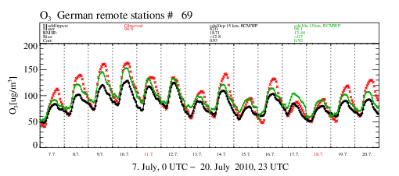
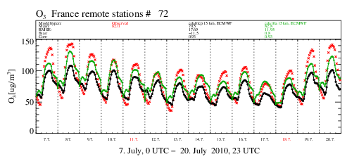
CAMS assimilation over Europe
On the benefit of initializing forecasts by analyses: effect on ozone forecasts with EURAD_IM (RIUUK)
Ozone concentrations
at background AIRBASE
measurement sites
from 7th to 20th of July 2010.
Germany
Without assimilation
Initialized by analysis (every-24h)
Reference observations
France
(The analysis is the result of assimilation in EURAD-IM of surface and satellite observations)
Friese, Elbern (RIUUK)

Slide 20
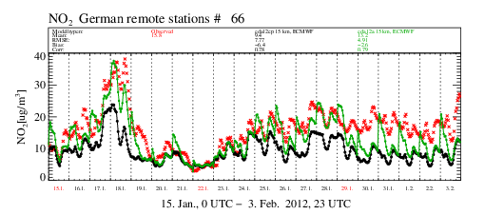
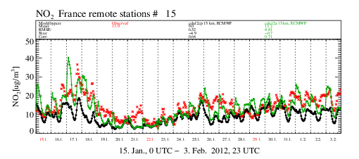
CAMS assimilation over Europe
On the benefit of initializing forecasts by analyses: effect on NO2 forecasts with EURAD_IM (RIUUK)
NO₂ concentrations
at background AIRBASE
measurement sites
from 15th of January
to 3rd of February 2012.
Germany
Without assimilation
Initialized by analysis (every-24h)
Reference observations
France
(The analysis is the result of assimilation in EURAD-IM of surface and satellite observations)
Friese, Elbern (RIUUK)

Slide 21
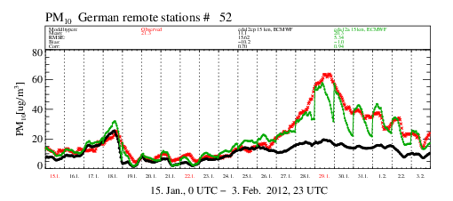
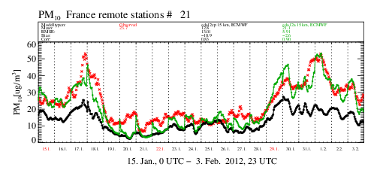
CAMS assimilation over Europe
On the benefit of initializing forecasts by analyses: effect on PM forecasts with EURAD_IM (RIUUK)
PM10 concentrations
at background AIRBASE
measurement sites
from 15th of January
to 3rd of February 2012.
Germany
Without assimilation
Initialized by analysis
Reference observations
France
(The analysis is the result of assimilation in EURAD-IM of surface and satellite observations)
Friese, Elbern (RIUUK)

Slide 22
Conclusion
Surface observations are a key component of the CAMS Regional production over Europe, both for assimilation and for evaluation of the products,
Objective classification of surface stations is needed to select the most representative measurements for our purpose; revision and updates of the classification are on-going,
Results from the different models suggest (depending on the assimilation configuration, however):
  A positive impact of analyses on the successive forecasts of ozone, longer than for NO2 and for PM,
  Potential benefits of the assimilation of PM10 on PM2.5 analyses,
  Slight impact of the assimilation of ozone on other species,
  A benefit of the assimilation of MODIS AOD on PM surface analyses, as a complement of the assimilation of PM surface observations.

Slide 23
Perspectives
Analyses at upper-levels will be developed from 2017,
3 new models (AQUM, DEHM, GEM-AQ) will develop and evaluate their own assimilation system in 2017,
The assimilation of upper-air observations is a mid-term perspective for many models: assimilation of aerosol profiles (lidars) and satellite optical depth (MODIS, Metop/PMAP, Sentinel-3, etc),
Potential for assimilation of reactive gases (ozone, NO2, SO2, HCHO, CHOCHO) over Europe from the upcoming Sentinels :
  Sentinel-5 (& -5P): polar-orbiting, UV-NIR-SWIR hyperspectral,
  Sentinel-4: geostationary (onboard METEOSAT 3rd Generation), UV-NIR hyperspectral.

