Slide 1

Rapid Update of Anthropogenic NO_{x} Emissions with Fused Satellite and Ground Observations
(Photo credit: action.earthday.net)
Daniel Tong
NOAA Air Resources Lab & George Mason University
Li Pan^{1,2}, Lok Lamsal³, Pius Lee¹, Youhua Tang^{1,3}, Hyuncheol Kim^{1,2}, Jeffrey McQueen¹, Jianping Huang¹, Hochun Huang¹, Shobha Kondragunta¹, and Ivanka Stajner¹
1 – NOAA; 2 – UMD; 3 - NASA
January 9, 2017

Slide 2
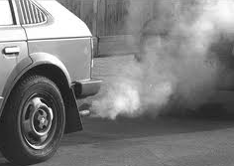







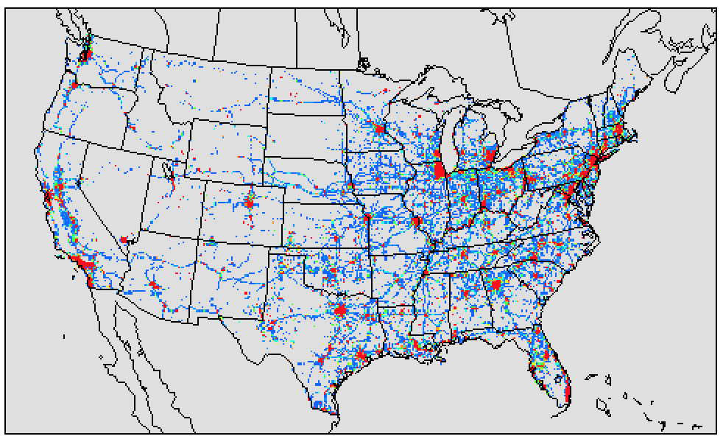
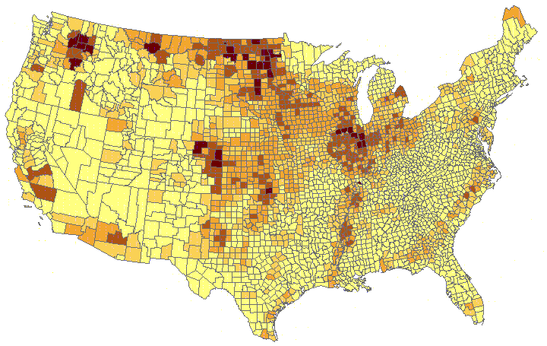
Emission Modeling
Air Quality Forecast
Real World Emissions
Meteorology Forecast
Emission Forecast
Model-ready Emission
Emission Inventories

Slide 3
Emission for Air Quality Forecasting
Time lag is a major obstacle for AQF.
Forecasters want: emissions for tomorrow;
Data availability: emission data 4+ years old.
How to overcome this problem?
NAQFC Practices:
Option 1, no update (2007-2011);
Option 2, use EPA projection (2012-2016).
Option 3, emission data assimilation.

Slide 4
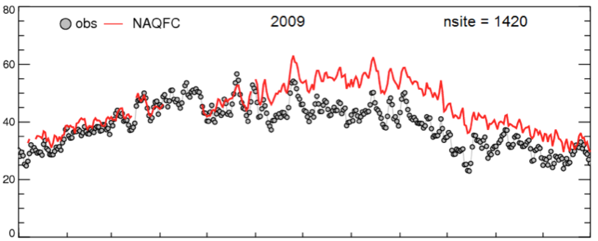
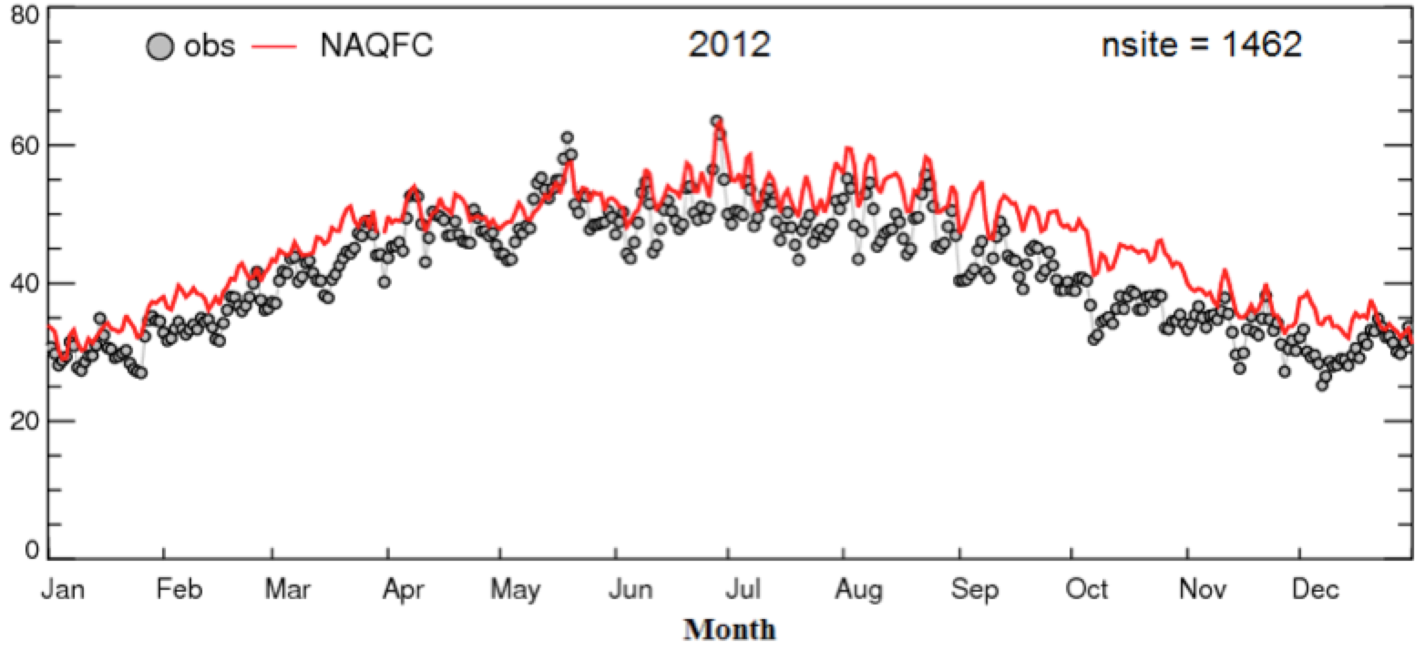
NAQFC Ozone Forecast
2009:
NEI Only
(NEI: National Emission Inventory)
Peak 8h Ozone (ppb)
2012:
NEI with Projection
(Tong et al., 2015)

Slide 5
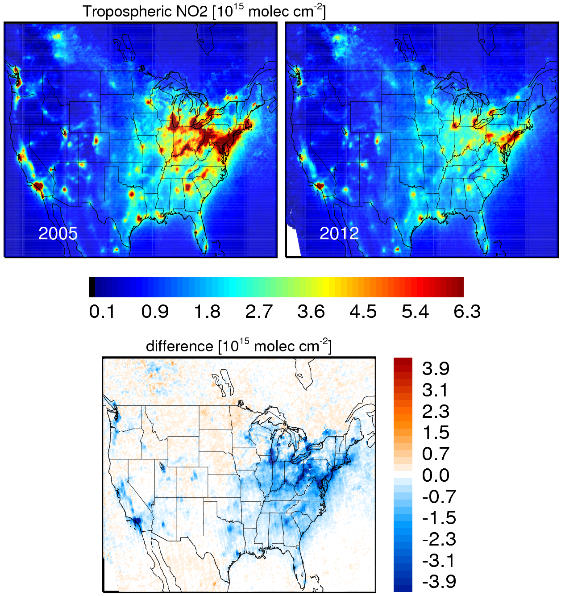
The 2008 Global Economic Recession
Cause: Housing bubble in 2007 followed by a subprime mortgage crisis in 2008;
NO₂ Changes from OMI
Impacts:
- Unemployment rate: 10.1% in 2009.
- Poverty rate: 16%;
- GDP: contract by 5.1%;
2005
2012
Worst economic recession since the Great Depression
Difference
Question: Was the change reflected in NAQFC emissions?

Slide 6
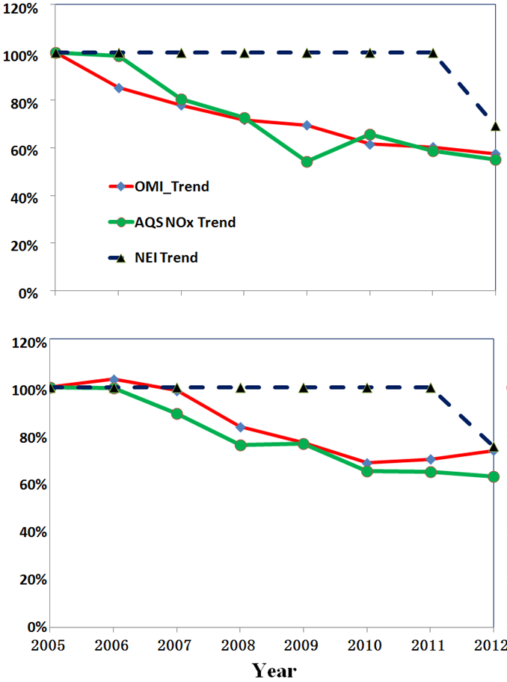
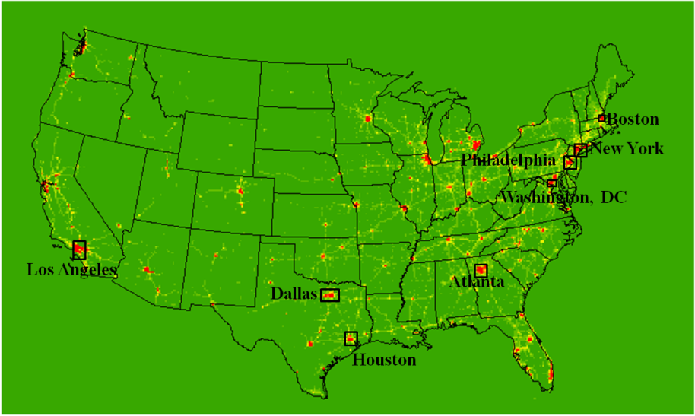
NO_{x} Trends from OMI, AQS and NAQFC
Comparison to 2005 values
Atlanta
Philadelphia
OMI (Space)
AQS (Ground)
NAQFC (Model)
Philadelphia
OMI = Ozone Monitoring Instrument on NASA’s Aura Satellite
AQS = Air Quality System
Atlanta

Slide 7
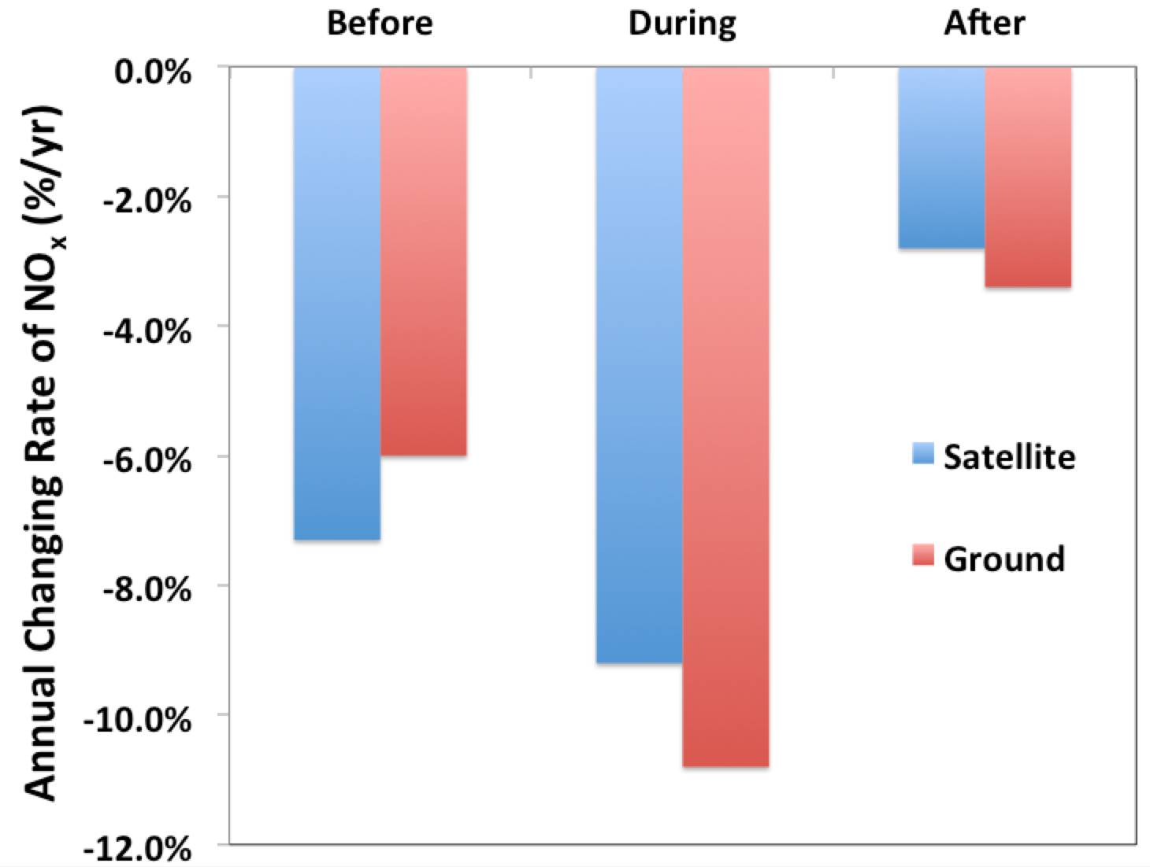
NO_{x} Trends during the Great Recession
Consistent trends from OMI and AQS;
Faster NOx reduction during the Recession and slower after that.
(Tong et al., 2015)

Slide 8
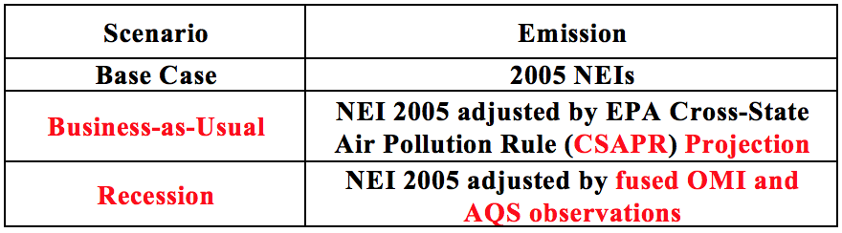
Recession Impact on Surface Ozone
To what extent has the 2008 economic recession affected US air quality?
2011 Meteorology;
NOAA NAQFC testbed (revised CMAQ 4.7).

Slide 9
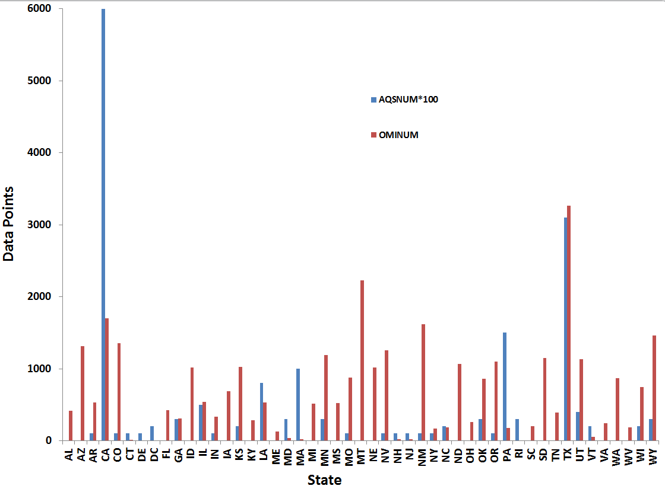

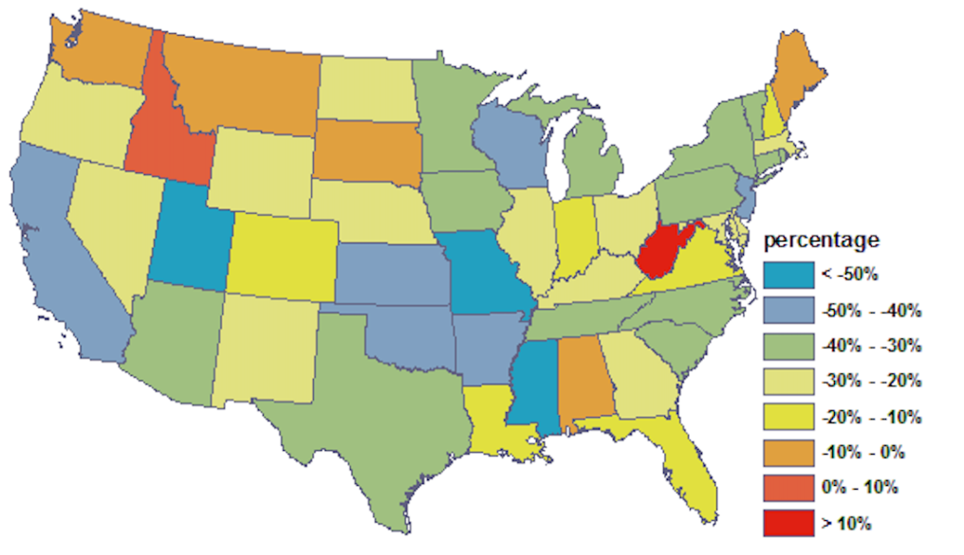
“Recession” Emissions
Use fused satellite (OMI) and ground (AQS) data to obtain realistic emission changes
Fusing AQS & OMI
State-level Changing Factors
Comparison of OMI and AQS (x100) Samples
(Source: Tong et al., 2015)
(2005 to 2012)
9

Slide 10
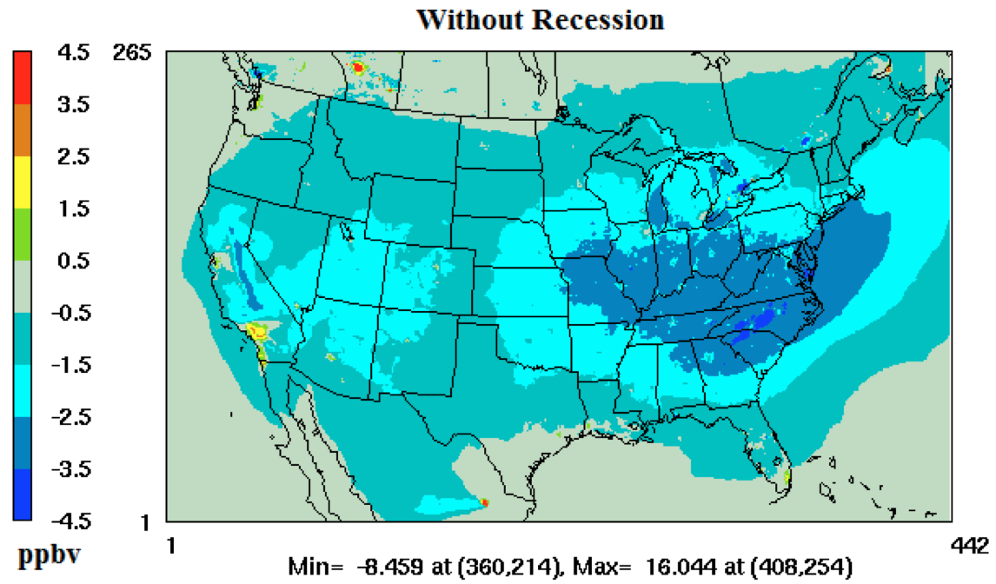
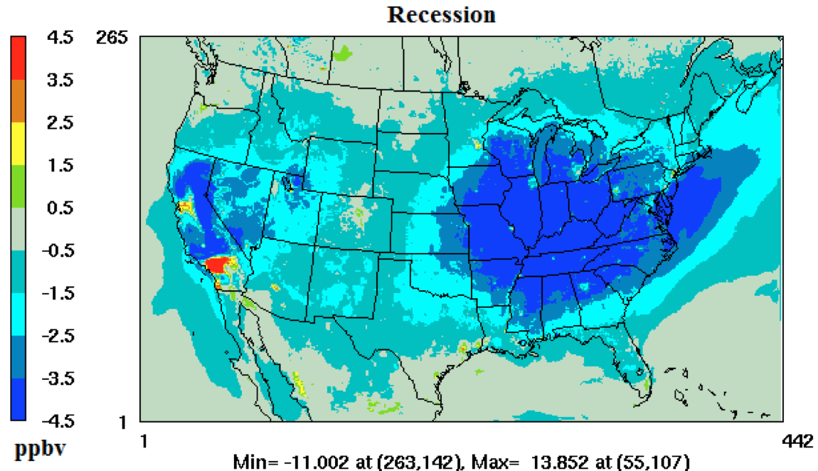
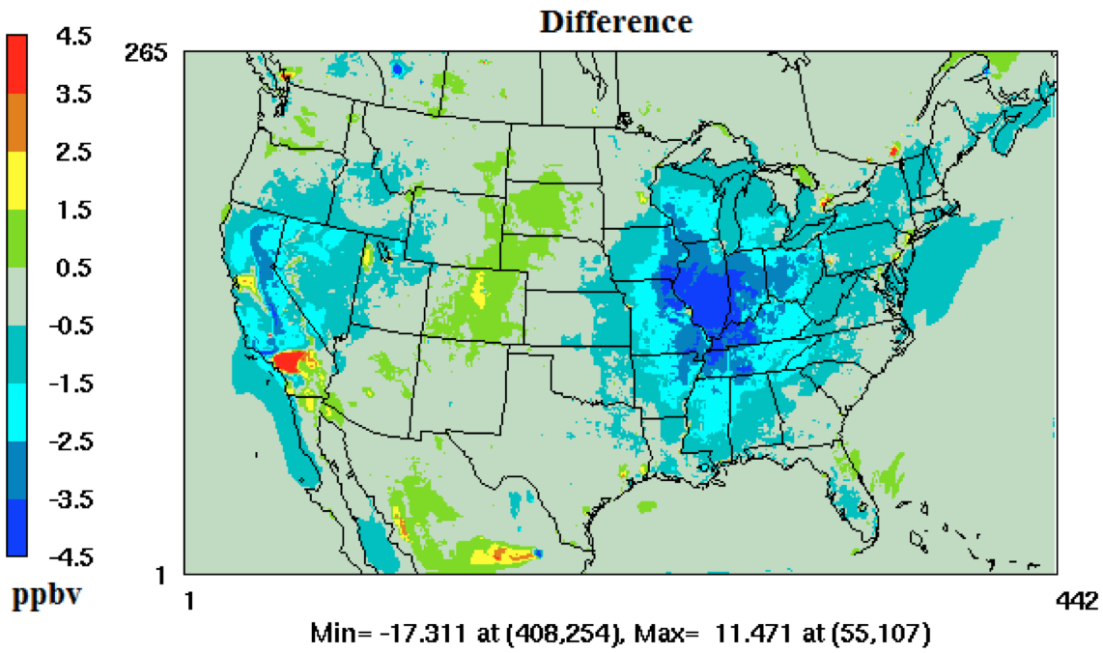
O₃ Changes with/without Recession (2005 – 2011)
Without Recession
Recession
(Tong et al., 2015)

Slide 11
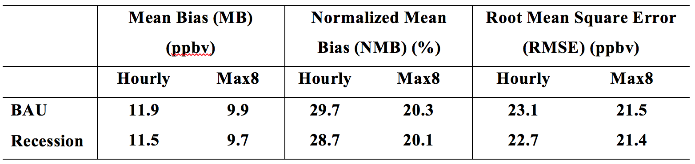
Will more “realistic” emissions produce better O₃ prediction?
Comparison between model and observations
BAU – Emission projection
Recession – Emission adjusted with fused obs.

Slide 12
Research to Operation with NOAA NAQFC
An Experiment in Summer 2016
Can the observation-based emission adjustment be used to improve real-time forecasting?
NAQFC Setup: CMAQ 5.0.2, NEI 2011, NAM;
NO₂ observations: AQS, GOME2, OMI (2011 – 2014);
Same emission adjustment algorithm;
Period: July – August 2016;
Evaluation conducted by early-adopter users;

Slide 13
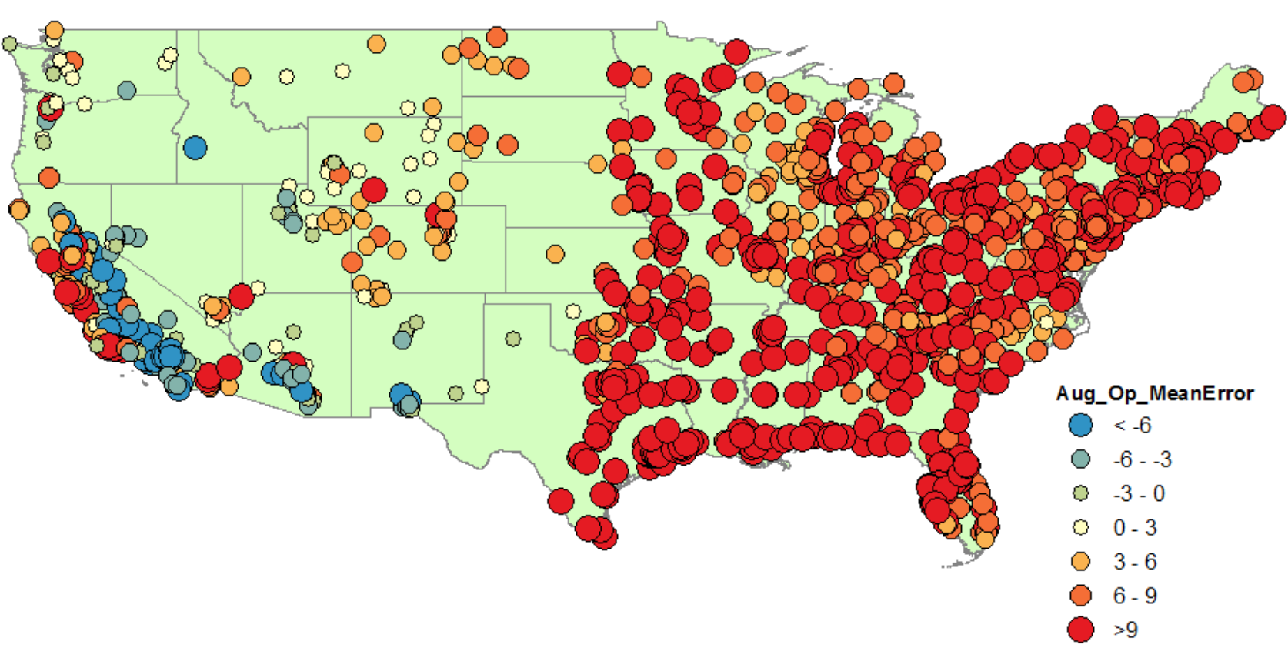
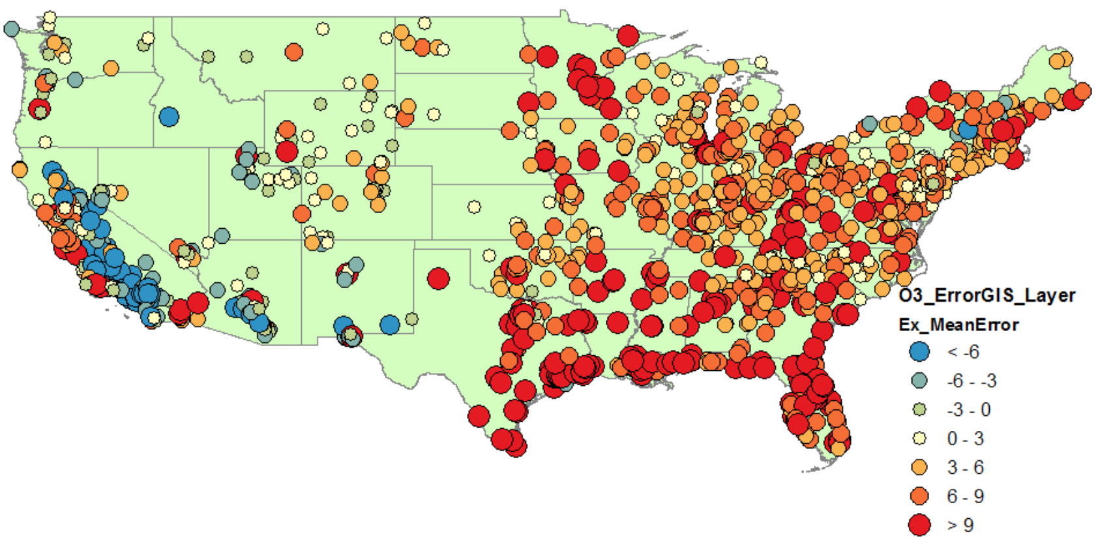
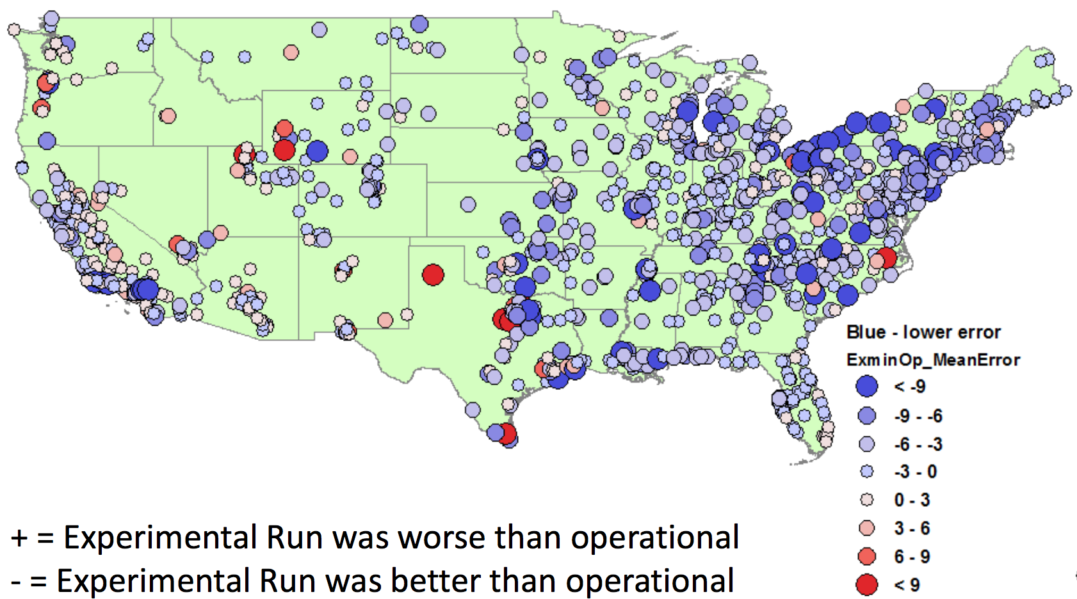
Peak 8h O₃: Experimental vs Operational
Operational
Experimental
Difference in Peak 8h O₃
(Courtesy: Joel Dreessen,
Maryland Dept. of Env.)

Slide 14
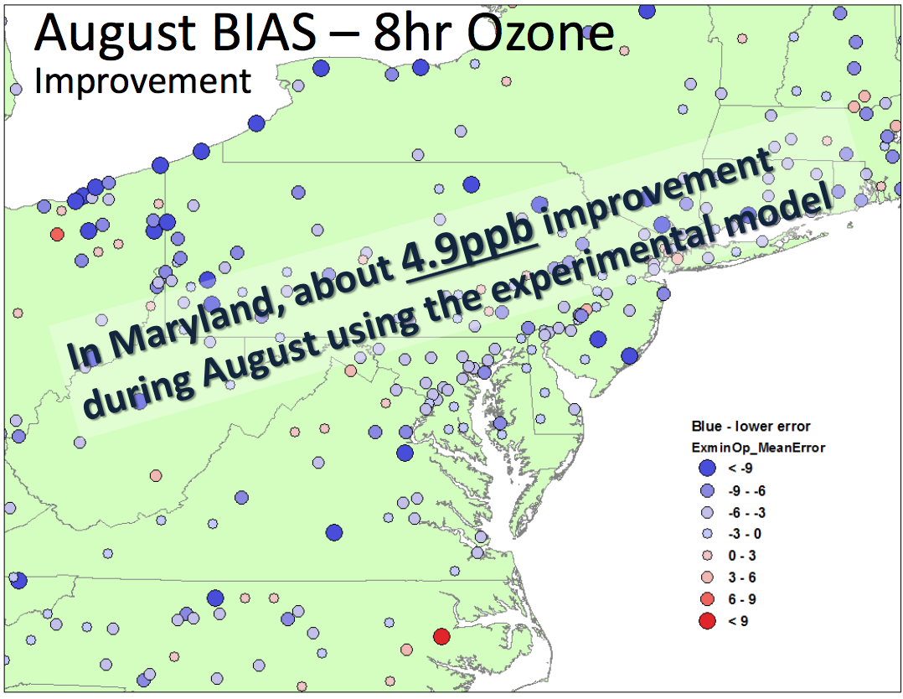
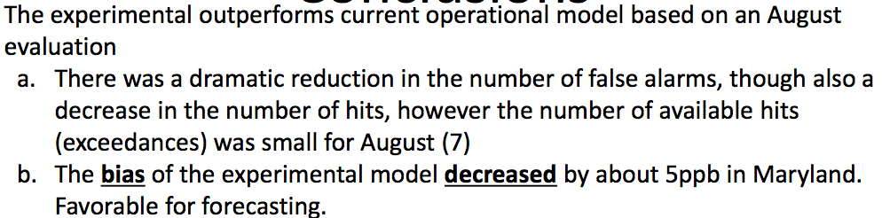
O₃ Forecast Over Maryland
(Courtesy: Joel Dreessen, Maryland Dept. of Env.)

Slide 15
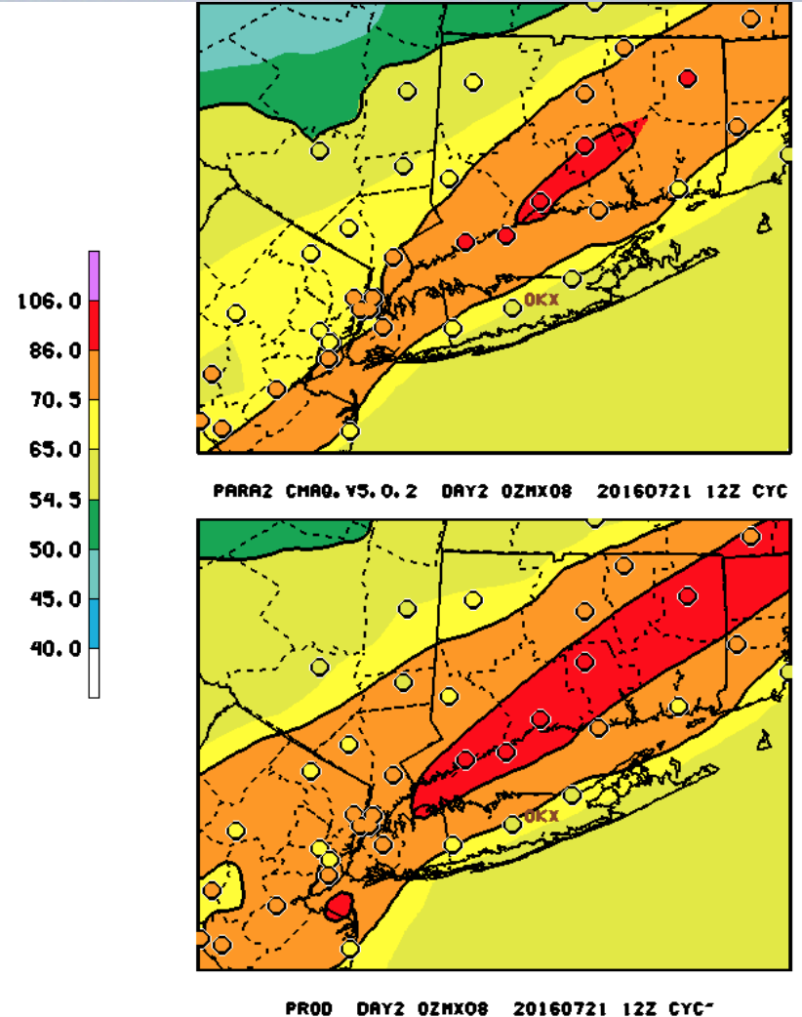
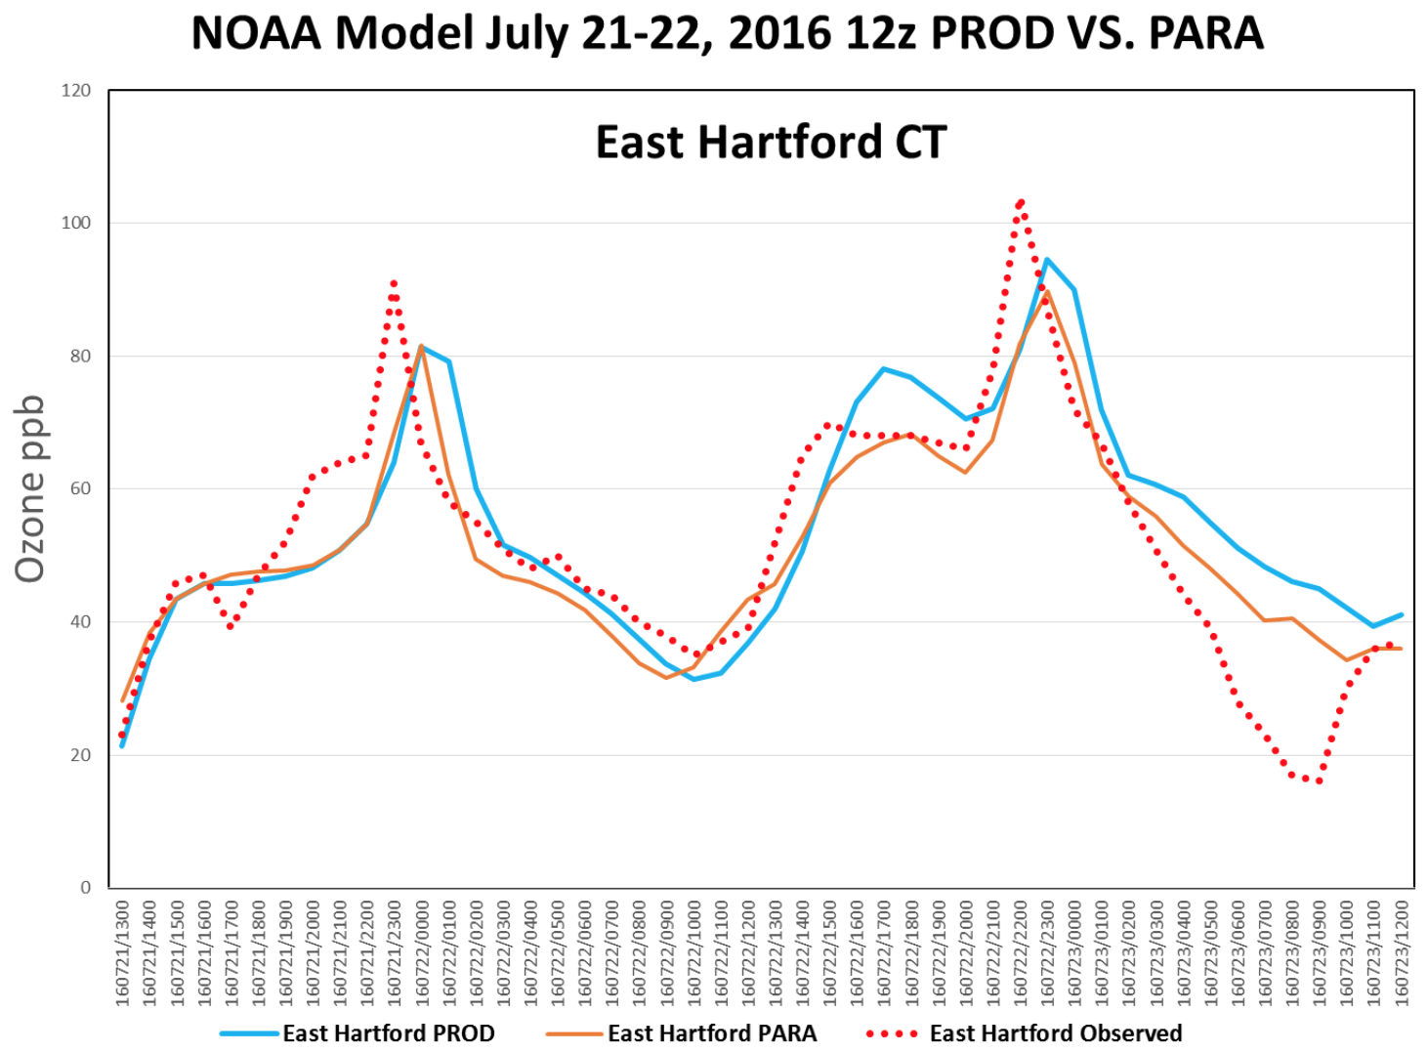
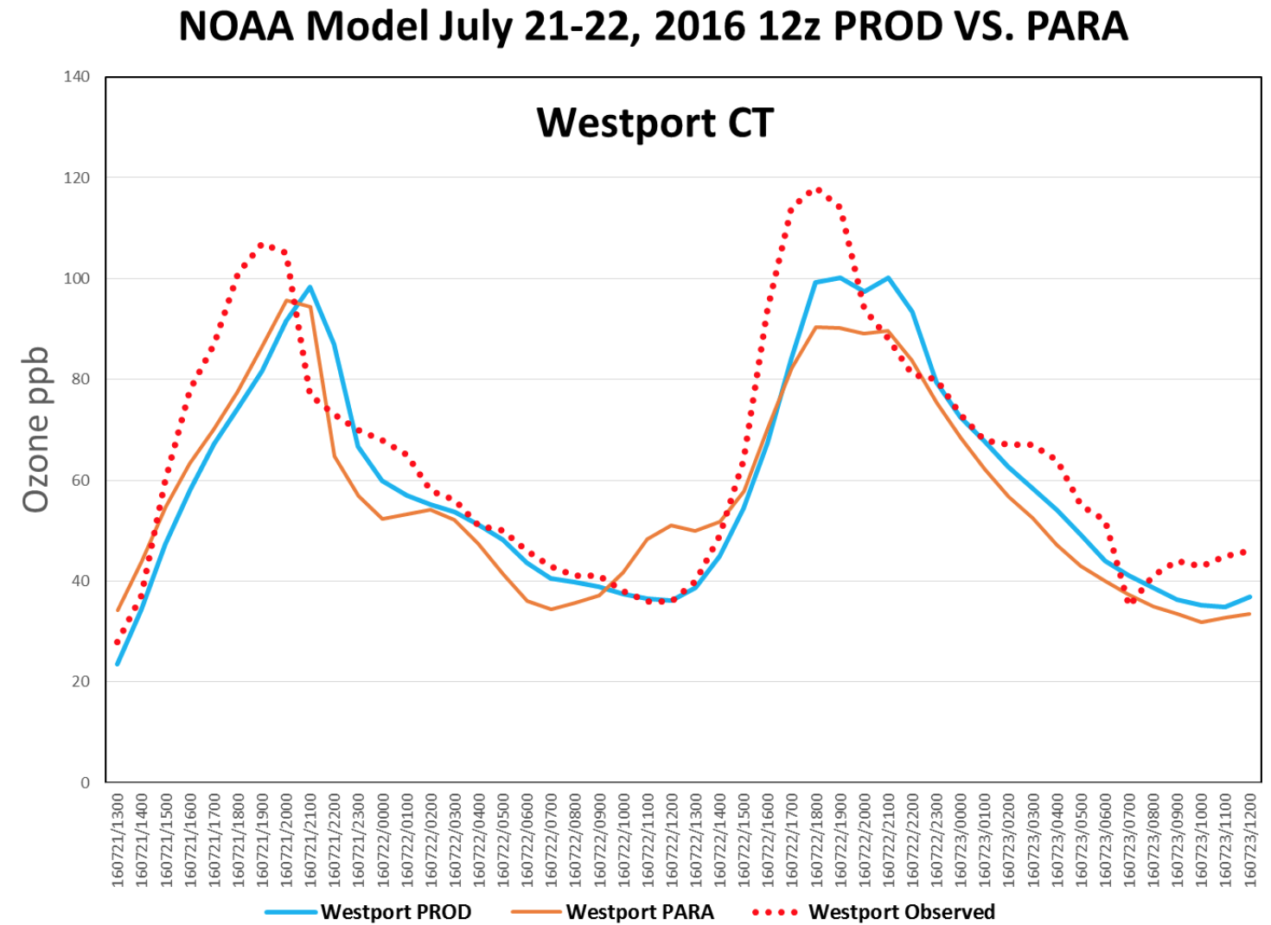
O₃ Forecast Over New England
(Courtesy: Michael Geigert, Connecticut DEEP)

Slide 16
Summary
Development of emission data assimilation capability;
Impact of socioeconomic events on air quality;
Initial application to NAQFC showing promises;
More challenging to forecast peak ozone with decreased emissions in North America ;
Reference:
Tong, D., L. Pan, W. Chen, L. Lamsal, P. Lee, Y. Tang, H. Kim, S. Kondragunta, I. Stajner, 2016. Impact of the 2008 Global Recession on air quality over the United States: Implications for surface ozone levels from changes in NO_{x} emissions. Geophys. Res. Let., 43(17), 9280-9288.
Tong, D., L. Lamsal, L. Pan, C. Ding, H. Kim, P. Lee, T. Chai, and K.E. Pickering, and I. Stajner, 2014. Long-term NO_{x} trends over large cities in the United States during the 2008 Recession: Intercomparison of satellite retrievals, ground observations, and emission inventories, Atmos. Environ., 107, 70-84.

Slide 17
Acknowledgment
NOAA National Air Quality Forecast Capability.
Funding support from NOAA Weather and Air Quality Program and NASA Health and Air Quality Applied Science Team.
Data producers of AQS, OMI and GOME2 NO₂ products.

