Slide 1
Update on operational air quality predictions for the United States: new predictions of fine particulate matter (PM2.5)
Ivanka Stajner¹, Jeff McQueen¹, Pius Lee², Ariel Stein², Phil Dickerson³, Sikchya Upadhayay^{1,4}
NOAA NWS (2) NOAA ARL (3) EPA
(4) Syneren Technologies
with contributions from the entire NAQFC Implementation Team
and global aerosol and atmospheric composition prediction developers
8th International Workshop on Air Quality Forecasting Research, Toronto January 10, 2017

Slide 2
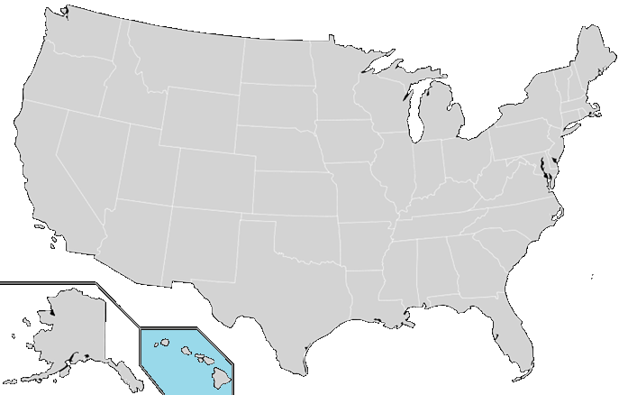
National Air Quality Forecast Capability status in January 2017
Improving the basis for air quality alerts
Providing air quality information for people at risk
Prediction Capabilities:
Operations:
Ozone nationwide
Smoke nationwide
Dust over CONUS
Fine particulate matter (PM2.5) predictions
Testing of improvements:
Ozone
Smoke
PM2.5
2004: ozone
2007: ozone and smoke
2012: dust
2016: PM2.5
2005: ozone
2009: smoke
2010: ozone
2016: PM2.5
2010: ozone & smoke
2016: PM2.5

Slide 3
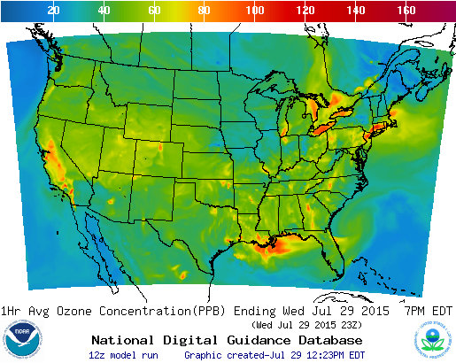
Ozone predictions
Operational predictions at http://airquality.weather.gov
Model: Linked numerical prediction system
Operationally integrated on NCEP’s supercomputer
NOAA/EPA Community Multiscale Air Quality (CMAQ) model
NOAA/NCEP North American Mesoscale (NAM) numerical weather prediction
Observational Input:
NWS compilation weather observations
EPA emissions inventory
Gridded forecast guidance products
On NWS servers: airquality.weather.gov and ftp-servers (12km resolution, hourly for 48 hours)
On EPA servers
Updated 2x daily
Verification basis, near-real time: Ground-level AIRNow observations of surface ozone
Customer outreach/feedback
State & Local AQ forecasters coordinated with EPA
Public and Private Sector AQ constituents
CONUS, wrt 70 ppb Threshold
Operational
Maintaining prediction accuracy as the warning threshold is lowered (now 70 ppb) and emissions of pollutants are changing

Slide 4
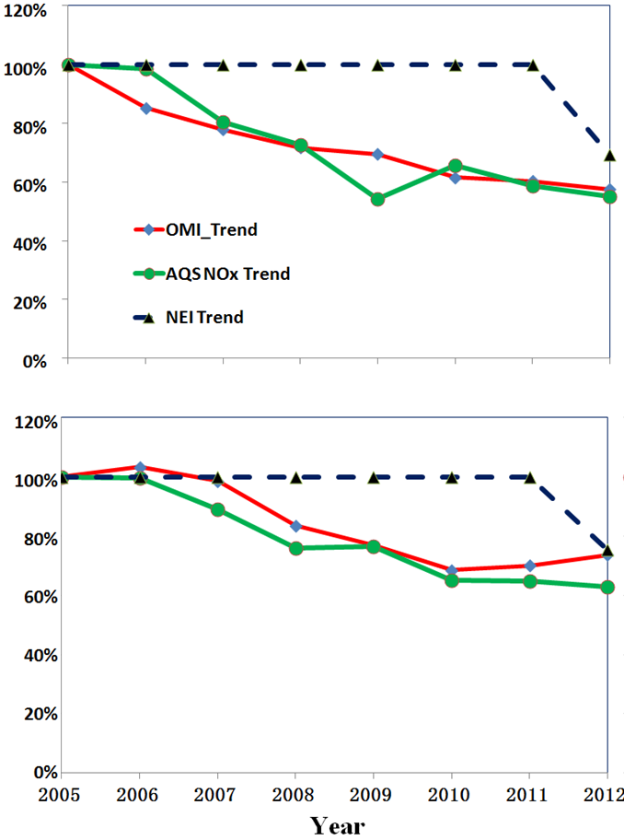
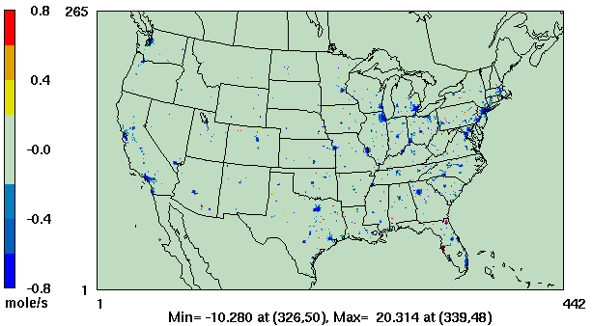
NOx changes
Comparison to 2005 values
Atlanta
OMI NO₂
AQS NO_{X}
NAQFC NO_{X} Emissions
Philadelphia
Comparison to 2005 values
Atlanta
Philadelphia
OMI = Ozone monitoring Instrument on NASA’s Aura Satellite
AQS = Air Quality System
Difference between NOx emissions used in 2012 and 2011 (blue indicates decrease in 2012).
Mobile and nonroad emissions are based on projections for 2012.
Further updates are being tested (Tong et al. Impact of the 2008 Global Recession on air quality over the US: Implications for surface ozone levels from changes in NOx emissions, GRL, 2016).
Comparison of projected emissions with surface and satellite observations shows that projected reductions from 2005 to 2012 are similar to observed (Tong et. al. Long-term NOx trends over large cities in US, Atm. Env. 2015).

Slide 5
Map service
New product dissemination option in testing
Example of ozone predictions in web enabled map service currently in testing

Slide 6
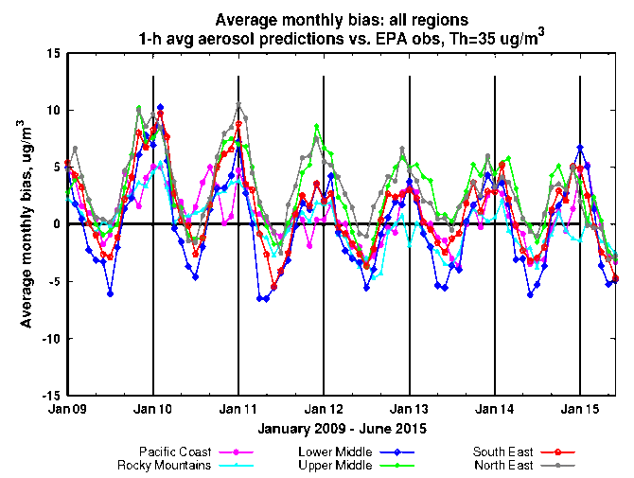
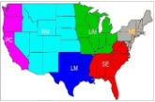
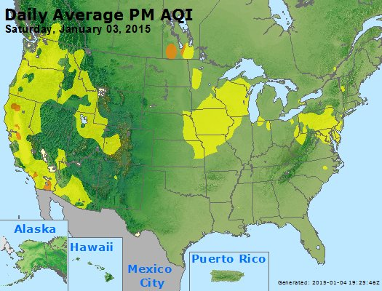
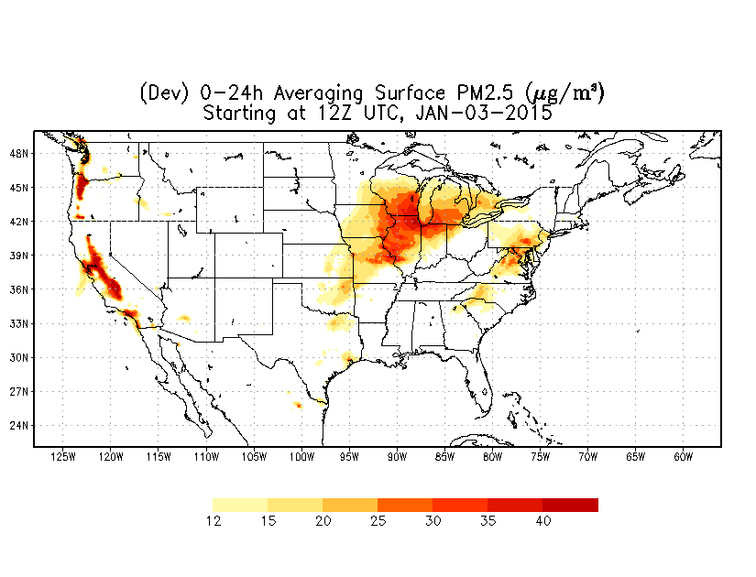
PM2.5 predictions
Predictions for 48h at 12km resolution over CONUS
From NEI sources only before summer 2014
CMAQ:
CB05 gases, AERO-4 aerosols
Sea salt emissions
Wildfire and dust emissions and suppression of soil emissions from snow/ice covered terrain included since summer 2014 (Lee et al., Weather and Forecasting 2016)
Model predictions exhibit seasonal prediction biases:
overestimate in the winter; underestimate in summer
Forecast challenges
Improving sources for wildfire smoke and dust
Chemical mechanisms eg. SOA
Meteorology eg. PBL height
Chemical boundary conditions/trans-boundary inputs
NAQFC PM2.5 test predictions

Slide 7
CMAQ system update in February 2016
Public release of raw model predictions and bias-corrected PM2.5 predictions
Lateral boundary conditions from global dust predictions
Increased vertical resolution from 22 to 35 layers in CMAQ v4.6 (to better align CMAQ and global model levels)
Analog forecast technique for PM2.5 bias correction

Slide 8
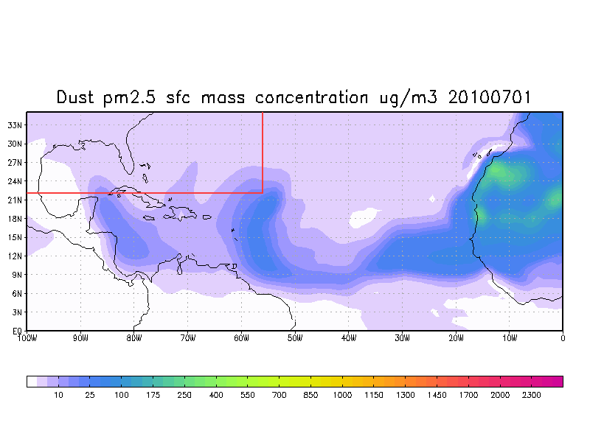
NGAC simulation of Saharan dust layer transport
Goddard Chemistry Aerosol Radiation and Transport (GOCART) model is the aerosol component of NGAC
NGAC is a global in-line aerosol forecast system (GFS-GOCART) that produces 120-hour global dust forecasts
Global-regional linkage: NGAC provides dust lateral boundary conditions for CMAQ
Lu et al., The implementation of NEMS GFS Aerosol Component (NGAC) Version 1.0 for global dust forecasting at NOAA/NCEP, Geosci. Model Dev., 2016.

Slide 9
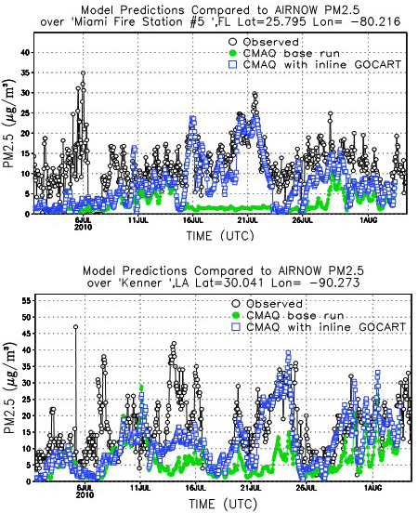
Impact of NGAC LBCs on CMAQ predictions of PM2.5
 | CMAQ with default LBCs | CMAQ with NGAC LBCs
Whole domain July 1 – Aug 3 | MB= -2.82 Y=1.627+0.583*X R=0.42 | MB= -0.88 Y=3.365+0.600*X R=0.44
South of 38°N, East of -105°W July 1 – Aug 3 | MB= -4.54 Y=2.169+.442*X R=0.37 | MB= -1.76 Y=2.770+.617*X R=0.41
Whole domain July 18– July 30 | MB= -2.79 Y=2.059+0.520*X R=0.31 | MB= -0.33 Y=2.584+0.795*X R=0.37
South of 38°N, East of -105°W July 18– July 30 | MB= -4.79 Y=2.804+.342*X R=0.27 | MB= -0.46 Y=-0.415+.980*X R=0.41
Observed
CMAQ default
CMAQ with NGAC LBCs
Observed
CMAQ default
CMAQ with NGAC LBCs
Time series of PM2.5 from EPA AIRNOW observations (black dot), CMAQ baseline run using static Lateral Boundary Conditions (LBCs) (green dot) and CMAQ experimental run using NGAC LBCs (blue square) at Miami, FL (top panel) and Kenner, LA (bottom panel).
Credit: Youhua Tang

Slide 10
Bias correction for PM2.5 predictions
Quality control of the observations is essential
Five different post-processing techniques were tested
Raw: Hourly AIRNow data available in real-time
PERS: Persistence forecast
7-day: 7-day running mean subtraction
KF: Kalman-filter approach
ANKF: Analog forecast technique followed by Kalman filter approach
AN: Analog Forecast technique
KF-AN: Kalman-filter approach followed by Analog forecast technique
Unsystematic component of the RMSE (top panel) and systematic component of RMSE (bottom panel) using hourly values for the month of November evaluated at the 518 AIRNow PM2.5 sites.
I. Djalalova, L. Delle Monache, and J. Wilczak: PM2.5 analog forecast and Kalman filter post-processing for the Community Multiscale Air Quality (CMAQ) model, Atmospheric Environment, 2015.

Slide 11
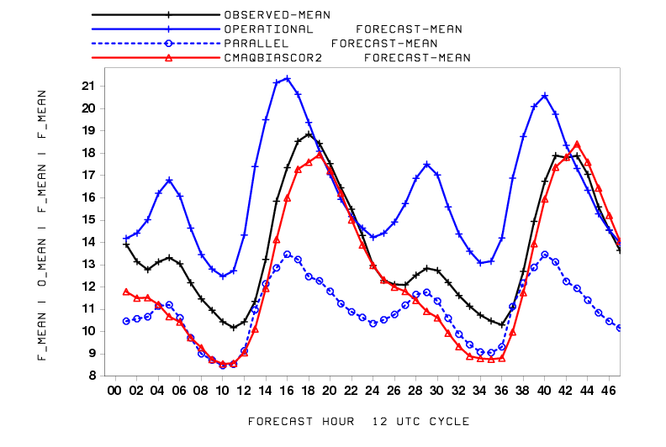
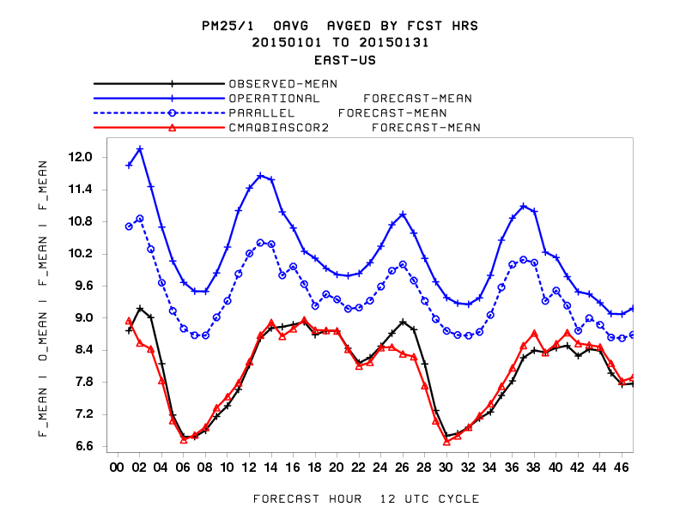
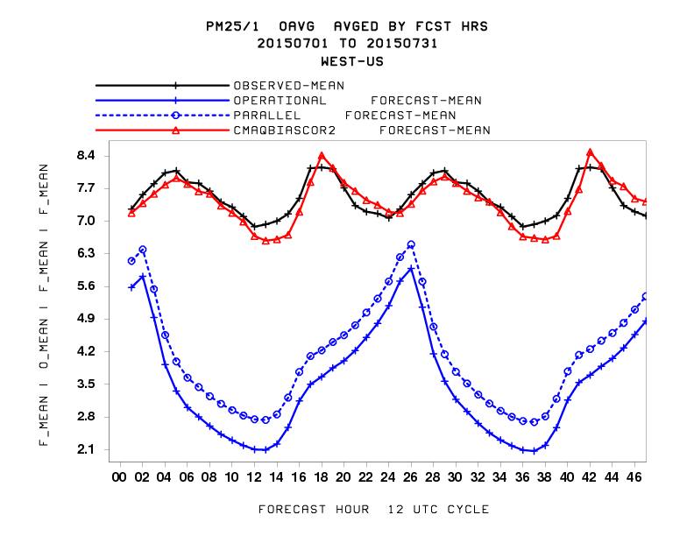
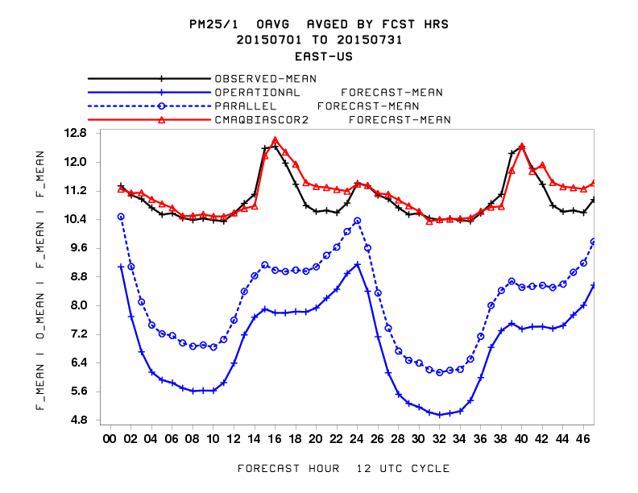
Raw and bias-corrected PM2.5 predictions
Winter
(Jan 2015)
Regional mean for each of 48 prediction hours
Western US
Eastern US
Observations
Previous model
Current model
Bias correction of current model
Summer
(July 2015)
Huang et al., Improving NOAA NAQFC PM2.5 predictions with a bias correction approach, Weather and Forecasting, 2016.

Slide 12
Testing of the CMAQ system updates proposed for FY 17
Update to CMAQ v5.0.2
Better representation of wildfire smoke emissions (updated BlueSky system and 24-hour “analysis cycle” to include emissions when they were observed)
Updated mobile NOx emissions: NEI 2005 projected to 2011 using Cross-State Air Pollution Rule (CSAPR) projection for US sources and then adjusted further to the forecast year using trends from surface and satellite observations from 2011 to 2014
Update of bias correction method to KFAN
Use updated NAM v4 meteorology

Slide 13
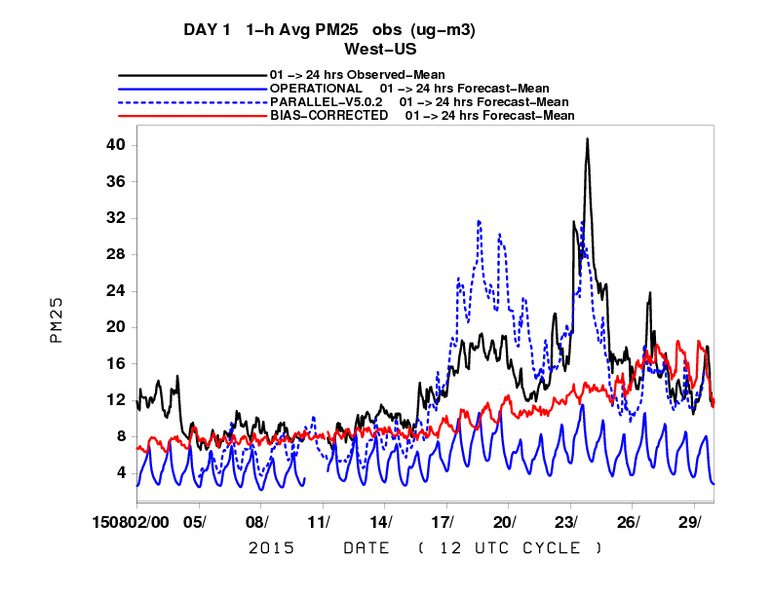
Representation of wildfires
Better representation of wildfire smoke emissions based on detections of wildfire locations from satellite imagery, BlueSky system emissions, included over previous 24 hours when fires were detected and projected with reduced intensity into the 48 hour forecast period
Daily mean for Western US
Observations
Current model
New model
Bias correction of current model
PM2.5 in August 2015

Slide 14
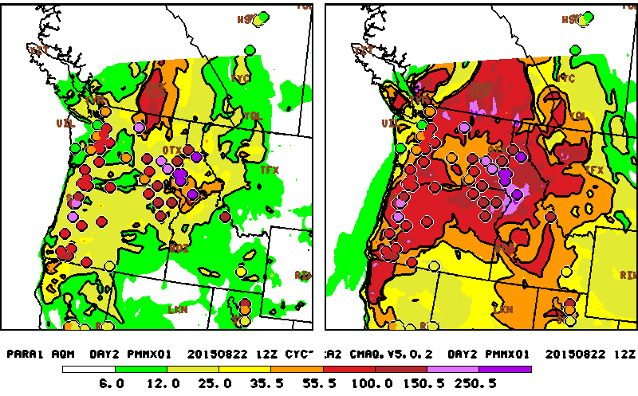
Representation of wildfires – NW U.S. example on August 23, 2015
Wildfires are strongly impacting air quality in the region
Observed daily maximum of hourly PM2.5 exceeds 55 µg/m³and even 100 µg/m³
Operational system predicts values below 25 µg/m³ for many of these monitors
Updated system in testing predicts values much closer observed

Slide 15
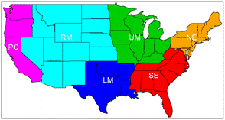
24 hour average PM2.5 concentrations
regional statistics for August 2015
24hour average PM2.5 Concentration for PROD vs. Aug 502EMI_ana-assisted-Forecast
[µg/m³] | Sample size |  | Obs. | Mean | Bias | RMSE | Corr. coeff.
CONUS | 13100 | PROD | 10.0 | 6.78 | -3.22 | 10.12 | 0.34
 |  | 502 test |  | 9.08 | -0.92 | 8.40 | 0.66
PC | 3000 | PROD | 14.0 | 5.67 | -8.33 | 14.98 | 0.57
 |  | 502 test |  | 12.22 | -1.78 | 12.14 | 0.63
RM | 1235 | PROD | 12.9 | 5.56 | -7.46 | 19.46 | 0.61
 |  | 502 test |  | 12.91 | 0.01 | 15.77 | 0.70
NE | 1850 | PROD | 7.8 | 7.91 | 0.11 | 3.78 | 0.56
 |  | 502 test |  | 7.74 | -0.06 | 3.87 | 0.52
UM | 2400 | PROD | 7.7 | 8.08 | 0.38 | 4.02 | 0.54
 |  | 502 test |  | 8.05 | 0.35 | 3.98 | 0.53
SE | 2050 | PROD | 9.2 | 6.85 | -2.35 | 5.35 | 0.29
 |  | 502 test |  | 6.72 | -2.48 | 4.61 | 0.38
LM | 1550 | PROD | 10.2 | 6.70 | -3.30 | 5.79 | 0.25
 |  | 502 test |  | 7.70 | -2.30 | 5.28 | 0.31
CONUS-wide statistics are improved.
Largest improvements are for wildfire-impacted western US regions

Slide 16
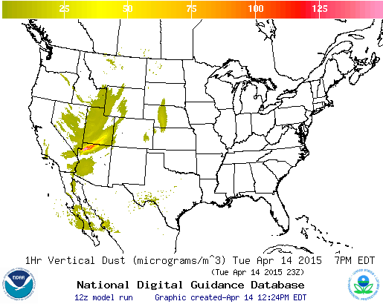
CONUS dust predictions
Operational Predictions at http://airquality.weather.gov/
Standalone prediction of airborne dust from dust storms:
Wind-driven dust emitted where surface winds exceed thresholds over source regions
Source regions with emission potential estimated from MODIS deep blue climatology for 2003-2006 (Ginoux et. al. 2010).
Emissions modulated by real-time soil moisture.
HYSPLIT model for transport, dispersion and deposition (Draxler et al., JGR, 2010)
Wet deposition updates in July 2013
Developed satellite product for verification (Ciren et.al., JGR 2014)

Slide 17
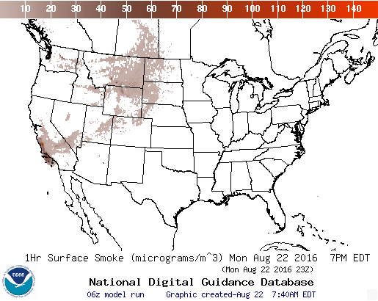
Smoke predictions
Operational Predictions at http://airquality.weather.gov/
Smoke predictions for CONUS (continental US), Alaska and Hawaii
NESDIS provides wildfire locations detected from satellite imagery
Bluesky provides emissions estimates
HYSPLIT model for transport, dispersion and deposition (Rolph et. al., W&F, 2009)
Increased plume rise, decreased wet deposition, changes in daily emissions cycling
Developed satellite product for verification (Kondragunta et.al. AMS 2008)
Implemented HYSPLIT version 7.4 (no impact on smoke predictions)
Testing updated BlueSky System v3.5.1 for smoke emissions (first BlueSky update since predictions became operational in 2007).
Testing predictions driven by newer parallel version of NAM meteorological predictions (NAM v4).
Testing ECCC sources for Canadian wildfires.

Slide 18
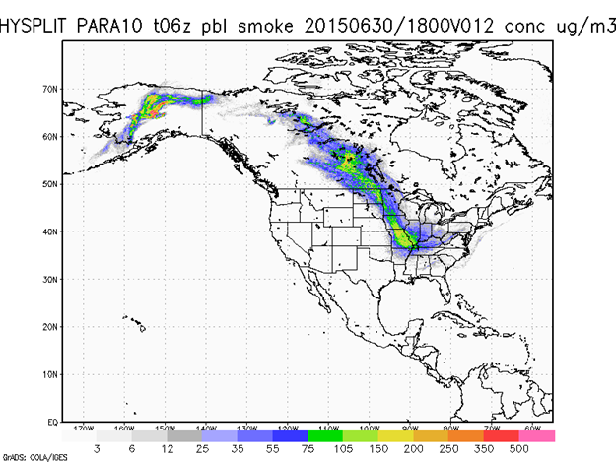
Testing of smoke dispersion with ECCC smoke emissions
Current Operational
With ECCC emissions for Canadian sources and new BlueSky for the US
Operational predictions use default quartz complex fuel load values for Canada and Alaska.
Test predictions with smoke emissions provided by ECCC for Canada and updated BlueSky for the US show impacts on smoke concentrations both near the sources and far downwind

Slide 19
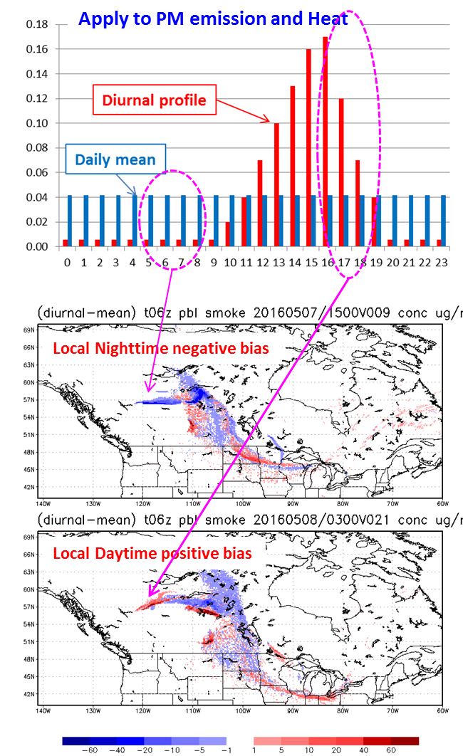
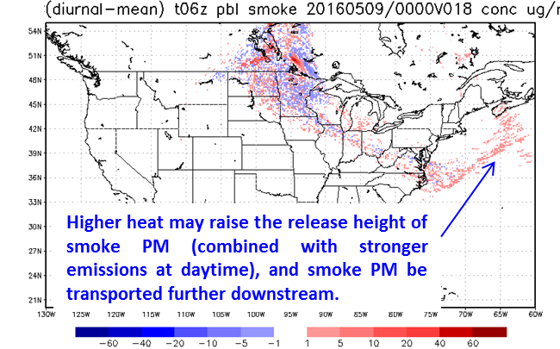
Impacts of diurnal variability
Canadian smoke fire emissions from Environment and Climate Change Canada (ECCC) “FireWork” are used
Comparison of temporally-resolved diurnal emissions profile (red bars) versus uniform daily emissions (blue bars)
Impacts on smoke predictions are seen locally and far downstream
Local suppression at night
Local enhancement during the day

Slide 20
Summary
US national AQ forecasting capability operational predictions:
Ozone nationwide; CMAQ with CB05 mechanism
PM2.5 - new since February 2016; CMAQ with NEI, wildfire and dust emissions, dust LBCs from global predictions
Smoke nationwide
Dust for CONUS
Current testing and plans to improve O3 and PM2.5 accuracy and utility:
Updating to newer CMAQ version 5.0.2
Updated wildfire smoke emissions (updated BlueSky system and Canadian sources)
Update NOx emissions using recent observed trends
Refinement of bias correction for PM2.5 using KFAN approach
Linkage with additional aerosols from global predictions
Extend predictions to 72 hours
Update display, dissemination and web presence
Finer resolution (longer term)

Slide 21
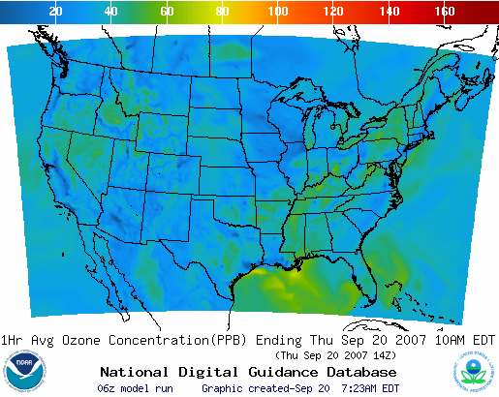
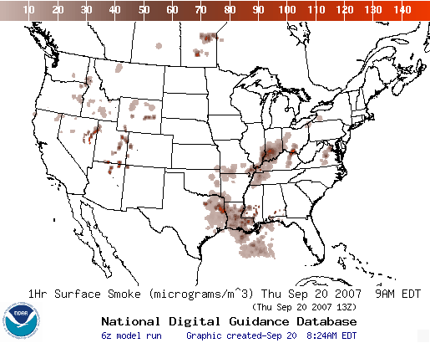
Operational AQ forecast guidance airquality.weather.gov
Ozone products Nationwide since 2010
Smoke Products Nationwide since 2010
Dust Products
Implemented 2012
Further information: https://www.weather.gov/sti/stimodeling_airquality

Slide 22
Acknowledgments: AQF implementation team members
Special thanks to previous NOAA and EPA team members who contributed to the system development
NOAA/NWS/OSTI Ivanka Stajner NAQFC Manager
NWS/AFSO Jannie Ferrell Outreach, Feedback
NWS/OD Cynthia Jones Data Communications
NWS/OSTI/MDL Marc Saccucci, Dev. Verification, NDGD Product Development
Dave Ruth
NWS/OSTI Sikchya Upadhayay Program Support
NESDIS/NCDC Alan Hall Product Archiving
NWS/NCEP
Jeff McQueen, Jianping Huang, Ho-Chun Huang AQF model interface development, testing, & integration
Jun Wang, *Sarah Lu Global dust aerosol and feedback testing
*Brad Ferrier, *Eric Rogers, NAM coordination
*Hui-Ya Chuang
Geoff Manikin Smoke and dust product testing and integration
Rebecca Cosgrove, Chris Magee NCO transition and systems testing
Mike Bodner, Andrew Orrison HPC coordination and AQF webdrawer
NOAA/OAR/ARL
Pius Lee, Daniel Tong, Tianfeng Chai CMAQ development, adaptation of AQ simulations for AQF
Li Pan, Hyun-Cheol Kim, Youhua Tang
Ariel Stein HYSPLIT adaptations
NESDIS/STAR Shobha Kondragunta Smoke and dust verification product development
NESDIS/OSDPD Liqun Ma, Mark Ruminski Production of smoke and dust verification products,
HMS product integration with smoke forecast tool
EPA/OAQPS partners:
Chet Wayland, Phil Dickerson, Brad Johns, John White AIRNow development, coordination with NAQFC
* Guest Contributors

Slide 23
Backup

Slide 24
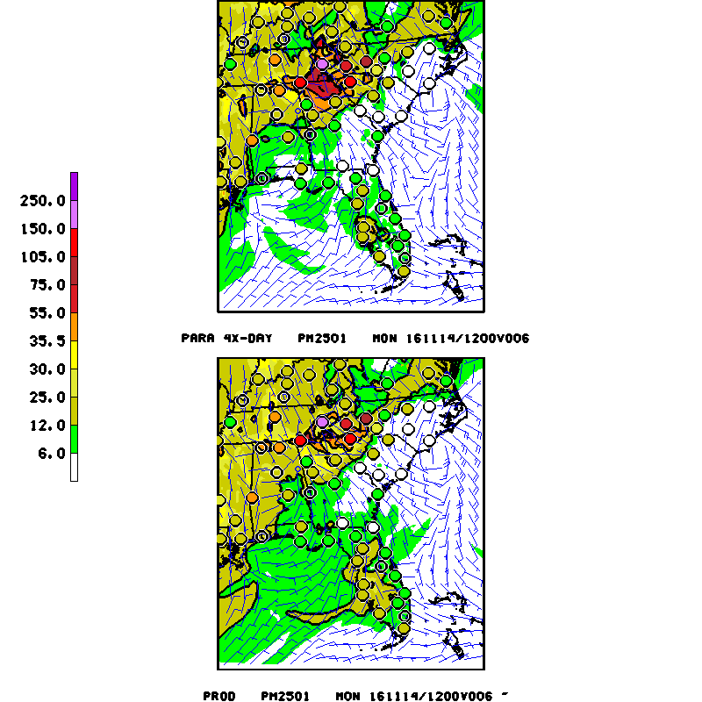
Recent fires in SE US
Example for November 14, 2016
Test prediction from the new CMAQ 5.0.2 system (top) shows larger impact of fires in SE US on PM2.5 than the operational prediction (bottom)
Test prediction (top) shows better agreement with observed PM2.5 than the operational prediction (bottom)

