Slide 1
Development of a high resolution planetary boundary layer height analysis system using aircraft, radiosonde, and NYS mesonet profiler data and the analysis impact on atmospheric transport and dispersion
Jeongran Yun, Sarah Lu, Qilong Min, and Wei-Ting Hung ¹
Jeff McQueen, Perry Shafran, Jeff Whiting, Geoff DiMego, Manuel Pondeca, Runhua Yang, and Yanqiu Zhu ²
Ariel Stein ³
¹the State University of New York, University at Albany
² NOAA/NCEP
³ NOAA/ARL
01/11/2017 , 8TH IWAQFR conference, Toronto, Canada

Slide 2



Outline
Motivation
NYS mesonet project
PBL analysis system and preliminary results
Dispersion application
Summary and future work
2017 8TH IWAQFR conference, Toronto, Canada

Slide 3
Outline
Motivation
NYS mesonet project
PBL analysis system and preliminary results
Dispersion application
Summary and future work
2017 8TH IWAQFR conference, Toronto, Canada

Slide 4
Motivations
Reliable and curate estimates of PBL heights are important due to its role in many applications: weather forecasting, dispersion and air quality modeling
PBL verification system has been established at the NOAA NCEP
PBL is not assimilated for operational purpose yet
The goal: to develop a high resolution PBL height analysis system, which can be used operationally in the future when NYS mesonet profiler observation data are available in 2017
2017 8TH IWAQFR conference, Toronto, Canada

Slide 5
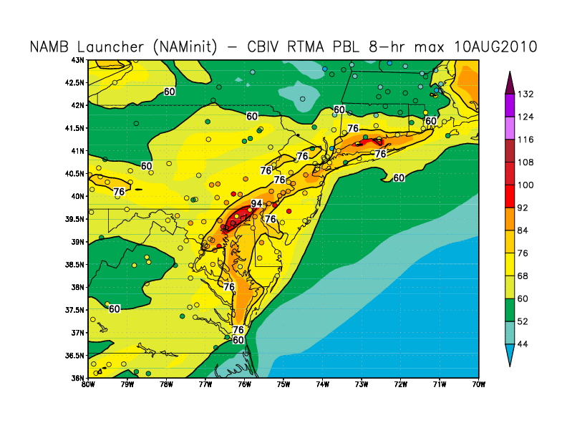
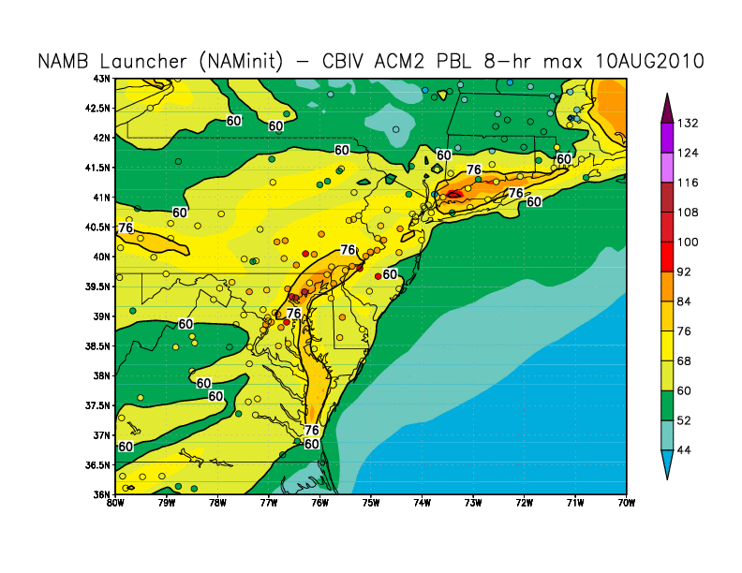
The impact of improved boundary layer on CMAQ ozone forecasts from the study
Comparison of daily 8hr max ozone prediction from the NAM-CMAQ with the operational CB-IV chemical mechanism to observations from the monitoring networks (e.g., EPA AIRNow, colored circles, ppb) using
  a) the CMAQ default derived PBL height
  b) the RTMA PBL height valid August 10, 2010
The ozone simulation shows improvement over the Baltimore-Washington urban corridor when using the PBL analysis
a)
b)
by Jeff McQueen
2017 8TH IWAQFR conference, Toronto, Canada

Slide 6
Outline
Motivation
NYS mesonet project
PBL analysis system and preliminary results
Dispersion application
Summary and future work
2017 8TH IWAQFR conference, Toronto, Canada

Slide 7
Why a Mesonet in New York?
Scarcity of weather observations in NY
Long-term trends of heavier rainfall
Recent history of very expensive high-impact events
State economy is especially sensitive to weather
Valuable for emergency management, utilities, ground transportation (roads, rail), aviation, agriculture, etc.
2017 8TH IWAQFR conference, Toronto, Canada

Slide 8
NYS mesonet brief overview
NYS mesonet awarded 1 April 2014
125 standard stations including:
  Soil moisture/temperature at 3 depths
  Camera (still images)
  20 snow sites
  17 profiler (“enhanced”) sites
  17 flux sites
Data collected in every 5 min
Currently 113 standard sites and 1 profiler site operational as of 1/6/2017
Continue to install 1-2 enhanced sites per week
The NYS MESONET: Jerald Brotzge, Christopher Thorncroft, and Everette Joseph
2017 8TH IWAQFR conference, Toronto, Canada

Slide 9
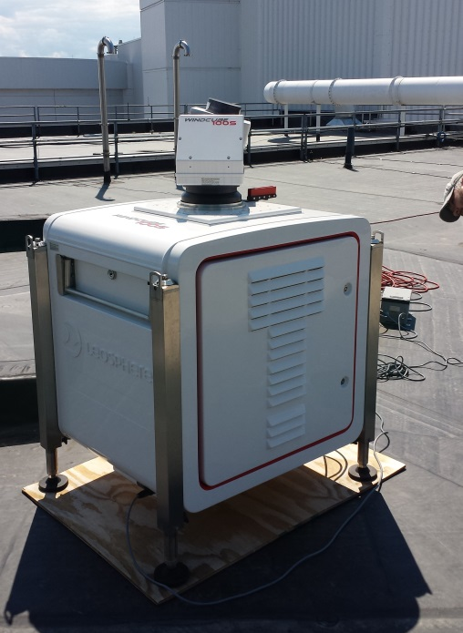
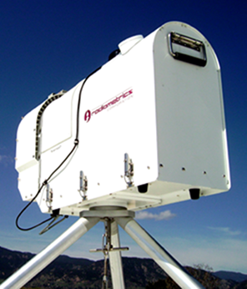
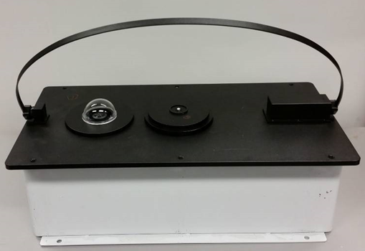
17 Enhanced stations
LIDARs
  Vertical wind profiles up to 3 km AGL
  Selected RNRG/Leosphere 100S
Microwave Radiometers
  Vertical temperature and moisture
  profiles up to 10 km AGL
  Selected Radiometrics MP-3000A
Sun Photometer (MMR/SSI)
  Multi-scan Multi-channel Radiometer
  Shadowband Sky Imager
  Designed/built by Mesonet/ASRC
2017 8TH IWAQFR conference, Toronto, Canada

Slide 10
Enhanced station
Output from Enhanced/Standard data:
  Clear sky/cloud classification – sky condition
  Accurate radiation (spectral, direct/diffuse)
  Profiles: Temp., RH, wind, and aerosols
  PBL height, cloud base height, LCL
  Aerosols: AOD & profile, SSA, Angstrom coefficient
  Clouds: cloud fraction, COD, effective radius
  Forecast indices (CAPE, k, etc)
Complex process:
  Characterize measurement, retrieval uncertainties
  Develop robust retrieval algorithms
  Products developed from synergistic retrieval/analysis approach (multiple sensors)
2017 8TH IWAQFR conference, Toronto, Canada

Slide 11
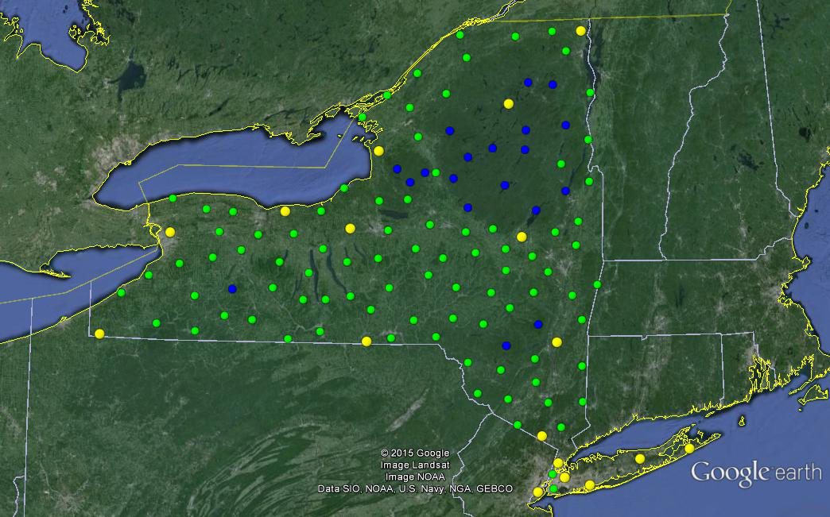
125 Sites
Spaced ~19 miles apart
Reports every 5 minutes
125 Standard Sites
20 Snow Sites
17 Enhanced Sites
The NYS MESONET: Jerald Brotzge ,Christopher Thorncroft, and Everette Joseph
2017 8TH IWAQFR conference, Toronto, Canada

Slide 12
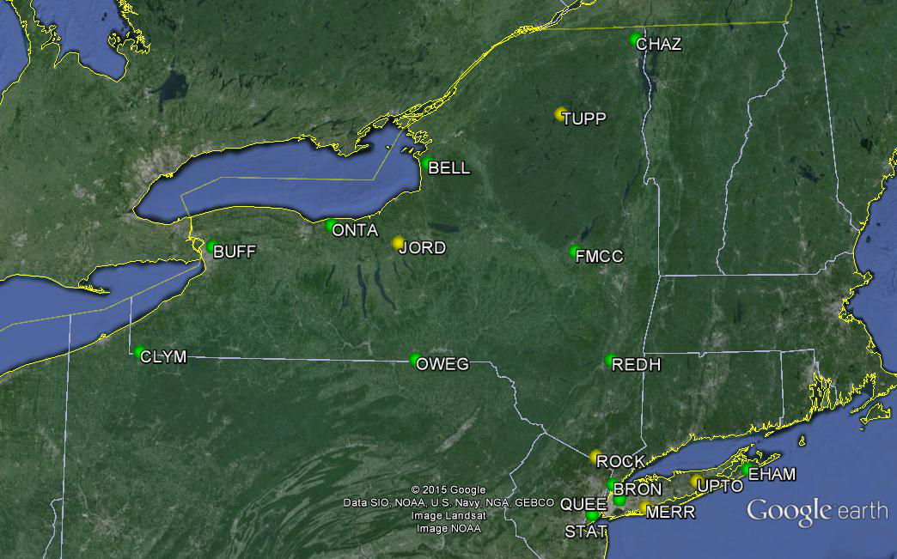
17 Enhanced Sites: ~ 4000 profiles per day
vs. 3 Radiosondes: 6 profiles per day
The NYS MESONET: Jerald Brotzge ,Christopher Thorncroft, and Everette Joseph
2017 8TH IWAQFR conference, Toronto, Canada

Slide 13
Outline
Motivation
NYS mesonet project
PBL analysis system and preliminary results
Dispersion application
Summary and future work
2017 8TH IWAQFR conference, Toronto, Canada

Slide 14
Real-time PBL analysis system using multi-platform profile observations
Profile Observations input: Derivation of PBL heights from the following observation data:
  Radiosondes, aircraft profiles, and NYS mesonet lidar profiles
Boundary Layer Analysis
ASRC-NCEP real time PBL analysis system
Cycle N
Cycle N+1
Model guess input: Evaluation of model 1st guess used for RTMA (NCEP’s weather model output):
  NAM, RAP, and HRRR
Analysis
+1 hr
Analysis
Repeat as previous cycle
Analysis output: PBL heights are assimilated into Real-Time Mesoscale Analysis (RTMA), which uses the 2DVar option of the Grid-point Statistical Interpolation (GSI) analysis system
Profile
observations
Model guess
Dispersion/air quality model application
Final product will be PBL height analysis (2.5 km resolution, hourly)
Application to air quality/dispersion models with RTMA PBL analyses
2017 8TH IWAQFR conference, Toronto, Canada

Slide 15
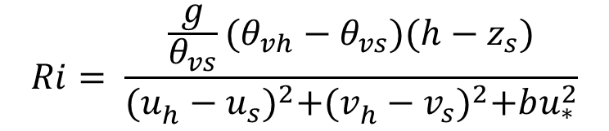
Derivation of PBL height from observations
Bulk Richardson Number (RIB) approach (Vogelezang and Holtslag, 1996)
PBL height is defined as the level where the RIB exceeds the Richardson Critical Number (0.25)
Modification on PBL height derivation based on RIB gradient
ACARS data: u,v,t,and p from aircraft obs. and moisture fields from model guess
$$Ri= \frac{\frac{g}{θ_{vs}}(θ_{vh}−θ_{vs})(h−z_{s})}{{(u_{h}^{}−u_{s}^{})}^{2}+{(v_{h}^{}−v_{s}^{})}^{2}+bu_{∗}^{2}}$$
2017 8TH IWAQFR conference, Toronto, Canada

Slide 16
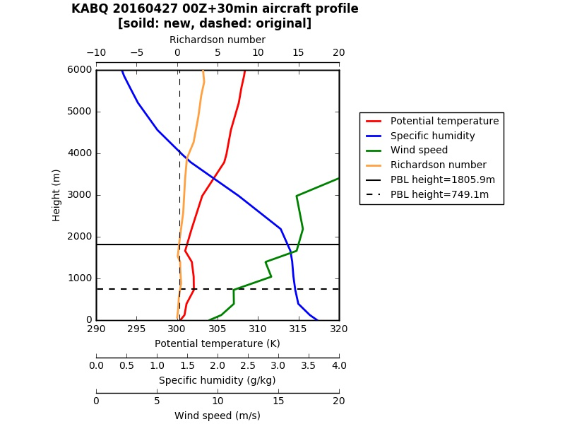
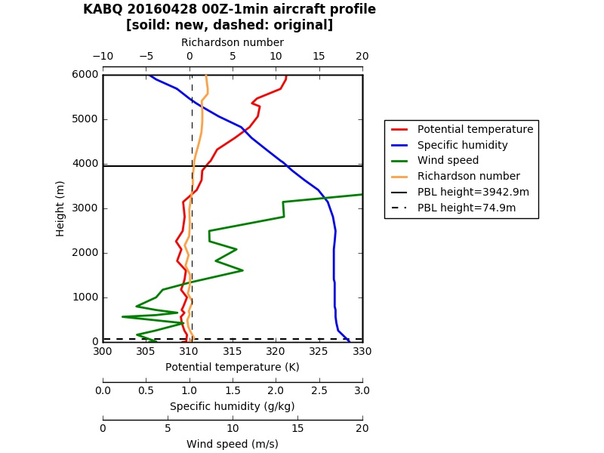
Derivation of PBL height from ACRAS data:
PBLH with RI no. (0.25) vs. PBLH with modification at Albuquerque International Sunport
Modified PBL height
PBL height when exceeding RI no. 0.25
2017 8TH IWAQFR conference, Toronto, Canada

Slide 17
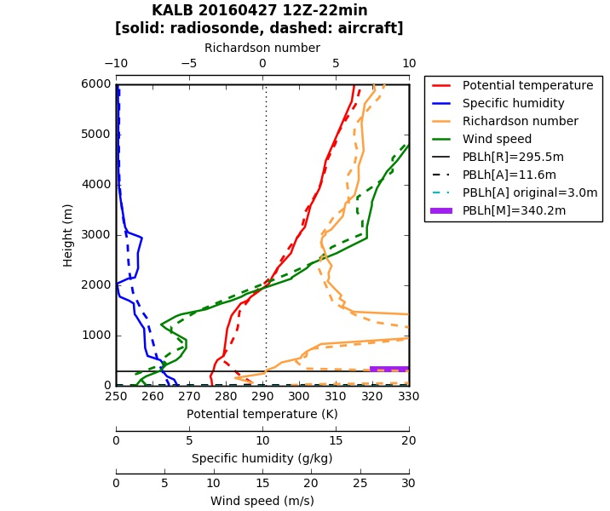
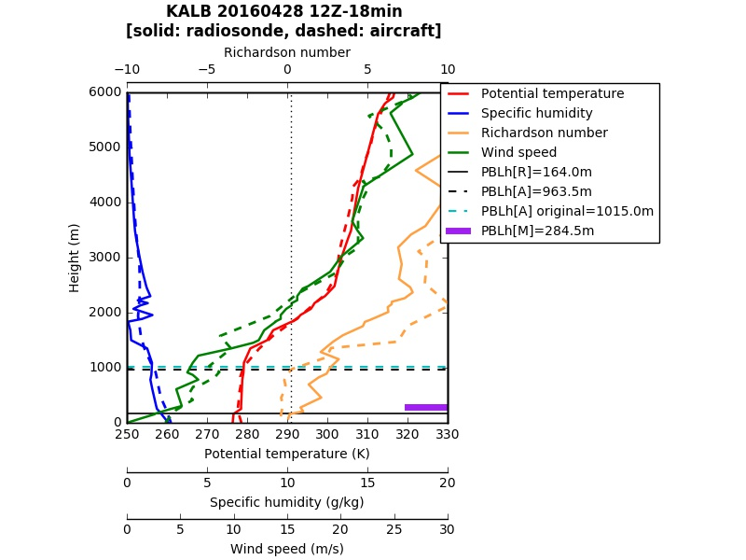
PBL height comparisons between obs. (radiosonde and ACARS) and model (RAP) at Albany International Airport
ACARS
RAP model
Radiosonde
2017 8TH IWAQFR conference, Toronto, Canada

Slide 18
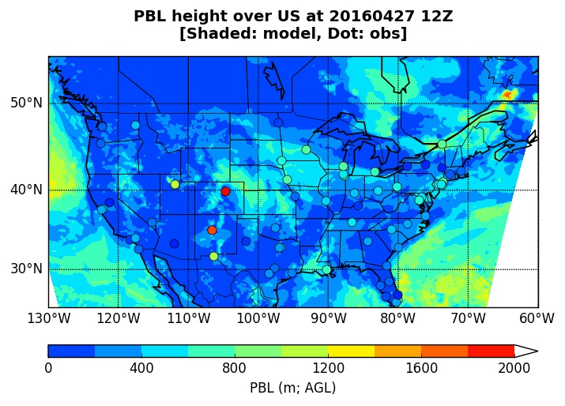
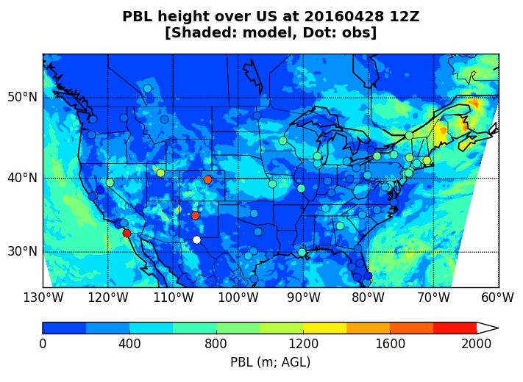
PBL height comparisons between
ACARS obs. (modified PBL height) and RAP model
Denver International Airport
Albany International Airport
Albuquerque International Sunport
2017 8TH IWAQFR conference, Toronto, Canada

Slide 19
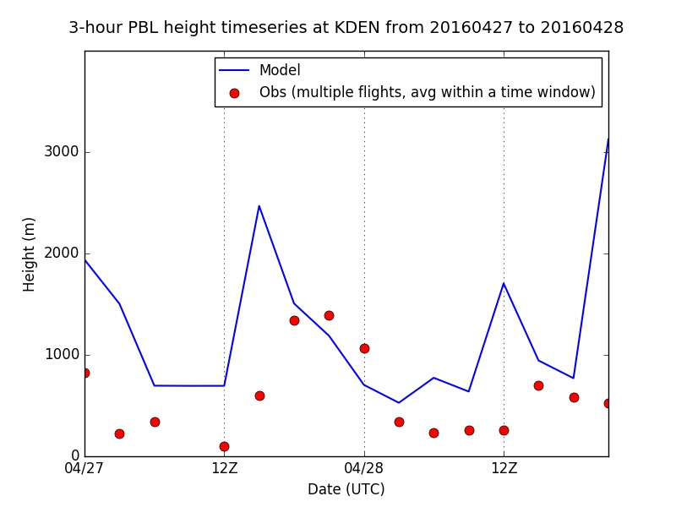
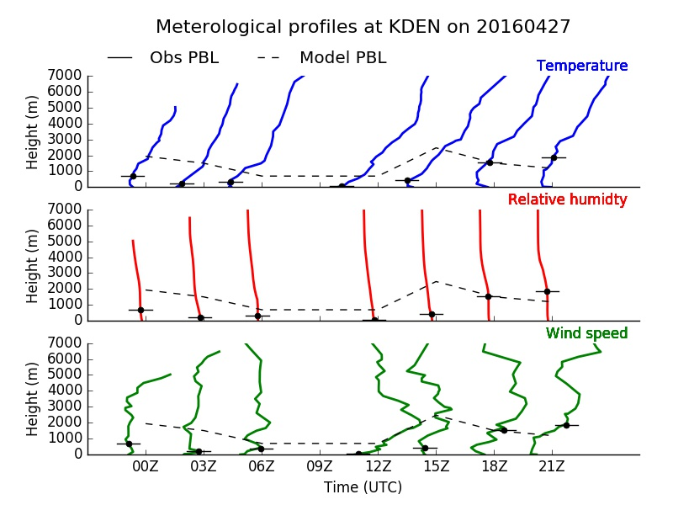
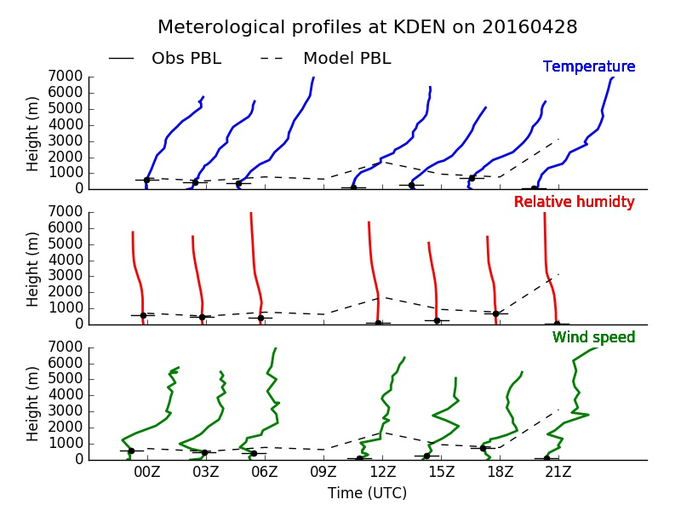
PBL height comparison between ACARS obs. (modified PBL height) and NAM model from 4/27 to 4/28 in 2016 and Meteorological profiles at Denver International Airport
2017 8TH IWAQFR conference, Toronto, Canada

Slide 20
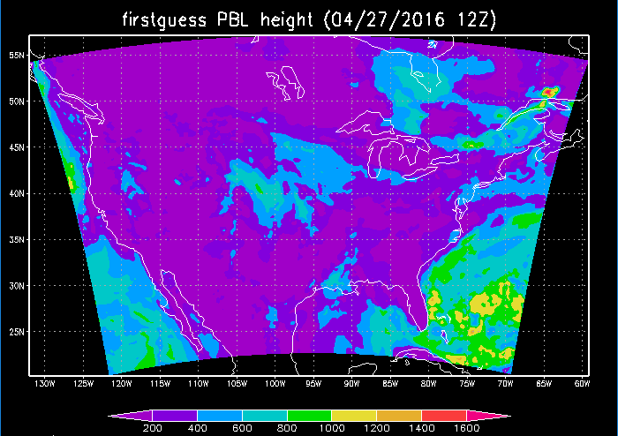
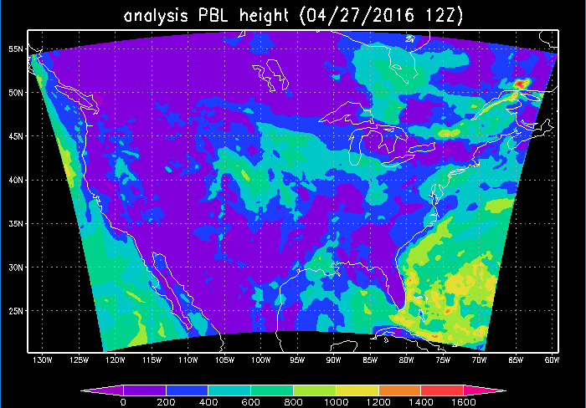
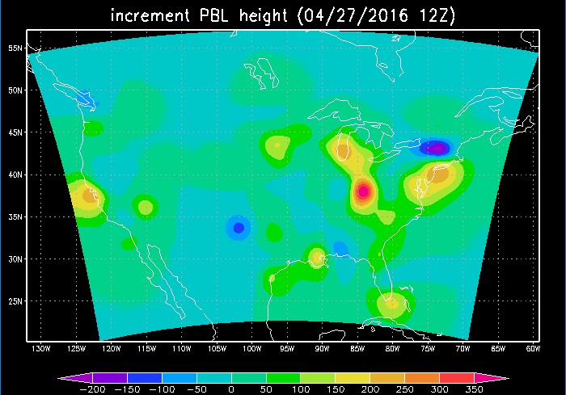
PBL height analysis on 4/27/2016 12Z using ACARS obs. and RAP model
2017 8TH IWAQFR conference, Toronto, Canada

Slide 21
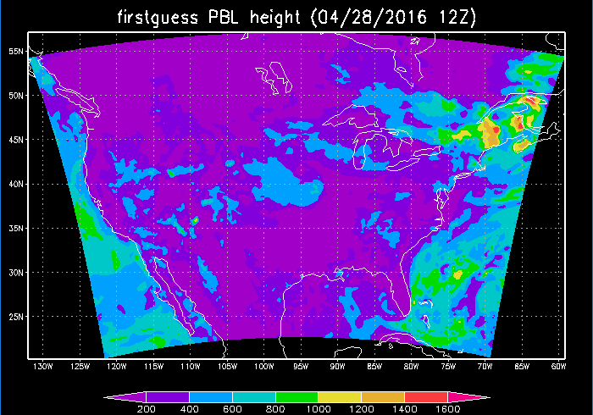
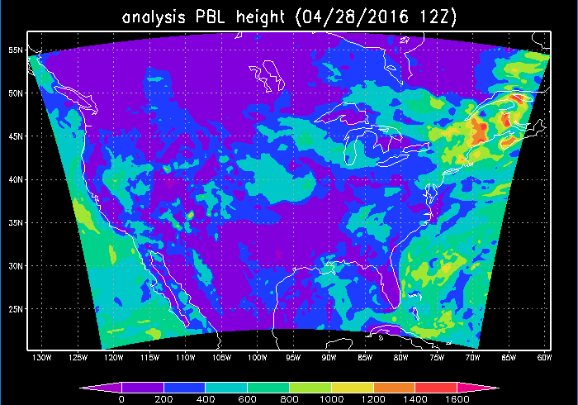
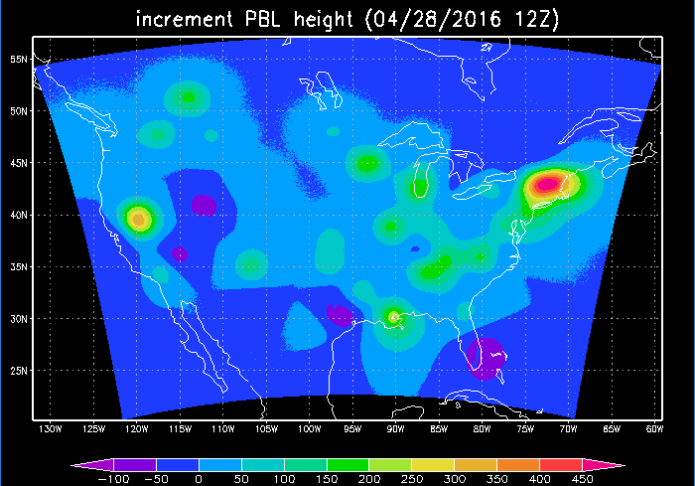
PBL height analysis on 4/28/2016 12Z using ACARS obs. and RAP model
2017 8TH IWAQFR conference, Toronto, Canada

Slide 22
Outline
Motivation
NYS mesonet project
PBL analysis system and preliminary results
Dispersion application
Summary and future work
2017 8TH IWAQFR conference, Toronto, Canada

Slide 23
Case run: event scenario and model configuration
Harriman State Park fire event
  Based on local news, two fires in Harriman State Park broke out on Sunday, Nov/13/2016, the first around 2:30 pm and the second at 11:45 pm. http://www.lohud.com/story/news/local/rockland/2016/11/14/harriman-state-park-fires/93790612/
  Location of Harriman State Park: Orange/Rockland counties, New York (41°14’N 74°06’W)
Experimental test on forward trajectory and air mass concentration dispersion based on this event
Trajectory and dispersion computed with HYSPLIT using WRF meteorology data:
  WRF met data generated:
    WRF version 3.7.1
    15 km resolution grid
    Initial time: 12Z 11/13/2016
Due to lack of real data on plume rise, emission rate and how much particles released, we made an assumption for the modeling
2017 8TH IWAQFR conference, Toronto, Canada

Slide 24
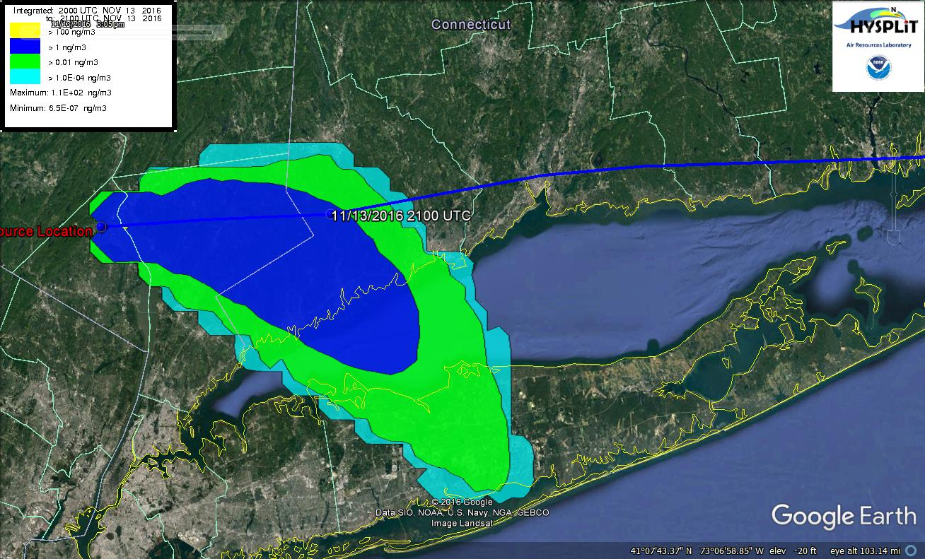
200m AGL release point
Surface to 5000m average, 1 hour average PM conc. from 20 Z to 21 Z, 11/13/2016
2017 8TH IWAQFR conference, Toronto, Canada

Slide 25
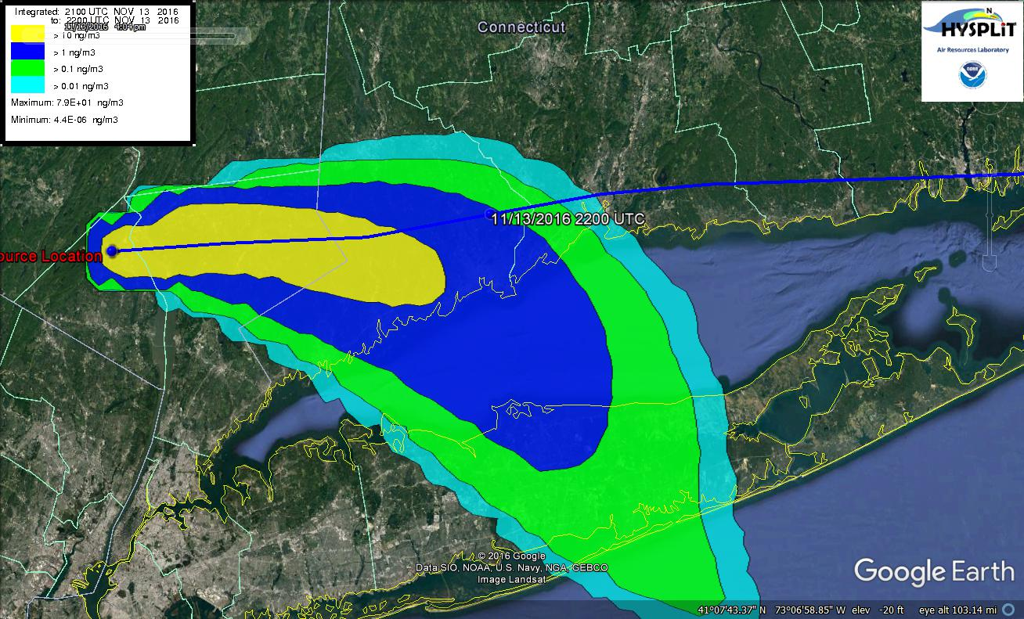
200m AGL release point
Surface to 5000m average, 1 hour average PM conc. from 21 Z to 22 Z, 11/13/2016
2017 8TH IWAQFR conference, Toronto, Canada

Slide 26
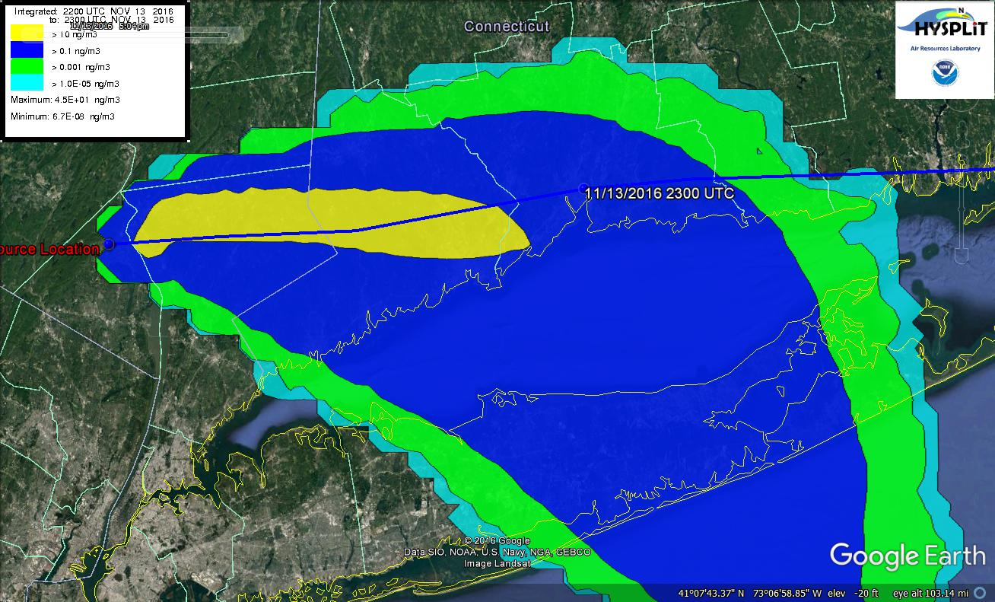
200m AGL release point
Surface to 5000m average, 1 hour average PM conc. from 22 Z to 23 Z, 11/13/2016
2017 8TH IWAQFR conference, Toronto, Canada

Slide 27
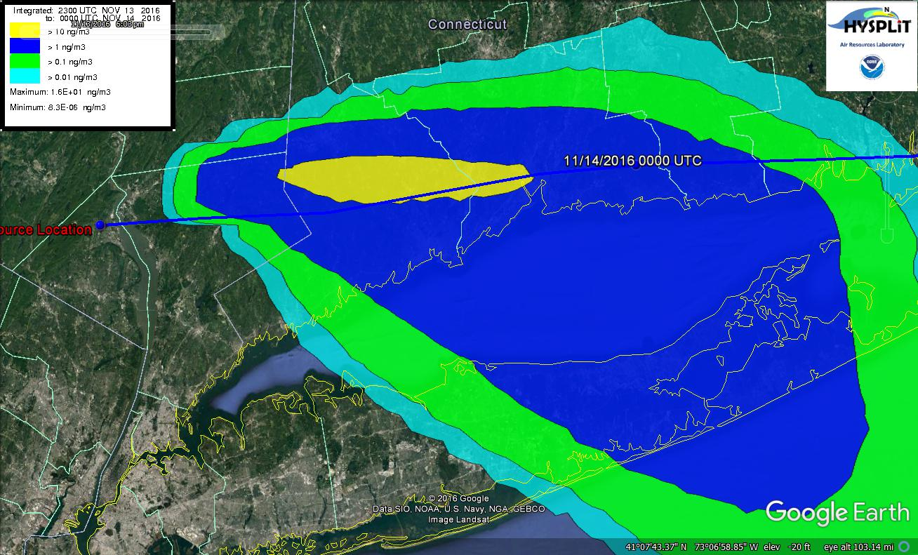
200m AGL release point
Surface to 5000m average, 1 hour average PM conc. from 23 Z to 00 Z, 11/14/2016
2017 8TH IWAQFR conference, Toronto, Canada

Slide 28
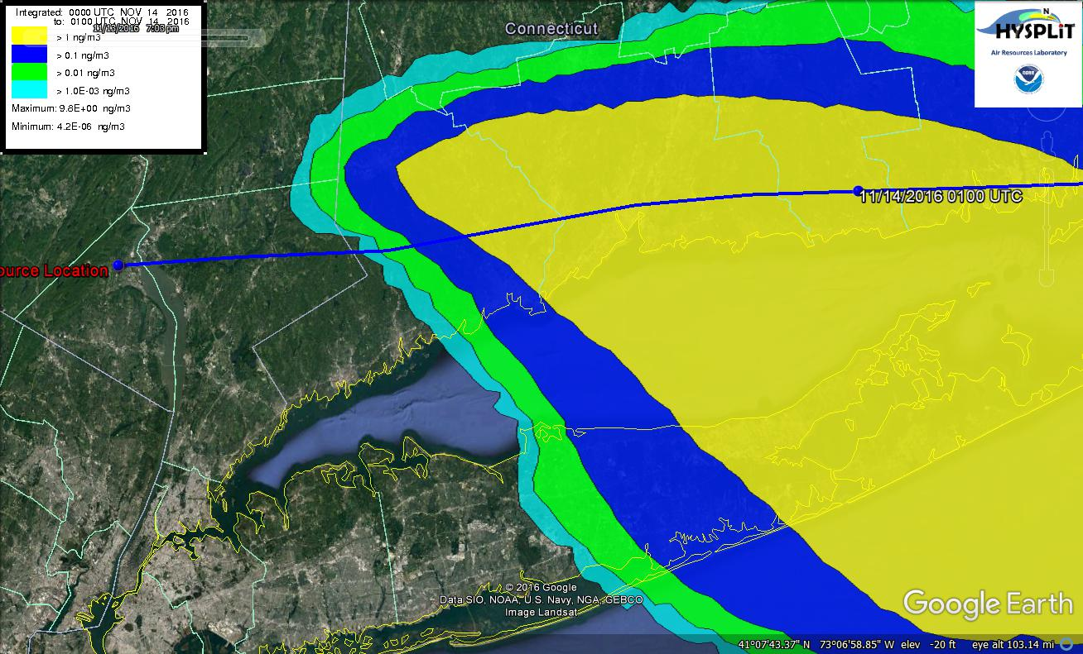
200m AGL release point
Surface to 5000m average, 1 hour average PM conc. from 00 Z to 01 Z, 11/14/2016
2017 8TH IWAQFR conference, Toronto, Canada

Slide 29
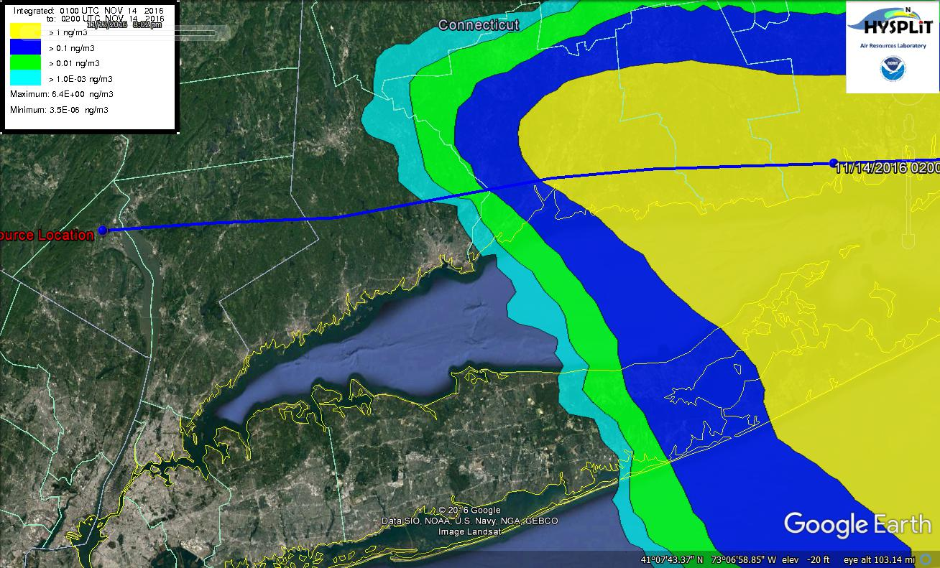
200m AGL release point
Surface to 5000m average, 1 hour average PM conc. from 01 Z to 02 Z, 11/14/2016
2017 8TH IWAQFR conference, Toronto, Canada

Slide 30
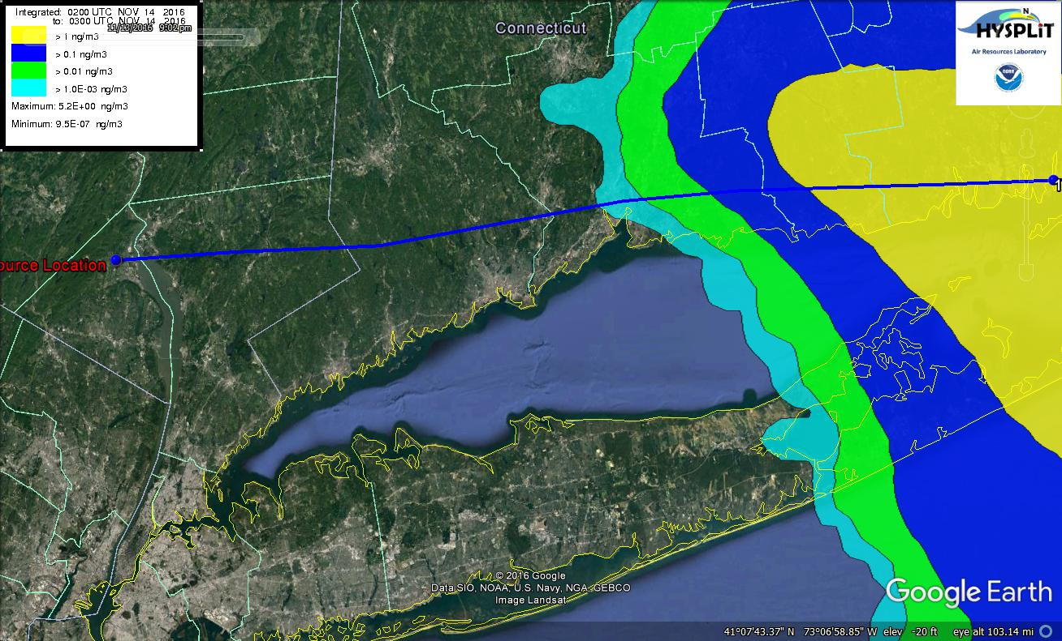
200m AGL release point
Surface to 5000m average, 1 hour average PM conc. from 02 Z to 03 Z, 11/14/2016
2017 8TH IWAQFR conference, Toronto, Canada

Slide 31
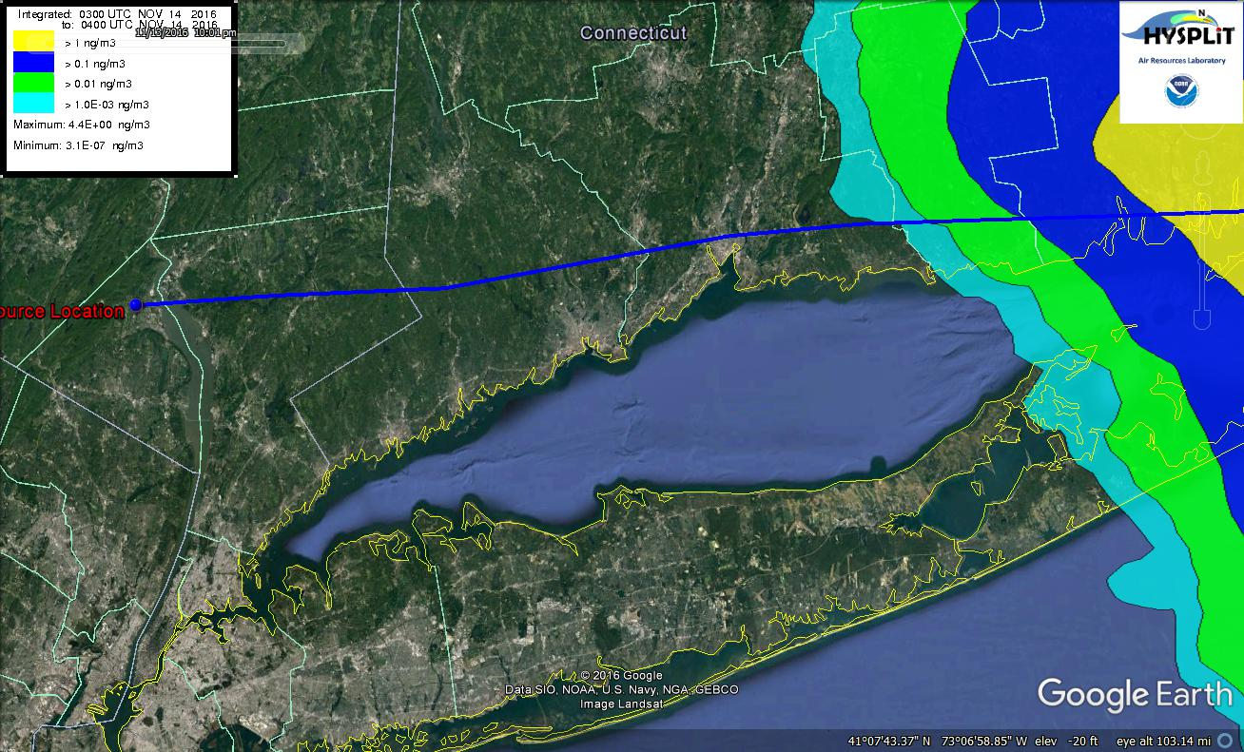
200m AGL release point
Surface to 5000m average, 1 hour average PM conc. from 03 Z to 04 Z, 11/14/2016
2017 8TH IWAQFR conference, Toronto, Canada

Slide 32
Outline
Motivation
NYS mesonet project
PBL analysis system and preliminary results
Dispersion application
Summary and future work
2017 8TH IWAQFR conference, Toronto, Canada

Slide 33
Summary and future Work
PBL
  Capable of PBL height analysis with ACARS data
  Will incorporate PBL heights from mesonet profiles into RTMA PBL height analysis
  PBL height derivation is improved by considering RI number gradient
  This modification will be added to the PBL height derivation from obs. before the RTMA PBL height analysis
Dispersion model
  PBL height analysis results will be used for dispersion modeling to see the impact on air mass dispersion
2017 8TH IWAQFR conference, Toronto, Canada

Slide 34
Thank you!

