Slide 1
High Resolution Air-Quality Simulations of Alberta and Saskatchewan Using GEM-MACH: Impact of Continuous Emissions Monitoring versus Inventory Estimates for Major Point Source Emissions
Ayodeji Akingunola¹, Paul A. Makar¹, Junhua Zhang¹, Pegah Baratzadeh¹, Michael D. Moran¹, Richard Melick², Ewa Przybylo-Komar², Tara-Lynn Carmody², Katelyn Mackay²
Modelling and Integration Section, Air Quality Research Division, ECCC
Environmental Monitoring and Science Division, AEP
International Workshop on Air-Quality Forecasting Research, January 10-12, 2017

Slide 2
Outline
An introduction to the Global Environmental Multiscale-Modelling Air-quality and CHemistry (GEM-MACH) model
  Version 1.5.1 (used up to September of 2016).
  Version 2.0 (used after September 2016).
  Initial evaluation of the model versions
The issue examined here: how does the level of information in major point source emissions data affect model results?
The experiments: base case and scenario description
The results: initial comparisons between base case and scenario
Preliminary Conclusions
Next Steps

Slide 3
GEM-MACH: EC’s AQ Model
First described in Moran et al (2010).
GEM-MACH is an on-line chemical transport model which includes:
  chemistry and meteorology combined in a single model (on-line)
  Gas-phase chemistry (42 species)
  Aqueous phase chemistry and scavenging
  Inorganic and organic particle formation
  2-or-12-aerosol size fraction representation
  8 aerosol species (sulphate, ammonium, nitrate, primary organic carbon, secondary organic carbon, elemental carbon, crustal material, sea-salt)
  Option for feedbacks between weather and air pollution in 12 bin mode, inclusion of PAHs, Hg, etc.
Comparison of v1.5.1 against 2006 and 2010 observations for North America and other peer models in Atmospheric Environment special issue on the Air Quality Model Evaluation International Initiative, Phase 2 (AQMEII-2); Makar et al, 2015 (a,b)).
V2.0 of GEM-MACH is now in use in Canada’s operational air-quality forecast – and for oil sands simulations carried out by ECCC.
Notes:
Note that this slide has been used in the Oil Sands Symposium, and was approved previously by management.

Slide 4
GEM-MACH Description (Old setup: version 1.5.1)
2-bin version (i.e., 2 aerosol size fractions):
  Ongoing experimental forecasts
  In continuous operation since October of 2012
  Used in support of the assessment of ecosystem and human health impacts
  2006/2010 emissions (v1.5.1)
12-bin version (i.e., 12 aerosol size fractions):
  Comparisons with field intensive observations
  Used for detailed chemical process analysis
  Short-term scenarios
  2010/2013 emissions (v1.5.1)
Notes:
Note that this slide has been used in the Oil Sands Symposium, and was approved previously by management.

Slide 5
GEM-MACH Description (New setup)
Both 2 and 12-bin oil sands simulations are now making use of GEM-MACH version 2
  Improved algorithms for advection and surface fluxes
  Links with the most recent version of the weather forecast model (GEM)
New emissions for 2013
  Canadian non oil sands area source emissions for 2013 (APEI), and NPRI major point sources for 2013.
  CEMA 2010 inventory and spatial allocations still used for the Athabasca oil sands region
  Alberta Environment and Parks Continuous Emissions Monitoring data obtained and converted for model use for August and September 2013 retrospective simulations
Notes:
Note that this slide has been used in the Oil Sands Symposium, and was approved previously by management.
Acronyms:
AEPI: Air Pollutant Emission Inventory
NPRI: National Pollutant Release Inventory
CEMA: Cumulative Environmental Management Association

Slide 6
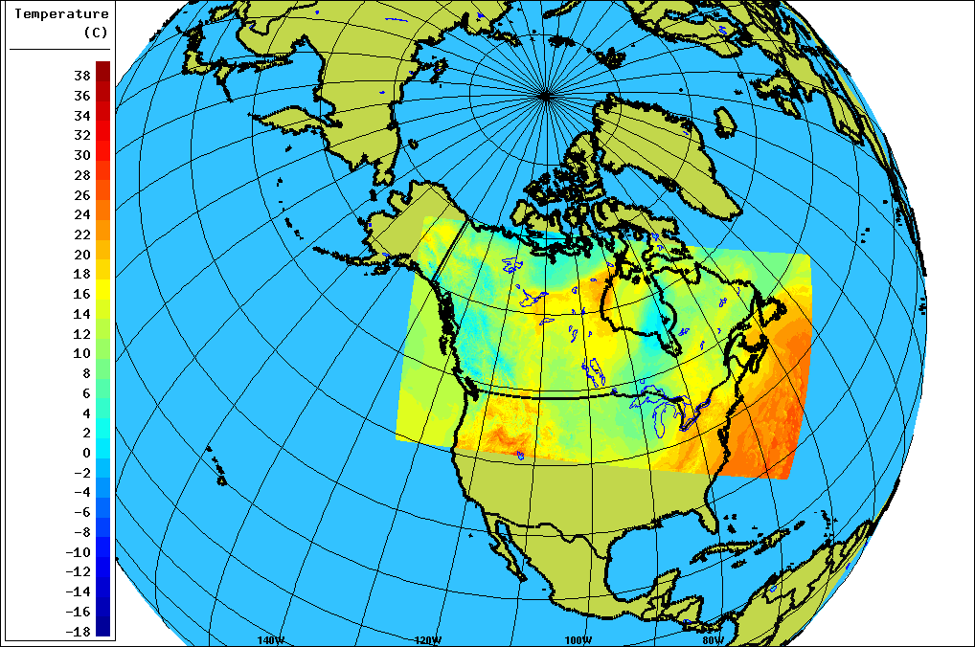
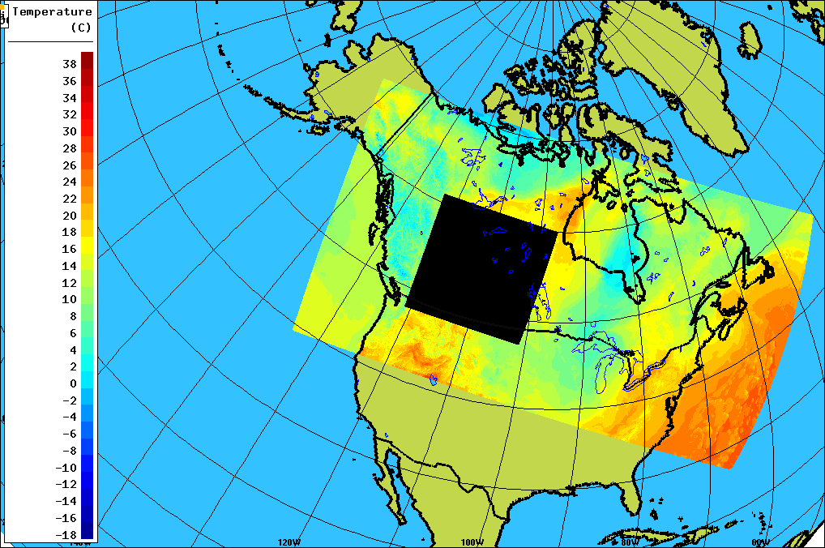
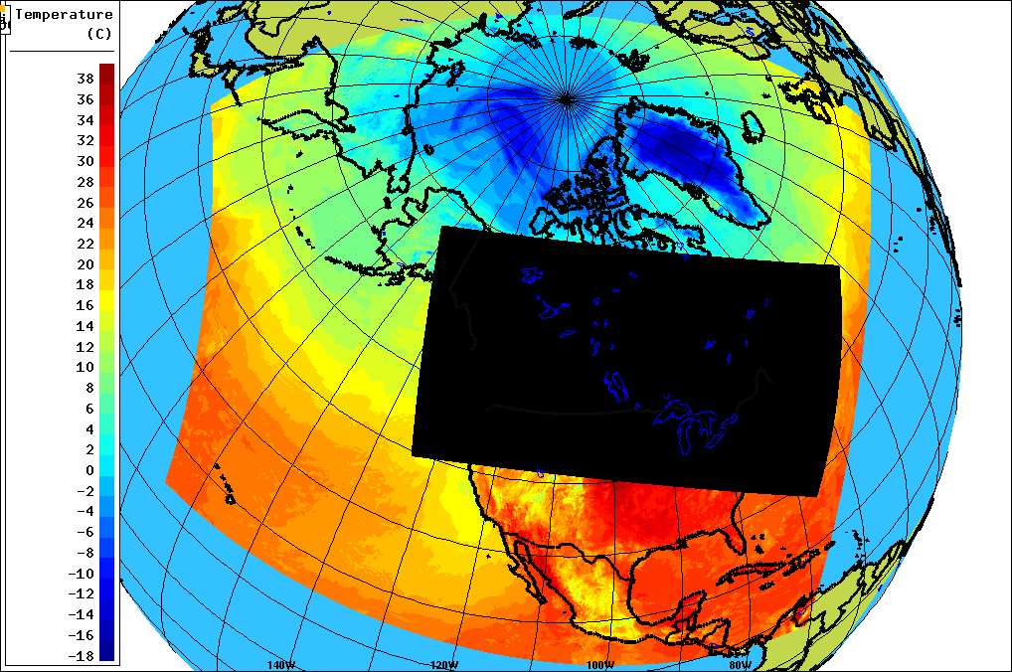
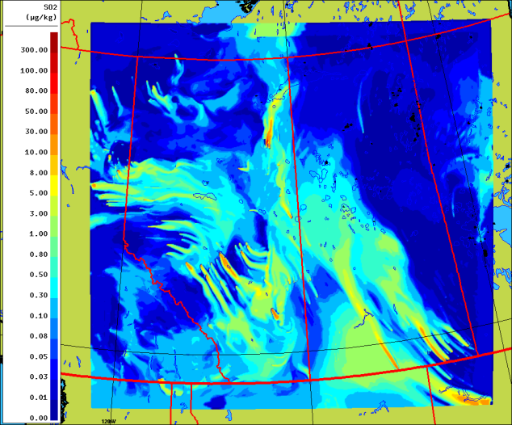
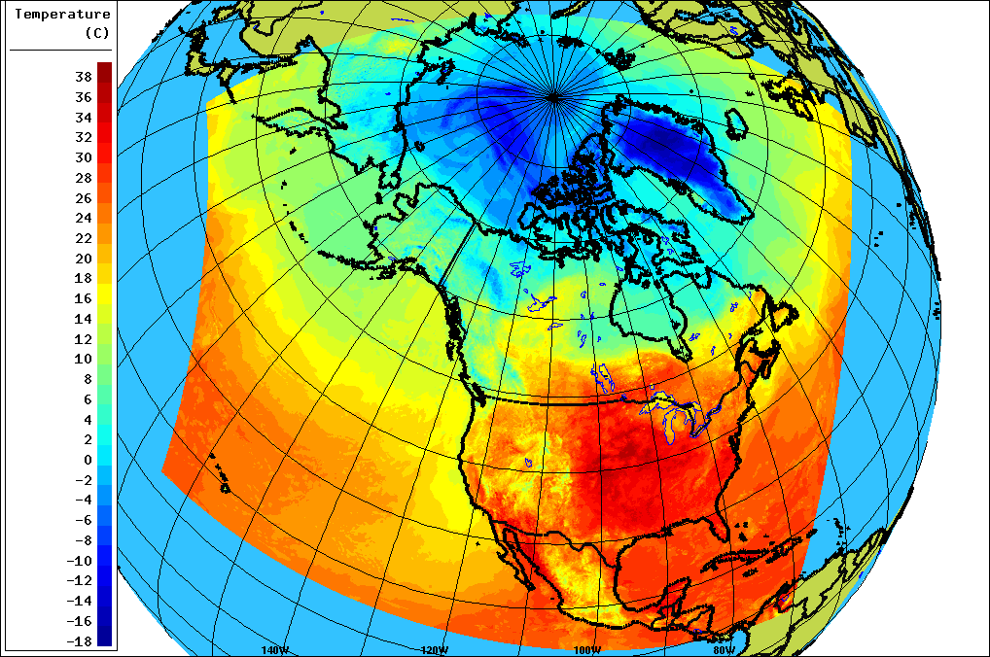
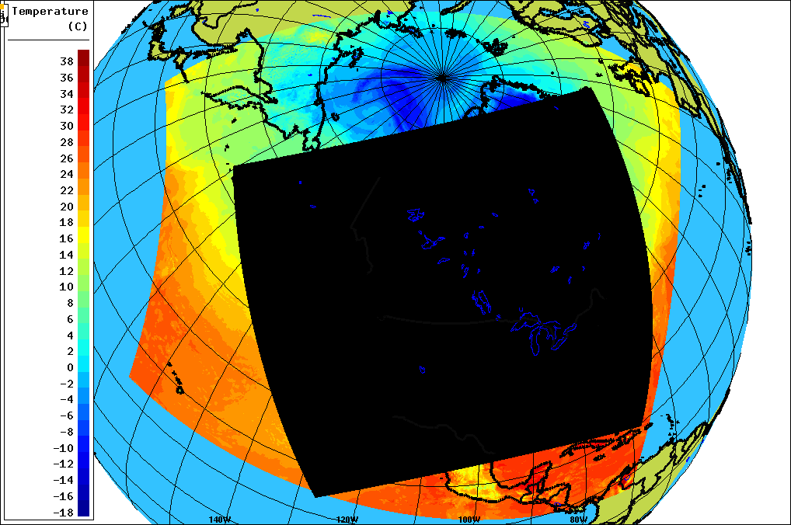
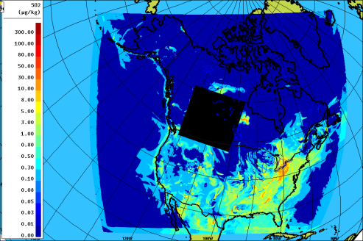
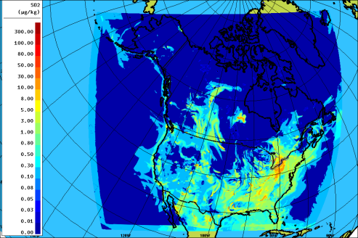
GEM-MACH Description (New setup)
…provides meteorology boundary conditions for the High Resolution Deterministic Prediction System (high resolution weather forecast)
…provides meteorology boundary conditions for the high resolution GEM-MACH forecast
Regional
Deterministic
Prediction
System
(Weather Forecast)
36 hour simulation of the High Resolution Deterministic Prediction System
24 hour high resolution GEM-MACH forecast, with roll-over of last time step chemistry for initial conditions of next time step chemistry
A cascade of model runs, repeated every day for the desired simulation.
36 hour simulation of the North American GEM-MACH forecast
…provides meteorology boundary conditions North American GEM-MACH forecast (MOZART climatologies for chemical boundary conditions)
…provides chemical boundary conditions for the high resolution GEM-MACH forecast
Notes:
Note that this slide has been used in the Oil Sands Symposium, and was approved previously by management.
This slide shows the hierarchy of models which are run in sequence at ECCC’s supercomputer center in order to be able to create the ongoing experimental forecast and the monitoring intensive forecasts for the Oil Sands projects.
When viewed in slide show mode, hitting the down-arrow key animates the images: the stages in the model run are viewed in sequence, starting from the left and going to the final result, the high resolution model run, on the right. These stages will be described verbally to the audience, one by one.

Slide 7
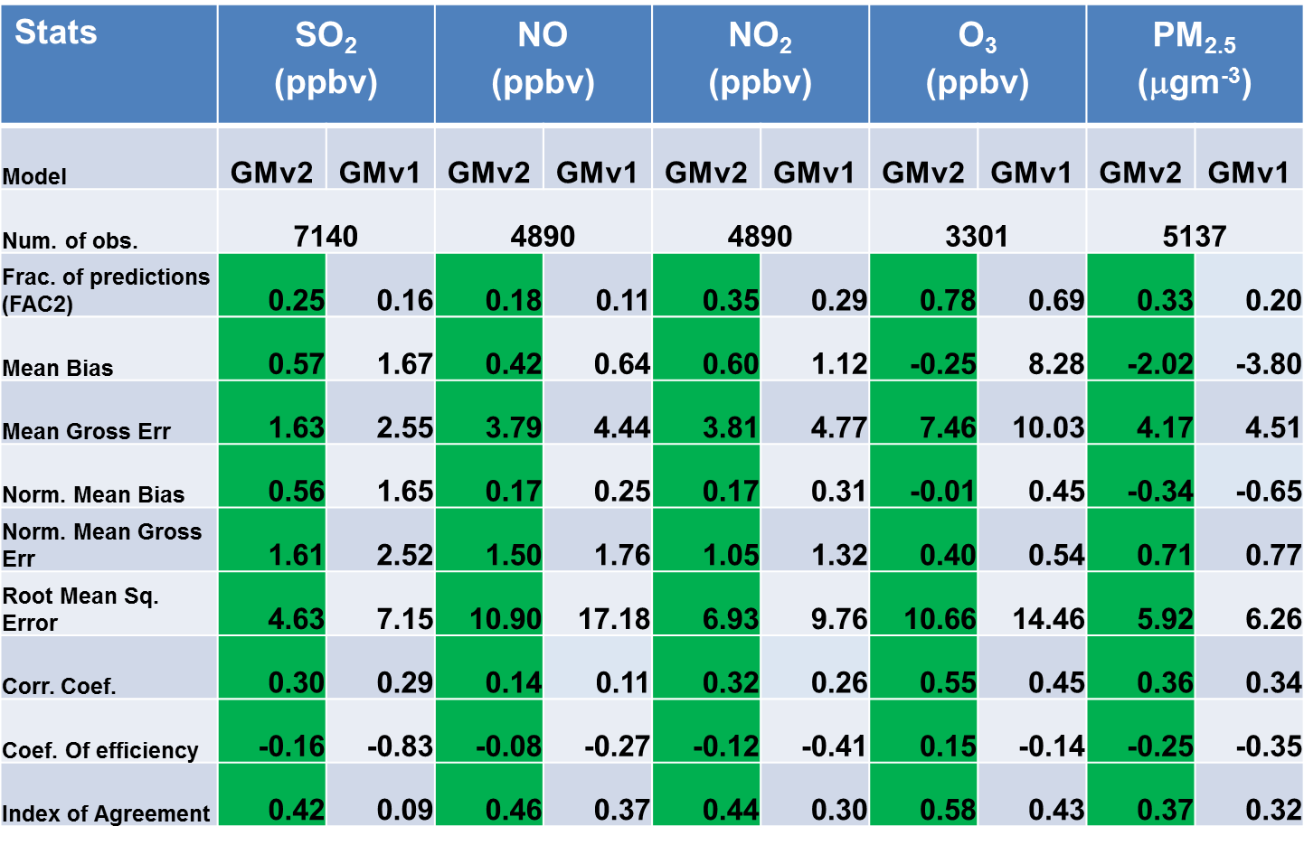
Tests of GEM-MACH version 2 compared to version 1.5.1
We tried a parallel run, evaluating both v2 (new) and v1.5.1 (old) model versions, using WBEA data for August and September of 2013.
The new version of GEM-MACH significantly outperformed the old version
At right: model with the better score has been highlighted in green.
Similar improvements for the 12 bin version of the model.
Notes:
Note that this slide has been used in the Oil Sands Symposium, and was approved previously by management.
The main issue issue here is that the new model performed better than the old model for all statistical measures.
The names of the different measures are shown on the left column; the pairs of columns are new model value (on the left) and old model value (on the right) for each of the chemicals SO2, NO, NO2, O3 and PM2.5. The model with the best score is coloured green – the new model did better than the old model for every statistical metric.
The new version of the model had better statistical scores for all metrics, when compared to the monitoring stations in the Wood Buffalo Environmental Association’s region. Sometimes this performance improvement was very high – e.g. previous ozone mean bias of 8.3 ppbv going to -0.25 ppbv, mean bias of SO2 decreasing by a factor of three. These results showed the new version of the model was so much better than the old version that ECCC decided to switch to the new version. Setting up that switch took the first half of the current fiscal year (2016-2017).

Slide 8
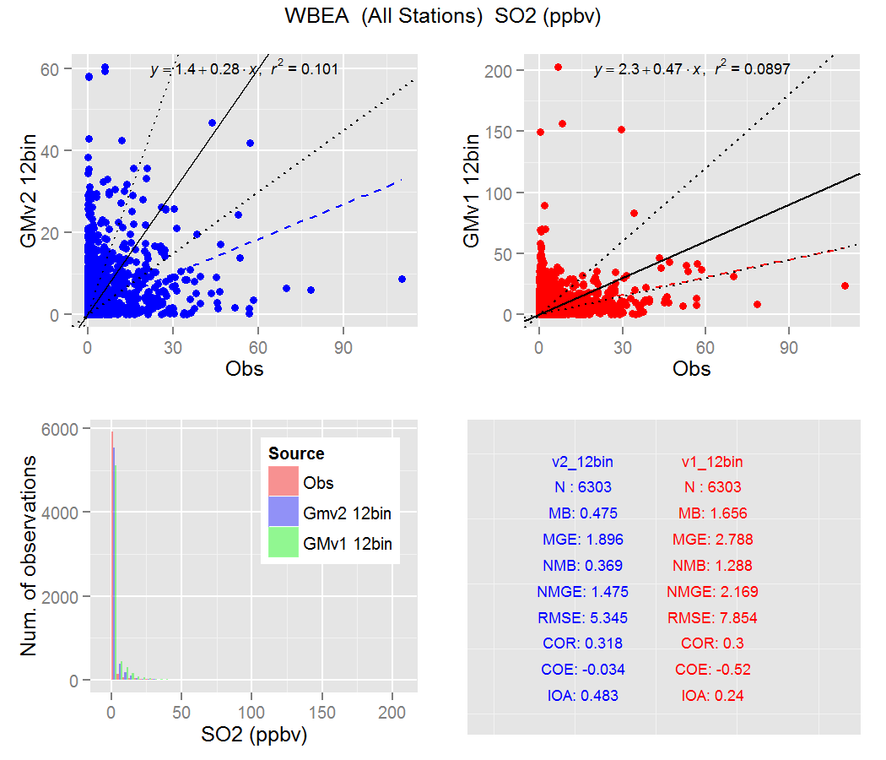
SO₂ Model Performance: Oil Sands stations
Version 2
Version 1.5.1
Notes:
This slide shows some of the performance statistics for model predictions of sulphur dioxide (SO2) relative to observations, for the two runs, for surface monitoring stations operated by the Wood Buffalo Environmental Association in the vicinity of the oil sands.
The image on the upper left is compares Version 2 modelled versus hourly observed SO2, while the image on the upper right shows the equivalent plot for version 1. Note that the scales of the two plots differ: the version 1 plot on the right sometimes has very high overpredictions of SO2 (the y axis maximum is 200 ppbv), while the version 2 plot on the left does not have these very high model values. The new model version thus has a better bias performance relative to observations (MB in the table of statistics on the lower right).
For mean bias and all of the other statistics, the model performance improved.
Variables:
N : Number of model – observation pairs in the statistical comparison
MB: Mean Bias (a perfect score would be zero)
MGE: Mean Gross Error (a perfect score would be zero)
NMB: Normalized Mean Bias (a perfect score would be zero)
NMGE: Normalized Mean Gross Error (a perfect score would be zero)
RMSE: Root Mean Square Error (a perfect score would be zero)
COR: Pearson Correlation Coefficient (R – a perfect score would be 1)
COE: Coefficient of Efficiency (a perfect score would be zero)
IOA: Index of Agreement (a perfect score would be unity)

Slide 9
Tests of GEM-MACHv2 compared to v1.5.1
The improvement in model performance was sufficiently high that we decided to:
  Switch the ongoing experimental forecast to the new model version (completed September 2016)
  Carry out a repeat run of August 2013 through July 2014 (runs underway, will complete January 2016).
    Acid deposition impacts to be re-estimated using new model version

Slide 10
How much detail is needed in “large stack” emissions data, for accurate simulations?
  One of the findings from AQMEII (Air Quality Model Evaluation International Initiative – Phase II) project was that most air-quality models, including GEM-MACH, perform poorly in forecasting SO₂ in North America (Makar et al. (a,b), 2015).
  Some of the reasons for this poor performance has been attributed to the (in)accuracy of :
    Emissions information
    Plume rise parameterization algorithms
    Model meteorological predictions used in calculating plume rise
    Deposition algorithms and meteorological inputs for calculating the SO₂ deposition rate.

Slide 11
SO₂ Emissions in GEMMACH
SO₂ emissions in the oil sands region are mostly from large point sources.
SO₂ emission inventory data are available from different sources:
  National Pollutant Release Inventory (NPRI) – annual total emissions
  Cumulative Environmental Management Association (CEMA)
  Continuous Emissions Monitoring observations (Alberta Environment and Parks)
Continuous Emissions Monitoring (CEM) include:
  Hourly observations of emissions of SO₂ and NO₂ emissions in large stacks
  Hourly information on the stack temperature and flow rate
Annual total emissions from CEM data are identical with the annual total from NPRI… how much do the hourly variations matter, for predicting concentrations, using GEM-MACH?

Slide 12
Comparison of Emissions Information (1)
Annual total emissions of SO₂ for a facility in the oil sands, from two 2010 inventories, shown as hourly emissions in kg/hour, using the assumption of a constant emission rate during August of 2013
SO₂ emissions levels (kg/hr)
Notes:
This sequence of slides shows how different sources of emissions information can vary, depending on the source of that information, and how much this information can influence emissions levels on an hourly basis.
In this slide, the blue line shows the hourly SO2 emissions levels that result from using the annual total SO2 emissions from National Pollutant Release Inventory for 2010, distributed in time by hour, according to one set of assumptions regarding how that annual mass is distributed by month of the year, day of the week, and hour of the day.
The purple line shows the hourly SO2 emissions levels that result from using the Cumulative Environmental Management Association 2010 inventory, with a different set of temporal distribution assumptions.
Both sets of temporal distribution assumptions result in constant emissions across the days shown here (August of 2013).

Slide 13
Comparison of Emissions Information (2)
Compare: different hourly limits for SO₂ reporting of exceedances (black dotted line), and upsets (turquoise dotted line), and the facility total SO₂ limit (pink dotted line. Both inventory estimates are below these criteria.
SO₂ emissions levels (kg/hr)
Notes:
This sequence of slides shows how different sources of emissions information can vary, depending on the source of that information.
Here, the different regulatory limits for reporting “Upsets”; conditions in which unusual emissions conditions are occurring, are shown.
→ An Exceedance of the Sulphur Recovery Unit at this particular facility occurs at an SO2 emission rate of 930 kg/hr (black dotted line).
→ If the emission level from the Sulphur Recovery Unit reaches 7,100 kg / hr, the SRU is considered to be in an “Upset” condition (turquoise dotted line).
→ The pink dotted line shows the Total Limit for hourly SO2 emissions for the facility (15,000 kg/hr)
Note that if the hourly emissions derived from using annual totals and assuming a constant emission rate over time (NPRI and CEMA solid lines), none of these limits are being exceeded.

Slide 14
Comparison of Emissions Information (3)
Now compare to direct observations (green line, Continuous Emissions Monitoring), and flare stack emissions estimates (orange line) during abnormal operating conditions. These short-term events may have a LARGE effect on hourly emissions levels.
SO₂ emissions levels (kg/hr)
Notes:
This sequence of slides shows how different sources of emissions information can vary, depending on the source of that information.
We now add in measured SO2 emissions.
The green line shows the SO2 emissions directly measured in the main stack of the facility.
→ Most of the time the measured values are less than the values resulting from the 2010 inventories and a constant emission rate during the month.
→ For a short period of a few hours, the measured emissions are greater than the Sulphur Recovery Unit Exceedance level (black dotted line).
However, not all of the emissions during this period are being emitted in the main stack. At this facility during upsets, SO2 is directed to a “flare stack” in which high temperature jets at the top of the stack are used to loft the SO2 emissions upwards. Direct measurements of SO2 using CEM can’t be made in these stacks due to the high temperatures at the stack top. However, estimates of the SO2 emissions can be made from other data.
The yellow line shows these data: much higher levels of SO2 emissions were derived from the flare stack data than were monitoring directly in the main stack (green line). These flare stack emissions levels are often higher than were measured directly by CEMS, are above the SRU Exceedance level for one day, and are above the Facility Limits for a few hours (circled) on another day.

Slide 15
Emissions Reporting
USA:
  Continuous Emissions Monitoring on large stacks
  Reporting of these hourly emissions to national inventories is required
  Typical volume flow rates and temperatures are also reported and are usually used for modelling
Canada:
  Continuous Emissions Monitoring on large stacks
  Reporting of annual totals to national inventories is required
  Typical volume flow rates and temperatures are reported and used for modelling.
Alberta:
  Continuous Emissions Monitoring on large stacks
  Hourly reporting of emissions, volume flow rates and temperatures.

Slide 16
The Experiments
Question: To what extent do the observed volume flow rates and temperatures influence the predictions of GEM-MACH (version 2, 12-bin version)?
New emissions data:
  CEM SO₂ and NO₂ major point source emissions, for the province of Alberta
  These sources account for >90% of Alberta SO₂ emissions and about 80% of Alberta NO₂ emissions
  Outside of Alberta: use NPRI inventory major point source emissions
Base case simulation: NPRI typical/annual stack temperature and volume flow rates are used
Scenario simulation: Measured (CEM), hourly, stack temperature and flow rates are used.
What is the impact on the model results of this additional data?

Slide 17
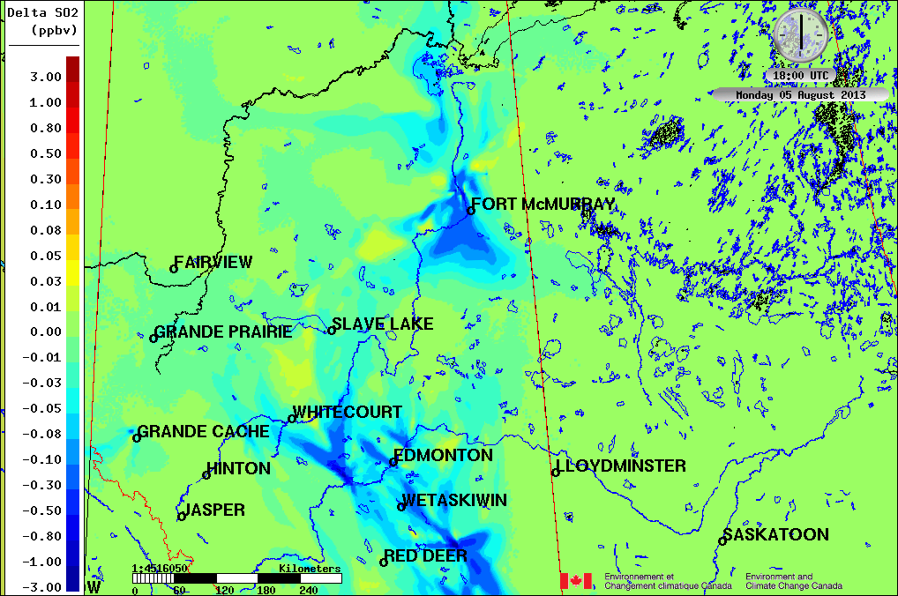
Results: average surface SO₂ concentration difference (ppbv)
SO₂ Concentration differences: example multiday average, Scenario – Base Case
3 ppbv
Average surface SO₂ concentrations decrease when the measured volume flow rates and temperatures are used, close to the sources.
Logarithmic scale
-3 ppbv
Notes:
These and the following figures are multiday average differences in concentration between the scenario (using measured volume flow rates and temperatures) and the base case (in which NPRI reported typical values are used.
They show that the use of these additional data have sometimes have a large impact on average surface concentrations. Note that this means at any given hour, the effects will be much larger than shown here.

Slide 18
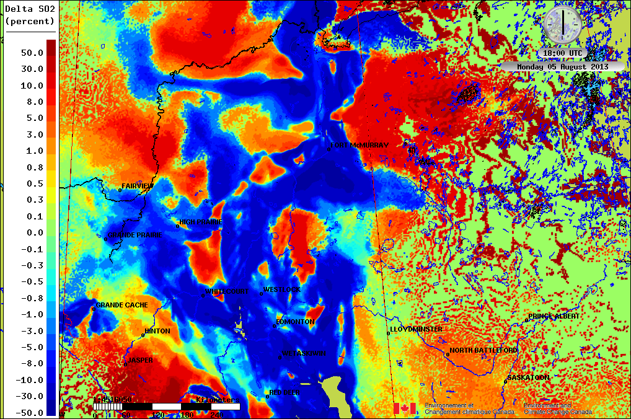
Results – average surface SO₂ concentration relative difference (percent)
SO₂ percentage differences (Scenario - BaseCase)/(BaseCase) x 100
+50 %
Average surface SO₂ concentrations decrease close to the sources, increase downwind.
Logarithmic scale
-50 %
Notes:
Plotted as concentration differences, it can be seen that the relative change in average surface SO2 concentration is often in the tens of percent.

Slide 19
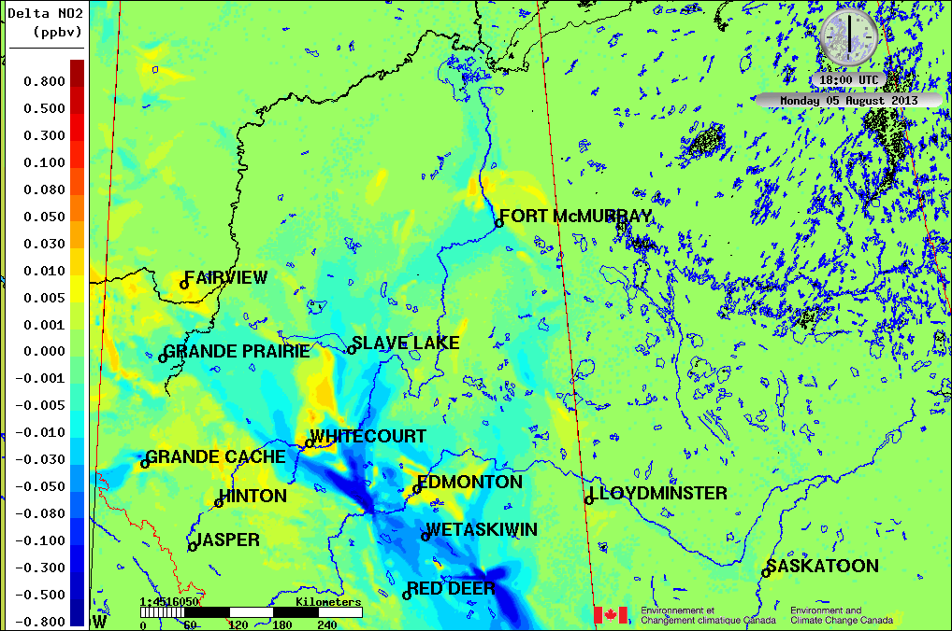
Results: average surface NO₂ concentration difference (ppbv)
NO₂ Concentration differences: example multiday average, Scenario – Base Case
0.80 ppbv
Average surface NO₂ concentrations decrease when the measured volume flow rates and temperatures are used, close to the sources.
Oil sands sources: smaller impact than for SO₂
Logarithmic scale
-0.80 ppbv
Notes:
NO2 concentration differences are smaller near the oil sands sources than the sources further south, compared to SO2.
The reason for this is that at the oil sands, the main source of SO2 is from the large stacks, while the main source of NO2 is from large “heavy hauler” trucks used to transport raw bitumen from the open pit mine faces to the processing facilities.
Consequently, the impact of the changes in the stack parameters is smaller for NO2 than for SO2, close to the oil sands.

Slide 20
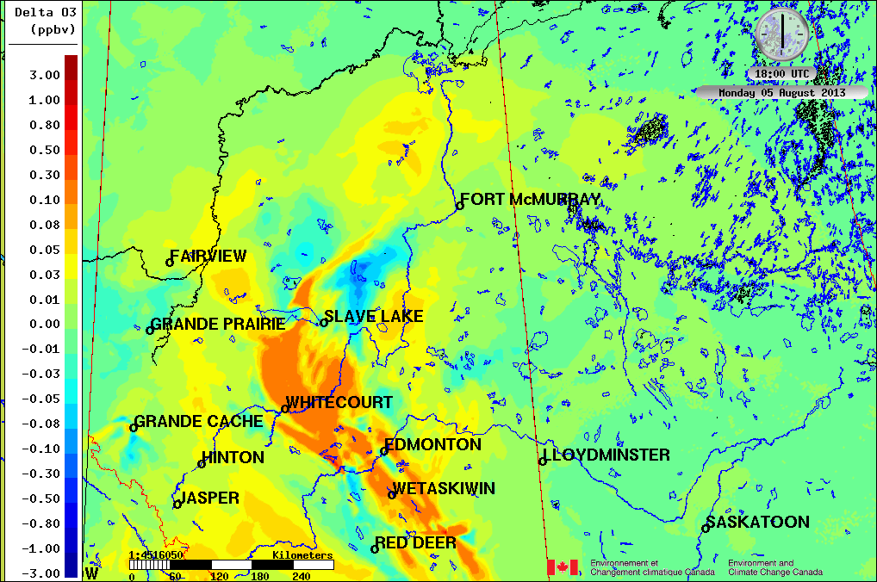
Results: average surface O₃ concentration difference (ppbv)
O₃ Concentration differences: example multiday average, Scenario – Base Case
3.0 ppbv
Close to the sources, where NOx titration of ozone takes place, the NOx level has decreased when the measured volume flow rates and temperatures are used: this causes a decrease in the titration rate of ozone, and the ozone concentration close to the sources increases by a few ppbv.
Logarithmic scale
-3,0 ppbv

Slide 21
Results: average surface O₃ concentration difference (ppbv)
O₃ Concentration differences: example multiday average, Scenario – Base Case
3.0 ppbv
Further away from the sources, where ozone production dominates, the scenario NOx level is slightly lower than the base case – here, the result is that ozone production levels are lower in the scenario than in the base case
Logarithmic scale
-3,0 ppbv

Slide 22
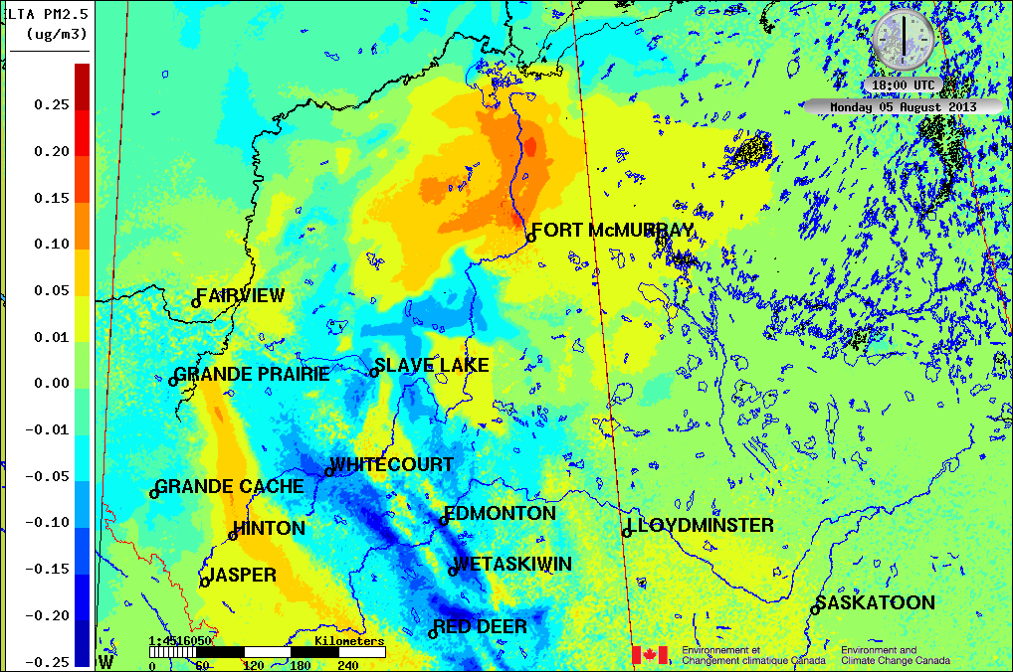
Results: average surface PM_{2.5} concentration difference (ug m⁻³)
PM_{2.5} Concentration differences: example multiday average, Scenario – Base Case
Average surface PM_{2.5} response is complex, and depends on the source region
Increases near the oil sands when the measured volume flow rates and temperatures are used
Decreases close to other sources in Alberta. at some locations downwind.
0.25 ugm⁻³
Linear scale
-0.25 ugm⁻³

Slide 23
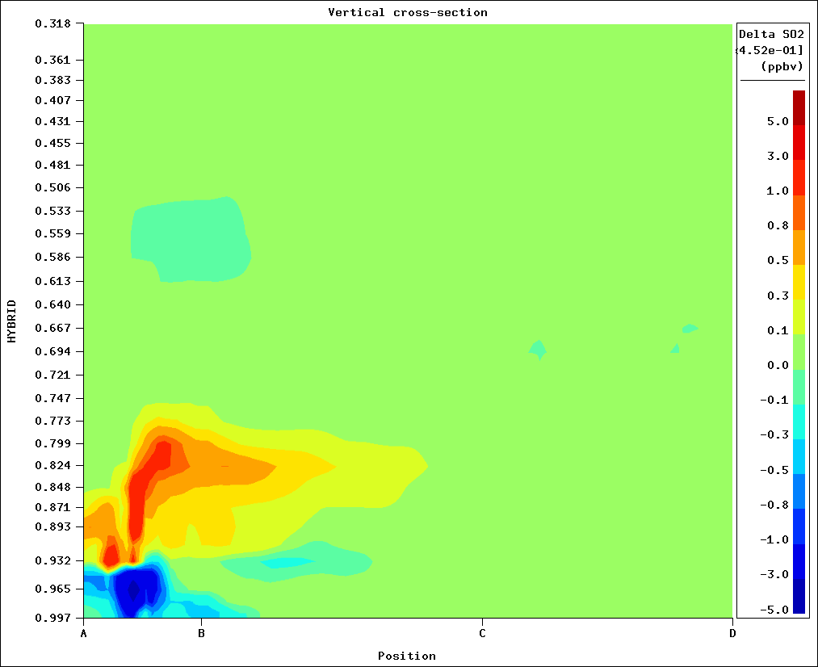
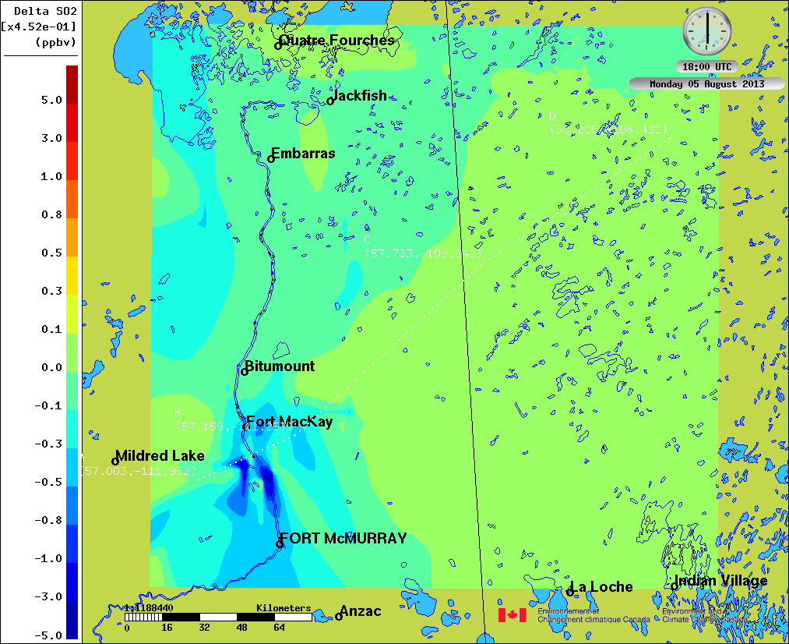
Results: impacts on average model SO₂ concentrations in the vertical: average cross-sections (ppbv)
Average SO₂ concentration differences, vertical cross-section (left) and surface map (right) near oil sands.
Location of the cross-section is shown on map at right.
Notes:
This image shows large differences in SO2 concentrations at the surface, but also fairly high up in the atmosphere.
The changes in the volume flow rates and temperatures result in a redistribution of mass, likely due to convective clouds.
→ In one simulation, the plume height upon emission is high enough to be carried further upwards by convection.
→ In the other simulation, the plume height is too low for the convective clouds to carry the SO₂ further upwards, giving rise to the images shown here.

Slide 24
Preliminary Conclusions
SO₂: Using time-varying, observed volume flow rates and temperatures instead of typical annual values results in a very significant change to the model’s SO₂ predictions.
  Maximum range of change in SO₂ of +/- 3 ppbv (+/- 50%)
  Spatial distribution of concentration changes
  These relative levels of change are seen everywhere in the lower atmosphere and also downwind of the emission sources.
NO₂: Model results for NO₂ shows relatively small effect from using the CEM stack parameters close to the oil sands, larger near other sources.
  Maximum range of change in NO₂ of +/- 0.80 ppbv (+/- 50%)
  Oil sands smaller impact due to the relatively small contribution of NO₂ major point emissions to total NO₂ emissions in that region.

Slide 25
Preliminary Conclusions – contd.
O₃: changes with a maximum +/- 3ppbv range (+/- 10%).
PM_{2.5}: changes with a maximum +/- 0.25 ug m⁻³ range (+/- 15%).
Overall, from this preliminary look:
➔ These changes are significant!
➔ Measured volume flow rates and temperatures in large stacks are not used in modelling and forecasting!
➔ The results thus far suggest they should be used!

Slide 26
Ongoing and Future Work
We are in the process of
  Carrying out a full month of simulations
  Evaluating the performance of the model using aircraft and surface monitoring network observations.
    ➔ Will we get better comparisons to observations when the measured volume flow rates and temperatures are used? TBD.

Slide 27
Thank-you for your interest!

Slide 28
Bonus slides
The following slides are “hidden slides” and will be shown if they help answer questions from the audience.

Slide 29
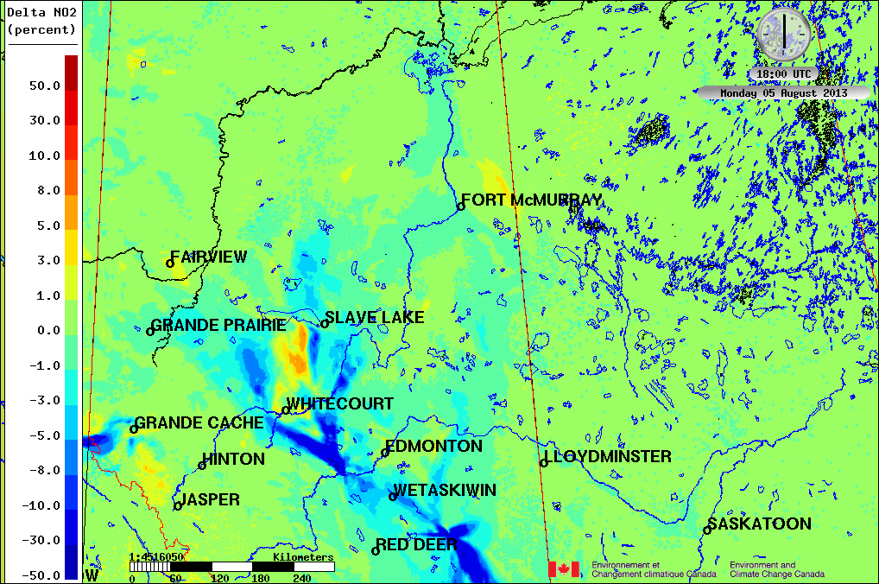
Results – average surface NO₂ concentration relative difference (percent)
NO₂ percentage differences (Scenario - BaseCase)/(BaseCase) x 100
+50 %
Average surface NO₂ concentrations decrease when the measured volume flow rates and temperatures are used, close to the sources.
Very similar pattern to absolute differences
Logarithmic scale
-50 %

Slide 30
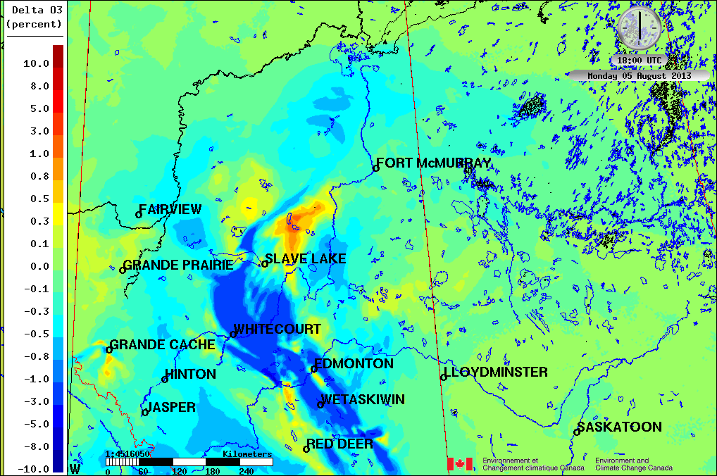
Results – average surface O₃ concentration relative difference (percent)
O₃ percentage differences (Scenario - BaseCase)/(BaseCase) x 100
10 %
Average surface O₃ concentrations increase when the measured volume flow rates and temperatures are used, close to the sources, and decrease at some locations downwind.
Less O₃ titration of NO_{x} close to the emissions sources, more O₃ production downwind.
Logarithmic scale
-10 %

Slide 31
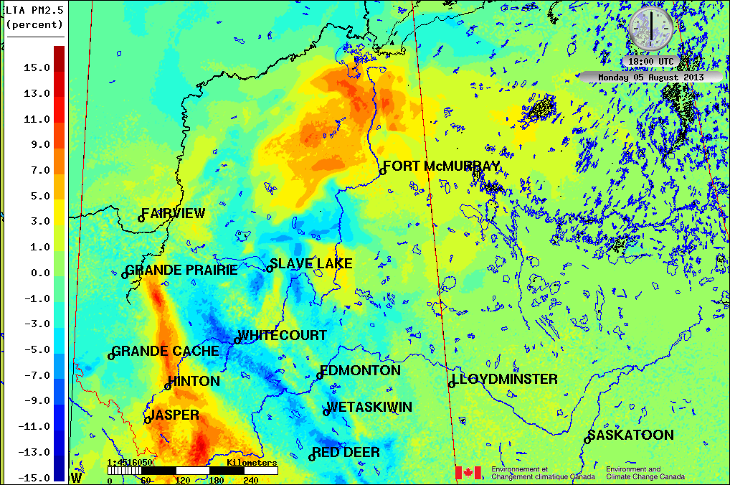
Results – average surface PM_{2.5} concentration relative difference (percent)
PM_{2.5} percentage differences (Scenario - BaseCase)/(BaseCase) x 100
+15 %
Average surface PM_{2.5} response is complex, and depends on the source region
Increases near the oil sands when the measured volume flow rates and temperatures are used
Decreases close to other sources in Alberta. at some locations downwind.
Logarithmic scale
-15 %

Slide 32
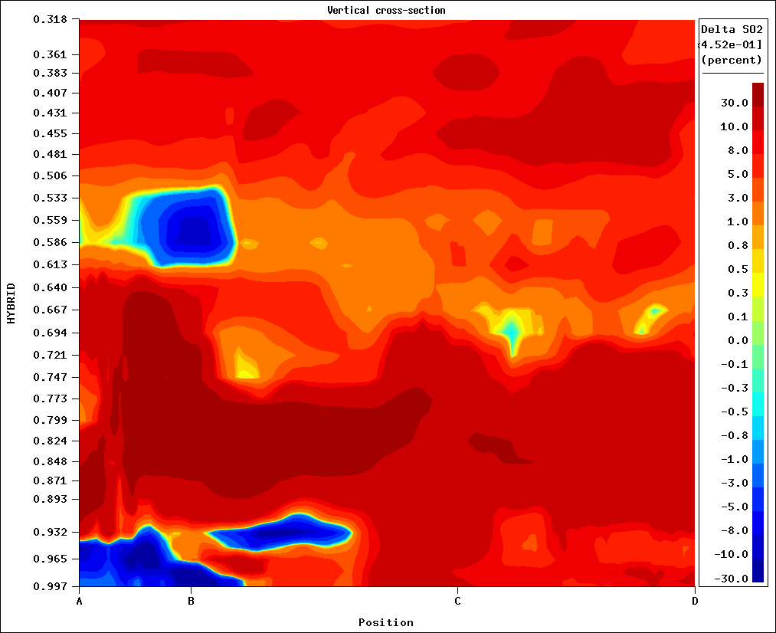
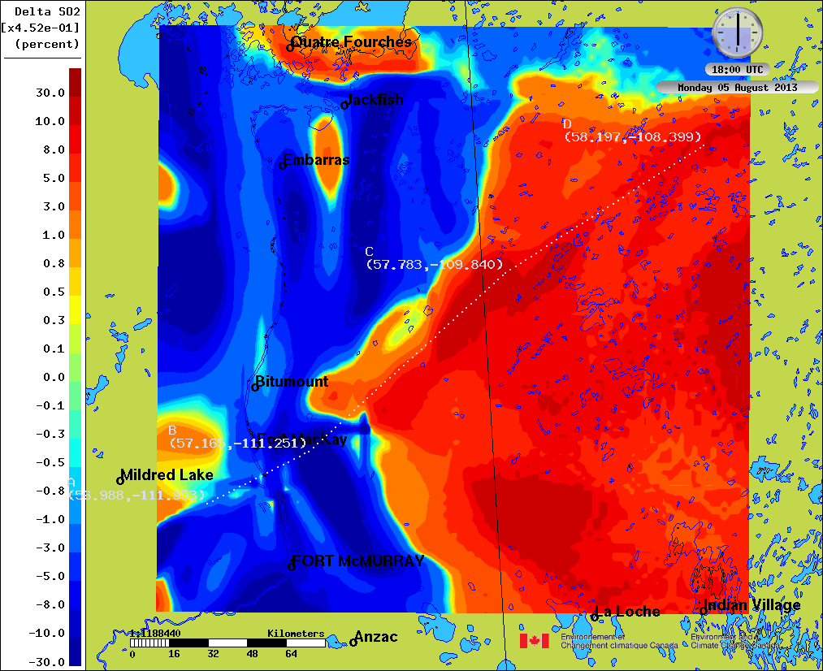
Results: impacts on average model SO₂ concentrations in the vertical: average cross-sections (% difference)
Average SO₂ percentage differences, vertical cross-section (left) and surface map (right) near oil sands.
Location of the cross-section is shown on map at right.

Slide 33
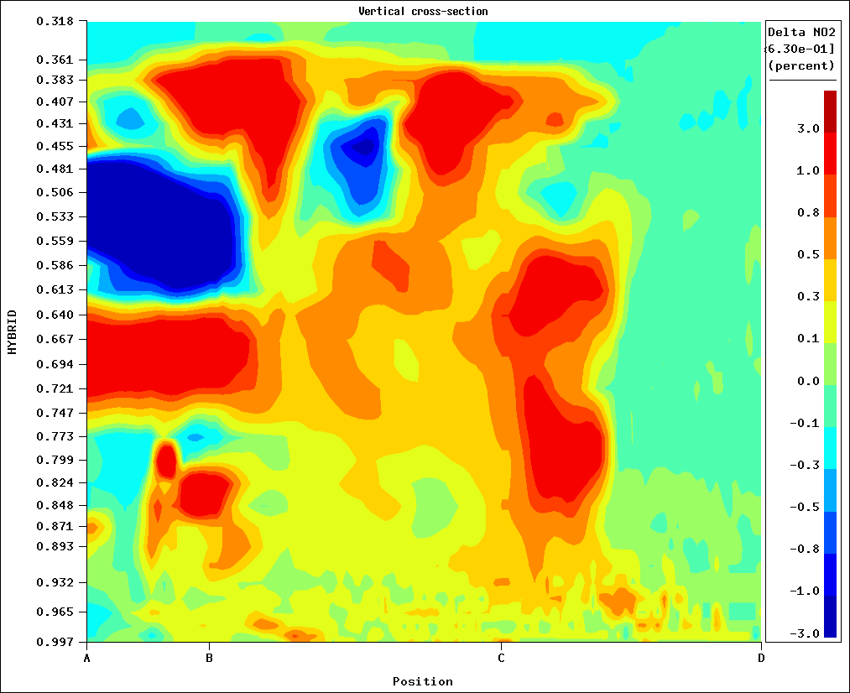
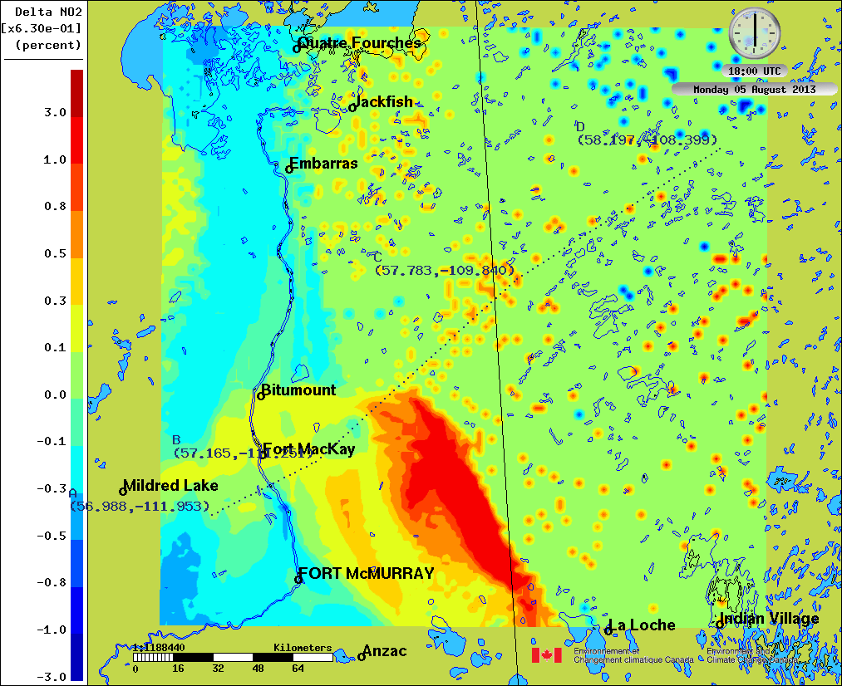
Results: impacts on average model NO₂ concentrations in the vertical: average cross-sections (% difference)
Average NO₂ percentage differences, vertical cross-section (left) and surface map (right) near oil sands.
Location of the cross-section is shown on map at right.

