Slide 1


Development of an operational assimilation system utilizing a Regional Chemistry Transport Model of Japan Meteorological Agency
Masaaki Ikegami^{1,2}, Akane Kamada^{1,2}, Mizuo Kajino², Makoto Deushi^{1,2}
¹Japan Meteorological Agency
²Meteorological Research Institute
Notes:
Thank you, chairperson. I am Masaaki Ikegami with the Japan Meteorological Agency, JMA.
Today, I’d like to talk about recent improvement of the ozone chemistry transport model for photochemical oxidant prediction.

Slide 2
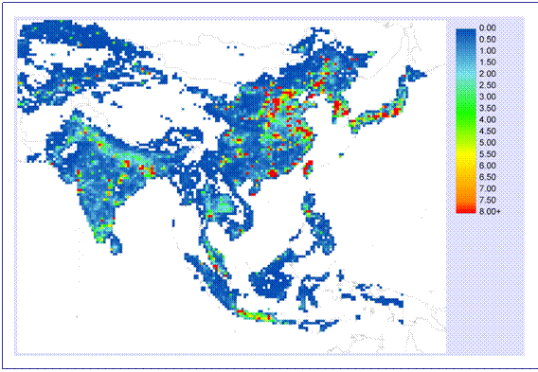
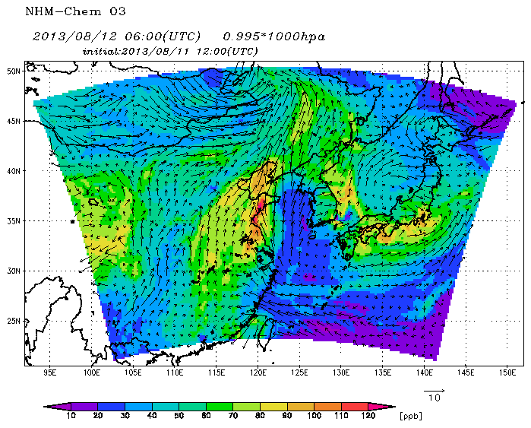
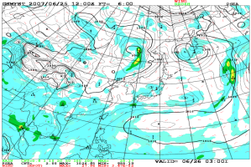
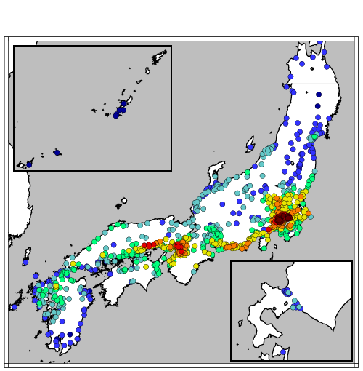
Photochemical oxidant advisory in Japan
2015~
Emission inventories
Chemistry
Transport
nesting
Global model analysis and forecast by JMA
Global CTM
(MRICCM2)
~110 km
Regional CTM
(NHM-Chem)
20 km
Deushi, 2011
nudging
Kajino, 2012
Observed surface ozone concentrations
QC
Bias
correction
O₃
Oxidant advisory
Category
advisory 2 (over 120 ppb)
advisory 1 (over 80 ppb)
advisory 0 (below 80 ppb)
JMA plan to adopt operationally the assimilation method in spring 2017.
Notes:
First of all, I’ll show you some background. In Japan, photochemical oxidant has damaged our life since 1960s, and this risk has not gone away completely. This slide shows how we issue photochemical oxidant information to the public in Japan. At present we operationally use a global ozone chemistry transport model called MRI-CCM2 and regional CTM called NHM-Chem, to estimate surface ozone concentration for Japan. They ware developed by the Meteorological Research Institute (MRI) of JMA. According to the simulated oxidant concentration we diagnose an oxidant advisory of three categories to each prefecture. The categorization is like this, if daily maximum surface ozone concentration at each prefecture seemed to be over 120 ppb, it is categorized as level 2 and, we essentially provide information on photochemical oxidant. But the current model system not assimilate observed surface ozone concentrations. Therefore we developed a method to assimilate observed surface ozone concentrations using a nudging technique for the regional CTM. We are going to operate this in 2017.
（参考）
The MRI-CCM2 model (e.g. Shibata et al., 2005) is designed to simulate the distributions and time- evolutions of ozone and related chemical species over the troposphere and the middle atmosphere comprehensively, and used for the operational prediction of photochemical oxidant near the surface at the Japan Meteorological Agency. In the MRI-CCM2 model, a chemistry module is coupled with a general circulation model (GCM) via the MRI Scup coupler.

Slide 3
Contents
Specification of prediction system
Observed data quality control
Data assimilation method (nudging)
Result of simulated Oxidant Verification
Notes:
These are today’s topics.
First, I would like to introduce the surface ozone prediction system.
Next, I will talk about the observed data quality control.
Then I will present data assimilate method, and results of simulation.

Slide 4
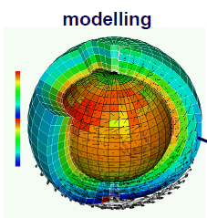
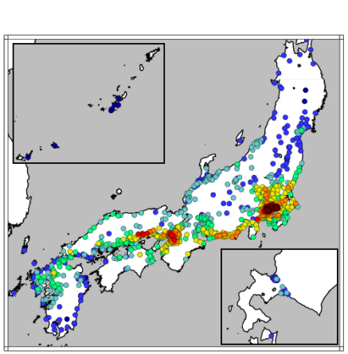
1. Forecast system using regional - global CTM
Global CTM (MRI-CCM2)
Regional CTM (NHM-Chem)
Emission inventories
TL159L64
Nesting
O₃ NO₂
NO CO
Horizontal 20km, 18 levels
nudging
QC
nudging
Meteorological data
nudging
Global model analysis and forecast by JMA
JMANHM （20km）
Observed surface ozone concentrations
4
Notes:
Next slide shows the relation between the global CTM and the regional CTM. The global CTM use emission inventories and nudged toward the operational Global Numerical Weather Forecast model analysis and forecast by JMA. The global CTM simulates O3 (ozone), NO2 (nitric dioxide), NO (nitric oxide), CO (carbon monoxide) and other chemicals, so we nest them from the global model to the regional model. The regional CTM also uses emission inventories. As to meteorological data, it uses forecasts by JMANHM with 20km resolution. This meteorological model also uses global meteorological analysis as boundary condition. And this time, we are developed a method to assimilate observed surface ozone concentrations using a nudging technique to regional CTM.

Slide 5
Specification of global CTM (Deushi and Shibata, 2011)
CTM Resolutions | TL159 (1.125°) / 64 levels (surface – 0.01 hPa)
Initial time and forecast time | At 12 UTC in 72 hours (once a day)
Tropospheric and Stratospheric Chemistry | Chemical species : 90 (long-lived: 64, short-lived: 26)
 | Chemical Reactions: 247 ( Photolytic: 59, Gas phase: 172, Heterogeneous: 16 )
Emission inventories | EDGAR v2.0 | anthropogenic | Global
 | GEIA | natural | Global
 | REAS1.1 | anthropogenic | East Asia
Notes:
Next slide is on the specification of our global CTM.
The model has a horizontal resolution of TL159 and 64 layers from surface up to 0.01 hPa. We operationally calculate the CTM once a day. The initial time is at 12 UTC, and forecast time has 72 hours.
The chemistry module has 90 chemical species, and 250 chemical reactions.
We use anthropogenic and natural emission inventories such as EDGAR, GEIA, and REAS. The REAS is East Asian anthropogenic emission inventory and is provided by Dr. Ohara in the National Institute for Environmental Study (NIES) in Japan.

Slide 6
1. Specification of the regional CTM
Model Resolutions | 20 x 20 km ( Lambert Coordinates ) / 18 levels (surface – 50 hPa)
Meteorological /Chemical Module (off line coupled) | JMANHM(Meso-Scale Model by JMA) / RAQM2 (Kajino et al., 2012)
Tropospheric Gas Chemistry | Chemical species : 72 Chemical Reactions: 214 (SAPRC99; Carter, 2000)
Emission inventories | REAS1.1 | anthropogenic
 | MEGAN2, etc. | natural
 | GFED3 | biomass burning
Notes:
This is specification about the regional CTM. Its horizontal resolution is 20 km by 20 km in Lambert Coordinates. The vertical resolution is 18 layers from the surface to 50 hPa in terrain-following coordinates. Its meteorological module is JMA’s meso-scale non-hydrostatic model. Its chemical module is RAQM2 developed by Dr. Kajino at MRI. We use the SAPRC99 gas-phase atmospheric chemical module and these emission inventories.

Slide 7
2. Observed surface ozone concentrations Data quality control
Ox_{t}>=80
NA
QC5
QC1
QC4
yes
Ox_{t}<=250
(in winter: Ox_{t}<= 100)
outlier
no
Ox_{t}>=100
QC2
correct
Ox_{t}=<μ_{t}+3σ_{t}
Ox_{t}<=μ_{t}+5σ_{t}
outlier
|dOx|_{t}<=90
outlier
QC3
|dOx|_{t-1}<=50 .and.
|dOx|_{t}<=50
Ox_{t}: Ox concentration at time t.
dOx_{t}: deference of Ox concentration between time t and t-1.
μ_{t}(σ_{t}): mean (standard deviation) of Ox concentration at the nearest 6 ~ 10 stations from the station within its 50 km radius at time t.
QC5_{t}: result (outlier or correct) of QC5 at time t.
winter: NOV. – FEB.
correct
correct
QC5_{t-1}=outlier
outlier
Notes:
In japan, air quality is observed by local government. JMA can use near real-time observed surface ozone data; however, as to final result after data screening by local government (FINAL), JMA can use it about 2 years later.
Therefore we applied original quality control (QC) methods to near real-time data.
QC1 is gross check. It is rare for surface O₃ concentration to increase over 250 ppb.
QC2 is spatial check. We previously calculated mean and standard deviation of O₃ concentration at the nearest 6 ~ 10 stations from the station within its 50 km radius. If a value was within the mean plus minus 3sigma, it is identified correct.
QC3 is hourly difference check. If the deference of O₃ concentration from previous value was within 50 ppb at time t and t-1, it is identified correct. QC4 has QC1, 2, 3. Moreover, QC5 is more strict spatial check and hourly different check if the data is over 100 ppb.

Slide 8
2. Observed surface ozone concentrations Data quality check
 |  | FINAL
 |  | correct | outlier
QC5 | correct | 3889(A) | 48(B)
 | outlier | 68(C) | 418(D)
 | Method | Ratio=(B+C)/total
 | near-real time data | 9.68%
QC1 | gross check | 6.64%
QC2 | spatial check | 8.32%
QC3 | hourly difference check | 6.65%
QC4 | combination of QC1, 2, 3 | 3.05%
QC5 | more strict check | 2.62%
Notes:
We compared near real-time data after these QC methods at 1191 stations from April 2010 to March 2013 with FINAL. 4423 samples were selected.
We classified outliers and others in every QC and FINAL as described in Table 5. Discrepancy rate of QC5 was best (Table 4). As result, we determined QC5 for data assimilation with NHM-Chem.

Slide 9
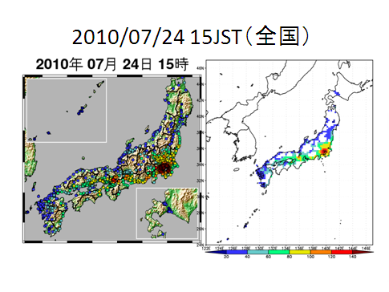
2. interpolate observational data to regional model grid value
Japan
After the QC of the observations at each station, grid point values are calculated by averaging the observations in each model grid (20x20 km).
Notes:
After the QC of the observations at each station, grid point values are calculated by averaging the observations in each model grid (20x20 km).

Slide 10
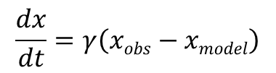
3.Data assimilation system (nudging)
Operational time schedule
04JST (local time)
calculation start
05 JST
calculation end
09:20 JST
Release the advisory
Observed surface ozone concentrations
2100
2200
2300
0200
0300 JST (local time)
Quality control
Interpolation to model grid
Data assimilation by nudging
Nudging in the boundary layer
Nudging time constant γ= 1/1000[s⁻¹]
$$\frac{dx}{dt}=γ\left(xobs−xmodel\right)$$
72 hour (operational)
Regional CTM
（NHM-Chem）
Forecast
・・・
・・・
Initial
Boundary
Global CTM
（MRI-CCM2）
・・・
・・・
・・・
Notes:
Our operational forecast system starts calculation at 04 japan standard time (JST) with initial time of 21 JST of the previous day.
Therefore, it assimilates oxidant data observed in 21 ~ 03 hours local time and forecasts after that.
We are perform observed ozone data assimilation by nudging in the boundary layer
Nudging time constant is 1000 seconds.

Slide 11
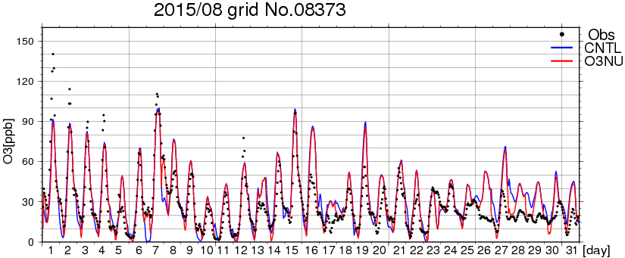
4. Result
Tokyo grid
Observation
no assimilation
assimilation
Simulated concentrations of O₃ are calculated continuously.
Observed O₃ concentrations are assimilated only night time (21 ~ 03 local time) .
The regional model simulates diurnal variations very well.
Notes:
To check the performance of this new assimilation method, we compered forecasts of the surface ozone concentration with observations. The period of the validation was from March to September 2015. This is an example of hourly observed values and simulated ones in August, 2015 at the regional CTM grid around Tokyo. Simulated concentrations of O3 are calculated continuously.
Observed O3 concentrations are assimilated only night time (21 ~ 03 local time) .
The regional model simulates diurnal variations very well. At night time, the model no assimilation tends to underestimate the ozone value. But the model surface ozone assimilated well reproduced those values during the assimilation on.

Slide 12
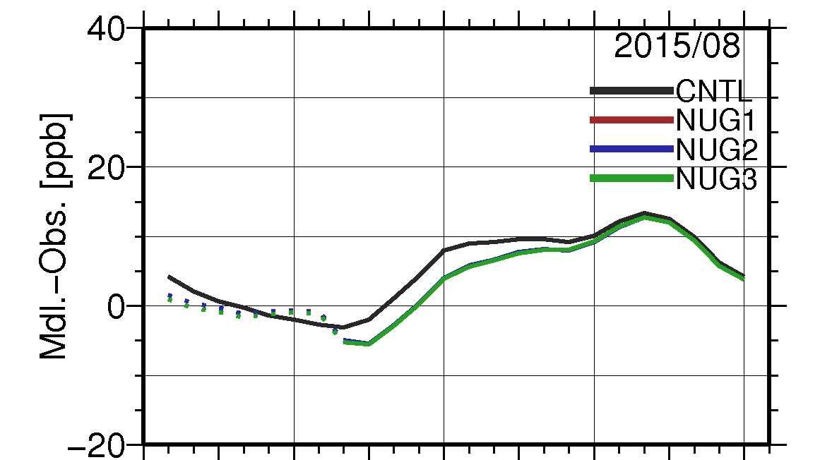
4. Result
Tokyo grid
no assimilation
assimilation
21 0 3 6 9 12 15 18 21 JST (local time)
Hourly time series of mean error in August 2015 in Tokyo grid
Observed O₃ concentrations are assimilated only night time (21 ~ 03 local time) .

Slide 13
4. Result of simulated Oxidant Verification
We verified all the points with data in Japan area.
Verification term：March ~ September, 2015
Forecast period：04～20JST (local time)
ozone assimilation | Mean Error | RMSE | R
OFF | 8.9 ppb | 15.7 ppb | 0.61
ON | 6.6 ppb | 13.7 ppb | 0.69
Notes:
We verified all the points with data in japan area. The verification is conducted during the period from march to September, 2015. The estimated model bias from the observation is reduced from 8.9 ppb to 6.6 ppb, RMSE is also reduced from 15.7 ppb to 13.7 ppb, and the correlation coefficient is improved from 0.61 to 0.69.

Slide 14
Statistical Guidance
Frequency Bias Correction Method
Guidance
Observation daily maximum
We use this method to make statistic guidance at every prefecture and every month.
O3(ppb)
(5%)
Ⅳ
<- category
120
Ⅲ
(10%)
Guidance
=bias correction
Ⅰ
Ⅱ
Ⅲ
Ⅳ
100
Ⅱ
(35%)
80
Ⅰ
(50%)
Ⅰ
Ⅱ
Ⅲ
Ⅳ
Model
daily maximum
(50%)
(35%)
(10%)
(5%)
frequency
67
78
85
O3(ppb)
Notes:
We forecast the daily maxima ozone concentrations by every prefecture. We make it from statistical guidance. So we conduct verification this statistical guidance too. First I explain the statistical guidance. Generally, model daily maxima ozone concentrations are lower than observed.
To compensate the underestimations of the daily maxima, a statistical guidance is introduced to our operational forecast system.
But before the statistical calculations, we have a problem that the frequency distribution of observation and model are different from each other. So, we need to correct the model frequency distribution.
Here, I divided observed daily maxima oxidant concentration into four categories at the thresholds by 80, 100, and 120 ppb.
The number of daily maximum oxidant concentrations is counted at each category. From this number frequency, we can newly calculate the appropriate threshold values in the model. These threshold values correspond to the categories of the model, and these model thresholds are used for the interpretation in the guidance.
If the simulated value is 82 ppb, the statistic guidance is 111 ppb. In this way we change simulated value to statistic guidance.

Slide 15
Verification of statistical guidance Threat Score (TS) or Critical Success Index (CSI)
Event observed
Event forecast
Yes
No
Its range is 0 to 1. Perfect forecast / TS=1
Yes
FO
FX
No
XO
XX
O₃ daily maximum
120ppb Threat Score （2013-2016）
Obs. O₃ assimilation | On | Off
TS | 0.33 | 0.32
Since data assimilation is done only night time, it is not very effective for the daily maximum value.
Notes:
To validate the statistic guidance, we use Threat Score (TS) or Critical Success Index (CSI) that is useful to validate rare phenomena. First, we categorize all the events into four by forecasted or not and observed or not like this table. Our target is rare phenomenon so XX number in this table is large. TS is the score without XX like this equation. Using this score, TS of the regional CTM assimilation on and off are 0.33 and 0.32.

Slide 16
Summary
We are developing a method to assimilate observed surface ozone concentrations using a nudging technique.
The performance of model using the assimilation method is better than it did without using it.
We plan to adopt operationally the assimilation method in spring 2017.
Thank you for your attention!
Notes:
In summary,
Thank you very much.

Slide 17
Reference
Carter, W.: Documentation of the SAPRC-99 chemical mechanism for VOC reactivity assessment. Final report to California Air Resources Board, Rep. 92-329, Univ. of Calif., Riverside, 8 May, 2000.
Deushi, M. and Shibata, K.: Development of an MRI Chemistry-Climate Model ver.2 for the study of tropospheric and strarospheric chemistry, papers in Meteor. Geophys., 62, 1-46 (2011).
Kajino, M., Y. Inomata, K. Sato, H. Ueda, Z. Han, J. An, G. Katata, M. Deushi, T. Maki, N. Oshima, J. Kurokawa, T. Ohara, A. Takami, S. Hatakeyama: Development of an aerosol chemical transport model RAQM2 and prediction of Northeast Asian aerosol mass, size, chemistry, and the mixing type. Atmos. Chem. Phys., 12, 11833-11856, 2012

