Slide 1
8th IWAQFR, Toronto, Ontario. January 10–12, 2017
Session 4: Urban and High-Resolution Air Quality Modelling
Impacts of urban heat-island circulation on distributions of air pollutants over Tokyo
*Makoto Deushi^{1,2}, Mizuo Kajino¹, Toshinori Aoyagi^{1,2}
¹ Meteorological Research Institute,
² Japan Meteorological Agency
Notes:
Thank you for introducing me. I am Makoto Deushi of Meteorological Research Institute, Japan.
Today, I’d like to talk to you about “Impacts of urban heat-island circulation on distributions of air pollutants over Tokyo”.

Slide 2
Outline
The effect of urbanization on local meteorological phenomena has been the subject of much research in Japan (e.g. Fujibe 2009).
However, the impacts of urban heat-island (UHI) on distributions of air pollutants over the Tokyo area, Japan, have received less attention so far.
We investigate the impacts of UHI circulation by using an online regional chemical transport model coupled to an urban canopy model.
Notes:
Here is an outline of this talk.
The effect of urbanization on local meteorological phenomena has been the subject of much research in Japan.
However, the impacts of urban heat-island on distributions of air pollutants such as ozone and NOx over the Tokyo region have received less attention so far.
In this study, we investigate the impacts of urban heat island circulation by using an online regional chemical transport model with an urban canopy model.

Slide 3
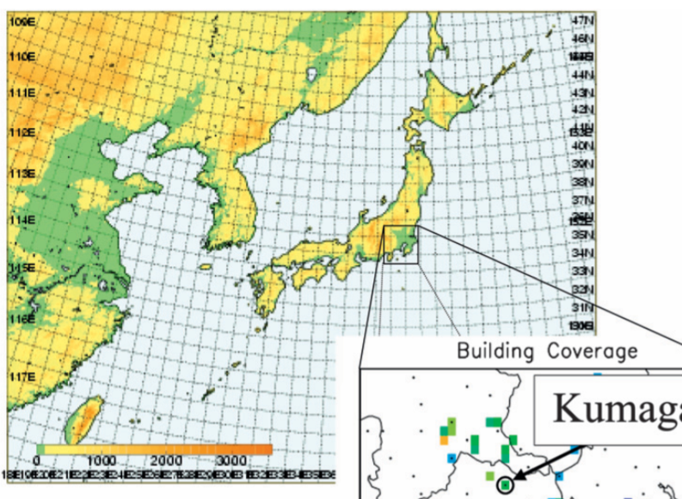
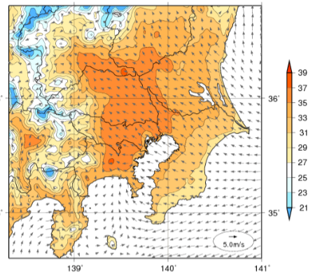
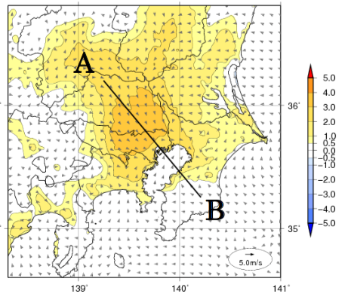
Urban heat-island in summer over Tokyo
JMA NHM simulation
Sea-breeze
Temperature at 15 JST
Diff. in Temperature between
URBAN run and NO_URB run
Notes:
This slide shows simulated surface temperature in a typical summer sunny day over the Tokyo and the suburban areas.
We used the meso-scale non-hydrostatic model coupled to the urban canopy model for this simulation.
This model has been developed at Japan Meteorological Agency, called JMA NHM.
As shown in the left figure, the high temperature area over 35 degrees is simulated at 15 local time.
The intrusion of sea breeze is deep over the land.
The estimated urbanization effect of the Tokyo area on the temperature at this time are shown in the right figure.
As you can see, the temperature increase due to the urbanization is over 3 degrees at maximum in this simulation.
The see-breeze weakens due to the urban-induced local circulation anomaly.

Slide 4
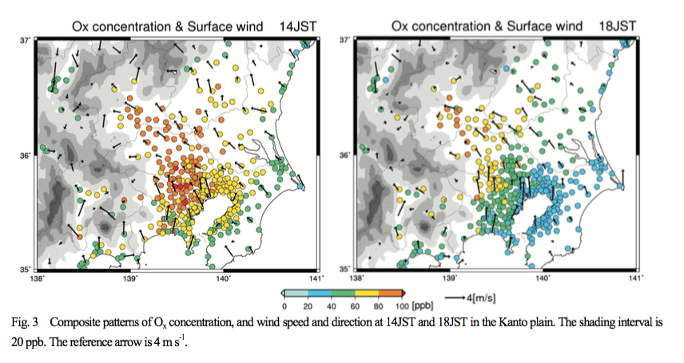
Relation between see-breeze and ozone in summer
14 JST
18 JST
Endo et al. (2013)
Notes:
This slide shows composite patterns of Ox concentration and surface wind vectors at 14 and 18 local times in Tokyo and the suburban areas.
Colored circles indicate the composite of observed Ox concentration under fair weather conditions in summer.
The maximum Ox concentration at 14 local time are observed near the Tokyo bay, where is both the most populous and largest industrialized area in Japan.
On the other hand, at 18 local time, the maximum Ox concentrations are found in a suburban area to the north-west of Tokyo.
The daytime sea-breeze from the south-east mainly transports pollutants such as ozone and NOx to the northwest inland area.
One of the questions is how the urban heat island circulation influence on this relation between see-breeze and distributions of the pollutants in summer.
.

Slide 5
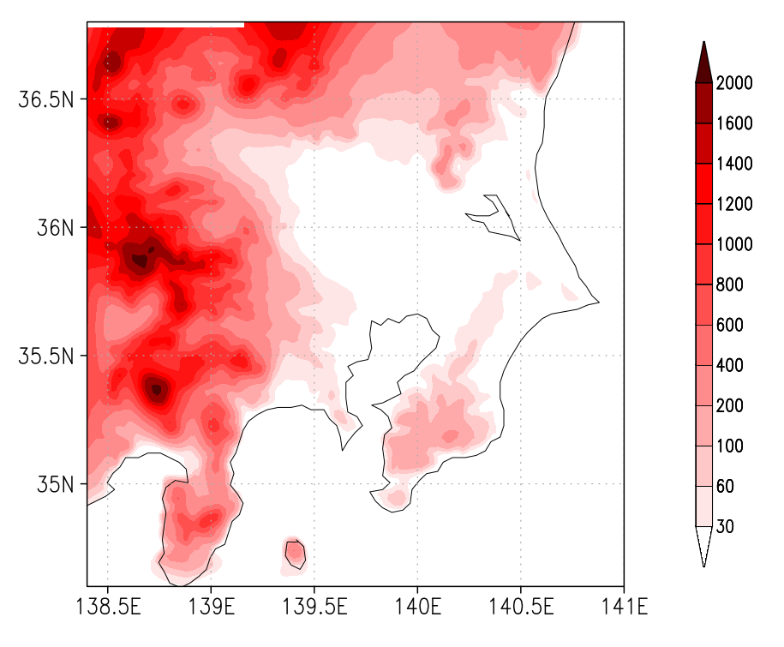
Air quality model
Model name:
NHM-Chem (Kajino et al., 2012)
Meso-scale atmospheric model:
JMA non-hydrostatic model (JMA NHM)
online coupled with chemistry module
Model Resolutions:
2km x 2 km, 50 levels
Tropospheric Gas Chemistry:
SAPRC-99 chemical mechanism
(Carter, 2000)
Emission inventories:
Anthropogenic : EAGrid-2010
Biogenic VOCs : MEGAN2
Biomass Burning: GFED3
Model domain with terrain height
Notes:
To investigate this point, we performed some numerical simulations by using the regional chemical transport model developed at Meteorological Research Institute, Japan, called NHM-Chem.
The chemistry module of this model is coupled online with JMA NHM.
The model domain covers Tokyo and the suburban areas with the horizontal resolution of 2 km.
The SAPRC99 gas-phase chemical mechanism and these emission inventory data were used in the simulations.

Slide 6
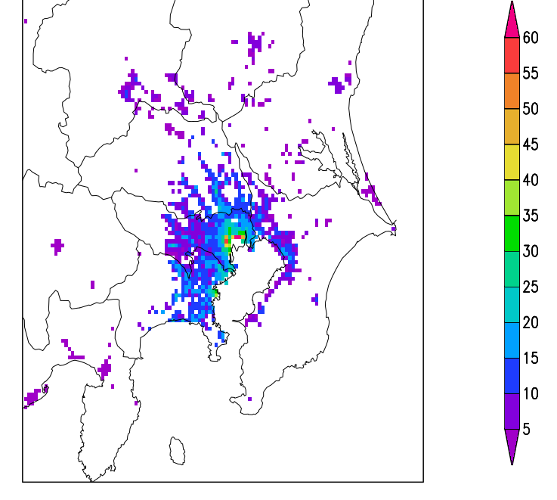
Simulations
・ URBAN simulation：
- SPUC urban canopy scheme (Aoyagi and Seino, 2011)
- Anthropogenic Heating (Senoo et al., 2004)
・ NO_URB simulation：
- Urban land use is replaced with Grasslands
- NO Anthropogenic Heating
The SPUC scheme was applied on those grids with more than 80% of the land use designated as urban building area, road area, and bare urban area.
Simulation Period: July-August 2010
Anthropogenic heating
Notes:
Here is an outline of the numerical simulations:
We performed two simulations for the period of July-August 2010 by using the NHM-Chem.
In the URBAN simulation, the SPUC urban canopy scheme was applied in order to take account of surface energy balance in the built area.
This scheme was applied only on those grids with more than 80% of the land use designated as urban building area, road area, and bare urban area.
The anthropogenic heating, as shown in the right bottom figure, was also considered in this simulation.
In the NO_URBAN simulation, urban land use was replaced with grasslands, and there was no anthropogenic heating.

Slide 7
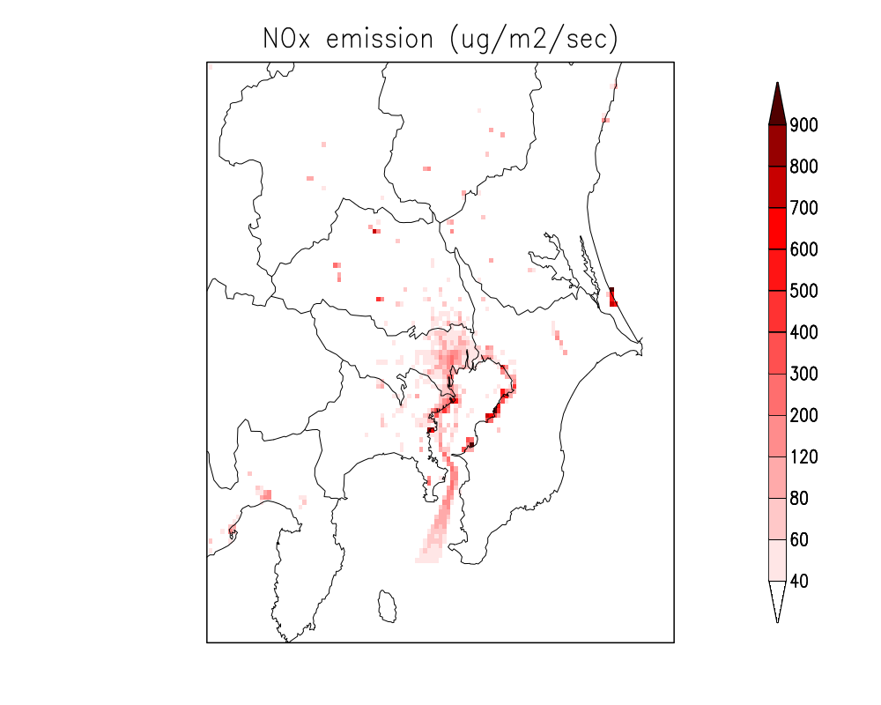
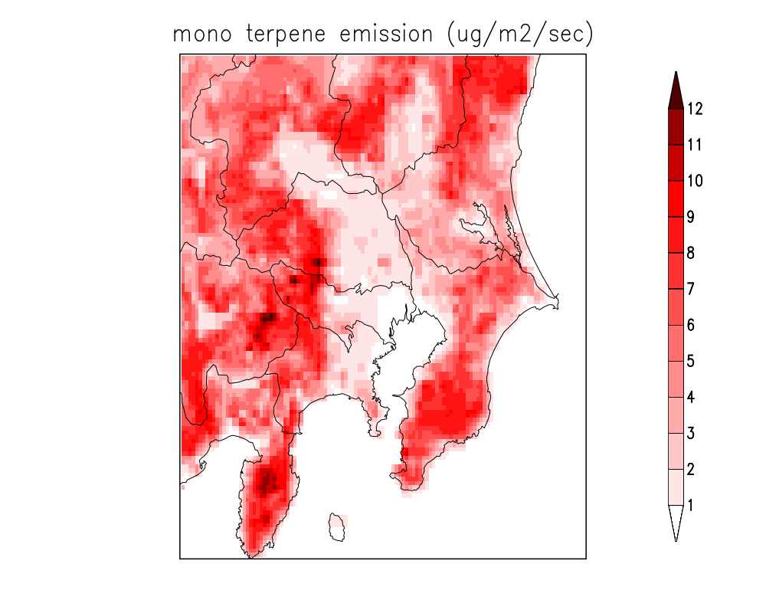
Emissions
NOx emission
Monoterpene emission
suburban
urban
Unit is ㎍/m²/sec.
Notes:
These figures show monthly averaged NOx and Monoterpene emissions in July 2010, which were used as boundary conditions in the two simulations.
As you can see, the anthropogenic emission of NOx is large around the Tokyo bay, where is the largest industrialized area in Japan.
On the other hand, biogenic VOC emissions such as isoprenes and terpenes are large in rural areas, which surround urban and suburban areas.
The red and green rectangles respectively indicate the urban analysis area and the suburban analysis area in this study.

Slide 8
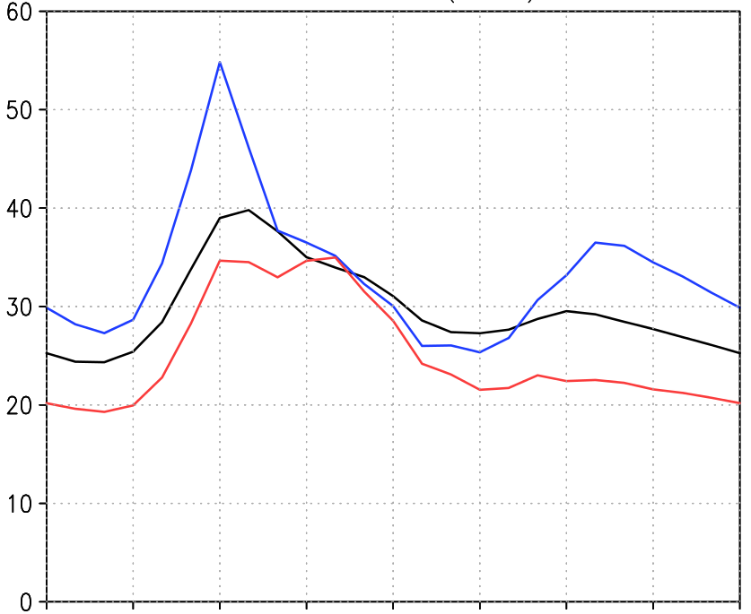
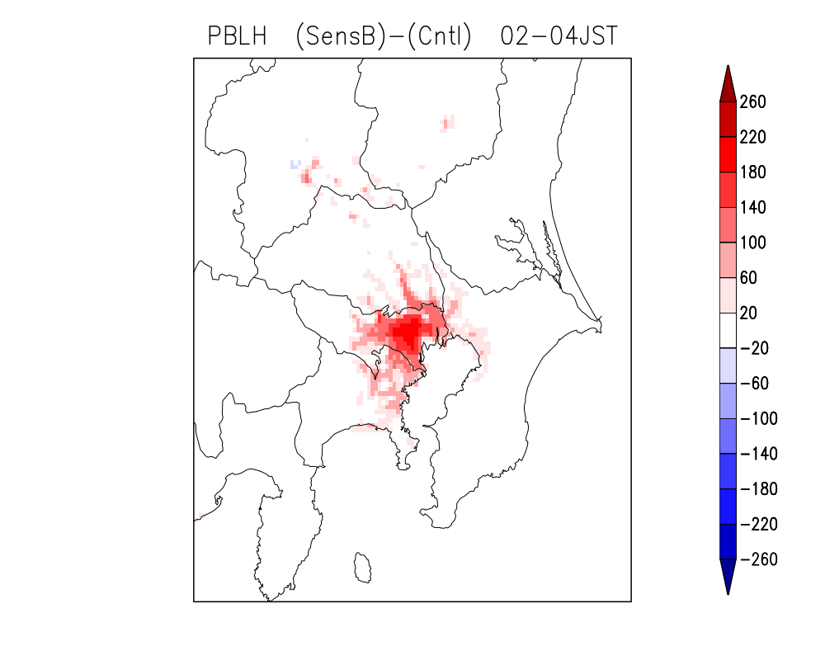
Results: Diurnal variation of NOx in urban area
NOx (ppbv)
Diff. in PBL Height (m)
(URBAN) – (NO_URB)
02-04 JST
0
6
12
18
24
JST
Black：OBS
Red ：URBAN simulation
Brue ：NO_URB simulation
July-August average
Notes:
Now, I'd like to look at results of the two simulations:
The left figure shows the diurnal variations of the surface NOx volume mixing ratios in July and August, which are averaged over the urban analysis area.
The black line indicates the observed diurnal variation, while the red and blue lines respectively indicate those in the URBAN simulation and the NO_URBAN simulation.
Compared to the observations, NOx concentration in the NO_URBAN simulation is higher during nighttime, especially at 6 local time.
On the other hand, in the URBAN simulation, the diurnal variation is rather realistically reproduced.
In the URBAN simulation, the deeper urban boundary layer, as shown in the right figure, leads to the lower NO2 surface concentration, especially in the early morning.

Slide 9
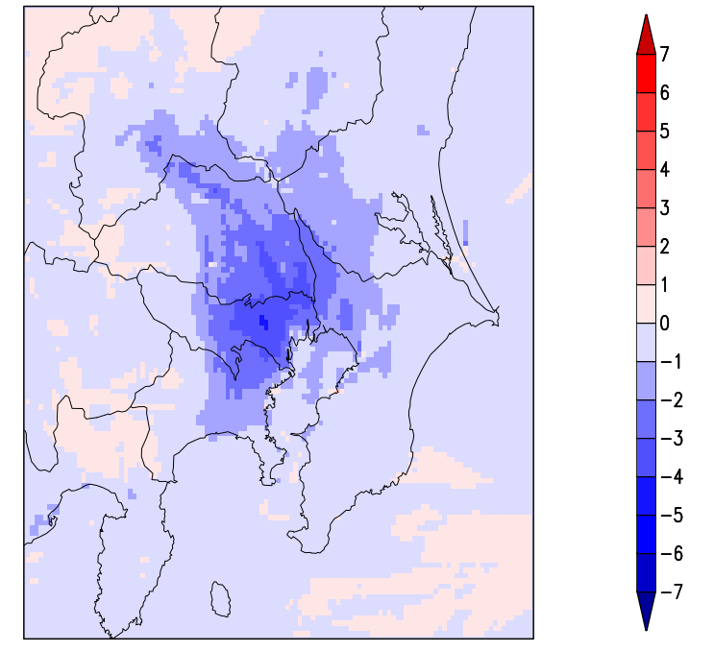
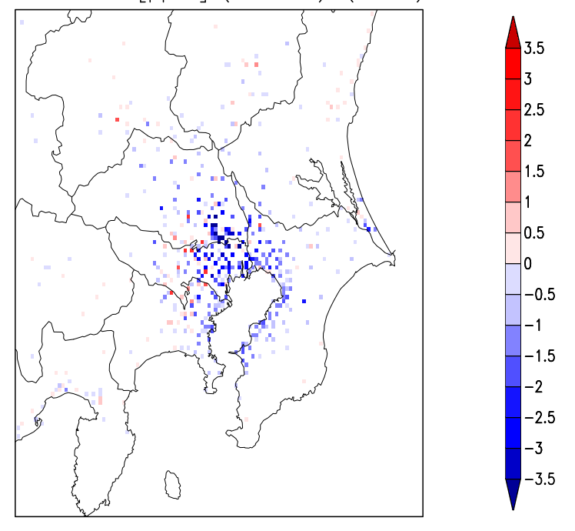
Difference in the surface NO₂ concentration
Difference between two runs
(URBAN) – (NO_URB)
NO₂ (ppbv)
NO₂ RMS Error (ppbv)
Notes:
These figures show differences in the surface NO₂ concentration and the root mean square errors between two simulations.
The lower NO2 concentrations are simulated not only in the urban area but also in the suburban areas. This suggests that not only the enhanced turbulence but also the urban-induced local circulation contribute to the lower concentrations.
The root mean square errors in the URBAN simulation are reduced at the greater part of the observation sites.
This means that the URBAN simulation captures better the observed surface NO2 distributions.

Slide 10
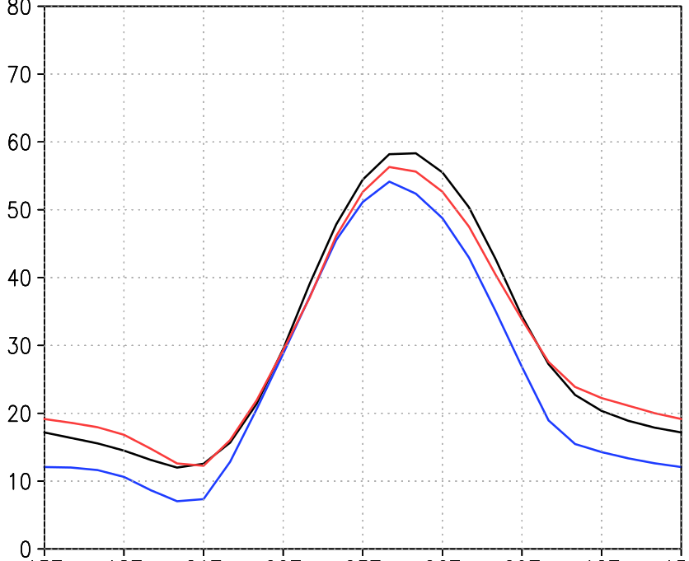
Diurnal variation of O₃ in urban
O₃ (ppbv)
0
6
12
18
24
Black：OBS
Red ：URBAN simulation
Brue ：NO_URB simulation
JST
July-August average
Notes:
You see here the diurnal variations of the surface O3 volume mixing ratios averaged over the urban analysis area.
On average, ozone concentration is 8 ppb higher during the nighttime in the URBAN simulation than in the NO-URBAN simulation. The negative bias during the night time in the NO-URBAN simulation is not seen in the URBAN-simulation.
The higher O3 concentration during the night-time is primarily due to the reduced O3 destruction by NO in the deeper urban boundary layer.
In the deep urban boundary layer, the primary pollutants such as NO and CO are diluted and hence their near-surface concentrations become lower.
The maximum ozone concentration during the daytime is also higher by about 3 ppbv in the URBAN simulation.

Slide 11
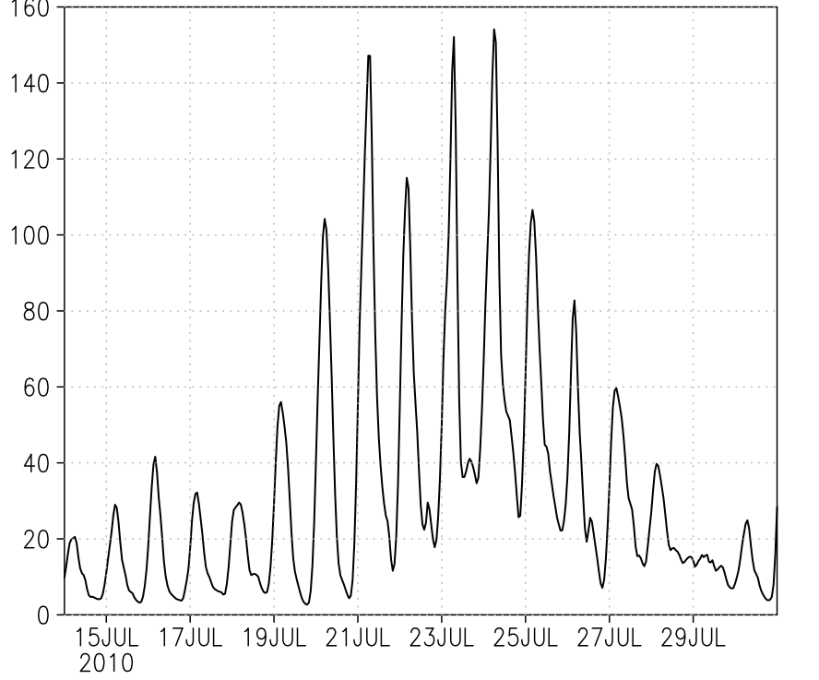
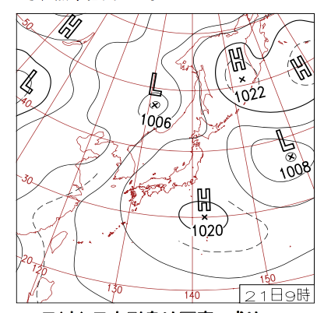
High O₃ event in Tokyo area
Time series of O₃ in July 2010
20-24 July
21 July, 2010
Notes:
Now, we focus on a summertime high ozone event in Tokyo.
The left figure shows the time series of the observed surface ozone concentrations averaged over the urban analysis area.
As you can see, a high ozone event occurred during the period of 20 July to 24 July of 2010.
In the weather chart on 21 July, the Pacific high-pressure system extended over the main island of Japan.
The Pacific-high remained during this period.
Many parts of Japan as well as the Tokyo area experienced significant high temperatures due to the predominant sunny conditions during this period.

Slide 12
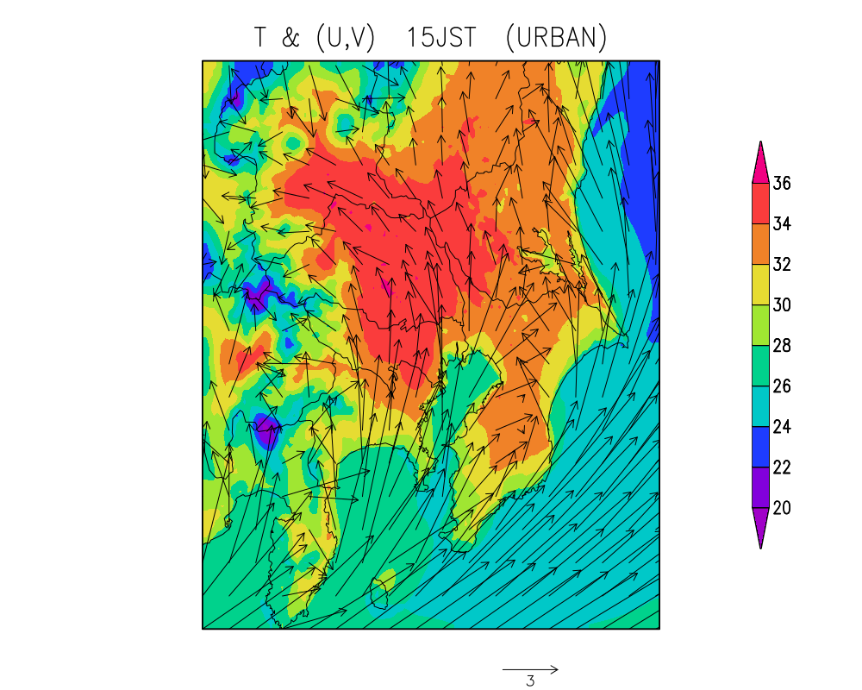
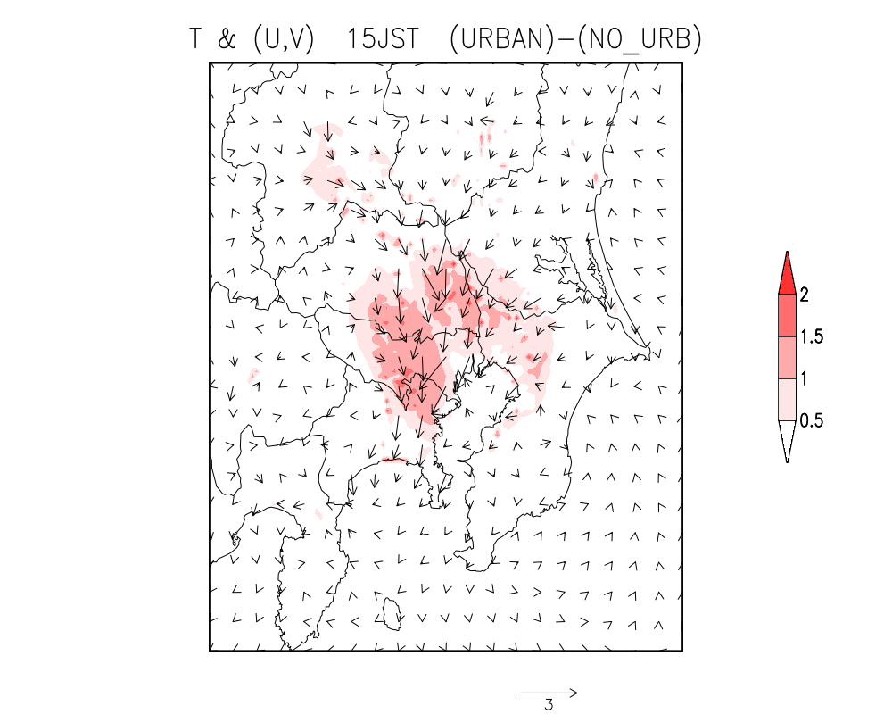
Temperature and sea-breeze in Tokyo
at 15 JST
20-24 July average
Surface Temperature and Winds
Diff. (URBAN) – (NO_URB)
B
B
A
A
A
Notes:
The simulated surface temperature and winds at 15 local time during this period is shown in the left figure.
In the right figure, their differences between the URBAN simulation and the NO_URBAN simulation are shown.
Blue arrows in the left figure indicate dominant wind directions.
The intrusion of sea-breeze from the south is deep over the land.
This sea-breeze basically weakens due to the urban-induced local circulation anomaly, as seen in the right figure.
The urban-induced local circulation anomaly is basically characterized by convergent flow anomaly toward the city center in the lower boundary layer.
Green arrows indicate this convergent flow anomaly.
Next, vertical cross sections from A to B will be shown.

Slide 13
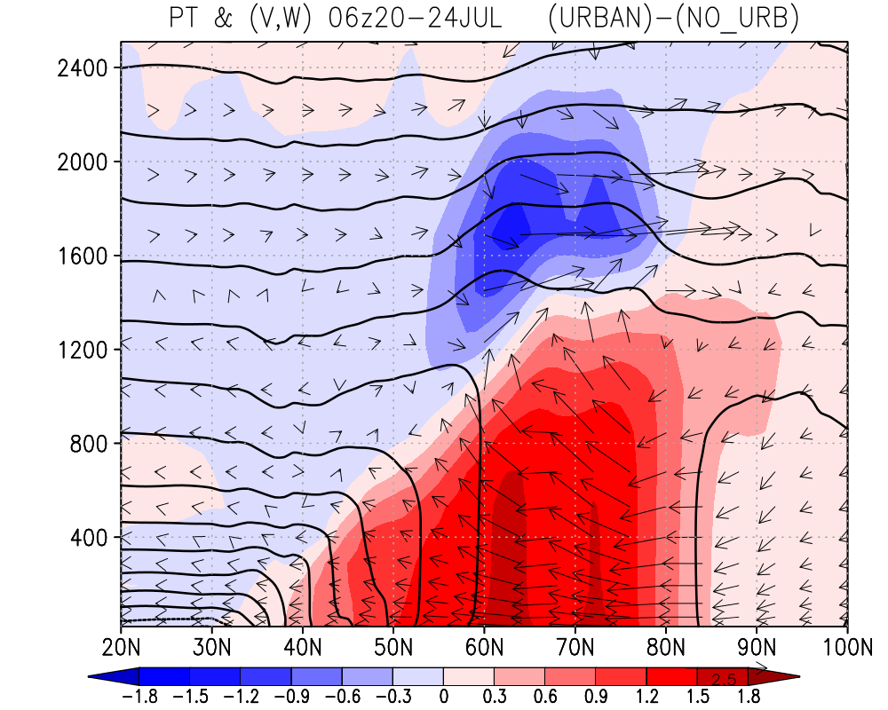
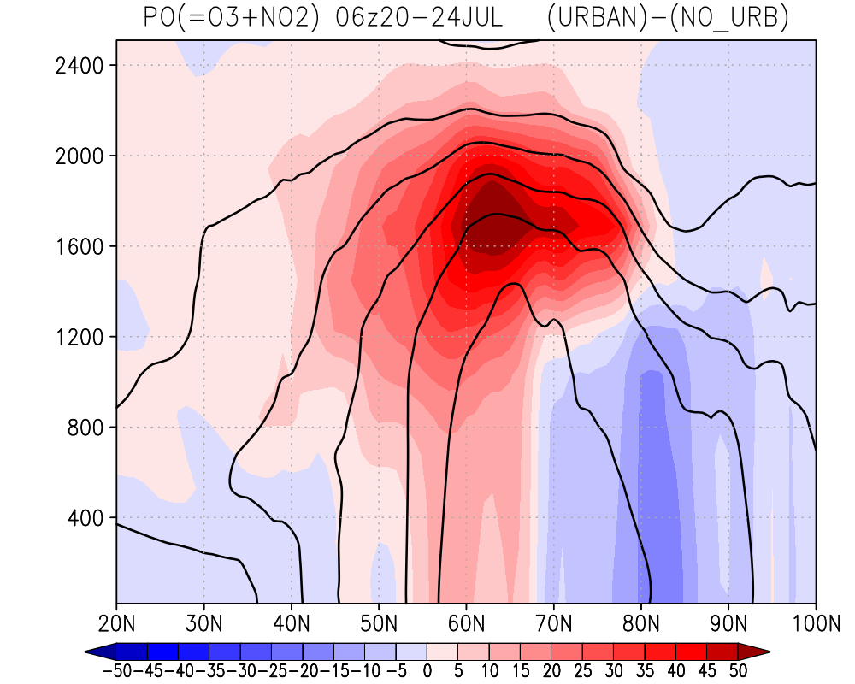
Vertical cross sections (ave. over 20-24 July)
Diff. in PT and (V, W)
(URBAN) – (NO_URB)
Z (m)
A
B
Diff. in PO₃ (=O₃+NO₂)
Z (m)
A
B
Notes:
In the upper figure, color shade indicates the vertical cross sections of difference in the potential temperature between the URBAN simulation and the NO_URBAN simulation.
Green arrows indicate convergent flow anomaly in the lower boundary layer and divergent flow anomaly toward the surroundings in the upper boundary layer.
Due to the urban-induced local circulation anomaly, the potential ozone, which is defined ozone plus NO2, increases in the urban area in the lower boundary layer, while it decreases in the suburban area.
The increased potential ozone near the surface in the urban area is effectively transported upward, leading to much higher potential ozone concentration in the upper boundary layer.

Slide 14
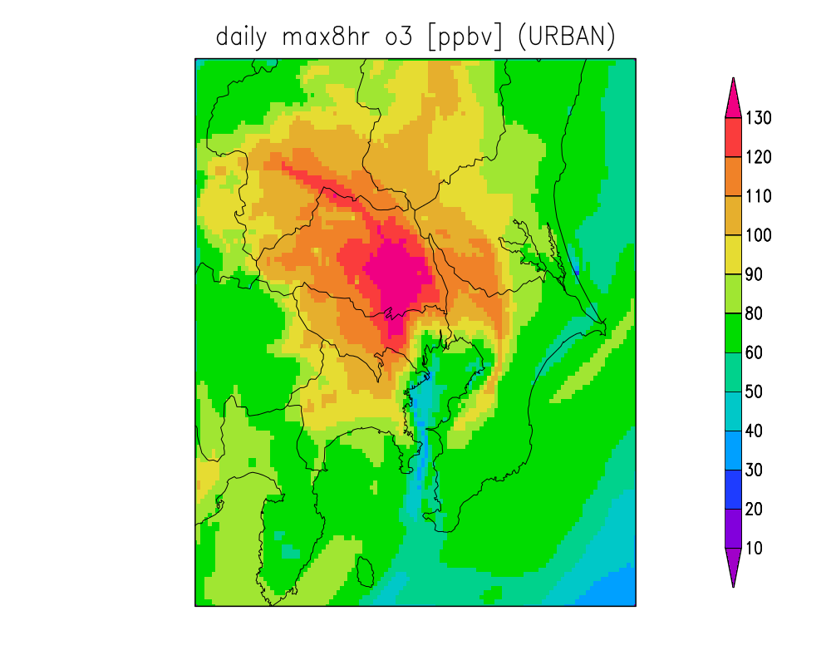
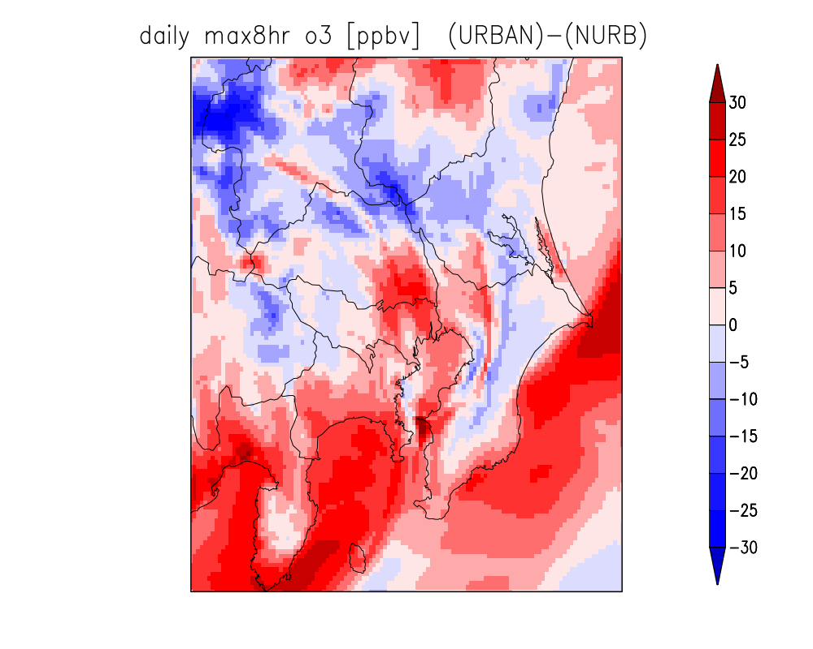
Maximum 8h O₃ concentration
20-24 July average
Max 8-hr O₃ (ppbv)
Diff. in max 8-hr O₃
B
A
Notes:
The horizontal distribution of maximum 8 hour ozone concentration is also influenced by this urban-induced local circulation anomaly.
In the URBAN simulation, higher and lower maximum 8 hour ozone concentrations are simulated over the urban area and the suburban area, respectively.

Slide 15
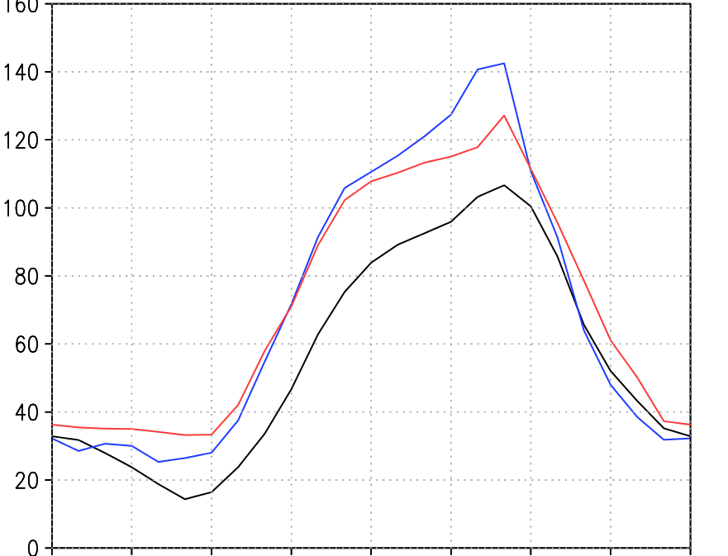
Diurnal variation of O₃ (ave. over 20-24 July)
suburban
O₃ (ppbv)
0
6
12
18
24
JST
Black：OBS
Red ：URBAN simulation
Brue ：NO_URB simulation
Notes:
Diurnal variation of the surface ozone concentration averaged over the suburban analysis area is significantly different between the two simulations.
Although the daytime ozone concentration in both the two simulations are positively biased, the positive bias in the URBAN simulation is significantly small compared to the NO_URBAN simulation.

Slide 16
Conclusion
The deeper urban boundary layer and the UHI circulation decrease surface NOx concentration in the urban and suburban areas, especially in the early morning.
The maximum 8h O₃ increases in the urban area and decreases in the suburban area due to UHI circulation.
Explicit consideration of urban canopy may be important for improving air quality forecasts in suburban areas as well as urban areas.
Notes:
Here is a conclusion of this study:
Impacts of urban heat-island circulation on distributions of O₃ and NO_{x} in Tokyo during the summer season are investigated by using NHM-Chem.
The deeper urban boundary layer and the urban heat island circulation decrease surface NOx concentration in the urban and suburban areas, especially in the early morning.
The maximum 8h O₃ increases in the urban area and decreases in the suburban area due to urban heat island circulation.
Explicit consideration of urban canopy may be important for improving air quality forecasts in suburban areas as well as urban areas.

Slide 17
Thank you for your attention!
Acknowledgement
This research was partly supported by MEXT as “Priority Issue on Post-K computer” .
Notes:
That’s all.
Thank you very much for your kind attention.

