Slide 1


COPERNICUS Atmosphere – Regional Production An Air Quality Ensemble modelling system over Europe. From research to operation.
Marion Pithon (Météo France)
On behalf of CAMS regional team

Slide 2
Plan
Copernicus Atmophere Monitoring Service : a response to environmental concerns.
CAMS Regional : An AQ Ensemble modelling system over Europe.
CAMS Regional : From Research to Operation.

Slide 3


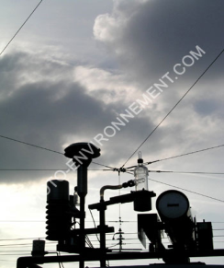
COPERNICUS : a EU program to monitor the Earth
6 thematic streams of services
http://www.copernicus.eu
Based on information from dedicated satellites « Sentinels » and by « in situ » measurement data.
For different needs and users : Policy makers, authorities, private and commercial companies, scientists, citizens.
On a full, free and open basis.
© Jean-Jacques Kissling

Slide 4
CAMS : An operational service after 10 years of research
GEMS, PROMOTE (ESA) → MACC → MACC II → MACC III → CAMS
2006 06/2009 12/2011 07/2014 03/2015
Need of an operational status for products and services :
Sustainability
Reliability and timeliness
ECMWF appointed by EU to implement CAMS.
CAMS is organized in about 15 different sub-projects.
Distributed activities (Open tenders) : Global products, Regional products, Policy support products, Solar radiation, Greenhouse gas fluxes, Climate forcings, Emissions products.

Slide 5
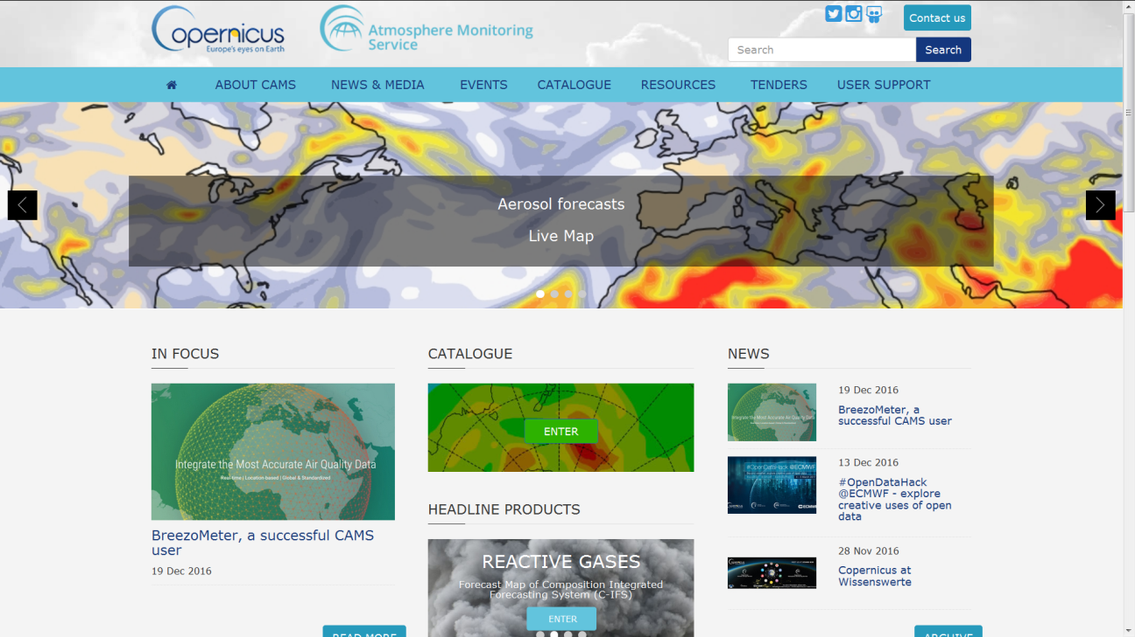
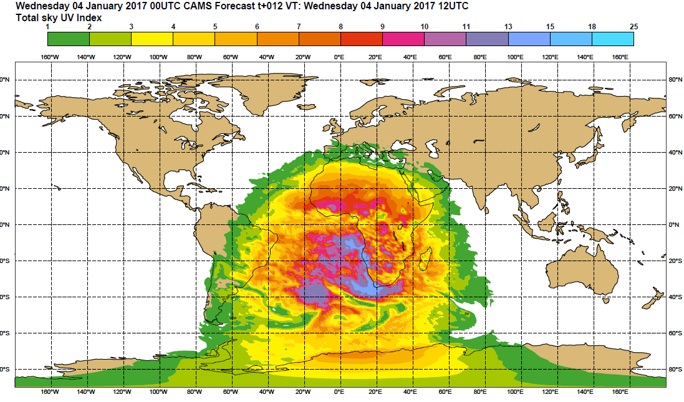
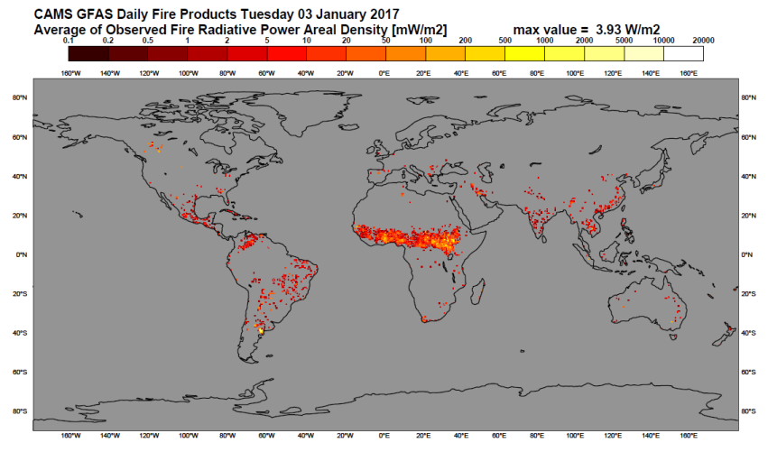
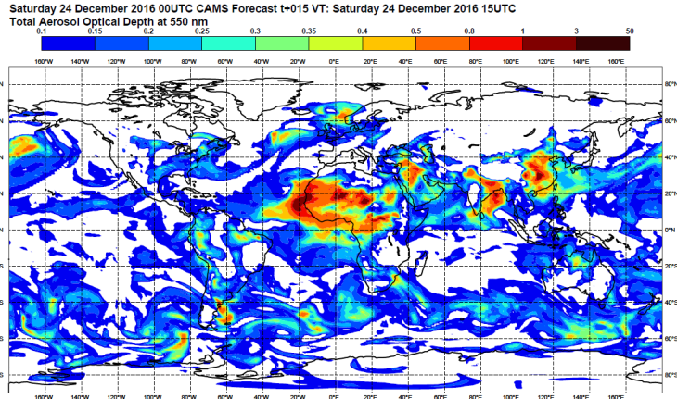
CAMS : An operational service after 10 years of research
Website : http://atmosphere.copernicus.eu
t
UV index
GFAS daily fire products
Total column SO2 forecasts
Forecast of aerosol optical depth

Slide 6
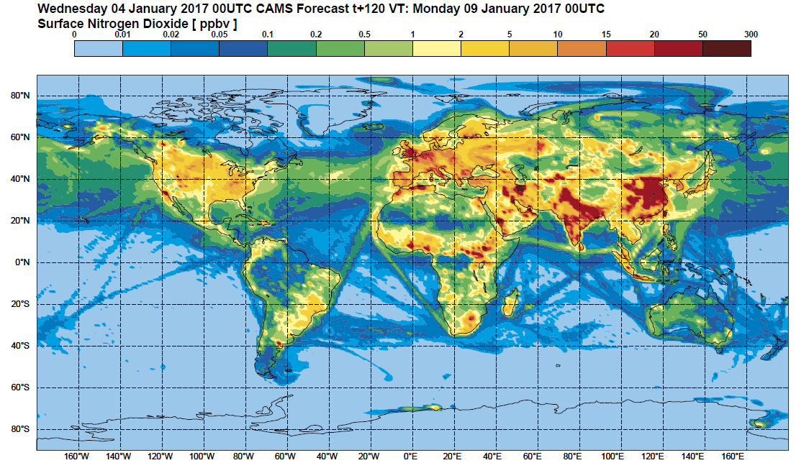
CAMS Atmosphere Global Production
Service operational since July 2015.
Provision of daily data and information on the global atmospheric composition.
Daily Analyses and Forecasts up to 120 hours.
To provide boundary
conditions for finer
scale.
40 km resolution
on the global domain.
Re-Analyses
production stream to
offer a multi-annual
consistent datasets.

Slide 7
COPERNICUS-Atmosphere – Plan
Copernicus Atmophere Monitoring Service : a response to environmental concerns.
CAMS Regional : An AQ Ensemble modelling system over Europe.
CAMS Regional : From Research to Operation.

Slide 8
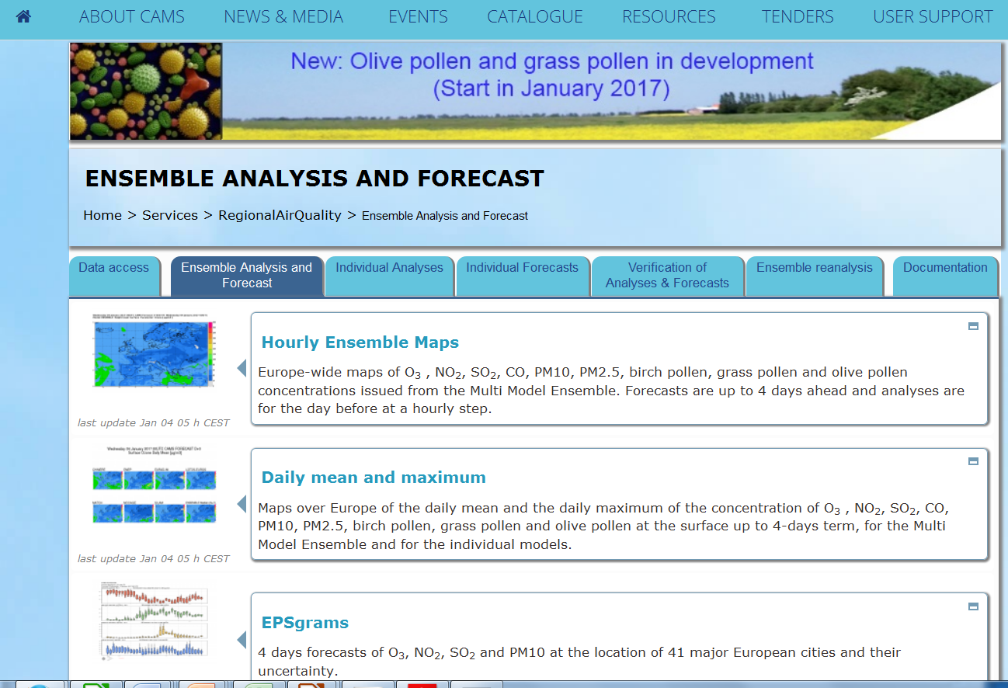
CAMS Regional Production
Meteo France and INERIS are responsible for the Regional production.
With 9 subcontractors from 9 different European countries.
3 year contract with ECMWF (EU agreement).
Requirement to provide maps
and data of main atmospheric
pollutants at the European scale :
With an Operational status,
and an easy access for users.

Slide 9









CAMS Regional Production : contribution of AQ models
7 operational AQ models provide daily, 4-day forecasts of concentrations of 10 major components : O3, NO2, SO2, CO, PM10, PM2.5, NO, NH3, NMVOC, PANs and Pollen (birch, olive, grass)
Over a large EUROPE domain.
For 8 vertical levels, from surface to 5000m.
The models are driven by the same meteorological forcings (IFS) and chemical boundary conditions (C-IFS).
The models use the same emission inventory (TNO-MACC 2011), GFAS wild fire emission data.
Provision of analyses of the day before by assimilation of the same observation datasets. In-situ observations are collected from the European Environment Agency in NRT.
Under evaluation for a next participation : 3 other models from UK, Danemark and Poland.
CHIMERE
INERIS, CNRS
0.15°x 0.1°
EMEP
MET Norway
0.25°x 0.125°
EURAD
RIUUK
15km
LOTOS-EUROS
TNO, KNMI
15km
MATCH
SMHI
0.2°
MOCAGE
METEO-FRANCE
0.2°
SILAM
FMI
0.1°
AQUM UKMET
0.11°x 0.11°
DEHM Aarhus Univ.
18km
GEM-AQ WUT
0.2°

Slide 10
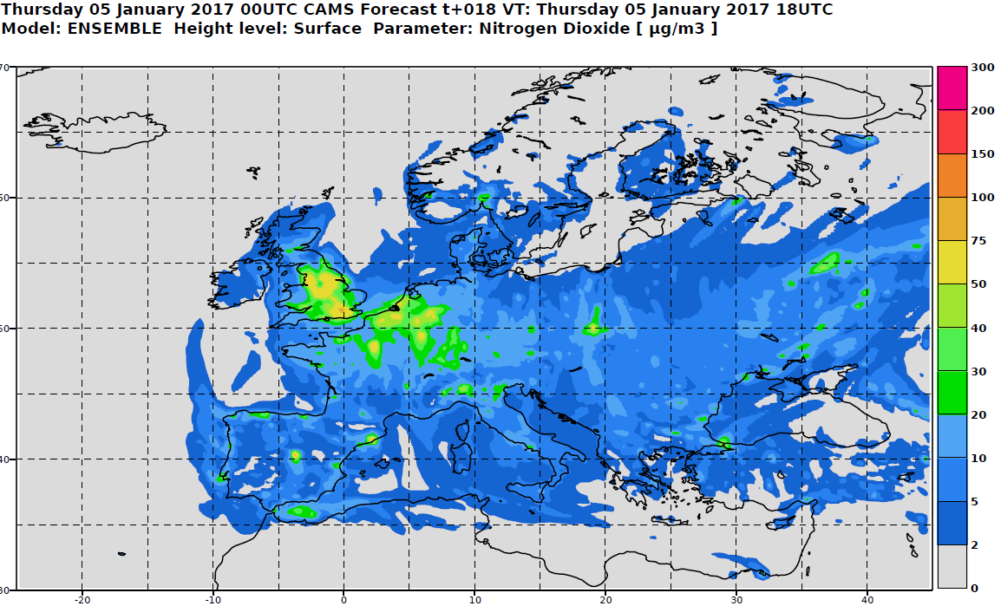
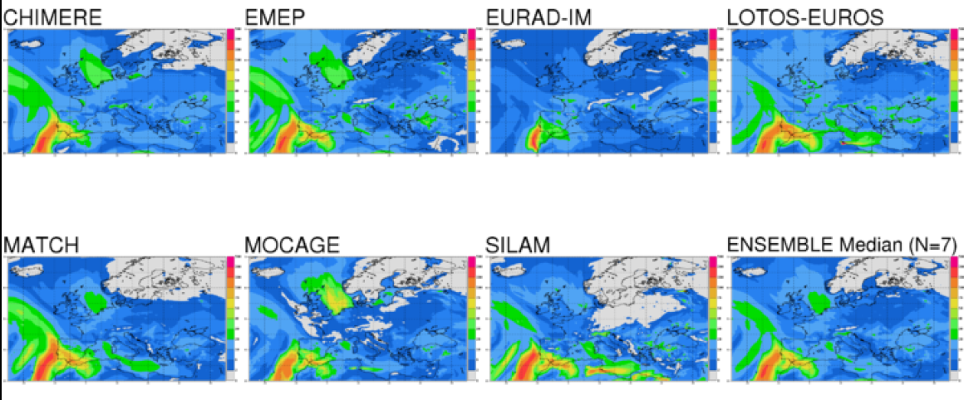
CAMS Regional Production : The ENSEMBLE products
The results (analyses and forecasts) are interpolated on a common regular grid (0.1°) and combined in an ENSEMBLE product (median value for each grid-cell)
Best combination of the different model contributions.
Less sensitive to outliers and occasionally missing models.
Cost effective

Slide 11
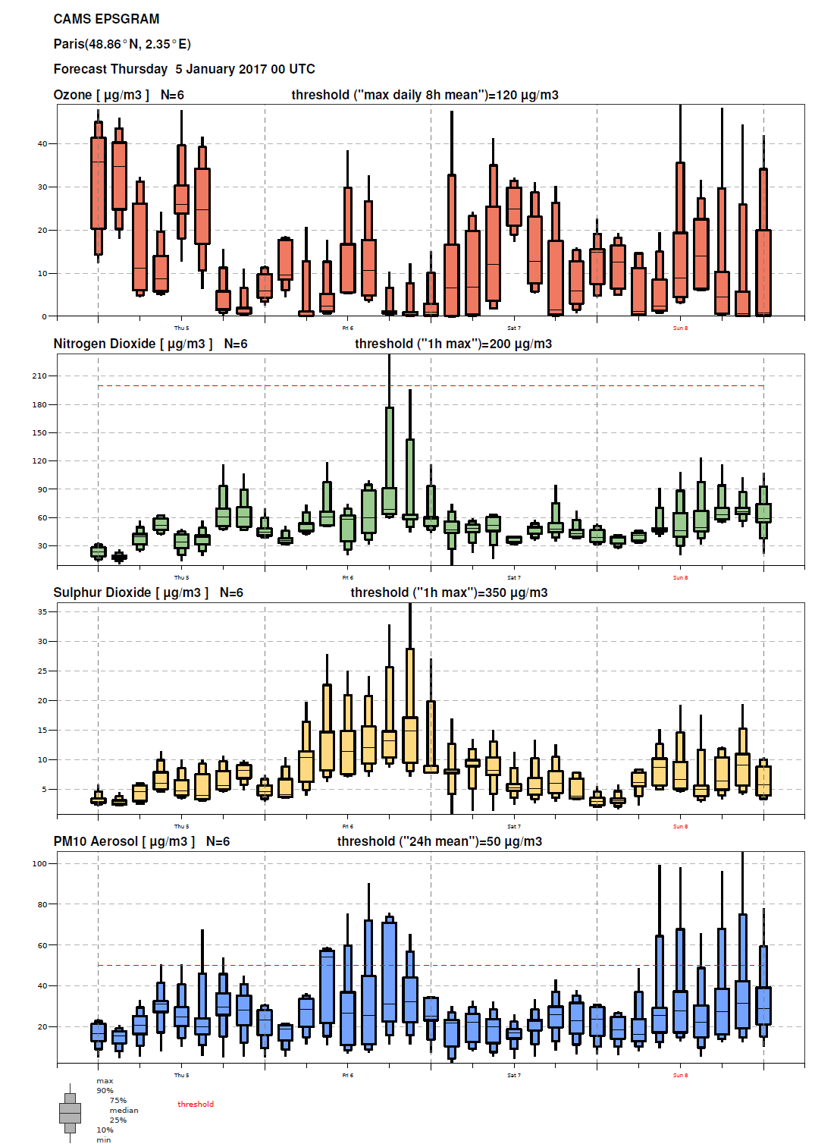
CAMS Regional Production : EPSgrams
Daily EPSgrams for 41 European capitals visualize the uncertainty given by the different models.
Forecast values plotted every 3 hours.
Values representative of the area around the city but not of the centre of the cities (too coarse resolution).

Slide 12
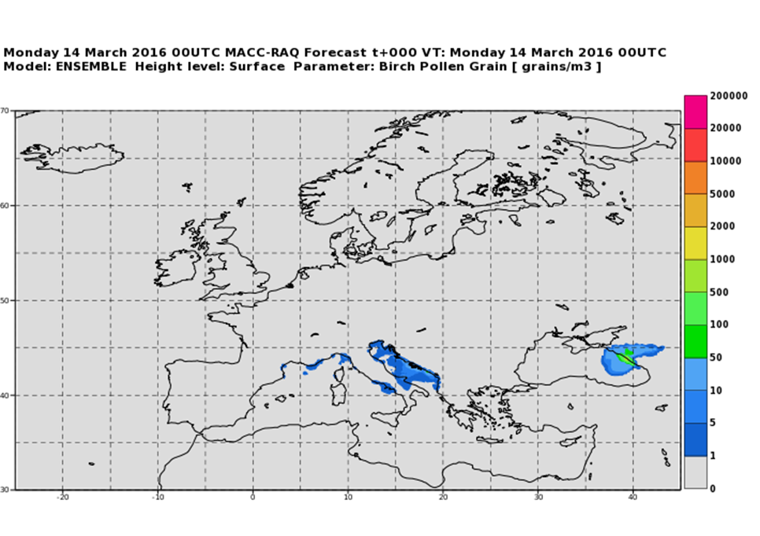
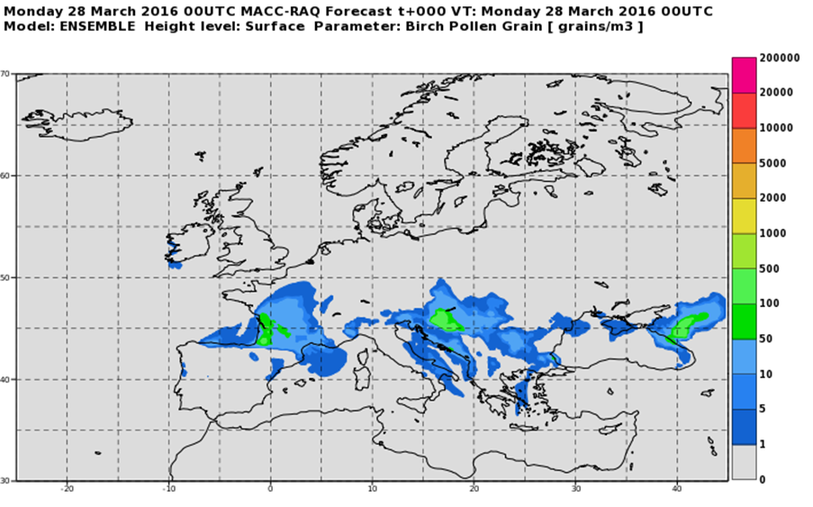
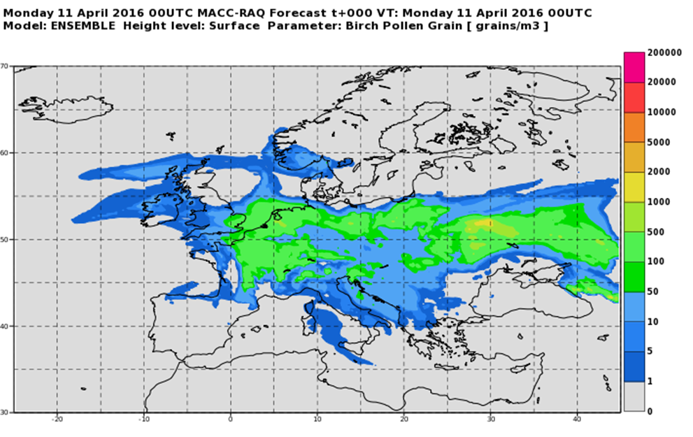
CAMS Regional Production : pollen forecasts
During pollen season (march-july), provision of ENSEMBLE forecasts of birch pollen concentration at surface.
This season (2017), provision of olive and grass pollen ENSEMBLE forecasts at surface.
Use of SILAM (FMI) emission modules. Evaluation made by FMI with EAN observations.
These forecasts have been evaluated against observation data from European Aeroallergen Network (EAN).

Slide 13
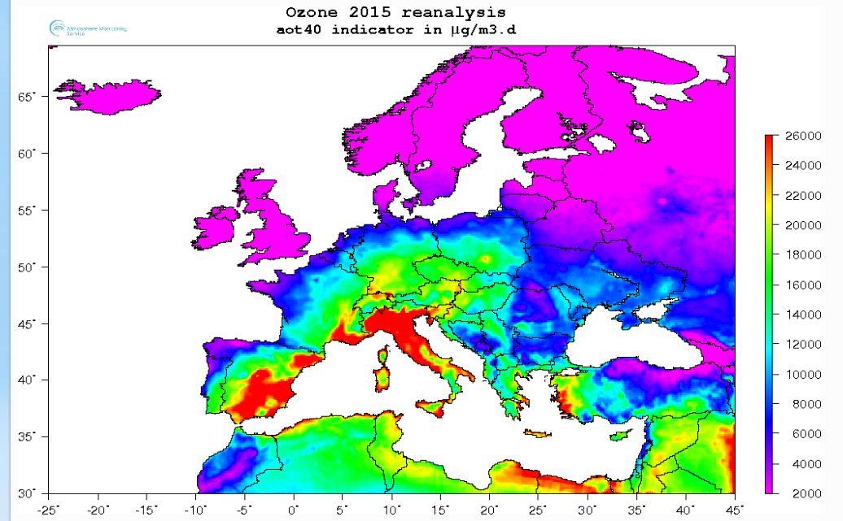
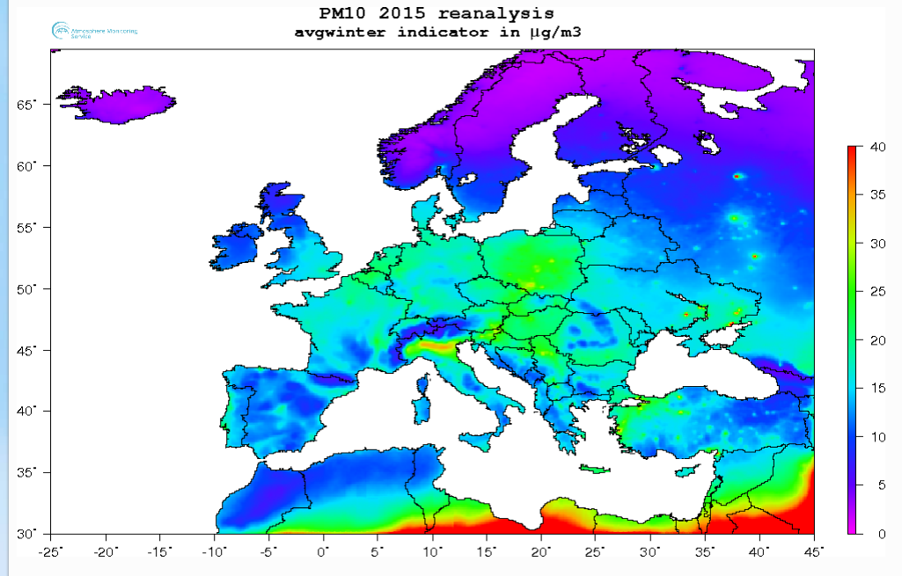
CAMS Regional Production
Re-analyses production stream to support particular policy applications (reporting duties).
Validated or Interim re-analyses of previous year are produced by using the same ENSEMBLE approach.
Specific indicators and plots are performed (seasonal averages, AOT40, SOMO35, T180, T240, T120)

Slide 14
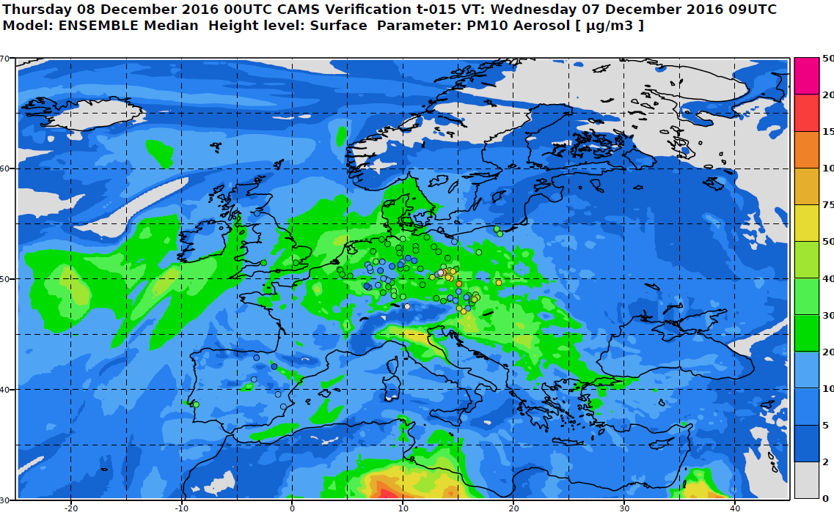
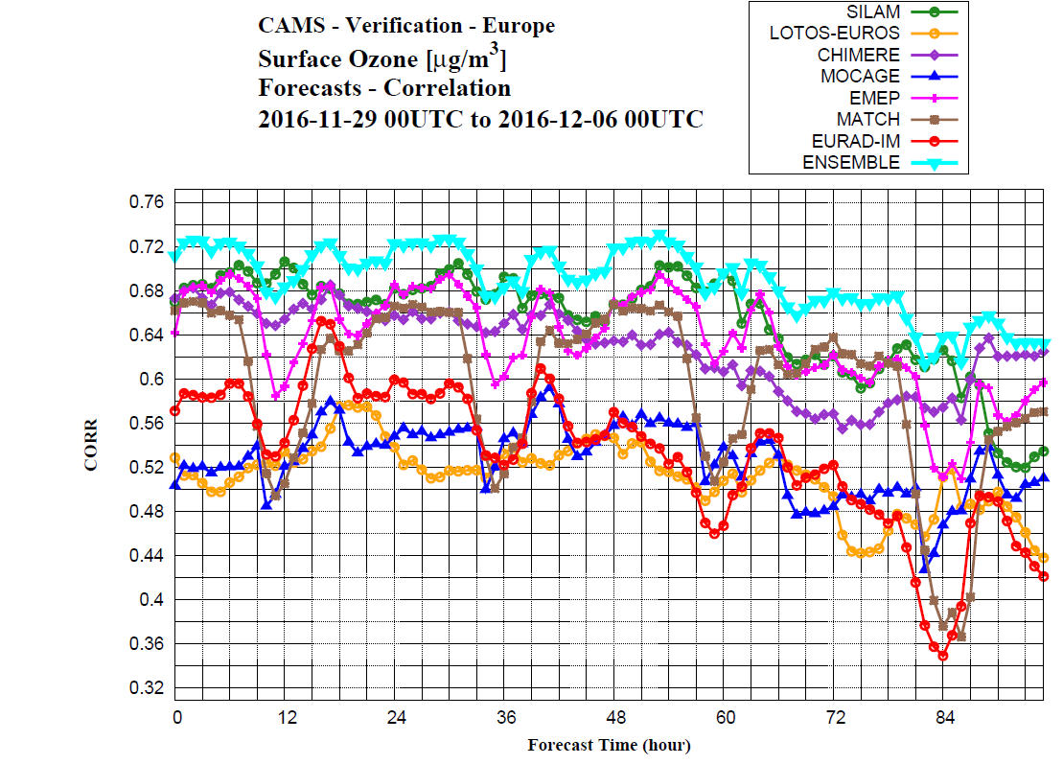
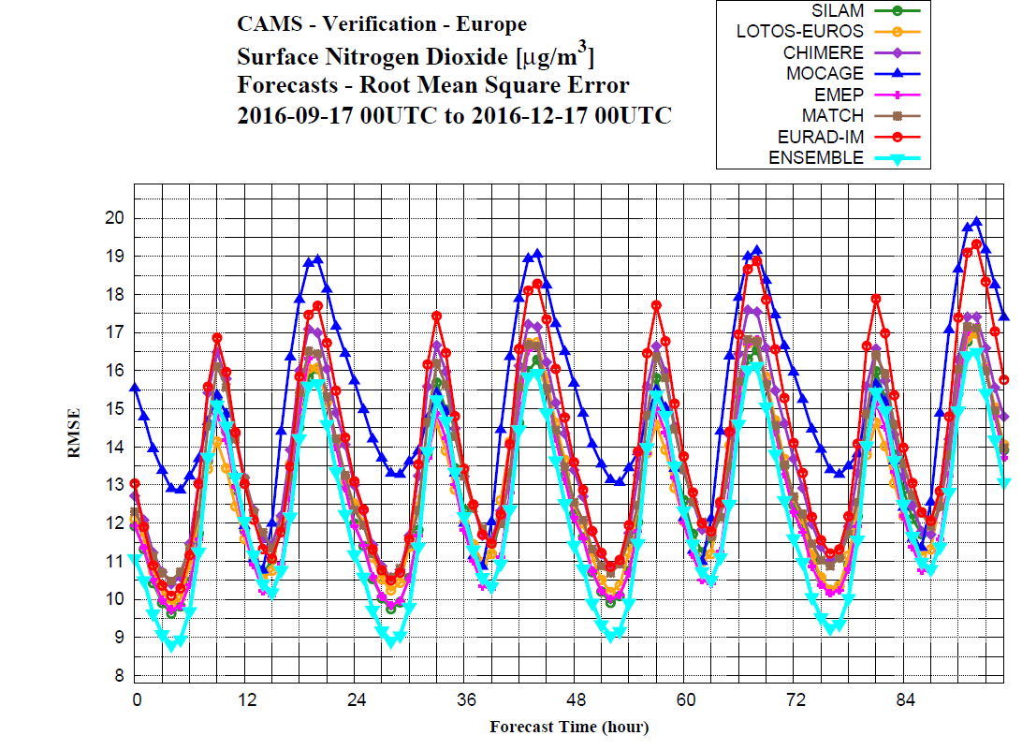
CAMS Regional Production
All these products are evaluated in comparison to in-situ observations (see M. Plu’s presentation)
Routine skill score statistics are provided daily on the Website (bias, correlation, RMSE, FGE).
Quarterly assessment reports are produced.

Slide 15
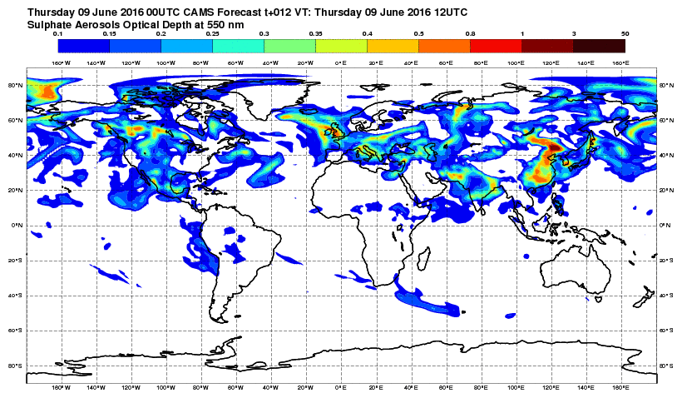

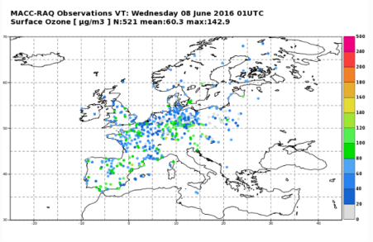
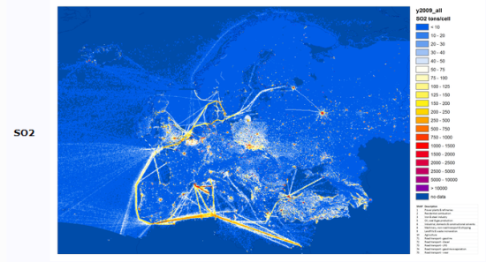






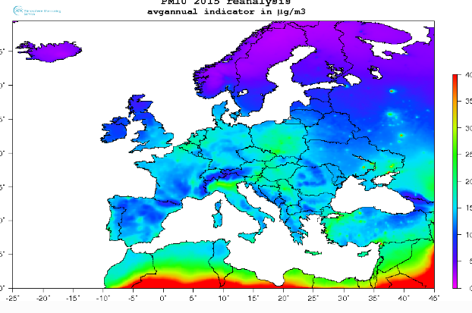
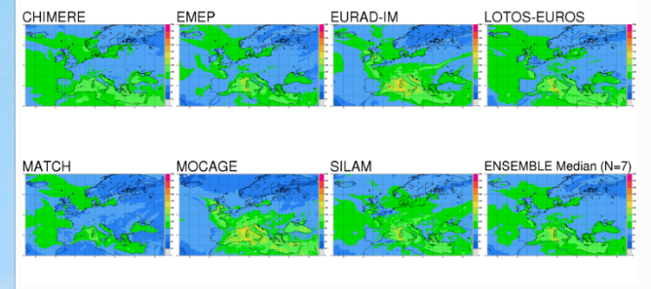


CAMS Regional Production : user oriented
Global model products
Regional emissions
Observations
Daily production
of air quality
forecasts and
Analyses
( Individual & Ensemble)
Annual production of
air quality reanalyses
Interim (YY-1) & Validated (YY-2)

Slide 16
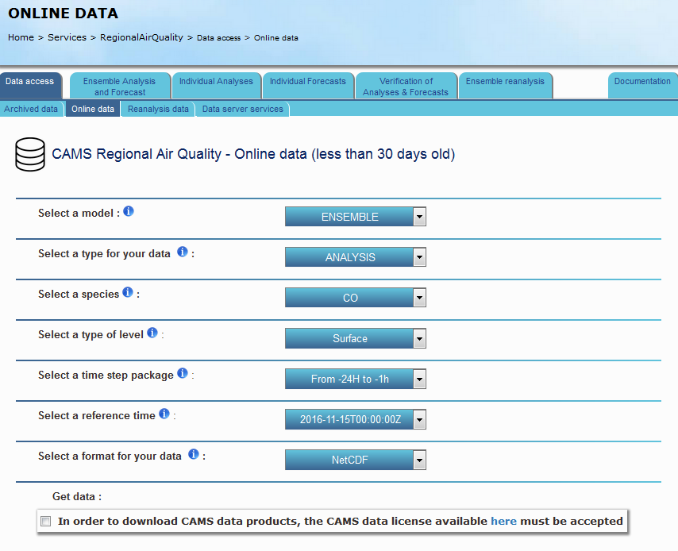
CAMS Regional Production : user oriented
Unique user interface for easy access to maps, plots and data (Netcdf format for individual models, GRIB2 and Netcdf format for ENSEMBLE).
Access through data download service “Online data” with fixed granularity (one day forecast). 30 days of data online available.
Access to archived data.
Support/help desk
http://www.regional.atmosphere.copernicus.eu/

Slide 17
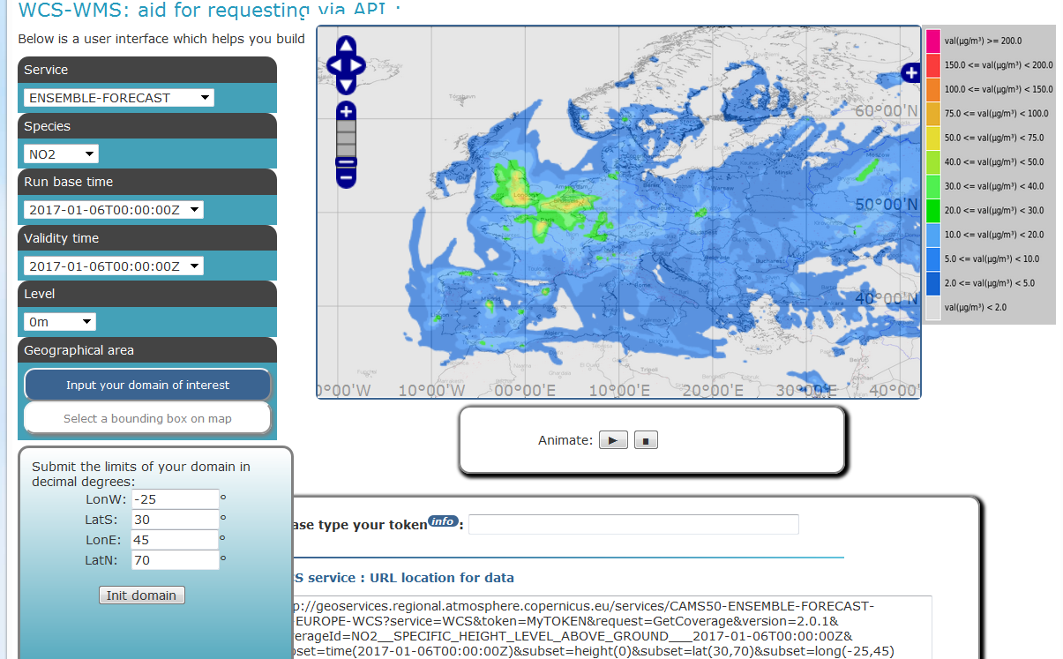
CAMS Regional Production : user oriented
Data access via Web portal (GRIB2 format) after registration.
Access via WCS and WMS services.
WCS allow to download numerical data that suits user’s interest (choice of domain, steps, level, …)
Compliance to OGC standards.
Subscription possible, if registered.
http://data.regional.atmosphere.copernicus.eu

Slide 18
Plan
Copernicus Atmophere Monitoring Service : a response to environmental concerns.
CAMS Regional : An AQ Ensemble modelling system over Europe.
CAMS Regional : From Research to Operation.

Slide 19
CAMS-Regional : From research to OPERATION
Meteo France operates the Near Real Time (NRT) production
INERIS in charge of the Re-Analyses.
What does operational mean ?
Complete integration of the whole production process in the operational production chain of Meteo France that benefits from IT department service and organisation.
High level of availability (redundancy of databases, computer equipments, IT infrastructure, telecommunications, power supplies,…)
24/7 task monitoring by operators using recorded instructions.
Automatic monitoring mode with alarms and logs.
Degraded modes scheduled in case of failures.
Upgrades scheduled and limited (twice a year). Test suite configured for upgrades before evolutions of the models.

Slide 20
CAMS-Regional : From research to OPERATION
Operational status : what for ?
Production sustainability (user request of garantee on the sustainability of the products and services).
System reliability.
Punctuality (timeliness).
Garanteed level of availability of 99% for ENSEMBLE production (quality indicators provided each quarter).
Reliable technical interface to data and information.
Added value of research activities
Individual models are operated by the European teams that are also their main developers → very effective to allow model changes whenever issues are found or evolutions requested.
Use of mature and validated systems.
Use of common software modules (ex: Pollen emission).
Knowledge sharing.
R&D activities (development, algorithm, validation) are essential to remain at the best and up-to-date level.
Open to evolution led by interaction with users.

Slide 21

Acknowledements
CAMS50- Regional Production is funded by the European Commission under the COPERNICUS program.
Thanks to all participants of this project !
Among others :
Meteo-France, France : N. Assar, S. Guidotti, M. Pithon, M. Plu, S. Rouzeau.
ECMWF, United Kingdom : R. Engelen, V-H Peuch.
Aarhus University : C.Geels, J.H. Christensen.
FMI, Finland : R. Kousnetsov, M. Sofiev, J. Vira.
INERIS, France : F. Meleux, L. Rouil, A. Ung.
KNMI, the Netherlands : H. Eskes, J. Ntouros, R. Versendaal.
Met Norway, Norway : A. Benedictow, M. Gauss, A. Valdebenito.
RIU, Germany : H. Elbern, E. Friese, K. Krajsek.
SMHI, Sweden : E. Egström, J. Langner, L. Robertson.
TNO, the Netherlands : A. Segers, R.Timmermans.
UKmet, United Kingdom : P. Agnew, N. Savage.
WUT,EcoForecast, Poland : J.W. Kaminski, J. Struzewska.

