Slide 1
8th International Workshop on Air Quality Forecasting Research and 2015 Pan American/ParaPan American Games Legacy Data Workshop
Toronto, Ontario
January 10 - 12, 2017
Long Term Forecast and Modelling of South Athabasca Oil Sands (SAOS) and Provincial Emissions in Alberta
Xin Qiu¹ and Wen Xu²
¹ Novus Environmental Inc.
² Alberta Environment and Parks

Slide 2
Outline
Objectives
SAOS and AB Emission Inventories
AQ Forecasting for Future Years
Conclusions

Slide 3
Objectives
Development of comprehensive AB province-wide emissions database
Development of the South Athabasca oil sands area (SAOS) emissions inventories for future years (2020 and 2050)
Oil sands air quality long-term forecasting

Slide 4
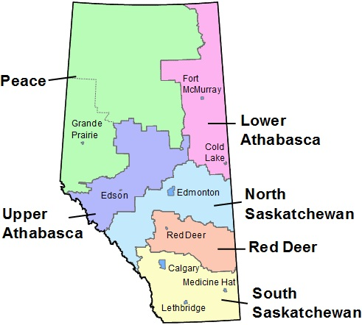
Development of AB Province-Wide Emissions Baseline Database
Development of Alberta Baseline Emissions Inventory (2010/2013)
Region-level detailed inventories (by 7 landuse management zones)
Consolidated with:
The Joint Oil Sands Monitoring Program Emissions Inventory (JOSM 2013)
AEP’s SAOS/CEMA Inventories (2010)
Alberta EIAs
NPRI 2010/2013
Three Creeks Cold Heavy Oil Production (CHOP) Inventory (2011)

Slide 5
Development of AB Province-Wide Emissions Future Years Database
Development of Alberta Future Years Emissions Inventory (2020/2050) & (2030/2045) (2 versions)
Separated Projections: Oilsands and Non Oilsands Regions
Consolidated with:
The Joint Oil Sands Monitoring Program Emissions Inventory (JOSM 2013)
AEP’s SAOS/CEMA Inventories (2010)
Alberta EIAs
NPRI 2010/2013
Three Creeks Cold Heavy Oil Production (CHOP) Inventory (2011)
Considered policies by 2030:
Coal-fired power plants will be phased out
Conventional O&G will be mostly terminated

Slide 6
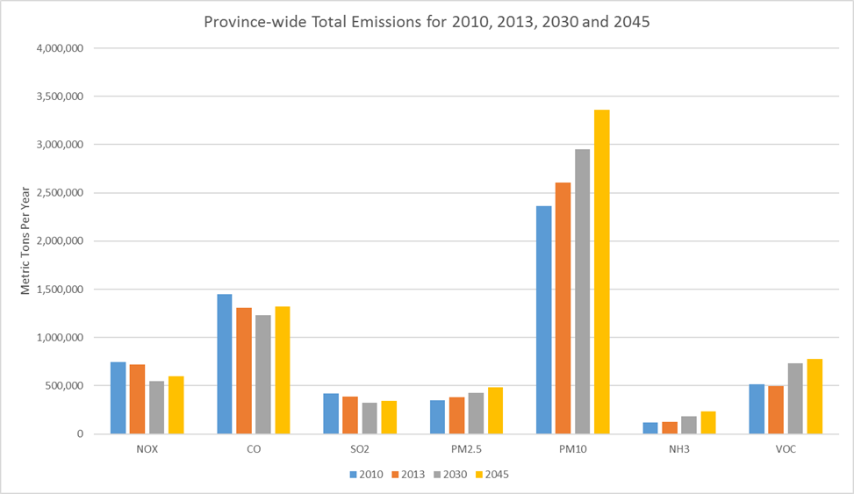
Province-Wide Emissions summary
Scenario | NOx | CO | SO₂ | PM_{2.5} | PM₁₀ | NH₃ | VOC
2010 | 746,004 | 1,447,391 | 421,991 | 348,613 | 2,362,858 | 118,490 | 514,000
2013 | 723,375 | 1,310,436 | 386,818 | 380,513 | 2,602,995 | 124,925 | 499,458
2030 | 546,762 | 1,232,885 | 322,071 | 426,691 | 2,949,375 | 184,191 | 731,159
2045 | 598,369 | 1,321,964 | 341,092 | 482,956 | 3,360,675 | 231,655 | 779,408
Ramboll Environ and Novus, 2016

Slide 7
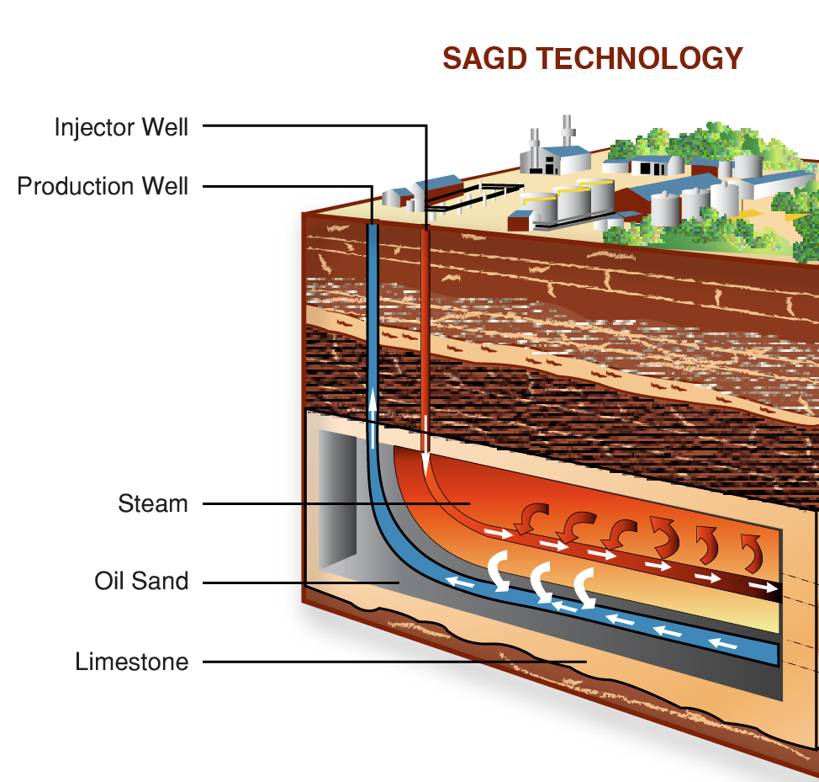
In-Situ Oil Sands
In Alberta, 80 per cent (135 billion barrels) of the oil sands are buried too deep below the surface for open
pit mining.
Can only be accessed through in-situ methods such as Steam Assisted Gravity Drainage (SAGD).
Major air emission sources are from Central Processing Facilities (CPFs):
Steam generator (OTSG)
Co-gen
Glycol heater
Flare
Line heater
etc.

Slide 8
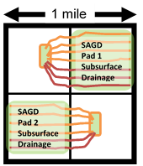
AEP Oil Sands Production Forecasting
Bitumen Production on average section/pixel production by pay thickness:
10m: 3000 bopd
20m: 5100 bopd
30m: 7600 bopd
Future locations selected randomly from remaining available sections/pixels
Per pixel

Slide 9
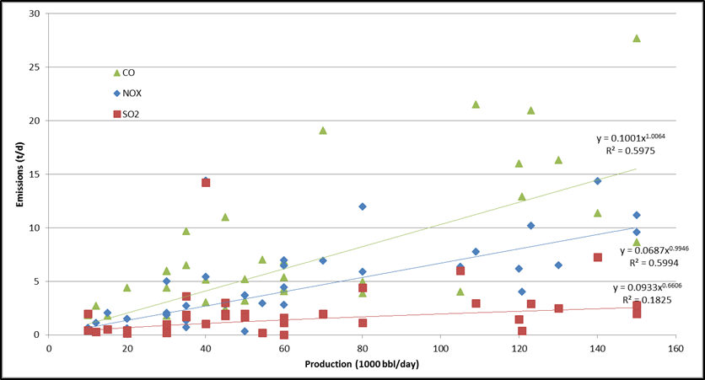
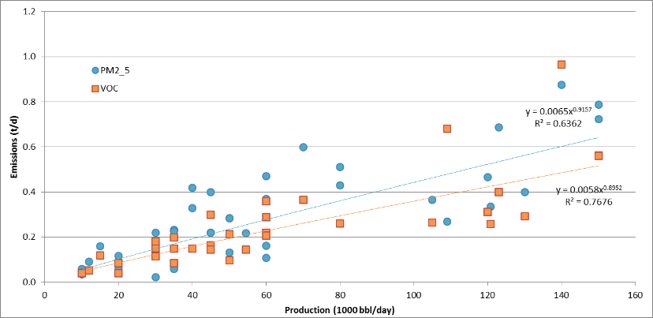
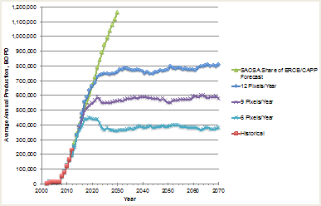
From O&G Production to Emissions
Emission rates of the existing in-situ facilities at various production scales were established
Nonlinear relationships of emission rates versus production levels were regressed and applied to estimating emission rates from the future CPFs
High
Medium
Low

Slide 10
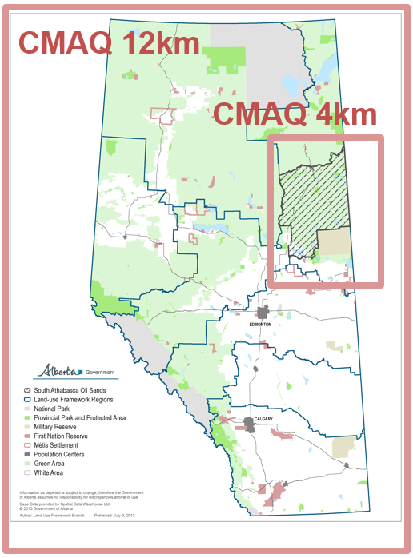
CMAQ Modelling
1-Year WRF (2010) for met input
CMAQ ran at 36/12/4km domains focused on SAOS area
Scenarios:
2020 High
2020 Low
2050 High
Reference:
Xu, 2016; Environ and Novus, 2016.

Slide 11
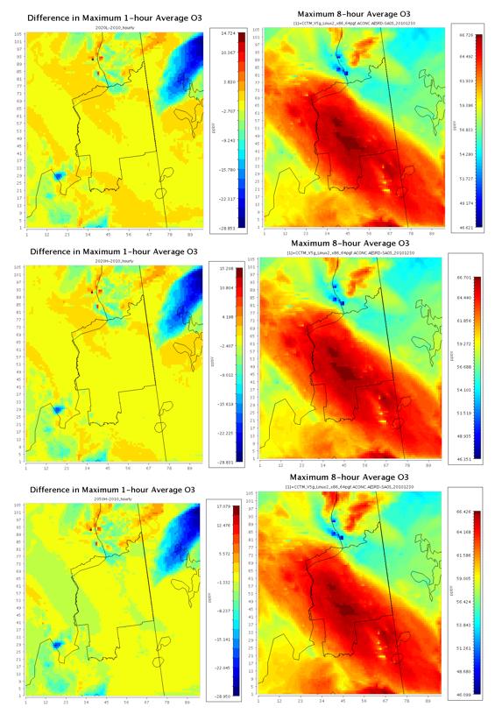
Ozone Modelling Results
2020 Low
2020 High
2050 High
The change in ozone level is insignificant in future years

Slide 12
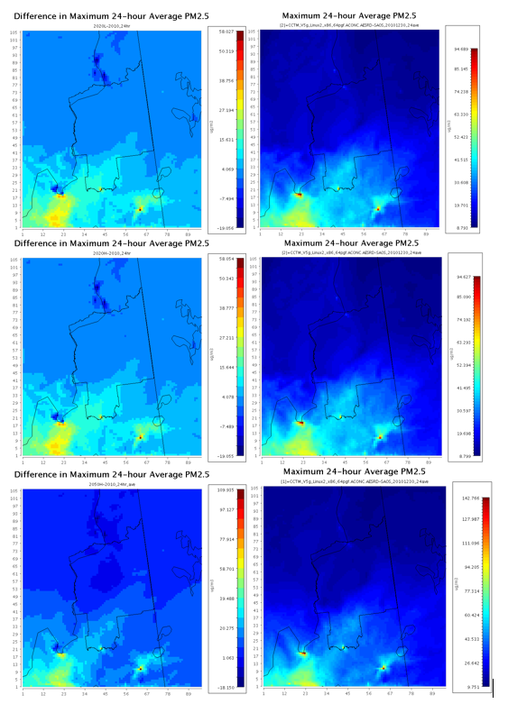
PM_{2.5} Modelling Results
2020 Low
2020 High
2050 High
The change in PM_{2.5} level is significant in future years, particularly in 2050:
In southern SAOS, 24-hr PM_{2.5} level increased from +5 to +15 μg/m³
+5
+5
+15

Slide 13
Emissions By Sectors
Future NO_{x} Emissions are mostly decreased outside oil sands
Annual NO_{x} Emissions
Explained why ozone levels are not significantly changed

Slide 14
Emissions By Sectors
Future PM_{2.5} Emissions are mostly increased across the province
Annual PM_{2.5} Emissions
Explained why PM_{2.5} levels are significantly increased in the future years

Slide 15
Conclusions
SAOS oil sands area emissions inventory for future years was developed based on AEP’s oil sands production forecasting scenarios.
1
Ozone and PM_{2.5} have different prospects in the future years; while change in ozone level is not significant, the + change in PM_{2.5} level is concerned.
2
3
Although focused on SAOS area, province-wide emissions have considerable impact on regional level concentrations. Further analysis is required.

Slide 16
Questions?
Xin Qiu, PhD
Principal, Novus Environmental
xinq@novusenv.com
416-320-1363
BTW, CMOS 2017 is open for abstract submission, and there is a Session specifically for Air Quality!

