Slide 1
Experimental post-processing of air quality forecast for the Toronto 2015 Pan Am Games
Andrew Teakles¹, Jonathan Baik², Rita So², Rowena Seto²
¹Prediction Services Directorate, Meteorological Service of Canada, ECCC (Halifax)
²Prediction Services Directorate, Meteorological Service of Canada, ECCC (Vancouver)
Additional ECCC Contributions from: Stavros Antonopoulos, Jacques Montpetit, Paul-André Beaulieu, Hugo Landry, Radenko Pavlovik, Sylvain Ménard, Didier Davignon
,

Slide 2

Overview
Air Quality Health Index Forecast Support for PanAm
  Statistical Post-Processing System (XM-Tool)
Pan Am Opportunity: Motivation
Challenges Involved
Method and Outcomes
Lessons Learned
Notes:
I will talk briefly about AQHI Forecast support for PanAm. Other presentation tomorrow …
I got involved in the Toronto 2015 Pan Am Games and Parapan Am Games though a science initiative called the XM-Tool. Our participation was to assist the air quality Health index program with their forecast activites for panam. Our initial involvement was unplanned initially however the opportunity came up for us to make a contribution. Today’s talk will go over our activities/science project leading up to PanAm, what motivated our involvement, what challenges we faced, what lessons/outcomes came for our work.
How panam fit into the work we were doing and became an opportunity for us. We joined up with other research efforts to support panam

Slide 3
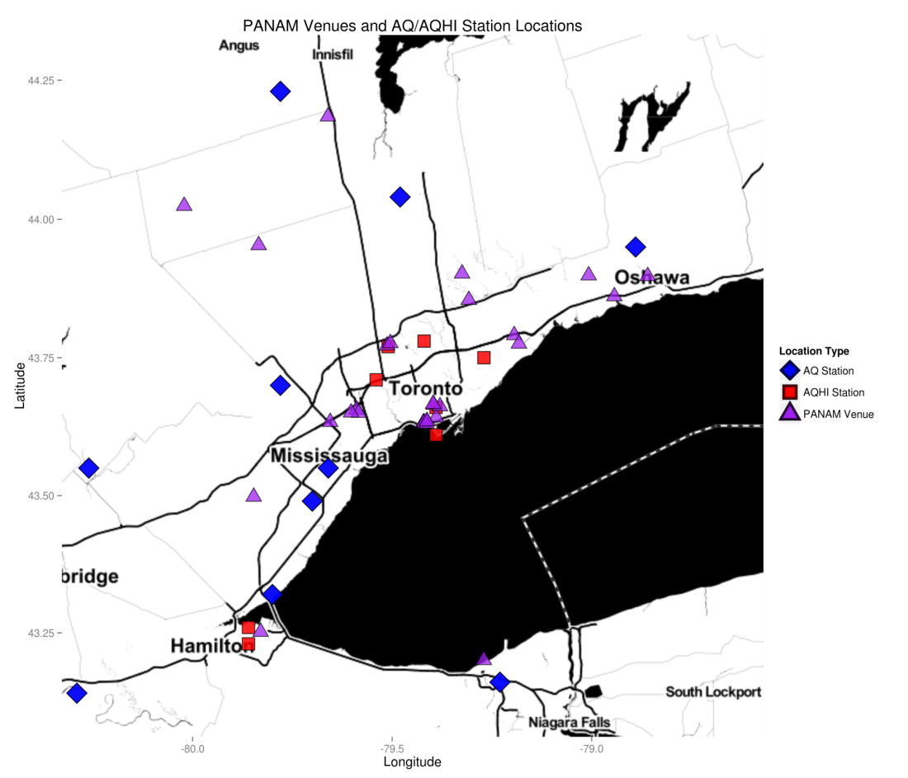
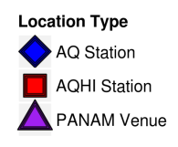
AQHI Forecast support for PanAm
AQ Monitoring
New AQHI monitors
CRUISER
AQHI Forecasts
Venues
Regions
GEM-MACH
Operational -10km
Experimental - 2.5km (Craig Stroud)
AQHI Objective Analysis (Alain Robichaud)
UMOS-AQ (operational post-processing system)
Notes:
MAYBE SPLIT THIS SLIDE UP
New Monitors ( 4 )
Research model ( GM2.5 km)
GM10 + emission update
Objective Analysis

Slide 4
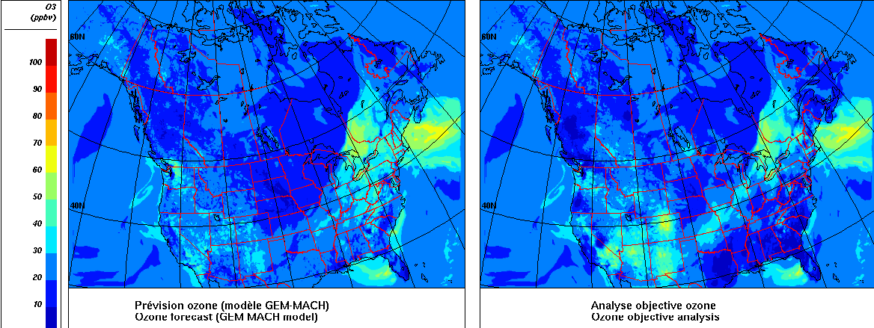
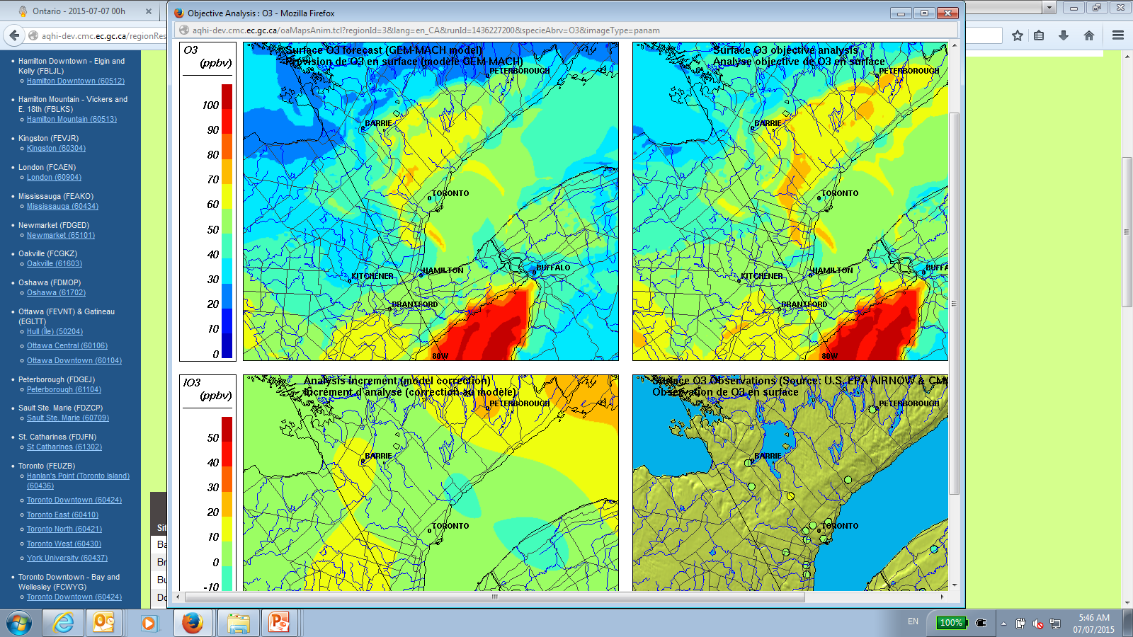
GEM-MACH (10km)
Objective Analysis (Ozone,10km)
GEM-MACH (2.5km)
Objective Analysis (Ozone, 2.5km)
Notes:
SPLIT UP MODEL AND OA SLIDES

Slide 5
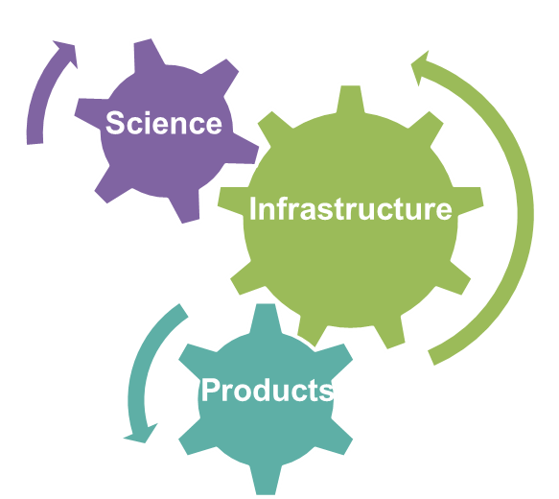
XM-Tool Project
Alternative statistical air quality forecasts of O₃, NO₂, and PM_{2.5} in support of the national AQHI Forecast Program
Science
Prototype Approaches
Antecedent (“lag”) Predictors
Infrastructure
Tech Transfer (formalize)
Experimental runs
Products
Diagnostics + Verification
Notes:
At the same time…
By start of 2015, we made progress with prototype methods and there was also interest in our modeling approach by the CMDW group that supported our science activities and we were in the process of transferring approaches to a more formal experimental setting at CMC.
Science phase had developed some prototype methods for improving the air quality forecast with some new
Antecedent conditions were used to improve forecast guidance
Science phase shifting to tech transfer of our methods (tested some methods). Interest in our methods and infrastructure supporting our studies. Products limited to diagnostics and verification.

Slide 6
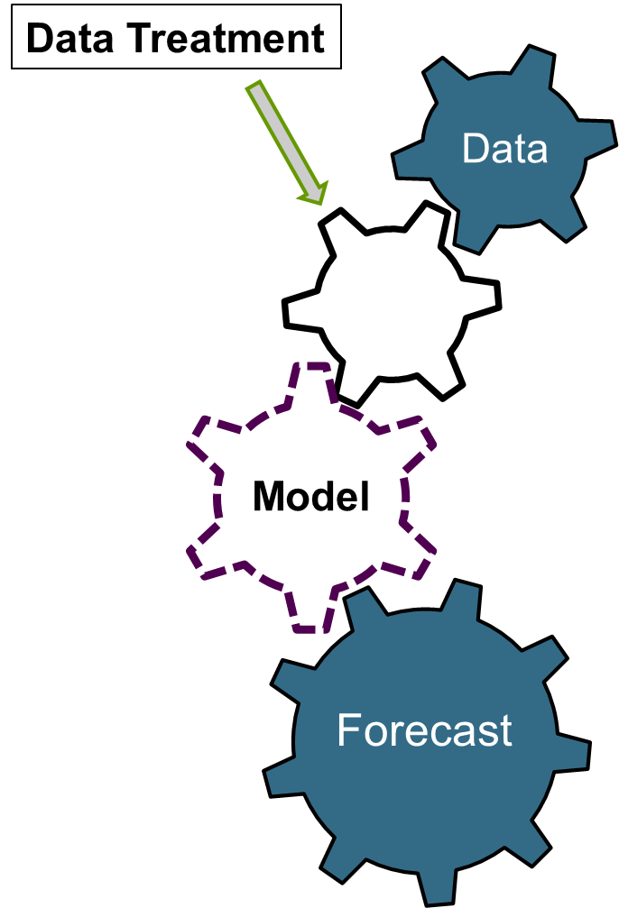
Post-Processing Infrastructure
Modular Modeling
Modular Modeling approach
Adopt higher level languages (R, Python) with extensive statistical modeling libraries
Experimental forecast run twice-daily for air quality (O₃, NO₂, PM_{2.5})
Notes:
[adopts high level languages to support data treatment and access extensible model
[
[Add Infrastructure Wheel and put Science First]
[UPDATE WITH MATERIAL FROM THE POSTER. Use modular modeling, higher languages → easy prototyping]
Data is obtained in stored in database, A library we developed provided functions to support pre-processing & modeling requirements. (more open source, extensible, modular,…)

Slide 7
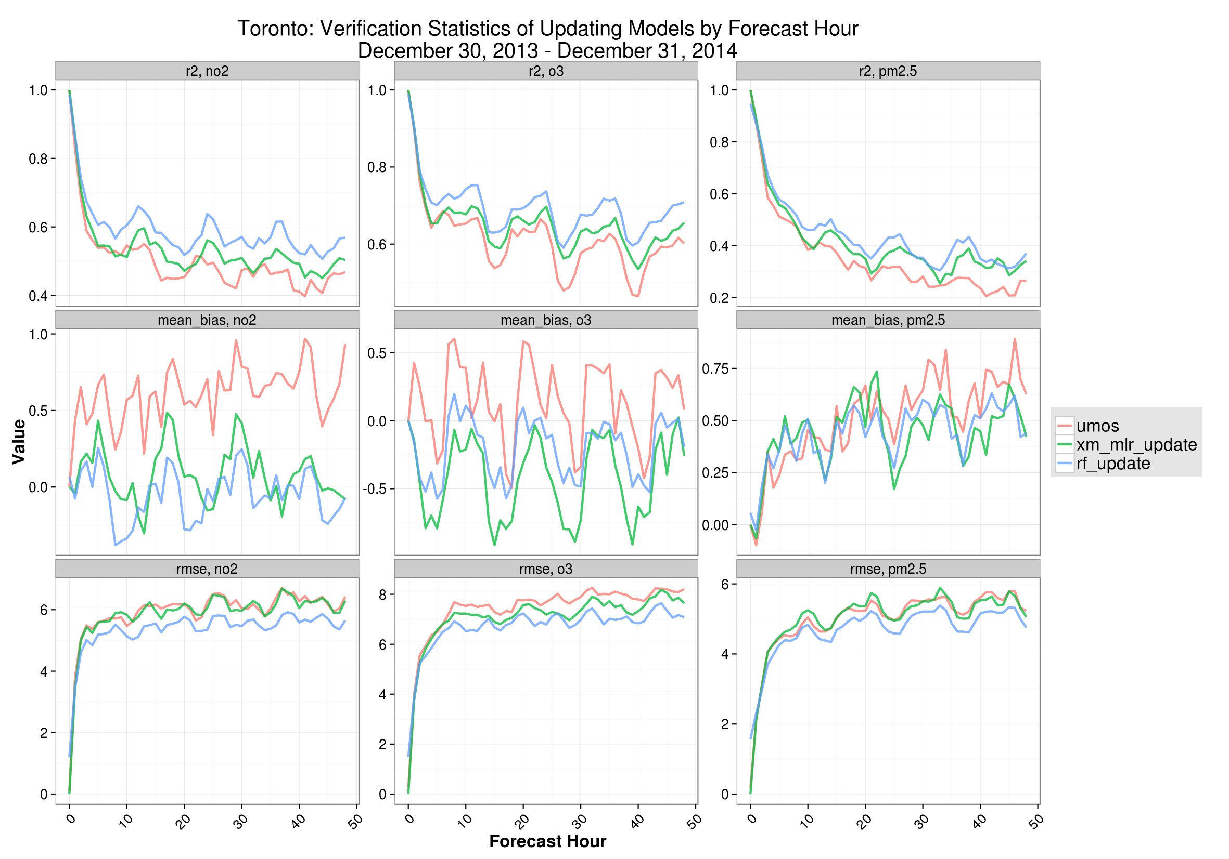
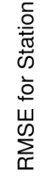
XM-Tool: Science
Yesterday’s AQ can improve today’s AQ forecast
Alternative statistical methods (RF, ELM, Kalman Filter, LASSO,…) have positive for some sites/pollutants
Improvements over existing UMOS-AQ forecasts
r², O3
RMSE, O3
UMOS-AQ
XM-Tool
XM_RF
Notes:
[in the science phase of the project we …. Overall, our work suggested improvement to air quality forecast could be achieved using additional lag predictor (what happened yesterday can improve today)
[We explore a variety of statistical models
RF and MLR (Toronto)

Slide 8
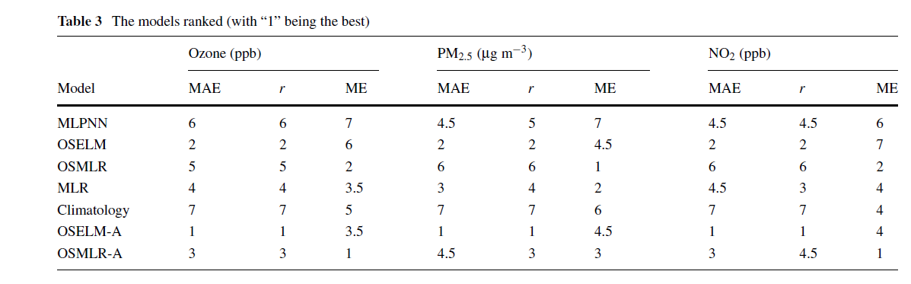
Extreme Learning Machine (ELM)
Specialized adaption to MLPNN with random weight in hidden layer (Huang et al., 2006)
ELM methods consistently ranked better but was still challenged with extreme forecasts
Huiping Peng, Aranildo R. Lima, Andrew Teakles, Jian Jin, Alex J. Cannon, William W. Hsieh, Evaluating hourly air quality forecasting in Canada with nonlinear updatable machine learning methods, Air Qual Atmos Health, 2016, DOI 10.1007/s11869-016-0414-3
Notes:
Some of our research efforts on non-linear techniques in collaboration with UBC were published last year.

Slide 9
Motivation
Support research staff providing guidance on AQHI forecast conditions to venue meteorologist for the Pan Am Games
Demonstrate the utility of the XM-Tool infrastructure to provide innovative forecast support products
Pilot experimental statistical methods in a real-time operational framework

Slide 10
Challenges
Infrastructure and Prototypes
  Expand experimental runs (2x daily, national AQHI + venues)
  Add new data sources and prototypes
Post-processing for GEM-MACH 2.5km
  Limited training data
  Late implementation
Venue forecast and New Stations
  Spatial Interpolation Method
Products Dissemination
  Product Dashboard
Notes:
Could we do some post-processing for the new experimental GEM-MACH (limited data and would be in development until May).

Slide 11
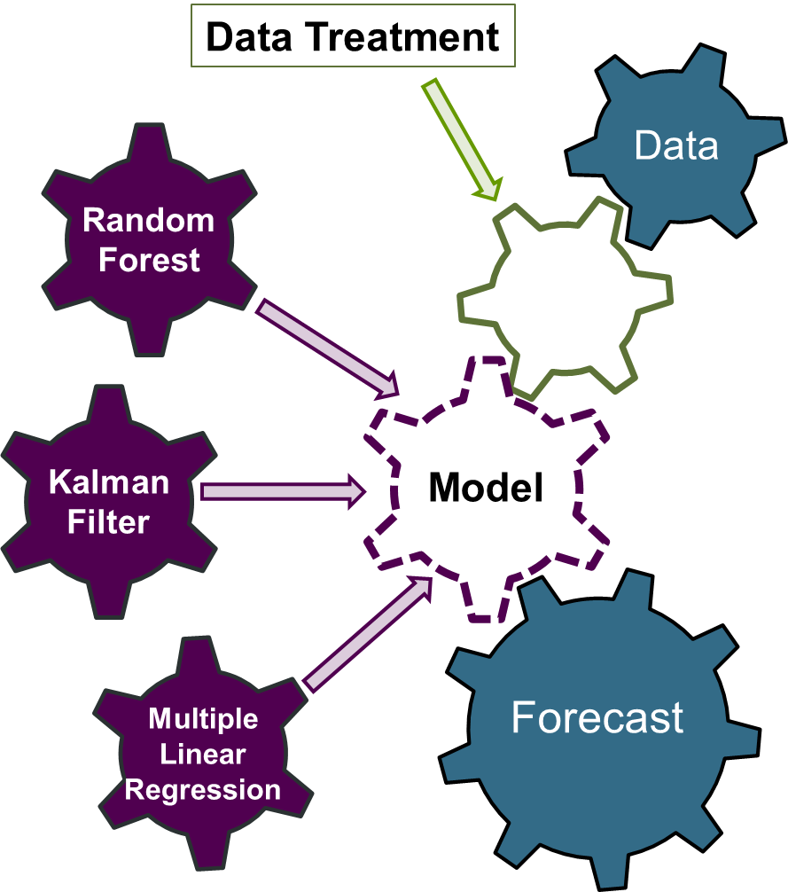
XM-Tool Prototypes
Forecasts using 3 prototypes statistical techniques:
MLR
Random Forests
Kalman Filter
Notes:
List DATA, DATA TREATMENT, and
Variety of approaches tried and evaluated. Some discussed here show how alternative methods can add value in various applications.

Slide 12
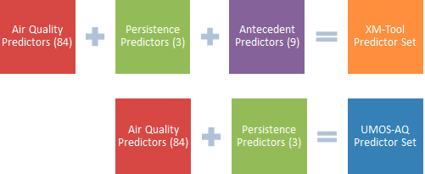
MLR + Antecedents (XM_MLR)
MLR + Antecedents
  (yesterday’s min, max, same LST hour)
No Seasonal Weights
GEM-MACH 10km training data from 2012 – 2015
Notes:
[Training Data]

Slide 13
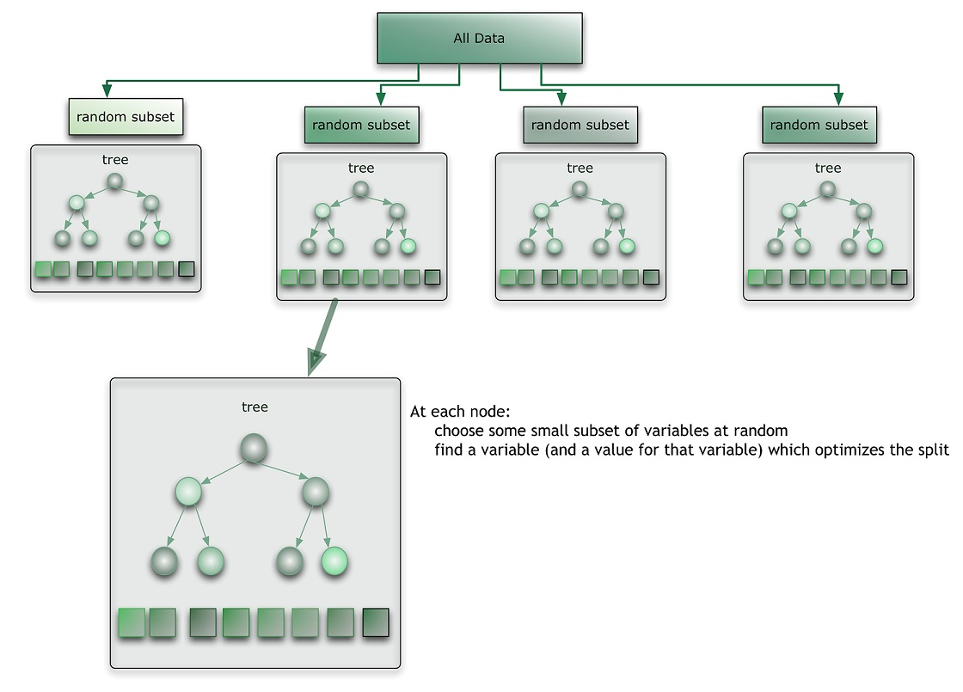
RandomForest
Ensemble of 300 Regression Tree.
Random variables for splits
GEM-MACH 10km training from 2012-2015
https://citizennet.com/blog/wp-content/uploads/2012/11/RF.jpg)
Notes:
(Source of Image: https://citizennet.com/blog/wp-content/uploads/2012/11/RF.jpg)
Each split try 35 random variables.
An ensemble of weak learner can make a strong learner

Slide 14
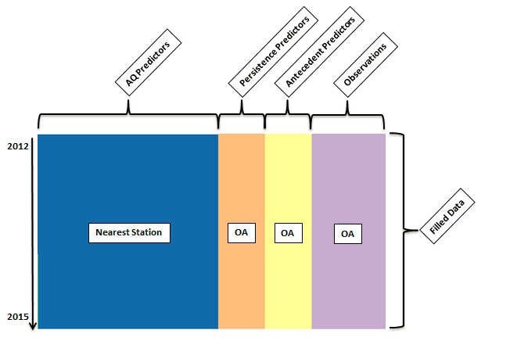
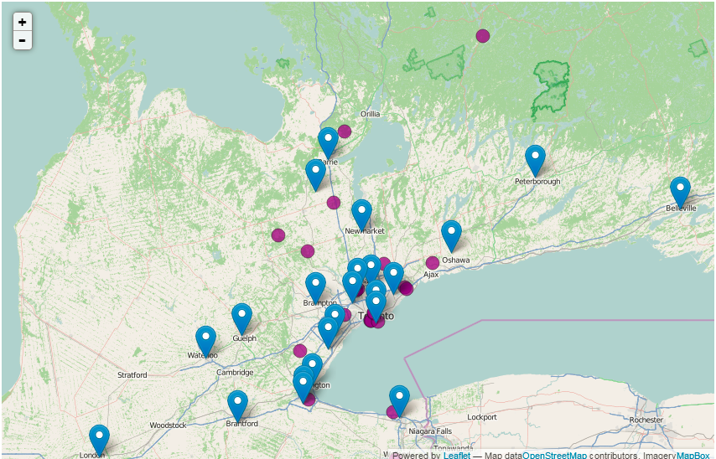
OA + Venue Forecast
AQHI Objective Analysis
Extract OA for venues specific statistical models and data filling (new monitors)
May preserve AQ episode better
Venue
UMOS-AQ/MIST
Interpolate forecast to venue (MIST)
Average correlation lengths

Slide 15
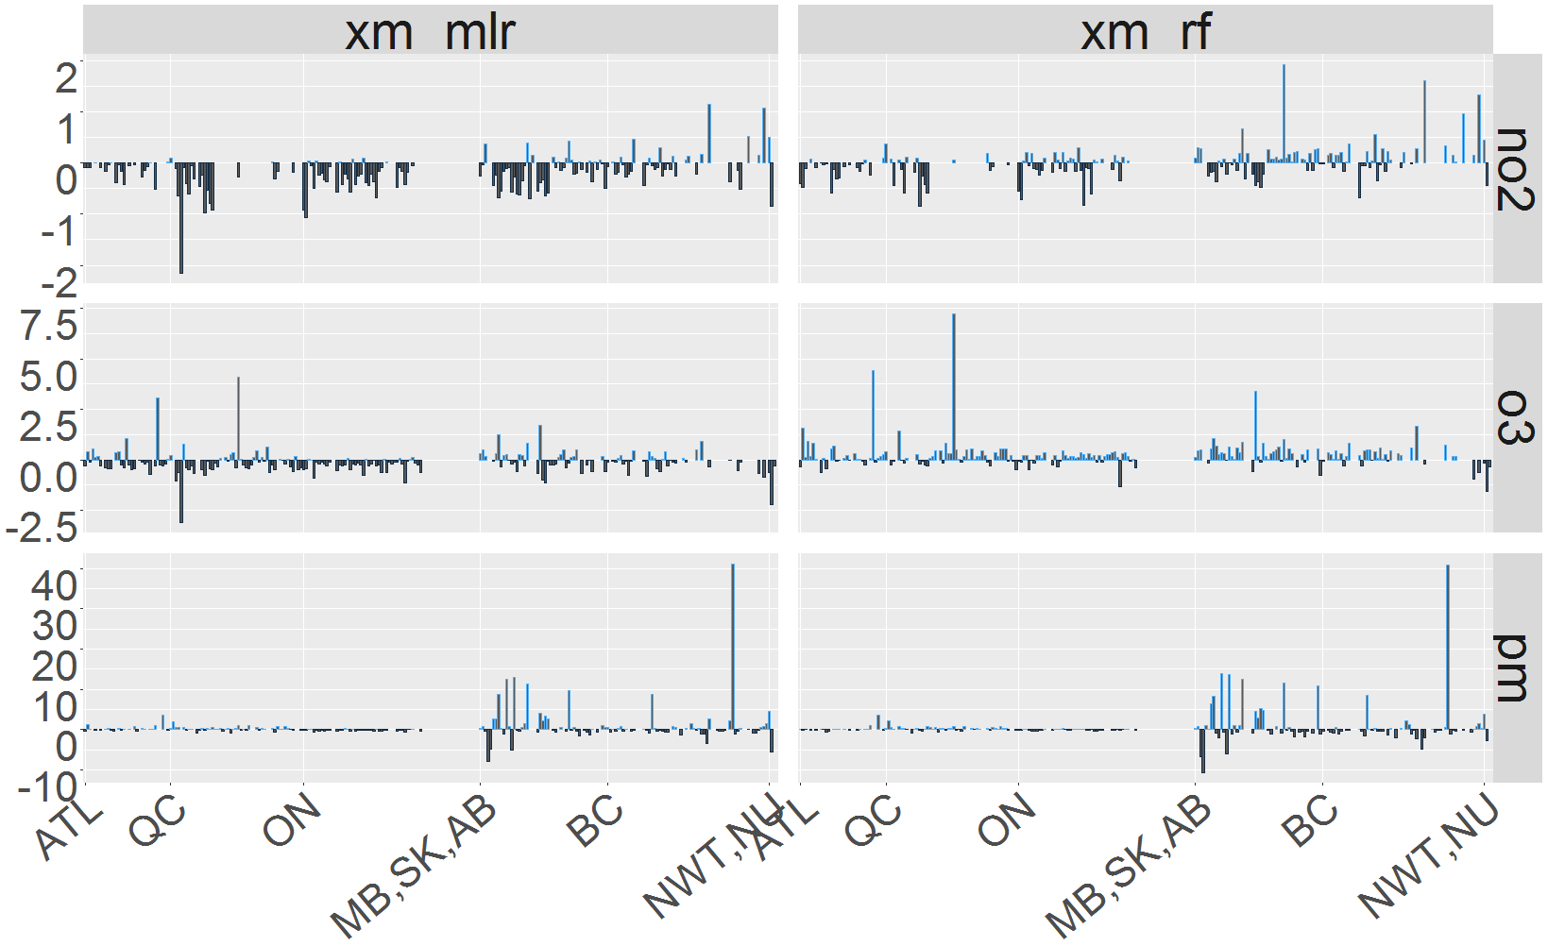
RMSE Improvement over UMOS-AQ
Network Performance Summary
less downside risk
RMSE DIFF (UMOS – XM-Tool)
Notes:
ADD LABEL FOR RMSE DIFF (UMOS – XM-Tool)

Slide 16
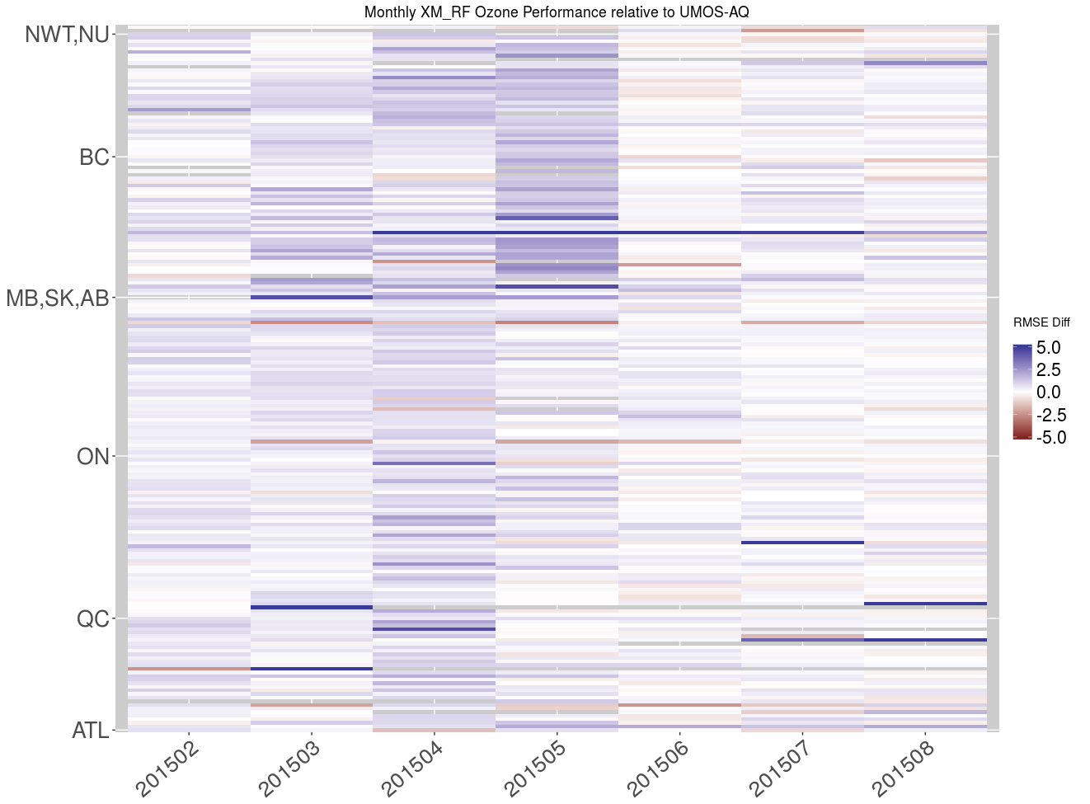
RandomForest (XM_RF)
Seasonal Ozone Performance
Large O₃ improvements
in spring

Slide 17
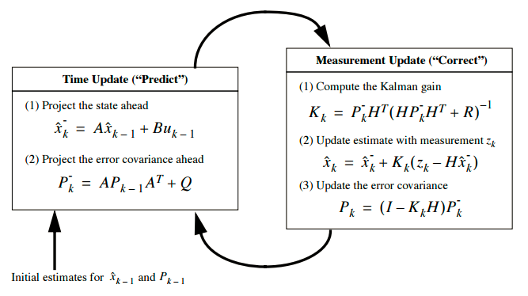
Kalman Filter
Recursive and adaptive learning method
Required less training data
Reduce overall systematic bias at each forecast hour
Applicable to both 2.5km and 10km GEM-MACH runs
Notes:
fkf(a0, P0, dt, ct, Tt, Zt, HHt, GGt, yt, check.input = TRUE)
a0 & P0 can be from previous runs/ a reasonable estm
HHt & GGt (use optim or pre-specified ratio: HHt/ GGt = 0.06 or 0.01)

Slide 18
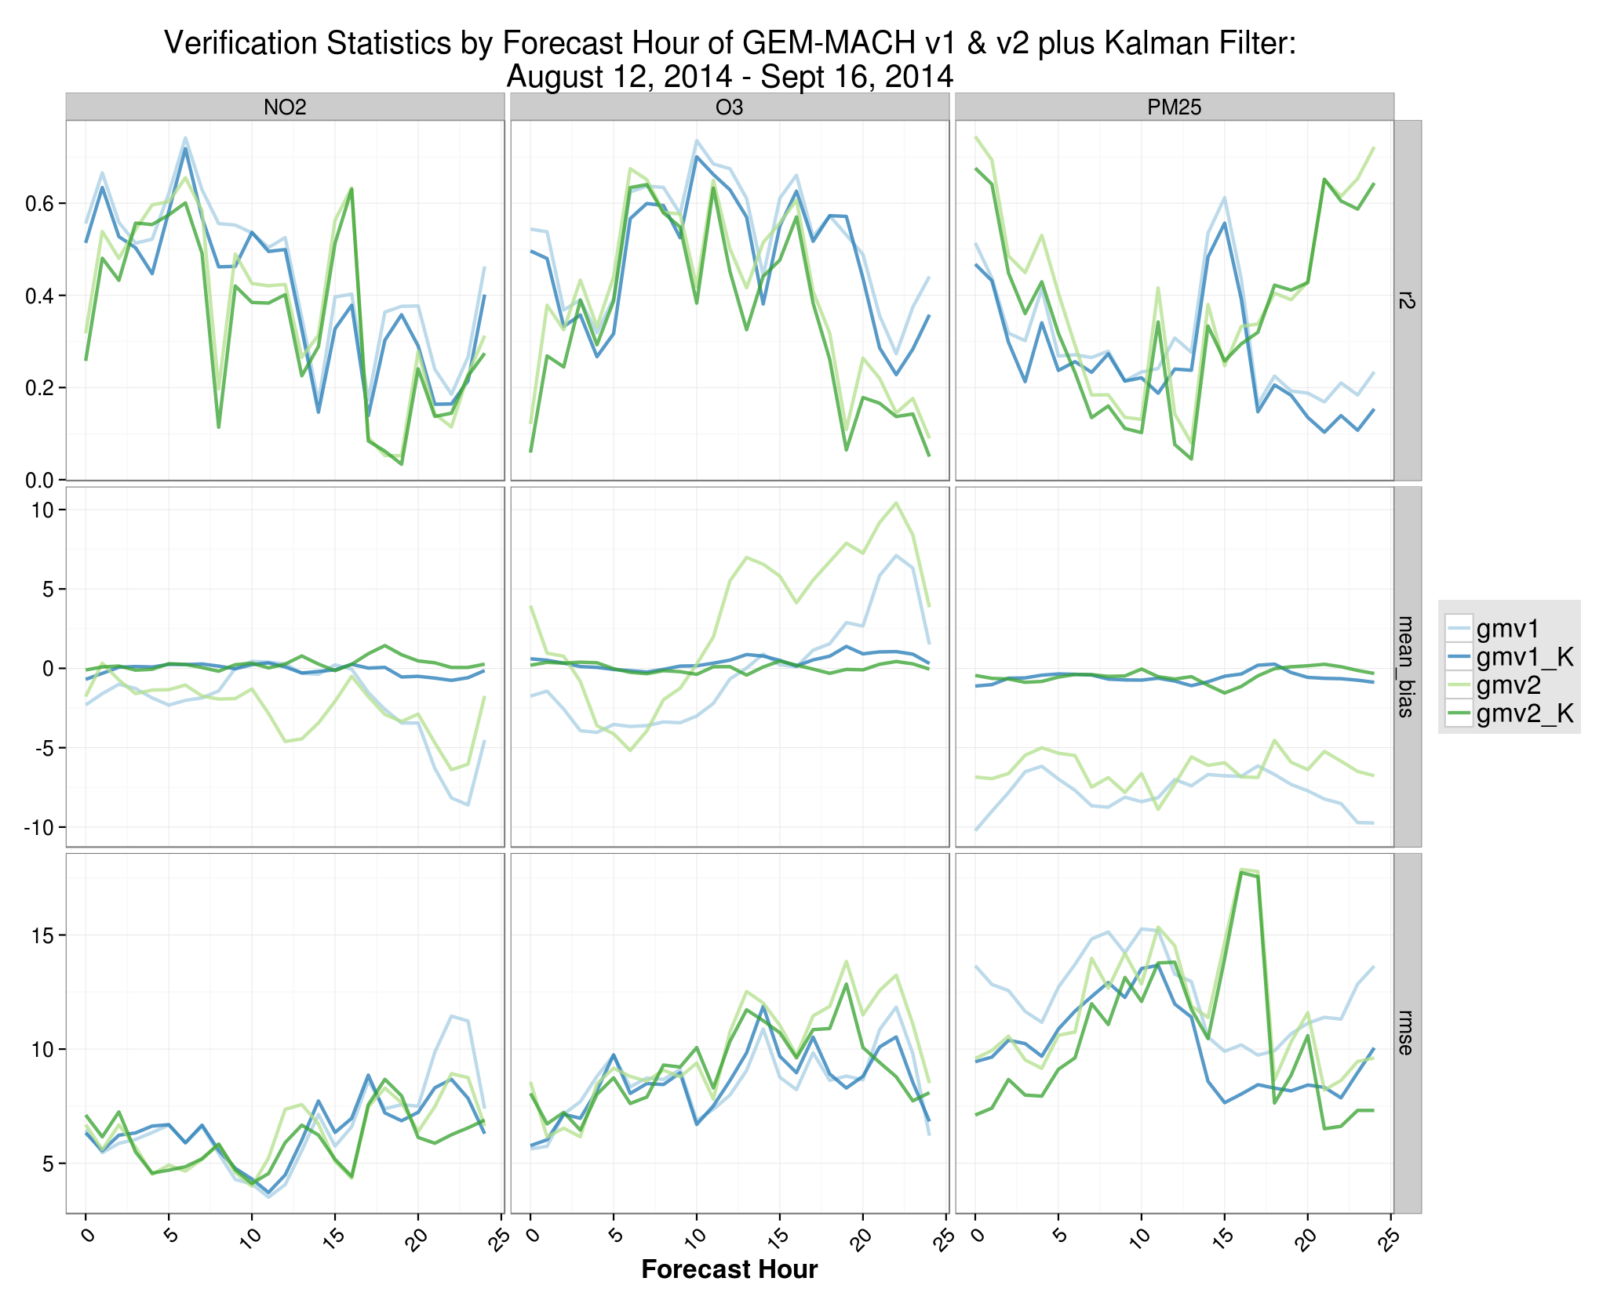
Kalman Filter (summer, 2015)
NO₂
O₃
PM₂₅
Mean Bias
RMSE
Notes:
Kalman filtering (dark green and blue) has reduced the overall model bias considerably. Improvement to RMSE also noticable. GMv2 (raw) does better for PM, worse for O3, better for NO2.

Slide 19
Modeling Summary
Kalman Filter effectively reduced MB from GEM-MACH with limited data
Random Forest made seasonal improvements over UMOS-AQ and provided for more consistent results
Marginal summer improvements may be due to:
  GEM-MACH 10km emission update
  Seasonal modeling approach needed for antecedants
Notes:
Finalize

Slide 20
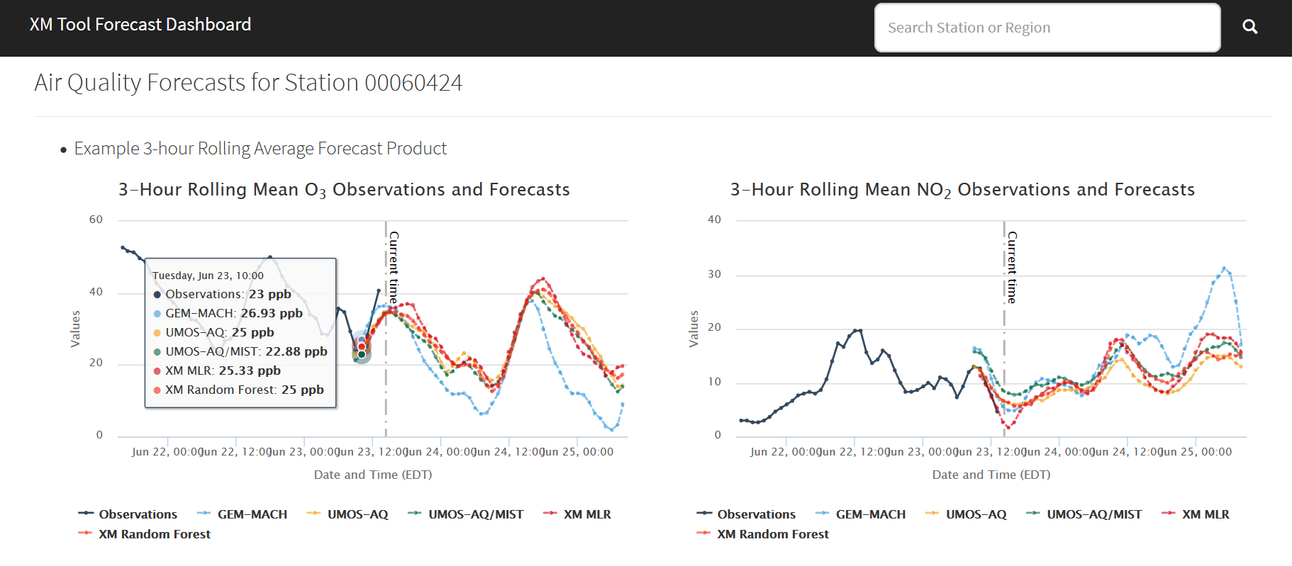
Multi-Product Overview

Slide 21
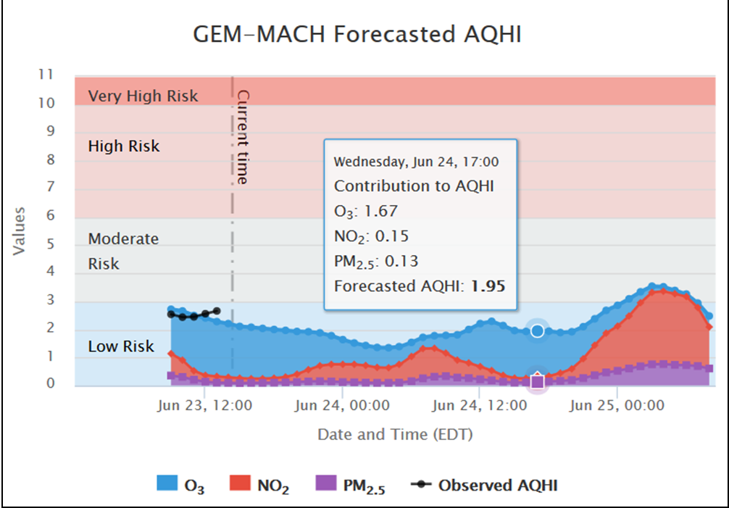
AQHI Guidance Product

Slide 22
Lessons Learned
Experimental Infrastructure successfully demonstrated to meet program needs for Pan Am
Product Dashboard well received
Prototypes have value yet more could be done to leverage the relative strength of each method
Objective Analysis may be underused in operational post-processing

Slide 23
PROGNOS
PROGNOS is an initiative to re-new the operational statistical post-processing infrastructure.
Improve capability to meet changing air quality and meteorological program needs
Data driven approaches will versatility to the modeling approach and lower system maintenance requirements
Improved links to research and development
Notes:
PanAm was a proof of concept for our system

