Slide 1
Improving Air Quality (and Weather) Predictions using Advanced Data Assimilation Techniques Applied to Coupled Models
Gregory R. Carmichael¹, Pablo Saide¹ Meng Gao¹ , Jhoon Kim², Chul Song³, and Myungie Cho²
Center for Global and Regional Environmental Research, University of Iowa
Yonsei University, Seoul, Korea
GIST, Gwangju Korea

Slide 2
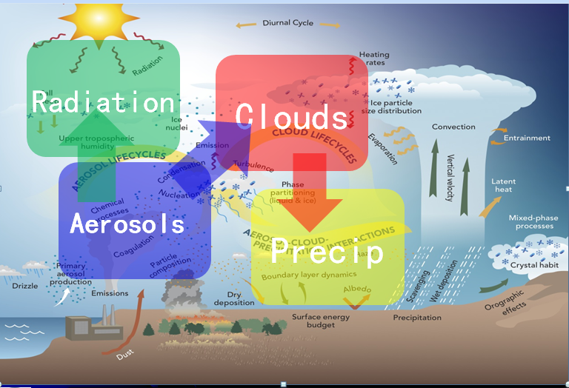
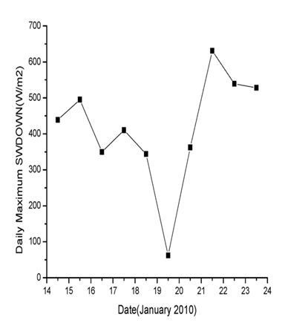
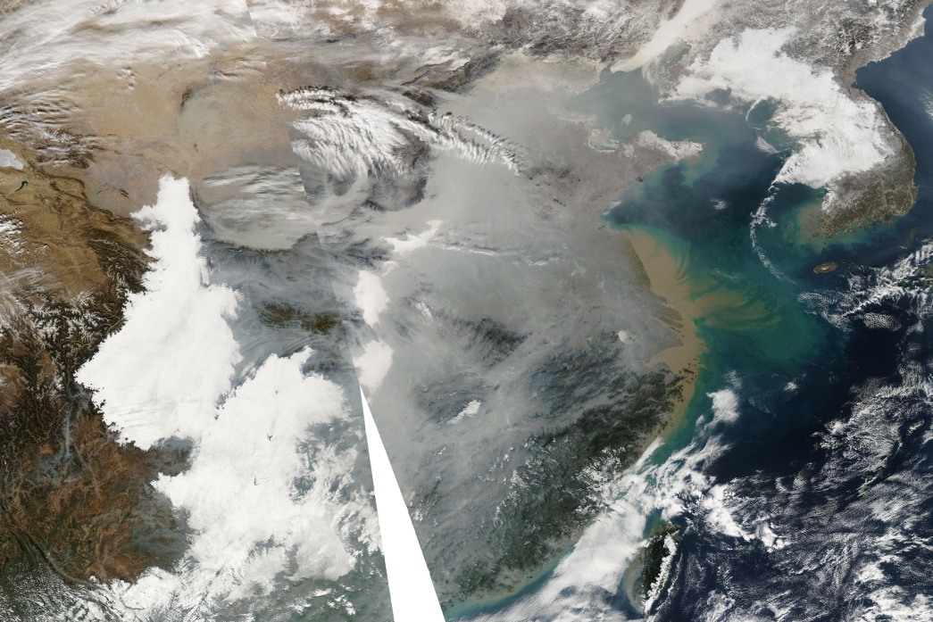
Modeling Atmospheric Composition Matters: To Air Quality, Weather, Climate and More
yet - still highly uncertain

Slide 3
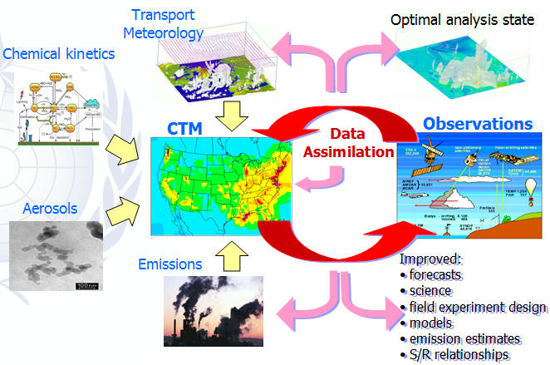
Models Constrained With Observations Play Increasing Important Roles In Research and Applications
Need for More aerosol and atmospheric composition data for use in assimilation
New observations streams are in the pipe-line …
Are our modeling & assimilation systems ready to use these data?
Little experience with coupled models!

Slide 4
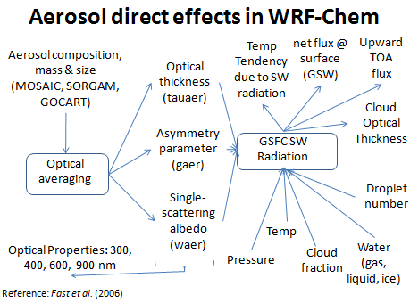
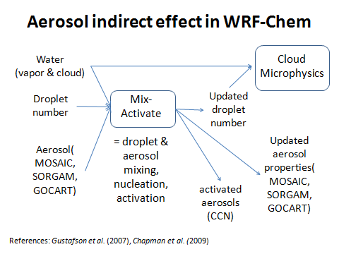
Building Assimilation Systems for WRF-Chem
(in WRF-PLUS)
We are developing the adjoint of the full WRF-Chem Model
Ref: Saide et al., 2013, Saide et al., PNAS 2012, GRL 2014, 2015a,b; Guerette and Henze GMD, 2015 for use in 3d (GSI) and 4dVar applications

Slide 5
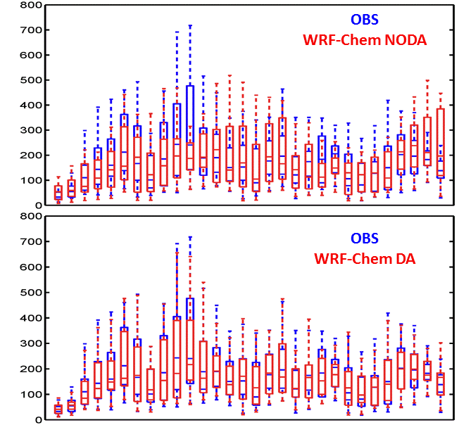
Assimilation of Growing Number of Surface PM2.5 Observations Enable Improved Predictions
Haze JAN 2013
PM2.5 Observations are growing rapidly
Impacts of assimilating surface PM_{2.5}
Mean over all surface observation
Health impacts from winter haze; e.g., Gao et al., Science Tot. Env., (2015), ACP, 2016, ES&T, 2017

Slide 7
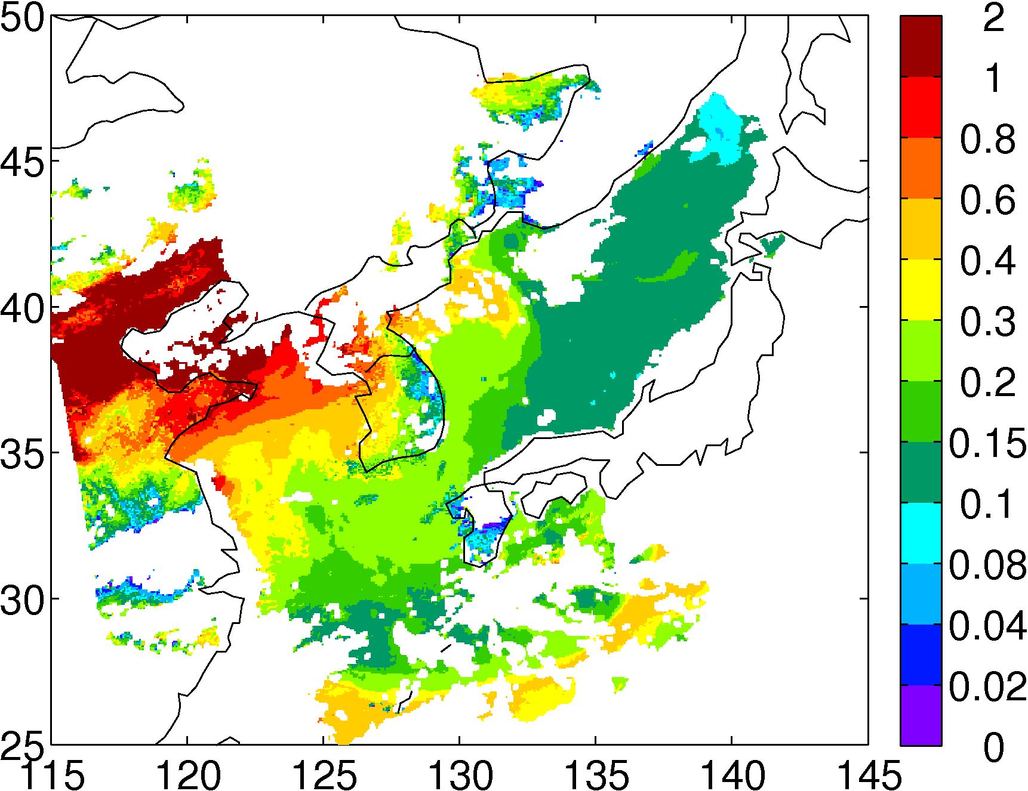
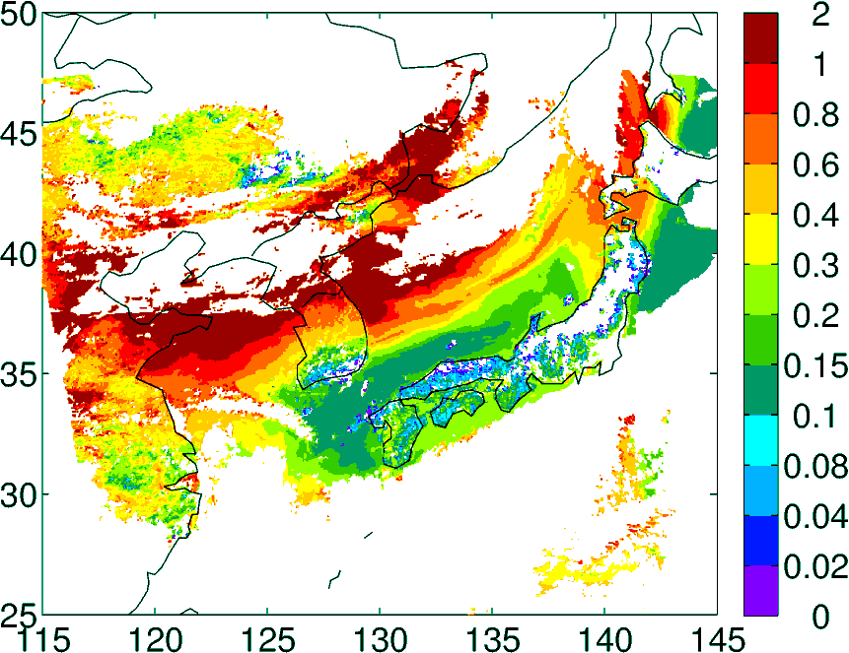
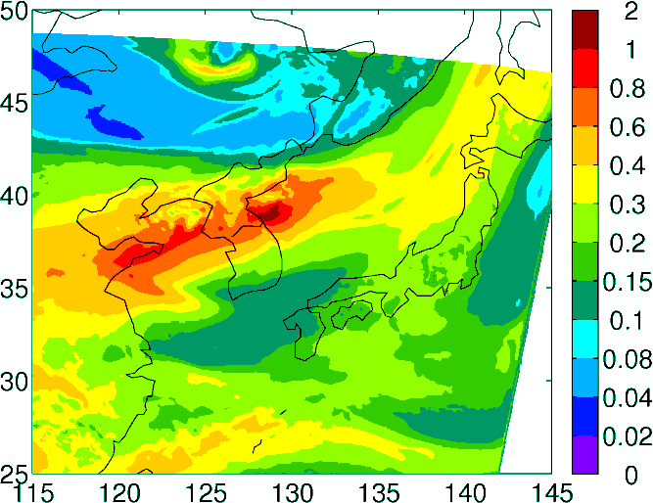
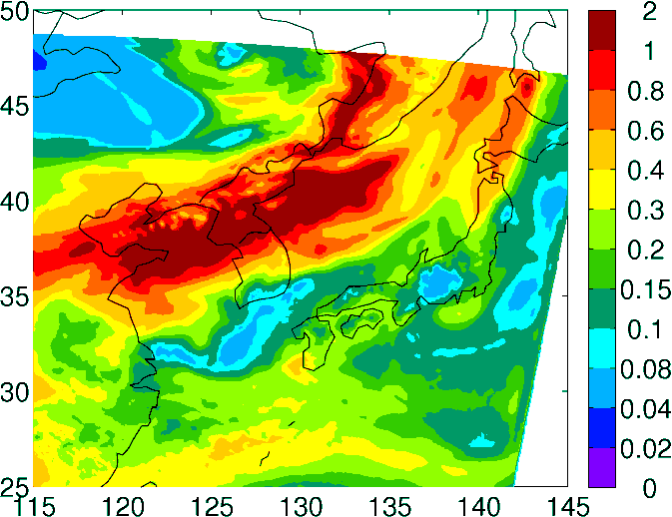
Application: Impacts of Geostationary AOD Assimilation
(Are we “ready “ to see an impact?)
GOCI AOD
Near future more assets , e.g., GEMS!!
Aug 27-29, 2012
Objectives: Assess performance of assimilating Geostationary GOCI AOD into a system already assimilating MODIS AOD
System: WRF-Chem - GSI for MOSAIC sectional aerosol model (Saide et al., ACP 2013) allows assimilation of multiple data
Experiments: GSI AOD assimilation every 3 hours, MODIS only, MODIS+GOCI. (Only over-sea
AOD used)
WRF-Chem NO Assim
WRF-Chem MODIS+GOCI Assim
Saide et al., GRL, 2014

Slide 8
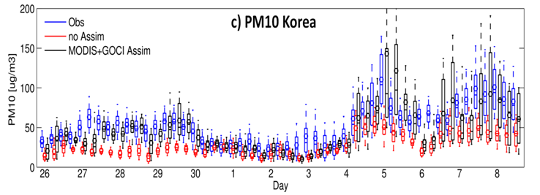
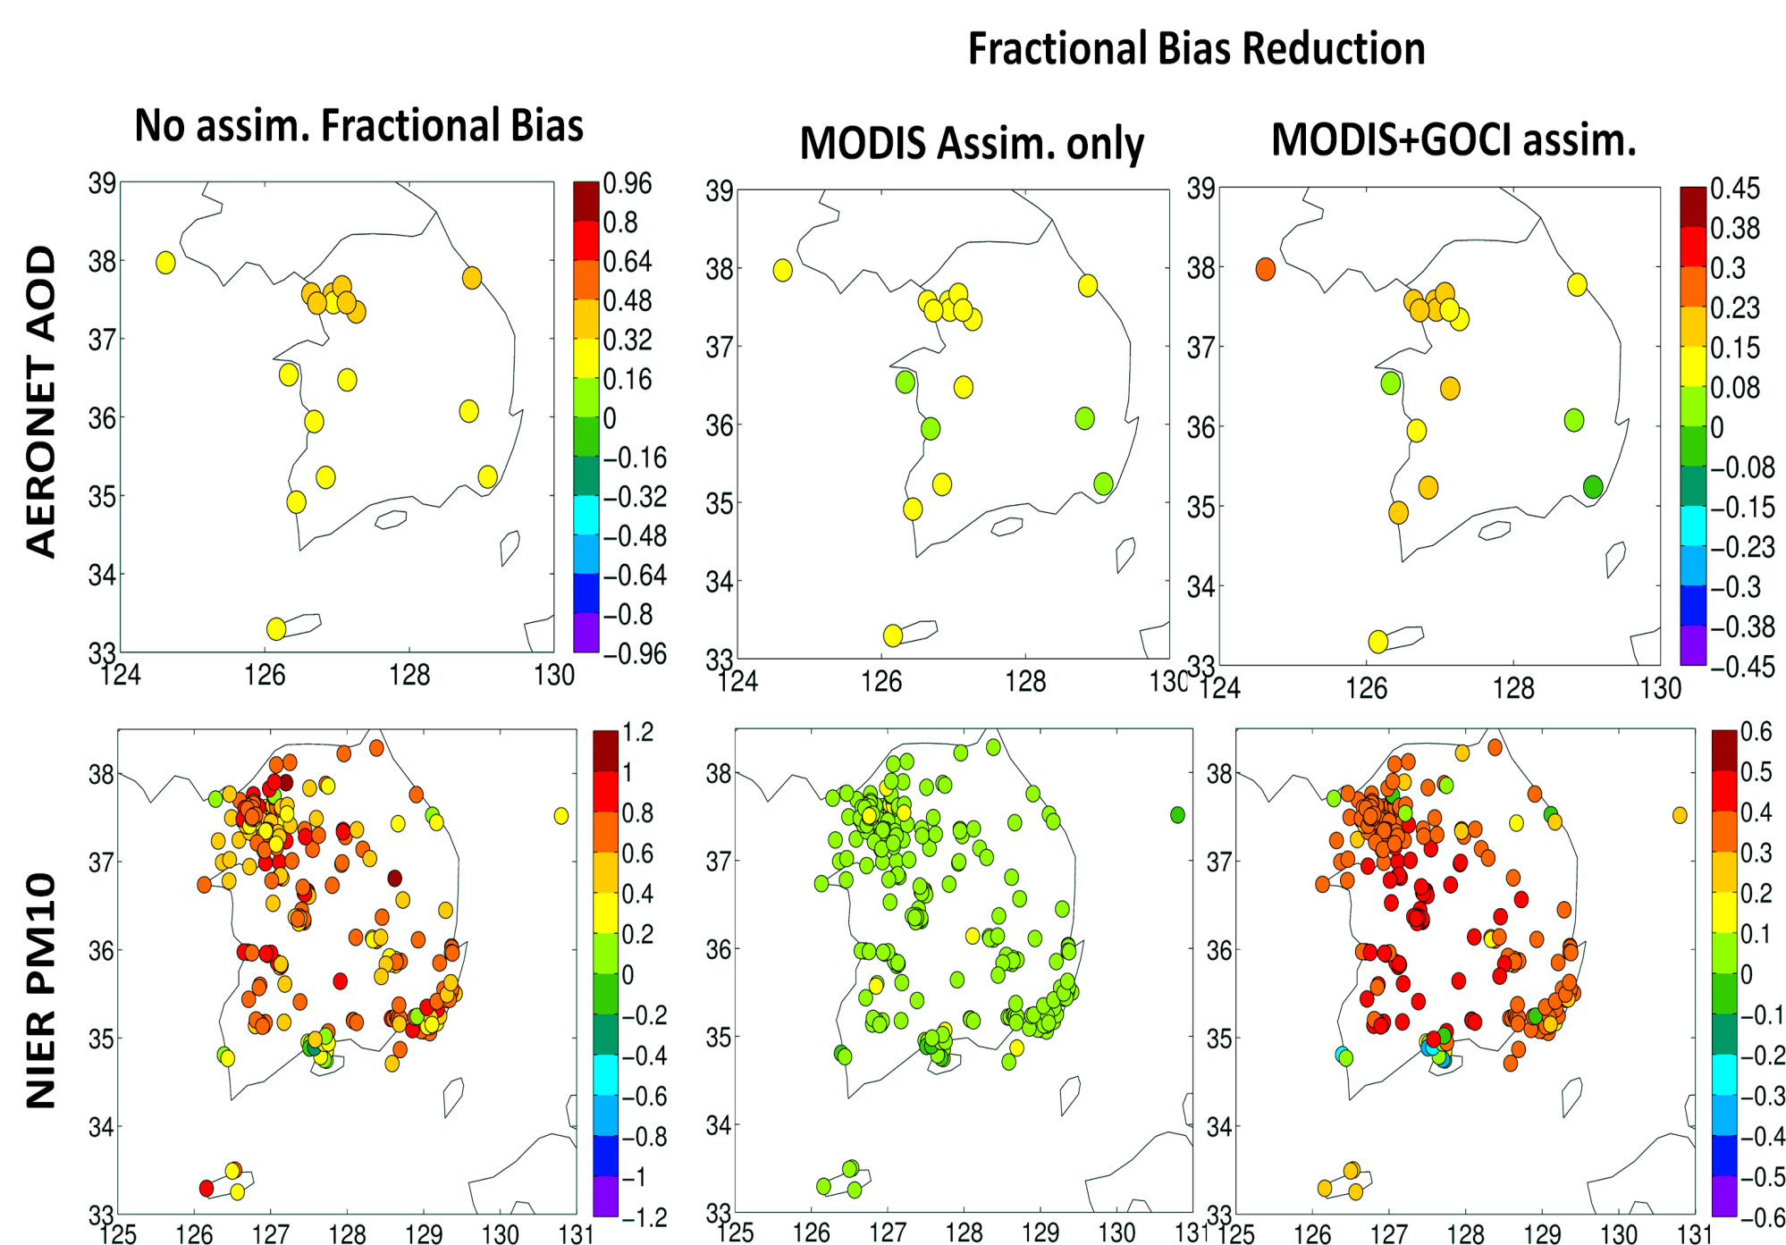
Impact of GOCI on PM10 Prediction
MODIS
MODIS+GOCI
Fractional Bias reduction

Slide 9
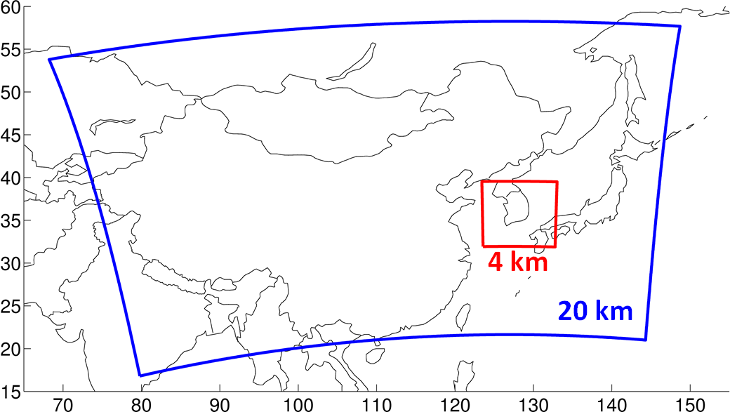
KORUS-AQ forecasting system
WRF-Chem with MOSAIC aerosols and a Reduced Hydrocarbon chemistry (Pfister et al. JGR 2014), including simplified SOA formation (Hodzic and Jimenez, GMD 2011)
GFS and MACC meteorological and chemical boundary conditions
KORUS-AQ anthro (Jung-Hun Woo) and QFED fire emissions
AOD data assimilation using GSI (Saide et al., ACP 2013). MODIS and GOCI data were assimilated simultaneously every three hours.
Four days of forecasts were available for the outer domain, 2 days for the inner domain

Slide 10
KORUS-AQ forecasting system
(left) is no assimilation AOD at 600nm, (middle) is assimilation (MODIS, GOCI land and ocean), (right) their differences. Domain and locations of surface based AOD observations .

Slide 11
KORUS-AQ forecasting system

Slide 12
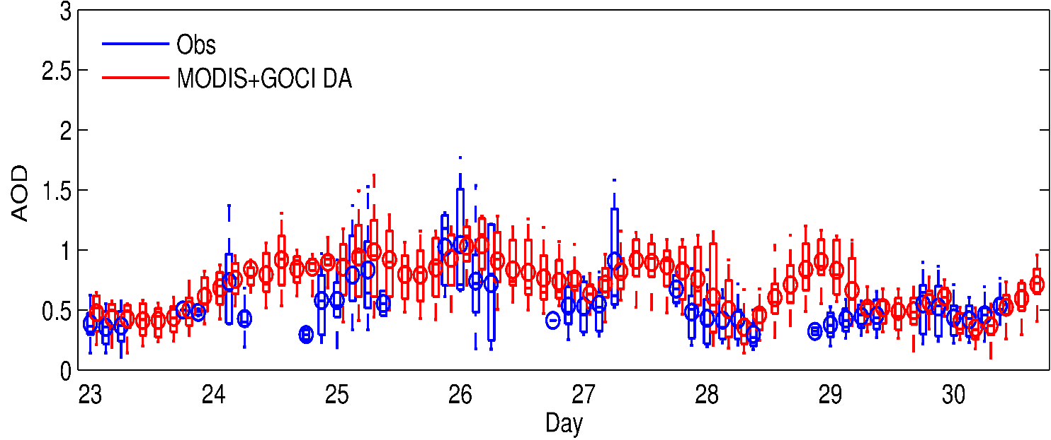
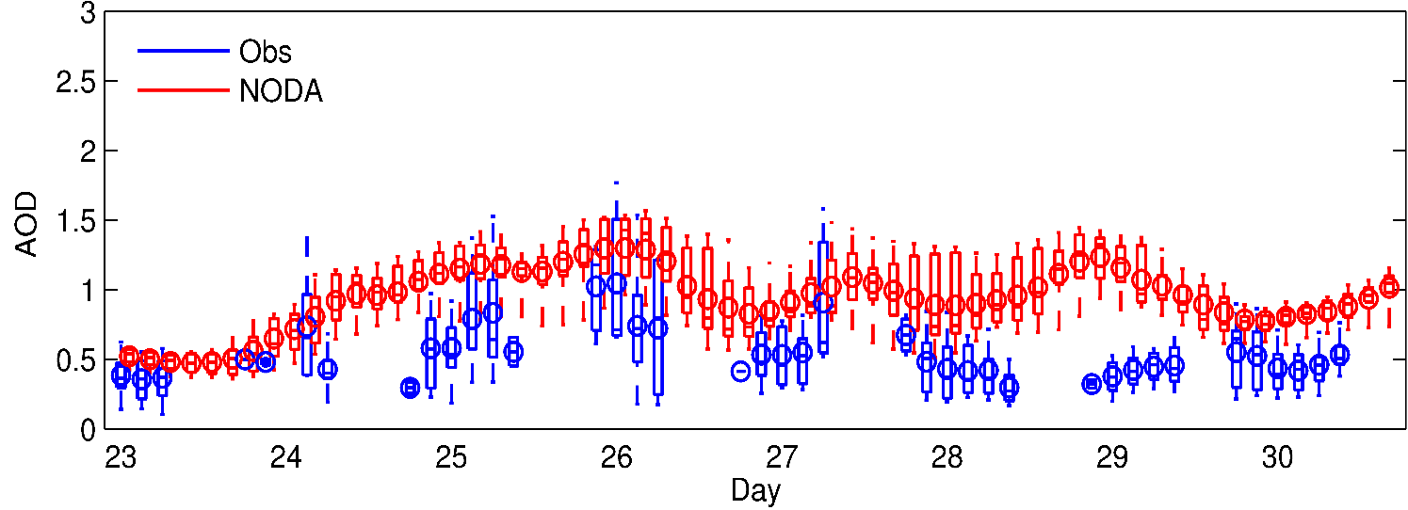
KORUS-AQ forecasting system
All Korean Sites 30+ hr forecast

Slide 13
Impact of Assimilation on PM Forecasts
PM10
All sites in Korea 30+ hr forecast
PM2.5
Further work needed to improve linkages between AOD and PM2.5

Slide 14
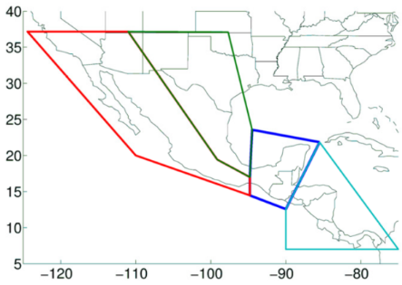
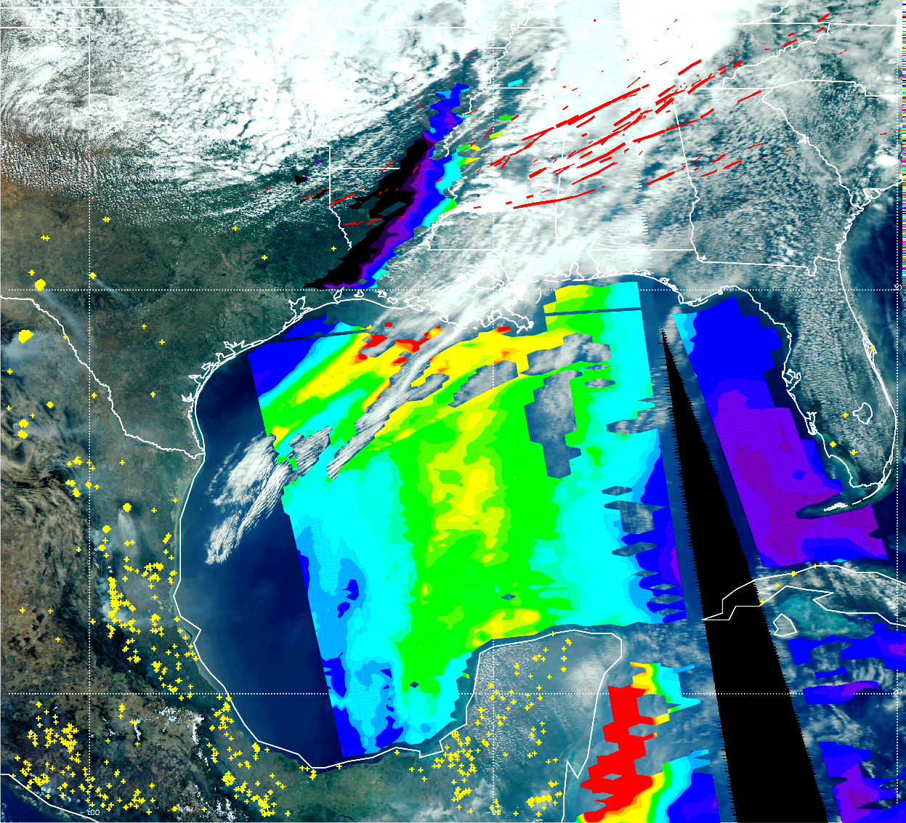
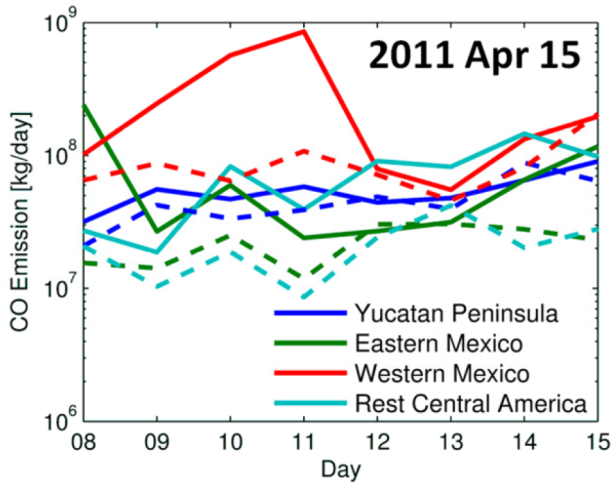
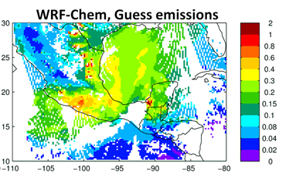
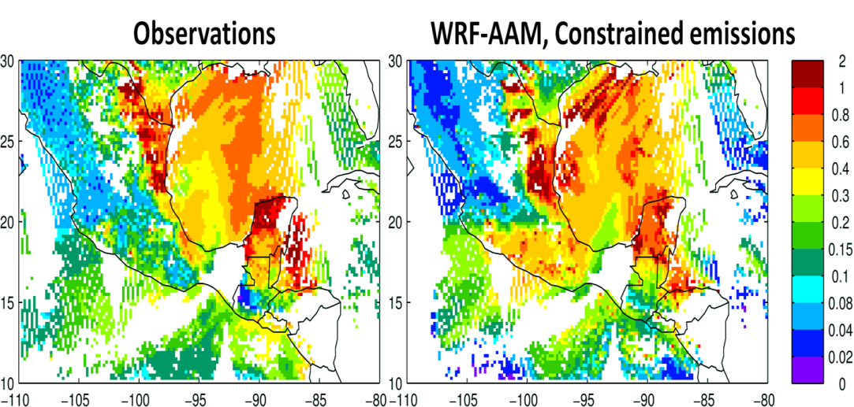
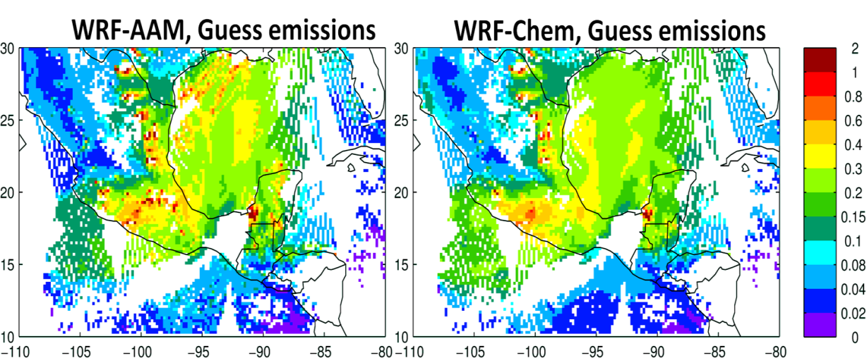
Constraining biomass burning emissions for improved prediction skill and assessing smoke-weather interactions
Saide et al., GRL, 2015
WRF with aerosol-aware microphysics (AAM) (Thompson and Eidhammer, 2014) and WRF-Chem emissions.
Inversion based on Saide et al. (GRL 2015b) using WRF tracers (no adjoint, no ensembles)
Plans for using it operationally for the NASA ORACLES and NOAA FIREX field experiments
Run 2 forecasts needed by the inversion method (with and without feedbacks) so that aerosol feedbacks impacts are also forecasted
Notes:
Notes:
Figure upper right: regions where scaling factors are applied to biomass burning smoke emissions
Figure at center-right: Time series of emissions on each region showing prior and constrained emissions. Note that scaling of emissions varies through time and region considerably, so scaling all emissions for all times by a single factor would not work
Bottom figure: Shows the improve fitting to observations after re-running with the constrained emissions

Slide 15
Emission Inversion method
Constraining biomass burning emissions for improved prediction skill and assessing smoke-weather interactions
Variational Inversion
Airborne
Full Chemistry
OBS Sensitivities
WRF-Chem
Observations
Ground
Hourly Tracers
Tracer Sensitivities
Correction factors
Satellite
Saide et al., GRL, 2015

Slide 16
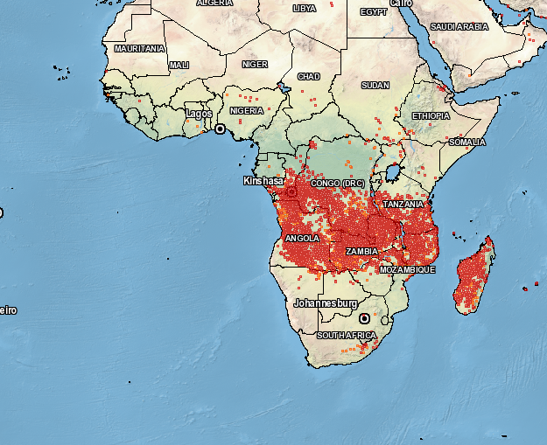
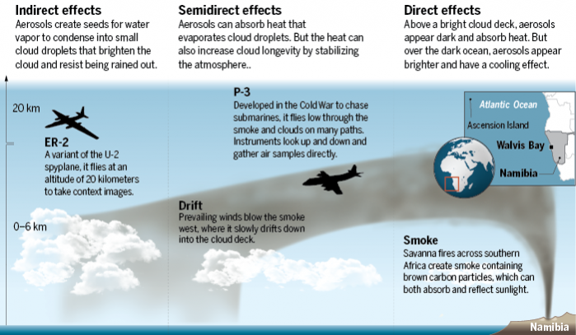
ORACLES (ObseRvations of Aerosols above CLouds and
their intEractionS)
Instrumentation & Models NASA Earth-Venture-Suborbital-2 project

Slide 17
ORACLES (ObseRvations of Aerosols above CLouds and
their intEractionS)
Instrumentation & Models NASA Earth-Venture-Suborbital-2 project
Proposed modeling domains: To match the plotting domains for flight planning
Forecast model configurations:
Full-chemistry/aerosols and data assimilation:
Similar to the system run in KORUS-AQ and SEAC4RS
GSI AOD assimilation coupled to GMAO NNR retrieval
Simplified aerosol model with near-real-time inversion (WRF-AAM):
Aerosol scheme adds ~10% of WRF computation (Thompson et al., 2014), achieving short latency
Outputs aerosol number and AOD
By running two simulations we can perform an inversion and assess aerosol-cloud-radiation interactions in NRT
Top down estimates of fire emissions
12 km
WRF-Chem
36 km for WRF-Chem
12 km for WRF-AAW

Slide 18
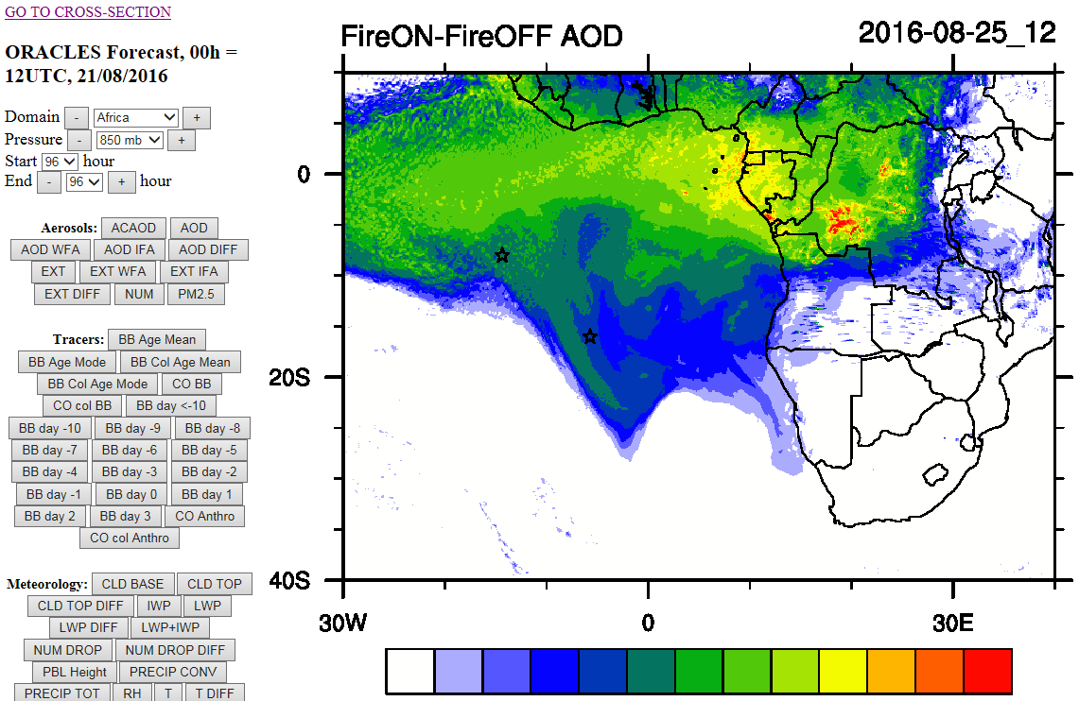

Slide 19
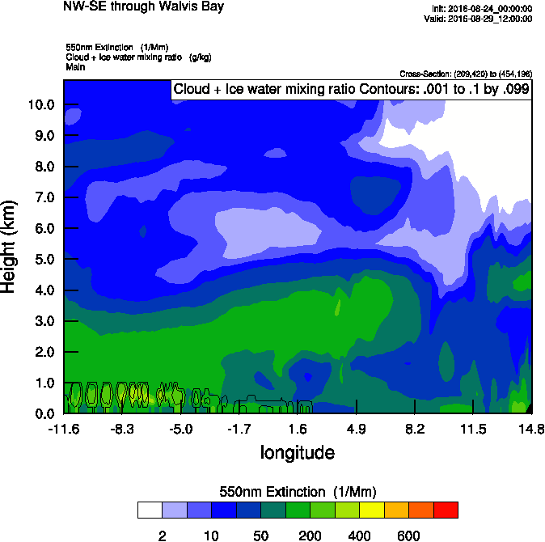
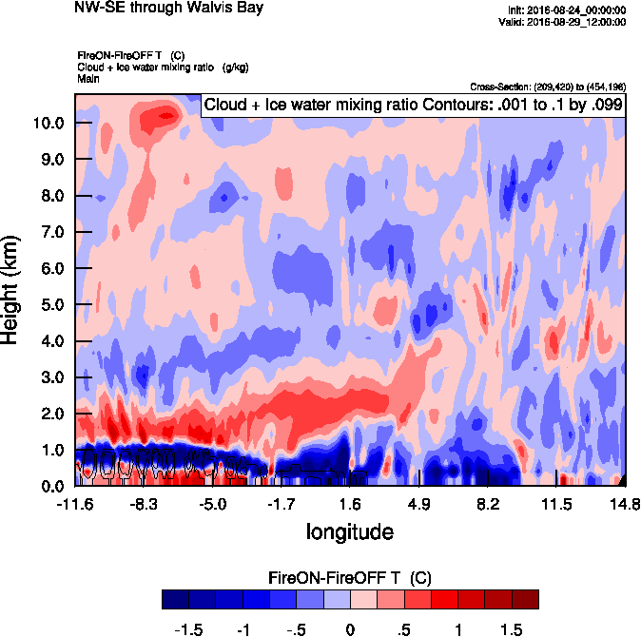
Δ Ex
Δ T

Slide 20
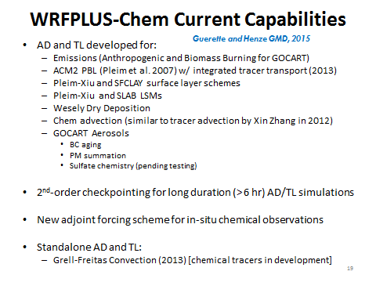
Building Assimilation Systems for WRF-Chem
Ref: Saide et al., 2013, Saide et al., PNAS 2012, GRL 2014, 2015a,b; Guerette and Henze GMD, 2015 for use in 3d (GSI) and 4dVar applications Guerrette and Henze, in review, ACP

Slide 21
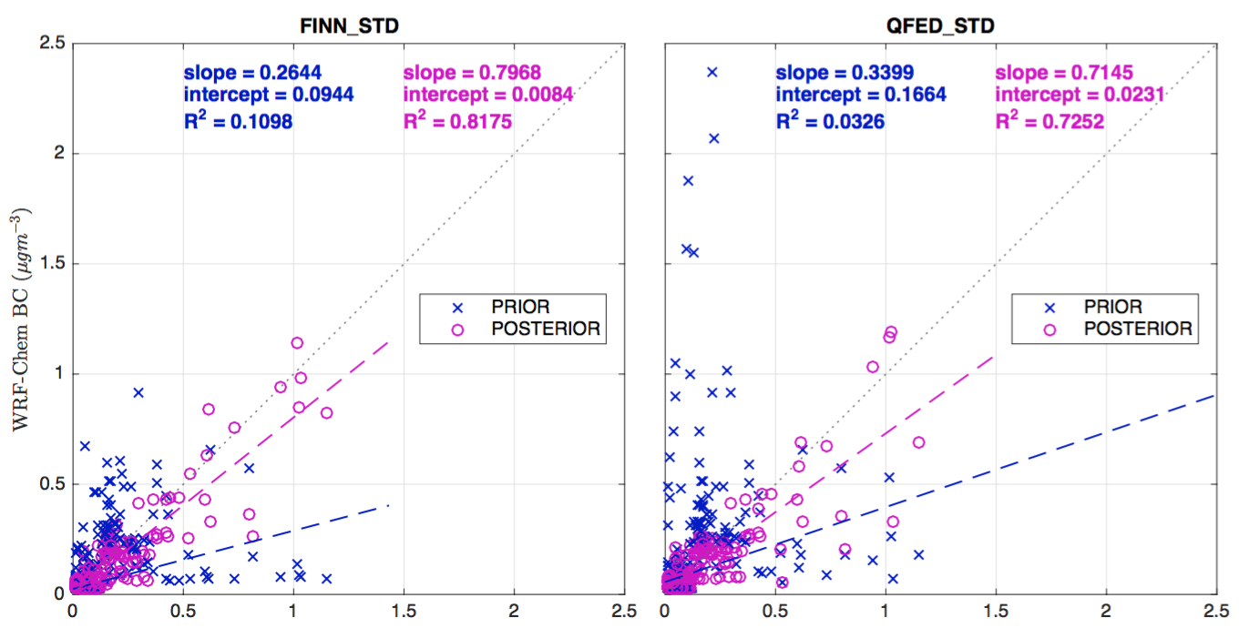
June 22, 2008 ARCTAS-CARB Case Study 4dVar Biomass Burning BC Emissions
MODEL$−$OBS $={y−y}^{o}$
22 June
[Kondo et al., 2011; Sahu et al., 2012]
Low Bias
Mixed Bias
-1.5
0.0
+1.5
($μg/m^{3}$)
[Guerrette and Henze, 2015, GMD]

Slide 22
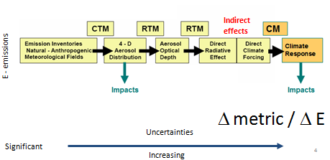
Closing Thoughts
Atmospheric composition-Chemistry-Climate interactions are critical to air quality, weather & climate prediction and policy assessments.
Advanced data assimilation techniques applied to coupled models can improve our predictive capabilities (air quality and weather) – but further developments needed.
Further expansion of our observing systems and improved assimilation tools are needed.
Future is promising with new observing systems and increased public awareness/need for environment services related to atmospheric composition

