Slide 1

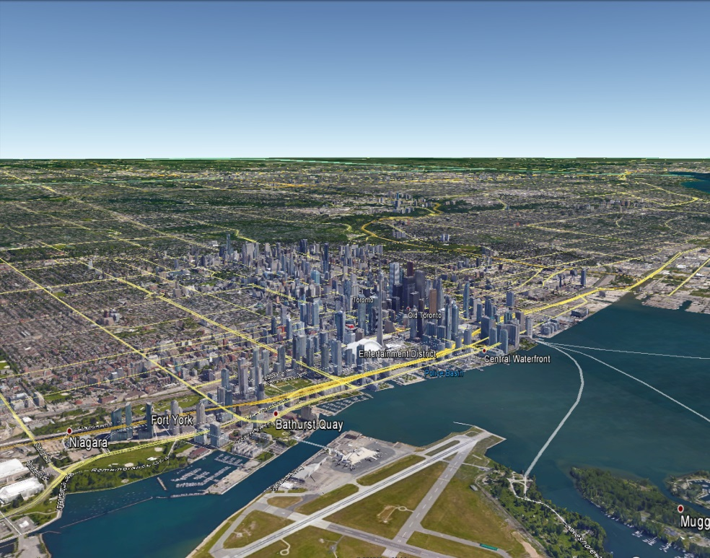
Towards an operational air-quality forecasting system at urban scale at ECCC
AQMAS: Rodrigo Munoz-Alpizar*
Radenko Pavlovic, Sylvain Ménard
Didier Davignon, Hugo Landry
Samuel Gilbert, P,-A, Beaulieu.
ARQI: Craig Stroud, Shuzhan Ren
RPN-E: Stephane Belair
CMDN: Manon Faucher
8th International Workshop on Air Quality Forecasting Research, Toronto, Ontario
January 10 - 12, 2017

Slide 2
Outline
Motivation and Background
Current status of High Resolution Forecast Systems at ECCC
Results of Urban Forecasts
Next Steps

Slide 3
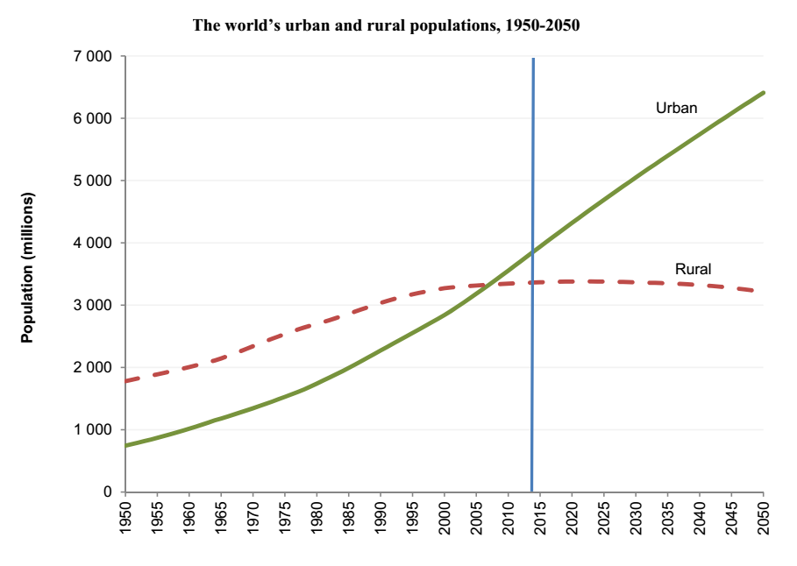
Motivation : Why High Resolution Forecasts?
Population growth and urbanization are among the main drivers of the increasing end-users* demand for more accurate forecasts and environmental and health assessments
* Municipalities, public health agencies, emergencies, etc..
In 2014, about 54% of global population already live in urban areas
By 2050, the world will be 34 % rural and 66 % urban
In Canada, 81%, of the population live in urban areas according to the Canada's 2011 census
Source: World Urbanization Prospects, 2014 Report

Slide 4
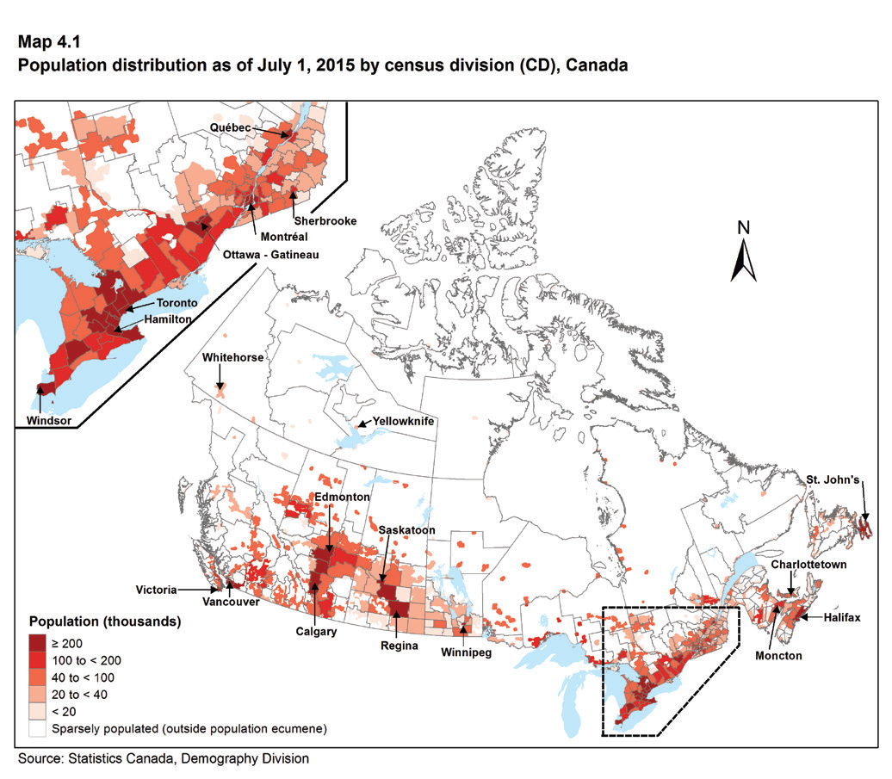
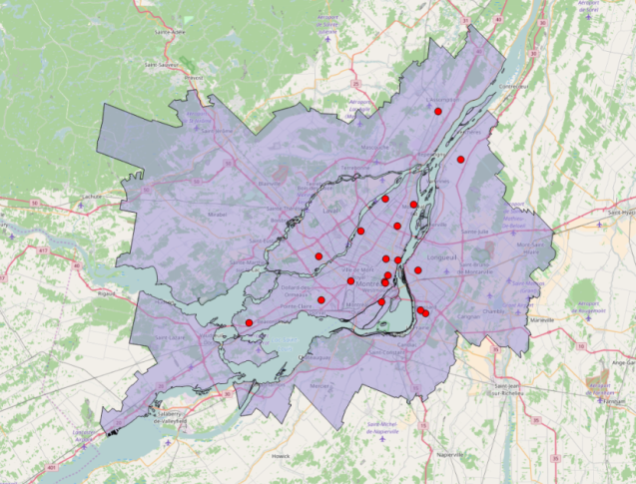
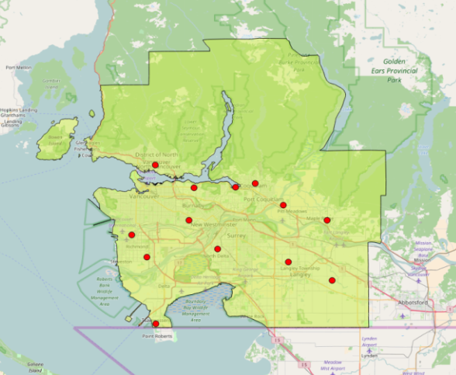
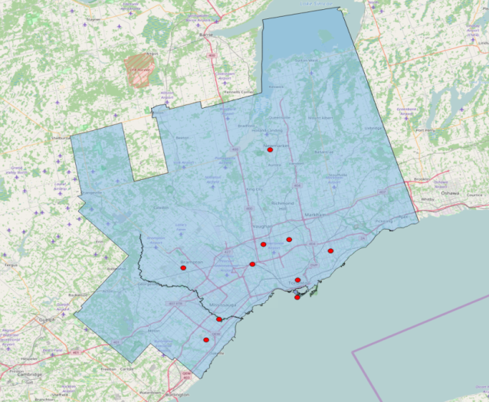
High density urban centres in Canada
VANCOVER
MONTREAL
AQ stations
More than a third of Canadian population (~ 13 millions) lives in these 3 metropolitan areas (Statistics Canada, 2015).
TORONTO
Canada has a small number of high density urban centres
Notes:
Population distribution in Canada has a small number of large urban centres that would have unique considerations such as heat island effects.
http://www.demographia.com/db-worldua.pdf
MAP http://www.statcan.gc.ca/pub/91-214-x/2016000/section04-eng.htm
The census numbers (2011) reflect metro areas. For example, Toronto’s density varies
City 4,149 /km2
Metro 945.37/km2 (CMA = City Metropolitan Area includes 24 census areas (boundaries excludes Guelph, Hamilton, Oshawa and Barrie)
http://www12.statcan.gc.ca/census-recensement/2011/as-sa/fogs-spg/Facts-csd-eng.cfm?Lang=Eng&GK=CSD&GC=3520005
https://www12.statcan.gc.ca/census-recensement/2011/as-sa/fogs-spg/Facts-cma-eng.cfm?LANG=Eng&GK=CMA&GC=535
Population Density
http://www12.statcan.gc.ca/census-recensement/2011/dp-pd/hlt-fst/pd-pl/Table-Tableau.cfm?LANG=Eng&T=205&SR=1&S=10&O=D&RPP=50
Demographic statistics
http://www.statcan.gc.ca/pub/91-214-x/91-214-x2016000-eng.pdf
There are different numbers depending on the year and land area.

Slide 5
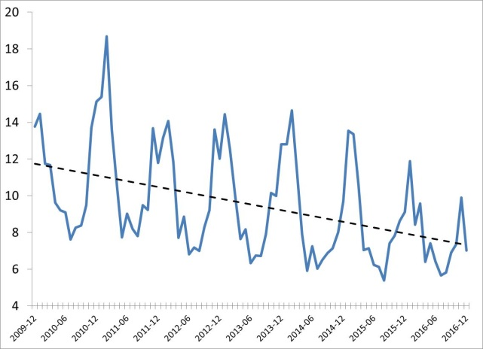
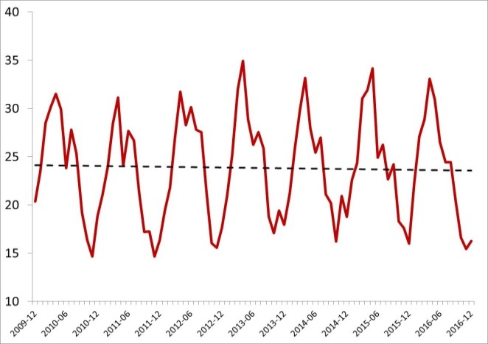
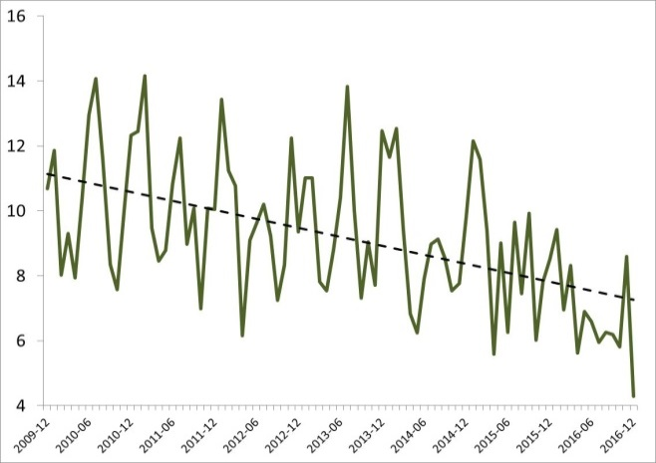
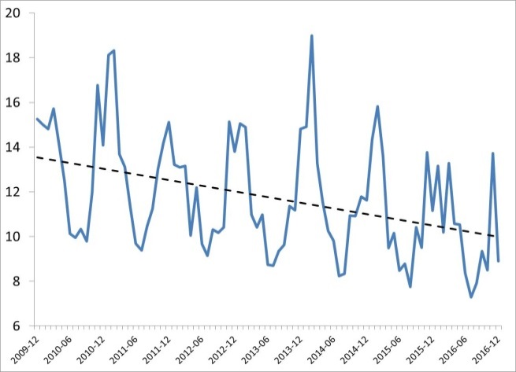
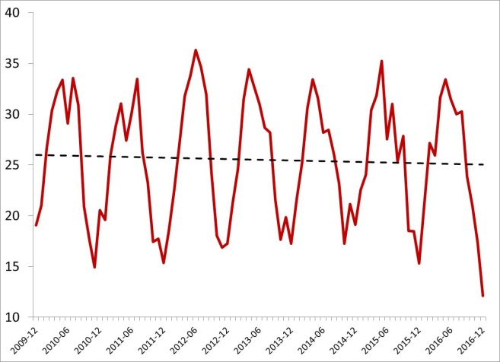
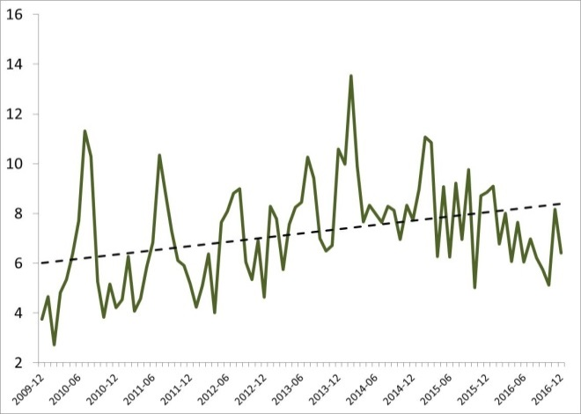
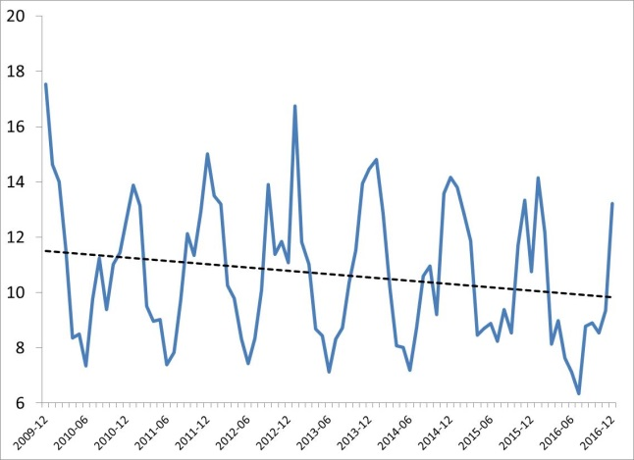
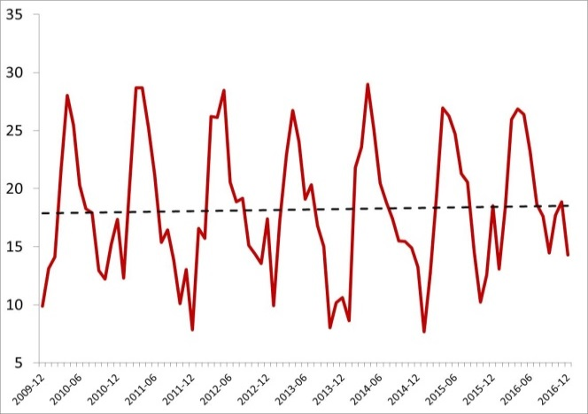
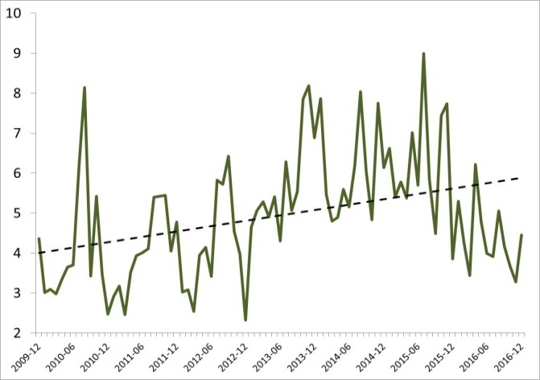
2010-2016 Observed Pollution Trends in Metropolitan Areas
NO₂
O₃
PM_{2.5}
MONTREAL
decreasing
NO₂
O₃
PM_{2.5}
TORONTO
NO₂
O₃
PM_{2.5}
VANCOUVER
NO₂ : decreasing concentrations
O₃ : without trend
PM_{2.5} : mixed trend

Slide 6
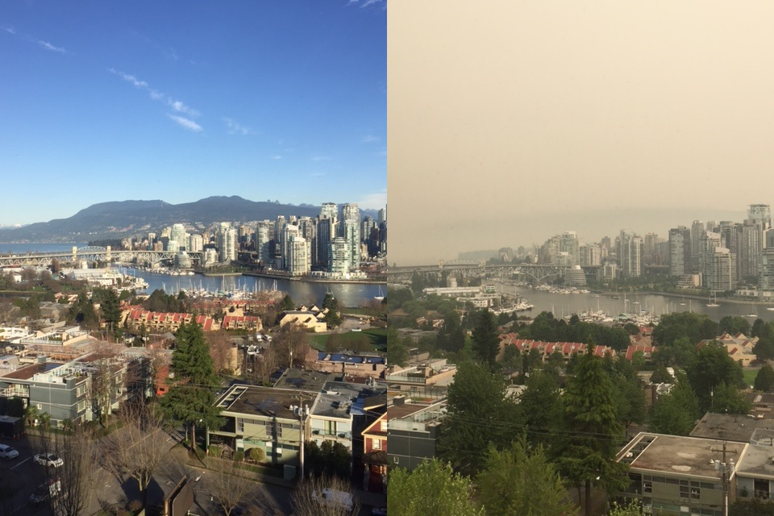
Poor Air Quality in urban environment
Example of pollution episodes
Vancouver
July 6th 2015
Observed hourly PM_{2.5} above 100 μg/m³
Curtesy of Julia Veerman, RWDI, Vancouver, BC
Despite the efforts made in reducing airborne concentrations of primary pollutants in urban areas, air quality continues to be a concern, especially during pollution episodes.

Slide 7
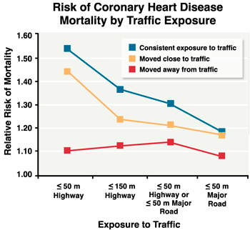
Adverse Health Effects of Urban Air Pollution
Low level exposure
Irritate eyes and respiratory tract
Could develop into chronic respiratory diseases
Gan et al., (2010) mapped the residential location of 450,000 adults aged 45 to 84 years who lived in Vancouver and did not have heart disease, and then followed these subjects for several years. By comparing subjects living away from traffic with subjects living near traffic, they found those living close to a highway or major road were about 29% more likely to die from coronary heart disease.
Source: Gan et al., 2010

Slide 8
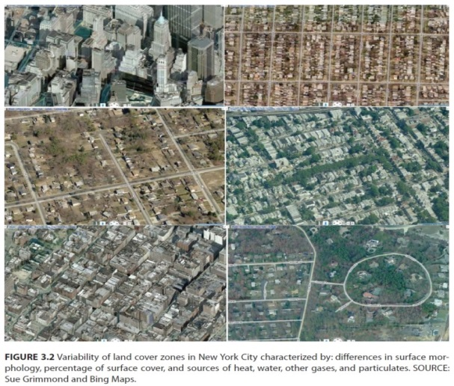
Modelling at the urban-scale
Urban areas are influenced by weather conditions at the synoptic, meso- and local scale;
Physical characteristics have a forcing effects on the boundary layer
Evapotranspiration
Absorption and reflection of solar radiation
Storage of heat
Winds and turbulence
Heterogeneous environments have significant variability at the urban scale
Example of variability in the urban fabric of a large city (New York) (Source: NRCNA, 2012)
Notes:
Urban environments can consist of high density skyscrapers or lower density surburban dwellings with greenspace
Paved surfaces affect stormwater management
Building and road materials contribute to heat island effect
Skyscrapers create wind tunnel effects

Slide 9
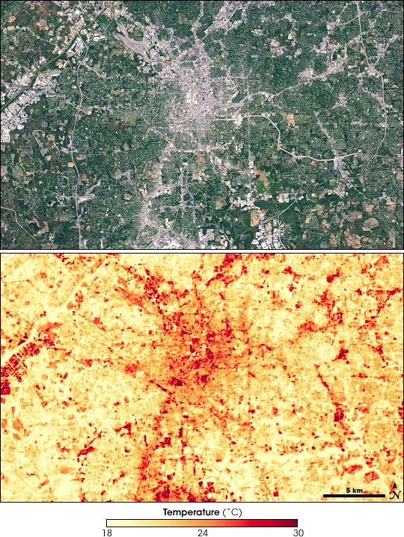
Modelling at the urban-scale
Stagnation enhances air pollution
Urban Heat Island (UHI)
Heat islands can affect communities by increasing energy consumption (e.g. 5-10%of peak electricity demand for cooling buildings in cities),
Increasing air pollution and greenhouse gas emissions
heat-related illness and mortality, and water quality.
UHI effect. Thermal imaging (bottom) shows the excess heat in the most urban areas of Atlanta, Georgia. Source: NASA images by Marit Jentoft-Nilsen, based on Landsat-7 data.
Breeze effects
Land and Sea breezes not only influences the heat island intensity but also distorts its size and shape due to prevailing local circulations.
Notes:
Urban environments can consist of high density skyscrapers or lower density surburban dwellings with greenspace
Paved surfaces affect stormwater management
Building and road materials contribute to heat island effect
Skyscrapers create wind tunnel effects

Slide 10
Modelling at the urban-scale
Is complex and has advanced
Improvements in physical process representation
Improved data assimilation (DA) methods used to define initial conditions
Advances in data processing capabilities
There is still a need :
Current AQ and Meteorological Forecast systems do not include physical surface prediction systems (land, vegetation, cities), chemestry DA
Emergence of probabilistic approaches to quantify the uncertainty of the initial conditions or parameters of the model
Improve data availability at urban scale :
Weather and Air Quality observations
Land use, buildings information, …..
Notes:
GPS sensors calculate speed and location providing information on road/traffic conditions. Users are also able to provide information on traffic accidents, police, etc.
http://www.pressurenet.io/
https://www.marsdd.com/about/our-partners/
Barometers to determine air pressure and short-term changes in weather (troughs, high-pressure zones, frontal boundaries). Toronto based PressureNet (now part of MaRs Innovation – multi-level government partnerships with industry (capital and start-ups)).

Slide 11
Main Purpose of the High Resolution Forecasts Systems at ECCC
Improves urban AQ and weather forecast to provide guidance for day 1-2 fcsts
Develop forecasting tools in urban environments for:
Health effects of air pollution
Urban climate, environment and comfort
Urban adaptation to global change
Urban planning strategies
Support to aviation services

Slide 12
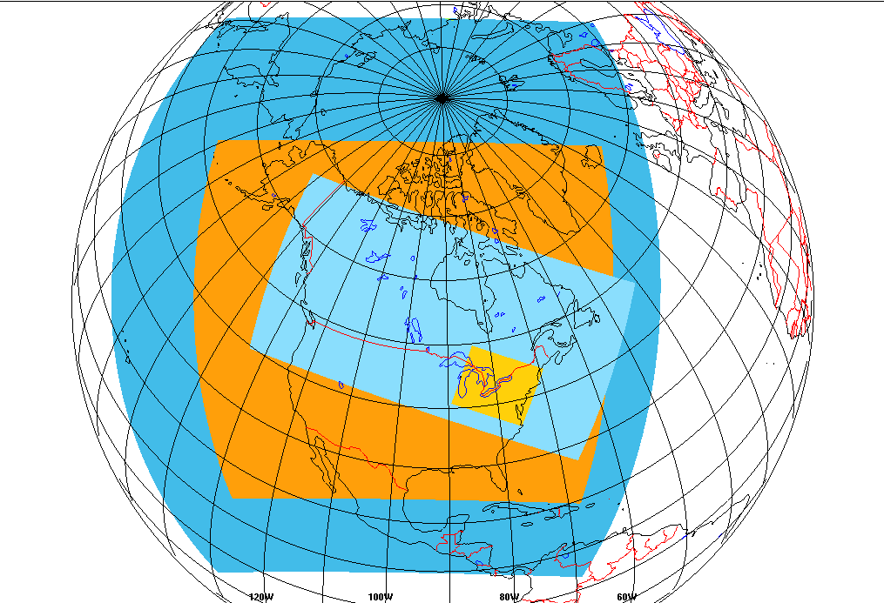
Current ECCC's capabilities for urban high-resolution numerical prediction
RDPS (10 km)
- operational, 4 x 48 h/day
- no surface DA
- upper-air DA
- official source of NWP guidance for day 1-2
RAQDPS/FW (10 km)
- operational, 2 x 48 h/day
- no upper-air & surface DA
- no upper-air & surface AQ-DA
- official source of NWP guidance for day 1-2
HRDPS (2.5 km)
- experimental, 4 x 48 h/day (running since Nov. 2014)
- no upper-air DA (downscaled, RDPS-10)
- surface DA (coupled CaLDAS)
HRAQDPS (2.5 km)
- experimental, 1 x 24h/day (used for the Vancouver 2010 & PanAm 2015 games)
- no upper-air DA (downscaled, RDPS-10)
- no surface DA (coupled CaLDAS) ?
- no upper-air & surface AQ-DA
- Allows for real-time predictions of AQHI at air quality stations
RDPS
RAQDPS
Domains covered by the different forecast systems.
HRAQDPS Includes:
Montreal, Toronto, Detroit/Windsor, Cleveland, Buffalo, Pittsburgh
3 Great Lakes to capture lake breeze effect
HRDPS
RDPS: Regional Deterministic Prediction System AQ: Air Quality
HRDPS: High Resolution Deterministic Prediction System
CaLDAS: Canadian Land Data Assimilation System
TEB: Town Energy Balance

Slide 13
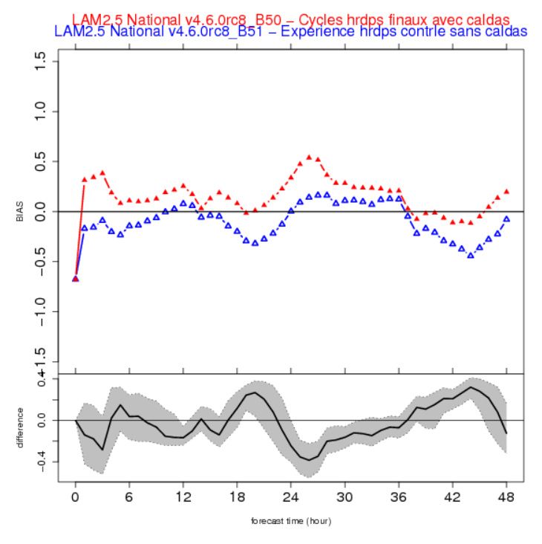
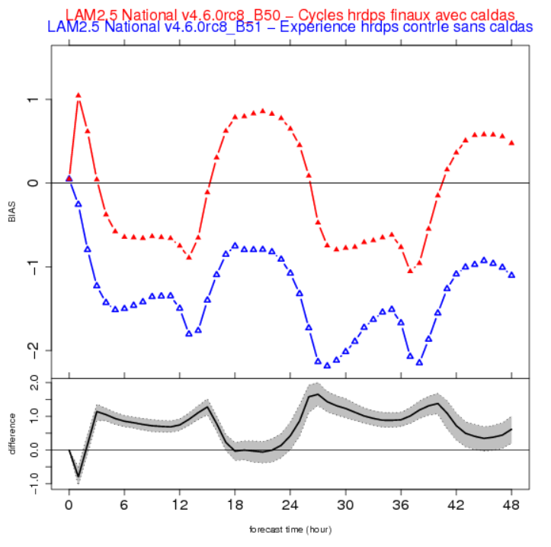
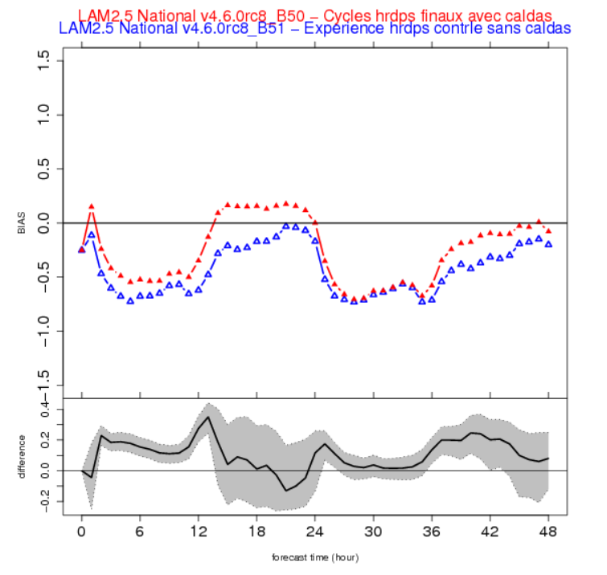
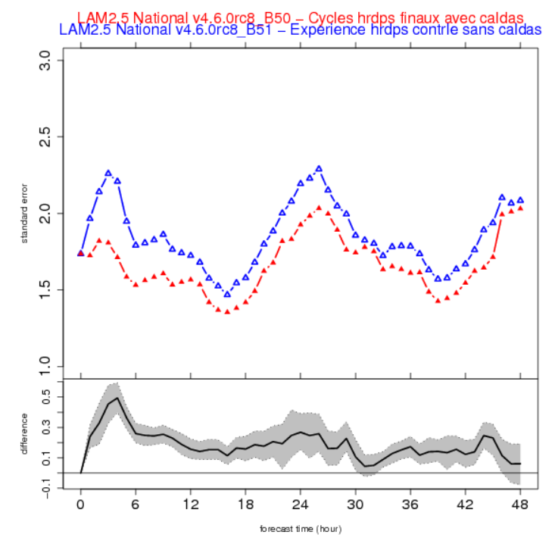
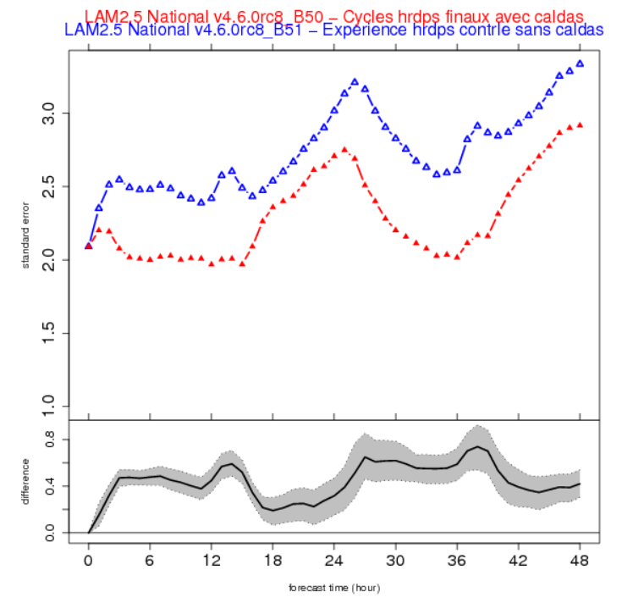
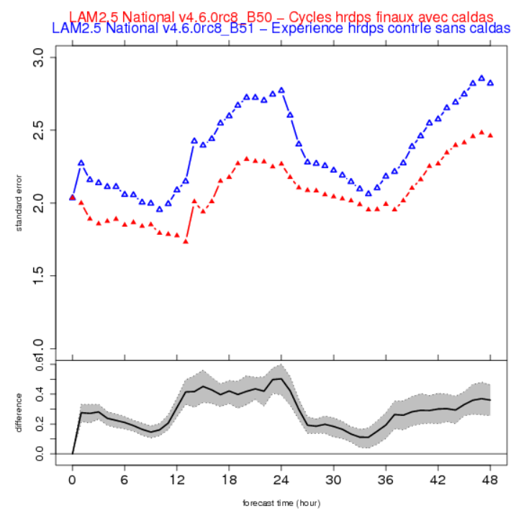
HRDPS 2.5-km with and without CaLDAS:
Summer (Top: Bias, Bottom: STDE) 00 UTC Cases
BC
Prairies
Que - Ont
BC
Prairies
Que - Ont

Slide 14
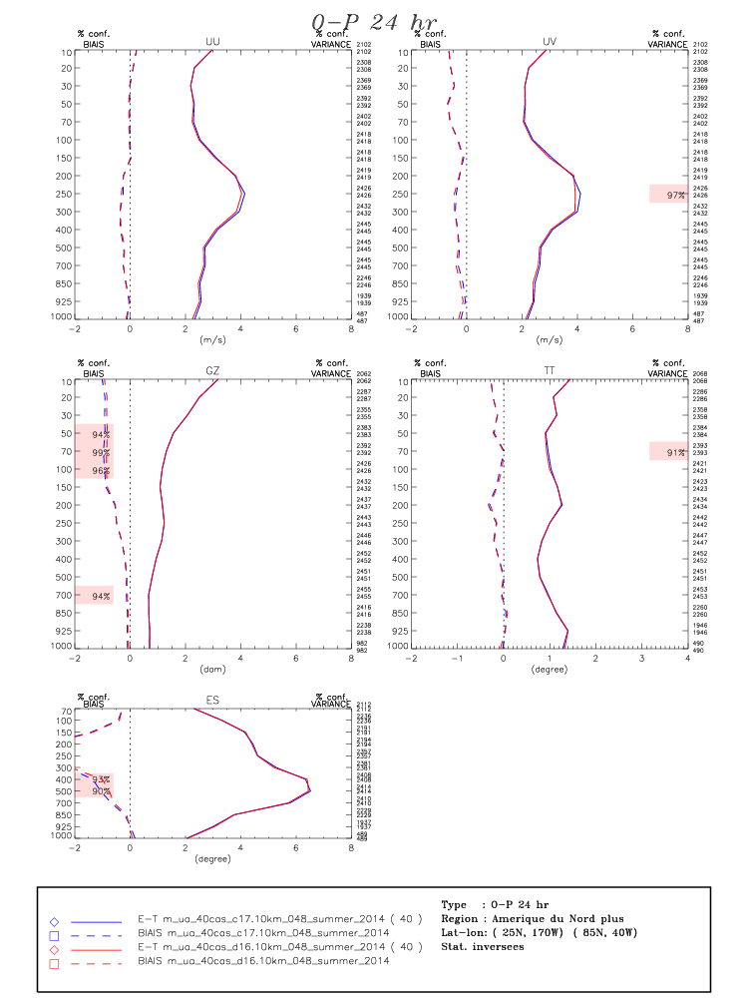
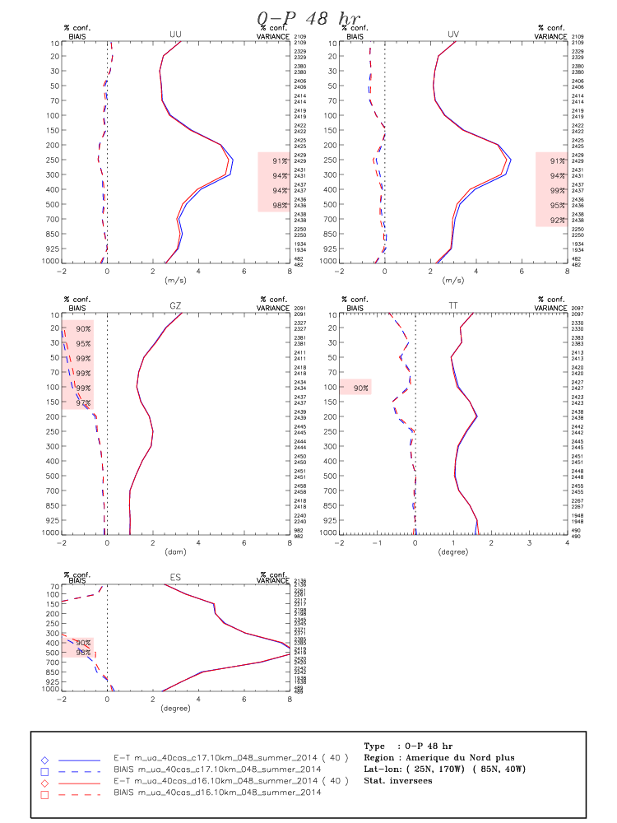
HRDPS 2.5-km with and without CaLDAS:
Summer 2014

Slide 15
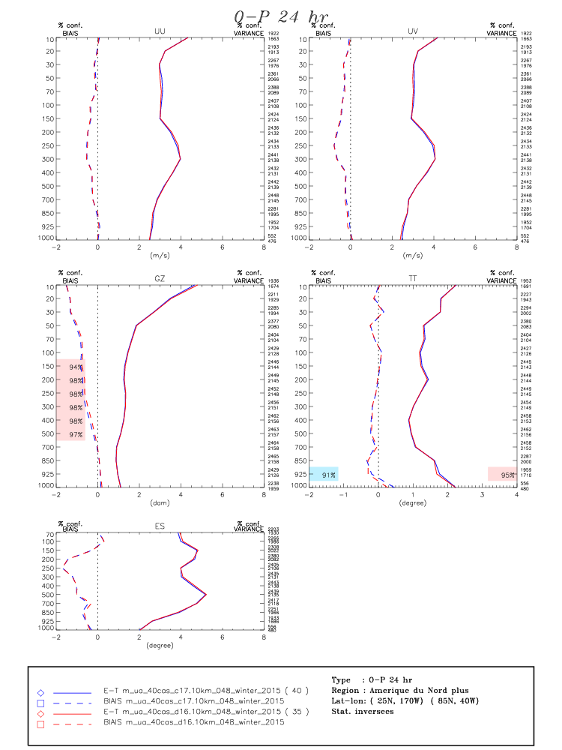
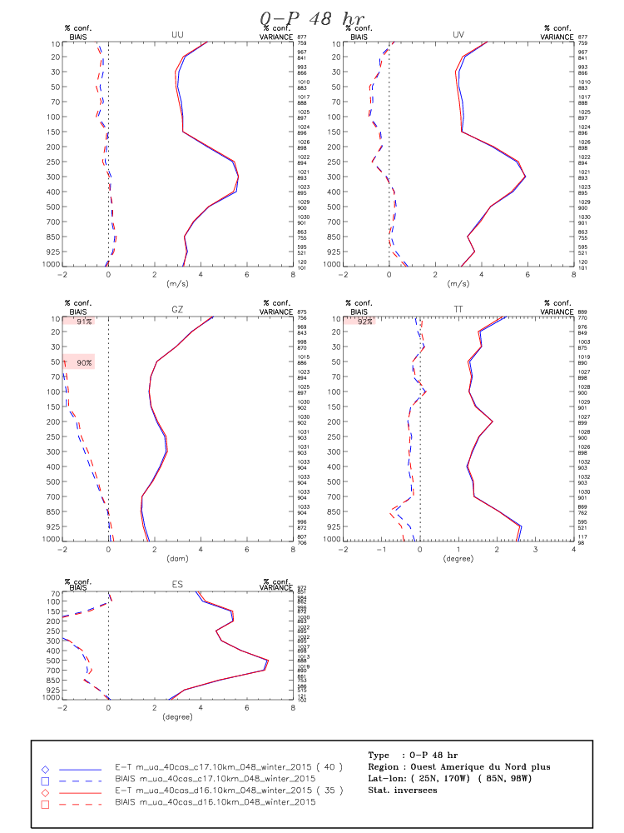
HRDPS 2.5-km with and without CaLDAS:
Winter 2015

Slide 16
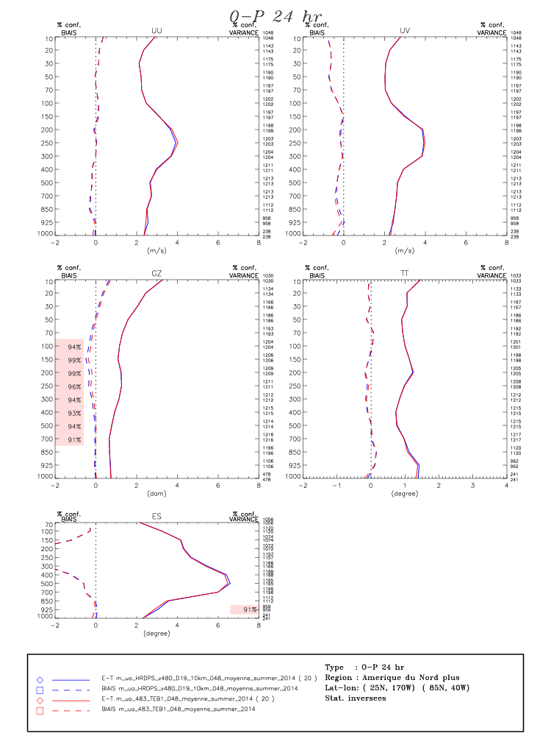
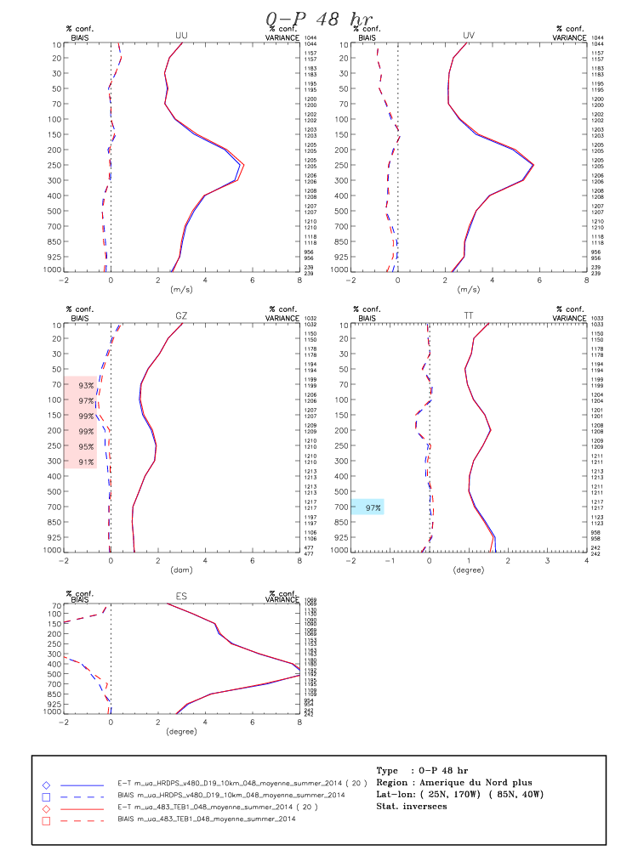
HRDPS 2.5-km with and without TEB :
Summer 2014

Slide 17
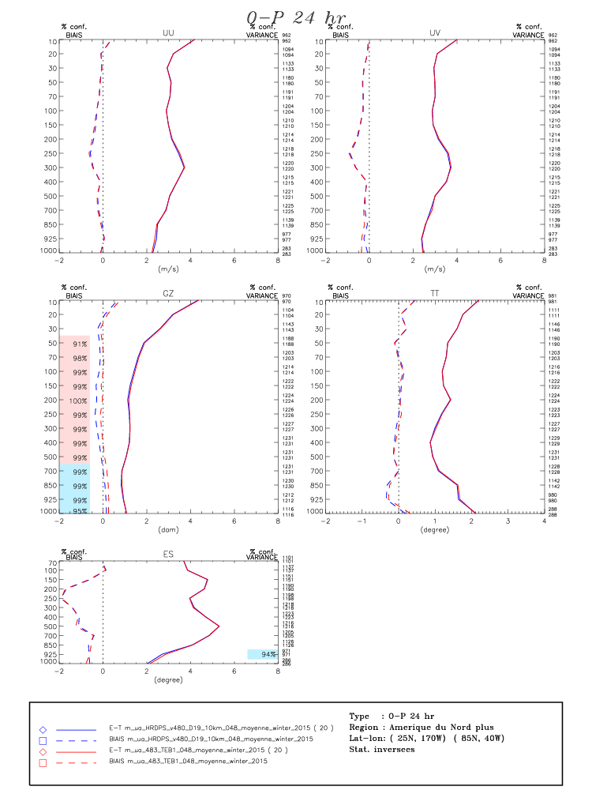
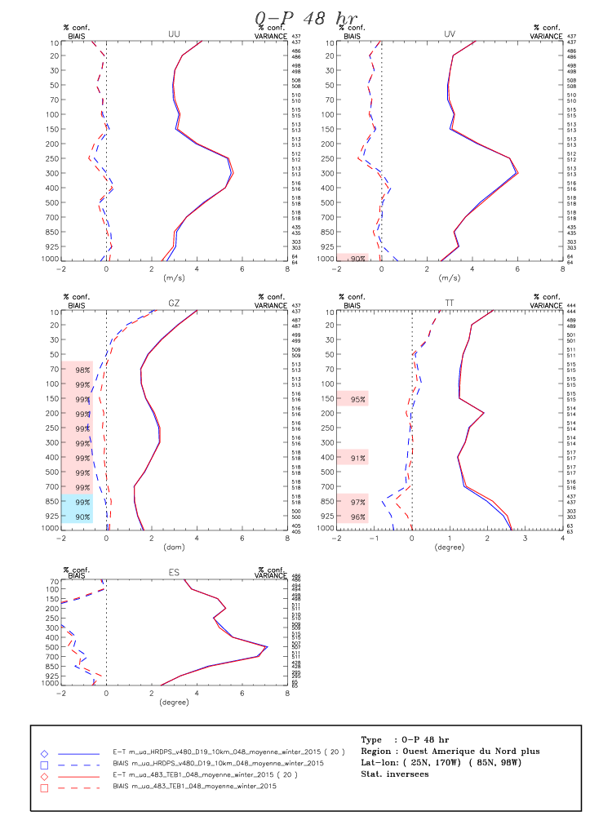
HRDPS 2.5-km with and without TEB :
Winter 2015

Slide 18
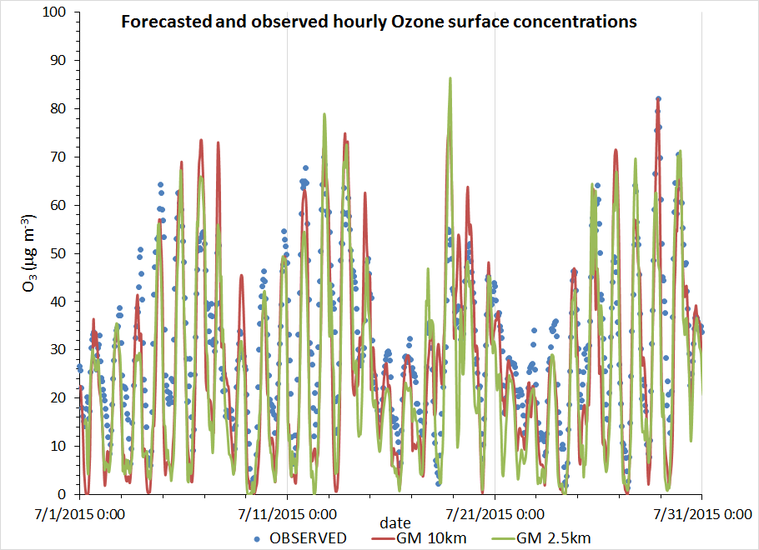
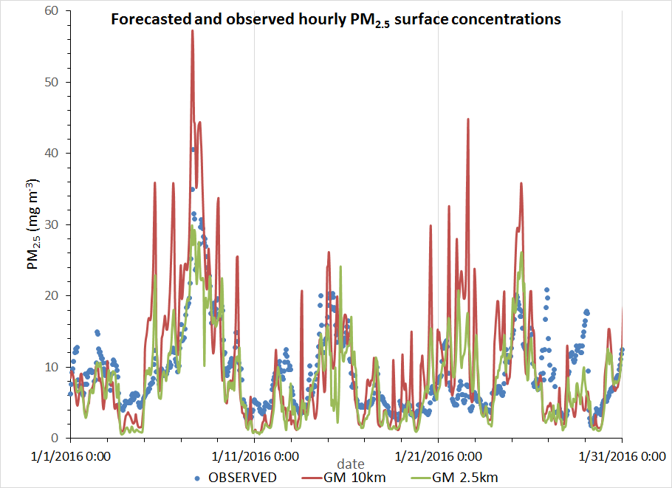
GEM-MACH 2.5km Pollutant Forecast
Summer 2015
Winter 2016
Average of 6 stations around Toronto

Slide 19

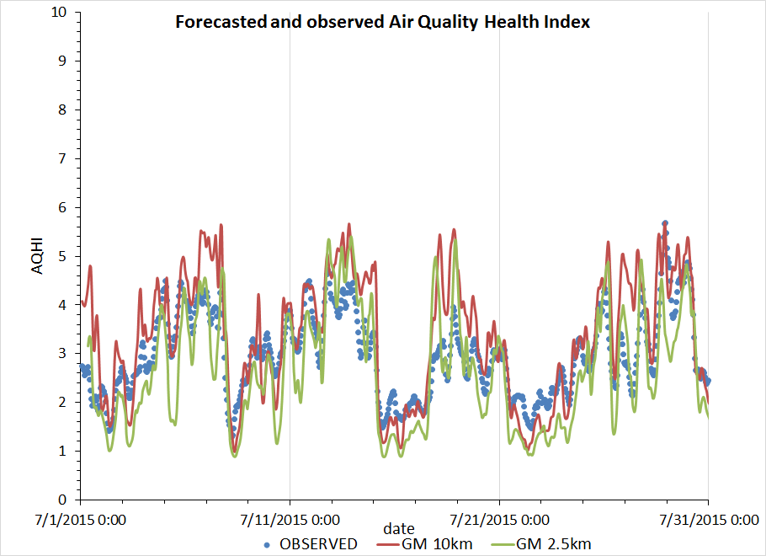
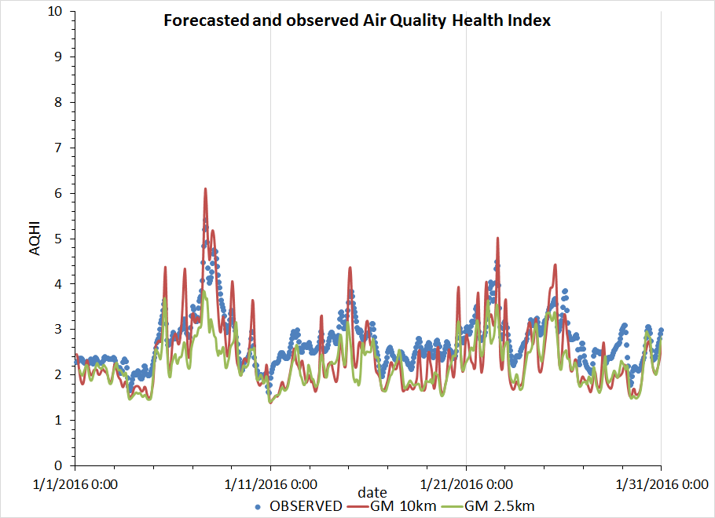
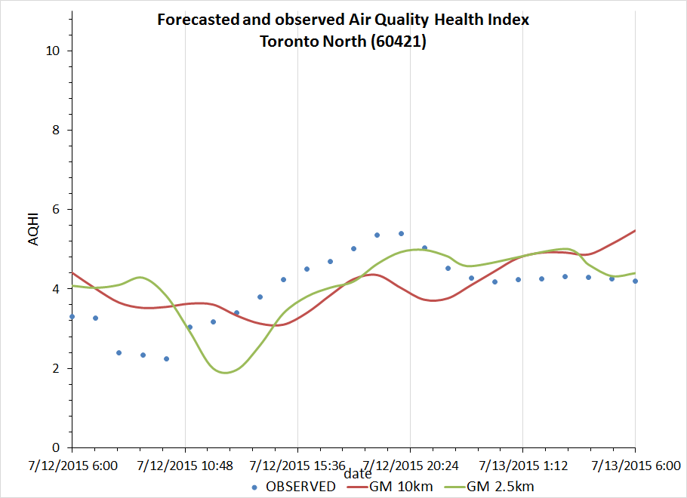
GEM-MACH 2.5km AQHI Forecast
Summer 2015
Winter 2016
Average over 6 stations around Toronto
AQHI = 10/10.4*100*[(exp(0.000871*NO₂)-1)+(exp(0.000537*O₃) - 1)+(exp(0.000487*PM_{2.5}) -1)]

Slide 20
Upcoming
HRDPS 2.5km will become operational (Fall 2017) and will gradually become the official source of NWP guidance for day 1 and 2.
operational, 4 x 48 h/day (minimum .. TBD)
upper-air DA (EnVAR) [possibly?…]
surface DA (coupled CaLDAS)
TEB
hydrometeor fields are “recycled” from the previous 2.5-km run
plus other improvements to existing system components
HRAQDPS 2.5km (experimental 2018? and operational 2020):
Improve the urban air quality modelling system, suitable to be applied to any Canadian urban area and point source (wildfires, emission scenarios e.g. biodiesel fuels, oil refinery, etc..), on the basis of available high resolution operational weather forecast system HRDPS (2.5 km).

Slide 21
Development / testing strategy:
HRDPS_4.2.0
CTR_1: 40 + 40 benchmark cases with configuration A1+B1+…
A1
B1
C1
D1
E1
F1
G1
DA/
Downscaling
Microphysics-
Radiation
Vertical
Levels
CaLDAS-
SVS
TEB
Diffusion
other
Test 1
Test 1 → G2
Test 1
Test 1 – based on new CTR_1
Upper-air data assimilation (DA) component
Jean-Francois Caron
Surface components
Stephane Belair
Test 2
Test 2
Test 3 → G3
Test 3 → B2
Test 1 – based on new CTR_2: A1 + B2 + C1 + …
Test 4
Test 2 → C2
Atmospheric model component Jason Milbrandt
Atmospheric model component Jason Milbrandt
Periodically, it is practical to run a new baseline set, based on latest. e.g. CTR_3: A1 + B2 + C3 + D1 + F1 + G3
A?
B?
C?
D?
E?
F?
G?
HRDPS_5.0.0

Slide 22
Development strategy for high-res urban AQ
Close interactions with HRDPS groups -> Creation of a Woking Group of High Resolution Air Quality Modelling for Urban Scale Coordinated by Craig Stroud (RPN-E, ARQI, AQMAS, CMDN)
Migrate chemistry GEM-MACH routines to the latest stable (operational) HRDPS version to benefit from improvements to :
urban and land surface processes (vegetation, coupling with atmosphere, anthropogenic fluxes, building energy model, roads module)
the ongoing boundary layer dynamics and cloud physics parameterizations:
Cycling hydrometeors and TKE fields
Continue to improve gas phase chemistry (e.g. ADOM-II vs vs SAPRC-07), new parameterization (e.g below-cloud scavenging of size-resolved particles by both rain and snow)
Improve chemical lateral boundary conditions (e.g. based on MOZART, MACC reanalysis)
Notes:
6.

Slide 23
Development strategy for high-res urban AQ
Improve emissions inventories and projections :
Update 2006 CAN and 2011 US inventories,
Use of improved spatial surrogates for megacities and large urban complexes
Improve temporal profiles (e.g., weekday and weekend)
Improve chemical speciation (e.g. on-road VOCs)
Model Evaluation
Evaluation and demonstration with PanAm dataset, satellite and sfc obs.
Evaluation tools , VAQUM, ValidatoR
Impact of cities on local circulations (e.g., breezes) and precipitation
Primary messaging tool : AQHI
Main target : urban areas > 100,000 population
Notes:
6.

Slide 24
Summary
ECCC objective is high resolution modelling
Increasing need of this modelling due to growing urban population
Al ECCC weather and AQ systems are moving toward this direction
Notes:
6.

Slide 25

Thank you for your attention!

