Slide 1
Development of a new analysis and data assimilation of surface pollutants at ECCC
Richard Ménard, Martin Deshaies-Jacques
with contributions from Alain Robichaud
Air Quality Research Division
International Workshop on Air Quality Forecasting Research
Toronto, January 11, 2016

Slide 2
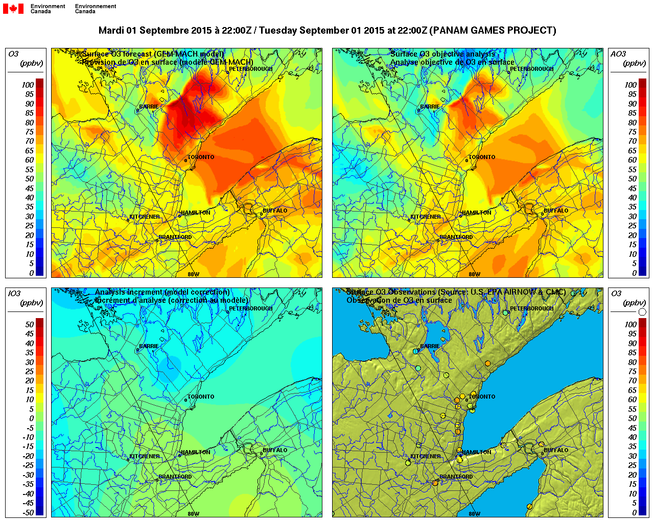
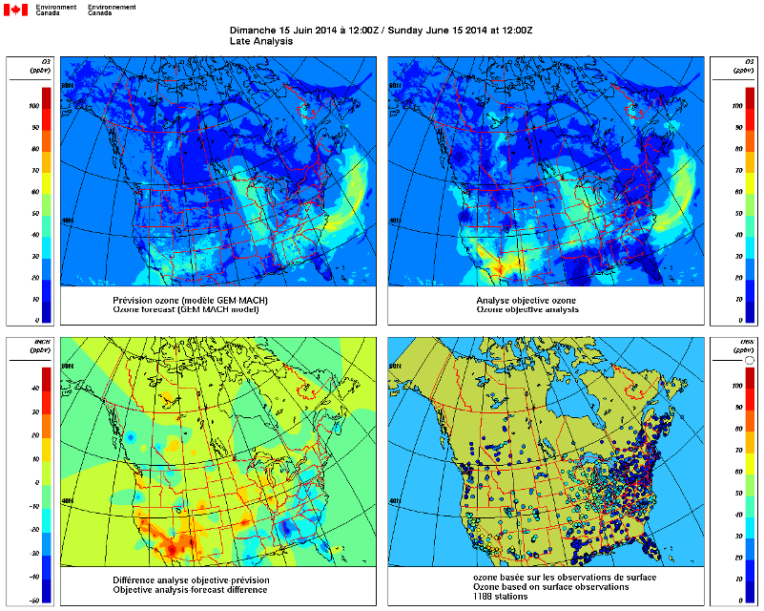
Current operational AQ analyses
An example of application of AQ monitoring
2D Optimum Interpolation and Offline :
AirNow observations + additional Canadian sites
GEM-MACH 10 km
Adjustment of error stat based on chi-square
3-month diurnal varying bias correction based on past years
O₃, PM_{2.5} – operational since Feb. 2013, but running in experimental mode since 2002
(Ménard and Robichaud 2005: ECMWF Proceedings) (Robichaud and Ménard 2014, ACP)
add NO, NO₂, SO₂, PM₁₀ since April 2015 (Robichaud et al. 2015, Air Qual Atmos Health)
see Yulia Zaitseva poster
GEM-MACH 2.5 km – PanAM Games

Slide 3
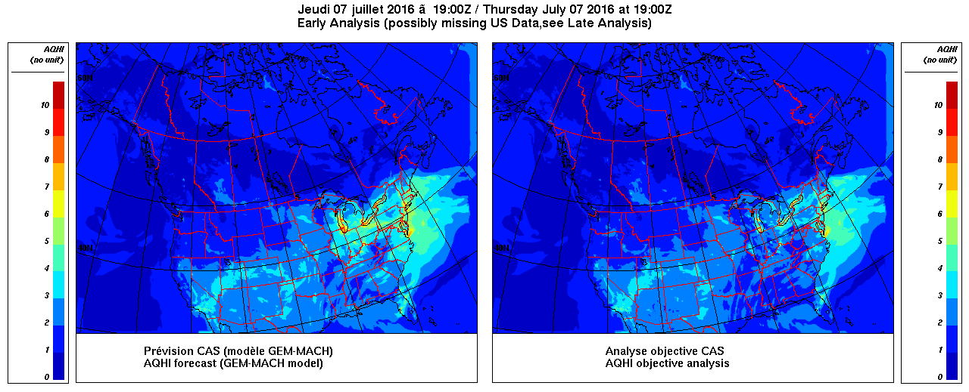
Near real-time mapping of the Air Quality Health Index
Canadian Air Quality Health Index (Stieb et al. 2008, JA&WMA)
Ten year old program that has evolved from an O₃-only forecast in Eastern Canada to a Canada-wide O₃, NO₂, PM_{2.5} forecast program
A map of AQHI is delivered operationally (each hour)
AQHI = 10/10.4×100×[(exp(0.000871[NO₂])-1)
+(exp(0.000537[O₃]) -1)+(exp(0.000487[PM_{2.5}]) -1)]

Slide 4
For Health impact studies
10 year AQ analyses using AirNow CHRONOS and GEM-MACH
Robichaud et Ménard, 2014, Atmos. Chem. Phys., 14, 1769-1800
Used in epidemiology studies
Ambient PM_{2.5}, O₃, and NO₂ Exposures and Associations
with Mortality over 16 Years of Follow-Up in the
Canadian Census Health and Environment Cohort (CanCHEC)
Crouze et al. (2015), Environ. Health Perspect., 123, 1180-1186
Exposure to ambient air pollution and the incidence of dementia
Chen, H., et al. Alzheimer’s & Dementia, 2016 (submitted)
+ 3 more papers underway
The Canadian Urban Environmental (CANUE) Health Research Consortium
Jeff Brook (PI) (ECCC and U of T) with 15 Canadian Universities and Governments
Develop an easy access geospatial data server (e.g. Google Earth)
to support quantitative research on the effect urban environment
on health. Data linked to postal codes will contain information
on numerous metrics, NDVI, local climatic zones, building density, land use,
noise level, air pollution, greenspace, walkability. Data from 1980’s up to now.
15 year of AQ analyses will be transferred on CANUE site in NetCDF format
Looking for partners to have a GEM-MACH 10 km reforecast since 2001
with OA or assimilation ??

Slide 5
Next: Improved analysis and assimilation
for monitoring and forecasting
Main features
3D Optimum Interpolation with data assimilation cycling each 3 hours
Background error covariance mix of homogeneous error correlations
and error statistics from ensembles of model forecast
β B_{ens} + (1-β) B_{homogeneous}
in a way similar to EnVar
Use of compact support error correlation functions
Have the option of using sparse matrix computation: to increase speed-up
and allow much larger number of observations without data selection
Overall , little or any additional computational cost over the existing objective analysis

Slide 6
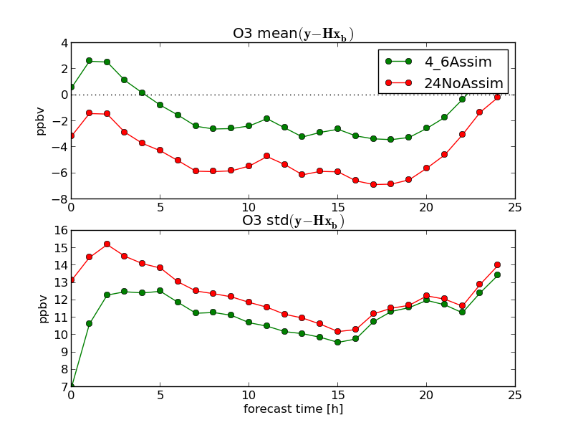
Assimilation cycles (6 hrs) using our operational environment software
MAESTRO (here only 00Z 06Z 12Z 18Z obs are assimilated)
Impact on forecast
Reduced bias
(yet same diurnal signature)
Reduced error variance
(but not persistent)
Caution: Preliminary results
only 00Z, 06Z 12Z and 18Z obs are used
error statistics are rudimentary and not tuned
frequency of cycling will be increased to 3 hr and using all observations

Slide 7
An important goal is to have an improved analysis
Use more observations
Use an advanced data assimilation scheme
the gain actually comes from having more realistic
error covariances between observations,
and between observations and model
use the model to generate an ensemble of forecasts
and thus an error covariance = Ensemble Kalman filter
that could mean ~ 60 GEM-MACH model integrations
in meteorology the ensembles are generated by a lower
resolution model - reducing the effective cost by an
order of magnitude
But is that a good strategy for AQ models ?
Spatial resolution in AQ simulation do matter

Slide 8
Main point I want to discuss is:
Is to show how to obtain some spatial and temporal variability and
inhomogeneity in the error statistics at little additional cost ?
Practically that means:
To get an improved OI or 3D-Var ?
There are two sources of data that provide information about error statistics
(error with respect to the truth)
Observation-minus-model residuals
- Provide combined information of model-minus-truth
and observation-minus-truth (not separately)
- Sparse only available at the observation locations
Ensembles
- Provide only information of model-minus-mean
(not model-minus-truth)
- Covers all variables and all spatial and temporal scales of the model
- Does not give information about observation errors

Slide 9
How can we obtain the spatial and temporal variability of
the error statistics fairly cheaply
Consider a sampling period of 60 days period
for both innovations and model output
Temporal variability
Error statistics for each hour of the day
Spatial variability
Local estimates of error variances
Non-isotropic error correlations
Instead of having an ensemble of 60 forecast issued at the same time,
we consider a daily sample of a single forecast over a period of 60 days
Over a period of 60 days we mix different weather conditions
(we do not expect to capture flow-dependent structures)
But the terrain features (e.g. proximity to water surfaces, mountains) and emissions correlation structures should
be captured

Slide 10
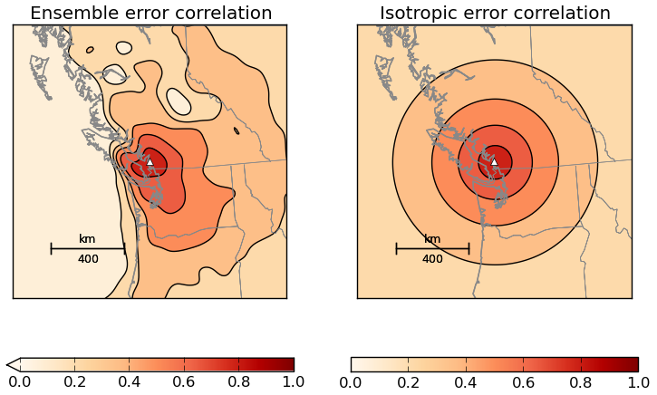
Use an ensemble of model forecast valid at a given time (over 2 months)
Use a similar procedure to EnKF on ensemble members:
localization + spatial smoothing of model output to degrade the resolution
We get terrain-dependent (land/water, mountain) error correlations
OAv2
OAv1
Impact of an observation
O₃ – 21 UTC
No additional forecast needed
Seem to address known problems with OA in costal areas and close to mountains
Ménard, R. and M. Deshaies-Jacques, 2017: The use of a time-serie air quality forecast to
develop an ensemble error covariance. (document in preparation, Atmosphere ?)

Slide 11
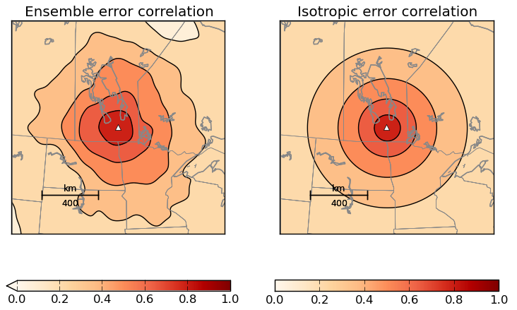
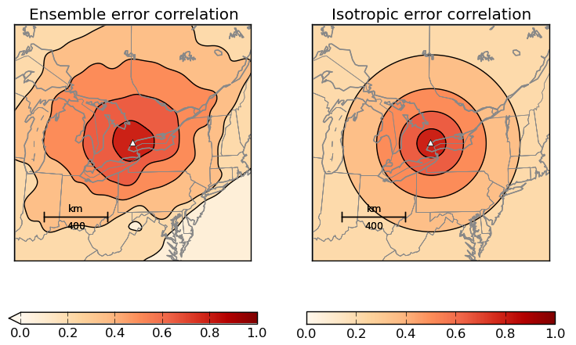
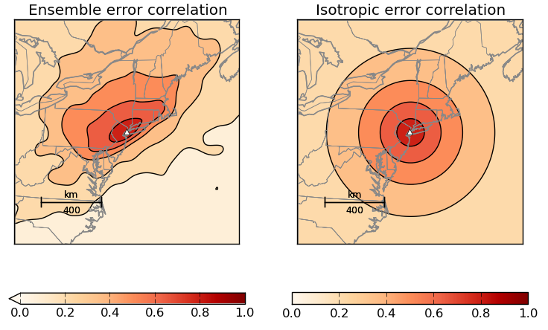
Plain terrain
isotropic correlation
Anisotropy south-east
Appalachian Mountains
Anisotropy south-east
Coastal station

Slide 12
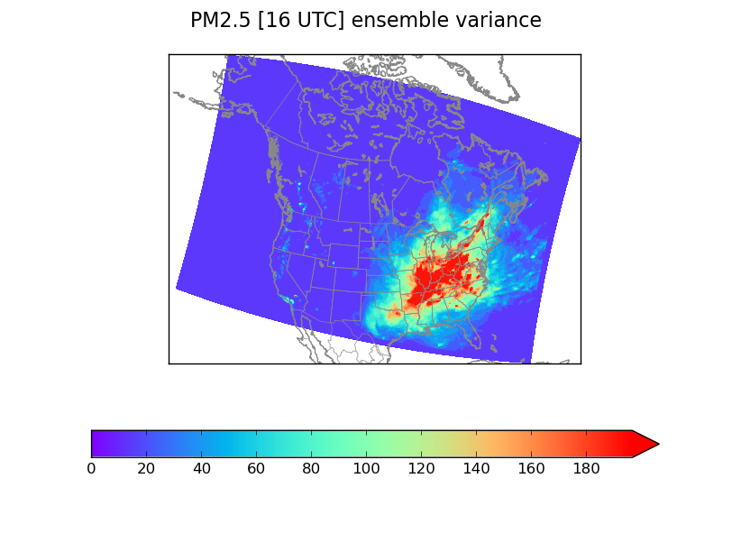
How representative is the time-series ensemble variance for
specifying background error statistics ?

Slide 13
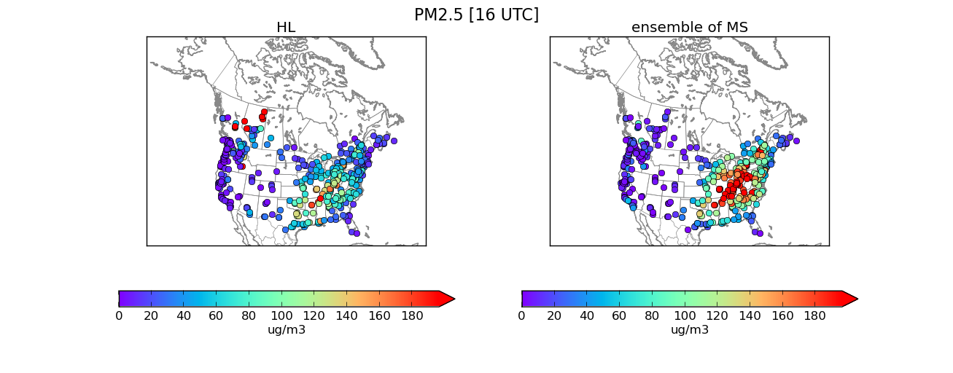
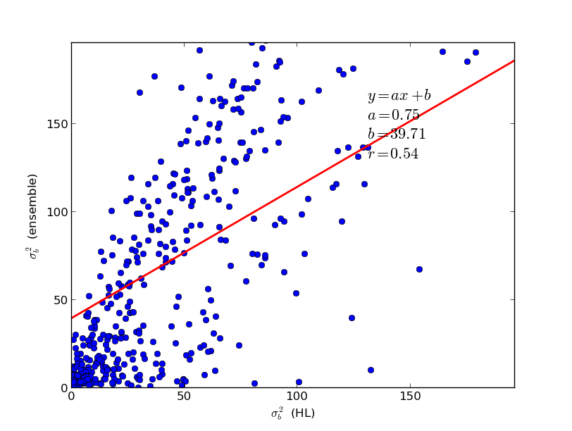

Slide 14
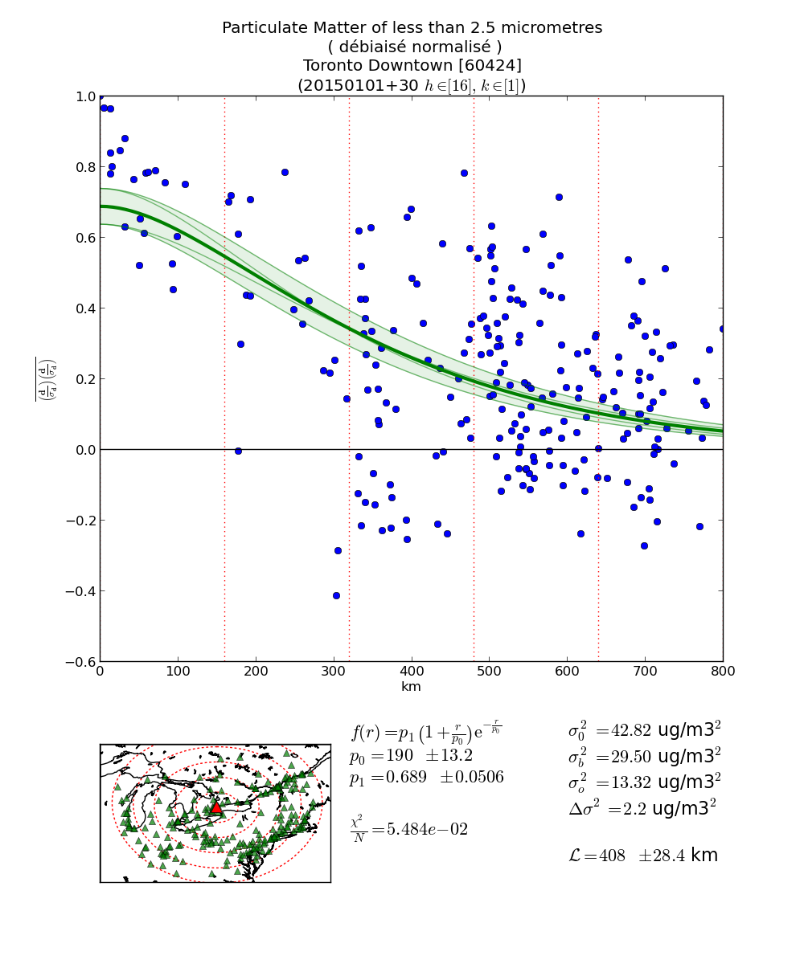
Can we get a reliable estimate of the spatial distribution of error statistics ?
Ménard, R., M. Deshaies-Jacques, and N. Gasset, 2016 (JA&WMA), IWAQFR Special Issue
Application of H-L method to obtain the error variances at each sites
Comparison of different methods to obtain correlation-length estimates;
Hollingsworth-Lonnberg, Maximum likelihood, Chi-square
Local Hollingworth-Lonnberg
where
H-L method estimation of (σ_{B}² , L_{c} )
about Toronto downtown using a SOAR
time 16 UTC, January 2015

Slide 15
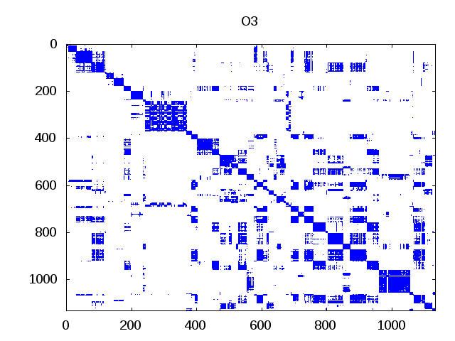
Improving computational efficiency of the analysis solver
To accomodate large volume of observations
variational analysis – 3D Var, EnVar
batch processing for compact support correlations (Houtekamer and Mitchell, 2001)
sparse matrix computation of Choleski decomposition and backsubstitution
by taking advantage of compact support correlations
Example : inversion of a 10,000 x 10,000 elements matrix with 20% sparsity
non-zero elements of HBH^{T}
Config | Wall time | Max. memory | #CPU
GNU | 241 s | 770 MB | 1
PGI | 772 s | 764 MB | 1
INTEL1 | 236 s | 780 MB | 1
INTEL2 | 121 s | 790 MB | 1
INTEL3 | 32 s | 795 MB | 8
MUMPS | 25 s | 790 MB | 1
typical sparsity 10%

Slide 16
Summary
OAv1 produced multiyear 2D maps of air quality that has been useful for health impact studies
OAv2 under development generates a 3D analysis in model variables, and has the added capability of assimilation. Useful for evaluation and to improve model forecast
Time-series of a single model forecast is useful to obtain terrain-dependent correlation structures, although not flow-dependent correlation structures (unless they are persistent over a period of 2 months)
By using a local version of the HL it is possible to get the spatial variability of error variances
Large volume of observation data and computational speed-up is obtained by using sparse matrix computation with compact correlation models

Slide 17
Thanks for listening

