Slide 1
Evolution of the Canadian Operational Air Quality Forecast Systems: Addressing Today’s Needs and Preparing for Tomorrow
IWAQFR 2017, Toronto, 2017.01.10
Didier Davignon¹
With results/contributions from:
M.-D. Moran², R. Pavlovic¹, R. Munoz-Alpizar¹, S. Menard¹, H. Landry¹, S. Gilbert¹, P.-A. Beaulieu¹, S. Cousineau¹
¹Air Quality Modeling Applications Section, Environment and Climate Change Canada,
Montreal, Quebec, Canada
²Air Quality Research Division, Environment and Climate Change Canada, Toronto, Ontario, Canada

Slide 2

Summary
Description of current operational AQ systems
Performance of systems (verification)
Products and clients
Trends
Implications for future developments

Slide 3
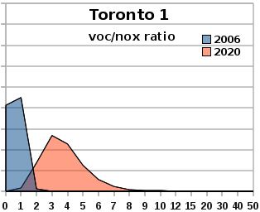
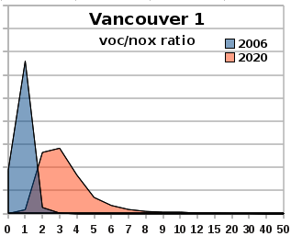
Context: Canada
Trend = air quality improving in general
Attributed to NO_{x}/SO_{x} emission reductions, mostly due to
Regulations in transportation
Phasing out of coal-fired power plants in Canada and USA
Fewer smog episodes reported
Exception: summertime PM_{2.5}, due to wildfire emissions
In large cities: similar observations
Ozone trend not as clear: chemical regime shifting
Distribution of VOC to NO_{x} ratios,
Simulated with AURAMS, 2006 vs 2020 projection (using total VOC for simplification)
Notes:
Voc to Nox plots: as an indication only. Based on emission projections dating from 2011. Compiled all hours from an annual run produced with the AURAMS model at a 22.5km resolution.

Slide 4
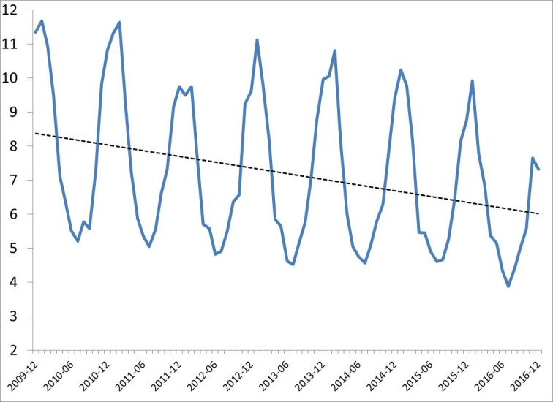
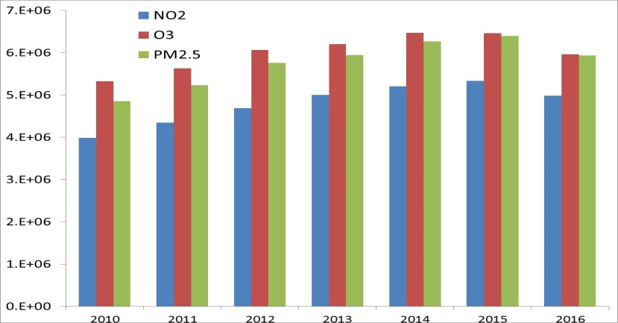
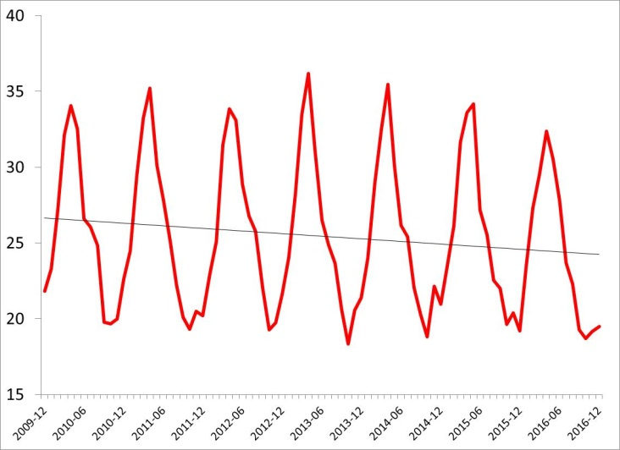
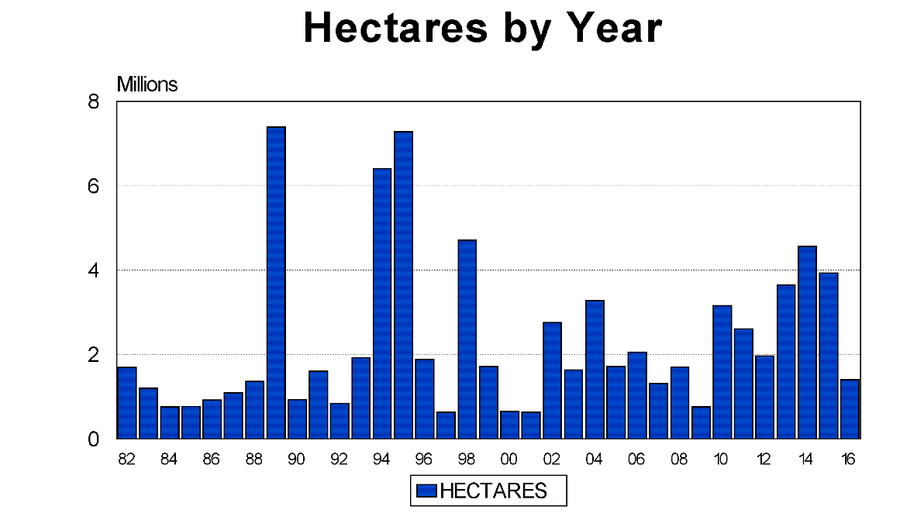
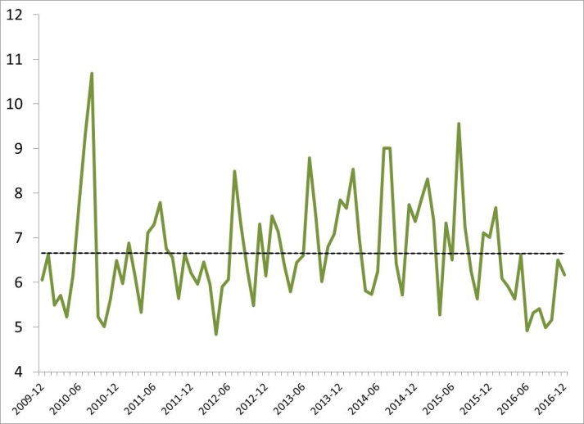
OBSERVED
pollution trend
(2010-2016) for Canada
NO₂
Decreasing trend
O₃
Slightly
decreasing trend
Annual (2010-2016) number of considered forecast & observed pairs
Strongly driven by wildfires
PM_{2.5}
No clear trend
Hectares burned (1982-2016) by wildfires in Canada
Source: Canadian Interagency Forest Fire Centre

Slide 5
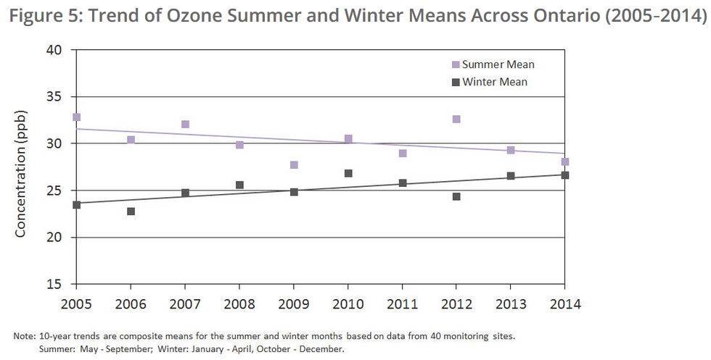
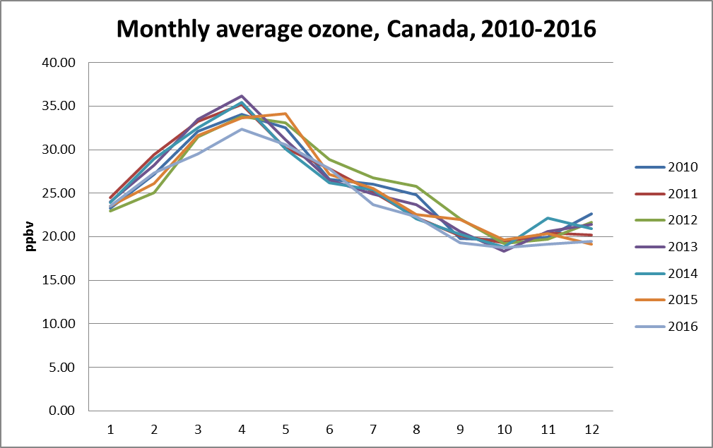
Trend for ozone: seasonal
Source: Air Quality in Ontario 2014 Report

Slide 6
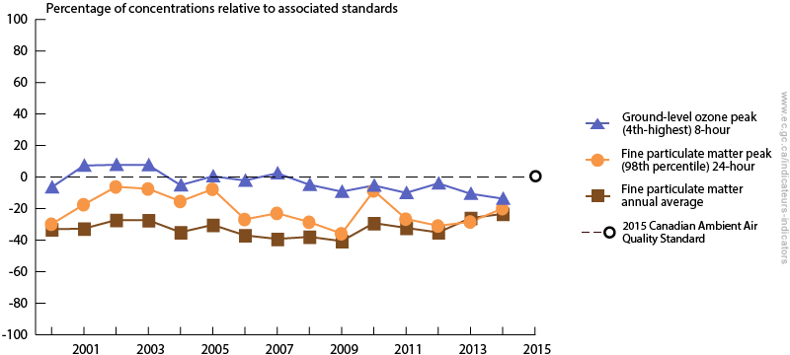
Trends according to standards
Fine particulate matter and ground-level ozone air quality indicators relative to the 2015 Canadian Ambient Air Quality Standards, Canada, 2000 to 2014

Slide 7
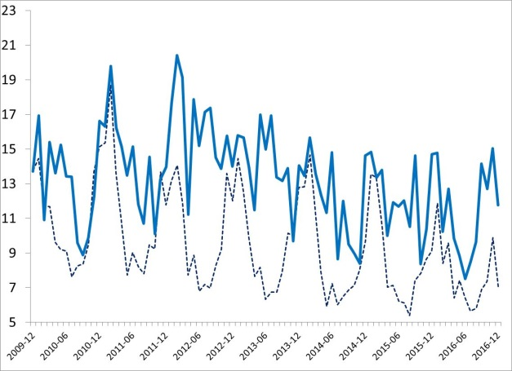
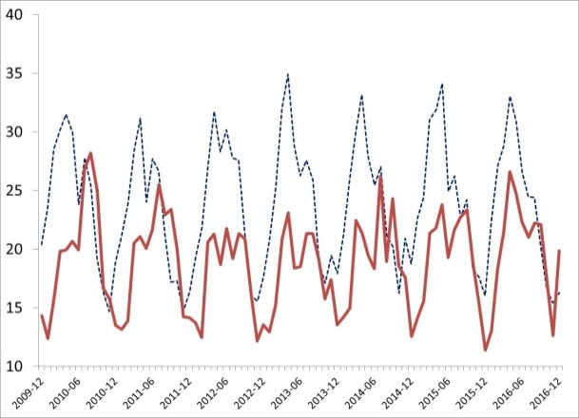
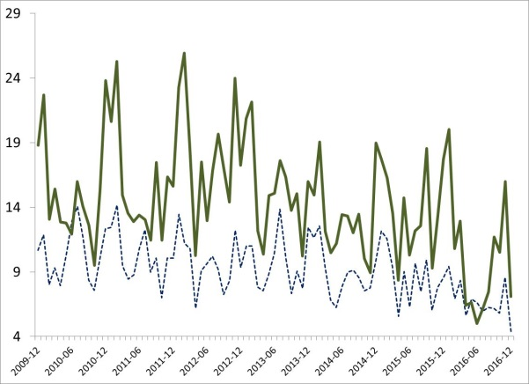
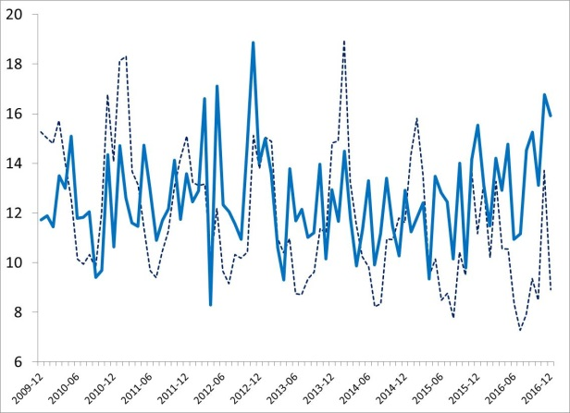
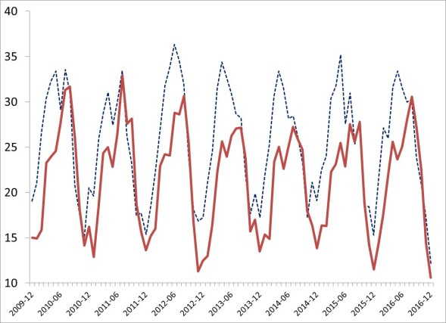
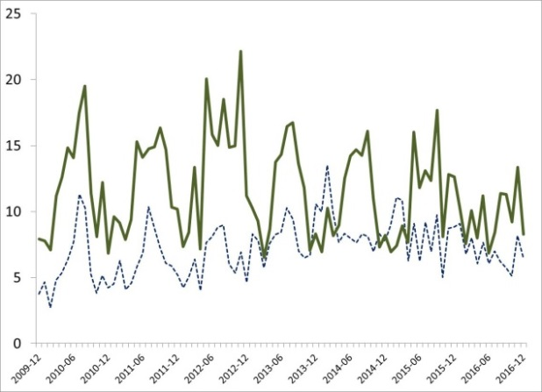
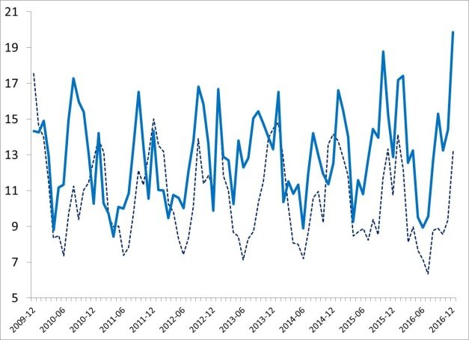
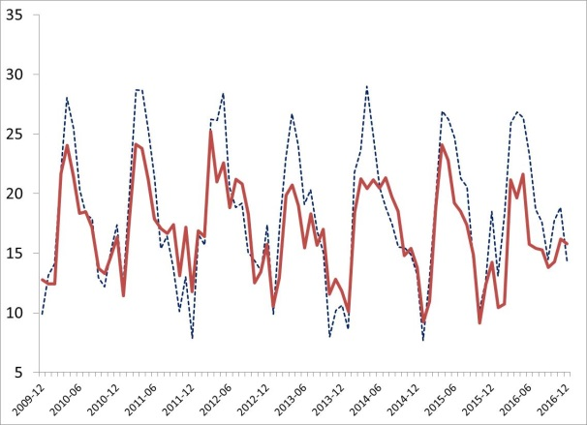
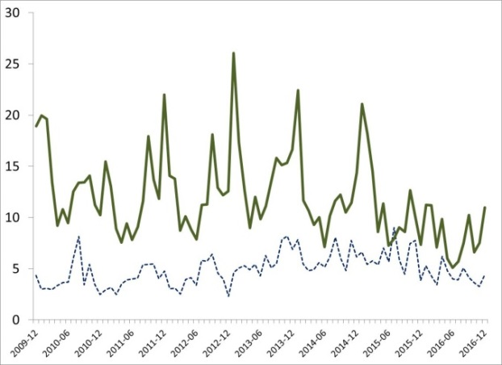
7-Year (2010-2016) Pollution Trends (Observed vs Forecasted ) in Montreal, Toronto and Vancouver
NO₂
O₃
PM_{2.5}
MONTREAL
NO₂
O₃
PM_{2.5}
TORONTO
Forecasted
Observed
NO₂
Forecasted
Observed
O₃
Forecasted
Observed
PM_{2.5}
VANCOUVER

Slide 8
MSC numerical modelling (partial overview)
Global deterministic
25km
240h, 2/d
Global ensemble
50km, 20 members + cntrl
364h, 2/d ; 768h 1/w
Global coupled:
Ocean, ice, waves…
Regional coupled:
Ocean, ice, waves Hydrology, …
Air quality (RAQDPS)
Regional ensemble
15km, 20 members + cntrl
72h, 2/d
Regional deterministic
10km, North America
48h/54h, 4/d (exp. 84h)
High resolution determ.
2.5km (National, North)
48h, 2/d
(Experimental)
High res. coupled:
(experimental / pilot)
High res surface model
Air quality …

Slide 9
Regional Air Quality Deterministic Prediction System (RAQDPS): components
Emissions:
- Anthropogenic - Biogenic
- (Forest fires)
Real time AQ obs
Config, landuse, etc.
AQ piloting from global model
Real time DB
Verif DB
Weather assimilation
GEM-MACH coupled AQ & weather model
OA
AQ assimilation
Operational environment and systems
Weather BCs from global model
Products: - AQHI - Specialized
- Custom
AQ initial conditions
UMOS- AQ
= Not yet

Slide 10
RAQDPS: GEM-MACH
Emissions:
- Anthropogenic - Biogenic
- (Forest fires)
Real time AQ obs
Config, landuse, etc.
AQ piloting from global model
Real time DB
Verif DB
Weather assimilation
GEM-MACH coupled AQ & weather model
OA
AQ assimilation
Operational environment and systems
Weather BCs from global model
Products: - AQHI - Specialized
- Custom
AQ initial conditions
UMOS- AQ
= Not yet

Slide 11
Recent changes to core model
Major upgrade to GEM-MACH AQ model and its GEM core dynamic library
Based on latest weather model GEM v4 (major update).
New vertical coordinate (hybrid in log-hydrostatic-pressure)
New vertical discretization (Charney-Phillips staggering) lowest layer depth is now 40-m;
Physics spin-up capability;
Global Yin-Yang grid (New LAM grid that align to it);
New PBL moist TKE scheme
New orographic blocking scheme
Surface level for tracers now defined at 20m (as opposed to 0m)
Covered this morning in: Recent Upgrades to the Chemical Transport Model Used in the Canadian Operational Regional Air Quality Deterministic Prediction System (Moran et al)

Slide 12
Recent changes to RAQDPS
Improvements to chemistry modules
Native (GEM) vertical diffusion scheme for chemical tracers
Comprehensive mass conservation for tracers, designed for LAM
Improved below-cloud scavenging
Corrected problems with emissions, dry deposition
Gas-phase dry deposition with improved LAI scaling
New 3D seasonal chemical lateral boundary conditions
Sea-salt emissions now precede vertical diffusion
Various minor corrections
Covered this morning in: Recent Upgrades to the Chemical Transport Model Used in the Canadian Operational Regional Air Quality Deterministic Prediction System (Moran et al)

Slide 13
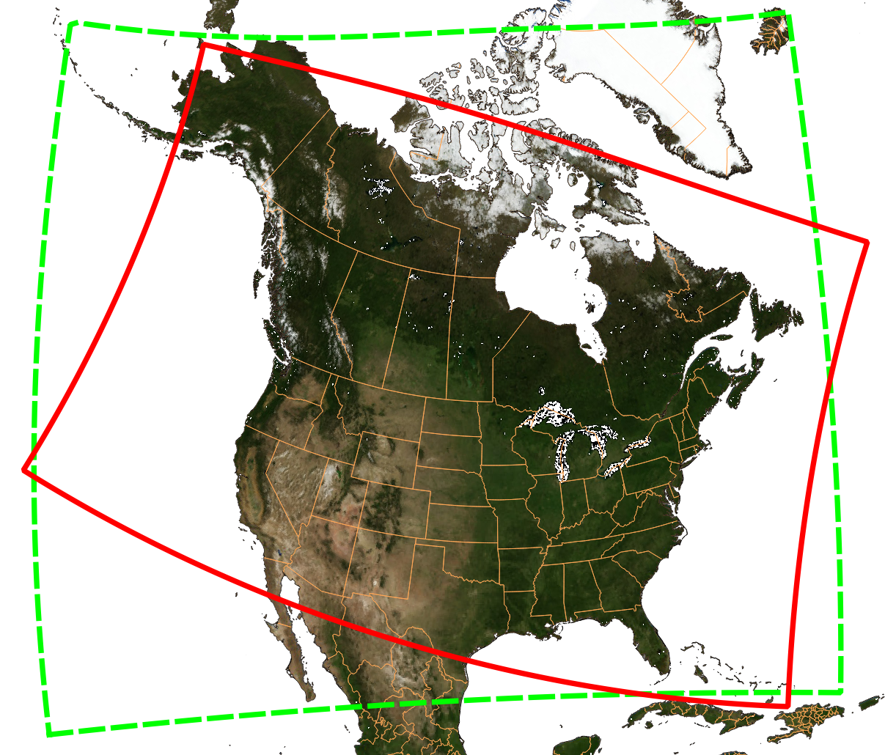
New RAQDPS domain (Sept 2016) – in green

Slide 14
RAQDPS: Forest Fires
Emissions:
- Anthropogenic - Biogenic
- (Forest fires)
Real time AQ obs
Config, landuse, etc.
AQ piloting from global model
Real time DB
Verif DB
Weather assimilation
GEM-MACH coupled AQ & weather model
OA
AQ assimilation
Operational environment and systems
Weather BCs from global model
Products: - AQHI - Specialized
- Custom
AQ initial conditions
UMOS- AQ
= Not yet

Slide 15
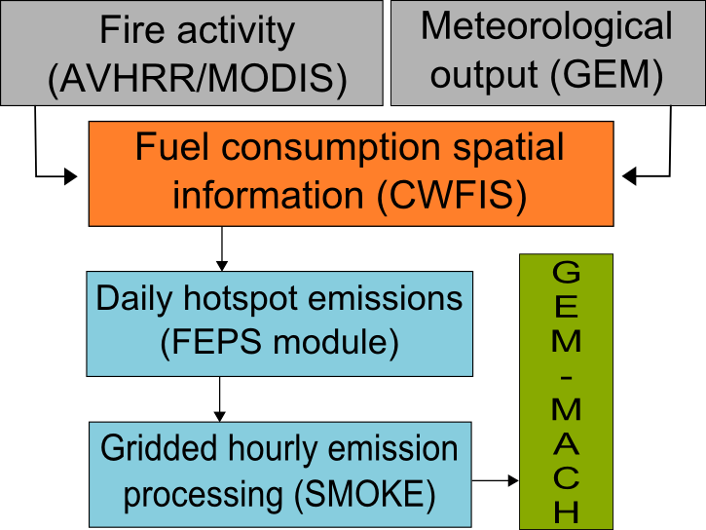
FireWork System
FireWork has the same configuration as GEM-MACH, the operational AQ model. The only difference is the inclusion of the near-real-time wildfire emissions
FireWork:
Run twice daily (initiated at 00 UTC
and 12 UTC)
Available at approximately at the same
time as the operational model
Additional products
Alternate AQHI based on FireWork
PM_{2.5}/PM₁₀ maps and animations based on difference fields (FireWork – GEM-MACH) to isolate plumes
Total column PM_{2.5}/PM₁₀ sums
Other specialized products available upon request
WildFire Emissions Data
See talk from J. Chen et. Al.
Currently CFFEPS, developed by CWFIS, is being tested and will eventually replace the current FEPS module

Slide 16
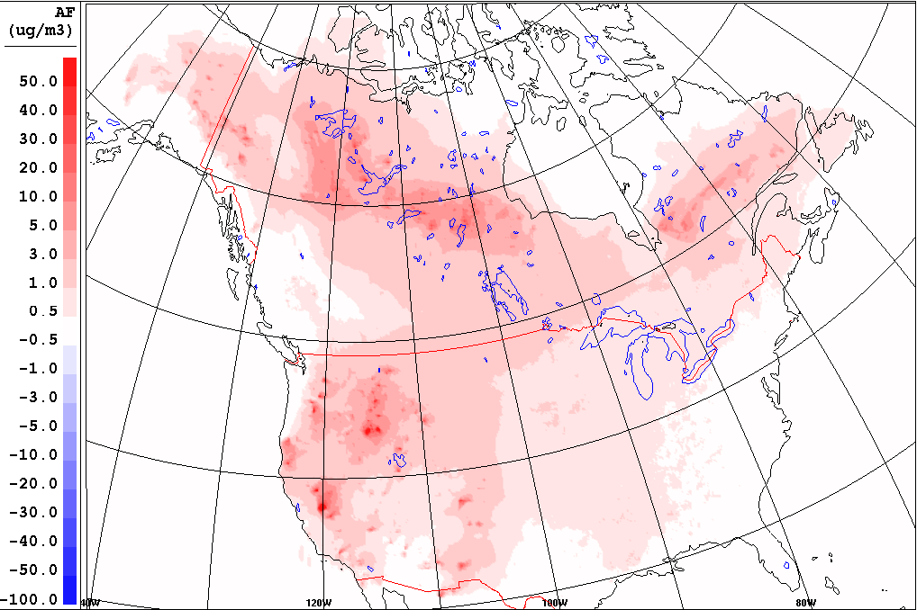
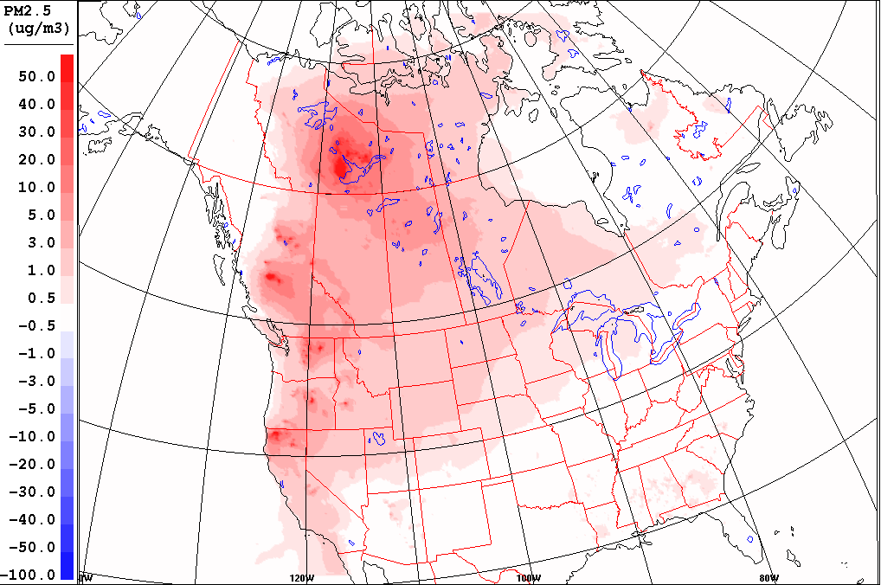
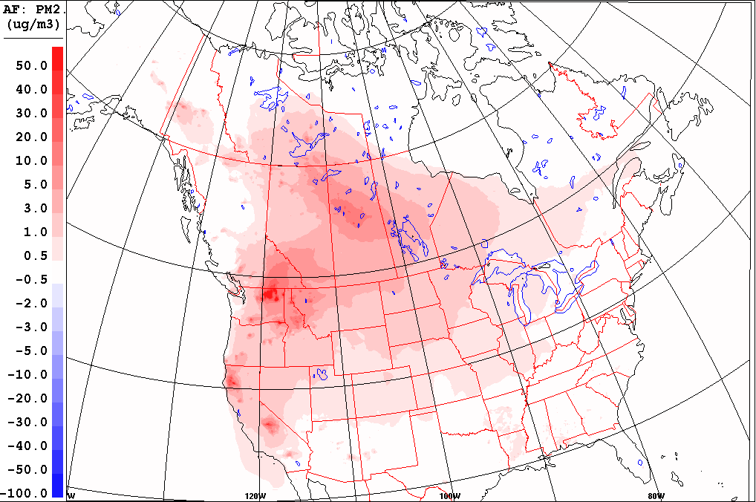
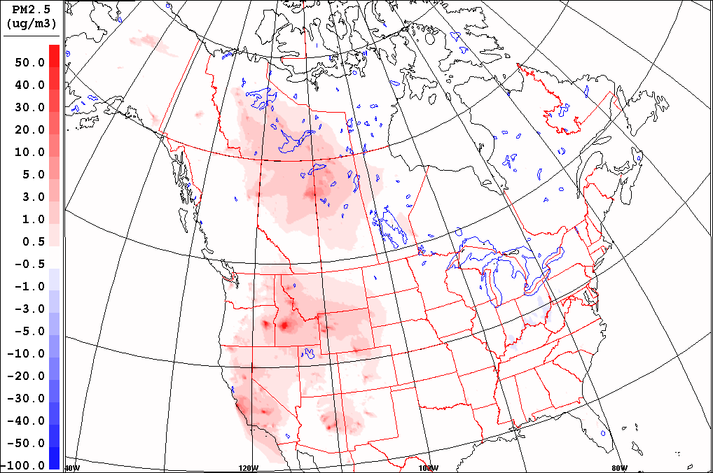
How Important are wildfires for AQ?
Forecasted wildfire emissions contribution to average summertime PM_{2.5} concentrations
2013
2014
"Wildfire in the Pacific Northwest (8776242994)" by Bureau of Land. Licensed under CC BY 2.0 via Wikimedia Commons - https://commons.wikimedia.org/wiki/
2015
In Canada, the impact of wildfire smoke on air quality is very significant.
Forecasted wildfire emissions contribution to the average summertime PM_{2.5} concentrations (2013-2015) ranges from a few µg/m³ to over 30µg/m³.
2016

Slide 17
Considerations for FireWork
Perspective of health partners:
Forecast: get the timing right
“Smoke aloft” forecast useful
Concentrations important for retrospective studies (exposure)
Public forecast
Probabilistic? “60% chances of heavy smoke” …
Higher resolution?
Dispersion may be sufficient for near-source details.
Science gaps
Plume chemistry: ozone production etc.
Emissions…
2-way interactions with weather
Tracer tagging vs assimilation

Slide 18
Regional Air Quality Deterministic Prediction System (RAQDPS): components
Emissions:
- Anthropogenic - Biogenic
- (Forest fires)
Real time AQ obs
Config, landuse, etc.
AQ piloting from global model
Real time DB
Verif DB
Weather assimilation
GEM-MACH coupled AQ & weather model
OA
AQ assimilation
Operational environment and systems
Weather BCs from global model
Products: - AQHI - Specialized
- Custom
AQ initial conditions
UMOS- AQ
= Not yet

Slide 19
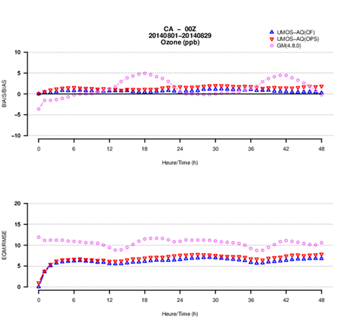
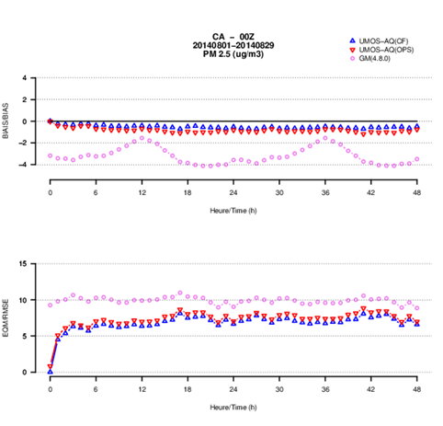
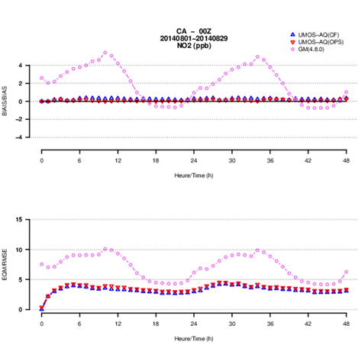
Statistical Model: UMOS-AQ
Post-processing applied to GEM-MACH raw model output
Reduces model bias and model error at point locations with AQ monitors through through multi-variate linear regression approach
Applied to meteorological variables since 2000
Adapted for air quality variables (O₃, NO₂, PM_{2.5}) in 2010
Equations are recalculated four times a month
GEM-MACH
UMOS-AQ
O₃
PM_{2.5}
NO₂
BIAS
RMSE

Slide 20
RAQDPS: objective analysis
Emissions:
- Anthropogenic - Biogenic
- (Forest fires)
Real time AQ obs
Config, landuse, etc.
AQ piloting from global model
Real time DB
Verif DB
Weather assimilation
GEM-MACH coupled AQ & weather model
OA
AQ assimilation
Operational environment and systems
Weather BCs from global model
Products: - AQHI - Specialized
- Custom
AQ initial conditions
UMOS- AQ
= Not yet

Slide 21
OA: Objective Analysis for Surface Pollutants
Operational as of February 2013, called RDAQA
Blends model forecasts with surface observations from Canadian regional networks and the U.S. EPA’s AIRNow observation network
Using an optimal interpolation approach
Knowledge of the errors of model and observation data is applied to weight each input accordingly
Products available hourly (2x = early and late analyses):
Available for : PM_{2.5}, O₃, NO₂, NO, SO₂, PM₁₀ and AQHI
A new system is under development (basis for 3D assimilation)
See talk from R. Ménard et al.

Slide 22
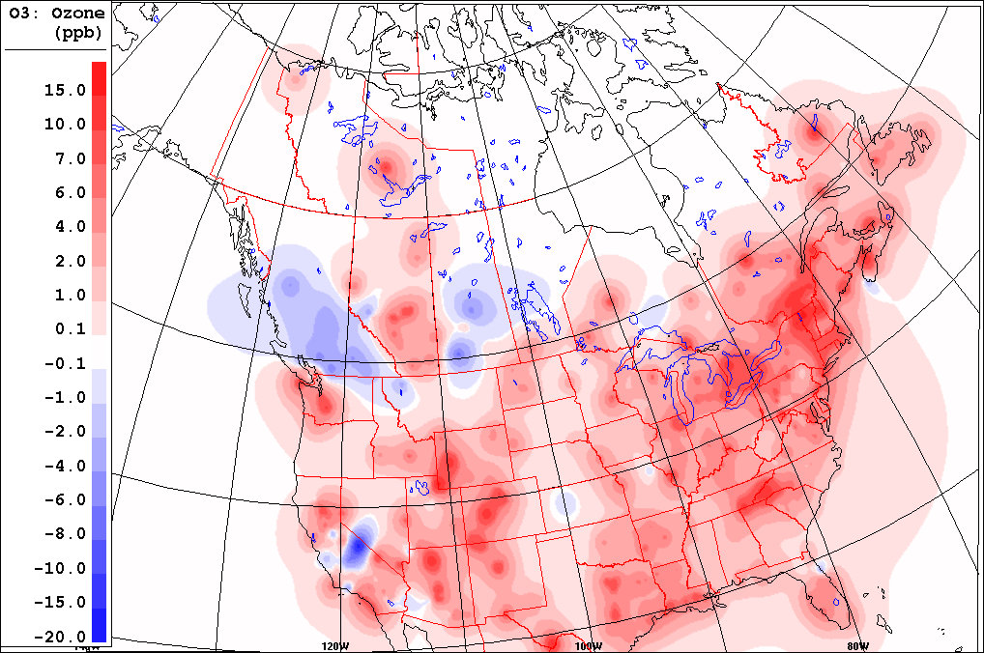
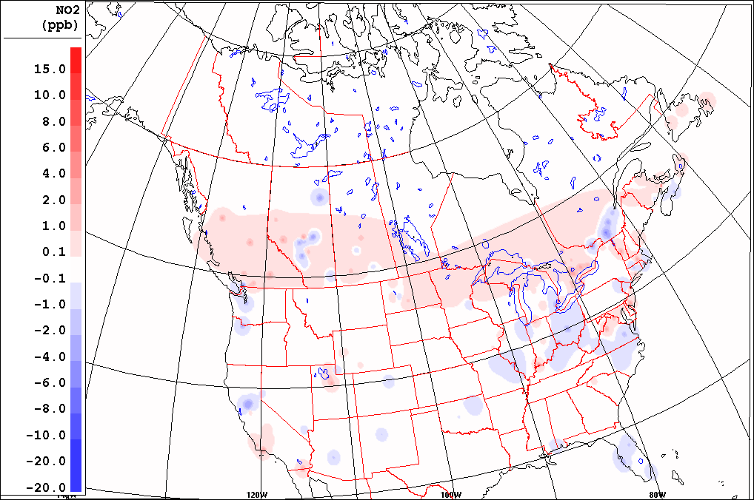
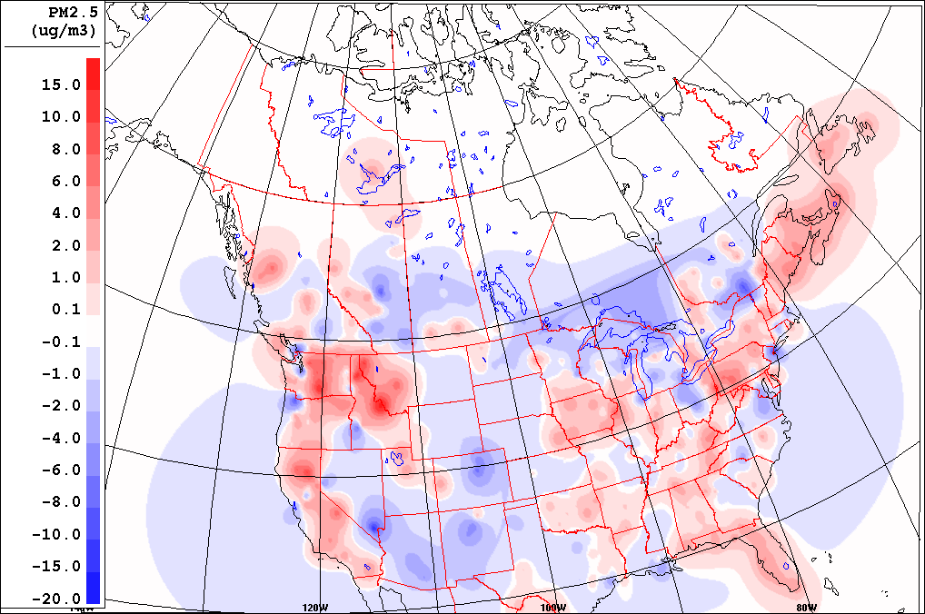
Surface OA increments : winter
NO₂
O₃
PM_{2.5}
Average of hourly surface analysis increments, January 2016

Slide 23
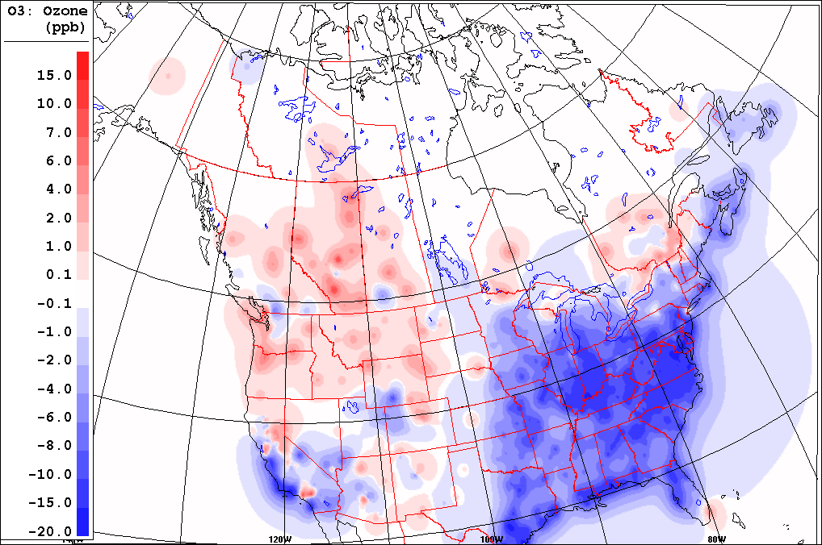
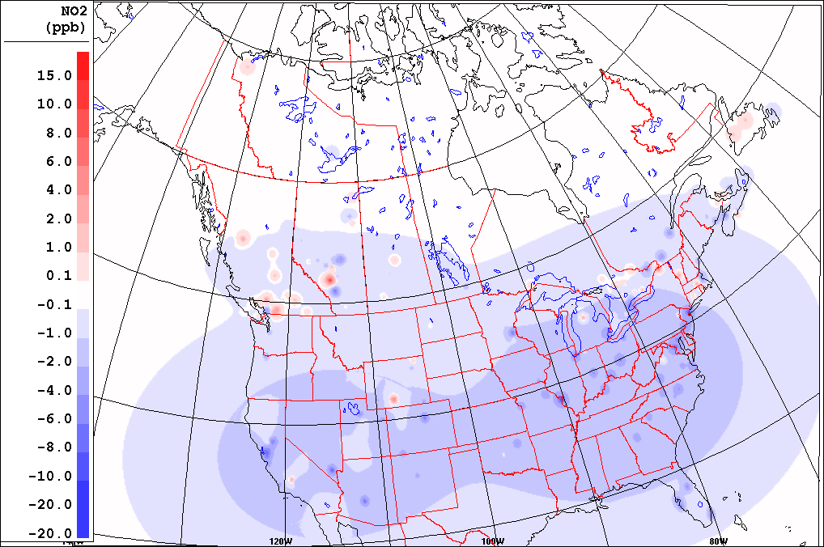
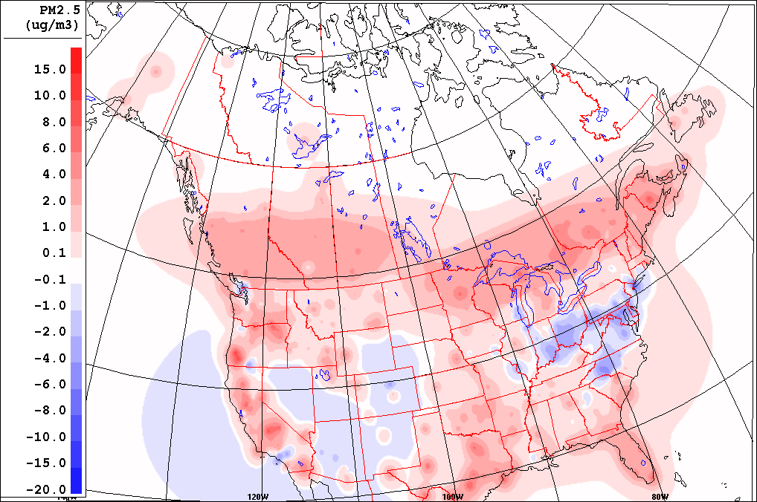
Surface OA increments : summer
O₃
NO₂
PM_{2.5}
Average of hourly surface analysis increments, Julyy 2016

Slide 24
RAQDPS: verification
Emissions:
- Anthropogenic - Biogenic
- (Forest fires)
Real time AQ obs
Config, landuse, etc.
AQ piloting from global model
Real time DB
Verif DB
Weather assimilation
GEM-MACH coupled AQ & weather model
OA
AQ assimilation
Operational environment and systems
Weather BCs from global model
Products: - AQHI - Specialized
- Custom
AQ initial conditions
UMOS- AQ
= Not yet

Slide 25
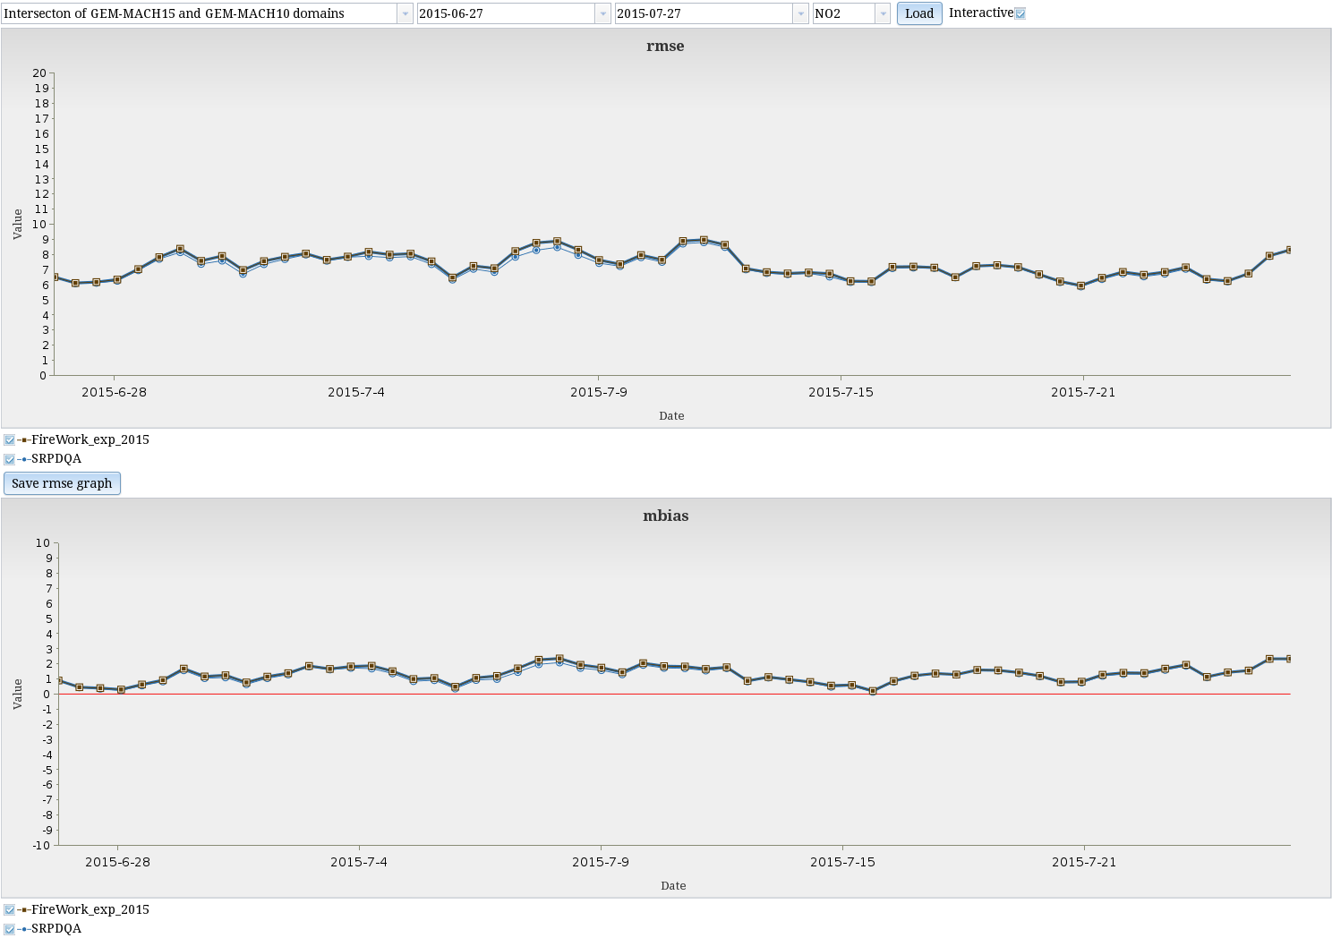
VAQUM: Verification for Air QUality Models
Designed a PostGIS database to store AQ observations and corresponding model outputs
Can ingest both real time and QC’ed historical datasets
Allows to produce various statistics & categorical scores
About 1730 stations (265 CAN, 1465 USA)
Collecting data since 2007
Essential tool to assess the impact of model updates
Also used to monitor the performance of the operational system
RMSE
NO₂
Automatic Operational Model Evaluation
MB
NO₂

Slide 26
VAQUM
PM_{2.5} stations with 75% observation availability for summer of 2015
Number of stations with available observations within the GEM-MACH domain

Slide 27
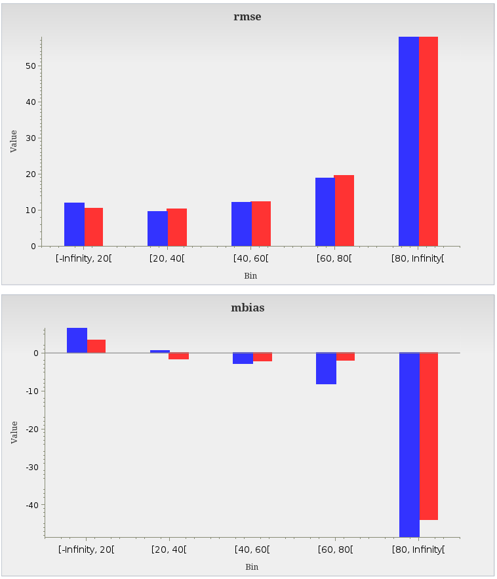
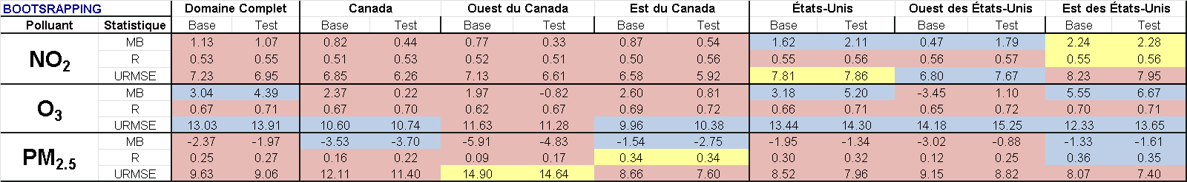
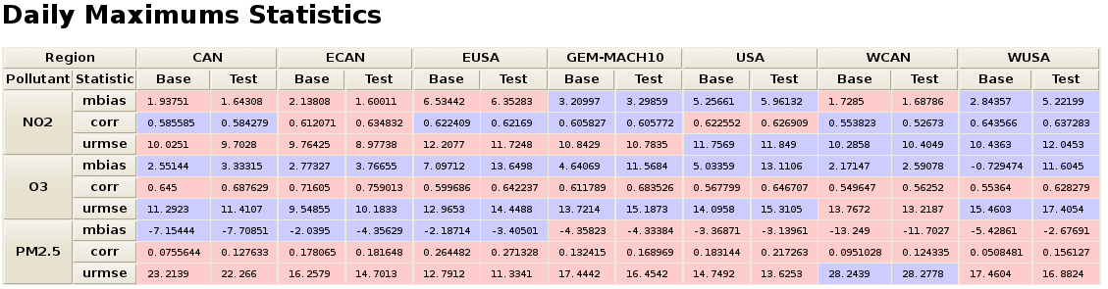
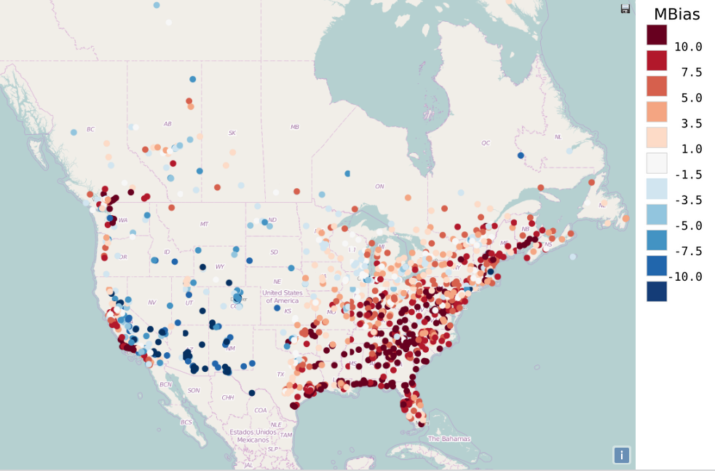
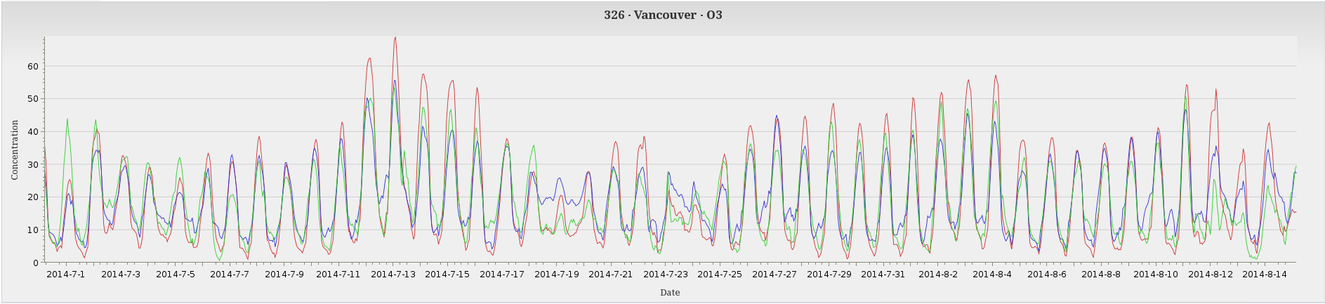
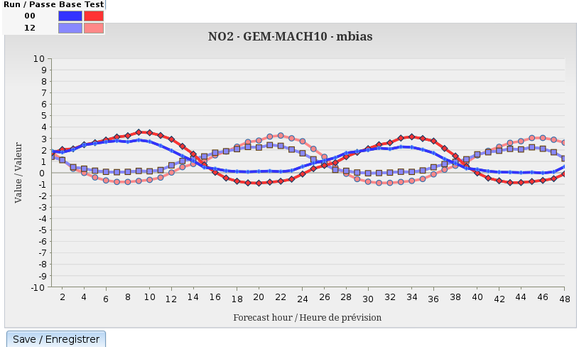
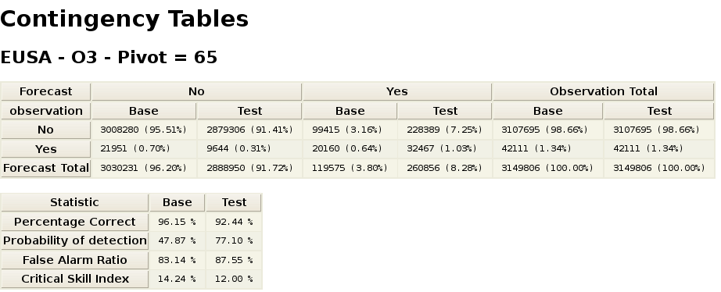
VAQUM Products
Per observation value bin graphs
Objective Scores – hourly forecasts
Per station statistics
Metropolitan Areas Time Series
Per hour statistics graphs
For further details, please see poster number 275 (Monday, 11th January)
Verification Tools for Air Quality Models

Slide 28
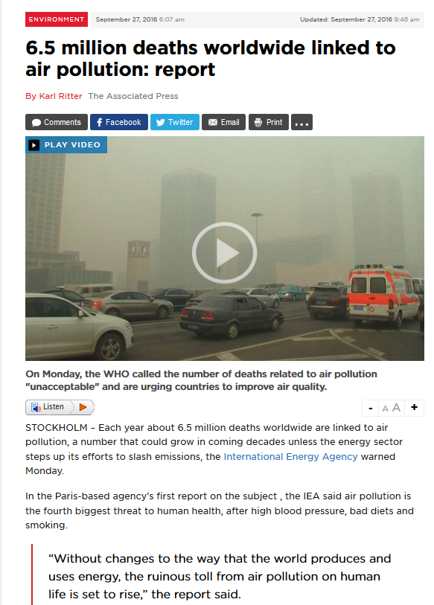
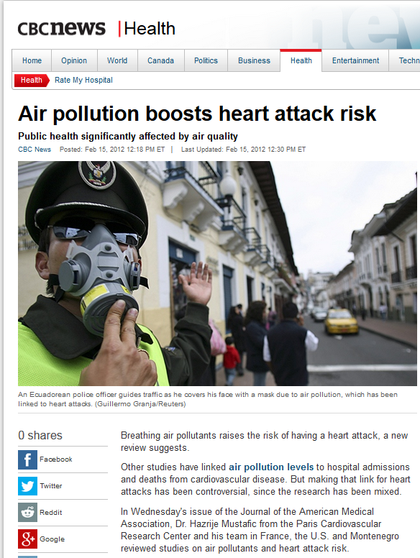

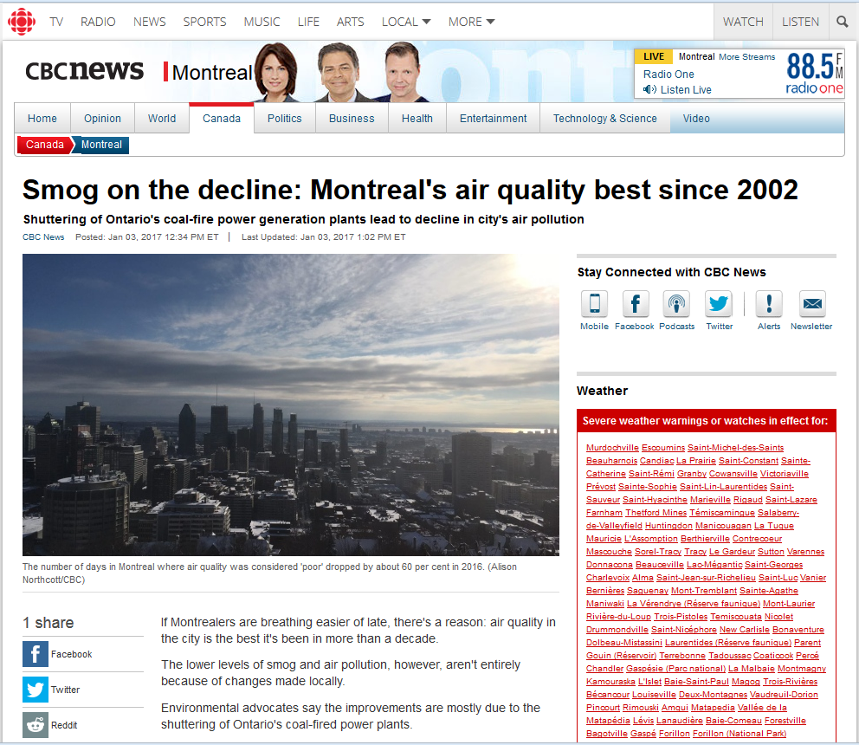
Context: public concern
Years of public outreach raised awareness
As provinces & territories engage in the AQHI program, ECCC adjusting to these partners (e.g. AQHI+)
Media coverage: exposing health risks

Slide 29
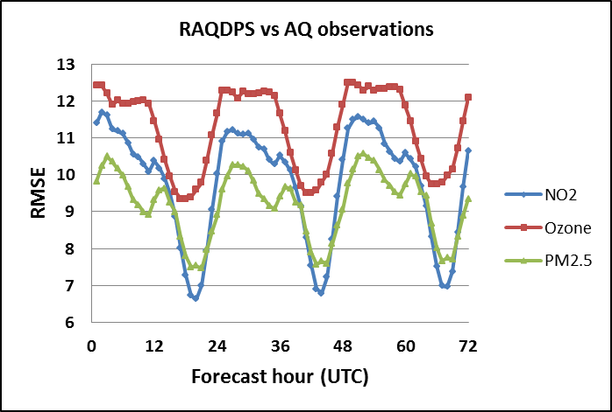
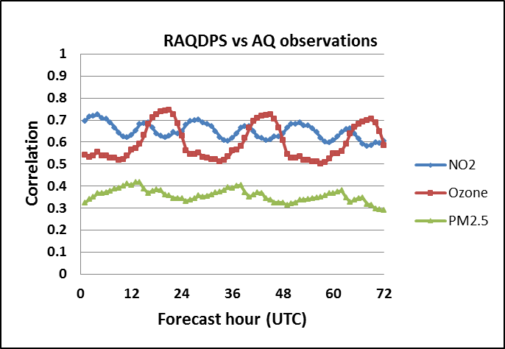
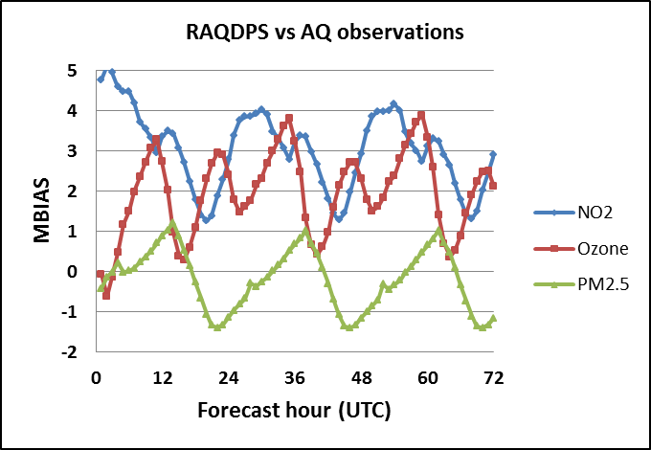
Extending forecast to day 3
Regional weather forecast now providing 84h (exp)
Can be used as LBCs for the RAQDPS
Indications that skill for day 3 forecast not much weaker than for day 2
Commitment of the AQHI program. Targeting 2018
See poster from Sylvain Ménard et al.

Slide 30
High resolution
Take advantage of high resolution weather forecast (2.5km)
Improved BL
Improved surface temperature
Capture intra-urban variability
Expected gain in finer representation on emissions
PanAm example:
Site-specific AQ forecast (as opposed to community average)
See presentation from R. Munoz-Alpizar

Slide 31
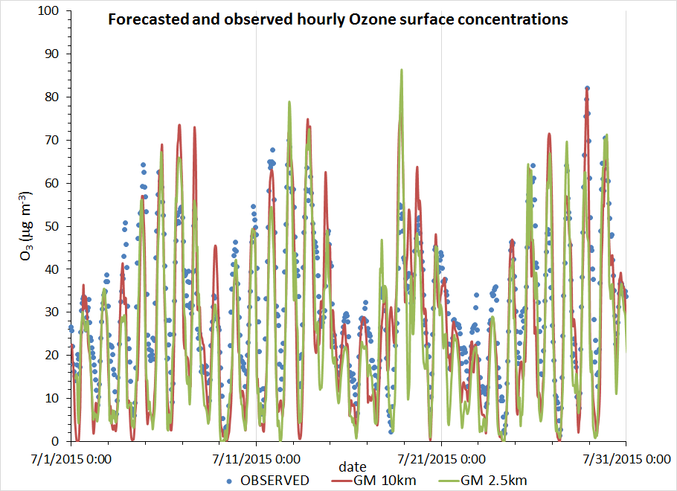
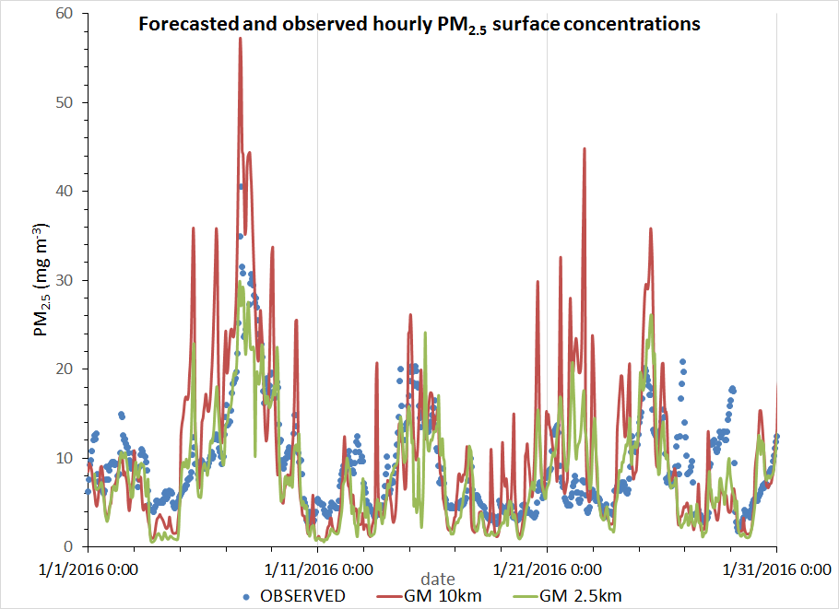
GEM-MACH 2.5km Pollutant Forecast
Summer 2015
Winter 2016
Mean concentration over several stations around Toronto

Slide 32
Next steps
Major changes to supercomputing environment.
Development slowed down until mid-2017
Hope to gain in performance (and delivery times)
RAQDPS
72h forecasts (next 2y)
Updated emissions inventories for Canada, U.S. and Mexico (planned for 2017)
Developing 2.5km subdomains (next 2y)
FireWork
Improved plume height estimates (2017)
Improved wildfire emissions estimates (2017)
Products: towards 2D public forecast.
WMS data access (ogc compliant, in beta testing)

