Slide 1
Performance Analysis of the Canadian Operational Statistical Air Quality Post-Processing Package
Radenko Pavlovic
Meteorological Service of Canada
Environment and Climate Change Canada
Authors:
R. Pavlovic¹, S. Antonopoulos², S. Gilbert¹, D. Davignon¹, A. Teakles³ and M.D. Moran⁴
¹Air Quality Modeling Applications Section, Environment and Climate Change Canada (ECCC), Montreal, Quebec, Canada
²Weather Element Section, ECCC, Montreal, Quebec, Canada
³ Atlantic Air Quality Science Unit, ECCC, Dartmouth, Nova Scotia, Canada
⁴Air Quality Research Division, ECCC, Toronto, Ontario, Canada
8th IWAQFR 2016, Toronto, Canada

Slide 2
Statistical Post-Processing (SPP)
Why is SPP important?
SPP can compensate for models’ inherent systematic errors
SPP takes into account scales and phenomena not yet resolved by dynamical models
SPP can be a very helpful tool for operational ECCC AQ forecasters
At the Canadian Meteorological Centre (CMC) Updateable Model Output Statistics (UMOS) is applied as a statistical post-processing system for weather- and AQ-related predictands.

Slide 3

Statistical Post-Processing (SPP) UMOS
At the CMC, UMOS has been operational since 1995, and UMOS-AQ since July 2010
UMOS-AQ provides station-specific forecasts for PM_{2.5}, NO₂, and O₃, allowing the calculation of a UMOS-AQ-based AQHI
More information about UMOS-AQ can be found in:
UMOS-AQ: Forecasting O₃, PM₂₅ and NO₂ hourly spot concentrations using an Updatable MOS methodology, 2nd IWAQFR, Antonopoulos et al., 2010.
UMOS-AQ / MIST: Improving O₃, PM₂₅ and NO2 GEM-MACH15 surface fields by optimally interpolating Updatable MOS (UMOS) forecasts, NATO-SPS ITM on Air Pollution Modelling and Its Application, Utrecht, The Netherlands, Antonopoulos et al., 2012.

Slide 4
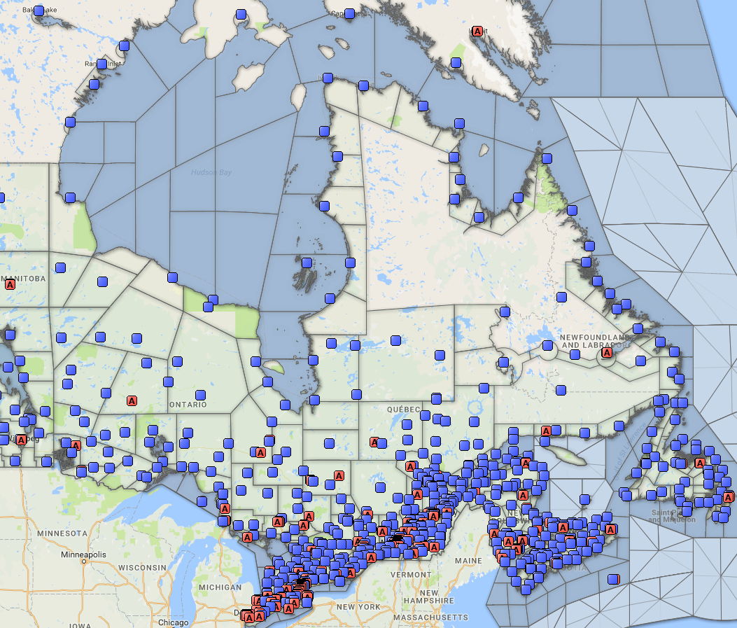
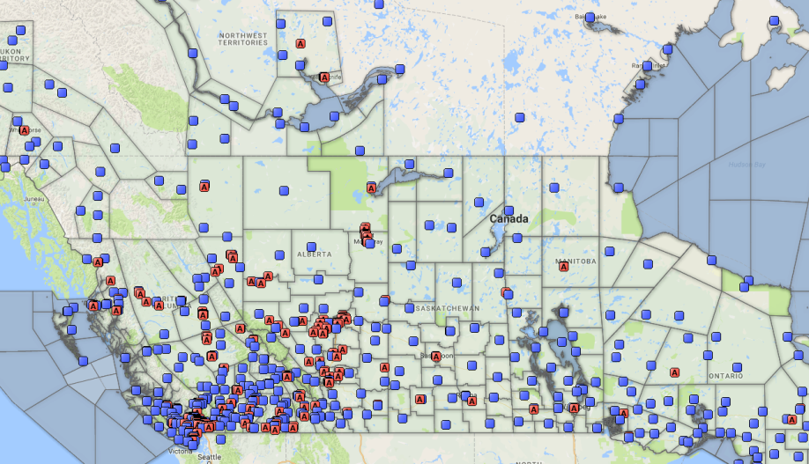
AQHI Observation Sites vs ECCC Forecast Locations
UMOS produces station-specific forecasts
The number of ECCC forecast locations outnumber UMOS-AQ locations
SCRIBE (Forecast Location)
AQHI Observation Sites

Slide 5
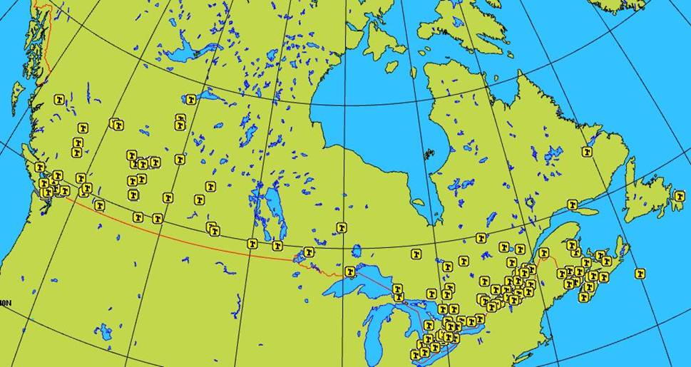
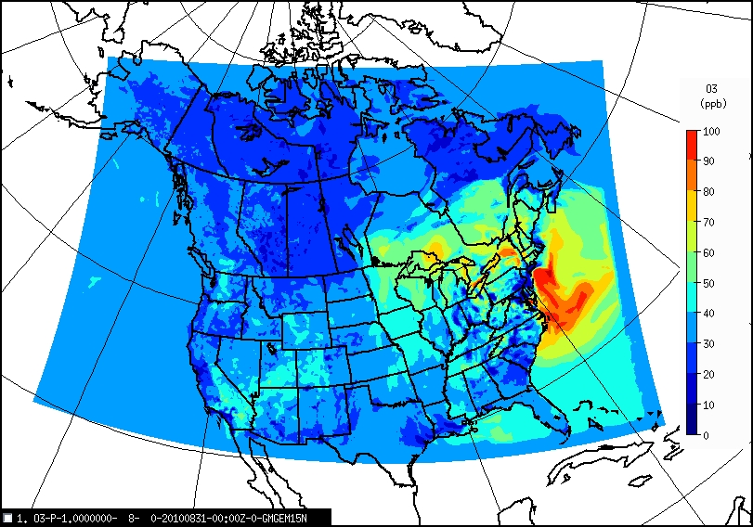
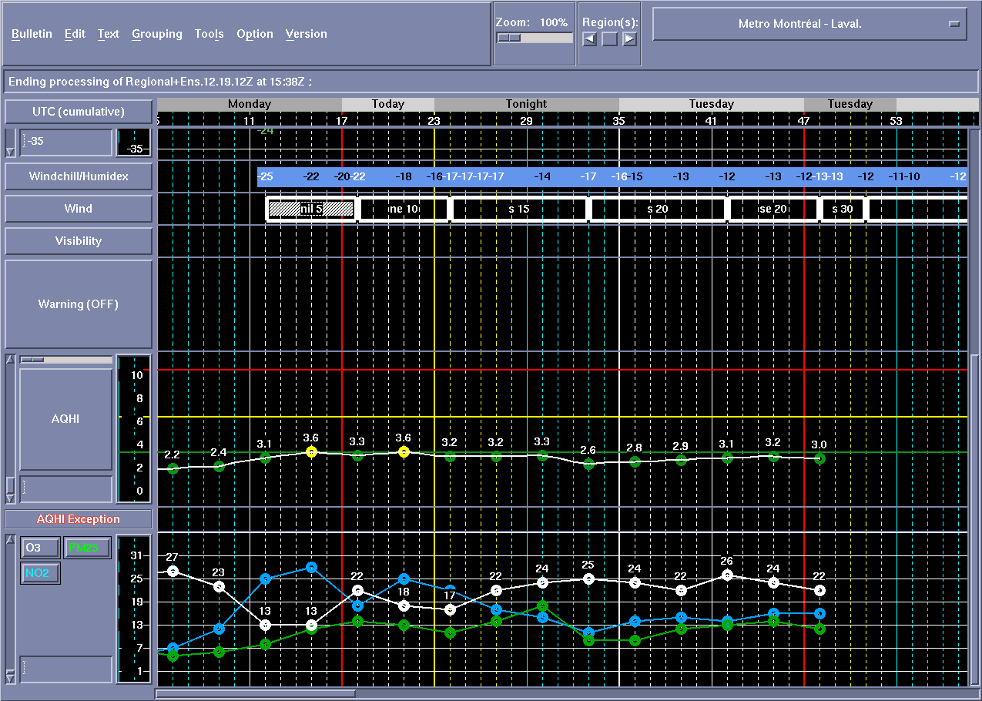
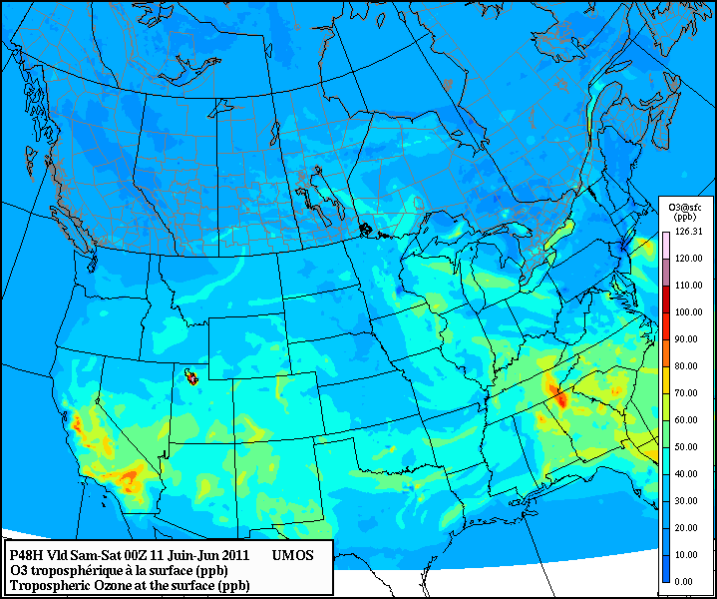
UMOS-AQ/MIST
UMOS-AQ
FORECAST
SCRIBE
Operational AQ Forecast interface
MIST
Moteur d'Interpolation STatistique
UMOS-AQ/MIST

Slide 6
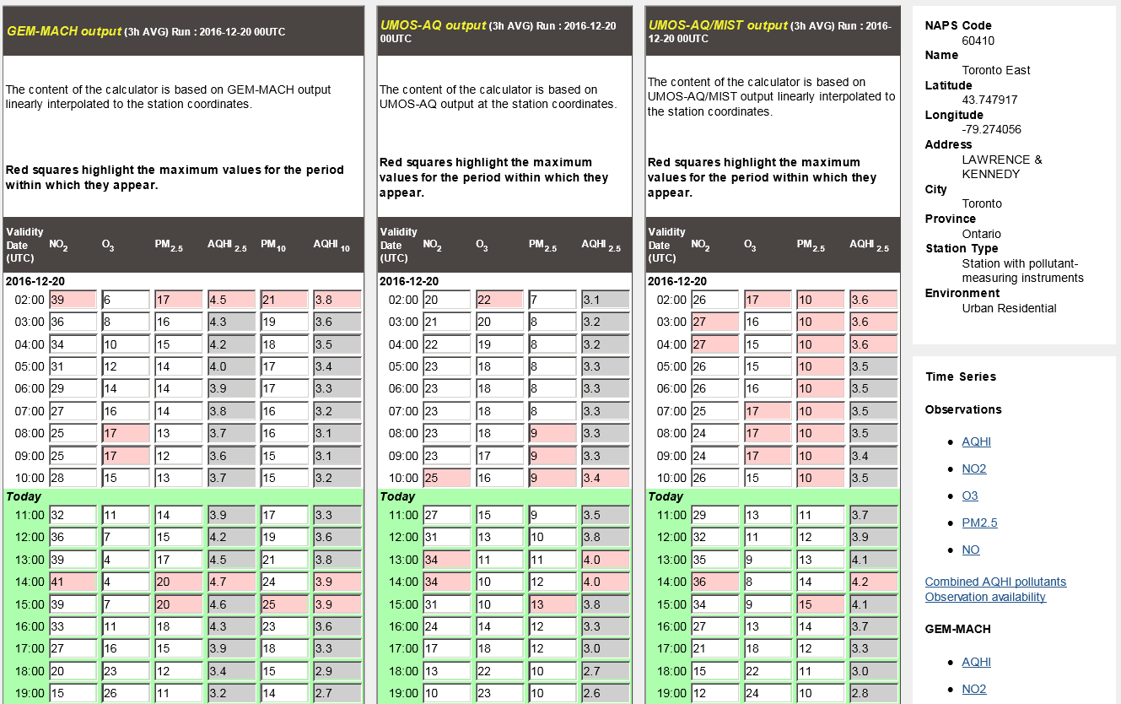
UMOS-AQ/MIST and Operational Forecasts
ECCC operational forecasters work directly with UMOS-AQ/MIST; It's the source of the operational AQ interface
This is why we are focusing on Statistical Post-Packaging Performance
If there are potential AQ problems, forecasters will verify AQ observations
If they have some particular concerns, and if time allows, they will analyze direct model outputs

Slide 7
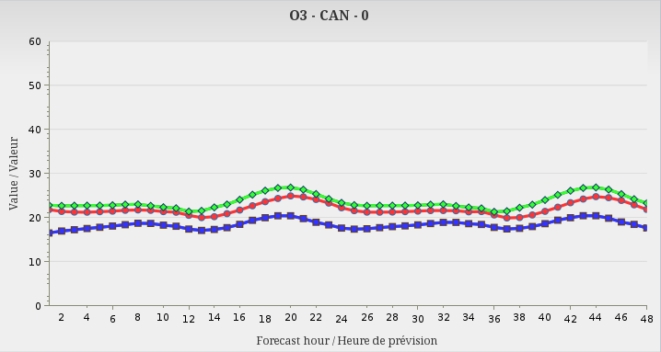
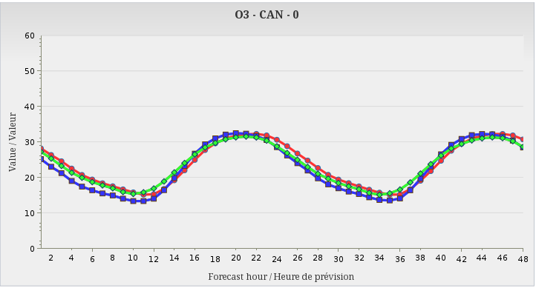
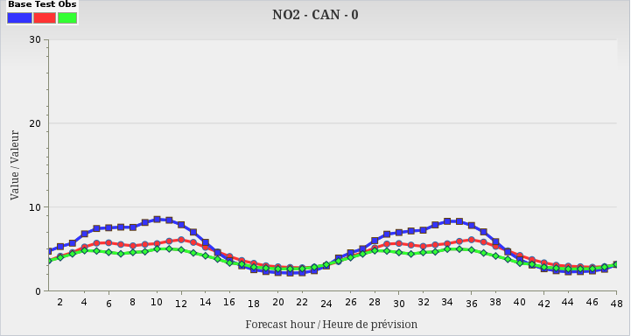
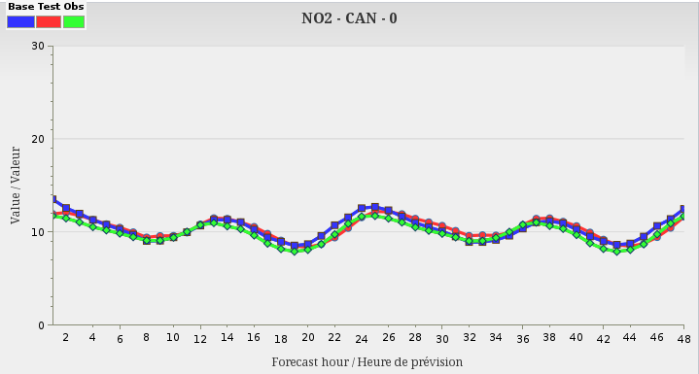
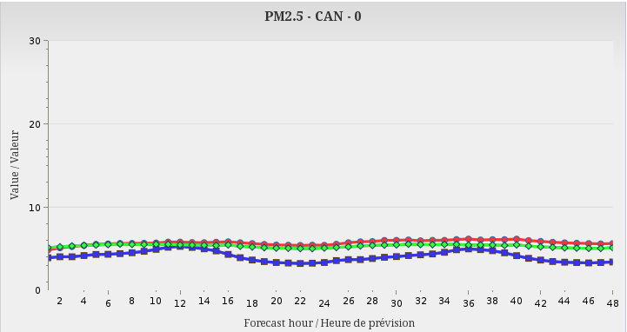
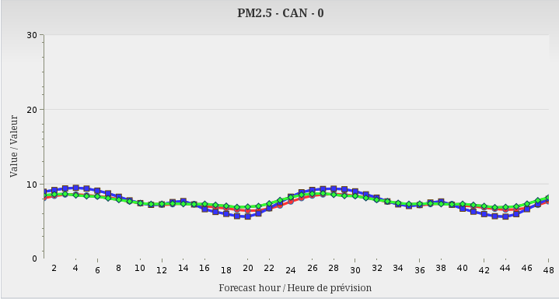
Canada Averaged Observed and Forecasted PM_{2.5}, NO₂ and O₃ Concentrations
Summertime – July 2016
Wintertime – January 2016
OBSERVED
RAQDPS
UMOS-AQ/MIST
OBSERVED
RAQDPS
UMOS-AQ/MIST
O₃ (ppb)
O₃ (ppb)
Significant improvement with UMOS-AQ/MIST
NO₂ (ppb)
NO₂ (ppb)
Significant improvement with UMOS-AQ/MIST
PM_{2.5} (µg/m³)
PM_{2.5} (µg/m³)
Significant improvement with UMOS-AQ/MIST

Slide 8
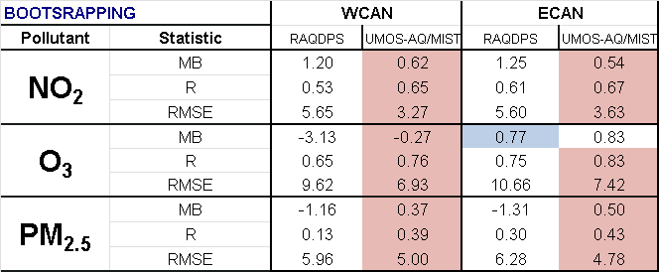
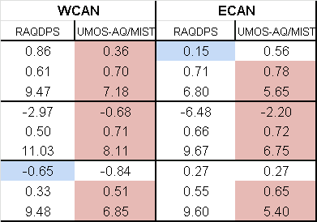
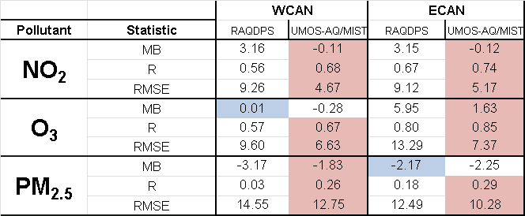
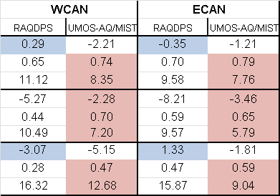

Performance Analysis Hourly and Daily Max Objective Scores
Summertime
Wintertime
Hourly
Root Mean Square Error (RMSE) and Correlation Coefficient (R) are also improved with UMOS-AQ/MIST
Daily Max

Slide 9
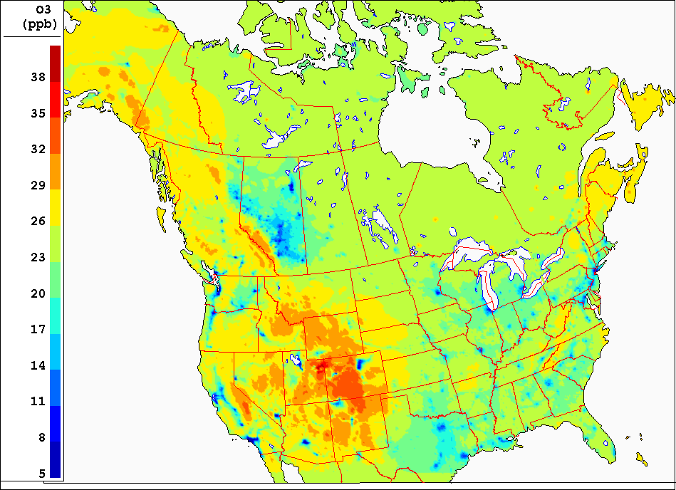
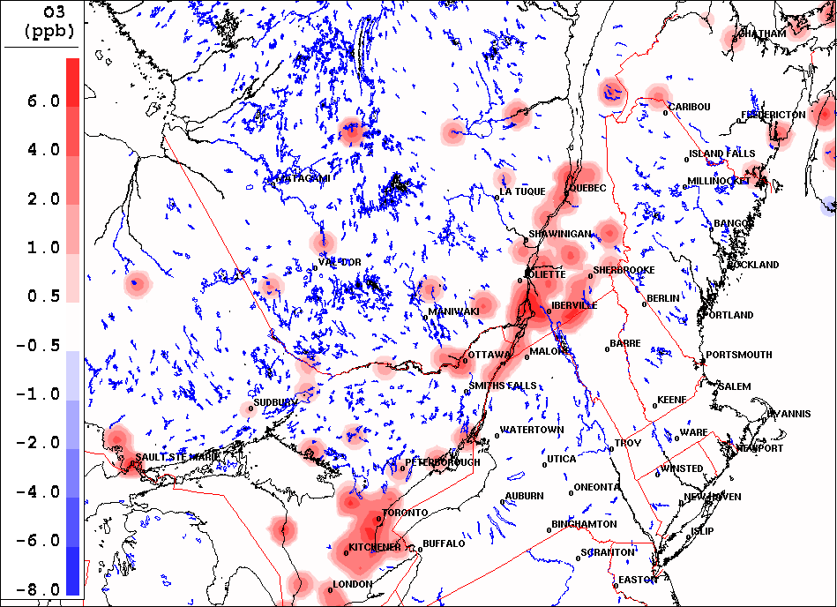
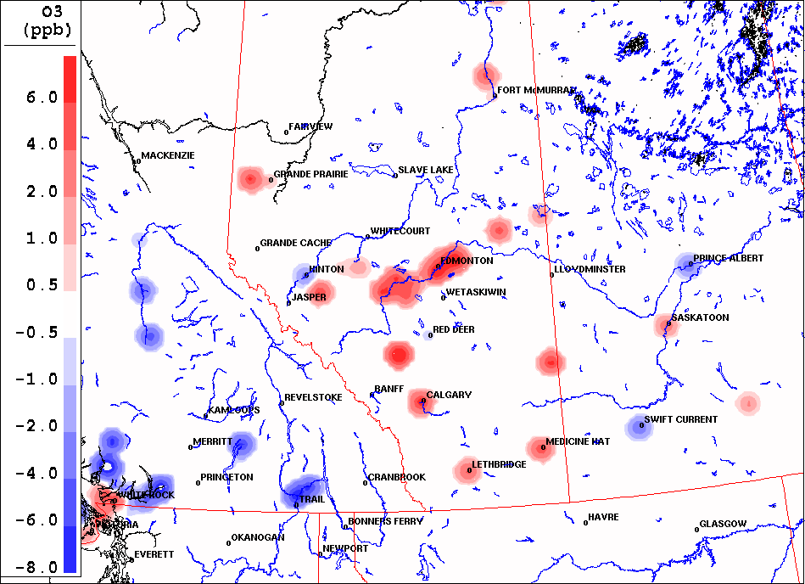
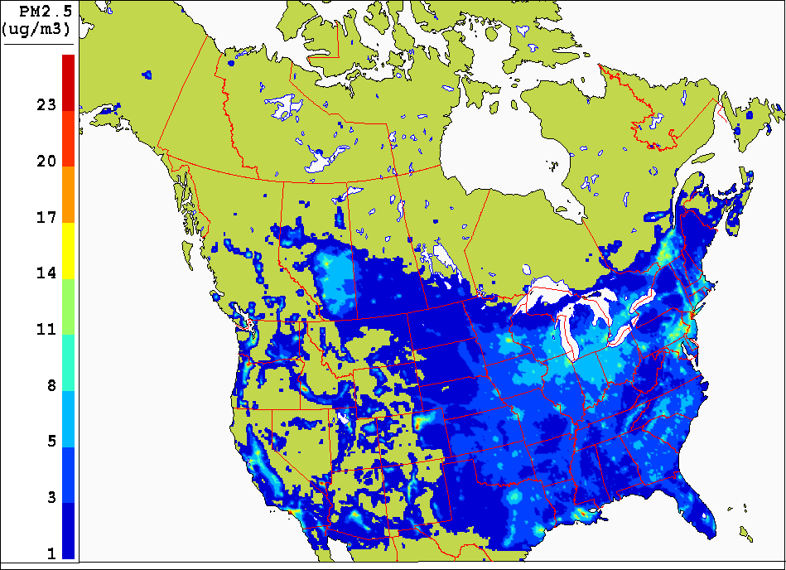
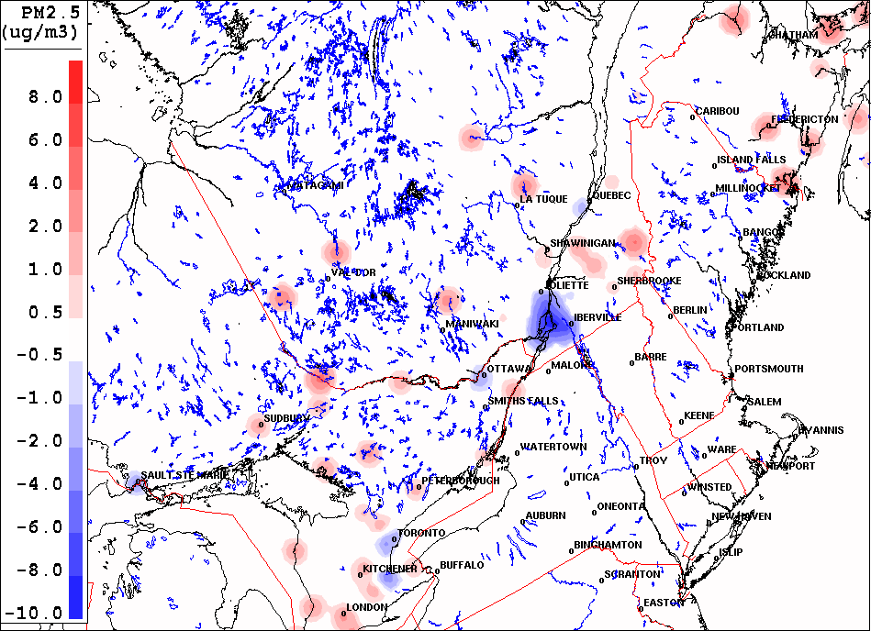
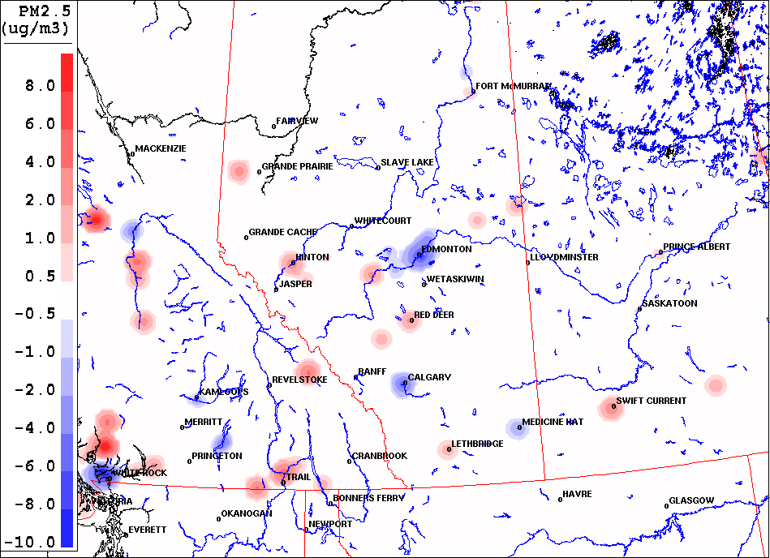
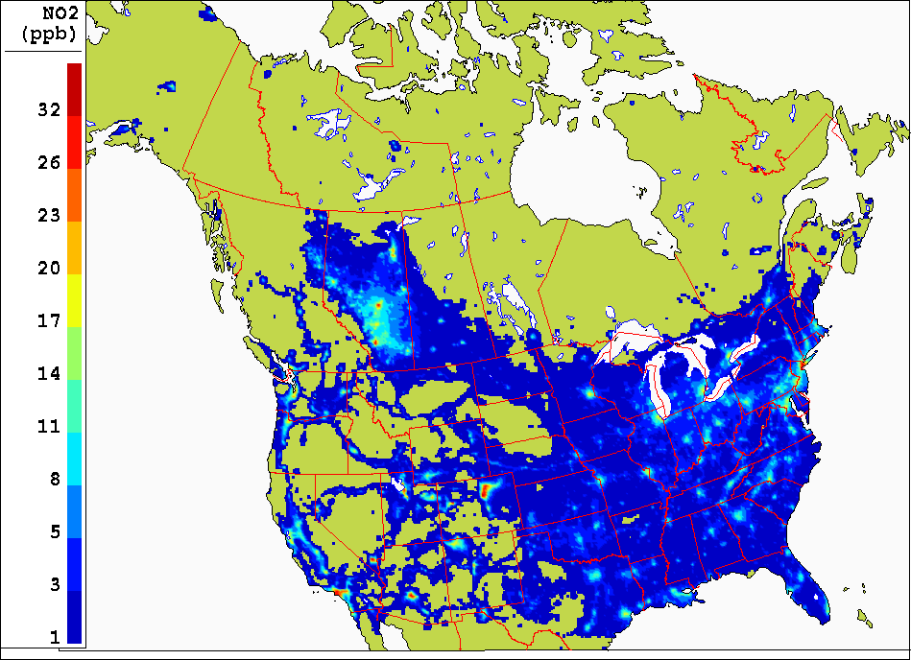
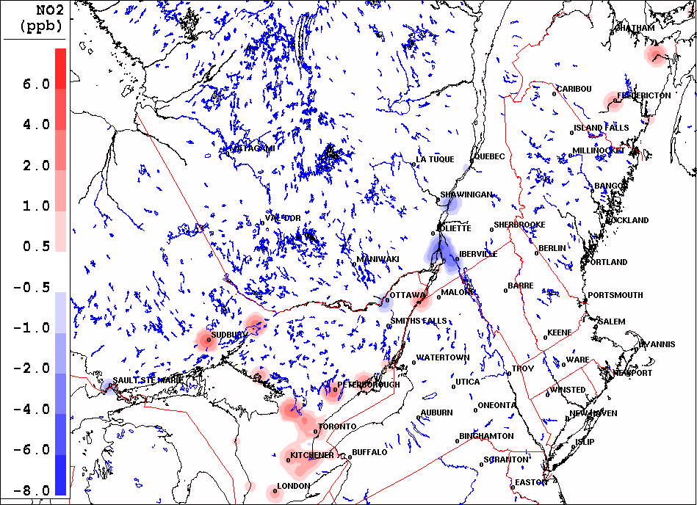
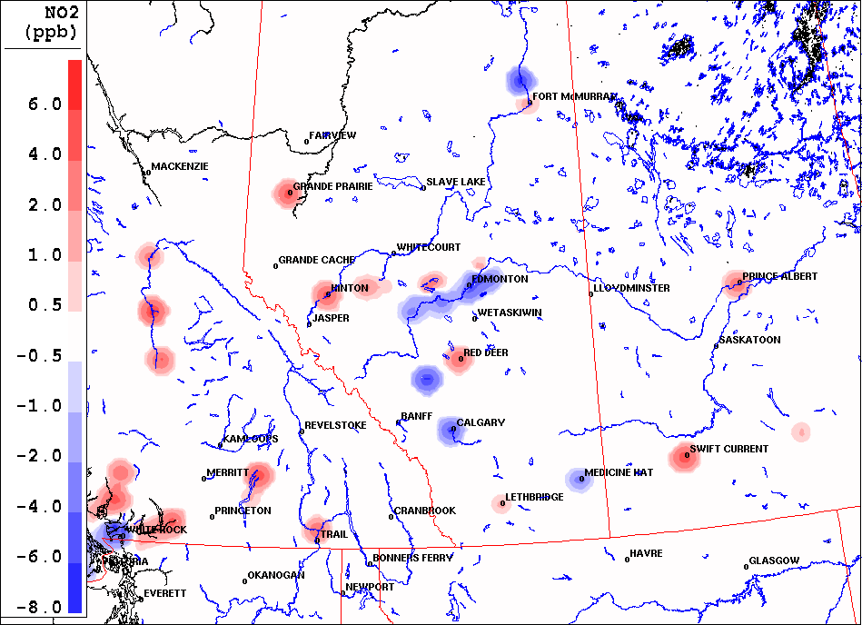
WINTERTIME
Eastern Canada
DIFF=UMOS-AQ/MIST - RAQDPS
Western Canada
DIFF=UMOS-AQ/MIST - RAQDPS
UMOS-AQ/MIST
Positive differences
O₃
Negative differences in major cities
PM_{2.5}
NO₂

Slide 10
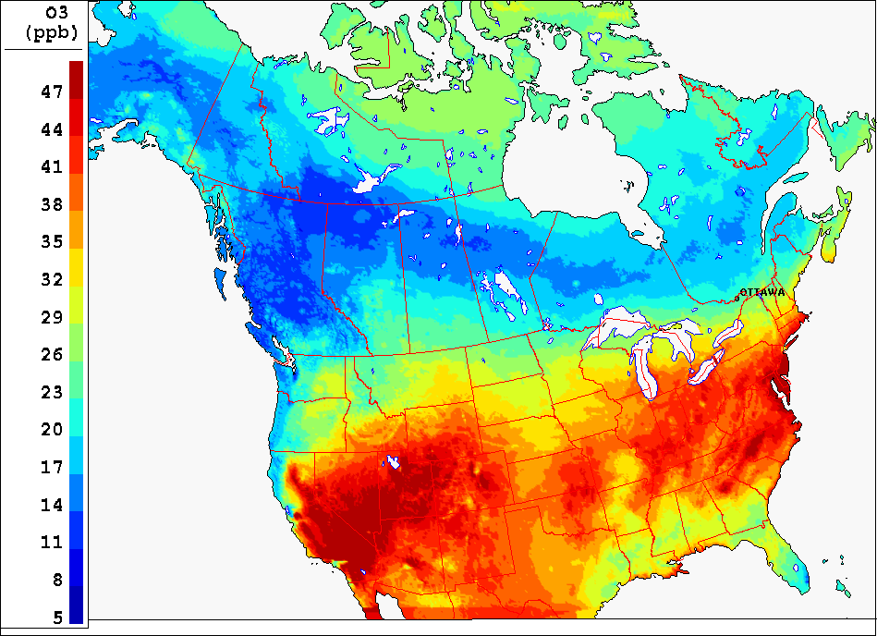
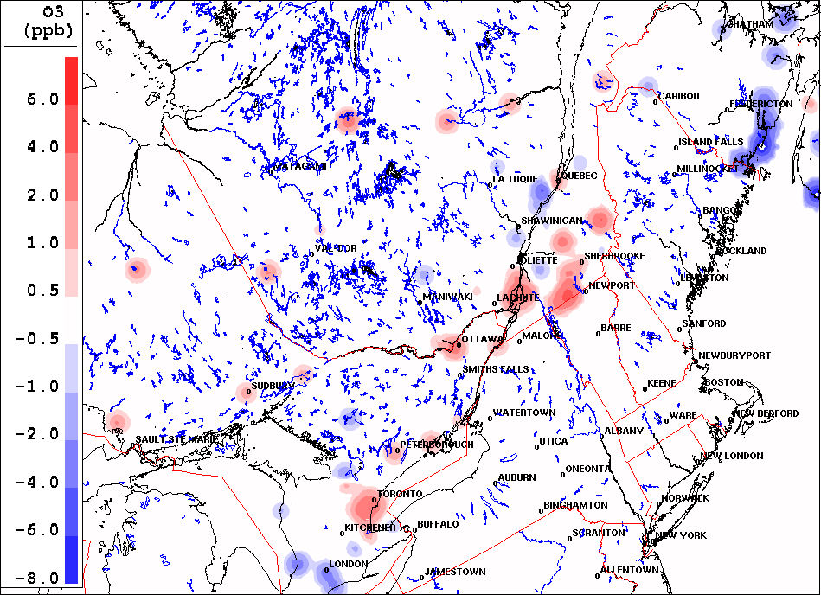
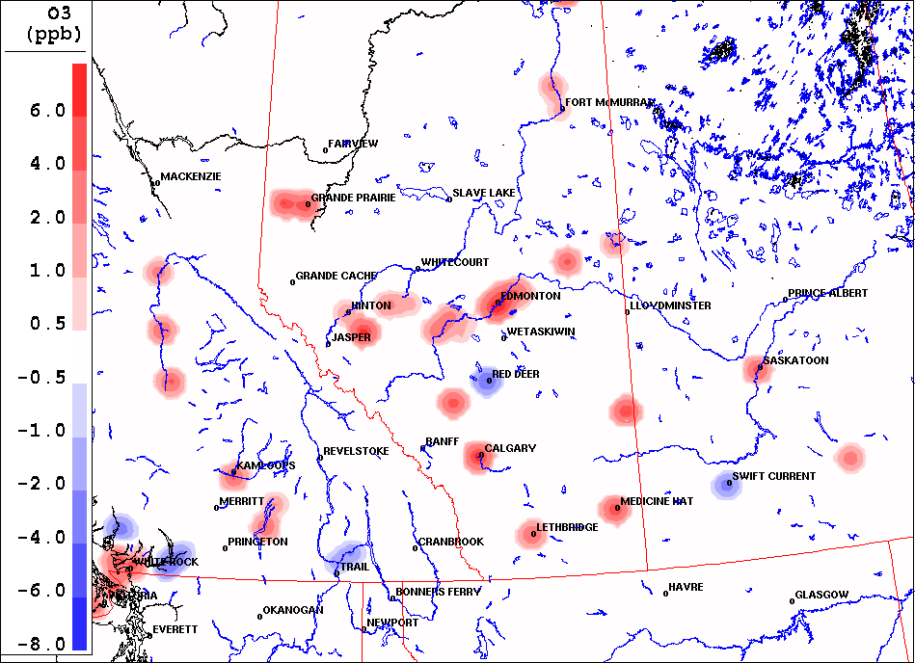
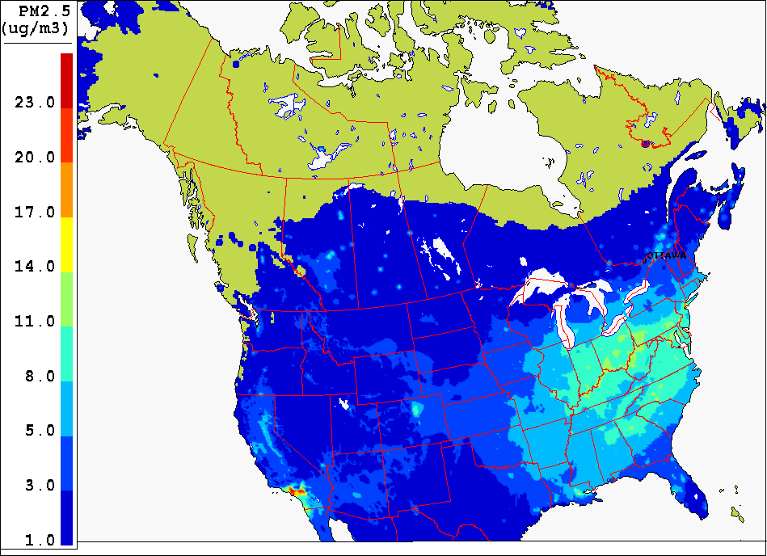
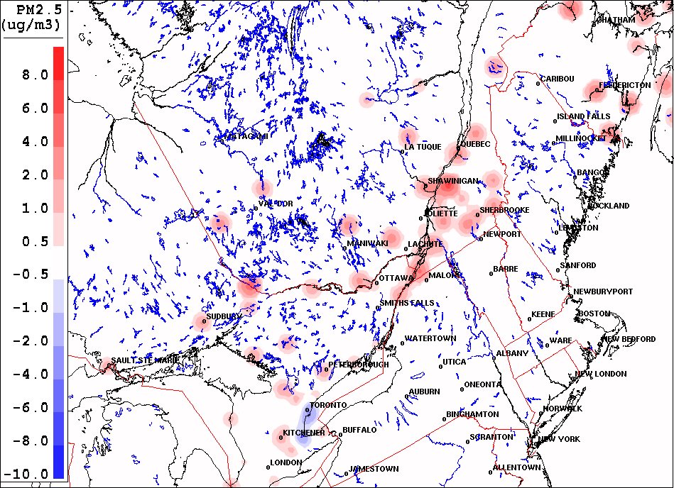
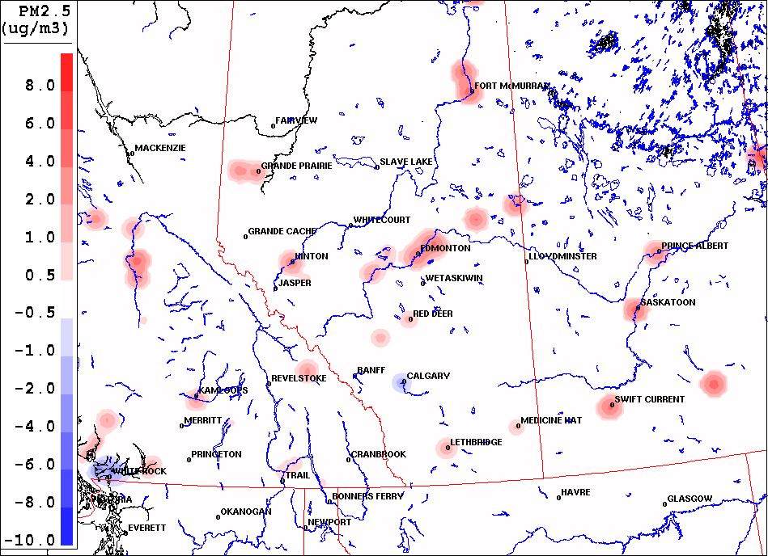
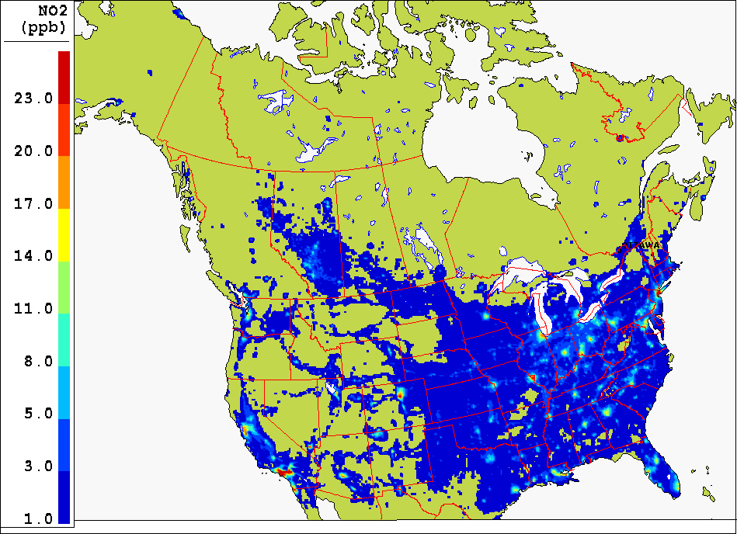
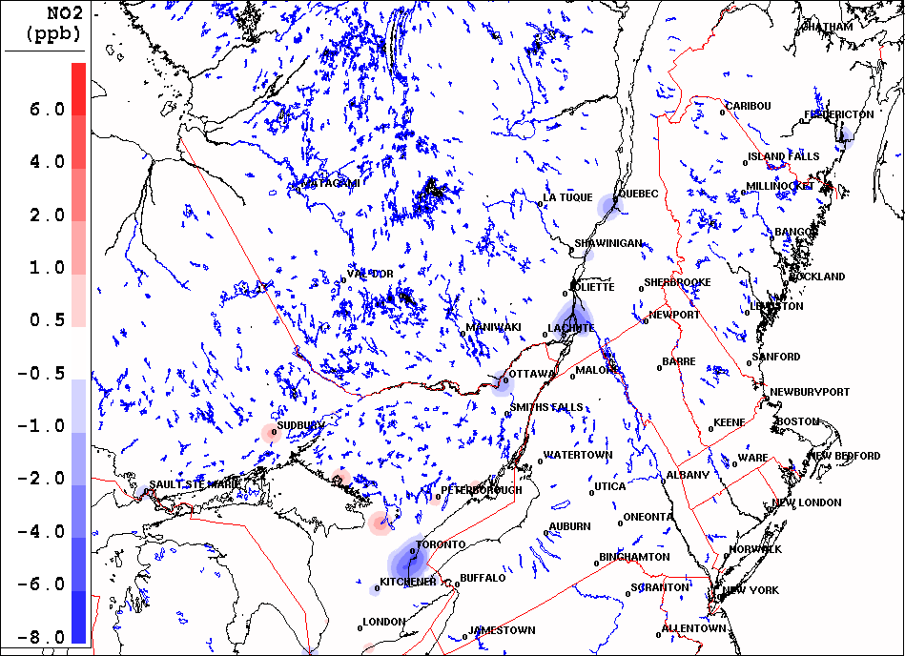
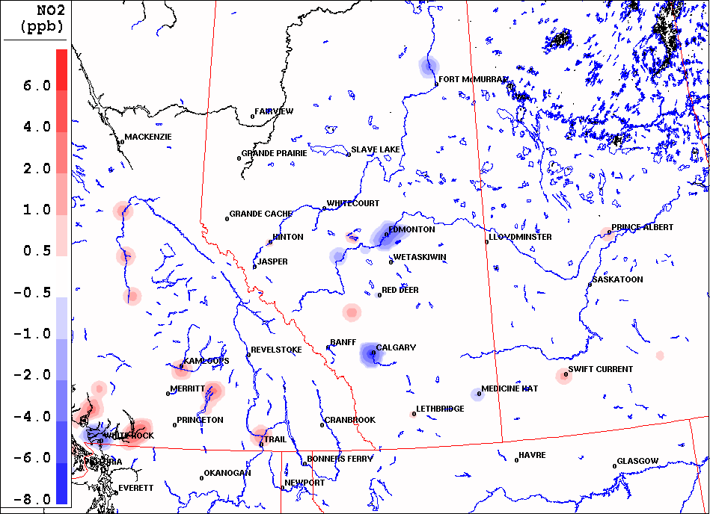
SUMMERTIME
Eastern Canada
DIFF=UMOS-AQ/MIST - RAQDPS
Western Canada
DIFF=UMOS-AQ/MIST - RAQDPS
UMOS-AQ/MIST
Positive differences
O₃
Positive differences
PM_{2.5}
Negative differences in major cities
NO₂

Slide 11
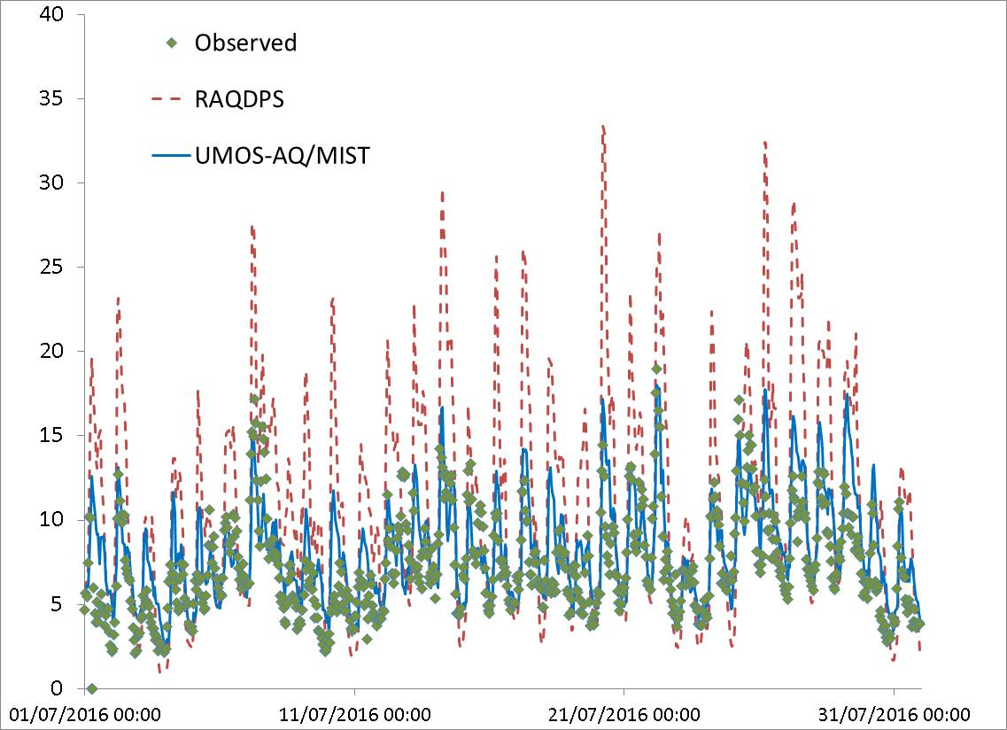
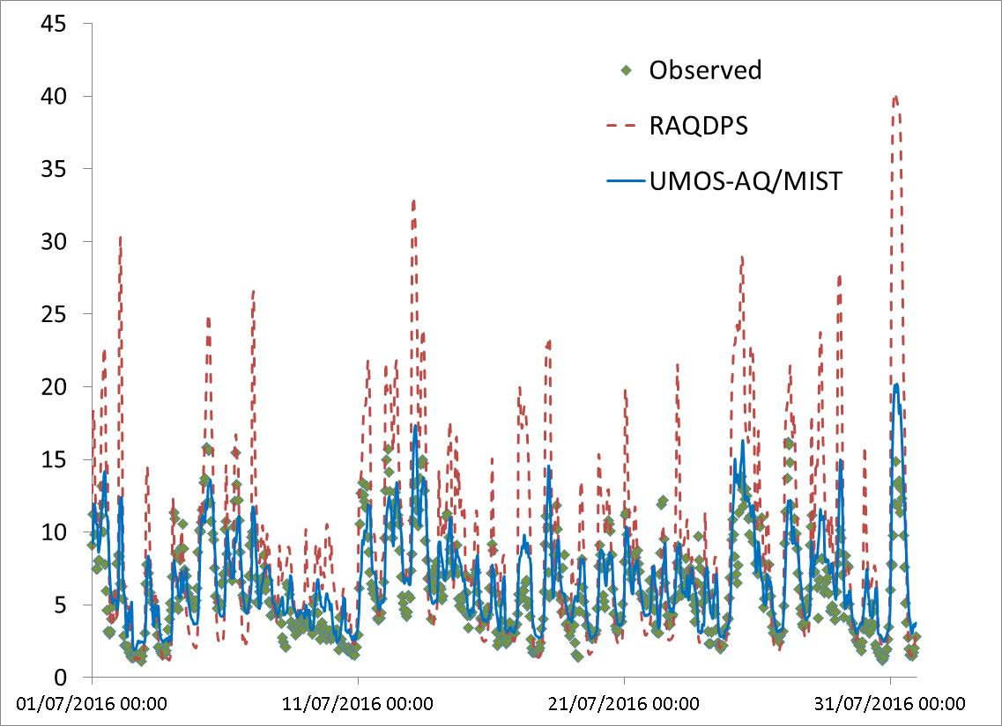
Summertime Time Series NO₂
Vancouver
Montreal

Slide 12
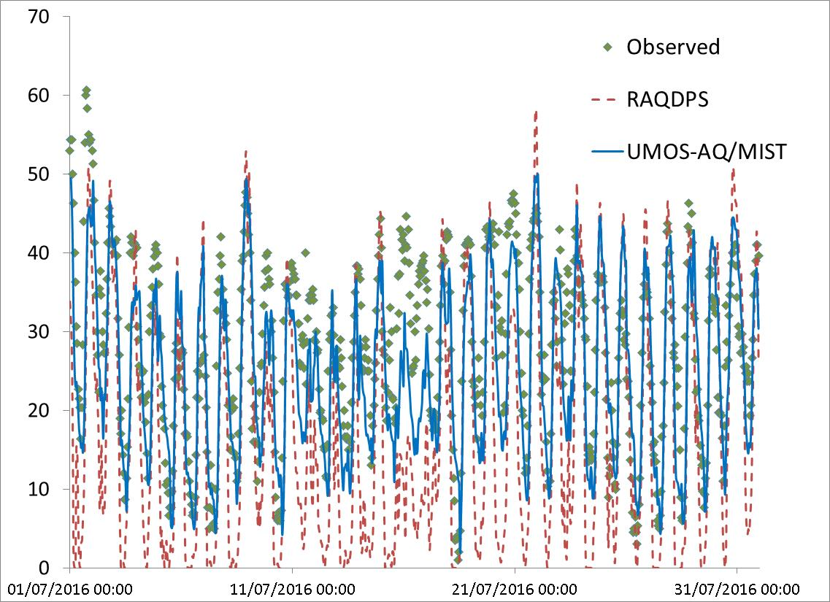
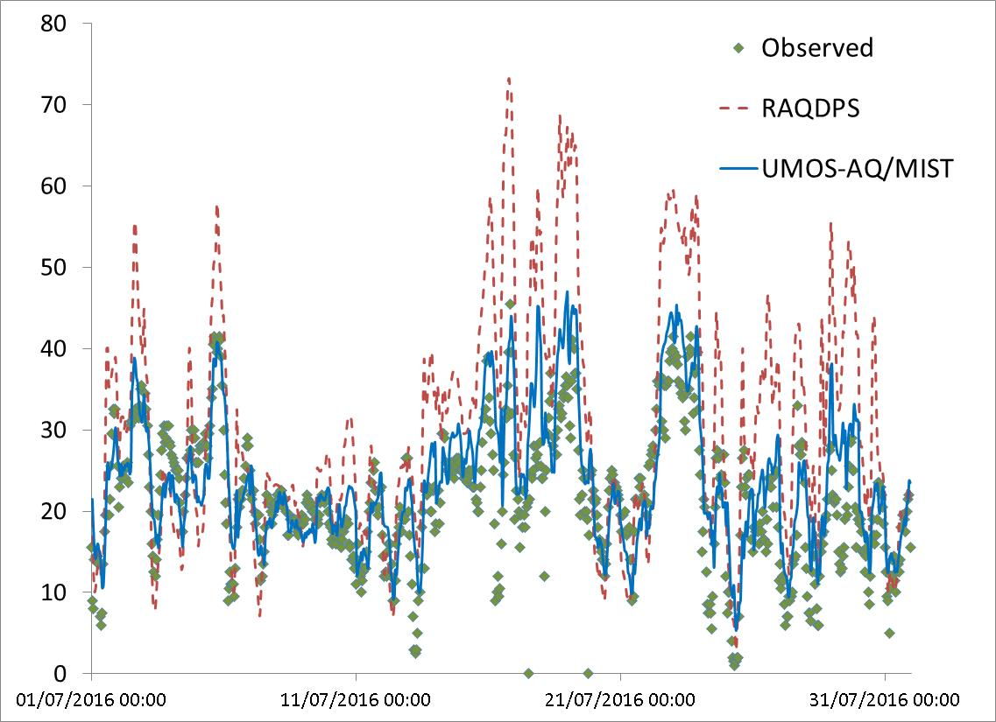
Summertime Time Series O₃
Calgary
Halifax

Slide 13
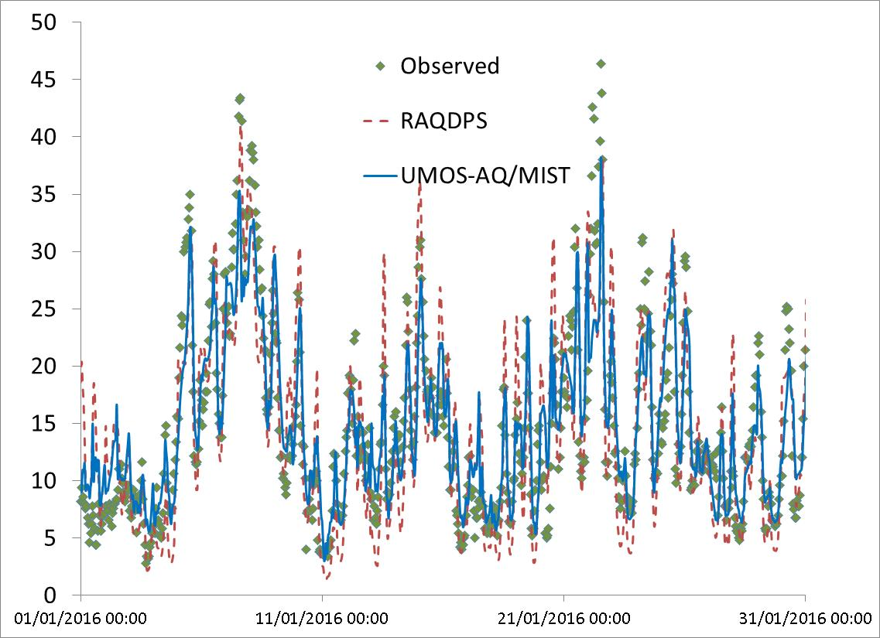
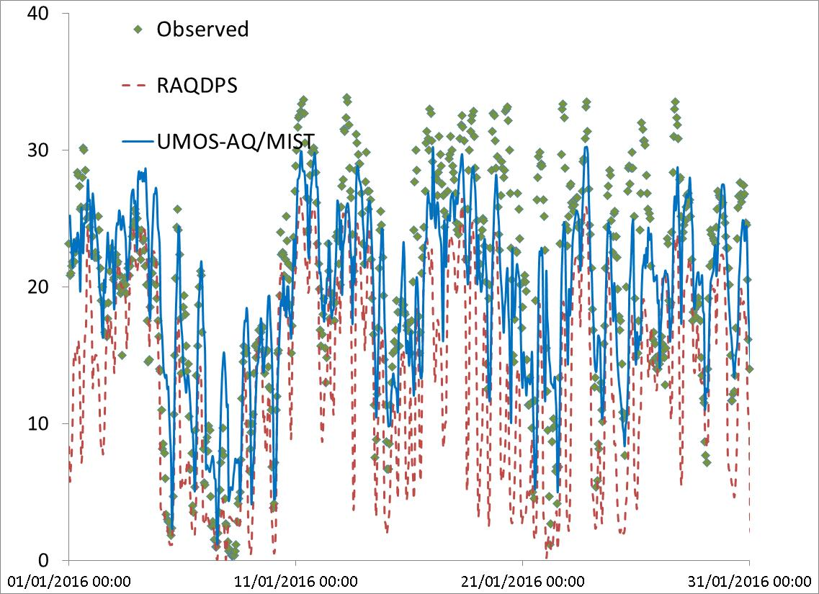
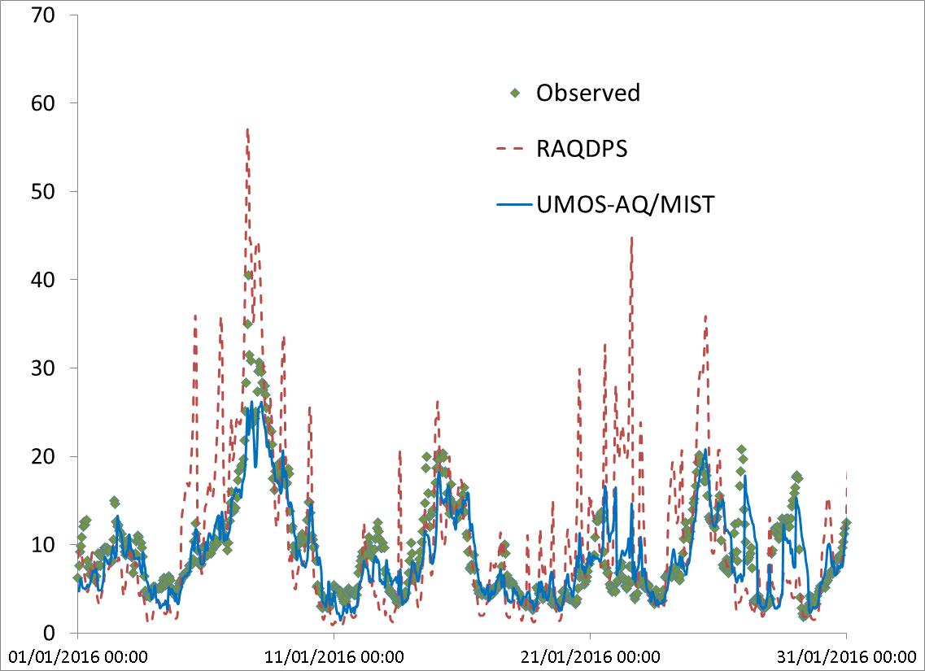
Wintertime Time Series - Toronto
NO₂
O₃
PM_{2.5}

Slide 14
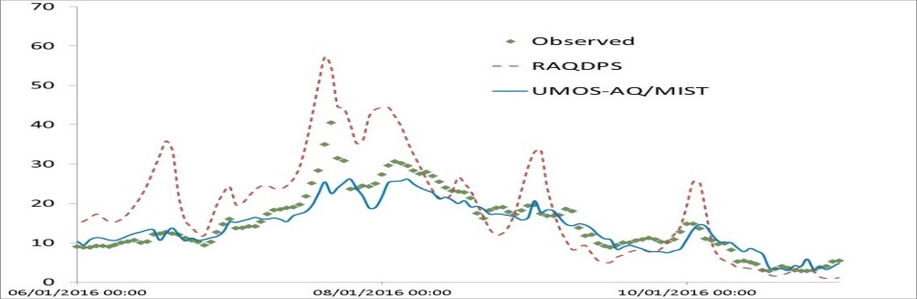
UMOS-AQ-MIST‘s Weaknesses (1)
Statistical post-processing (UMOS-AQ/MIST) significantly improves AQ forecasts. However, this system has some weaknesses:
Smoothing/correcting modelled peak concentrations
Due to the limited number of AQ stations, UMOS-AQ/MIST correction is applied to a limited area
Toronto
PM_{2.5}

Slide 15
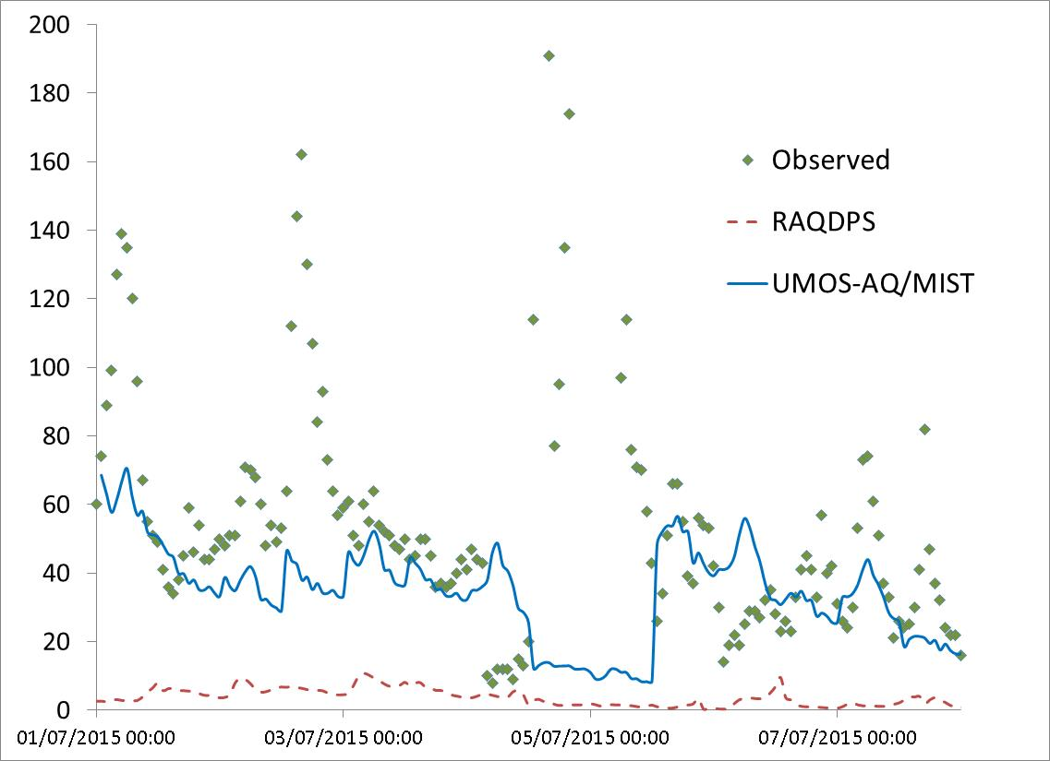
UMOS-AQ-MIST‘s Weaknesses (2)
UMOS-AQ/MIST is not good at handling extreme pollution events, like those generated by wildfires.
If a source is present for several days, UMOS-AQ starts to adjust the AQ forecasts
Peaks never well represented
Saskatoon
PM_{2.5}(ug/m3)

Slide 16
Current and Planned Improvements to Statistical Post-Processing Package (1)
Update post-processing system for extended, 72-hour- long RAQDPS forecast
Adapt Statistical Post-Processing System for wildfire pollution forecasts (FireWork system)
Ongoing
Planned

Slide 17
Current and Planned Improvements to Statistical Post-Processing Package (2)
New Statistical Post-Processing System named PROGNOS is being developed and tested. This new system is based on the XM-Tool project.
The XM-Tool initiative is focusing on improving the RAQDPS AQ forecasts in support of the AQHI Forecast Program
PROGNOS will provide a more versatile and easier to maintain SPP and will be able to process outputs of numerical weather forecast systems
Ongoing
More information about PROGNOS (IWAQFR, Jan 10th):
A. Teakles: PROGNOS - A new MSC initiative to renew the operational statistical post-processing infrastructure
More information about experimental post-processing (IWAQFR, Jan 10th):
A. Teakles: Experimental post-processing of air quality forecasts for the Toronto 2015 PanAm and ParaPanAm Games

Slide 18
Conclusions (1)
Statistically post-processed (SPP) forecasts are the principal source/tool for ECCC's AQ forecasters
AQ forecasts are significantly improved by SPP when compared to the AQ model's raw outputs. Both hourly and daily max scores (RMSE, MB, R) for NO₂, PM_{2.5} and O₃ are improved
SPP has some weaknesses, like forecasting extreme events
Constant improvements are made to the SPP and important system updates are planned for coming years

Slide 19
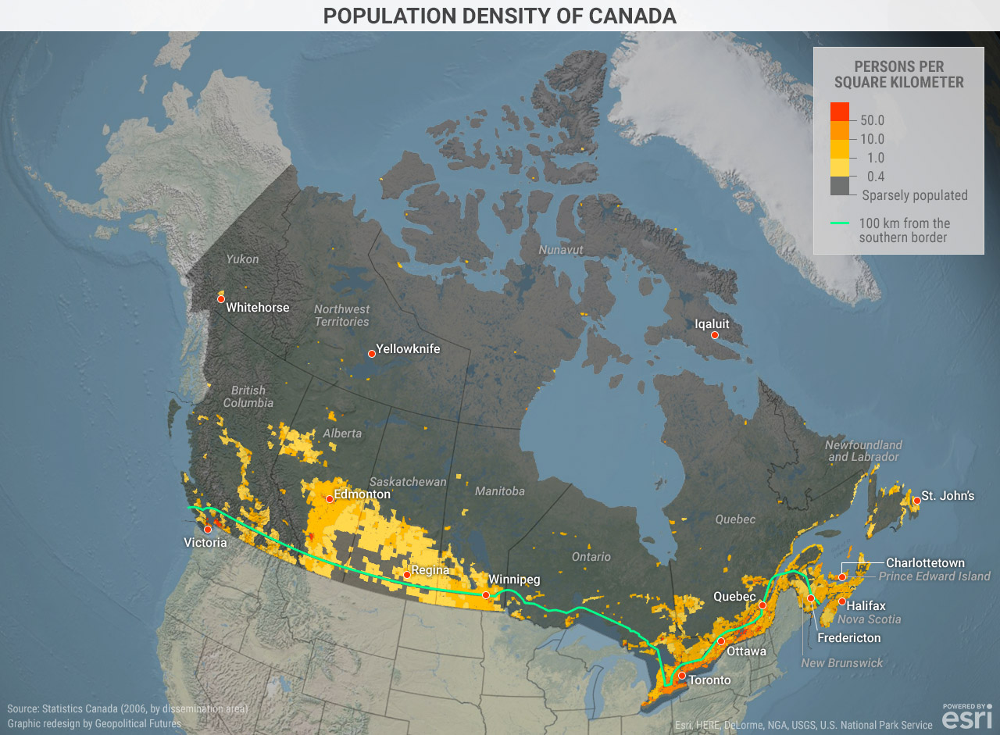
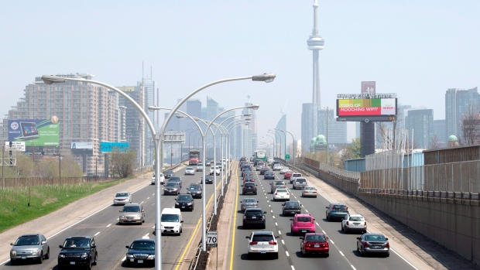
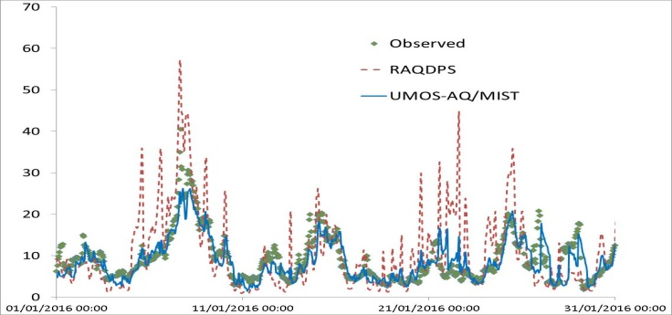
Conclusions (2)
UMOS-AQ Sites
POPULATION DENSITY OF CANADA
Source: Statistics Canada, graphic redesign by Geopolitical Futures
Toronto Smog Alert, (CTV News, Toronto, May 9th 2015)
Useful tool for urban AQ forecasting. In Canada, major urban centres are covered with large number of UMOS-AQ stations.
TORONTO
PM_{2.5}

Slide 20
THANK YOU!

