Slide 1
Background Fit to Space-based Observations
William F. Campbell
U.S. Naval Research Laboratory
Monterey, CA
17th JCSDA Technical Review Meeting and Science Workshop
May 29-31, 2019, NASA Headquarters, Washington, DC

Slide 2
Fit to Observations
Background fit to observations is a measure of how close, on average, a short forecast (background) is to the entire set of observations valid at the forecast time
The measure of closeness typically chosen is the innovation (observation minus background) standard deviation
Unlike most verification metrics, it is computed in observation space rather than model space
Observations used to measure the background fit need not be assimilated, but the observation operator must be computed

Slide 3
Motivation
ECMWF uses background fit to observations as their primary metric in evaluating short-range (up to 5 days) forecasts*
Decisions on the improvement or degradation of numerical experiments (relative to a control run) can be made much faster and (potentially) more reliably than with traditional forecast metrics
Any type of change between experiment and control can be evaluated using this method: dynamics, numerics, observations, error covariances, physics, data assimilation, …
The savings in computer time and, more importantly, researcher time are substantial
*Alan Geer, personal communication

Slide 4
Groups of Observations
Fit to observations is also a diagnostic tool
Millions of monitored and assimilated observations can be used an additional time to evaluate the prior forecast in observation space
We can aggregate similar observations in plots and scorecards to facilitate causal inferences
For example, an experiment improves the background fit to radiances sensitive to moisture in the boundary layer, but degrades the background fit to radiances sensitive to stratospheric temperature
Diagnostic information like this provides guidance on how to resolve issues, resulting in an acceleration of the software development cycle

Slide 5
Methodology
For each observation (e.g. NPP ATMS channel 4) and for each assimilation window, measure how well the background fits all of the observations by computing the innovation standard deviation
Form the ratio of innovation standard deviations of the experiment to the control
If the experiment fits the background better than the control, the ratio will be less than 1; if the control fits better, the ratio will be greater than 1
Form a time series of these ratios, and evaluate whether the mean is statistically significantly different from 1 (Student’s t-test on the log of the time series with lag-1 autocorrelation correction)
For that particular observation and time period:
If the confidence interval around the mean includes 1, the null hypothesis that experiment and control are indistinguishable cannot be rejected; else
If the mean is less than 1, the experiment is better than the control
If the mean is greater than 1, the control is better than the experiment

Slide 6
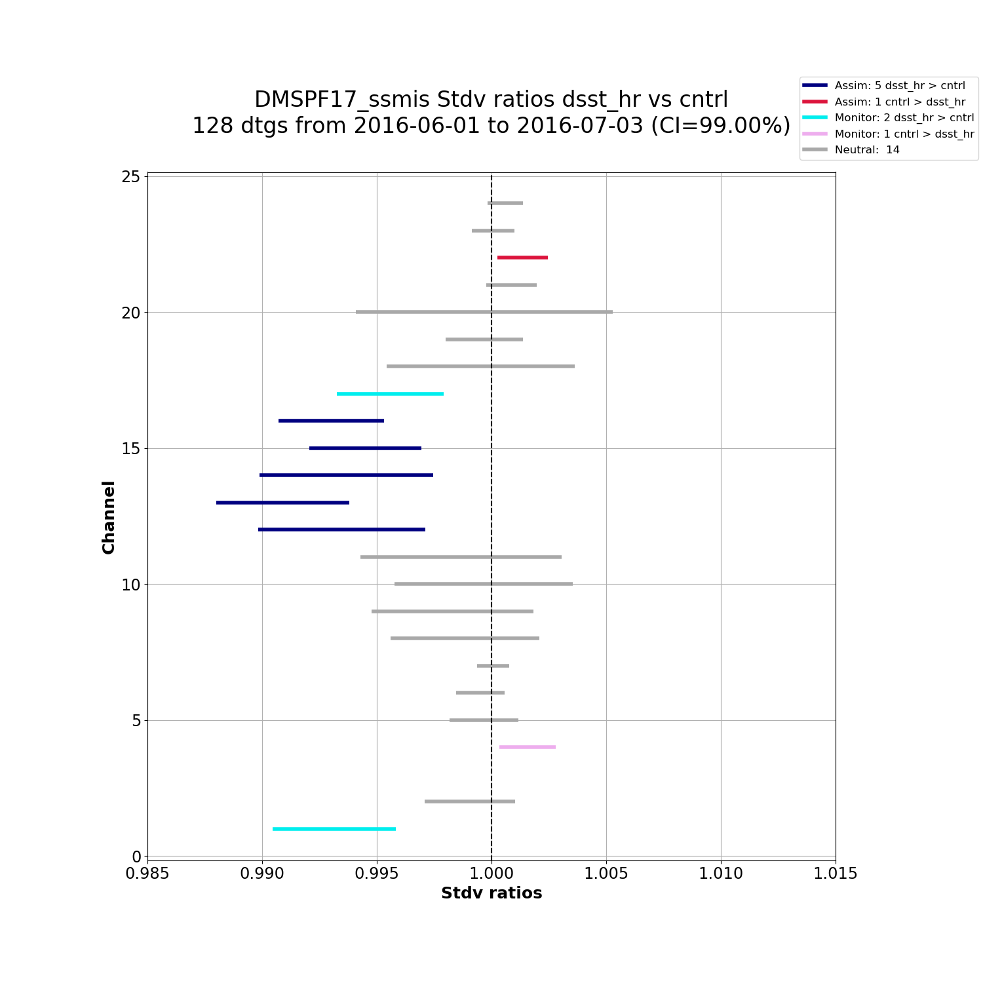
SSMIS Example
Strat Temp
Scattering
Water vapor
Surface
Water vapor
Scattering
Trop Temp
Notes:
The x-axis is the ratio of innovation standard deviations, experiment / control; the y-axis is channel number
Horizontal bars are 99% confidence intervals around the sample mean ratio
Blue/cyan bars are all to the left of 1.0, indicating that the experiment was better than the control
Red/magenta bars are all to the right of 1.0, indicating that the control was better than the experiment
Gray bars always include 1.0, and are neutral
Blue/red are assimilated channels; cyan/magenta are monitored
Satellite, instrument, channel group, range of dates are in the plot title

Slide 7
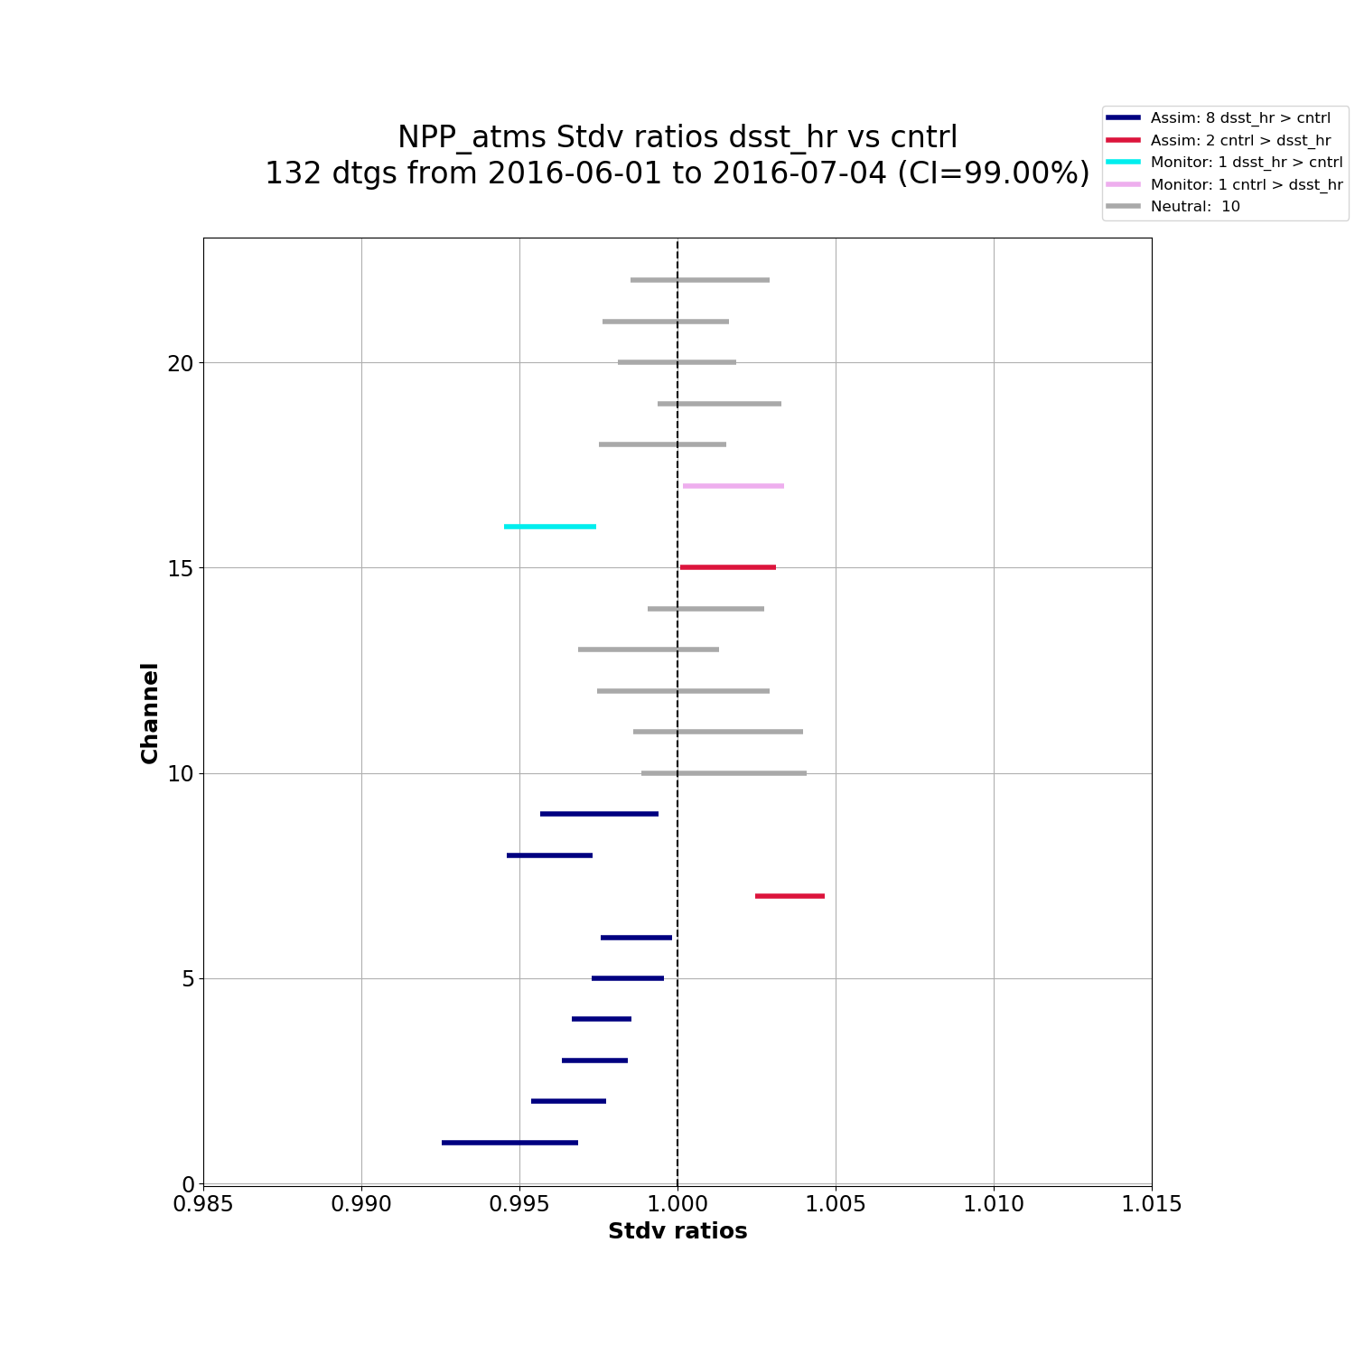
ATMS Example
Water vapor
Scattering
Strat Temp
Trop Temp
Water vapor

Slide 8
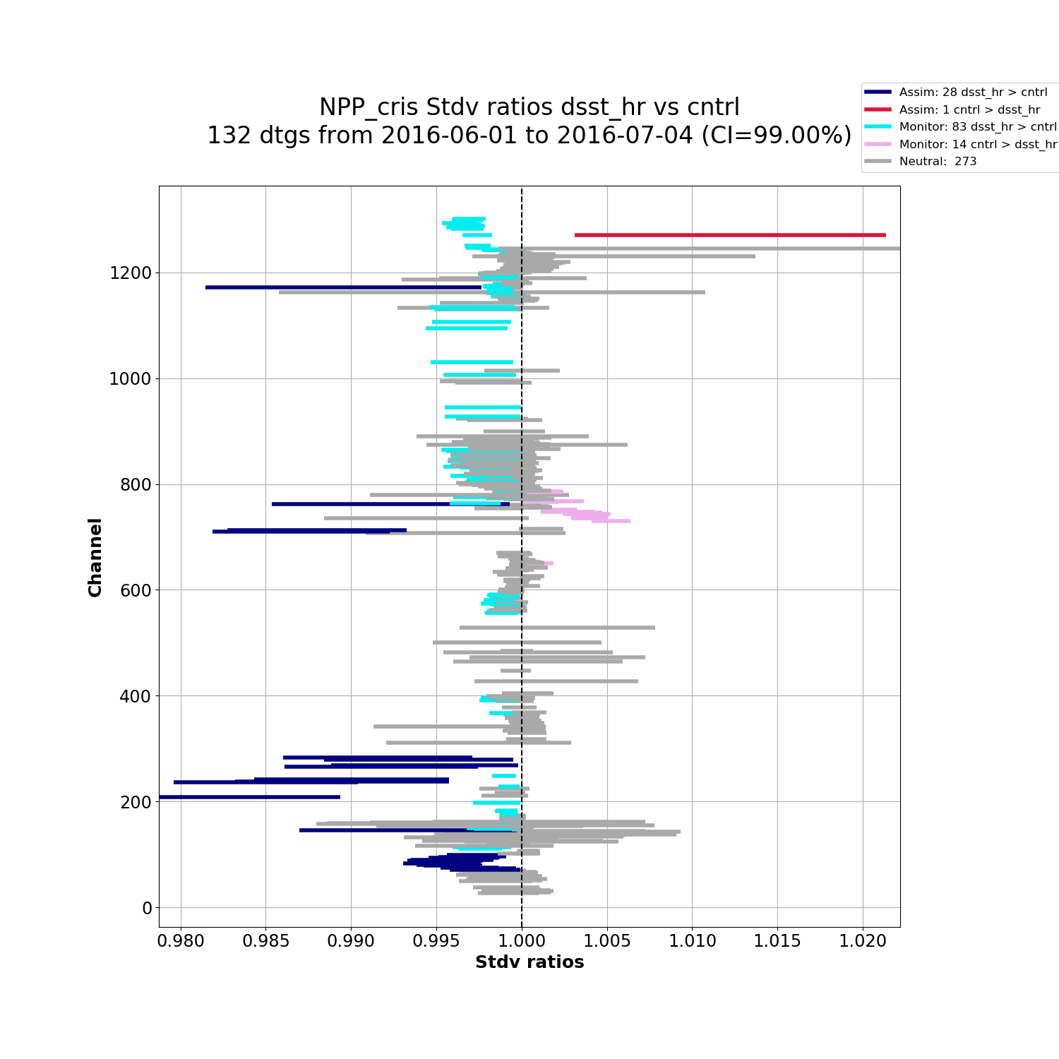
CrIS Example
SW Trop Temp
Water vapor
Ozone
Surface
Trop Temp
Strat Temp

Slide 9
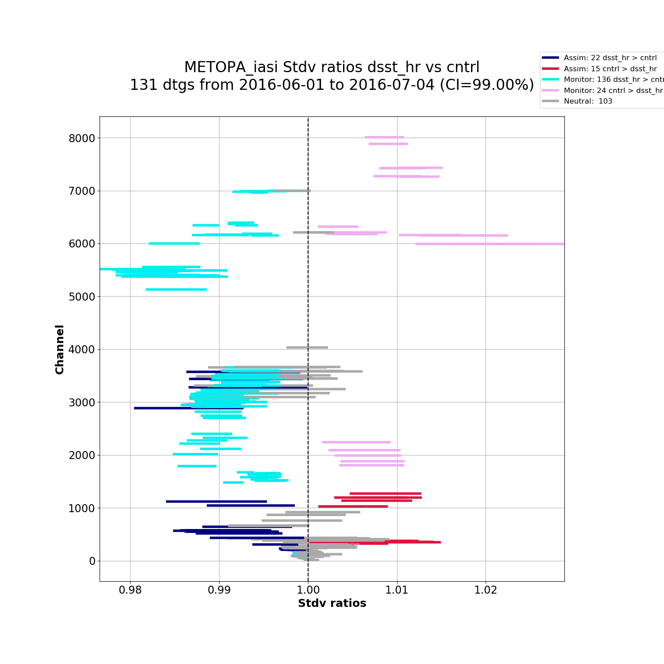
IASI Example
SW Trop Temp
Water vapor
Ozone
Surface
Trop Temp
Strat Temp

Slide 10
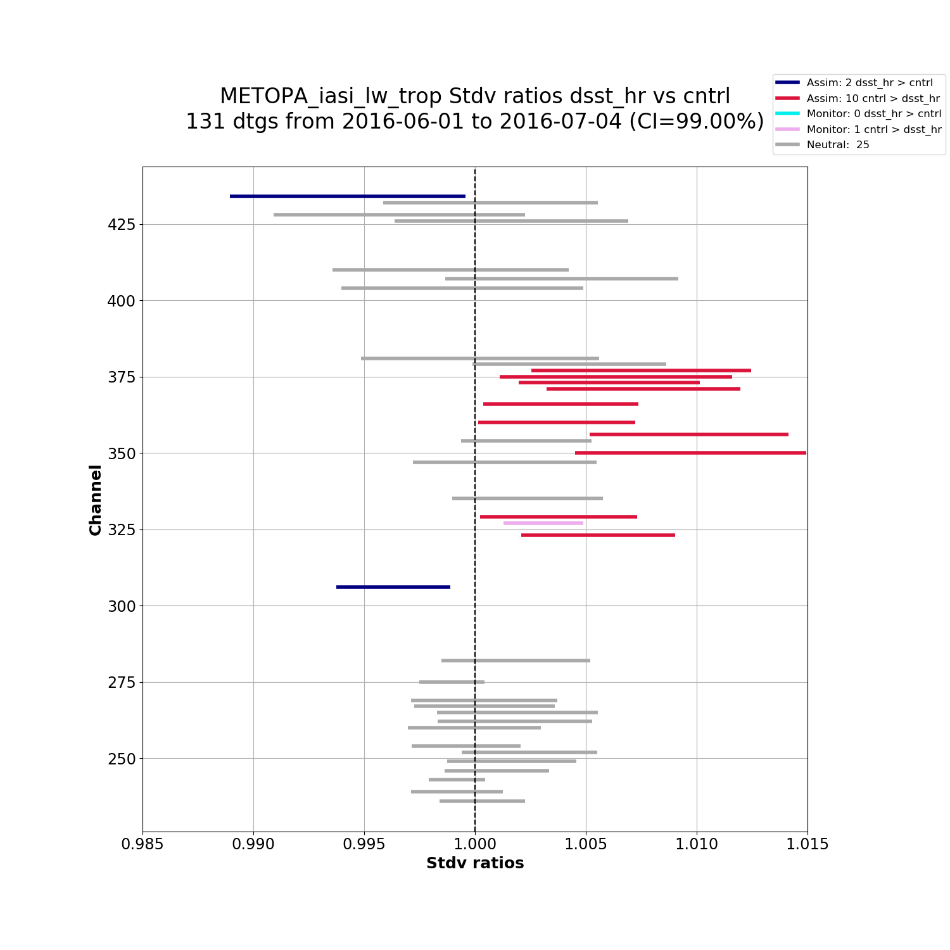
IASI Trop Temp
Trop Temp

Slide 11
Fit to Obs Scorecard
A scorecard can provide summary guidance as to whether enough evidence has been gathered to favor the experiment over the control or v.v., or whether not enough data has yet been evaluated to decide between them
As the time series of ratios becomes longer, confidence intervals get shorter, and observations that were neutral will eventually* show either a win or a loss
We can do this for individual observations, physically sensible groups of observations, and all observations aggregated together
For groups of observations, we chose a conservative criterion for declaring a group win: If number of individual wins exceeds the sum of losses and ties, we declare a group win; if number of individual losses exceed the sum of wins and ties, we declare a group loss; otherwise a group tie
* Assumes statistical stationarity, which may not be true. Some side effects may occur. Consult your doctor(ate) before using the scorecard.

Slide 12
Full Run Sample Scorecard
Cpl_jac_pb0 vs Cntrl
Jun 1 – Aug 31, 2016
Groups
All Channels
Assimilated Channels
All
Ozone
Surface
Strat Temp
Trop Temp
Water vapor

Slide 13
Three Weeks to Predict Win
Cpl_jac_pb0 vs Cntrl
Jun 1 – 23, 2016
Groups
All Channels
Assimilated Channels
All
Ozone
Surface
Strat Temp
Trop Temp
Water vapor

Slide 14
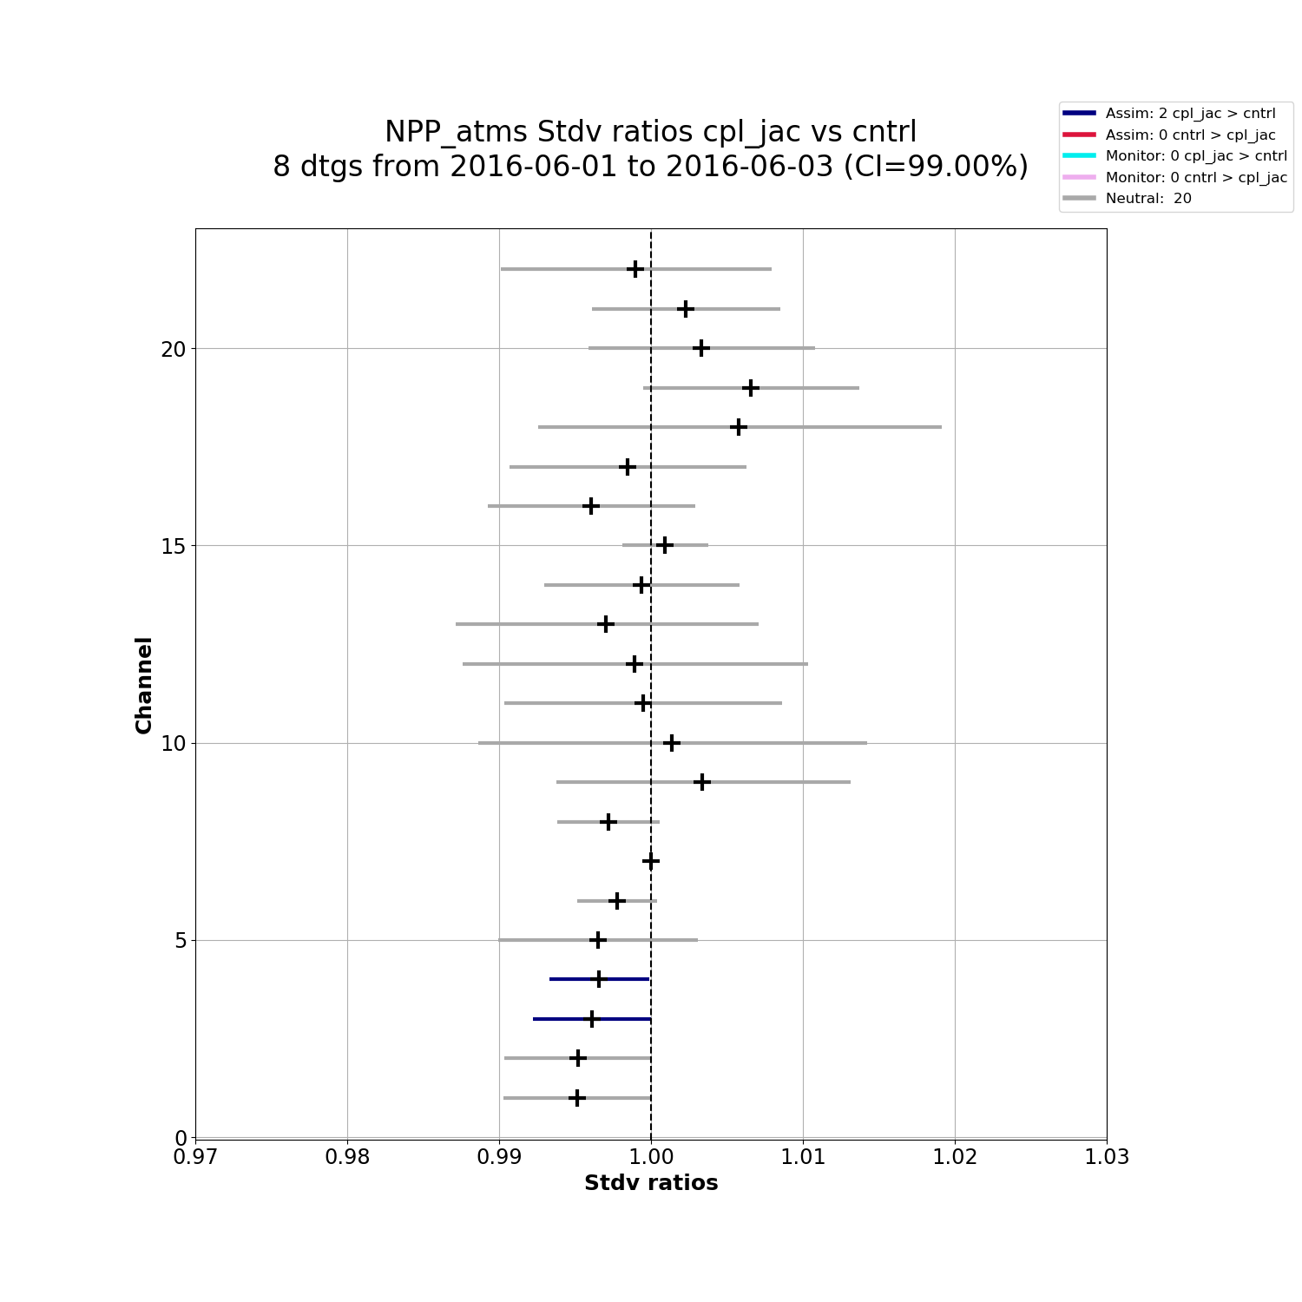
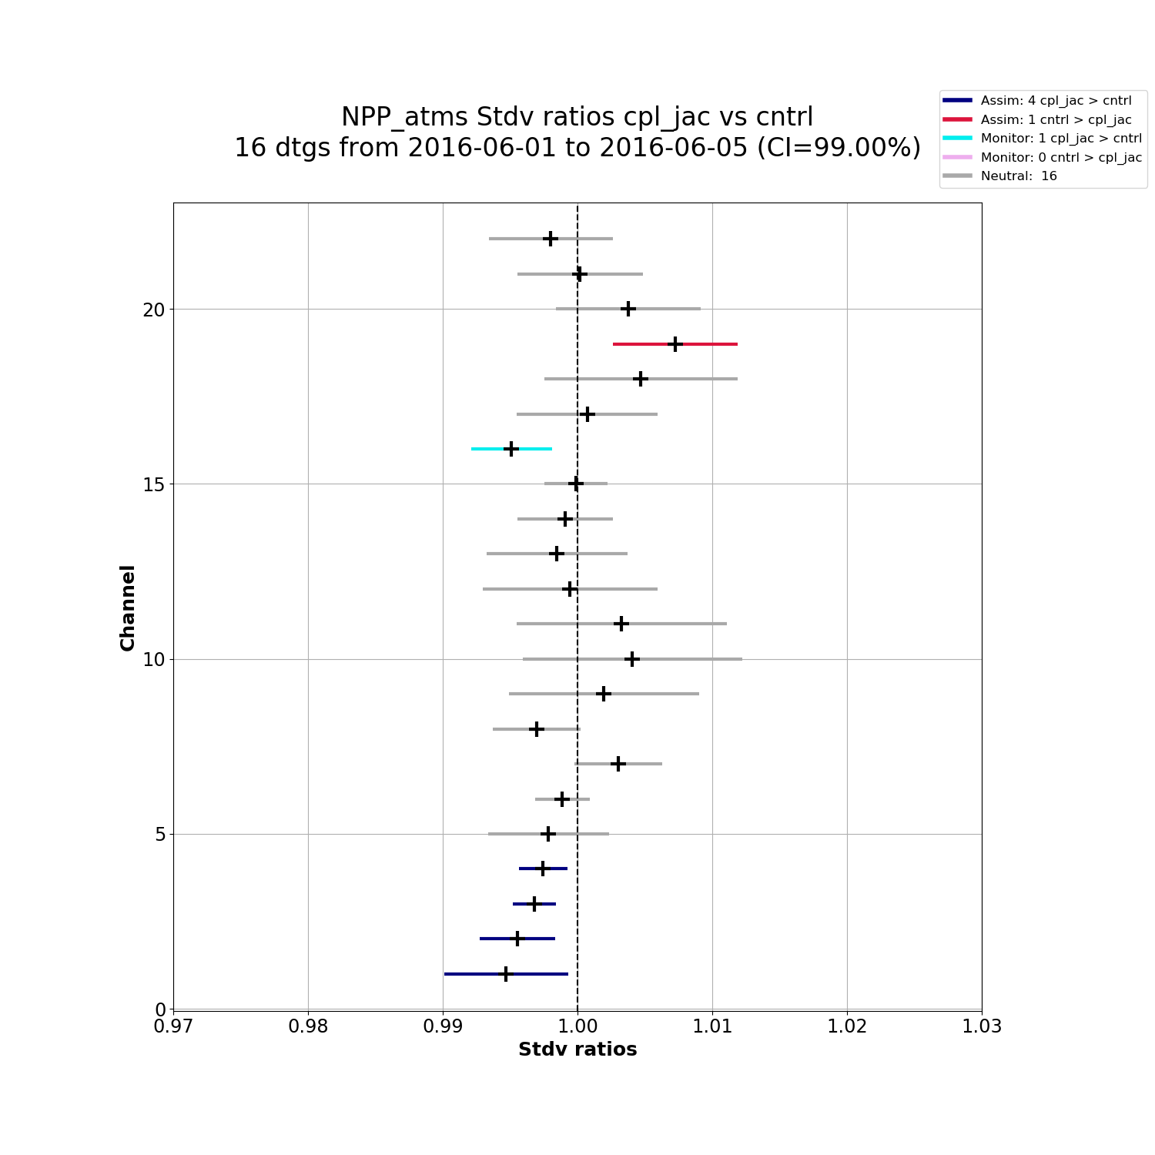
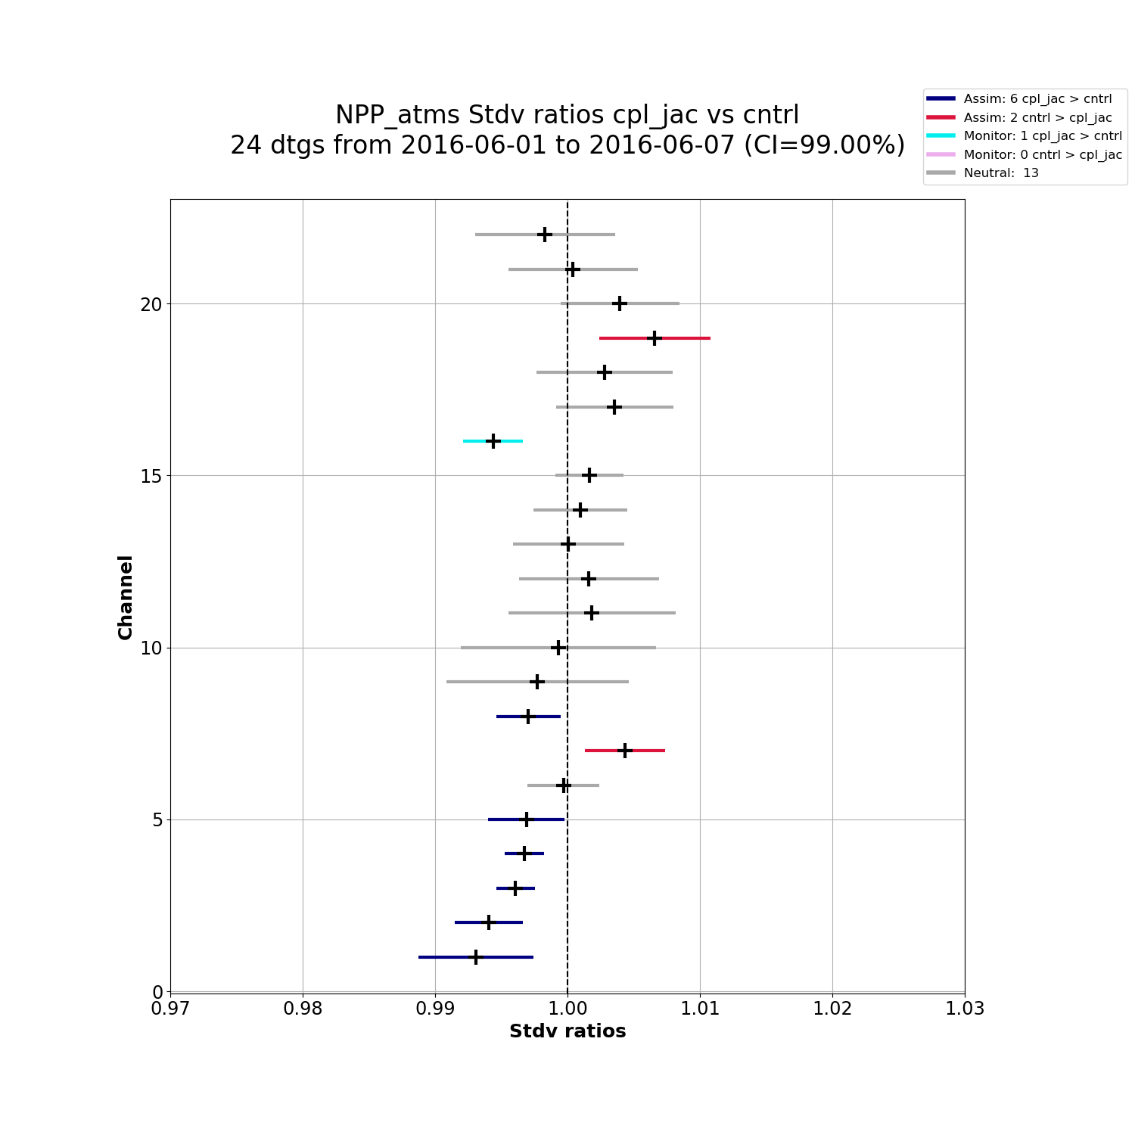
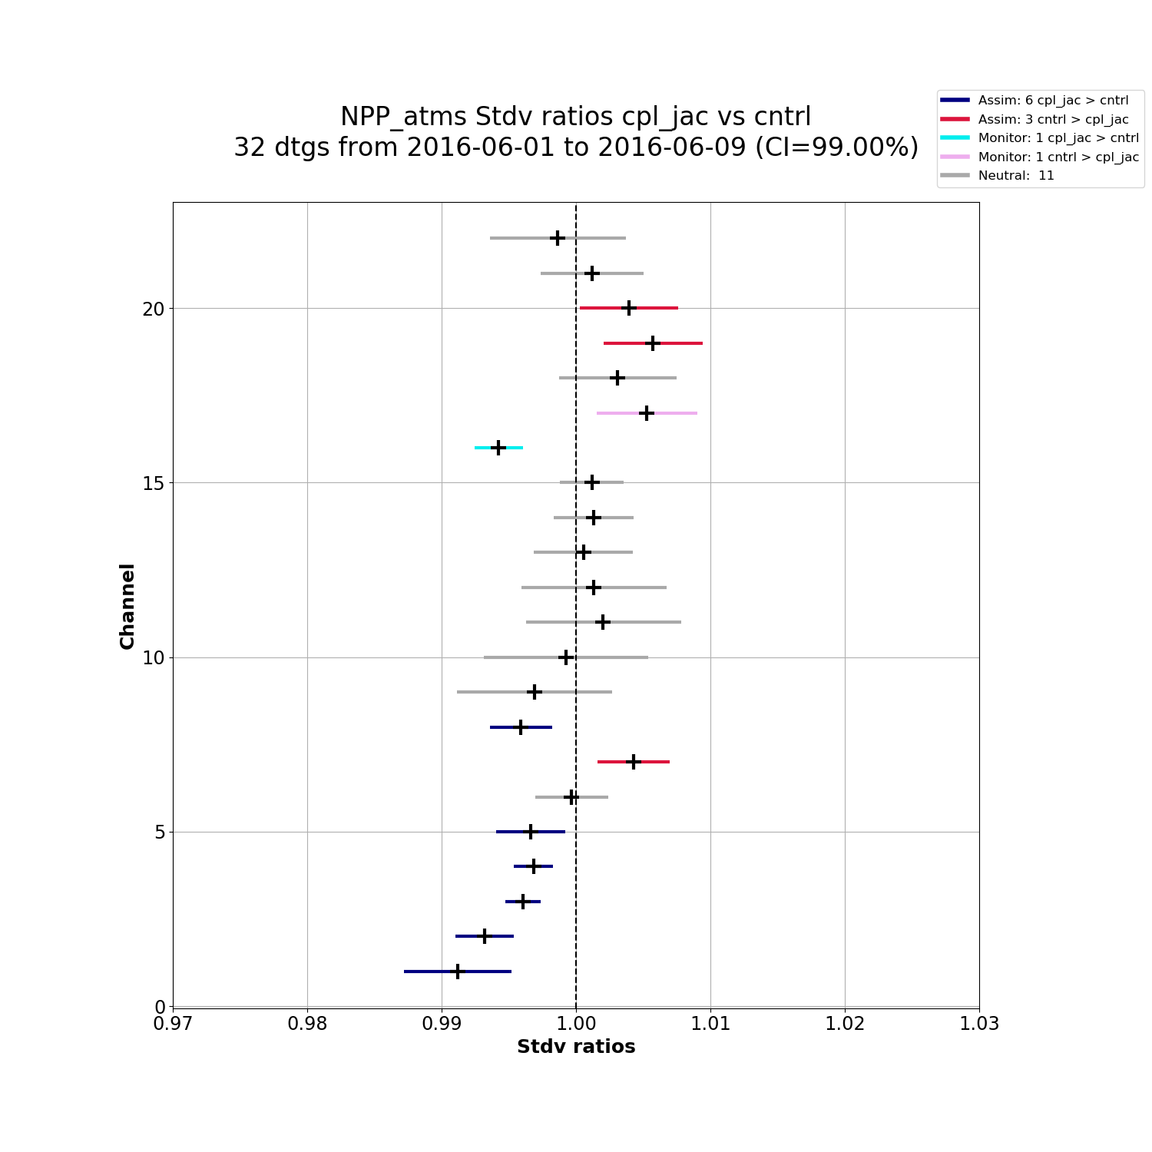
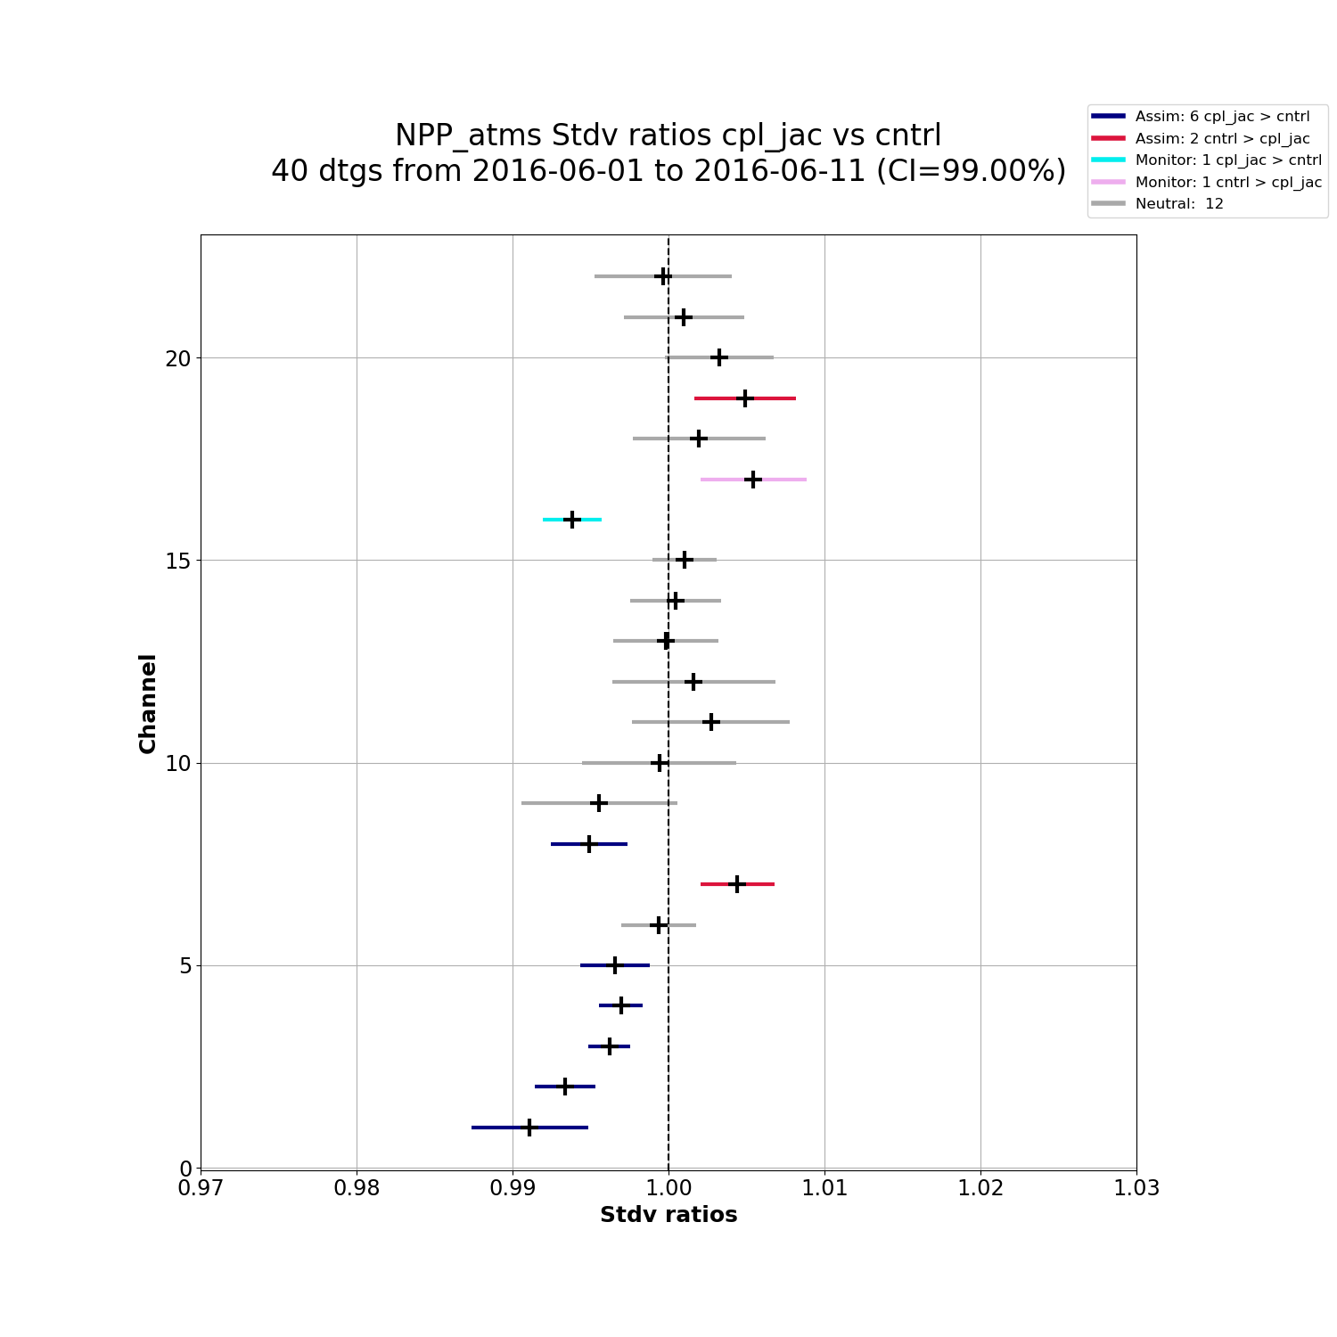
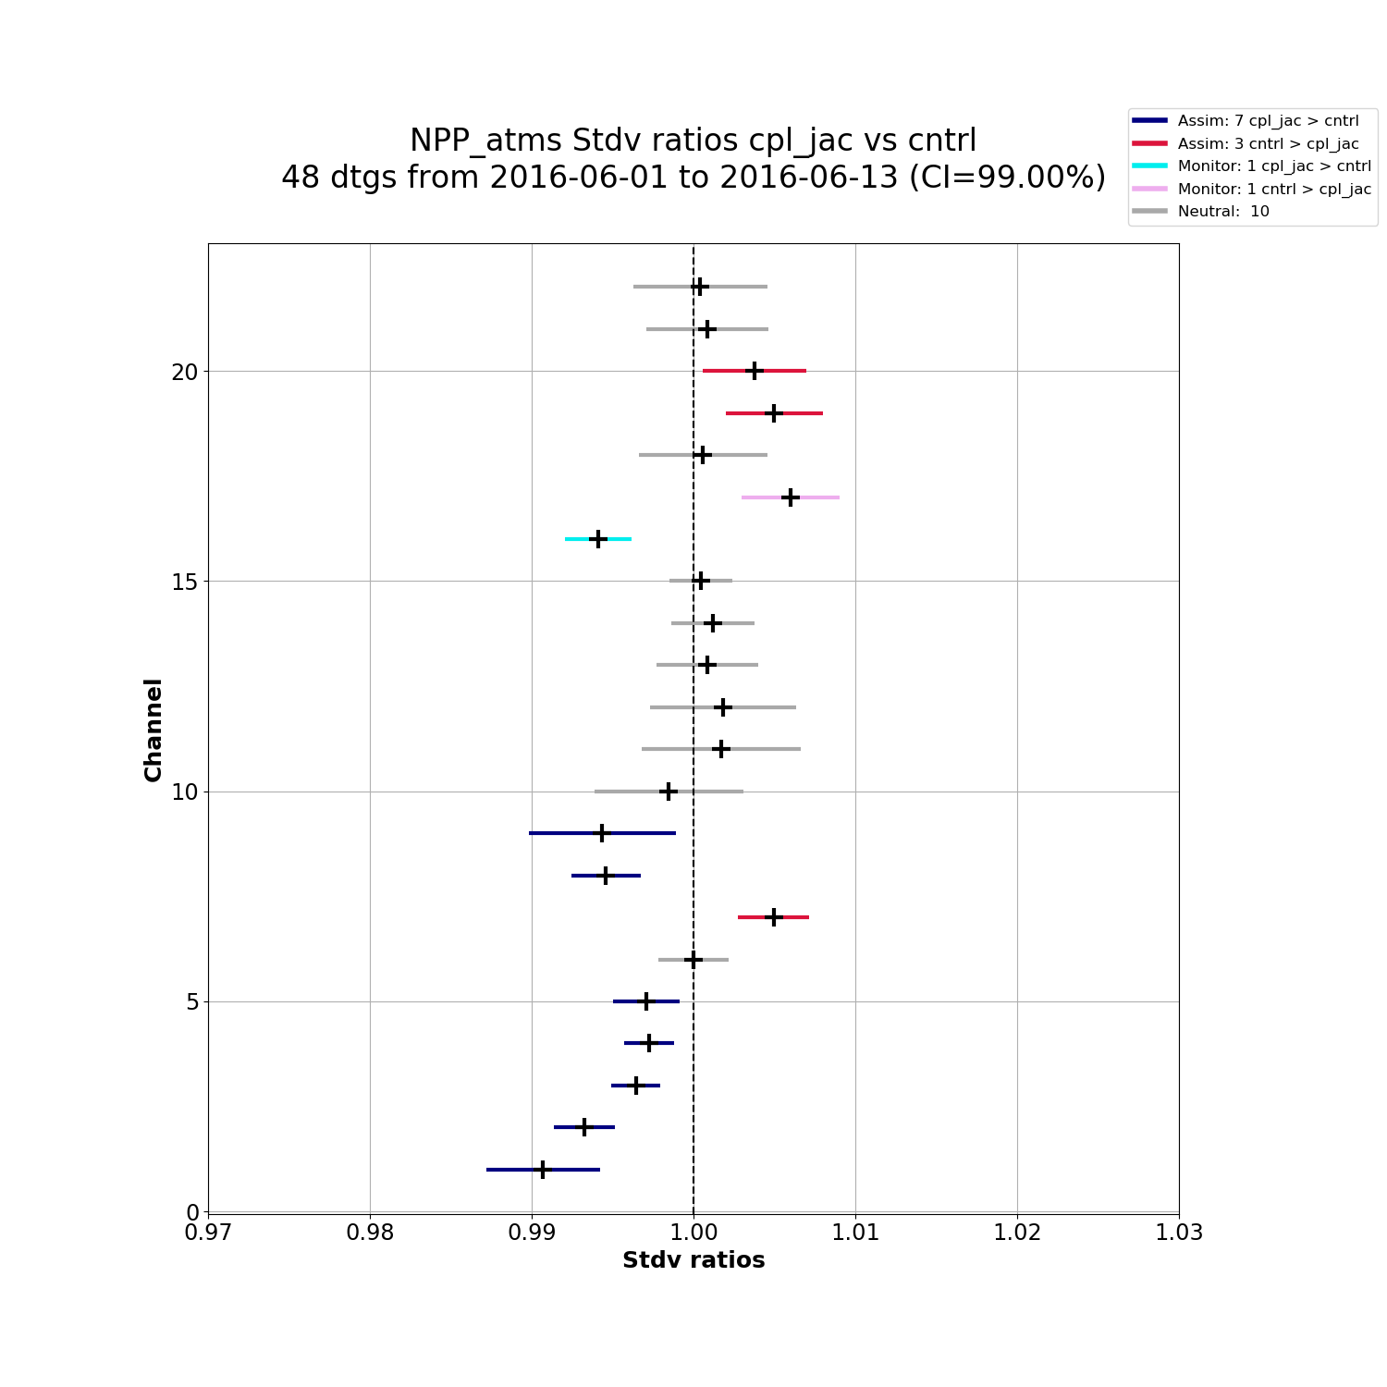
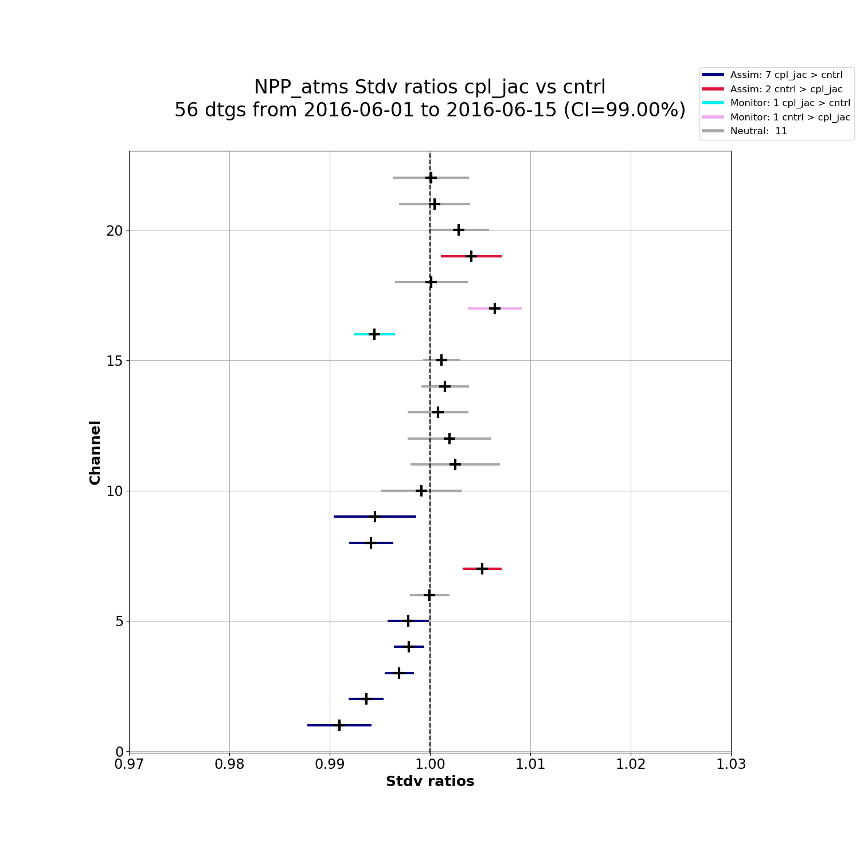
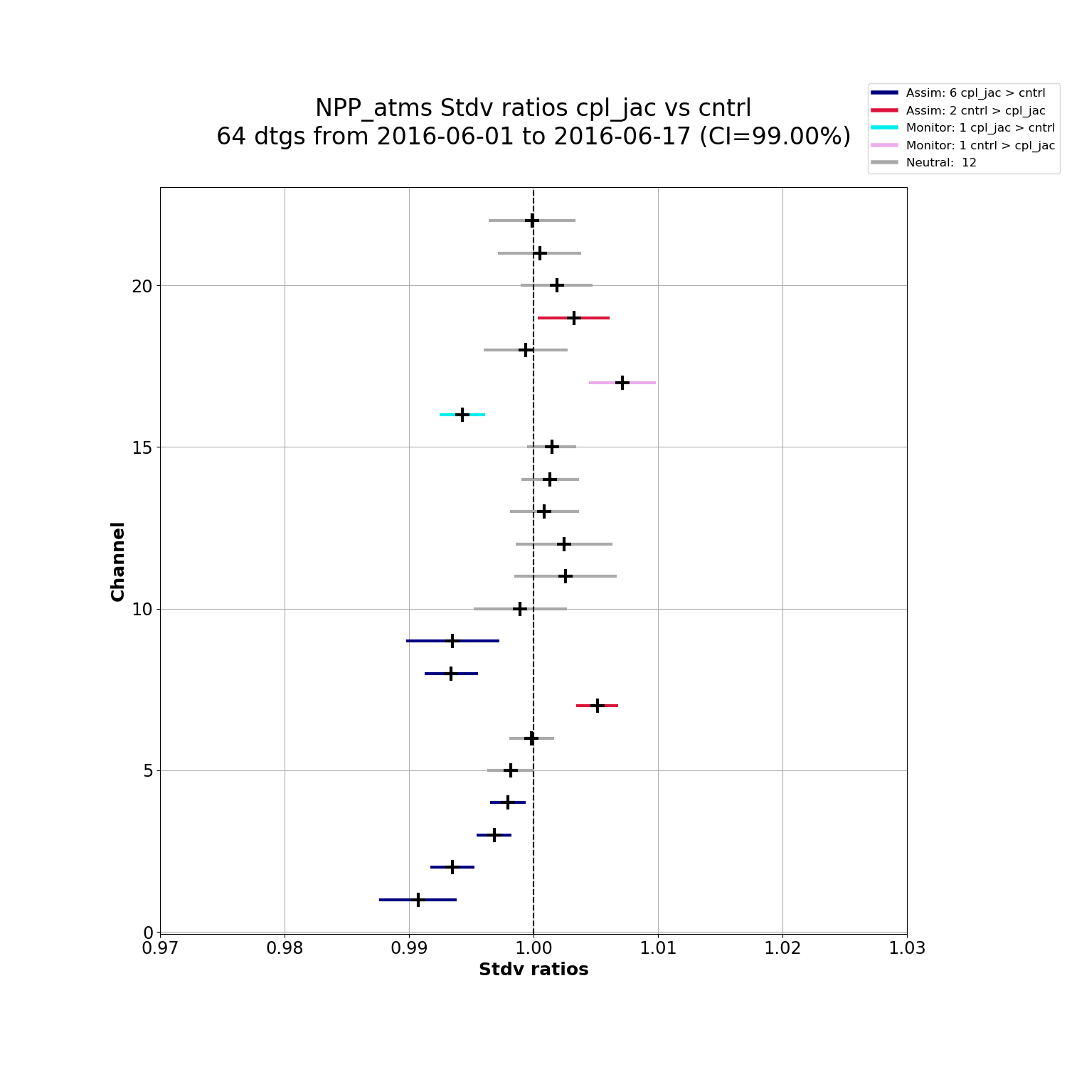

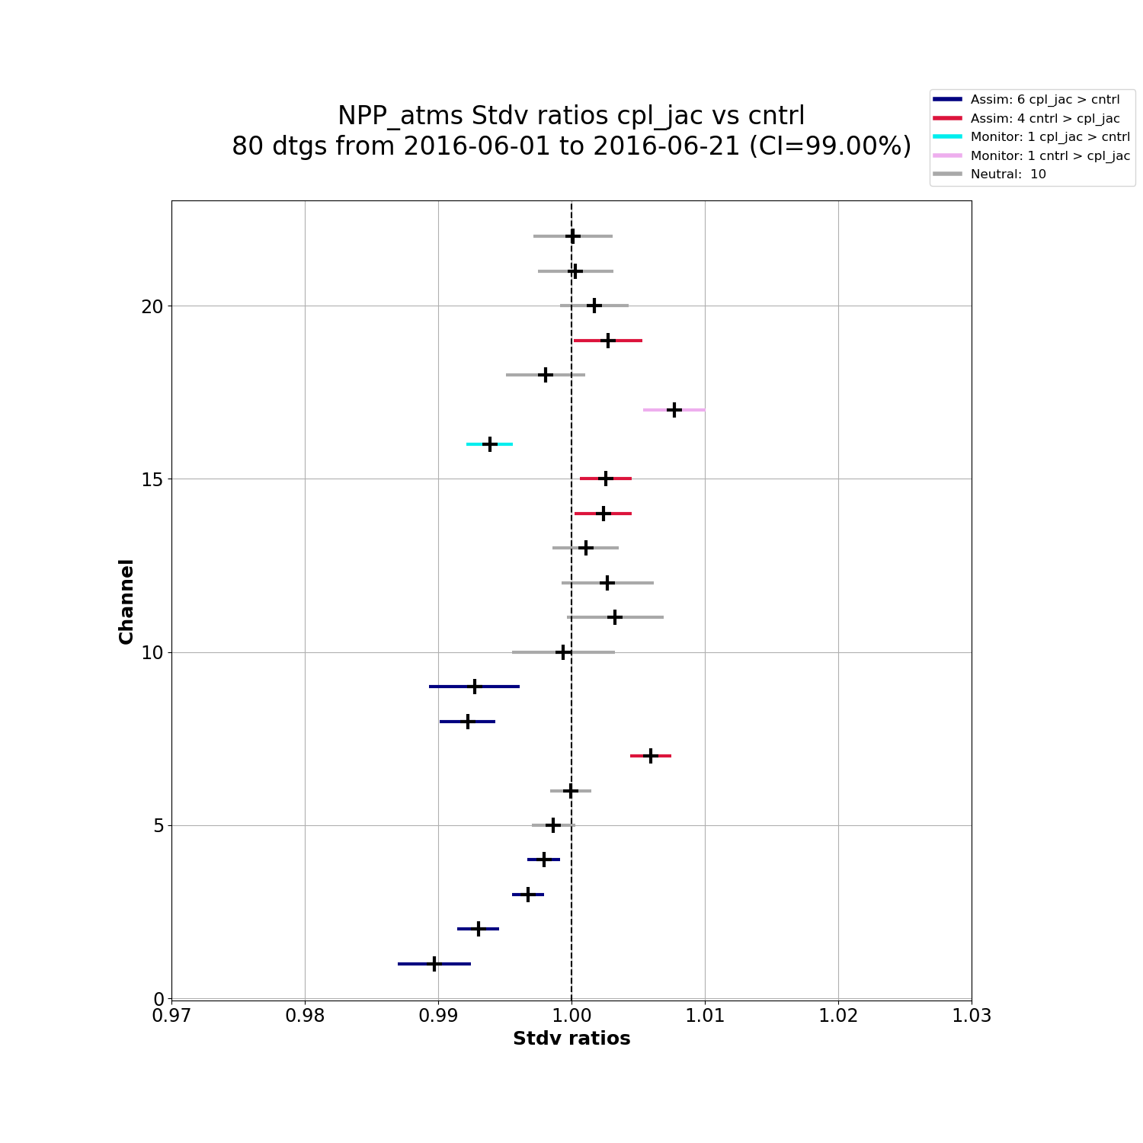
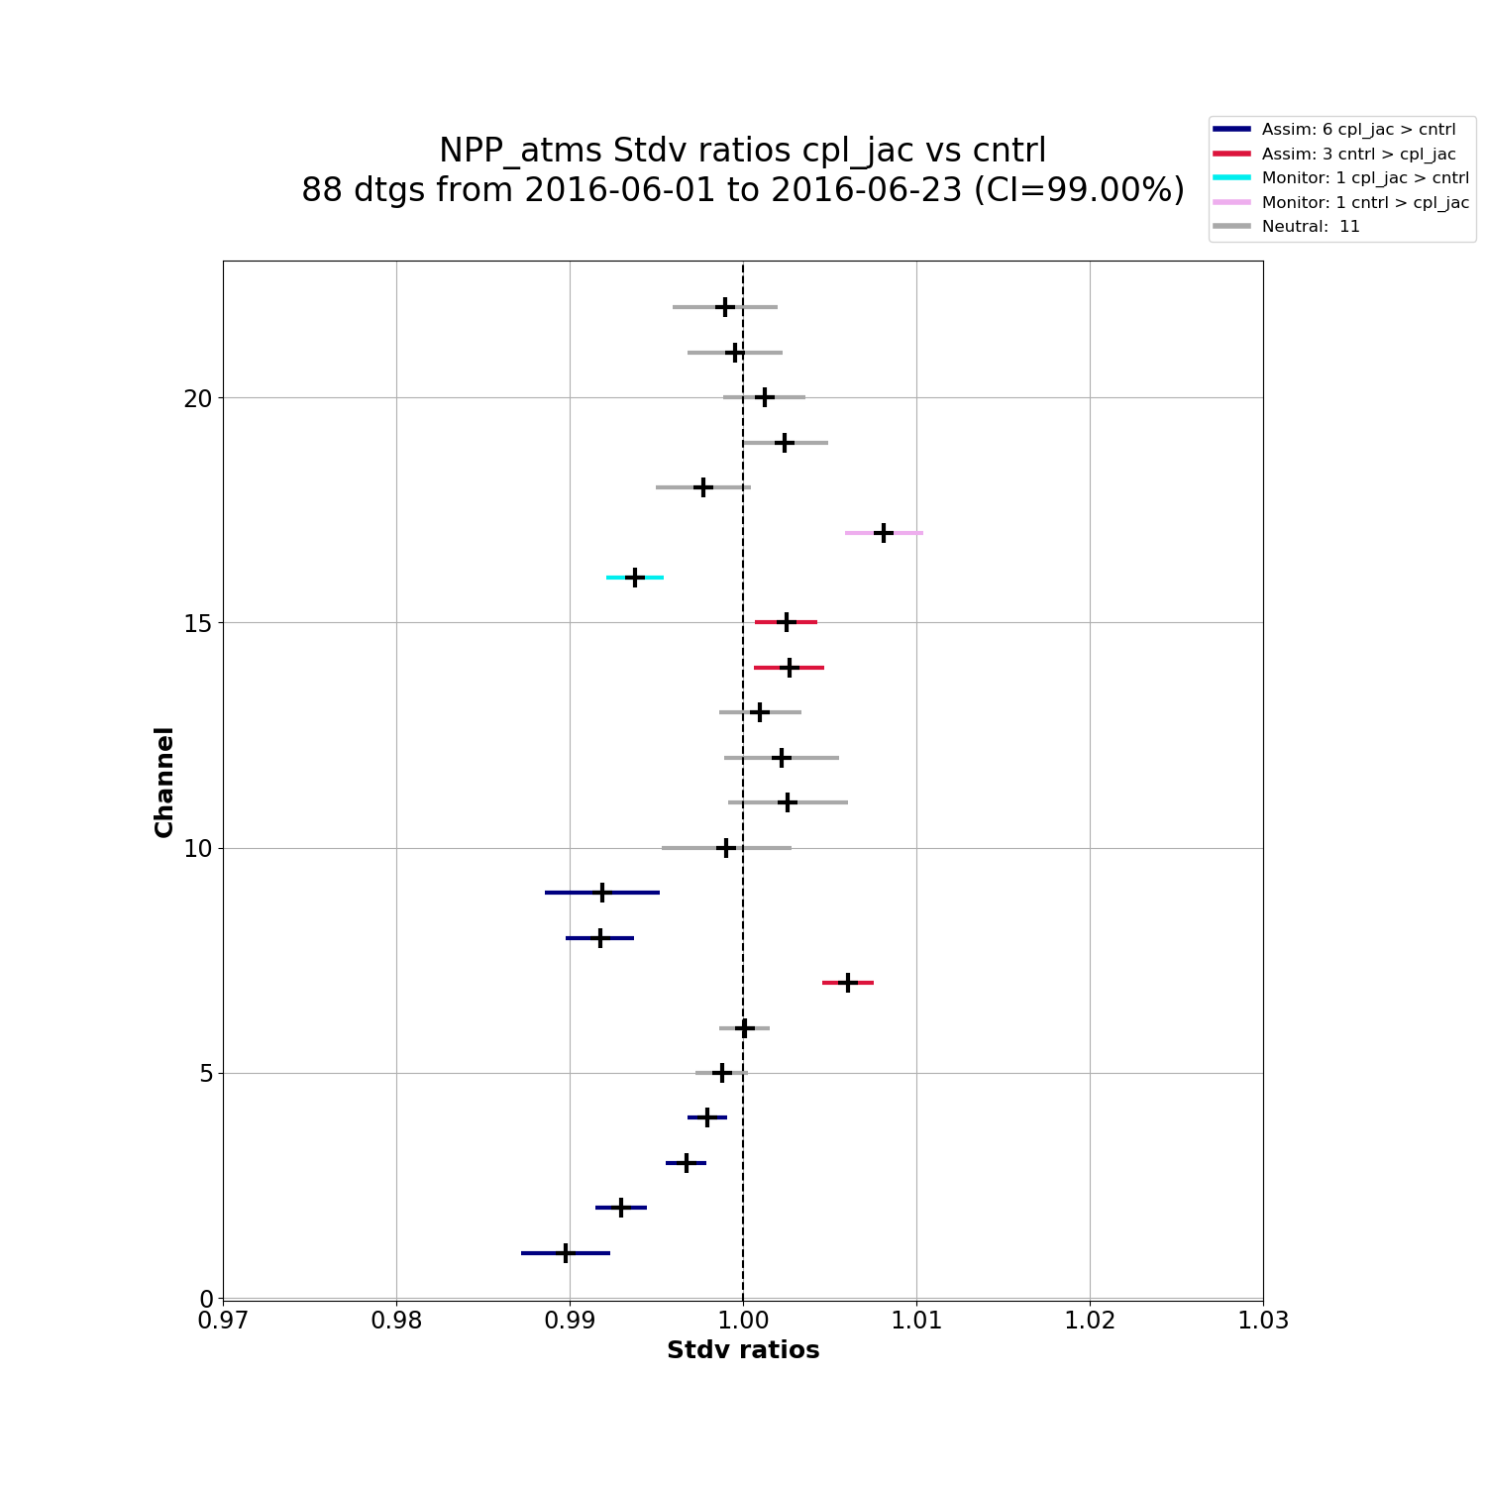
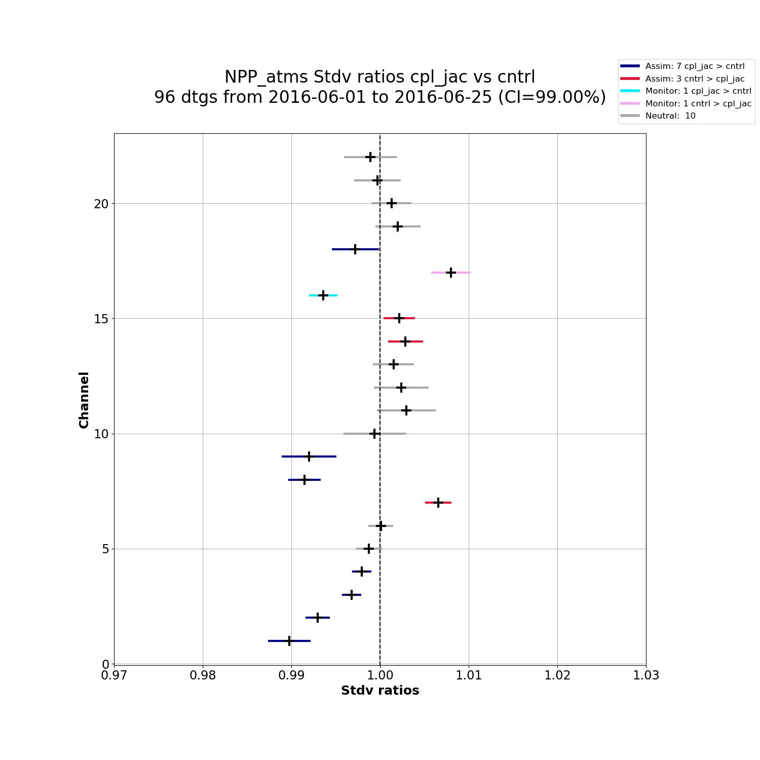
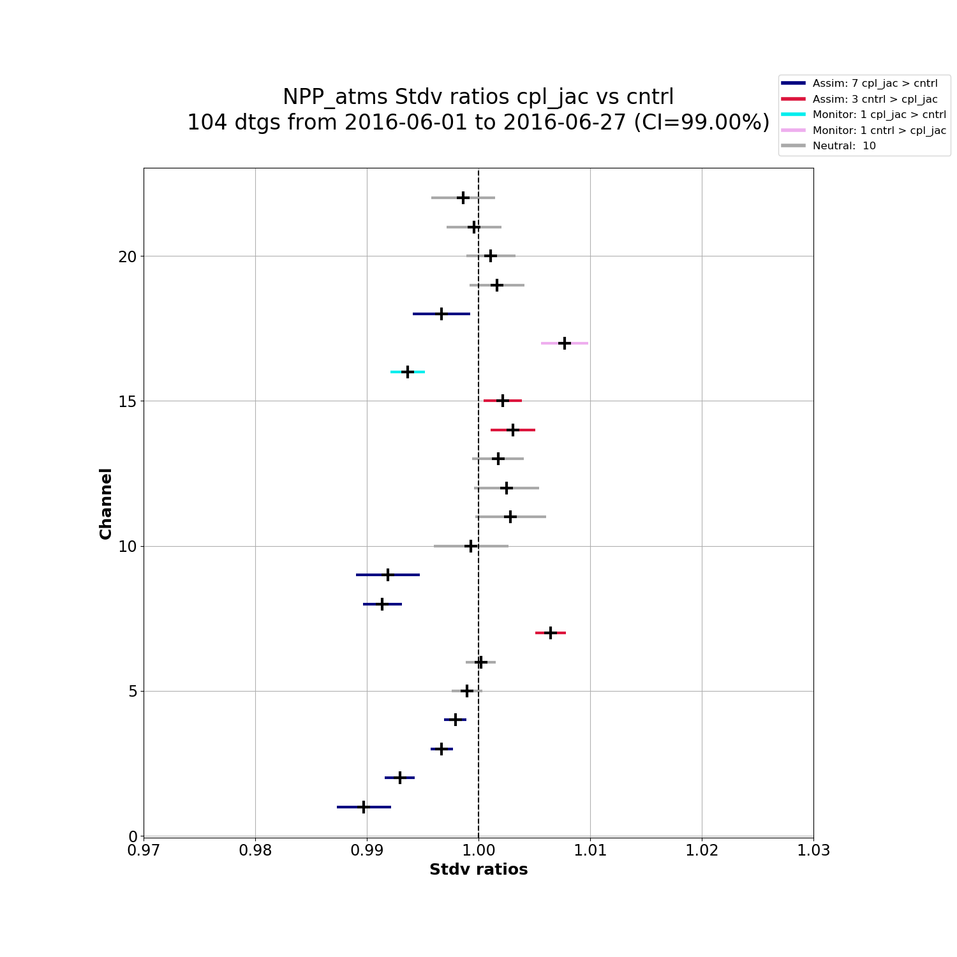
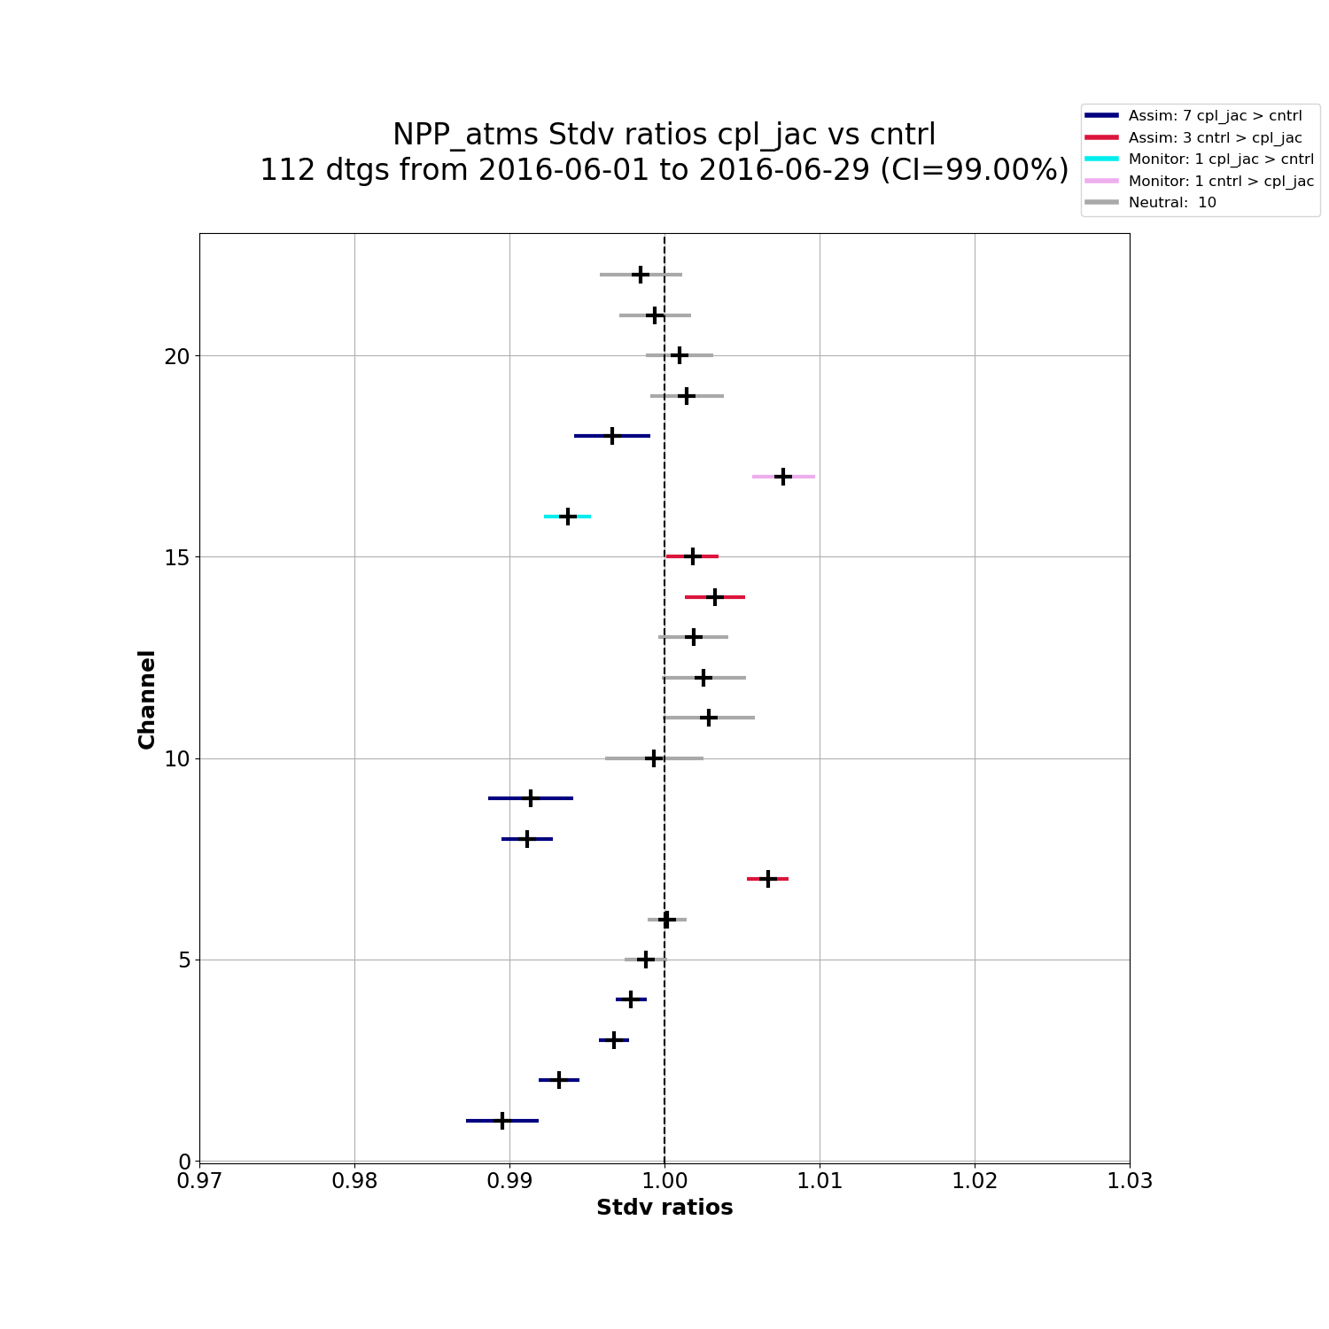
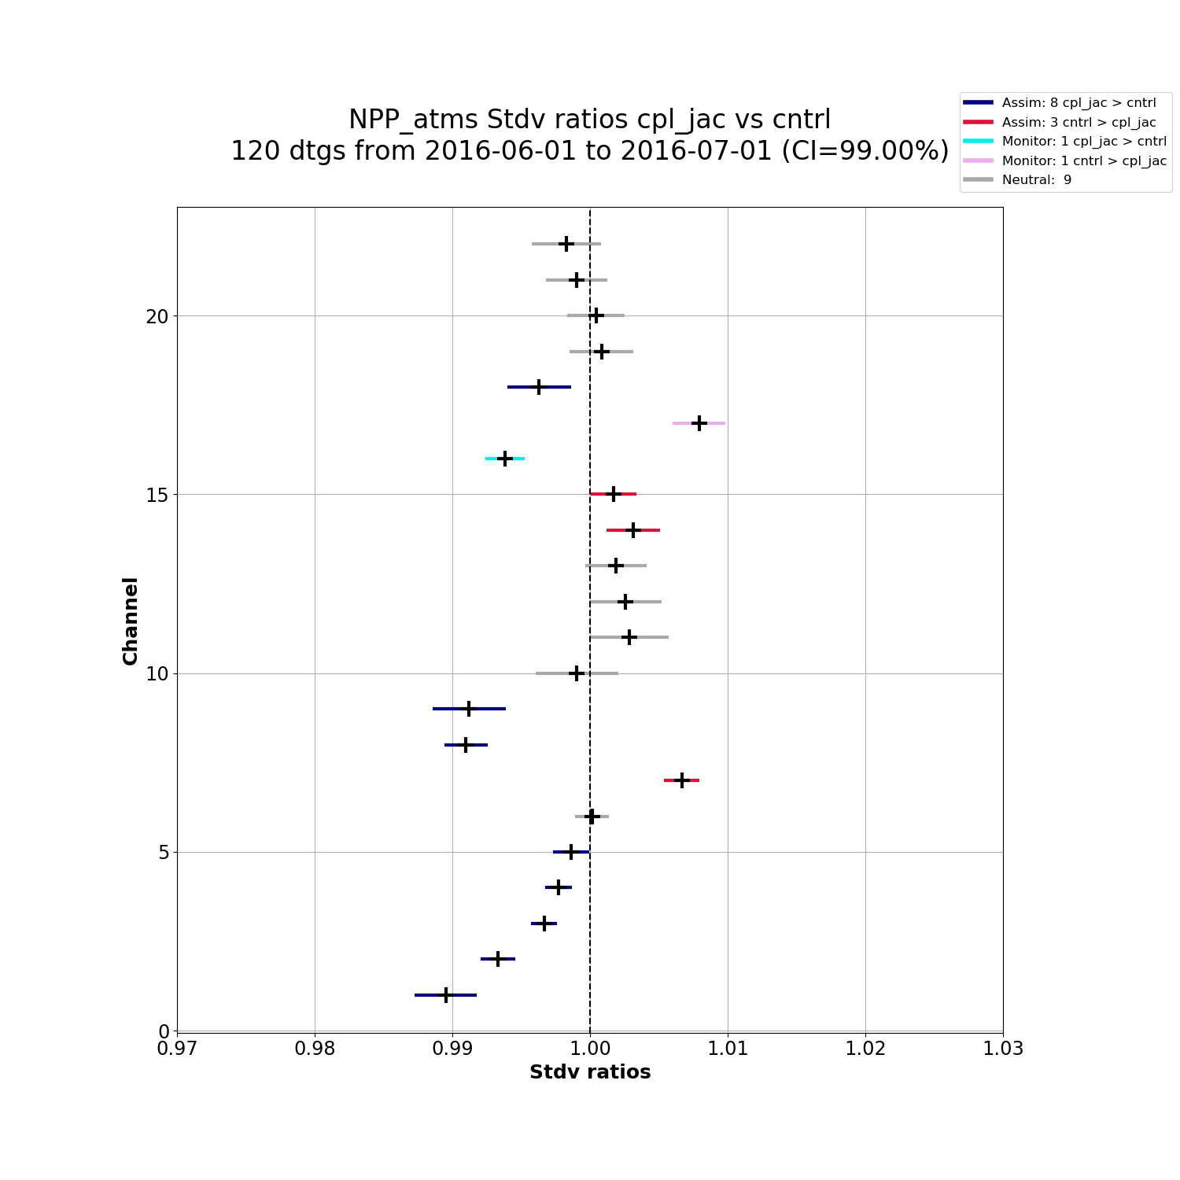
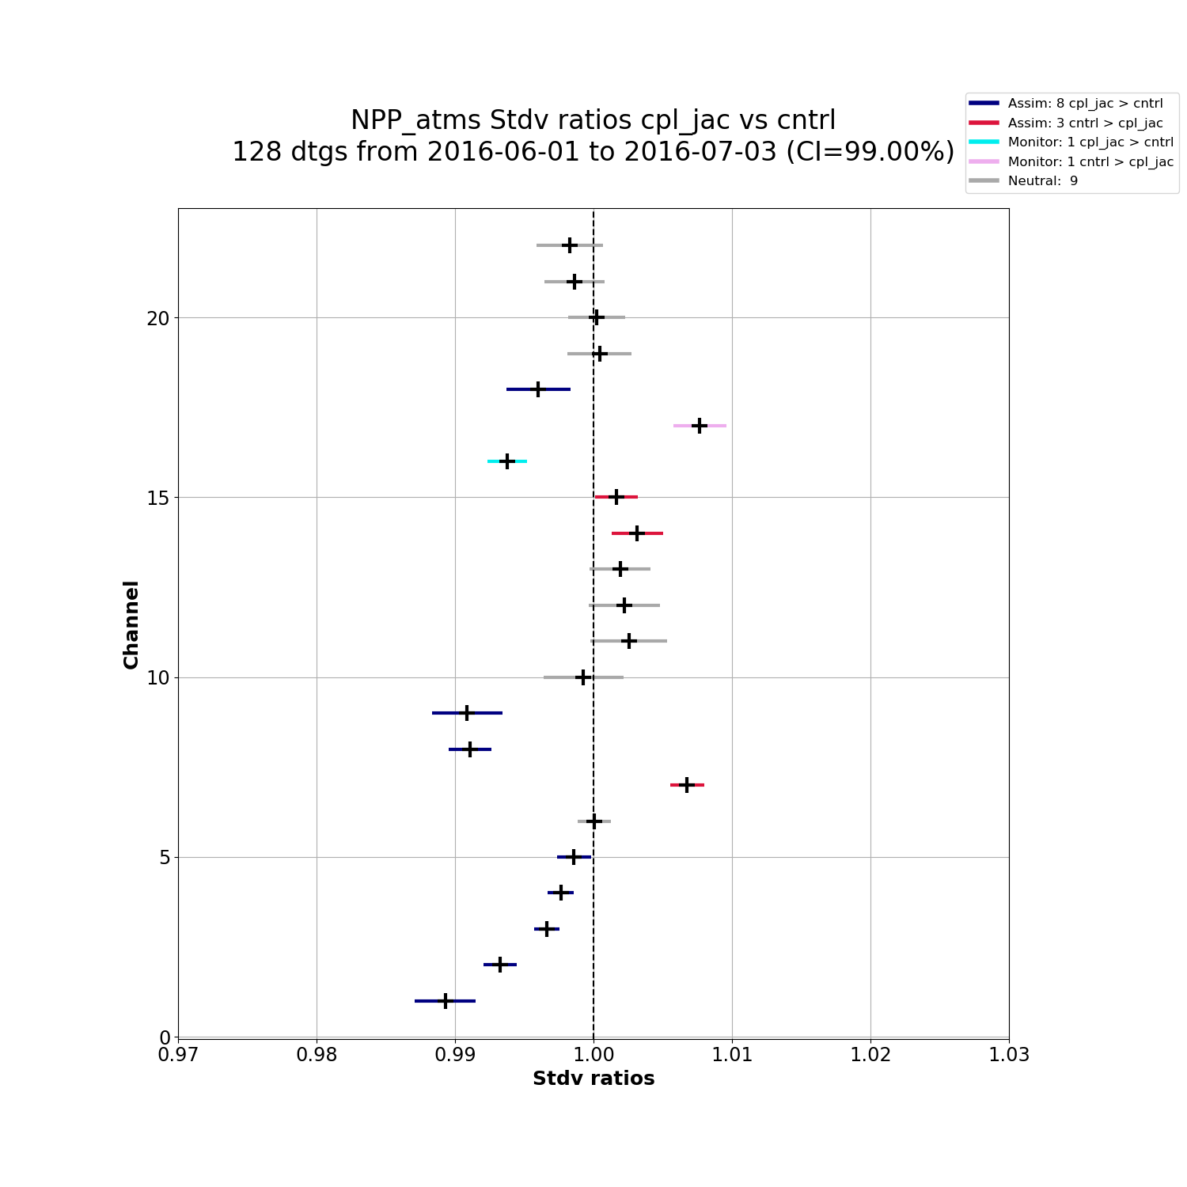
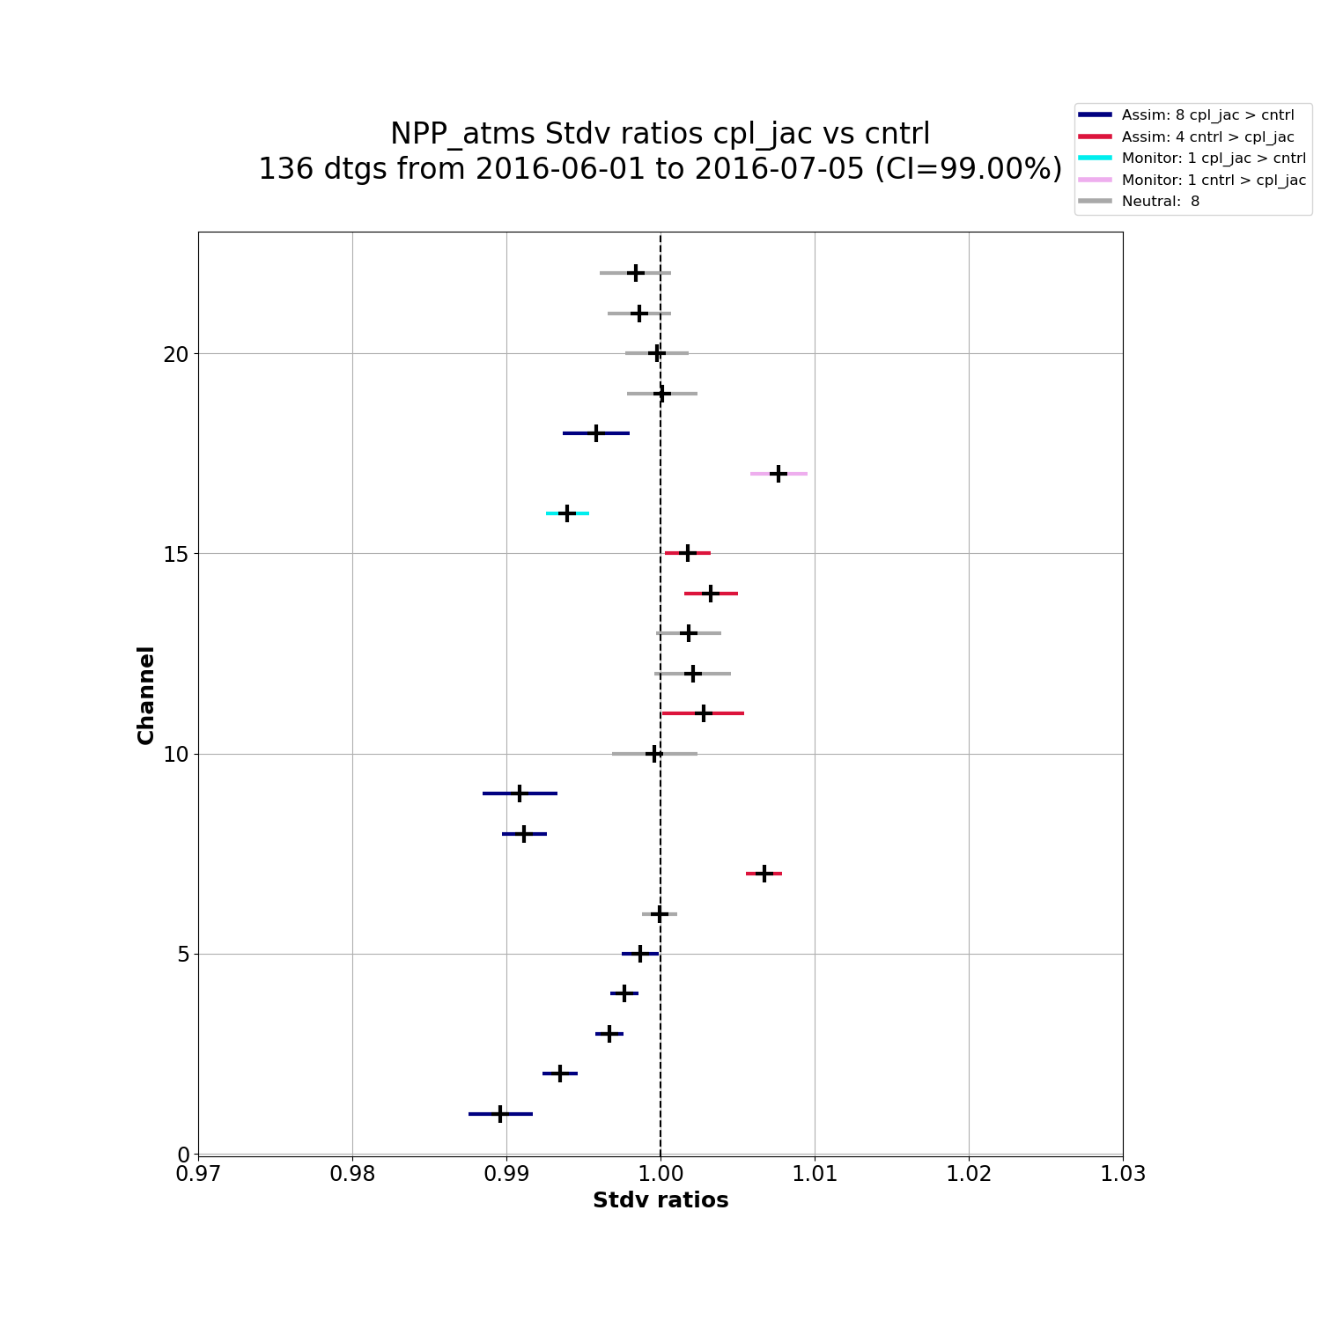
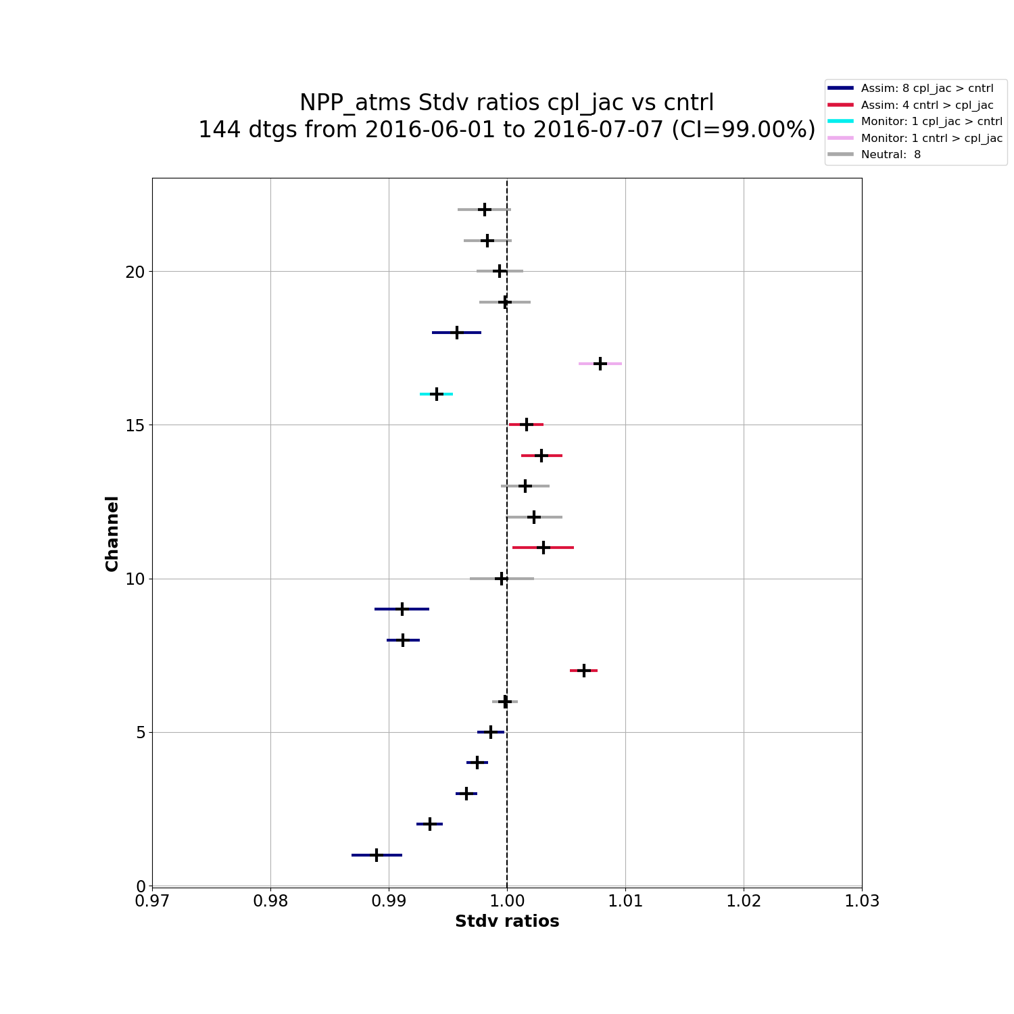
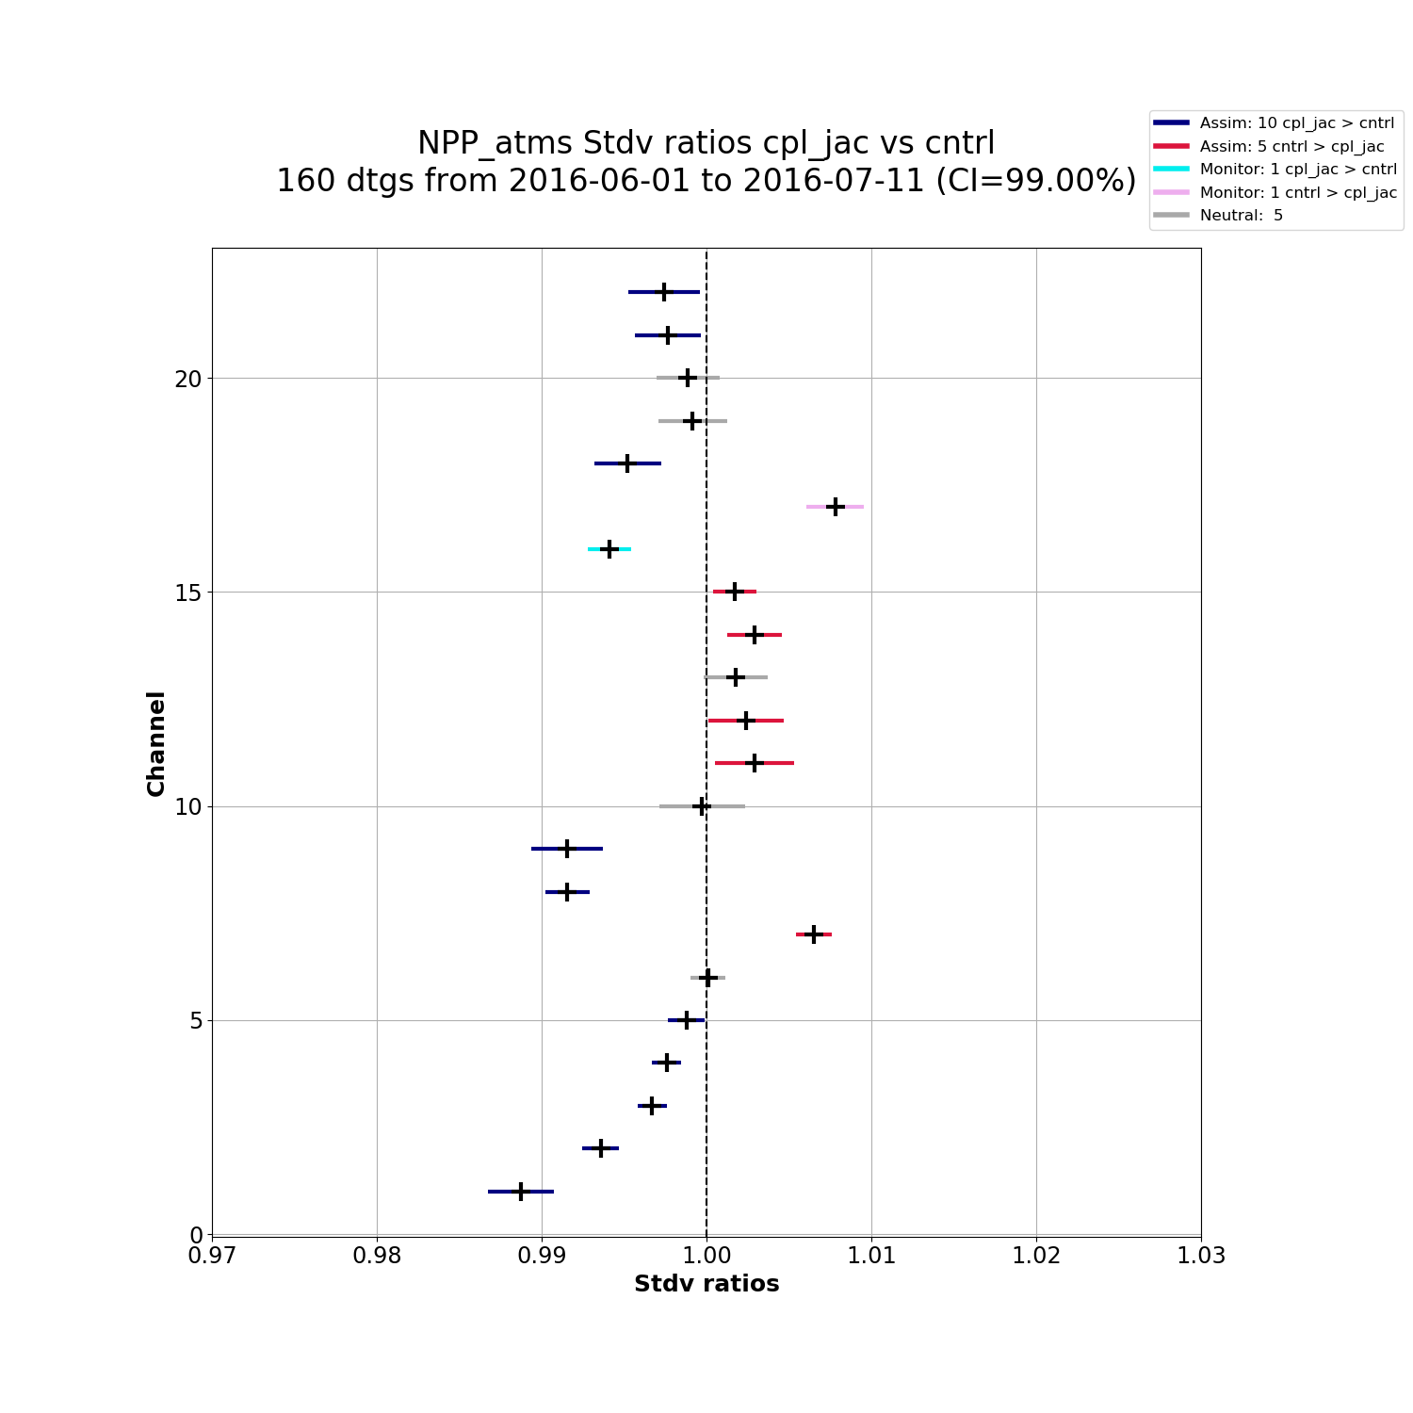
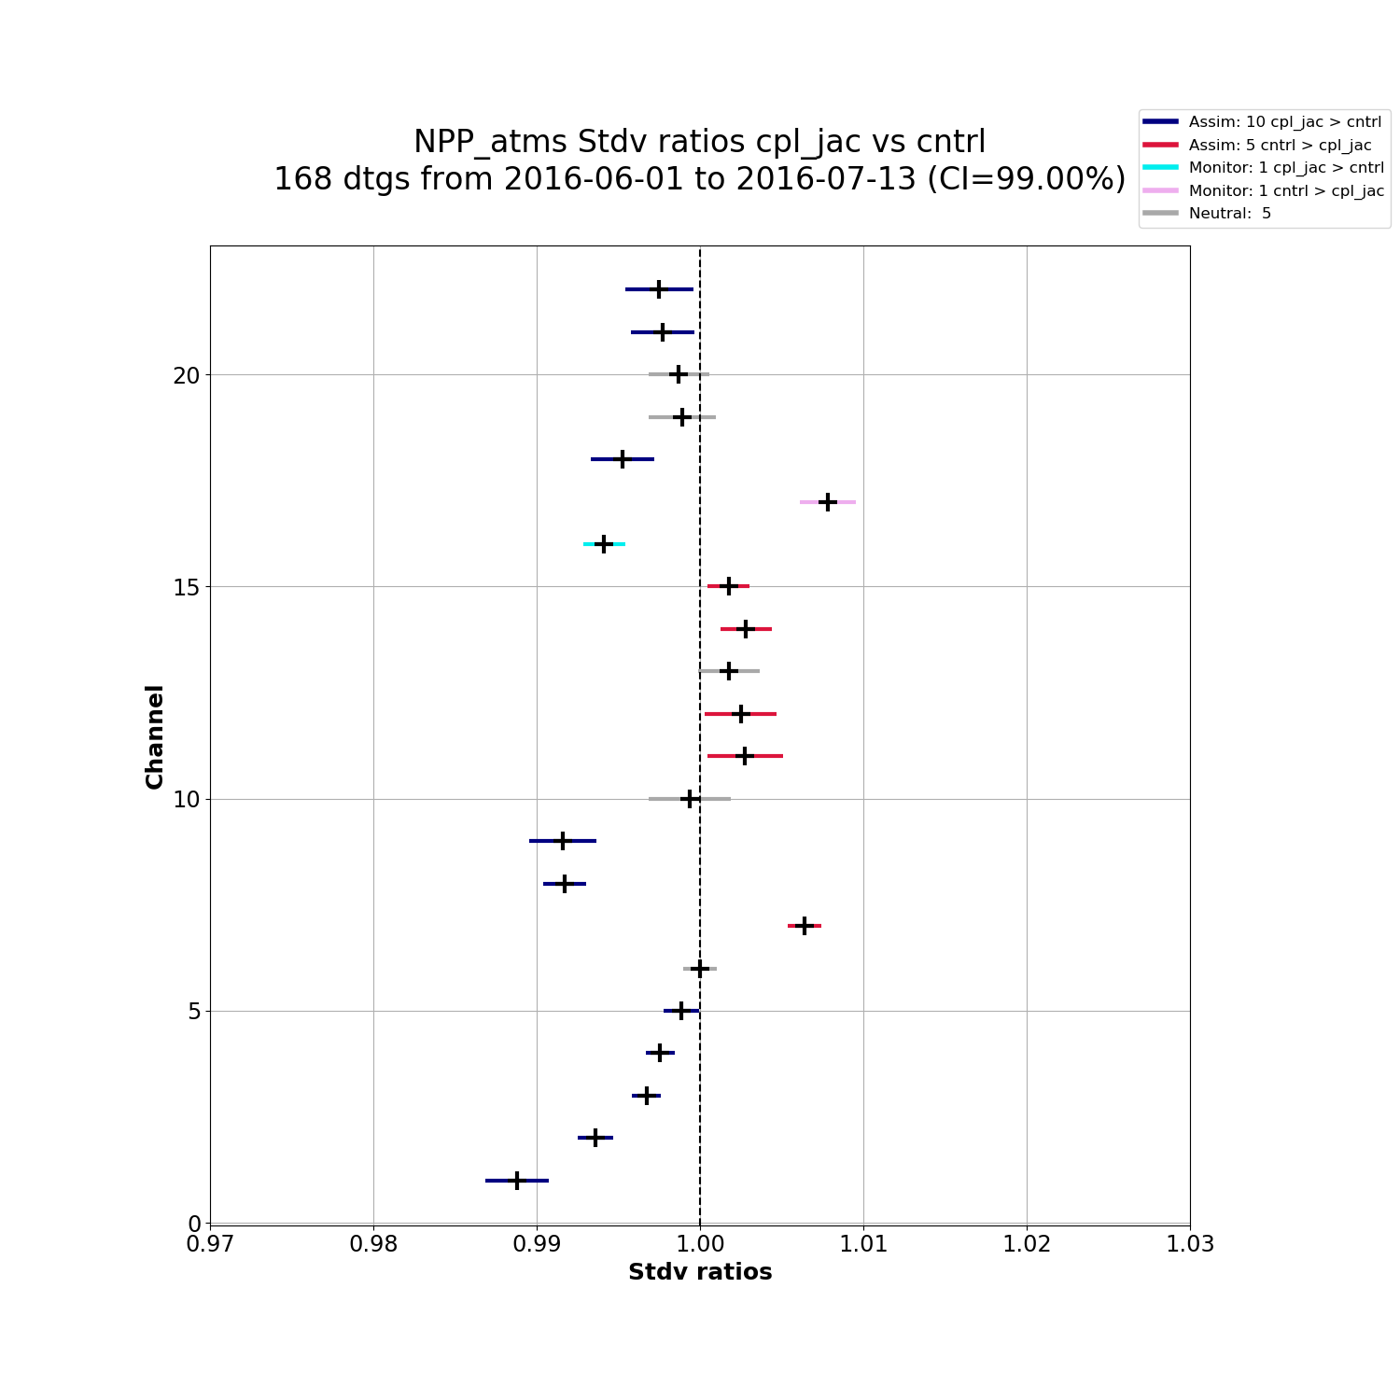


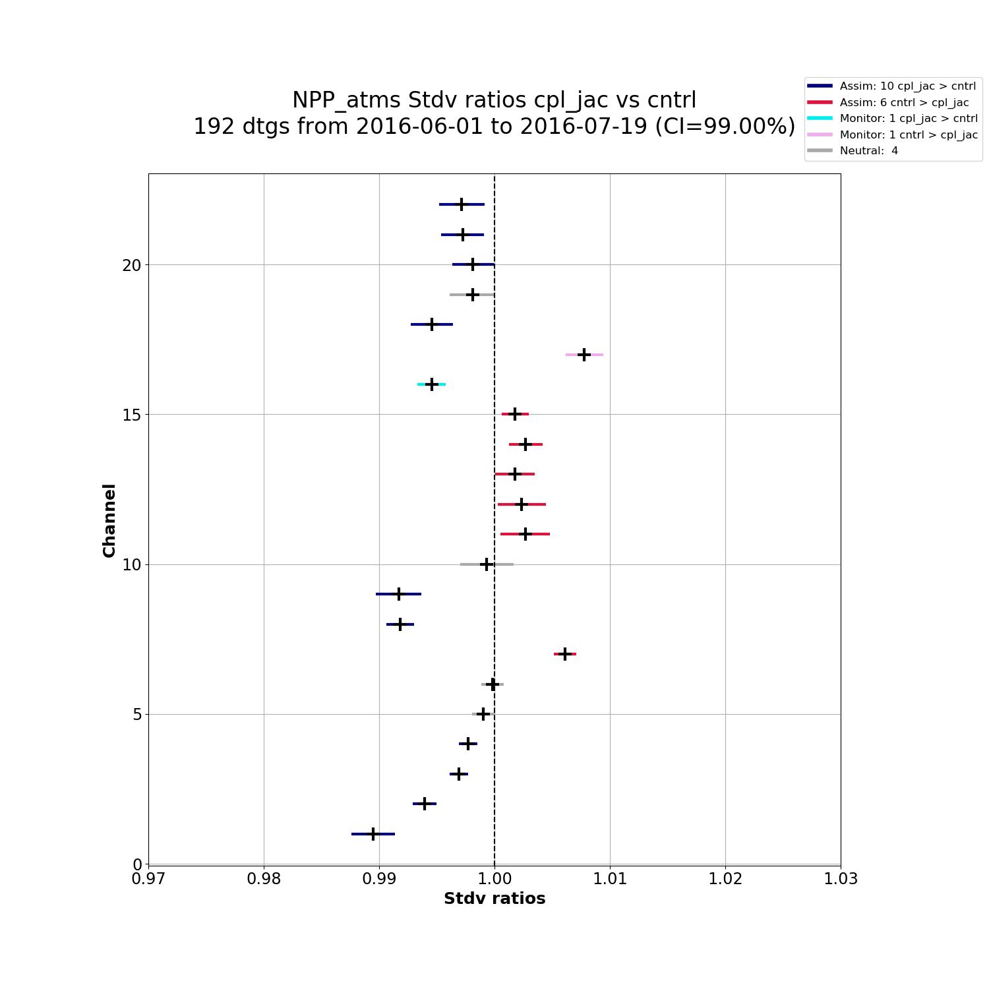
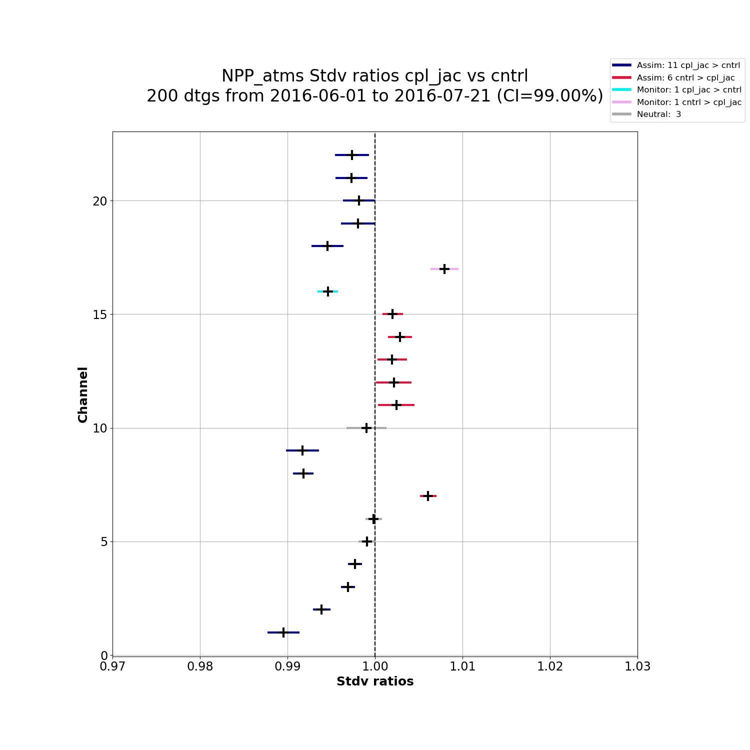
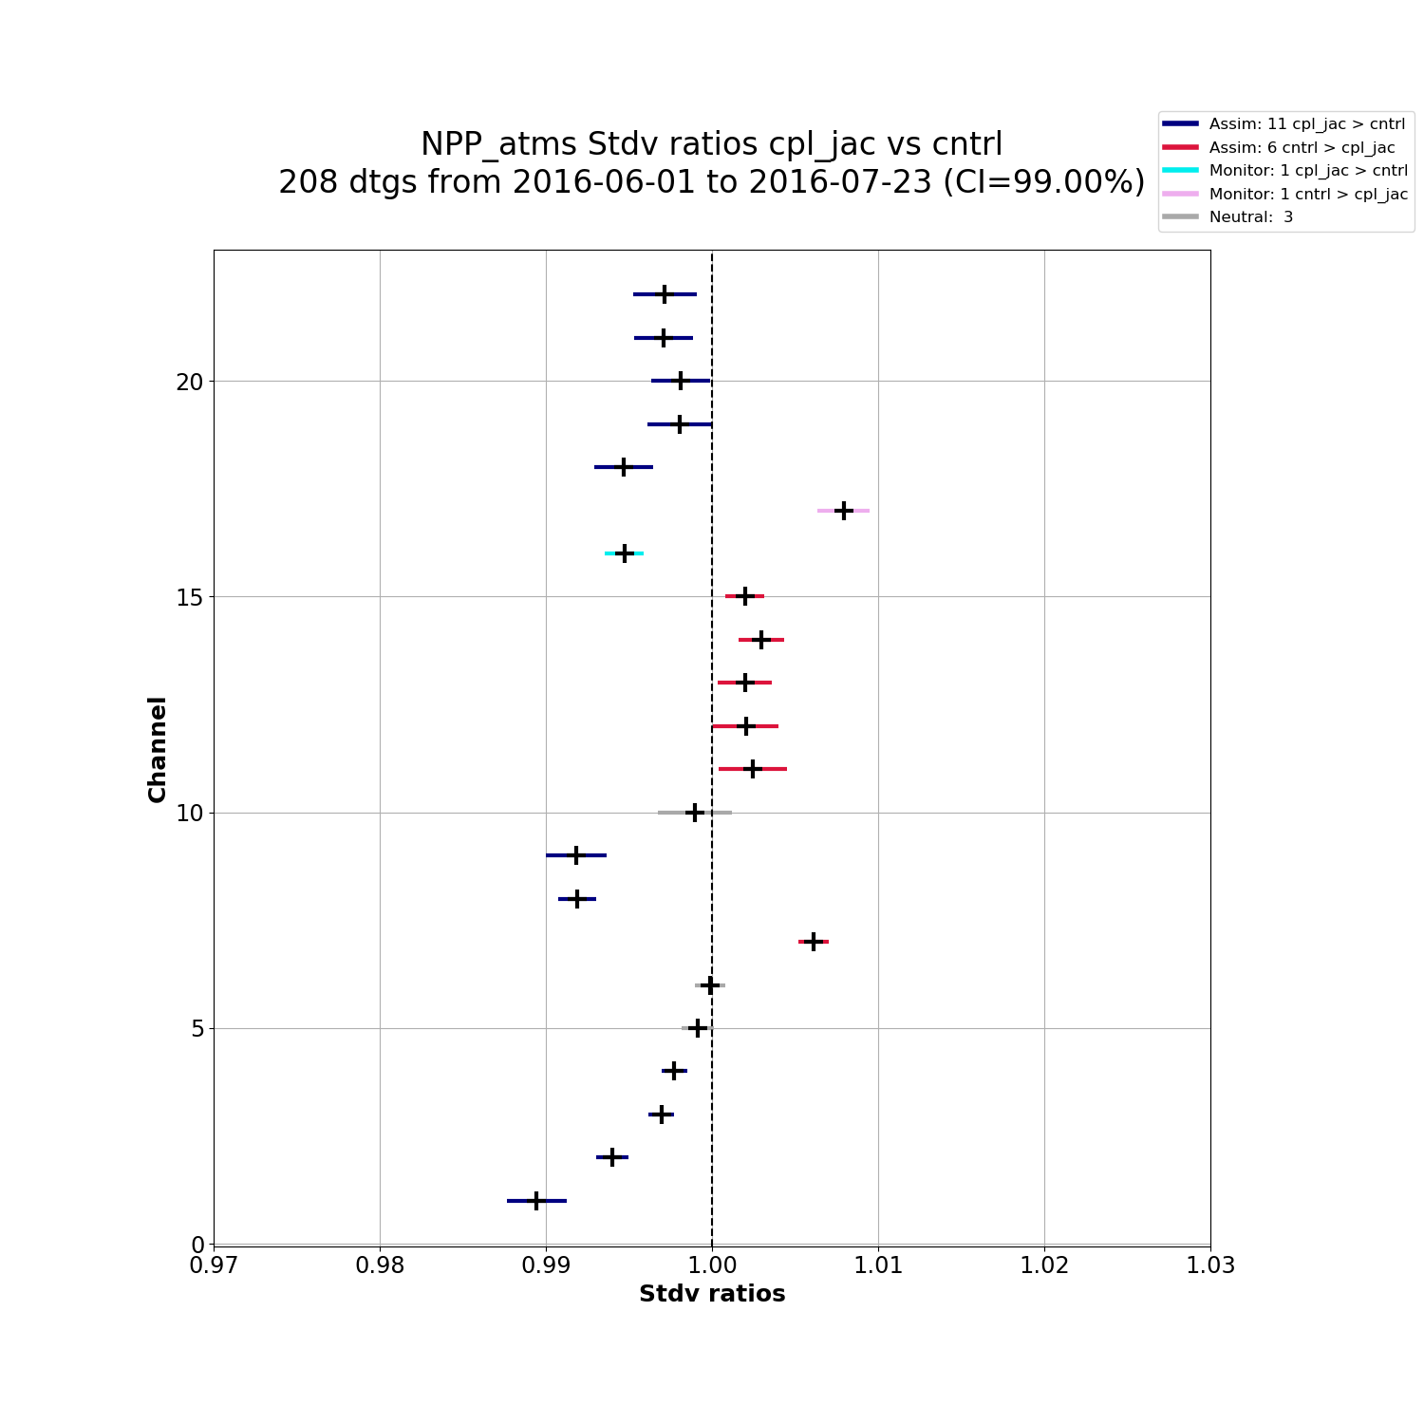
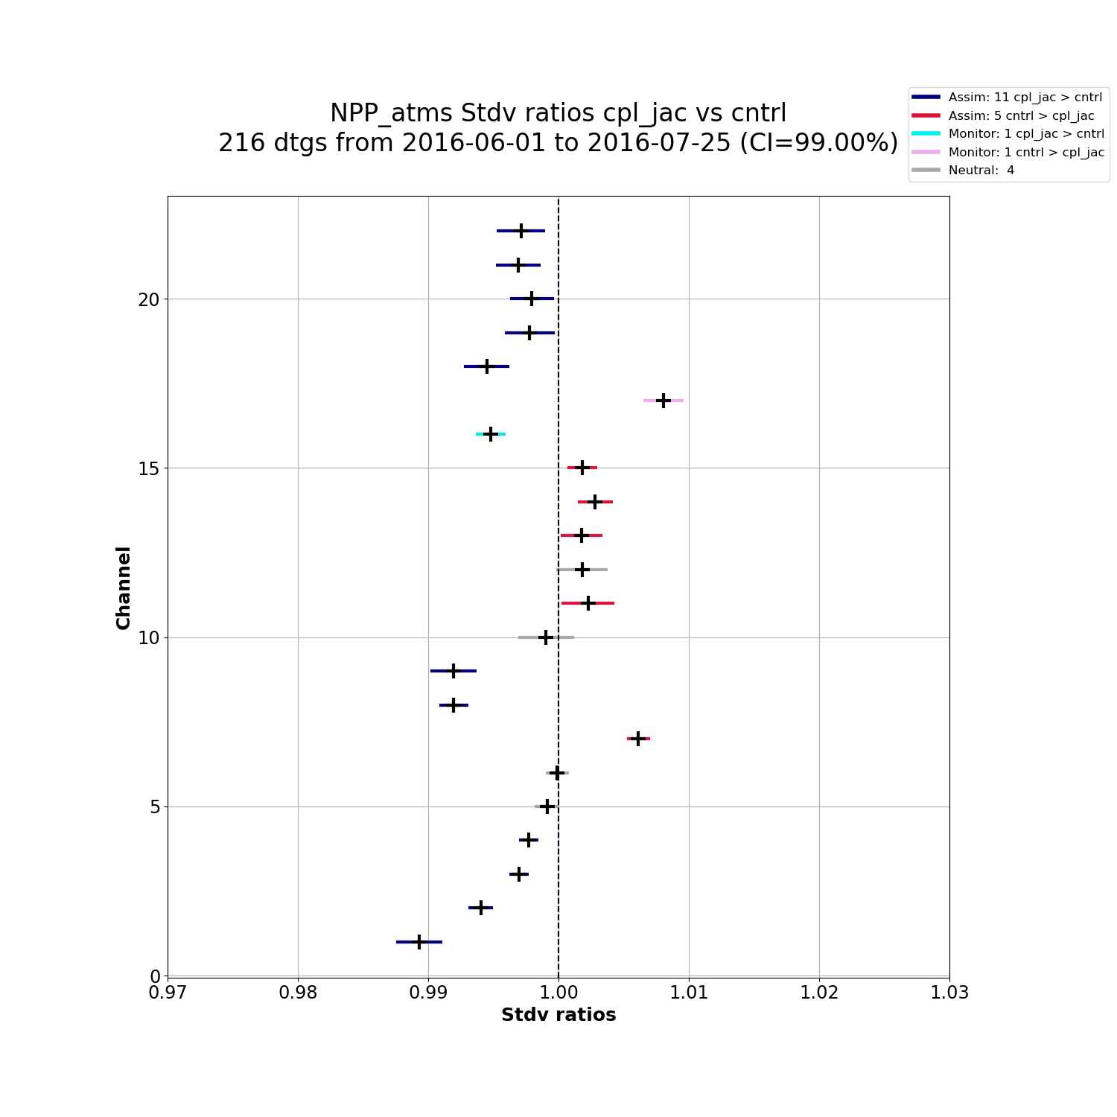


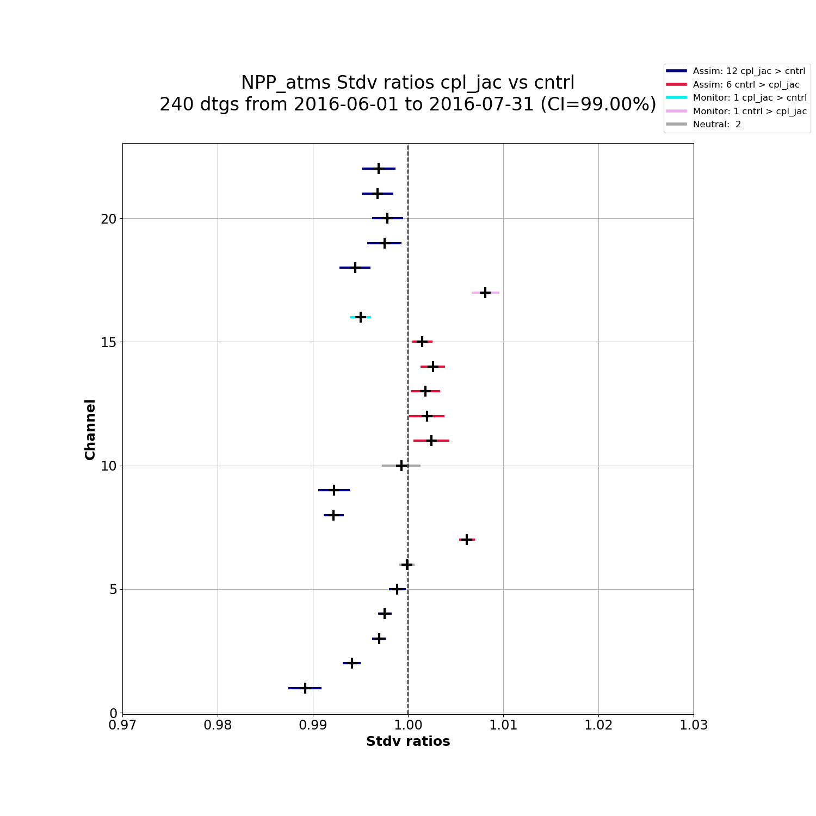
Fit as a Function of Time
Water vapor
Scattering
Strat Temp
Trop Temp
Water vapor

Slide 15
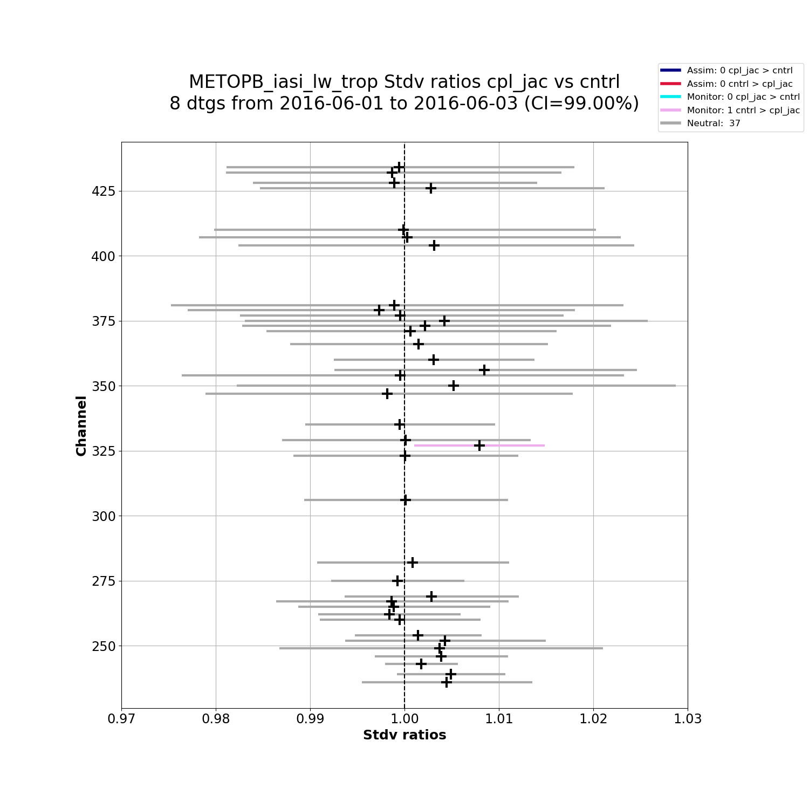
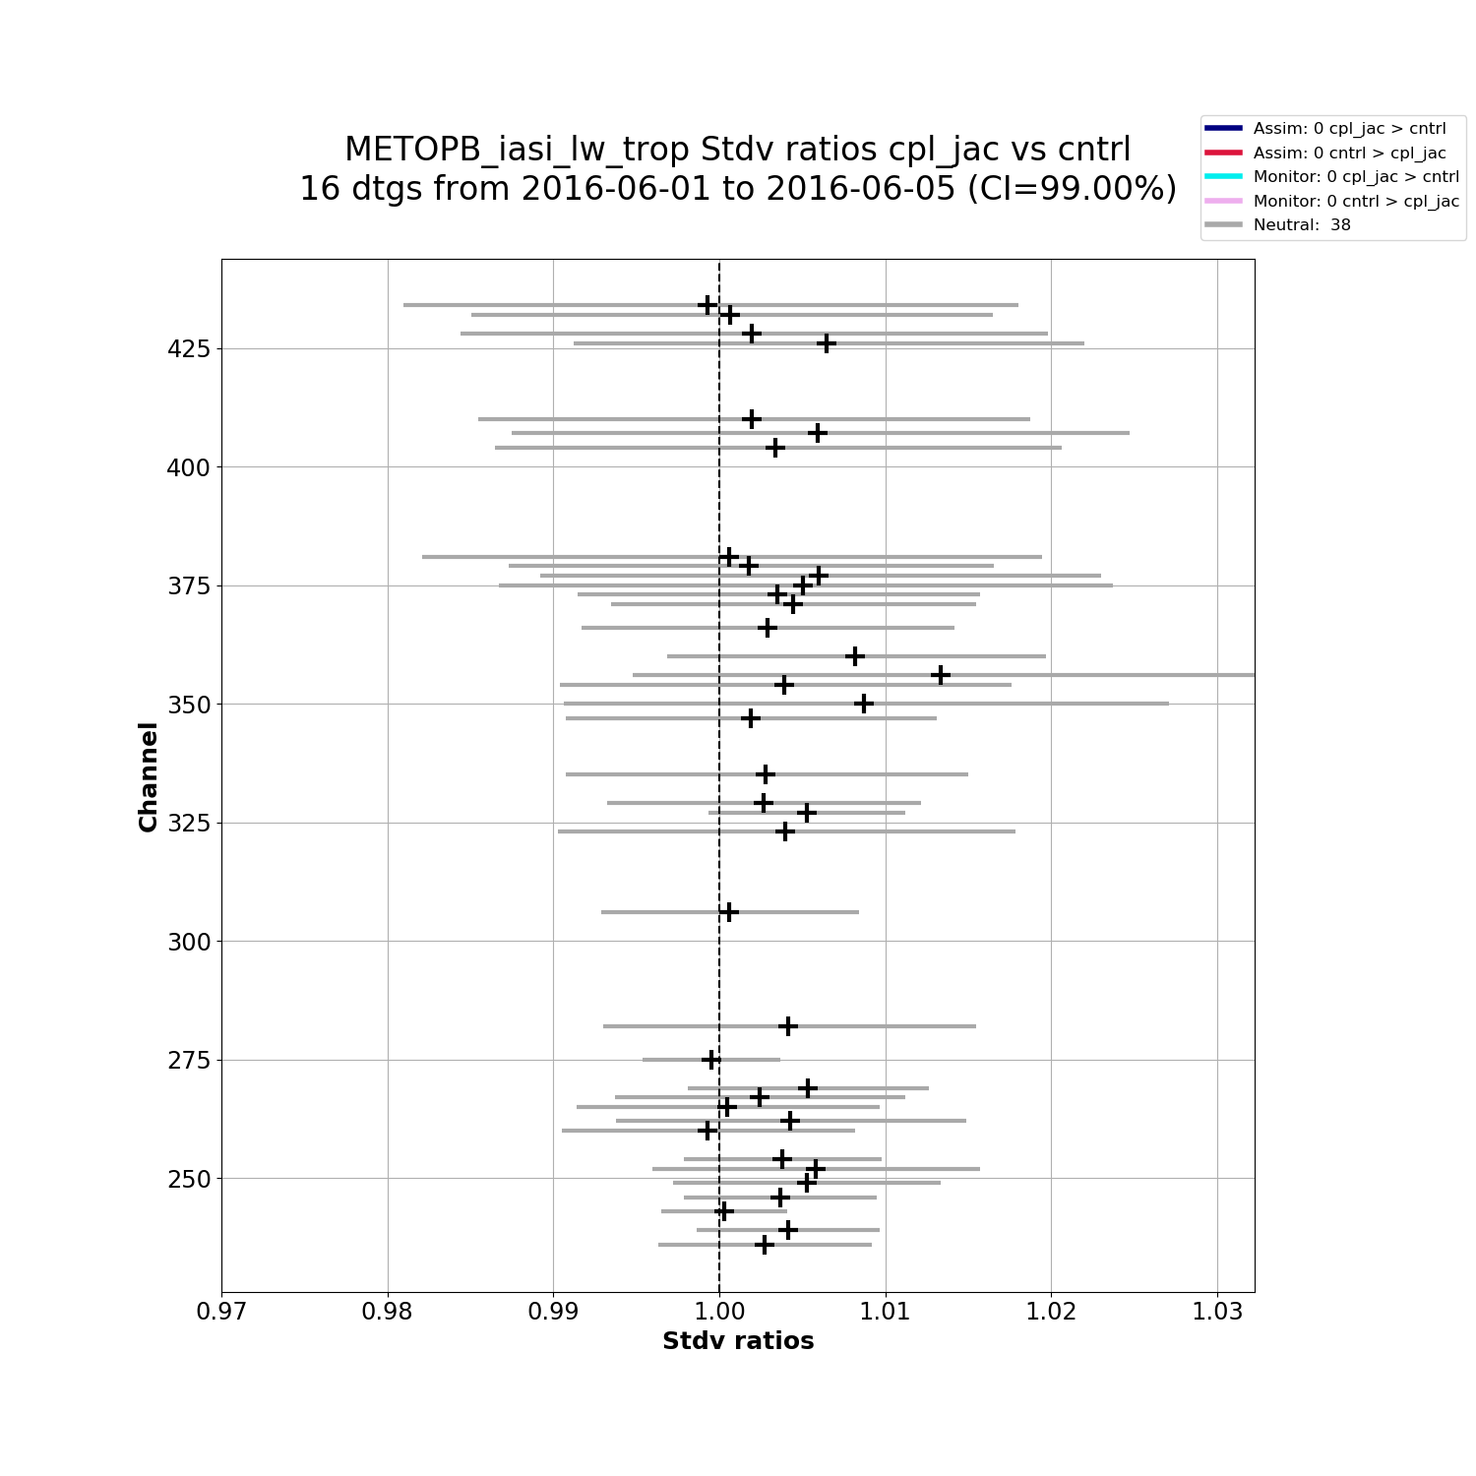
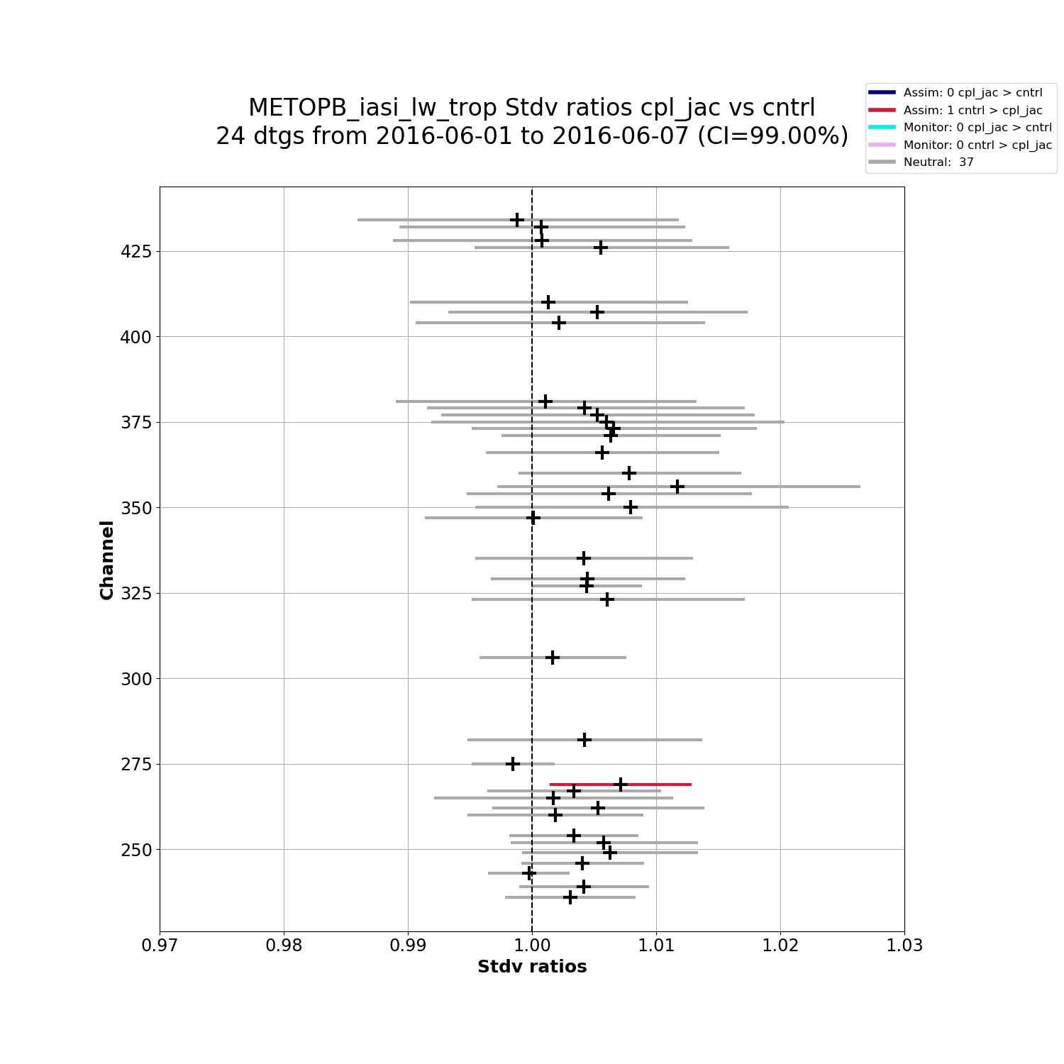
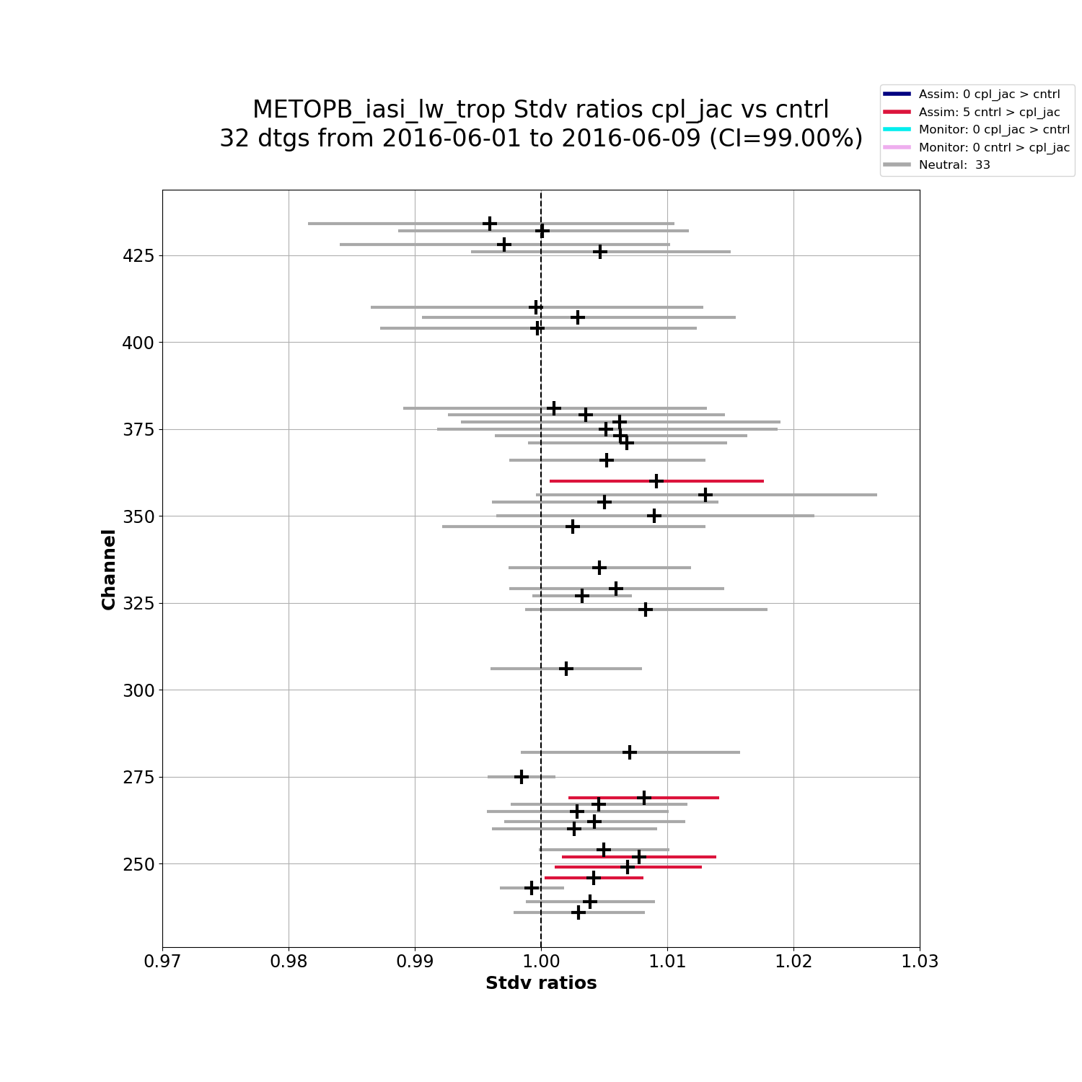
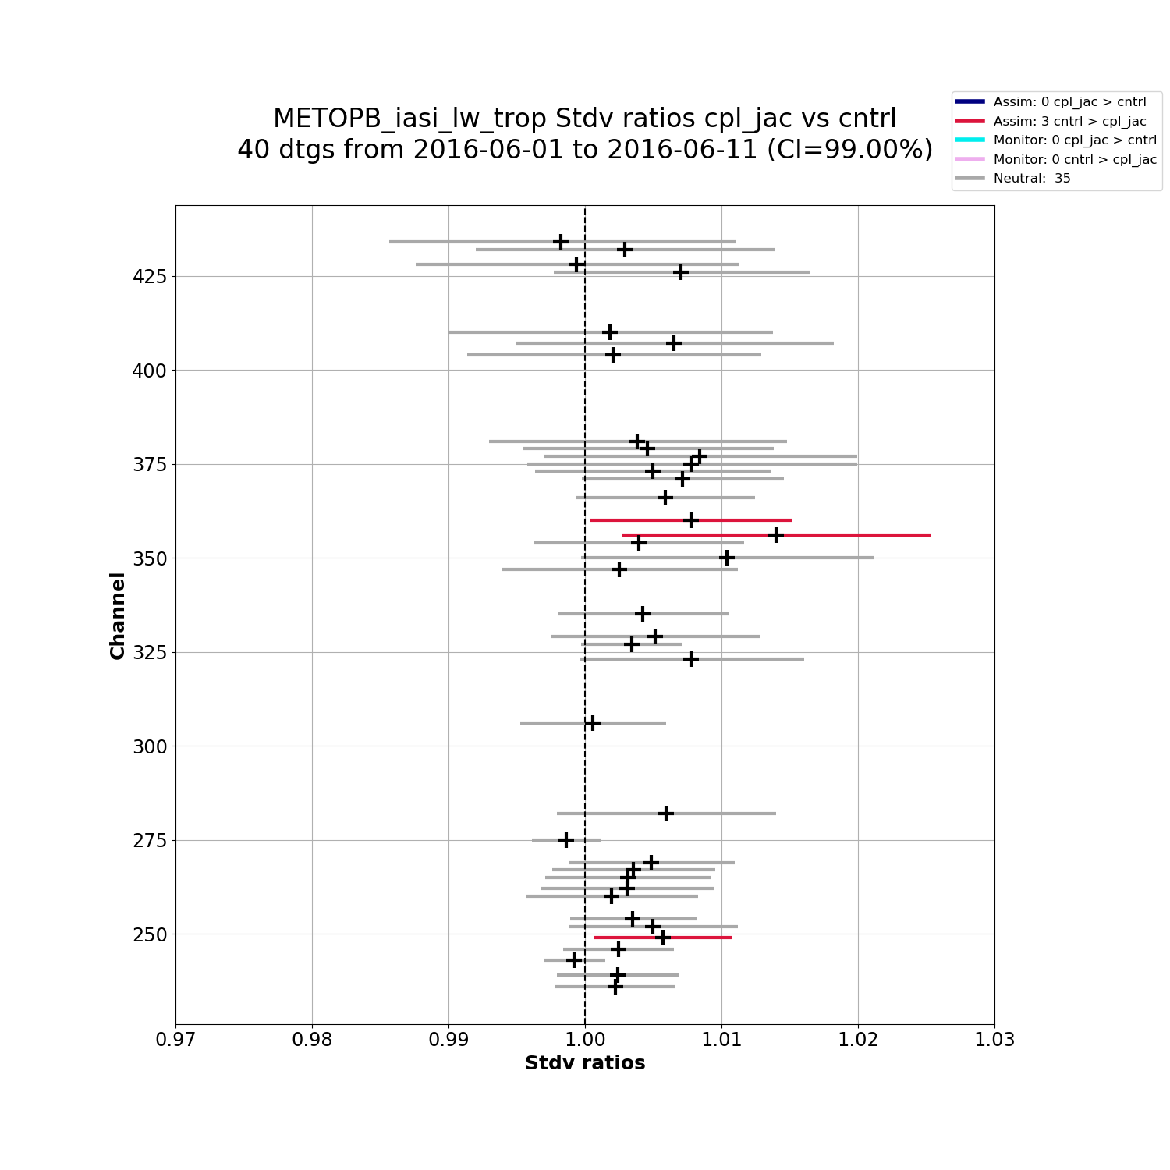
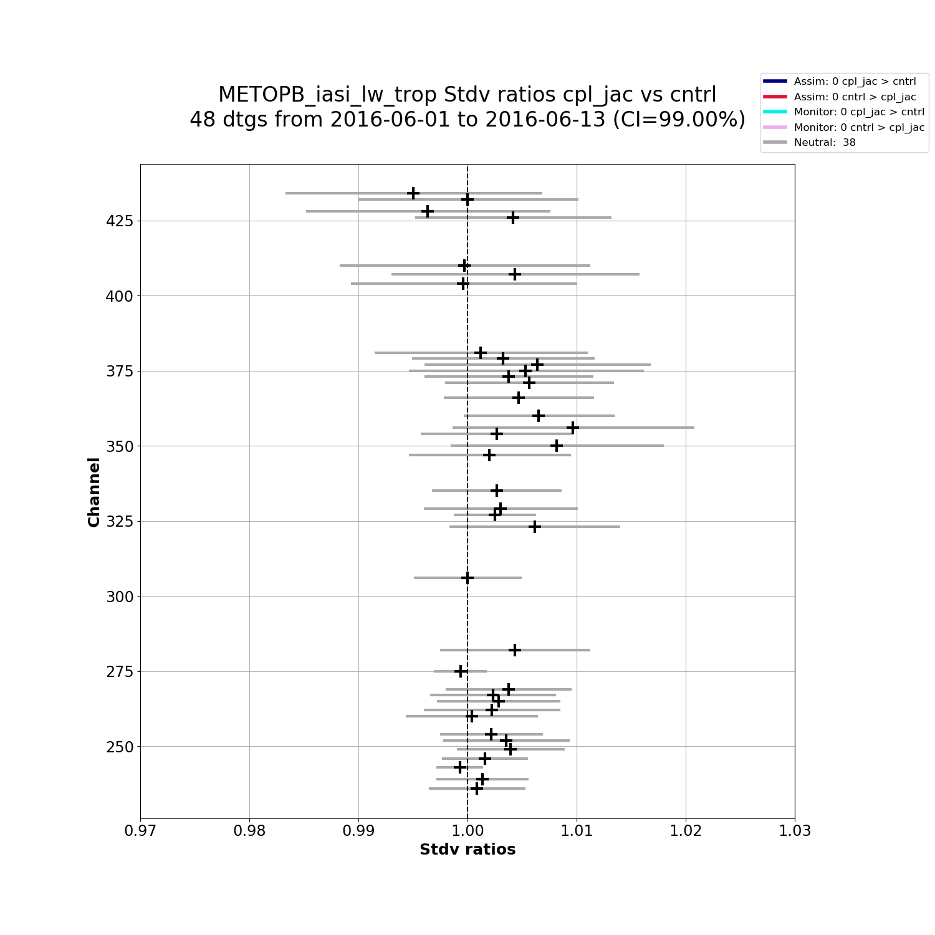
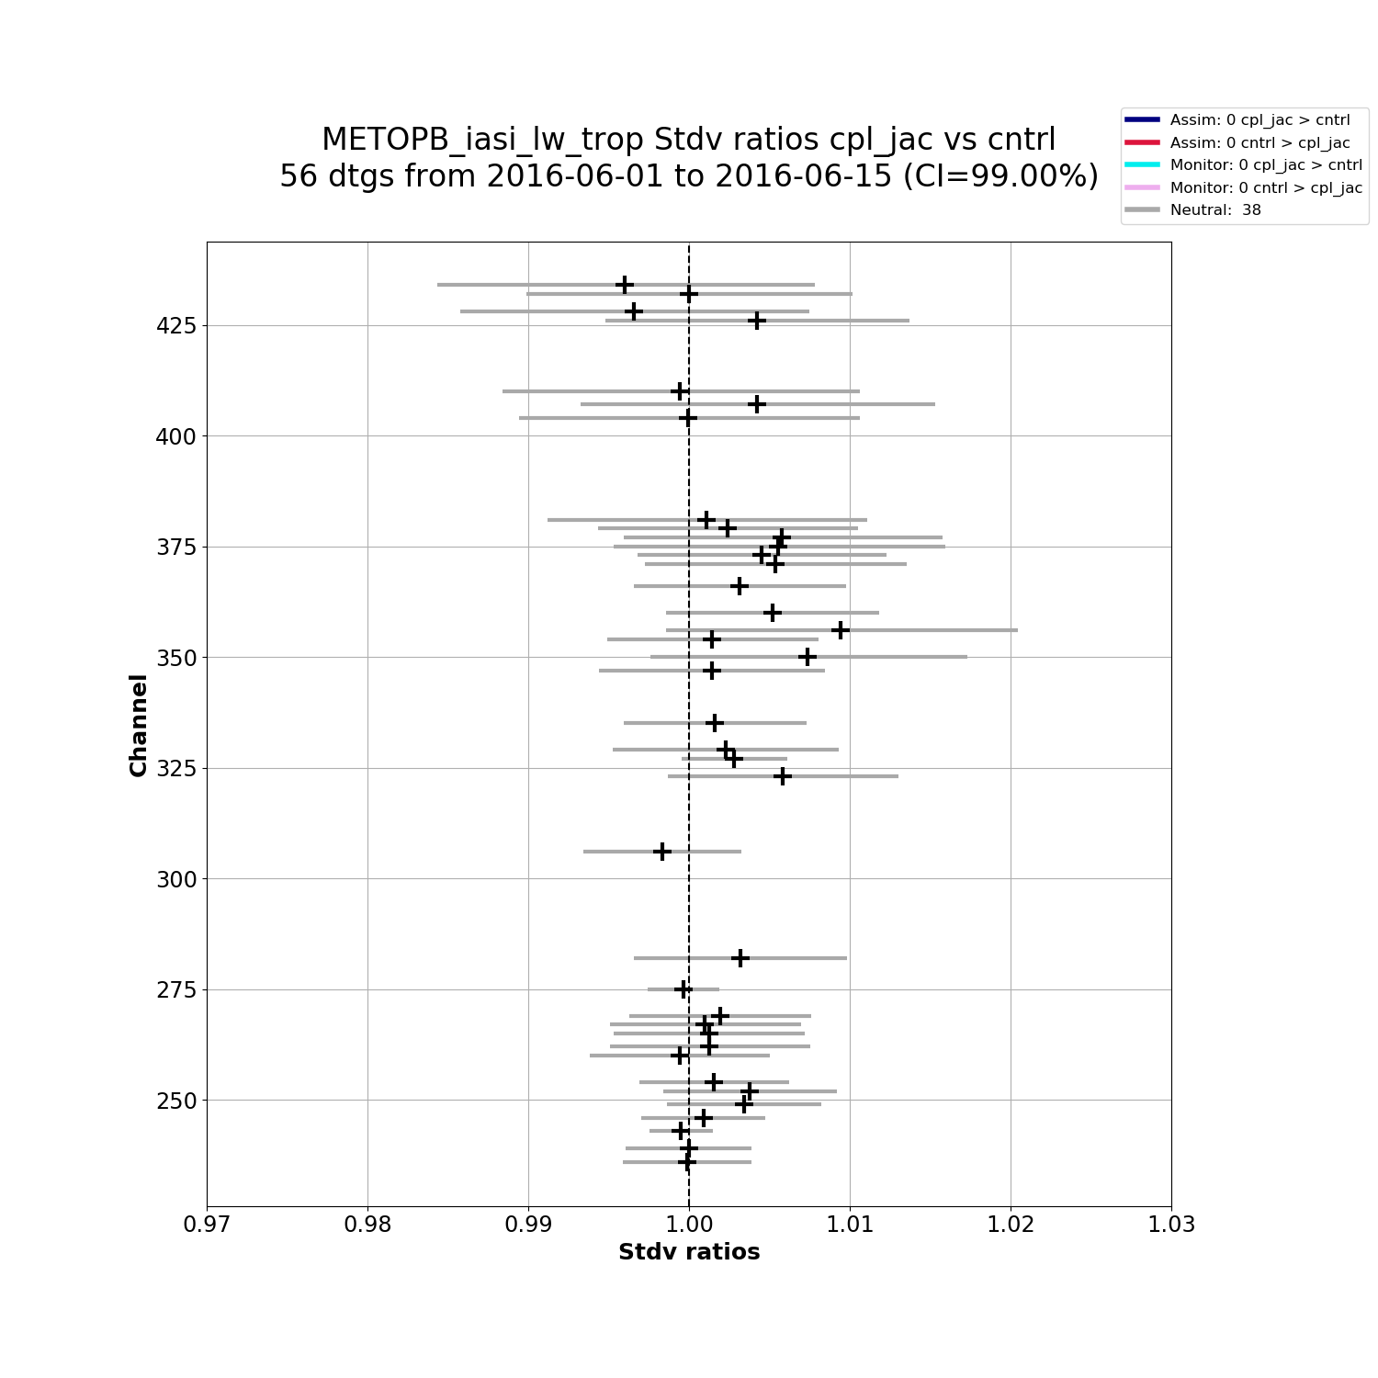
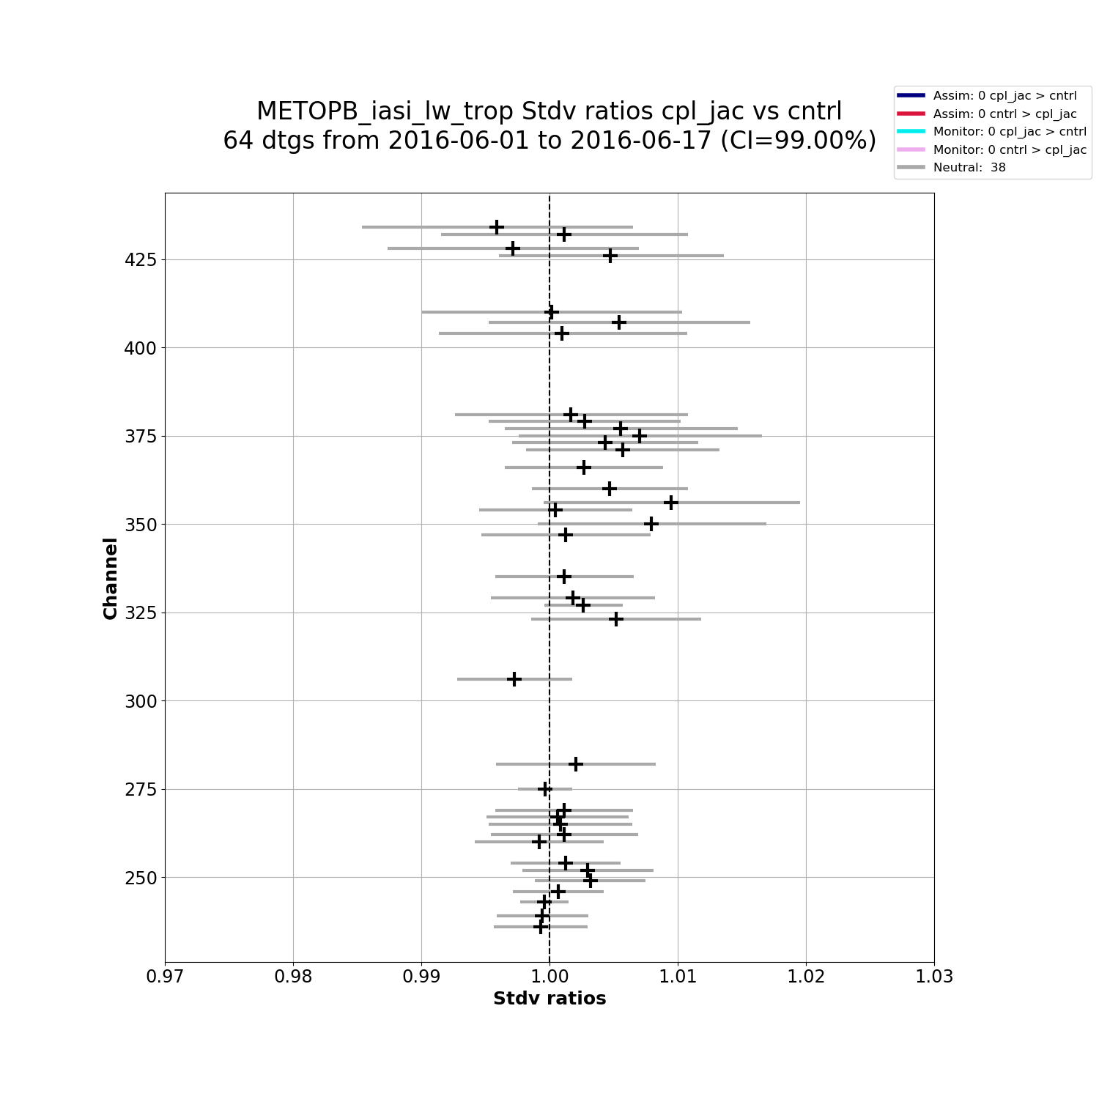
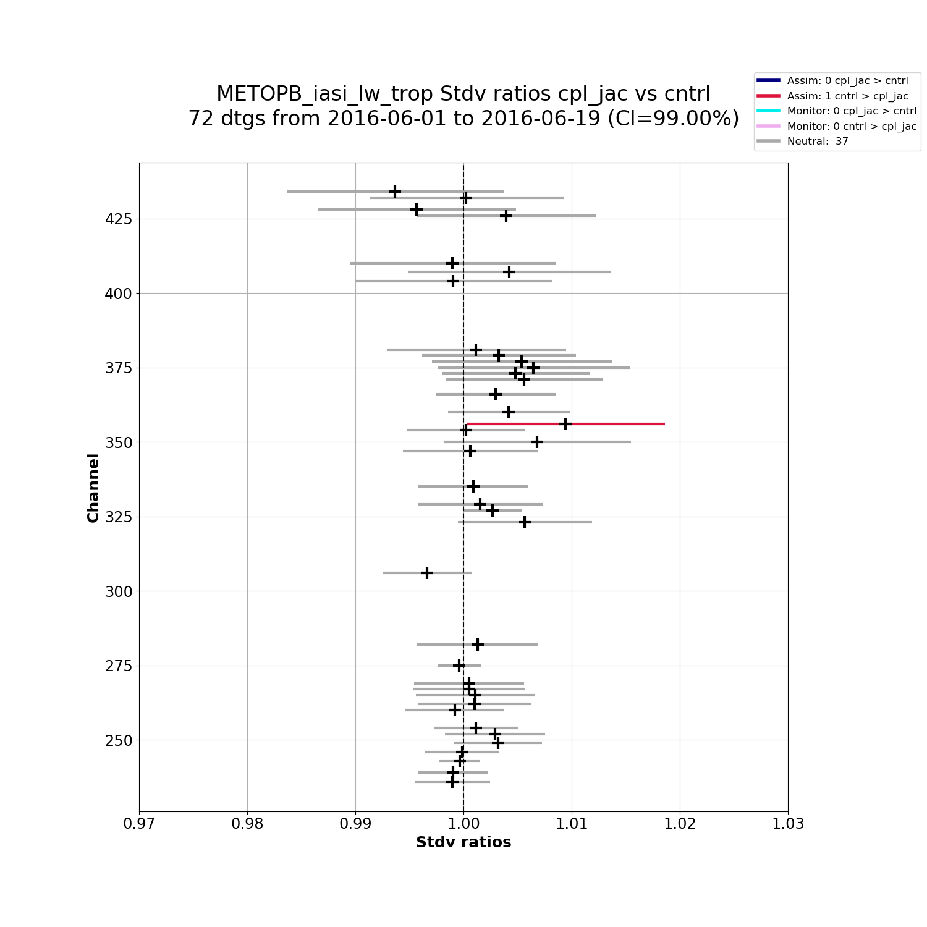
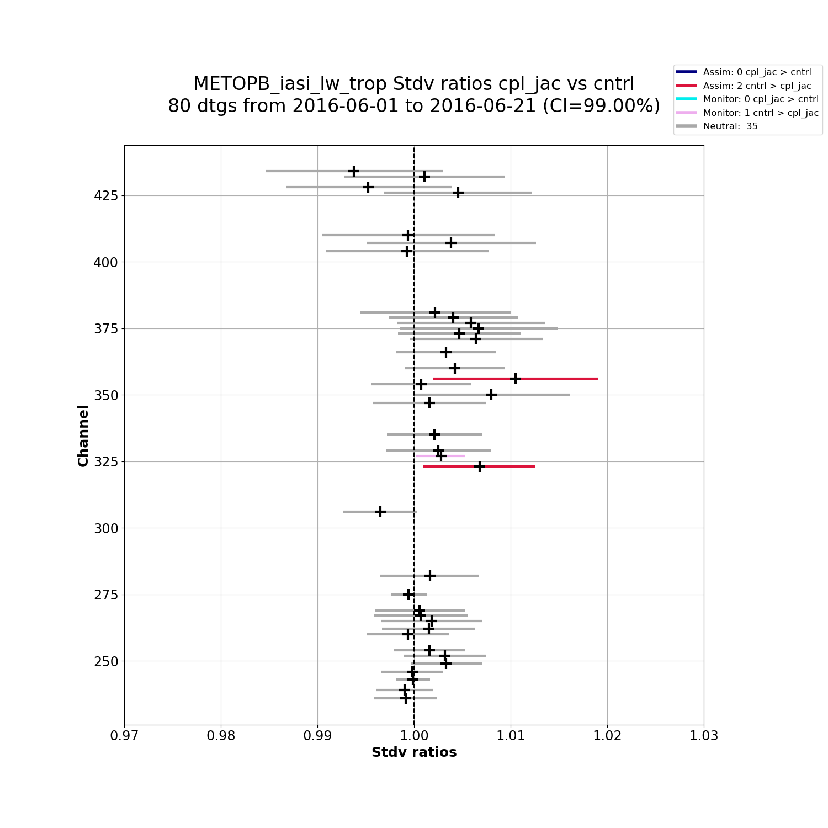
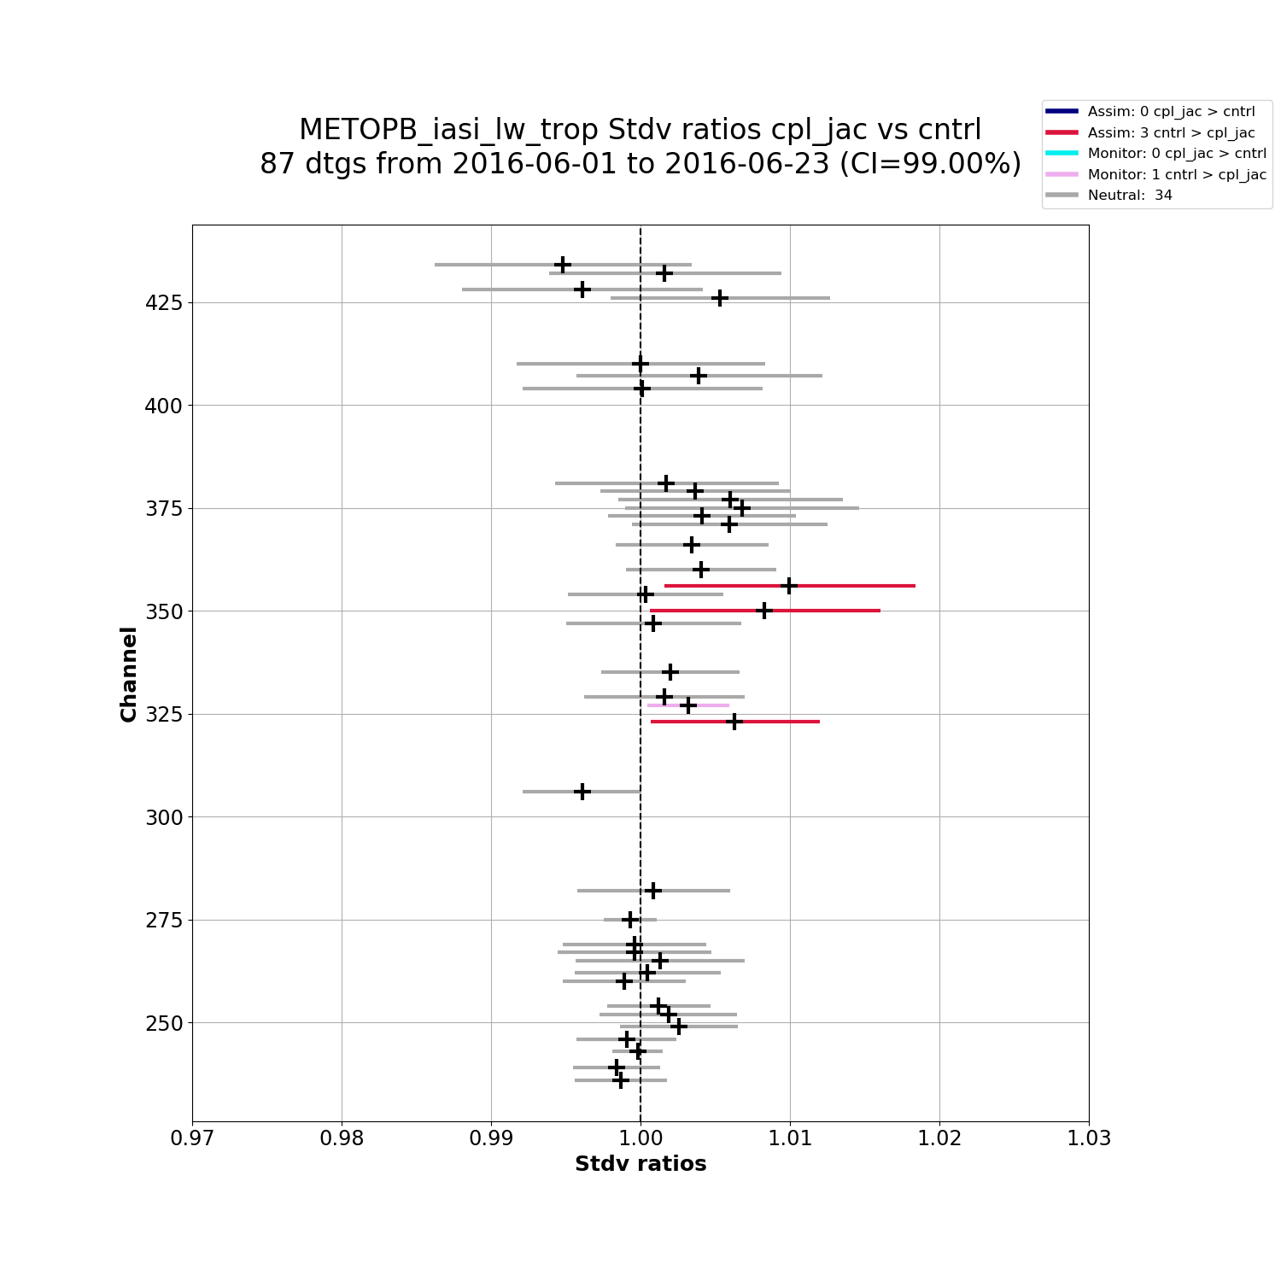
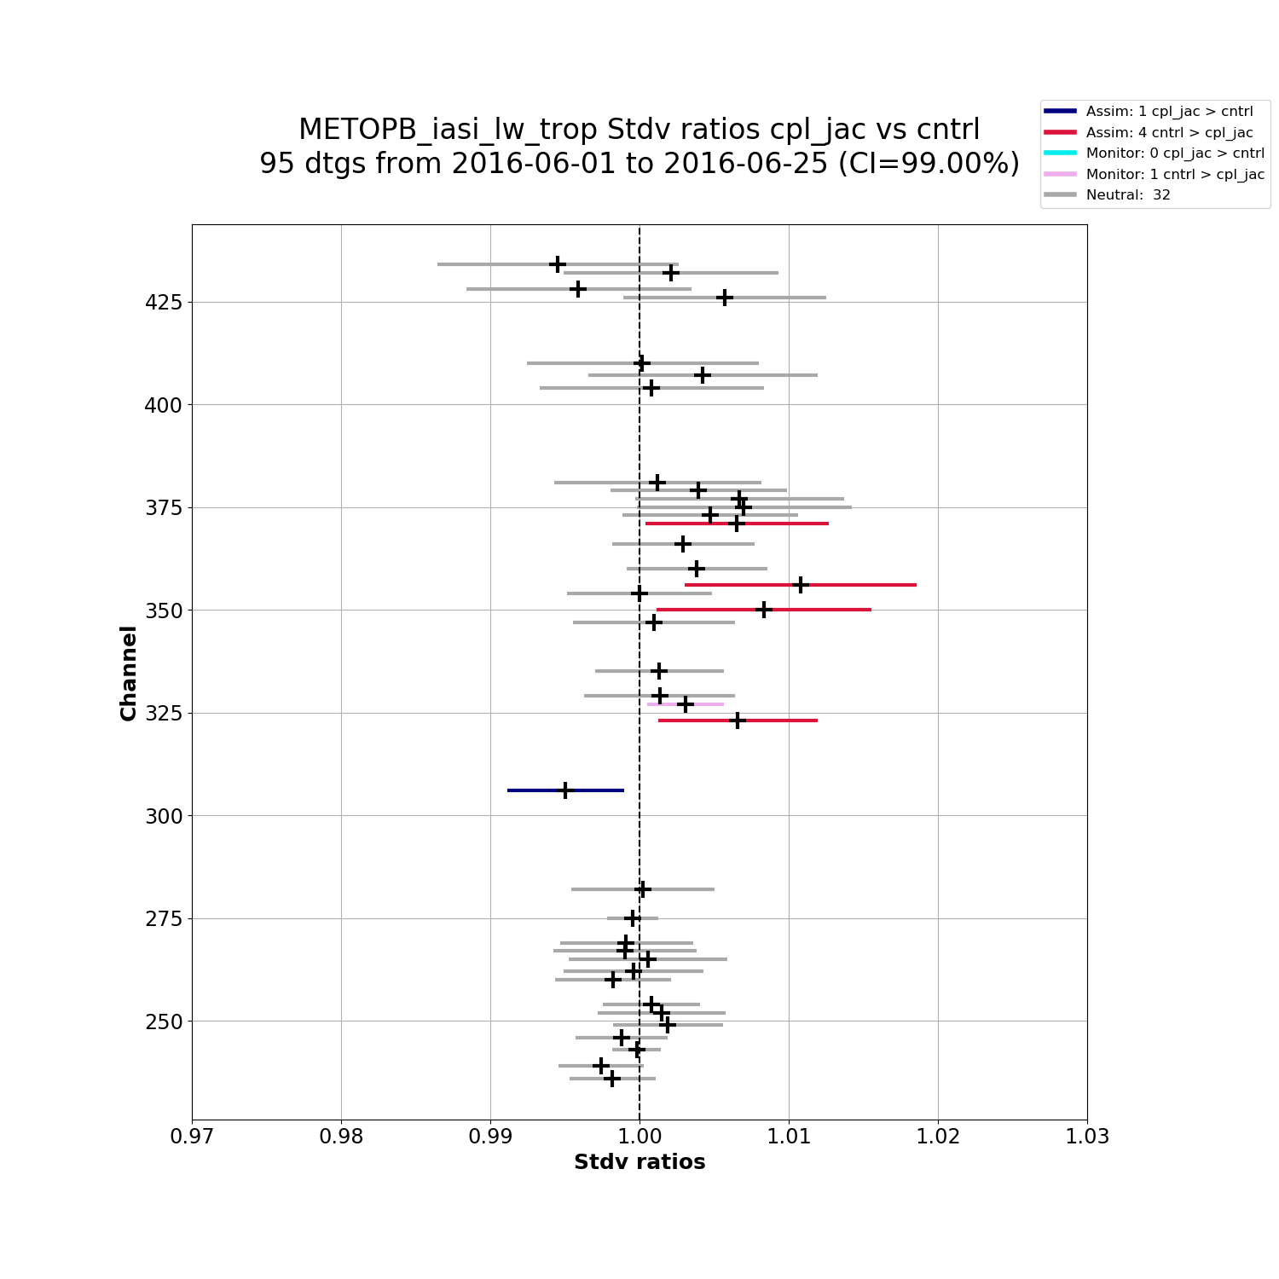
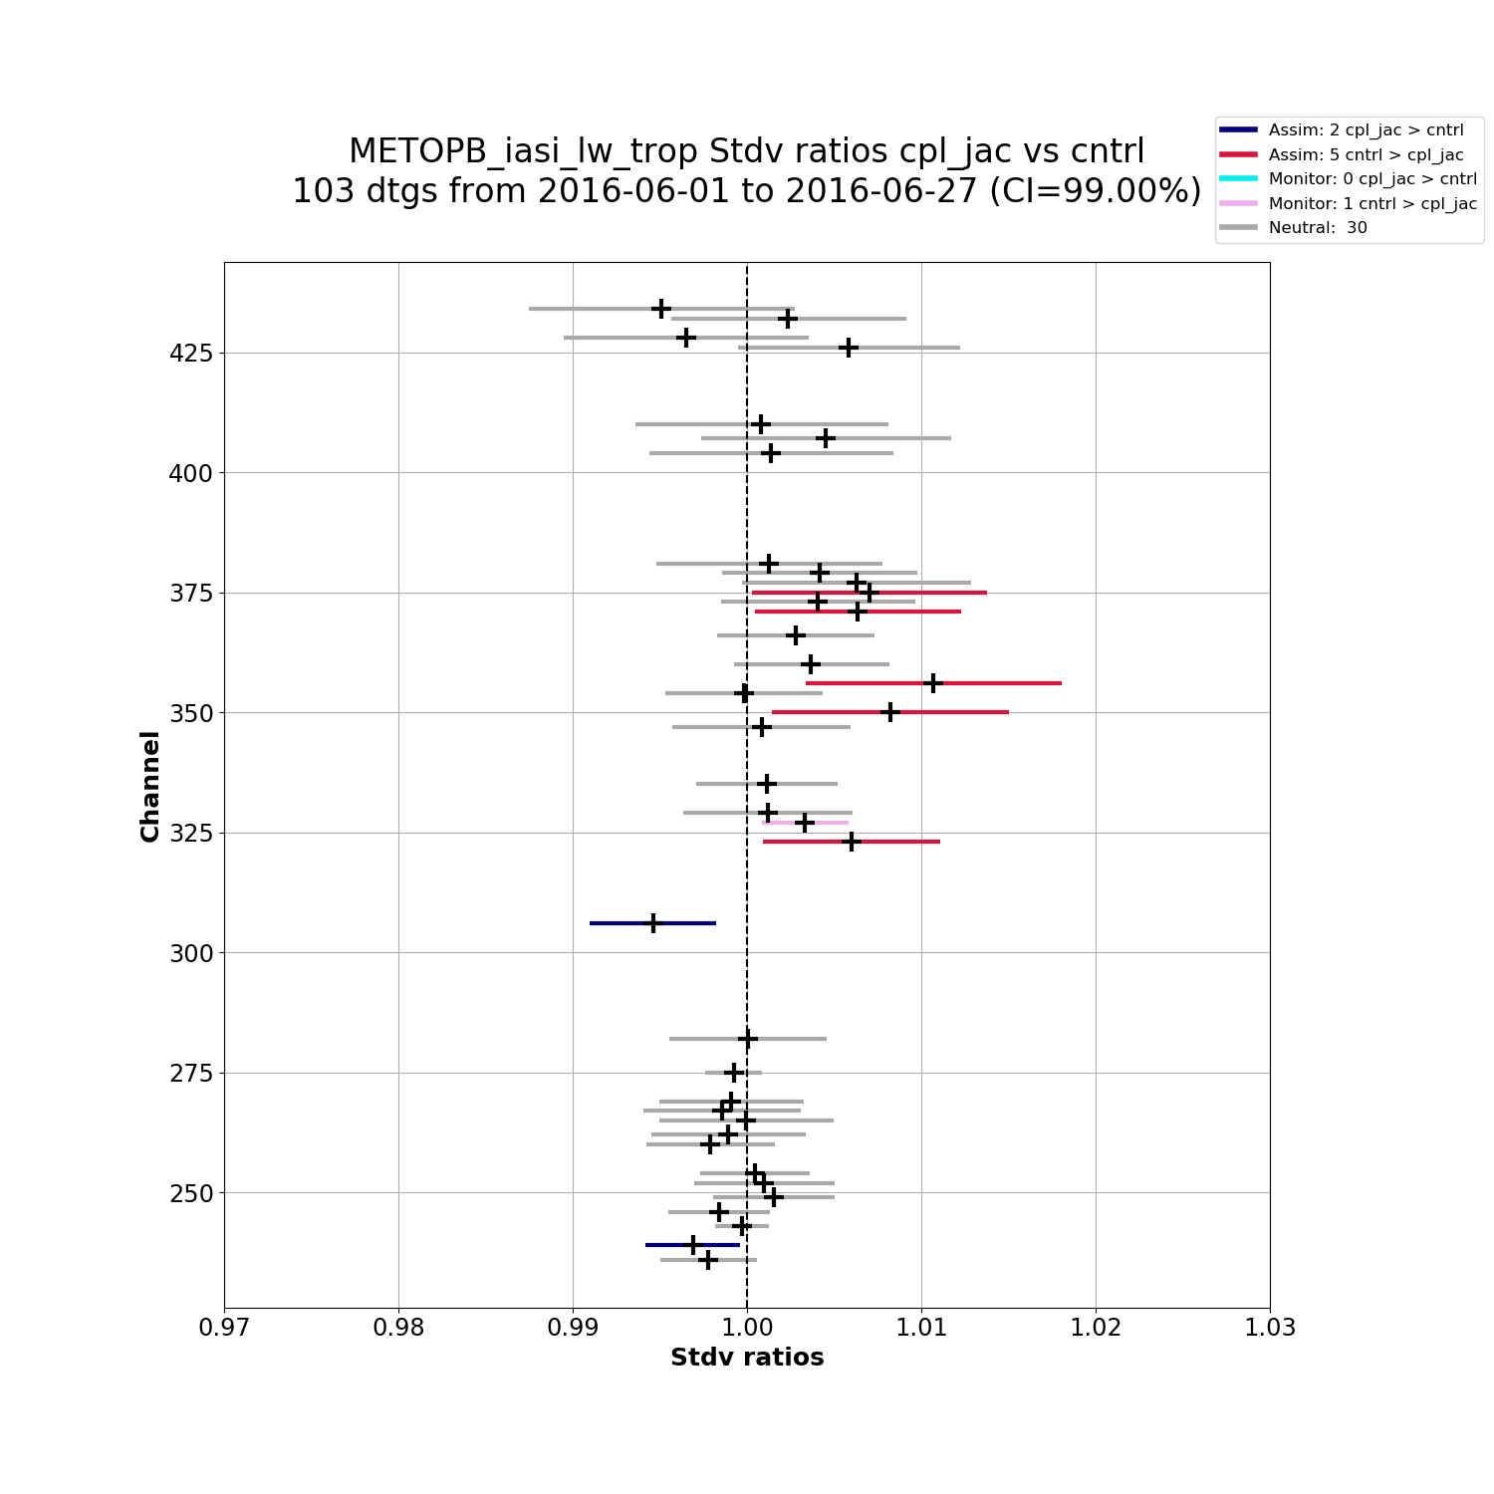

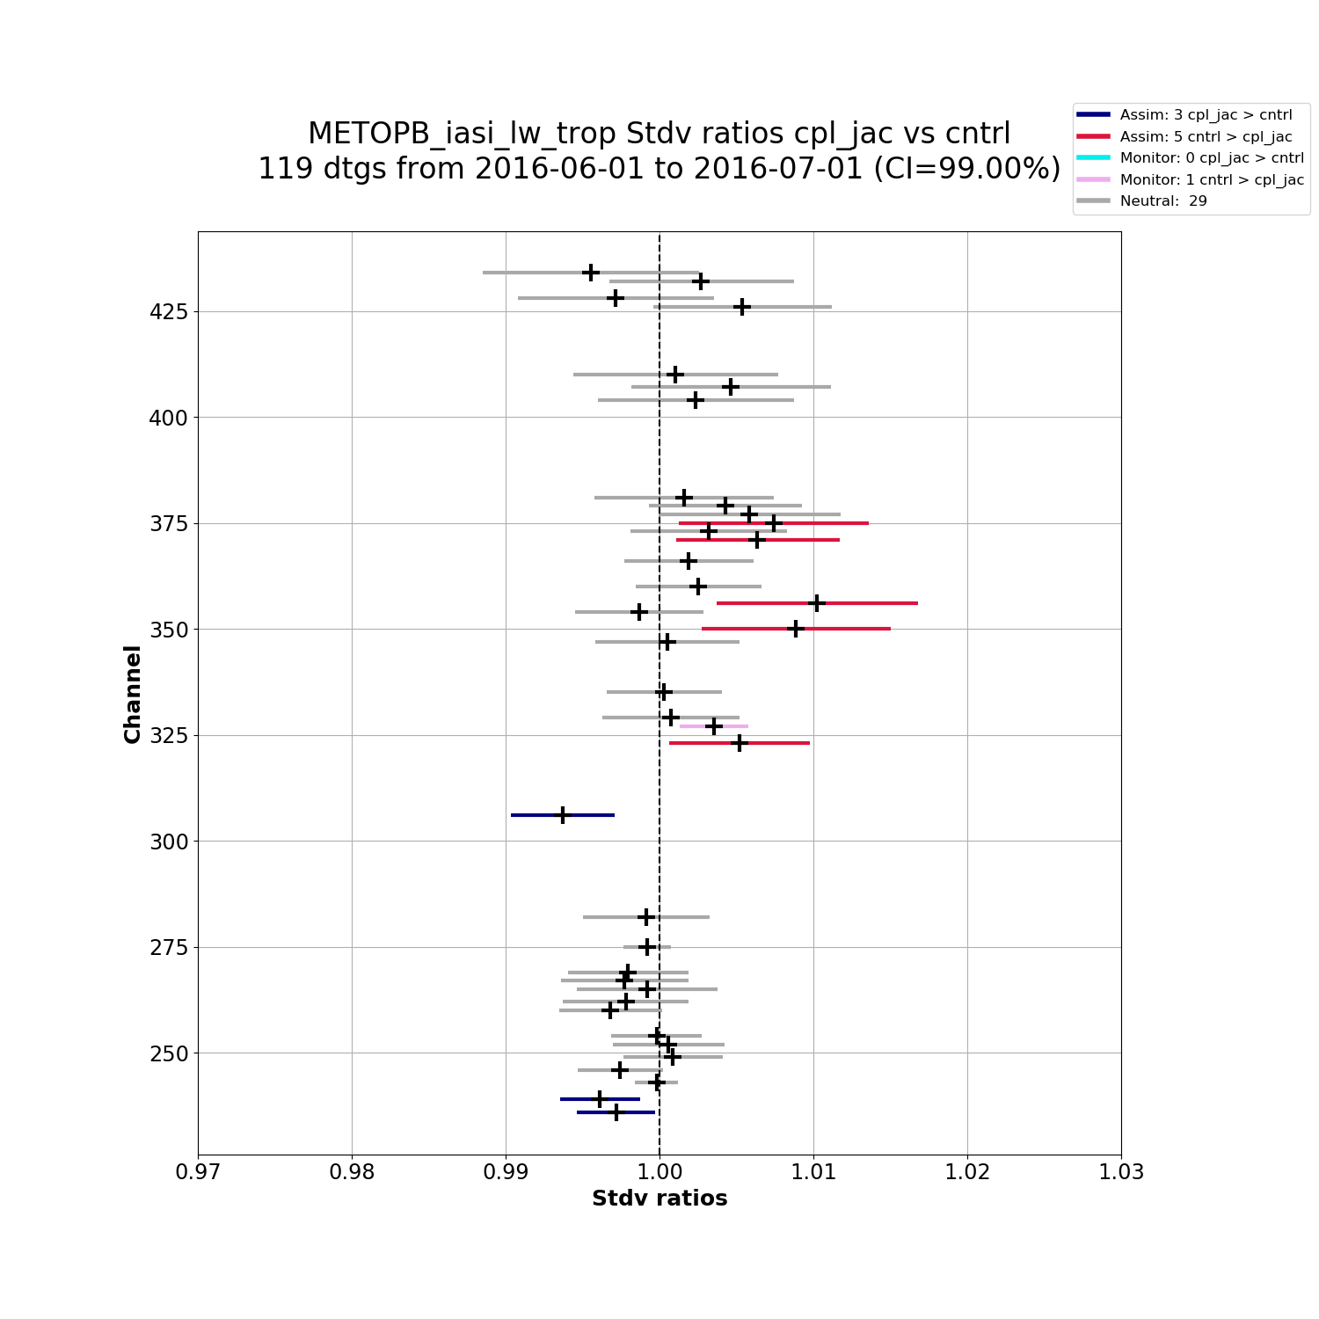



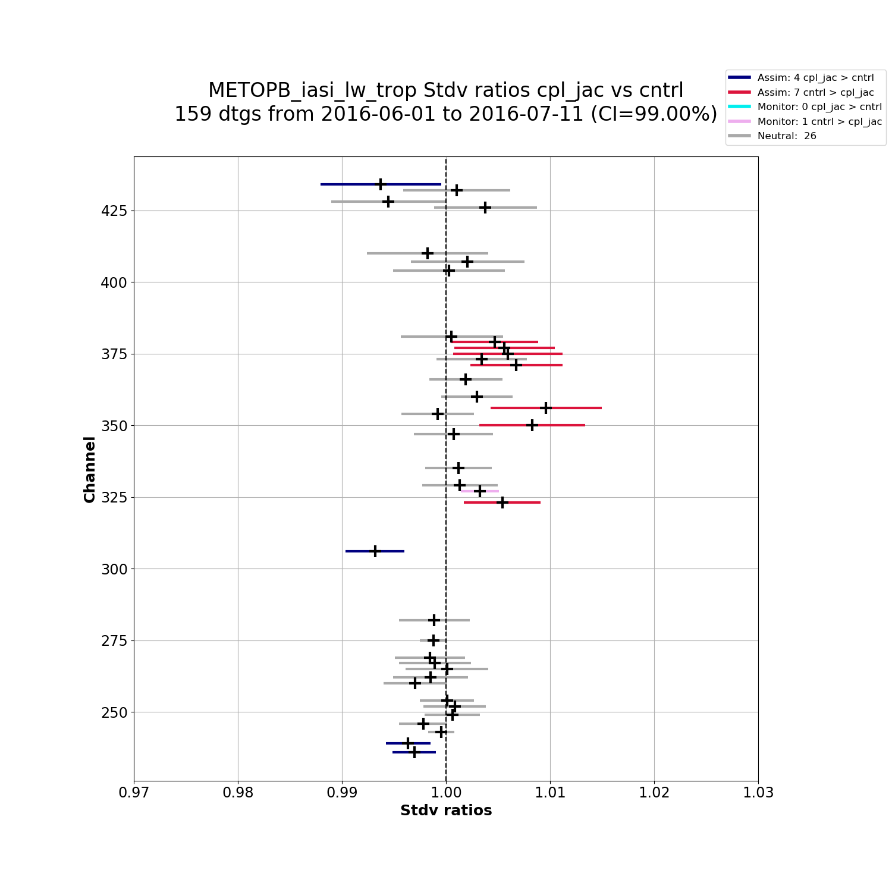
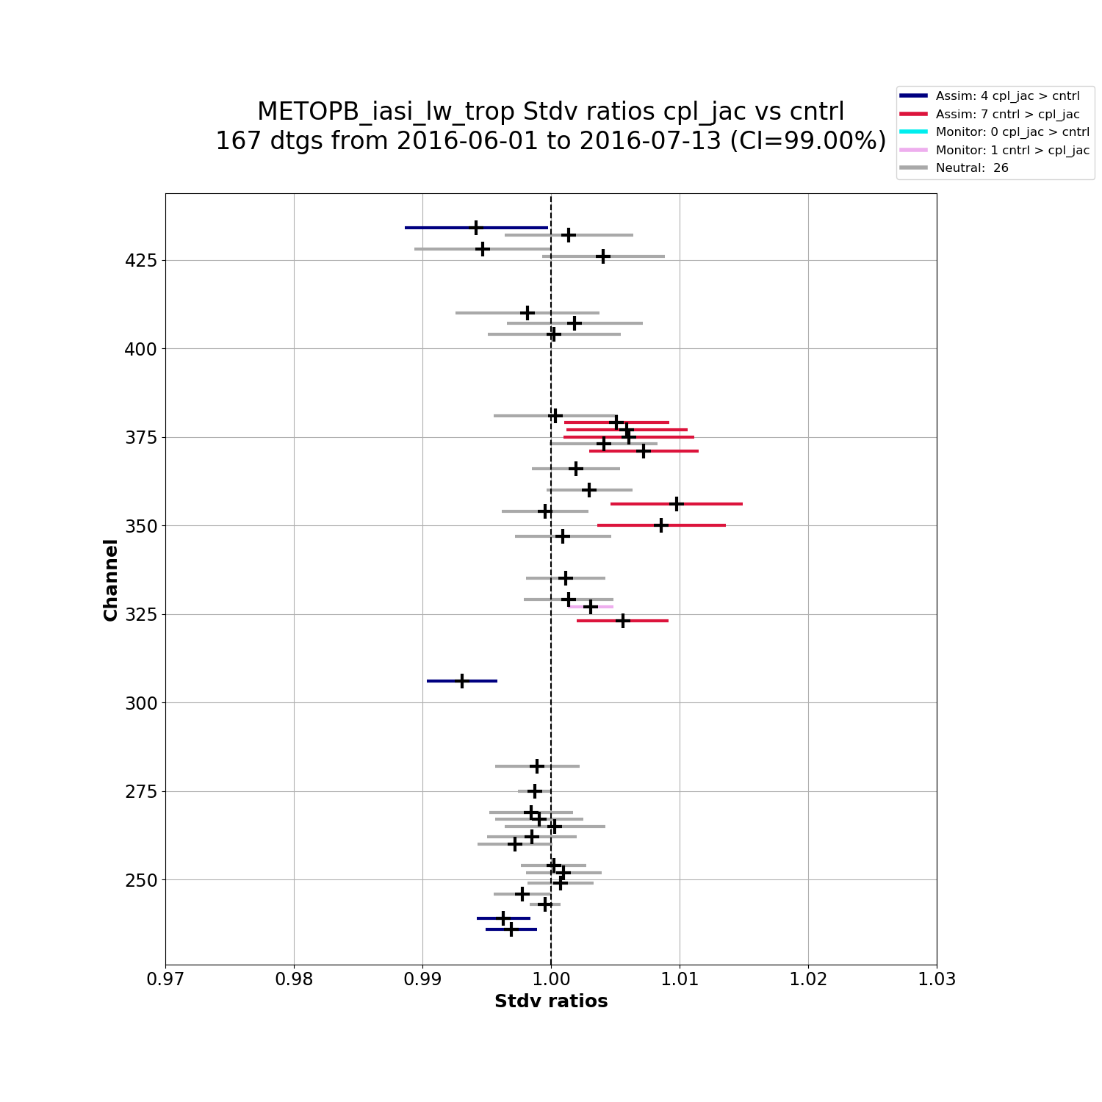
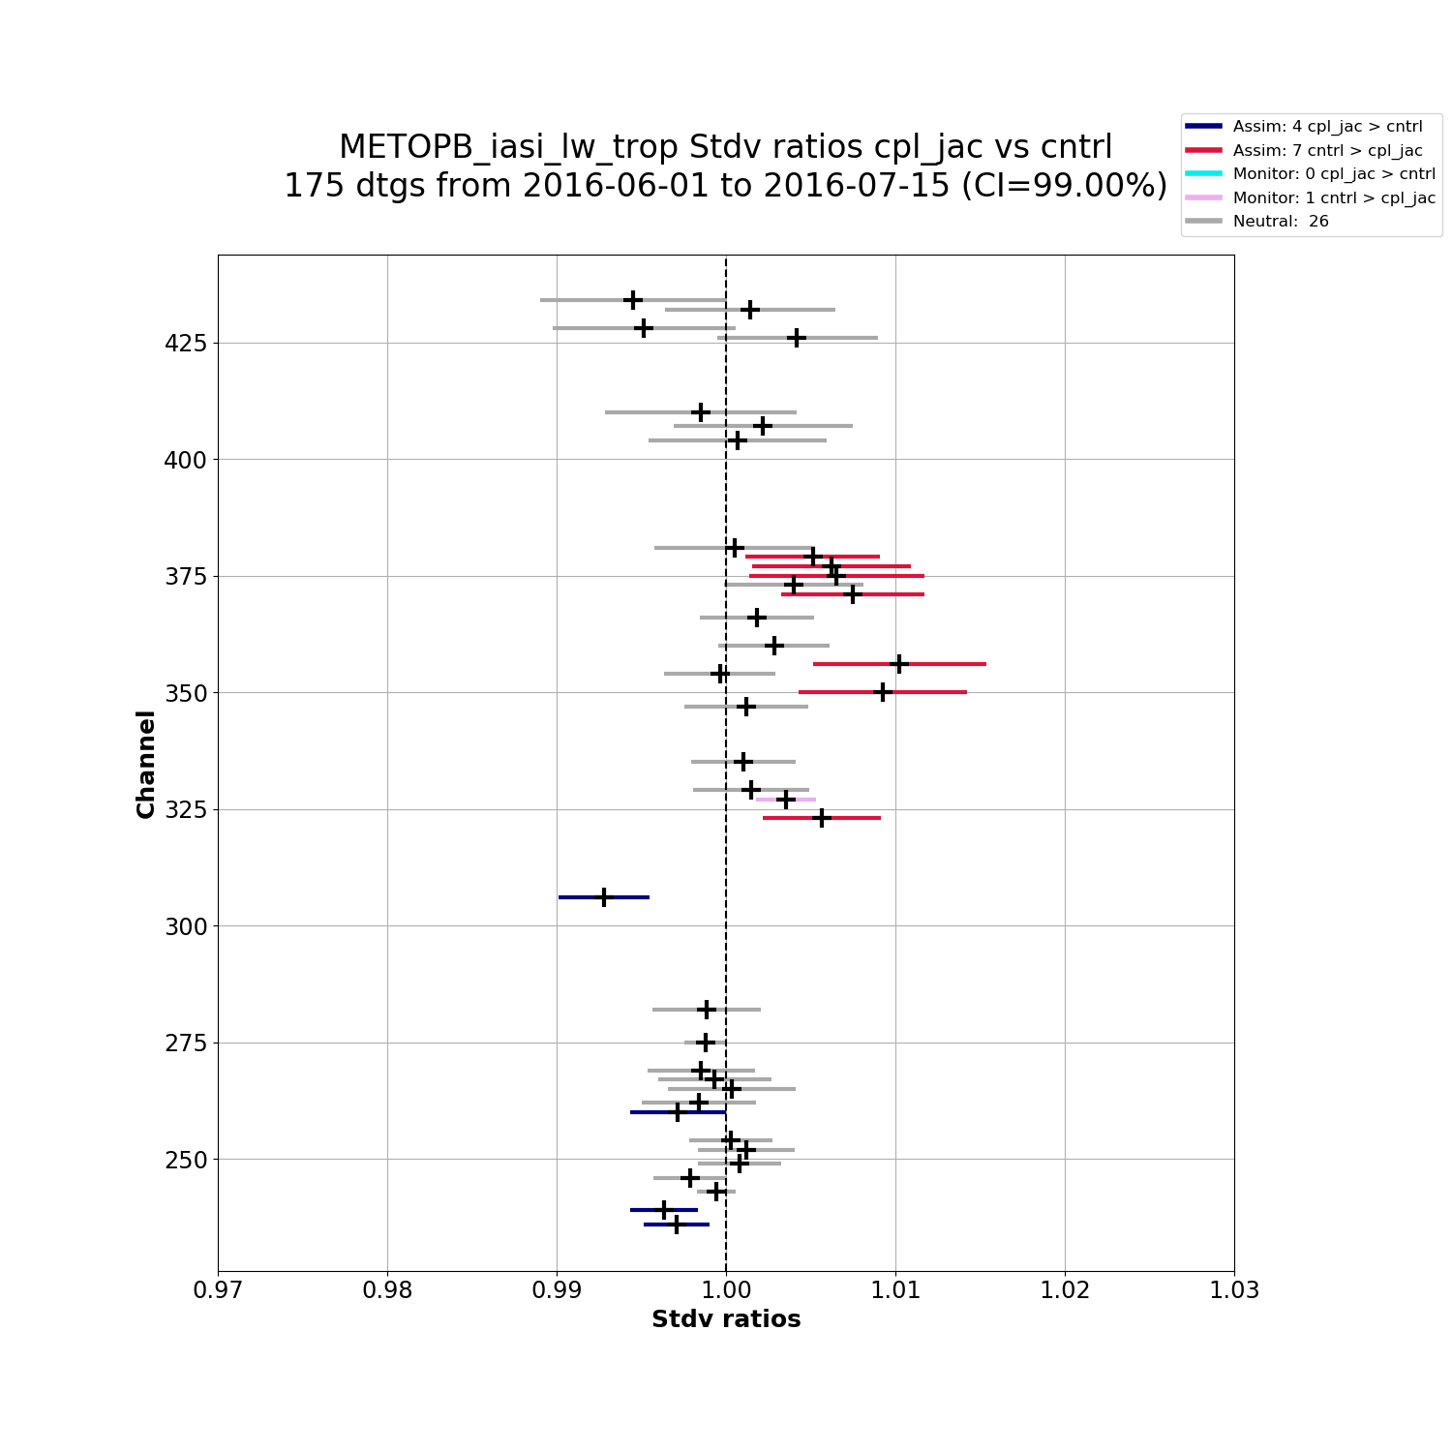

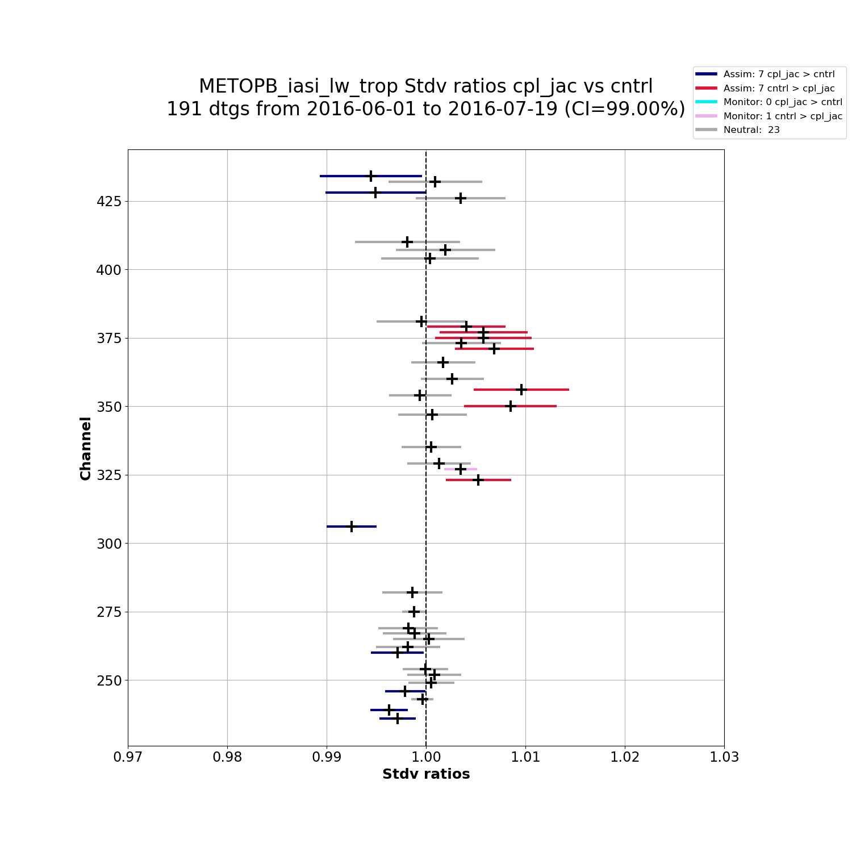
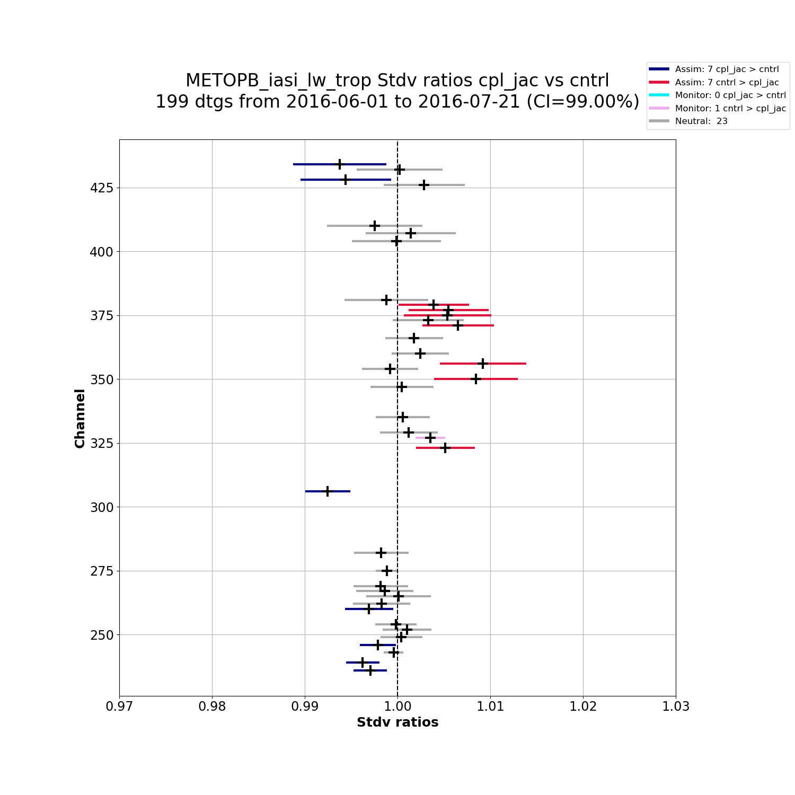


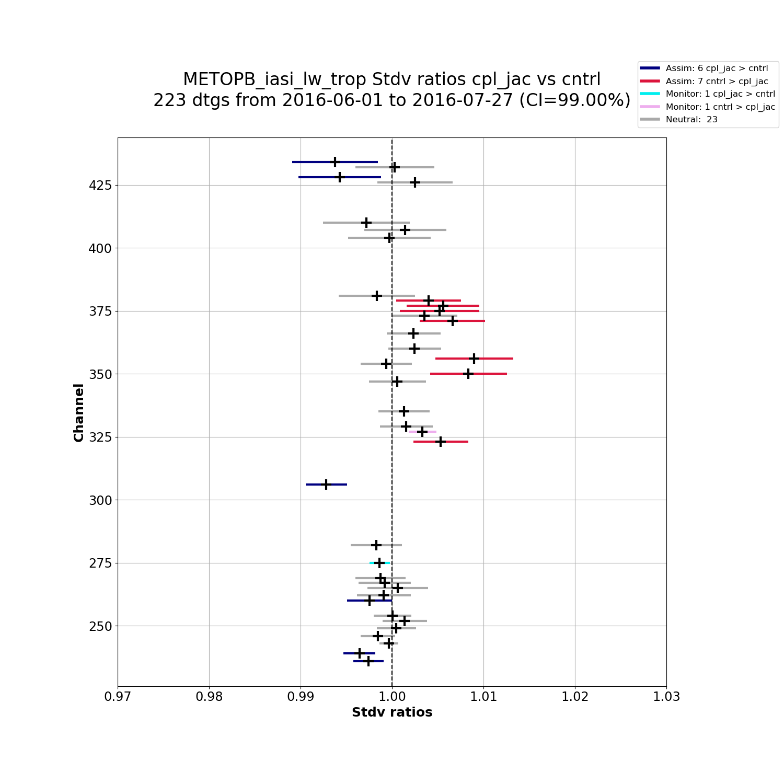

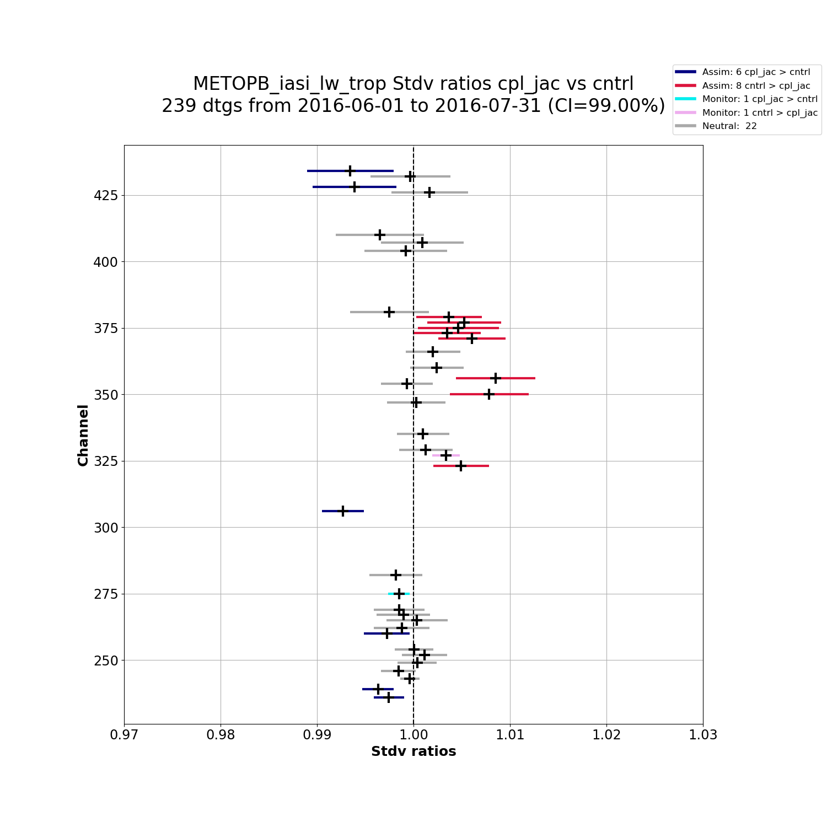
Fit as a Function of Time

Slide 16





























Fit as a Function of Time

Slide 17
Future Work
Evaluation of reliability and fidelity to traditional forecast scores
Fits to bias-corrected innovations, absolute bias
Add other space-based observations such as AMVs, scatterometers, GPS-RO, Lidar, future sensors
Regional statistics and scorecards to match traditional verification, or for limited area models
Longer lead times (e.g. fit to 5-day forecasts), which will project onto model error
OSE and OSSE applications, e.g. if new observations fit poorly, there may be a problem with the new observations or the forward model rather than the forecast model

Slide 18
Summary and Conclusions
Evaluating the background fit to observations is a useful verification tool in observation space that achieves statistical significance much faster than traditional verification methods in model space
Substantial savings in computer time and developer time can be realized
As it uses innovations that are already produced in the normal data assimilation process, there is little overhead needed to compute and evaluate their statistics
A lightweight Python implementation runs in minutes on a laptop for months of data (satellite radiances only at present)
Output plots for each satellite, instrument, and user-defined channel group yield useful diagnostic information to the researcher
Output scorecard is a useful summary and decision aid

