Slide 1
Dick Dee, ECMWF
JCSDA meeting, 31 May 2019

Slide 2
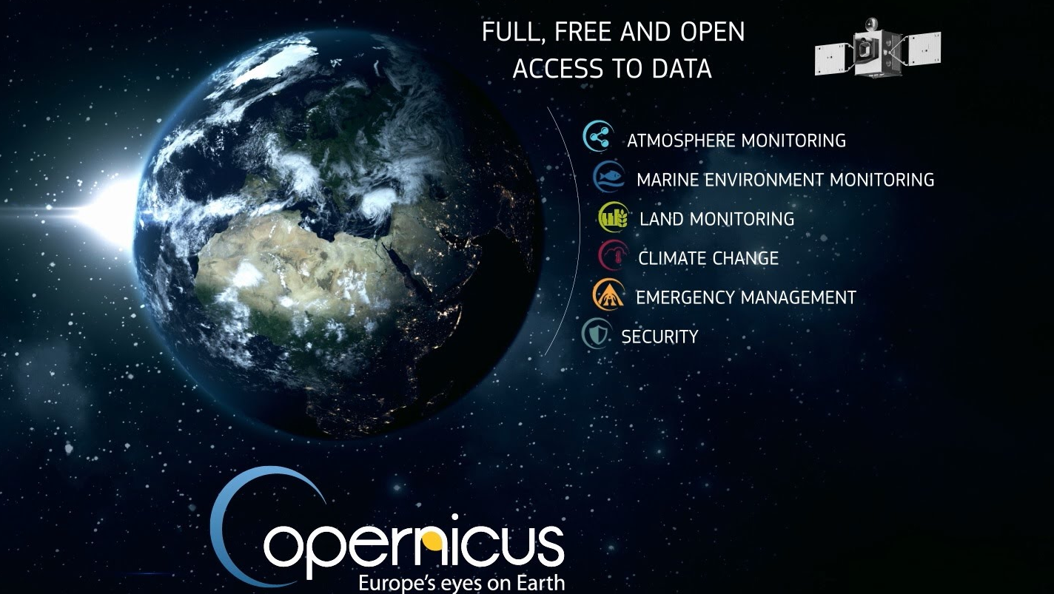

Slide 3


Slide 4
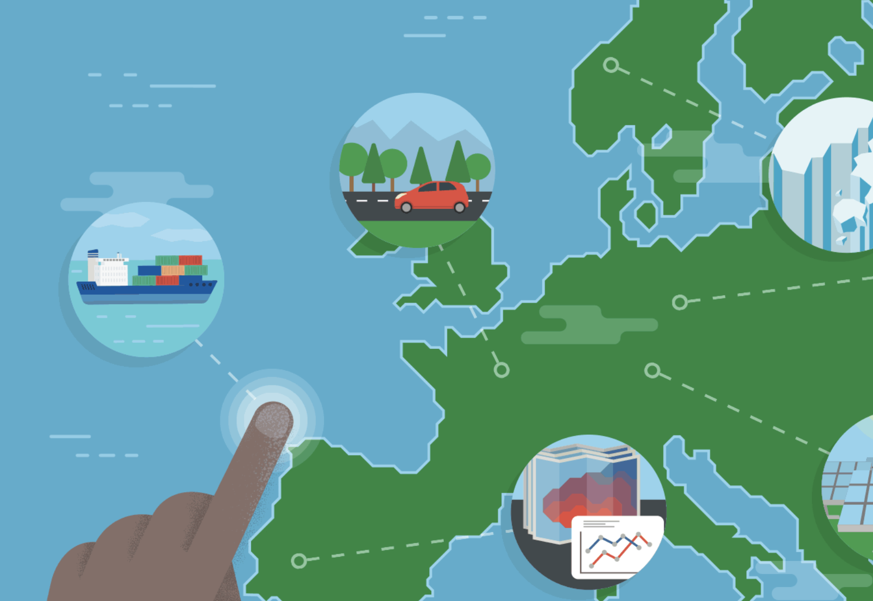
The Copernicus Climate Change Service (C3S)
Provide data and tools to support adaptation and mitigation policies
Build on existing expertise, capabilities and infrastructure
Enable development of climate services in the public and private sectors
  Operational
  Open and free
  User driven
  Quality-assured
  Consistent
Notes:
Starting from scratch, very aggressive timeline

Slide 5
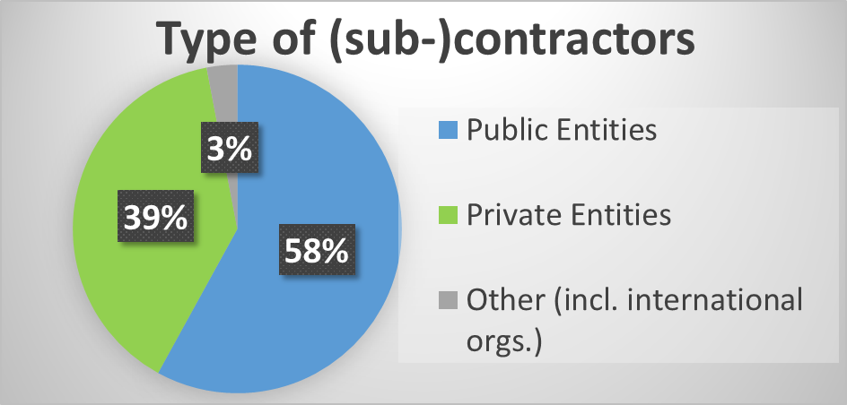
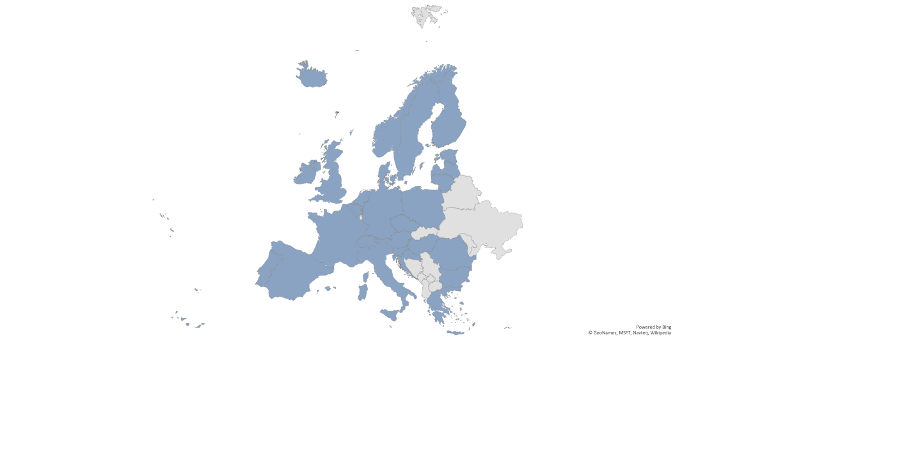
Program implementation by ECMWF
Delegation agreement EU/ECMWF
Annual budget roughly 40Meuro
Most of the work is outsourced
94 contracts with 256 entities
29 EU/ECMWF Member States
In-kind contributions e.g. NOAA/NCEI

Slide 6
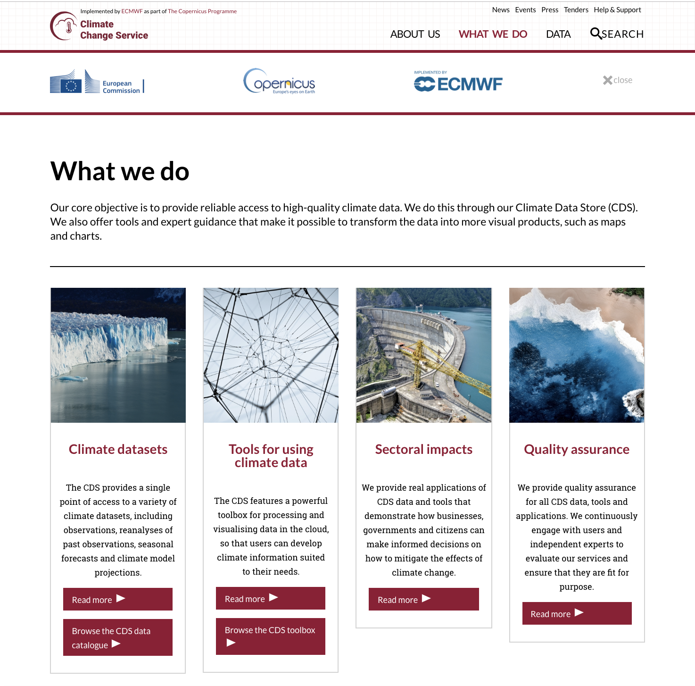
C3S operational since 2018
Access to climate data
Tools needed to use the data
Information on sectoral impacts
Quality assurance
User support and training
Climate change assessments
Outreach and communication
Notes:
This is a succinct summary of everything we do today

Slide 7
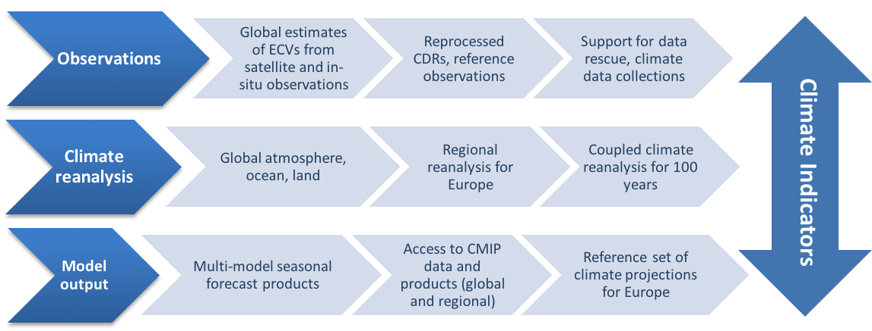
Climate data: Past, present and future

Slide 8
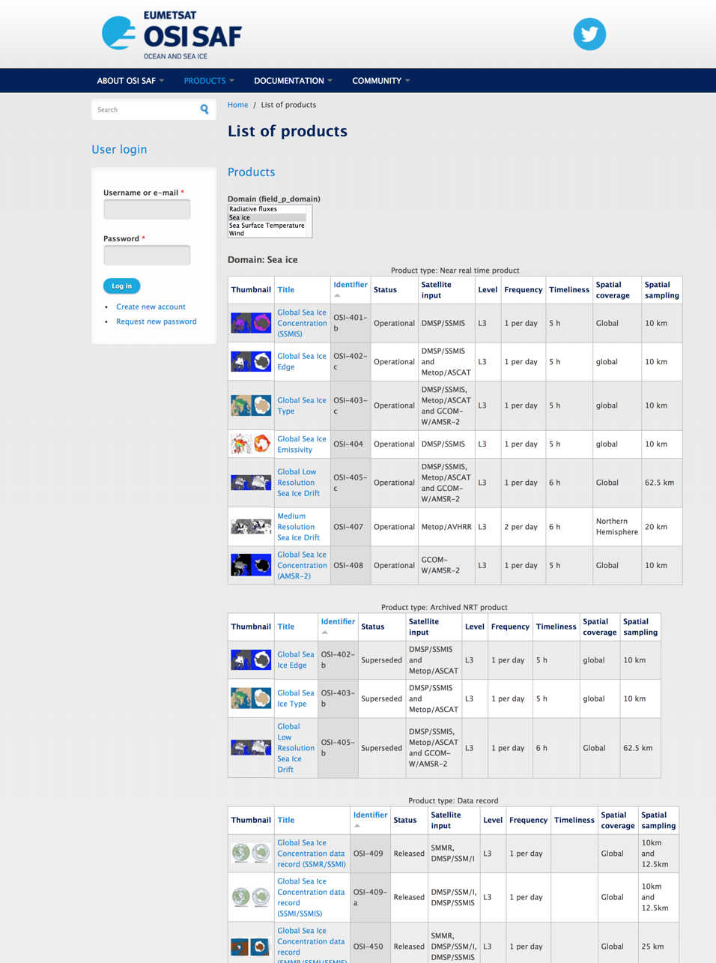
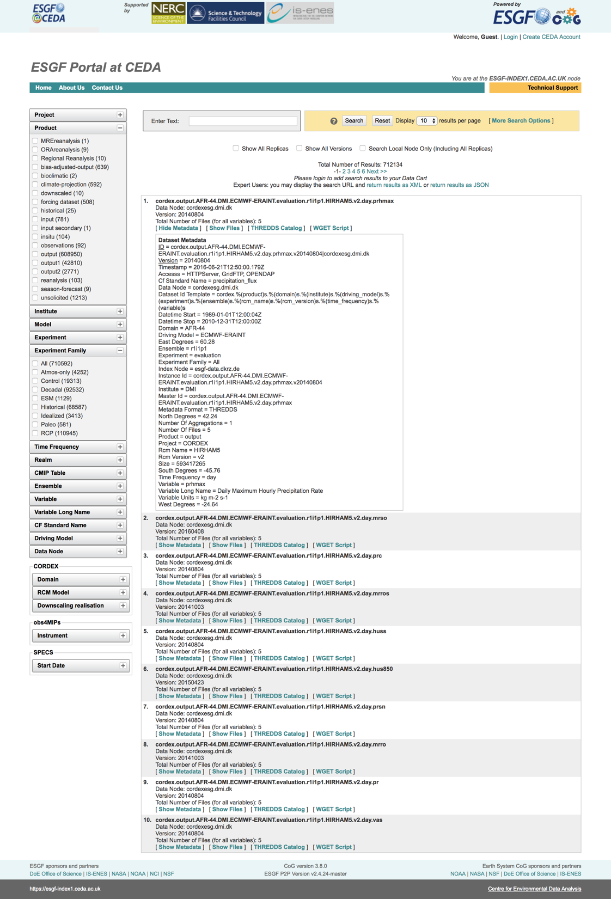
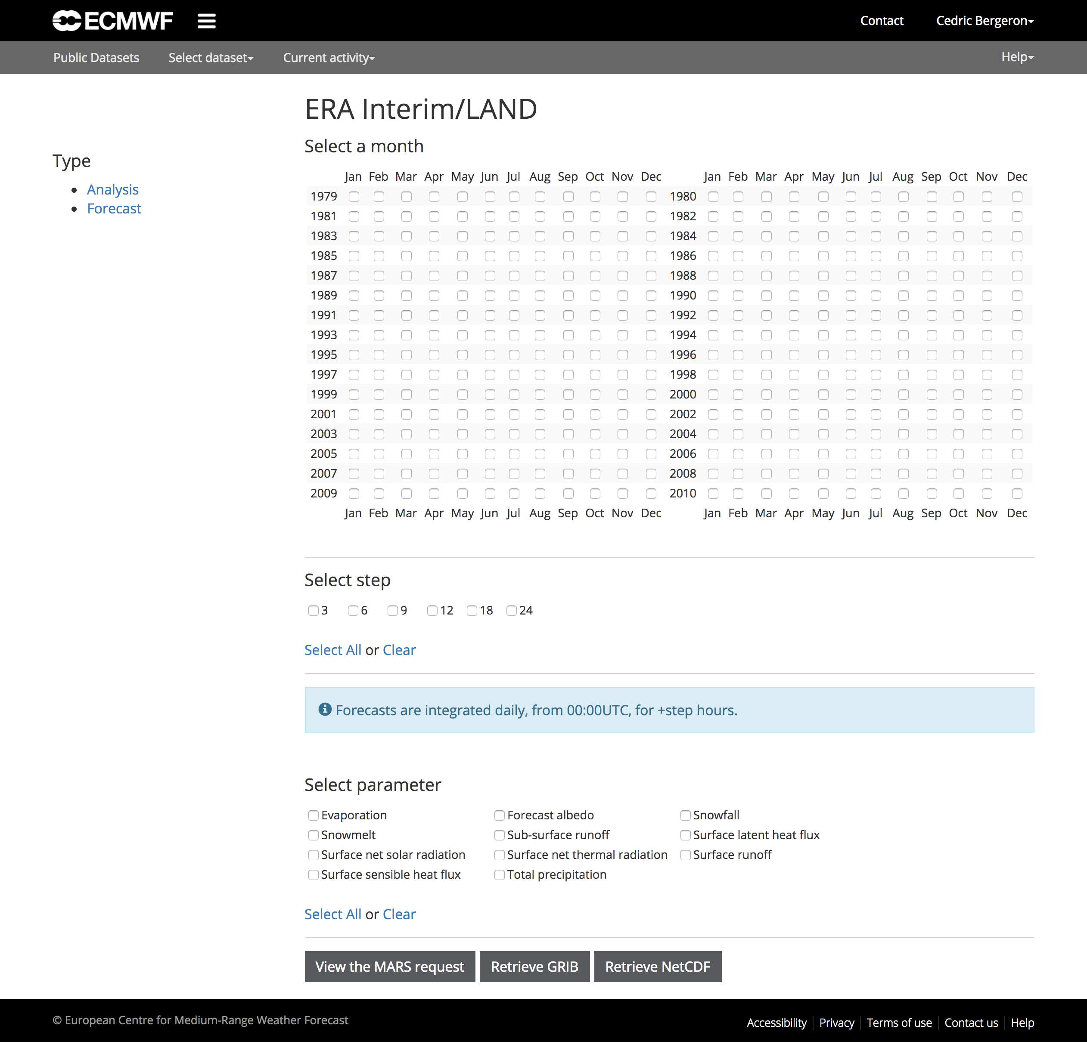
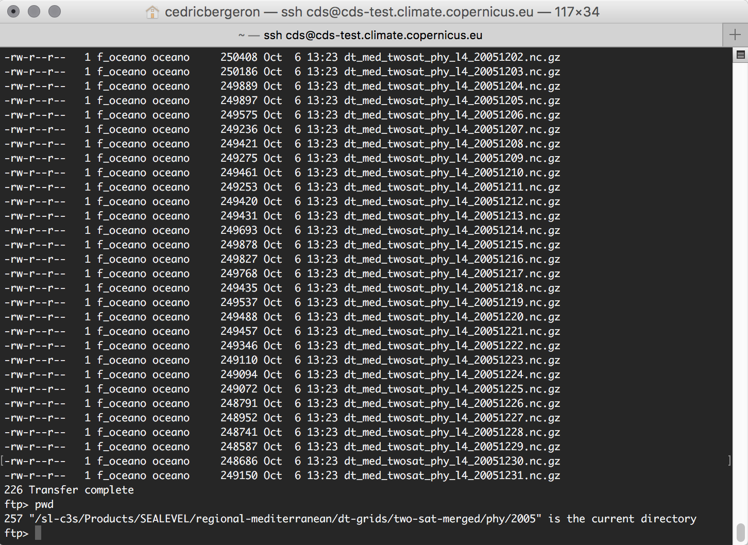
Before…
Access to climate data today…

Slide 9
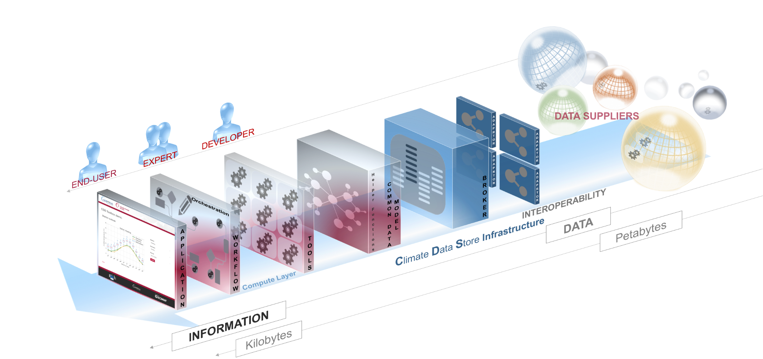
Concept for a Climate Data Store in the cloud

Slide 10



CDS software architecture
End User
Data Supplier
External Information
Systems
CDS EQC
CDS Administrator
Browse
Browse
API
Catalogue
Export
WEB PORTAL
Authentication
Users Management*
Data/Products Catalogue
Discover/View/
Download
Data/Product
Metadata Management*
Tools/Workflow Management*
Data/Products Catalogue
Iso19115 Export
Application Management*
CLIMATE DATA STORE
Applications Use
*Creation Modification Deletion
TOOLBOX INFRASTRUCTURE
BACK END
Monitoring / Metrics
Monitoring / Metrics
Data/Products Catalogue
User Settings
User Requests
Web Pages
Content Management System
Tools/Workflow Inventory
Applications
inventory
BROKER / Scheduler
Compute
Queues
Status
Tools/Workflows Repository
Computation Exec.
Staging
Computation Exec.
Results/Cache
Adaptor
Adaptor
Adaptor
Adaptor
Adaptor
Data Elaborated
Data Elaborated
DATA SUPPLIERS
Computation
Computation
DATA
Site n
Tools Repository
Tools Repository
DATA
DATA
Site 1
DATA
Site 2
DATA
Site 3
DATA
Site 4
DATA

Slide 11
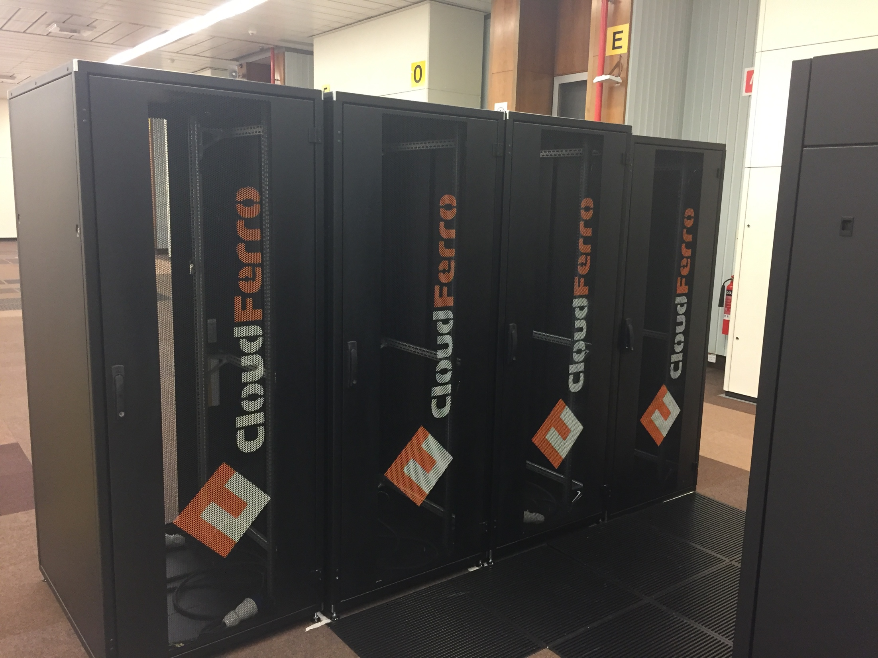
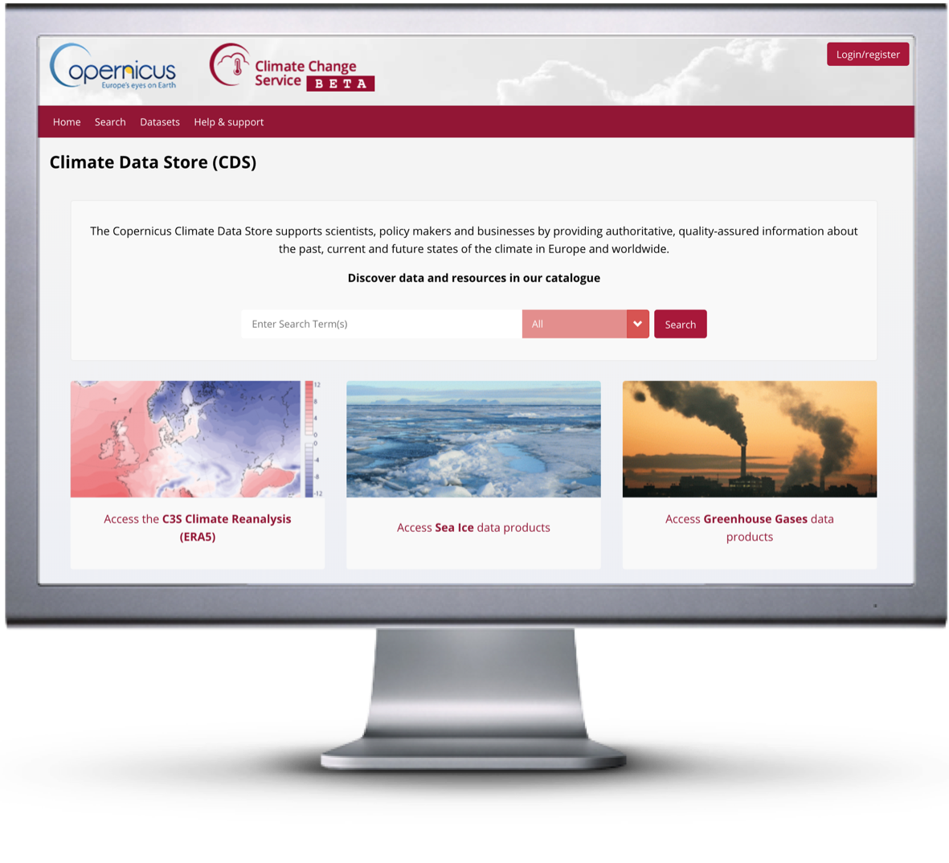
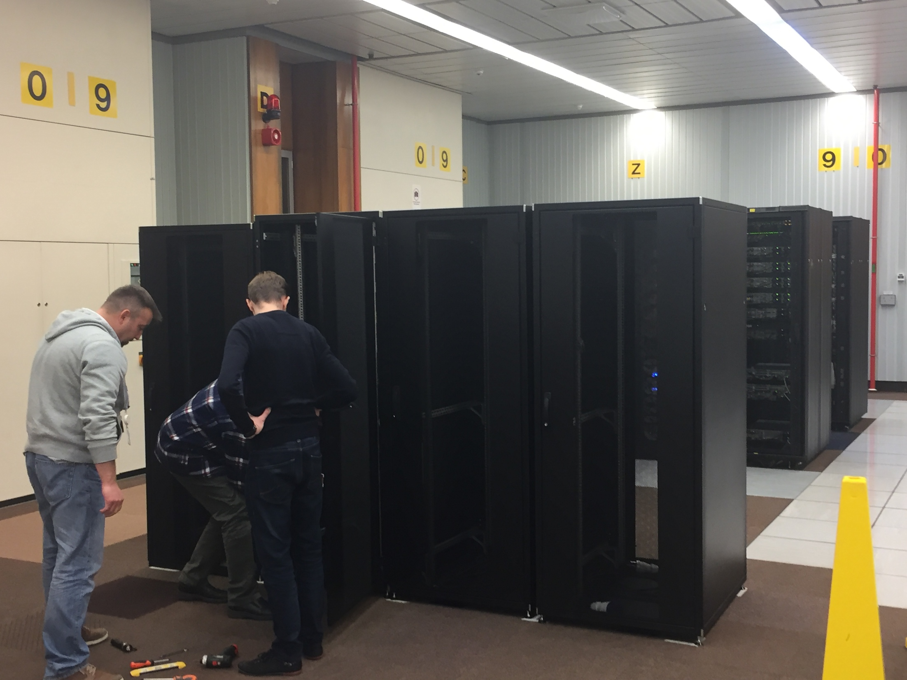
Implementation: cds.climate.copernicus.eu

Slide 12
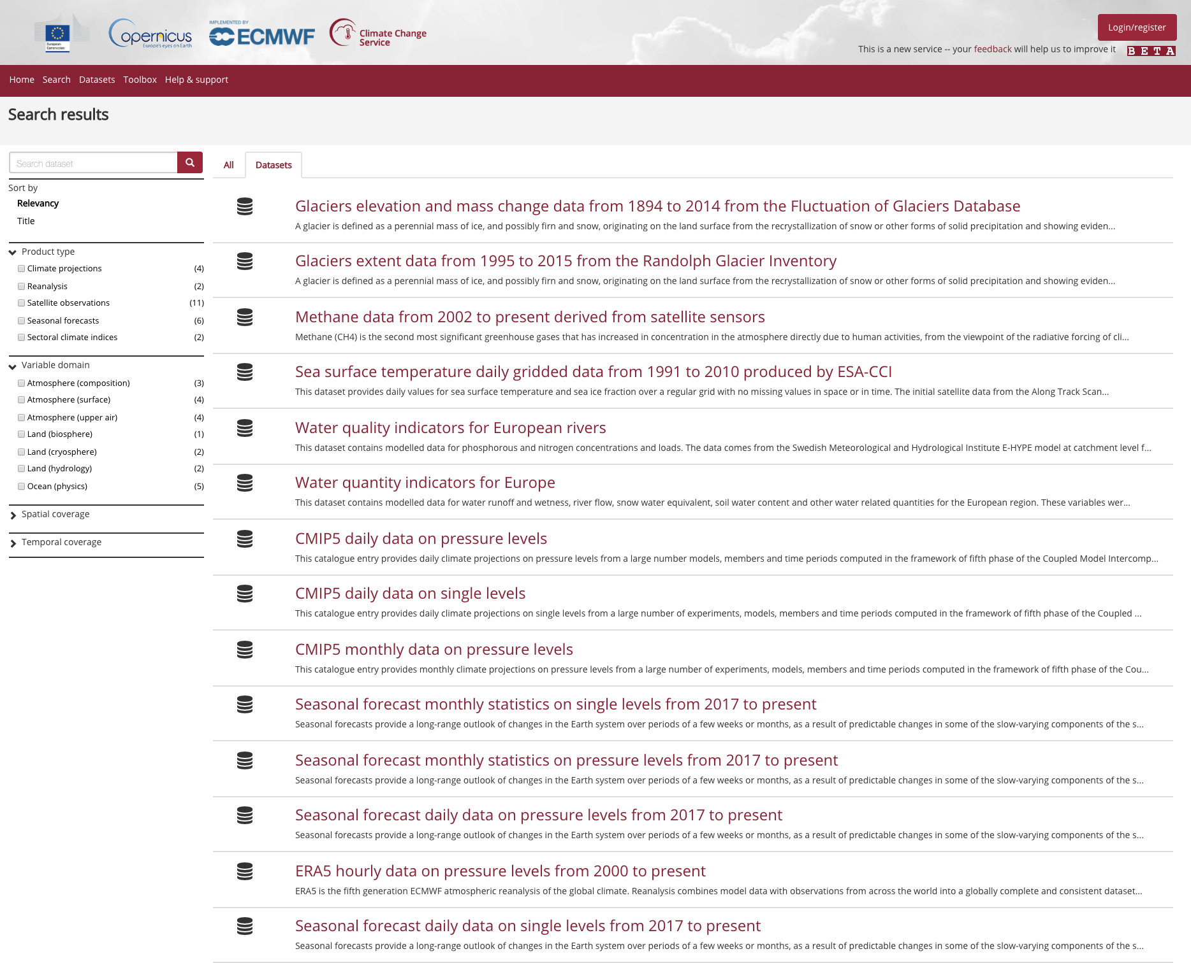
Before…
CDS catalogue of climate datasets
Notes:
Consistency:
In terms of appearance
In terms of dataset names and metadata
In terms of variables and units
In terms of download methods (select and click, api)
This is a big deal and requires a lot of work to get right

Slide 13
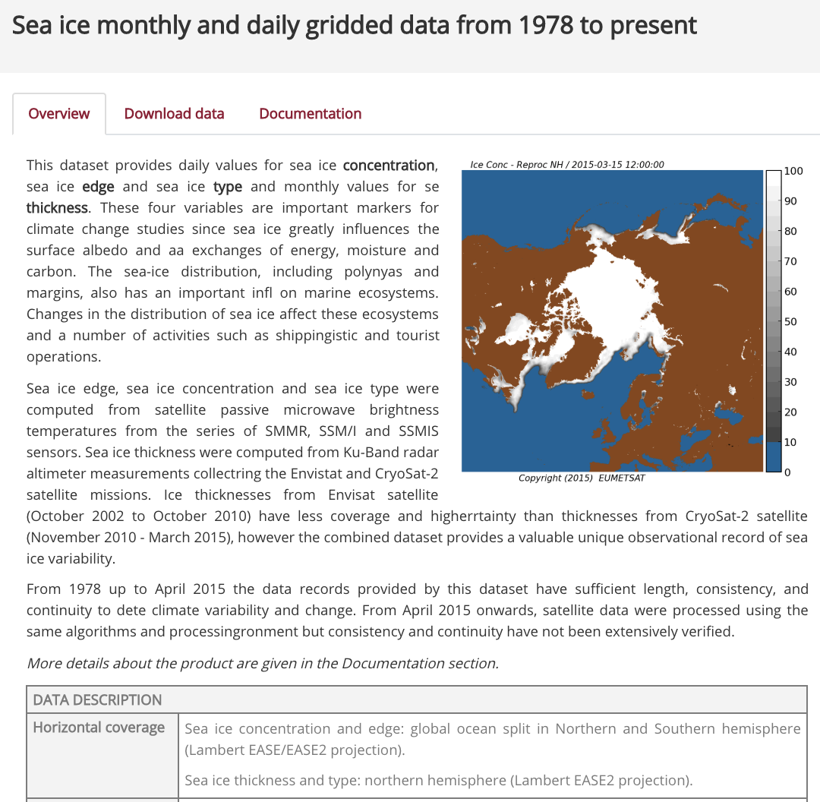
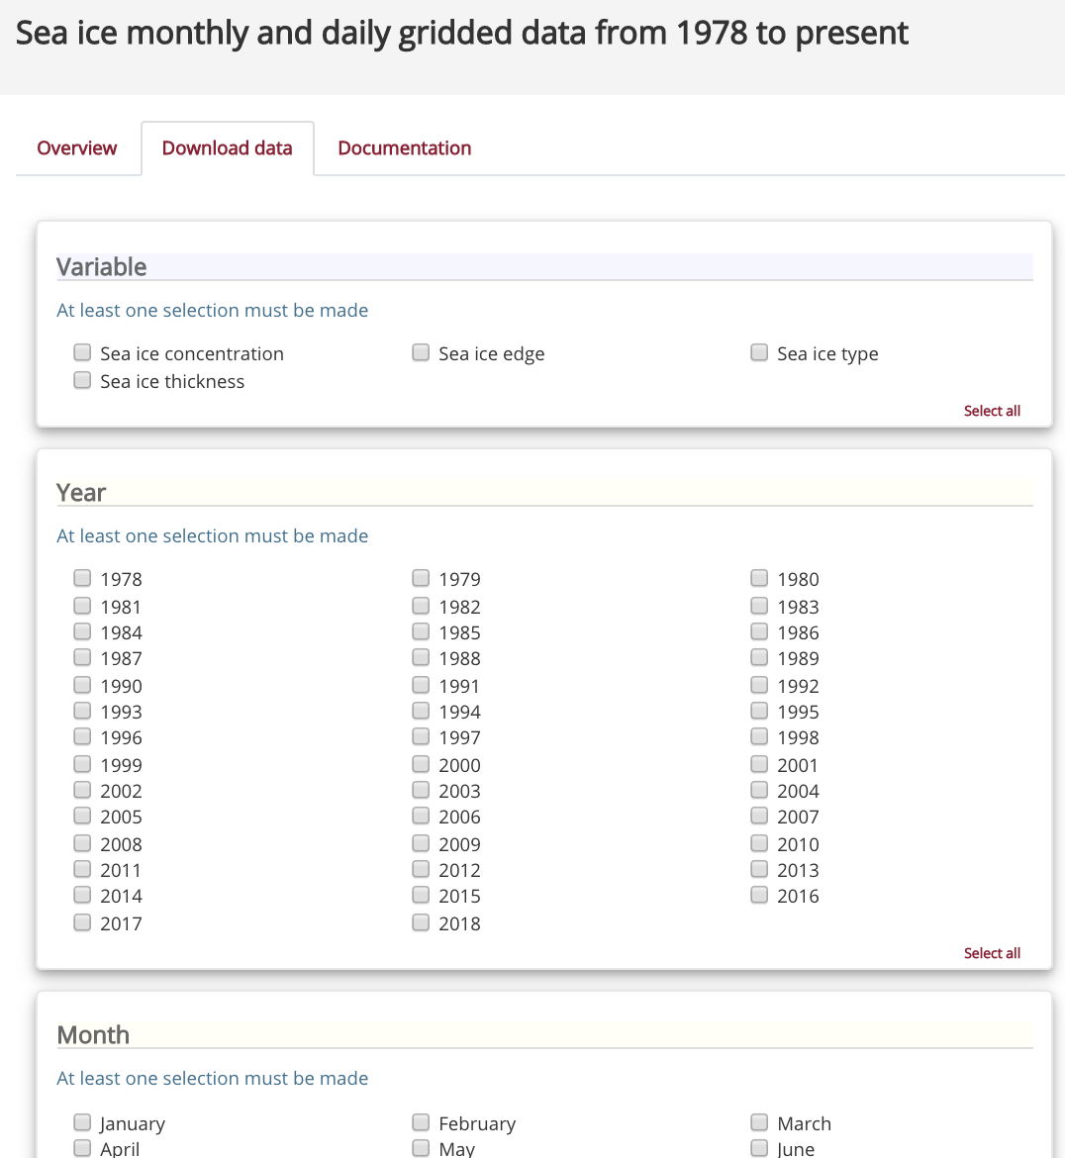
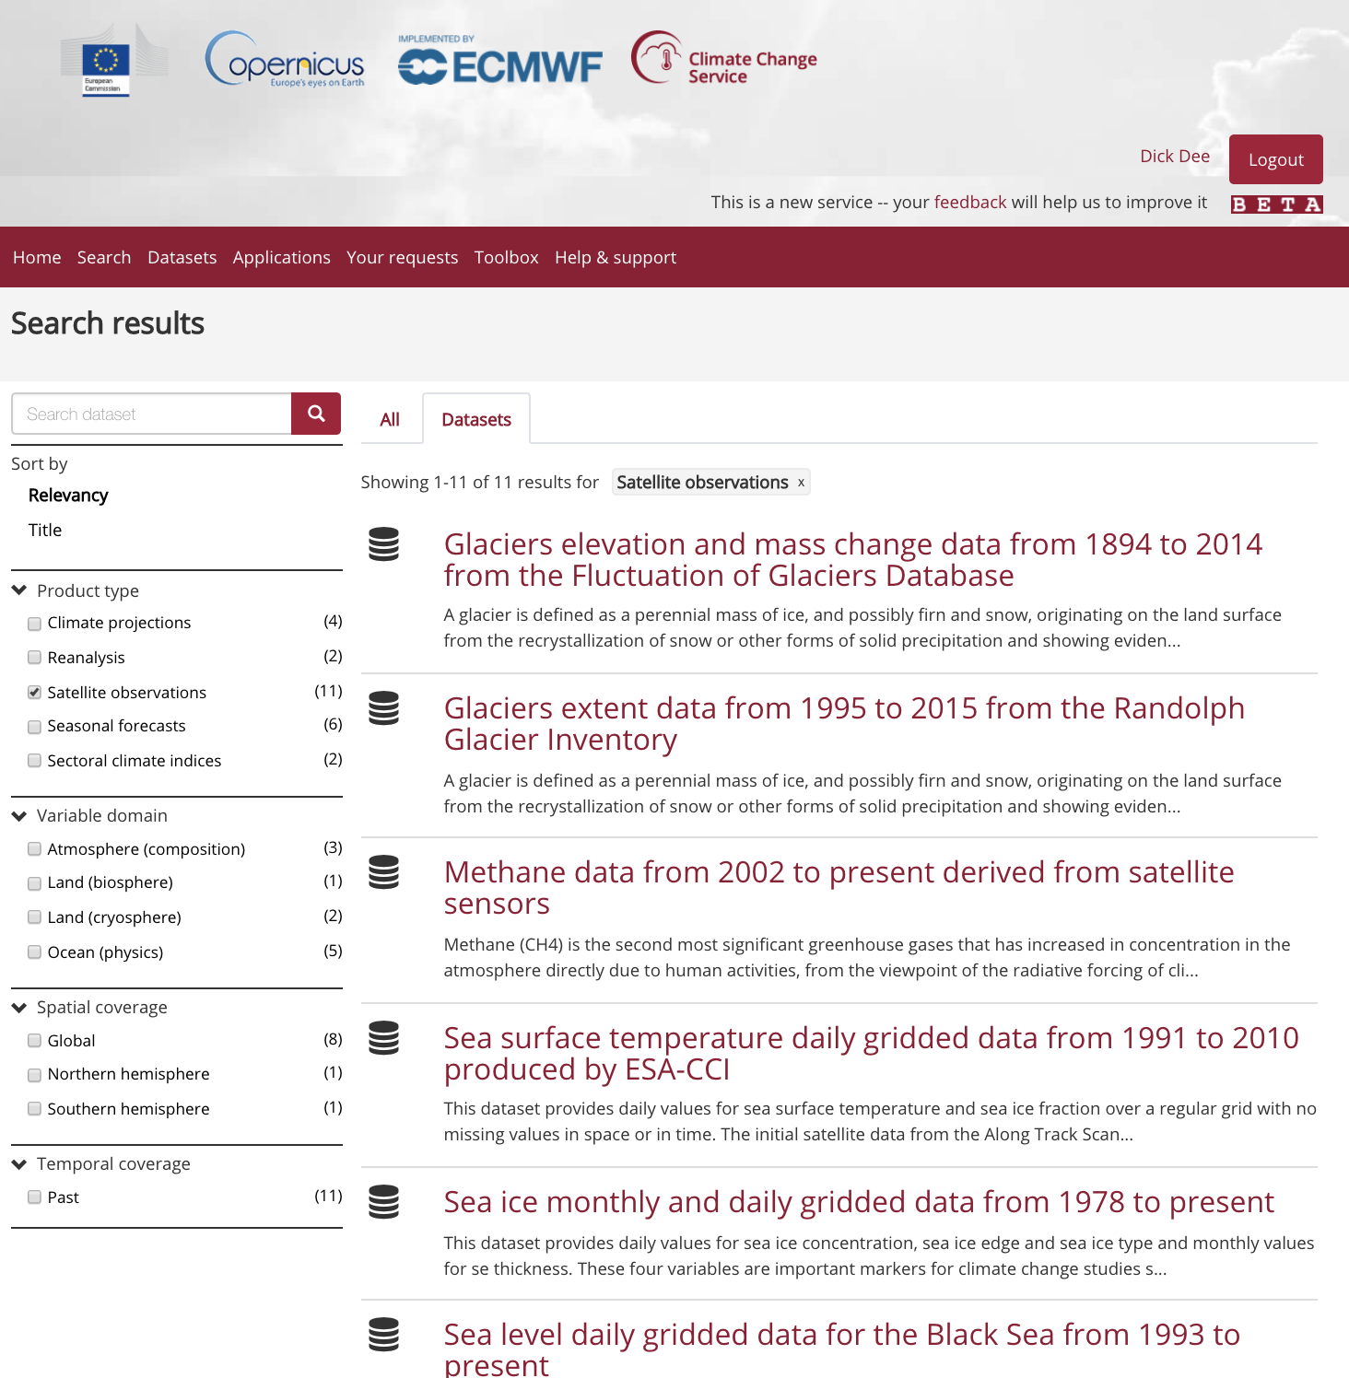
Before…
ECV products from Earth observations

Slide 14
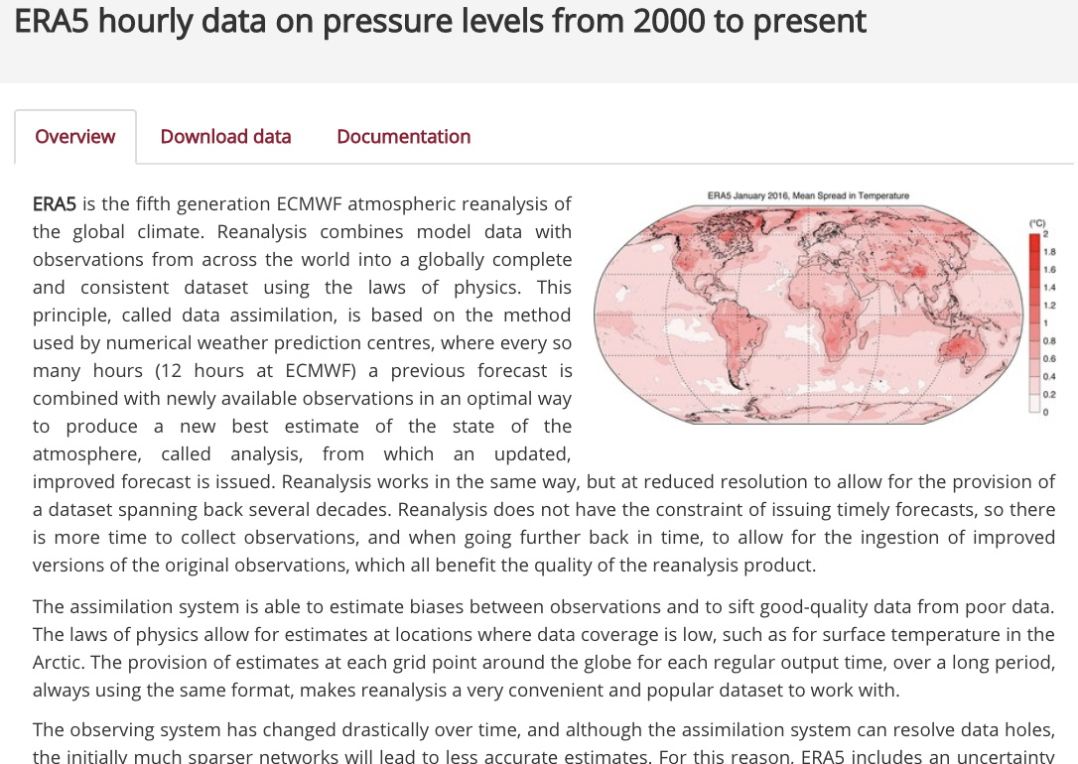
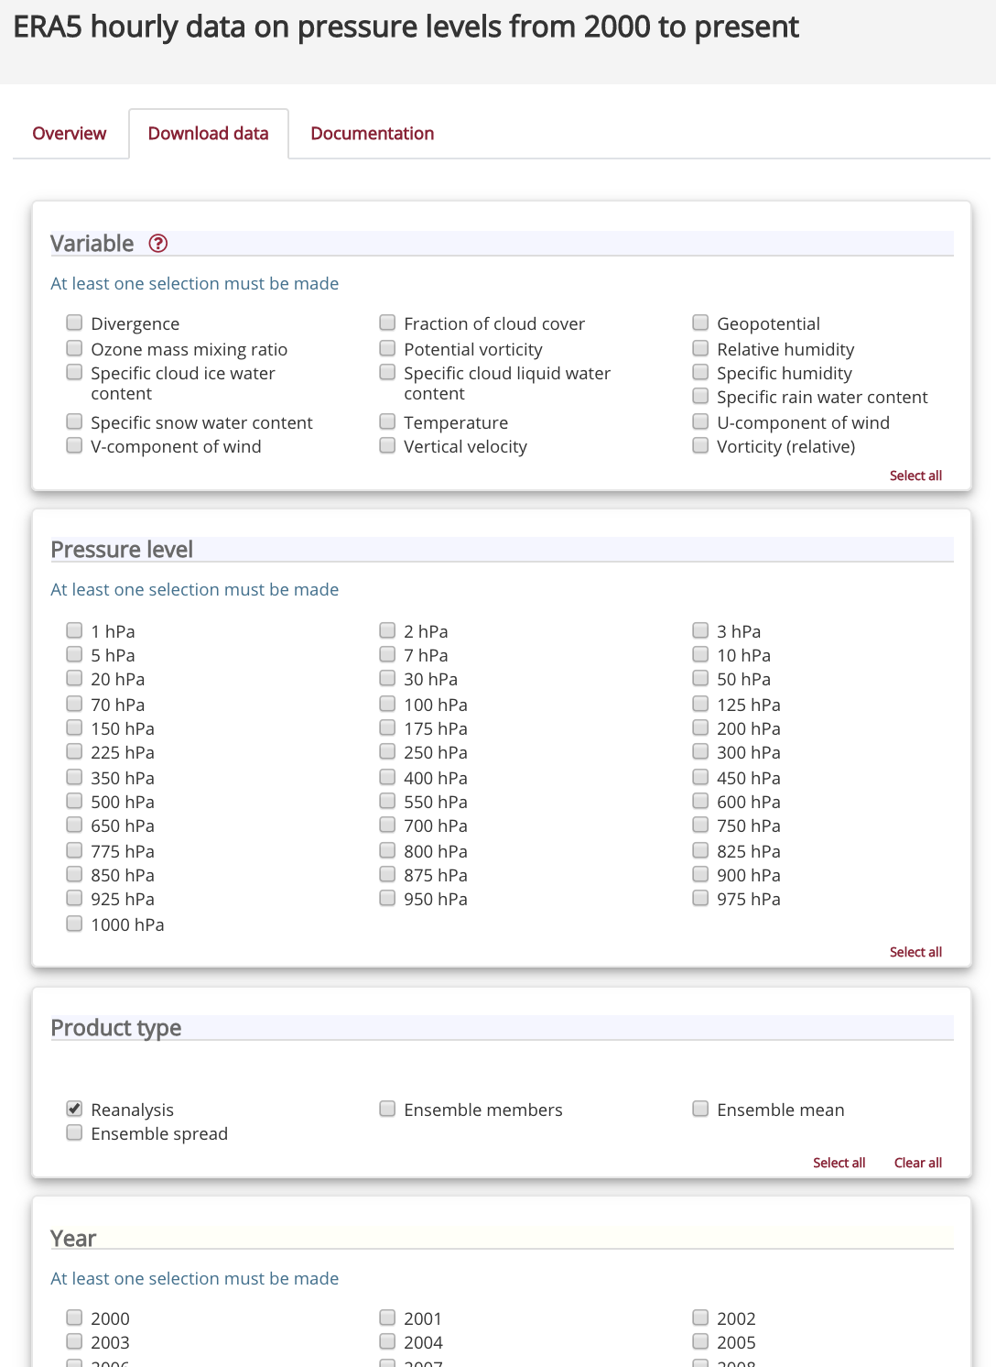
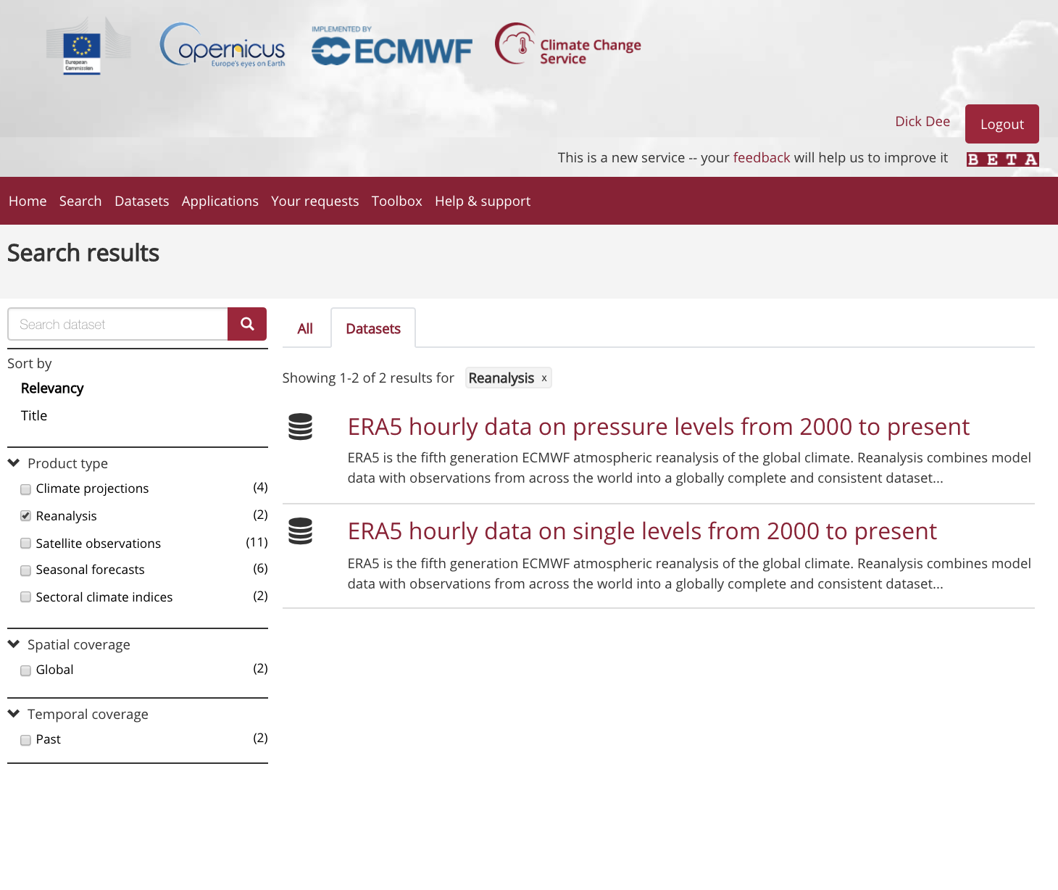
Before…
Global reanalysis data
Notes:
ERA5 from 1979 before end 2018
ERA5T before

Slide 15
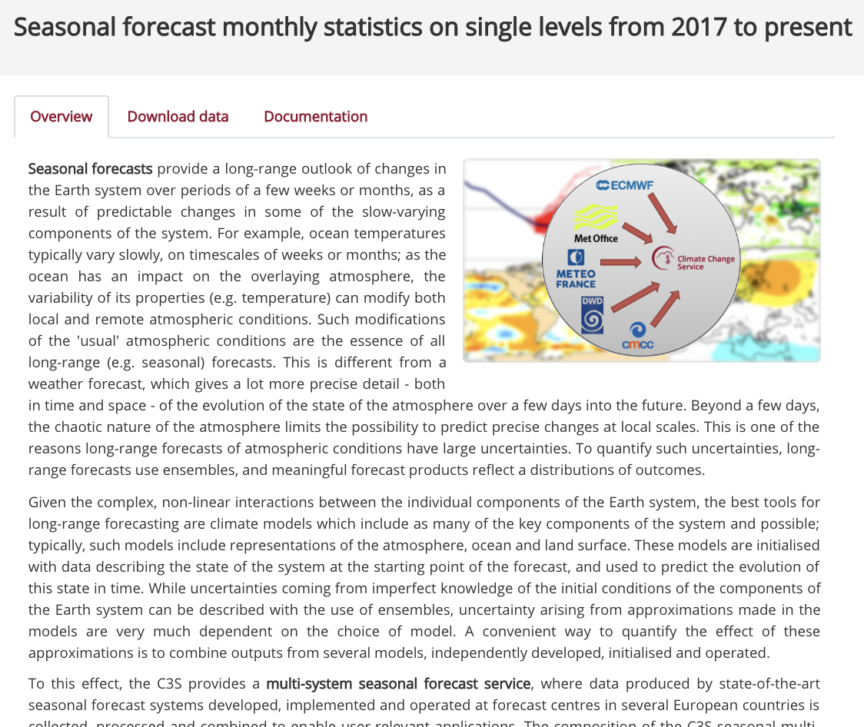
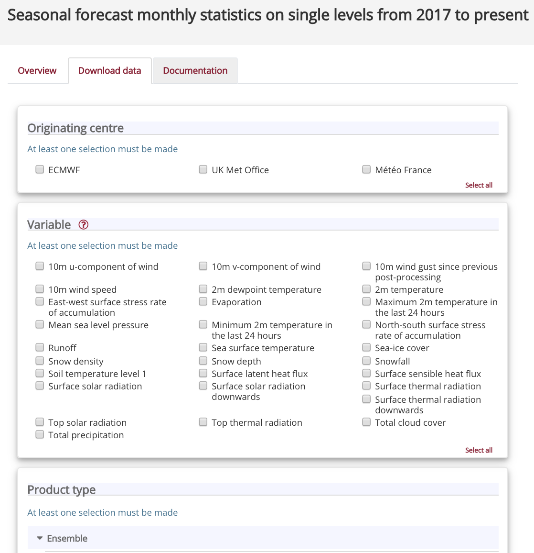
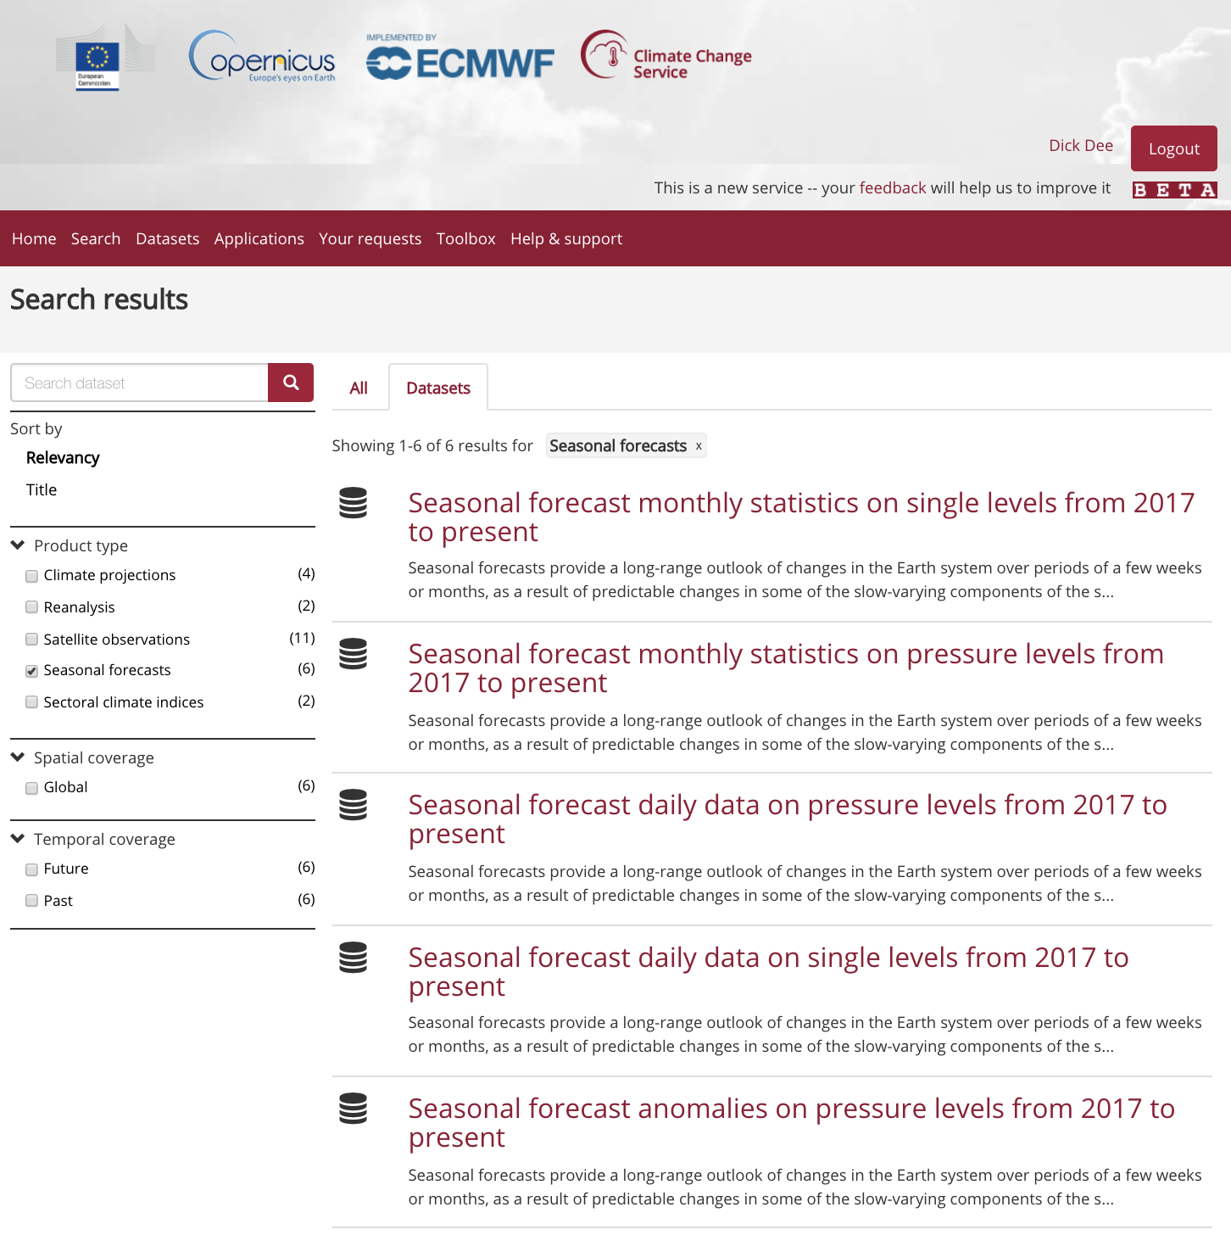
Before…
Multi-system seasonal forecasts

Slide 16
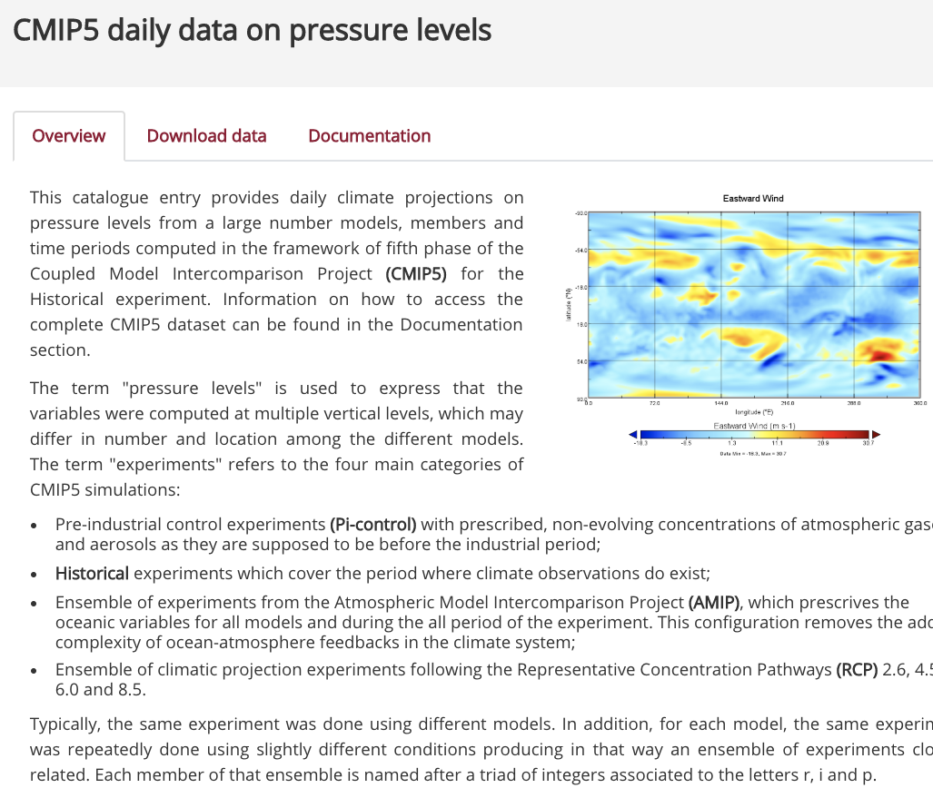
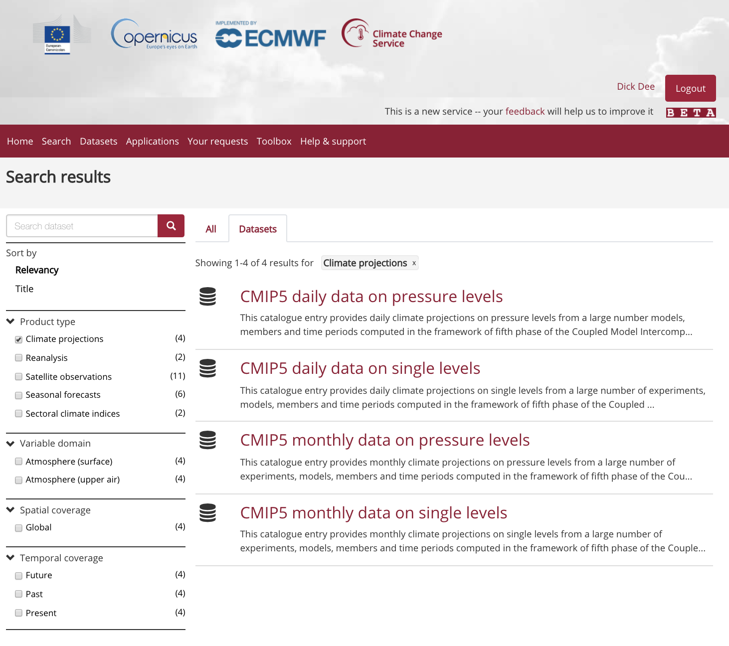
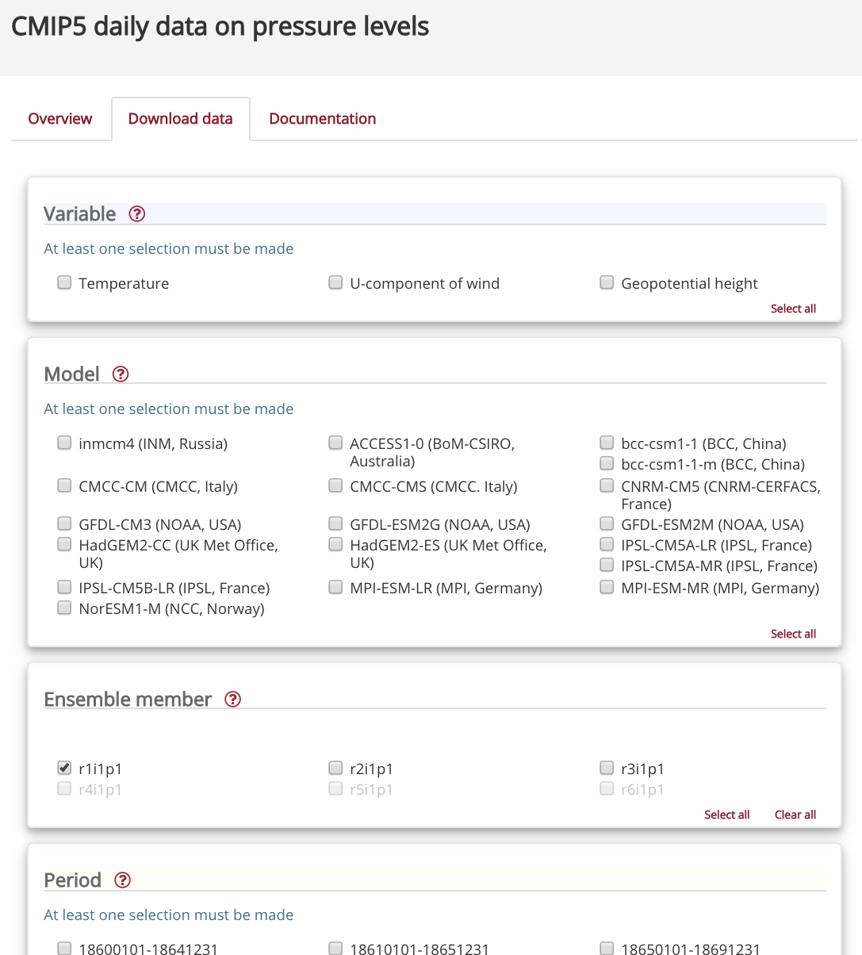
Before…
Climate model output via ESGF

Slide 17
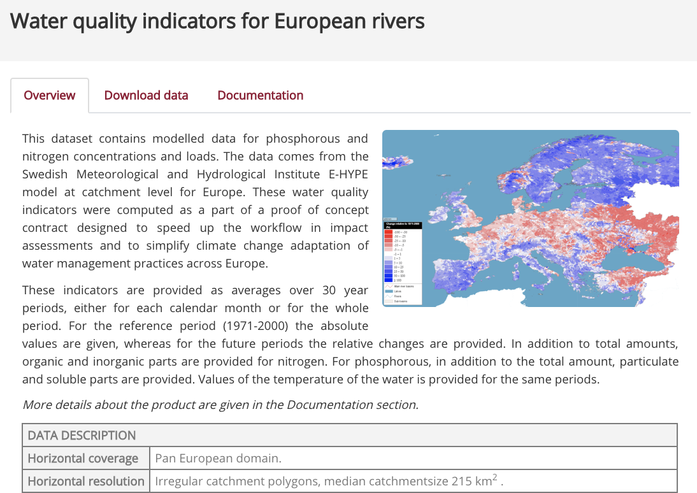
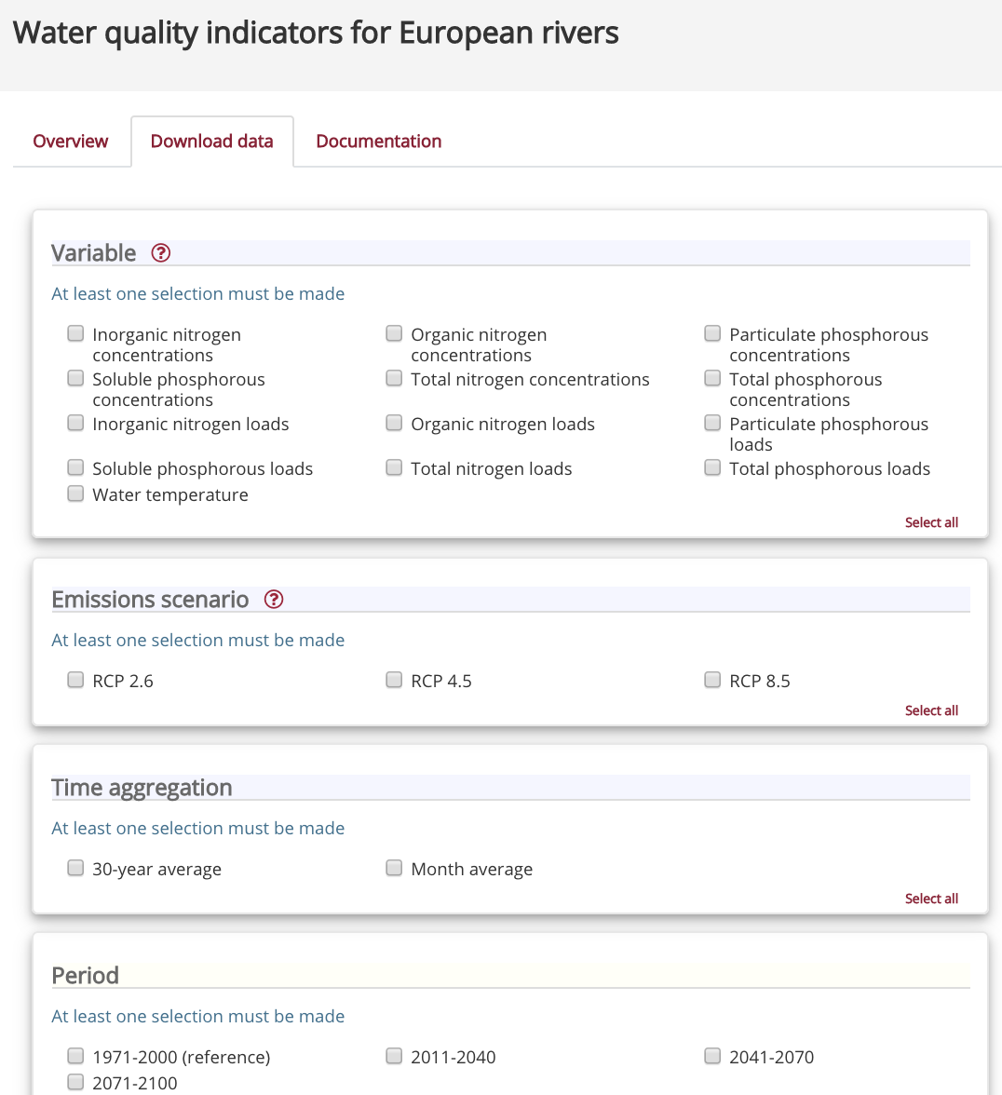
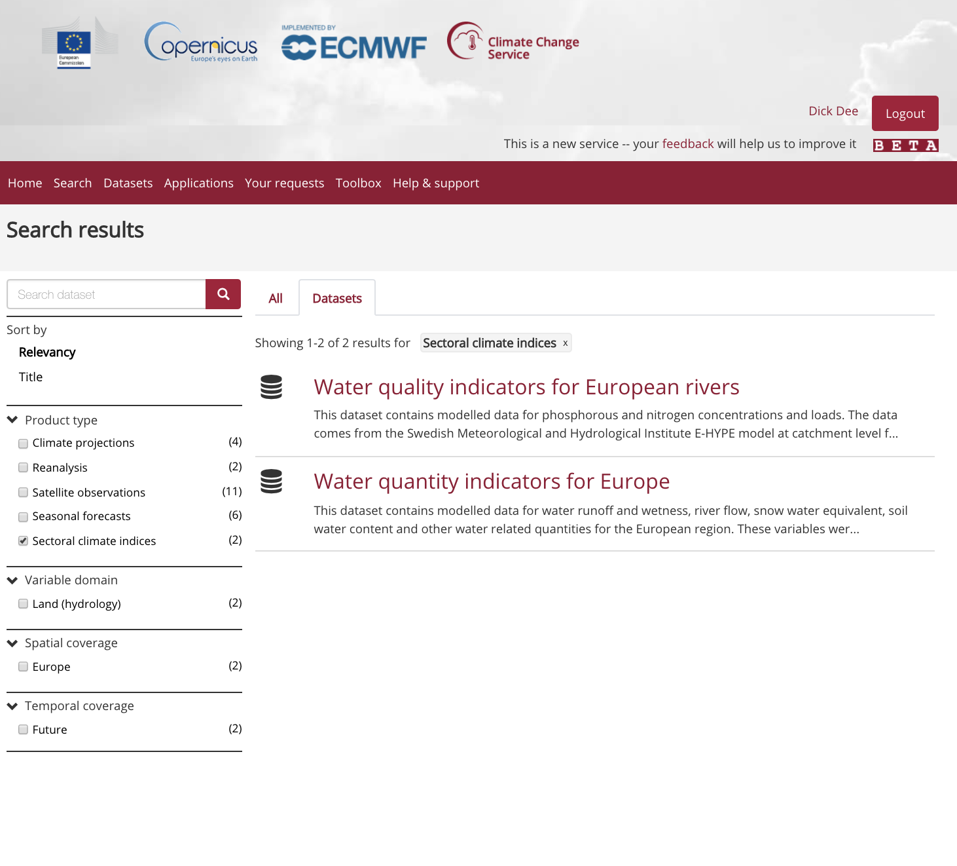
Before…
Climate change impact indicators

Slide 18
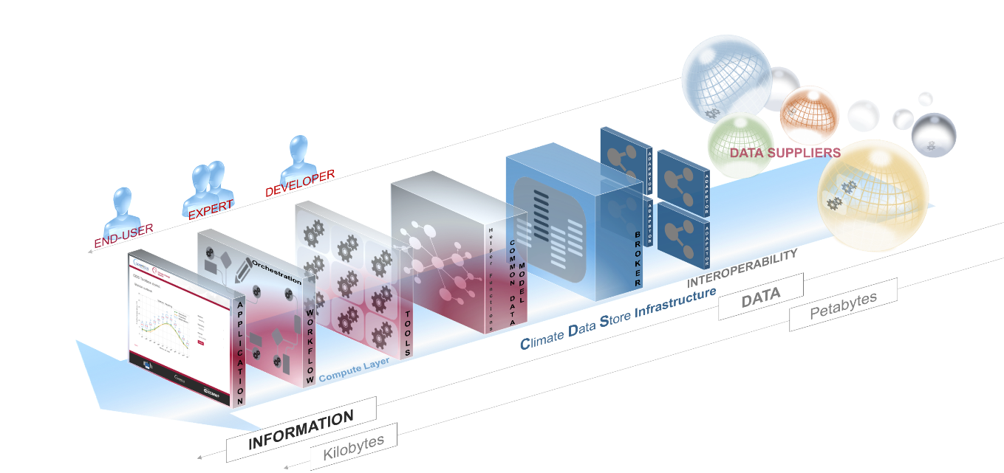
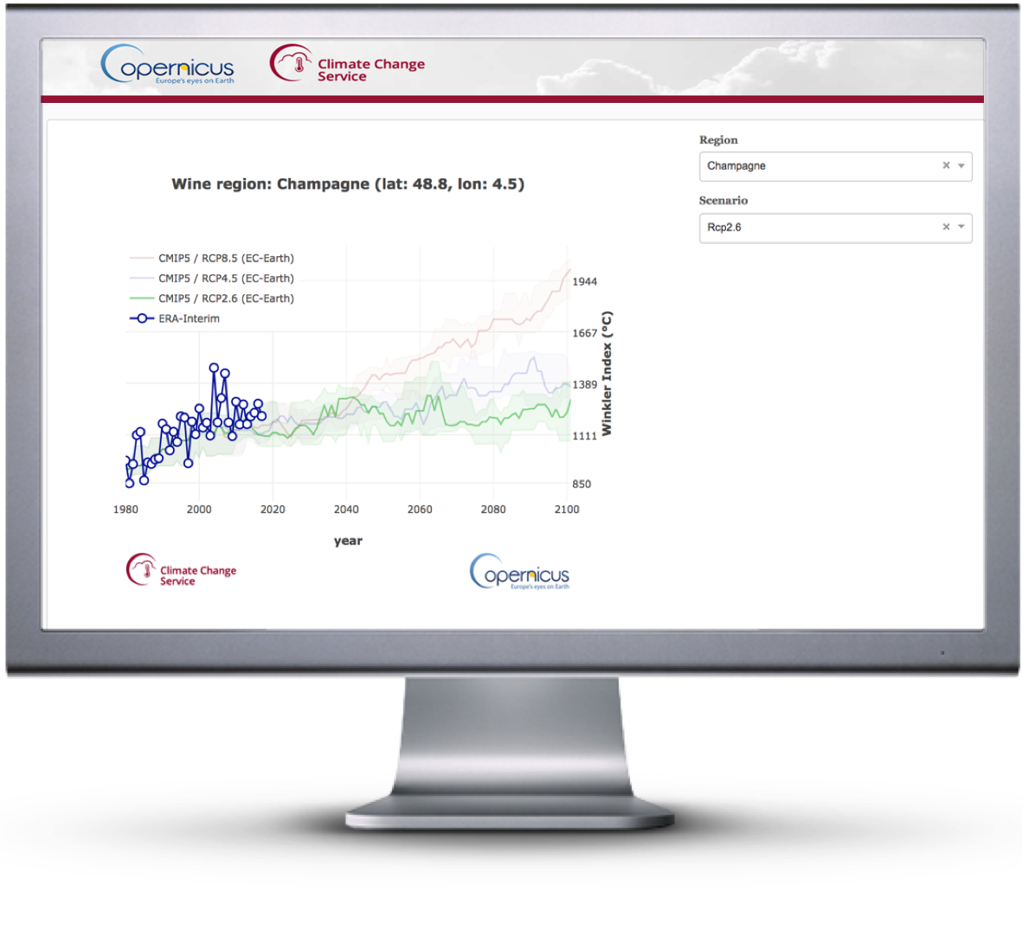
User applications
C3S service chain
Quality assured information and tools for scientists, consultants, decision makers.
Notes:
Technical challenges:
Diversity of users
Diversity of data sets
Very large data volumes
Data residing at different locations
Interoperability, efficiency
User-defined workflows
Variety of presentation methods
Need for interactivity
Access via API
User management
Performance monitoring

Slide 19
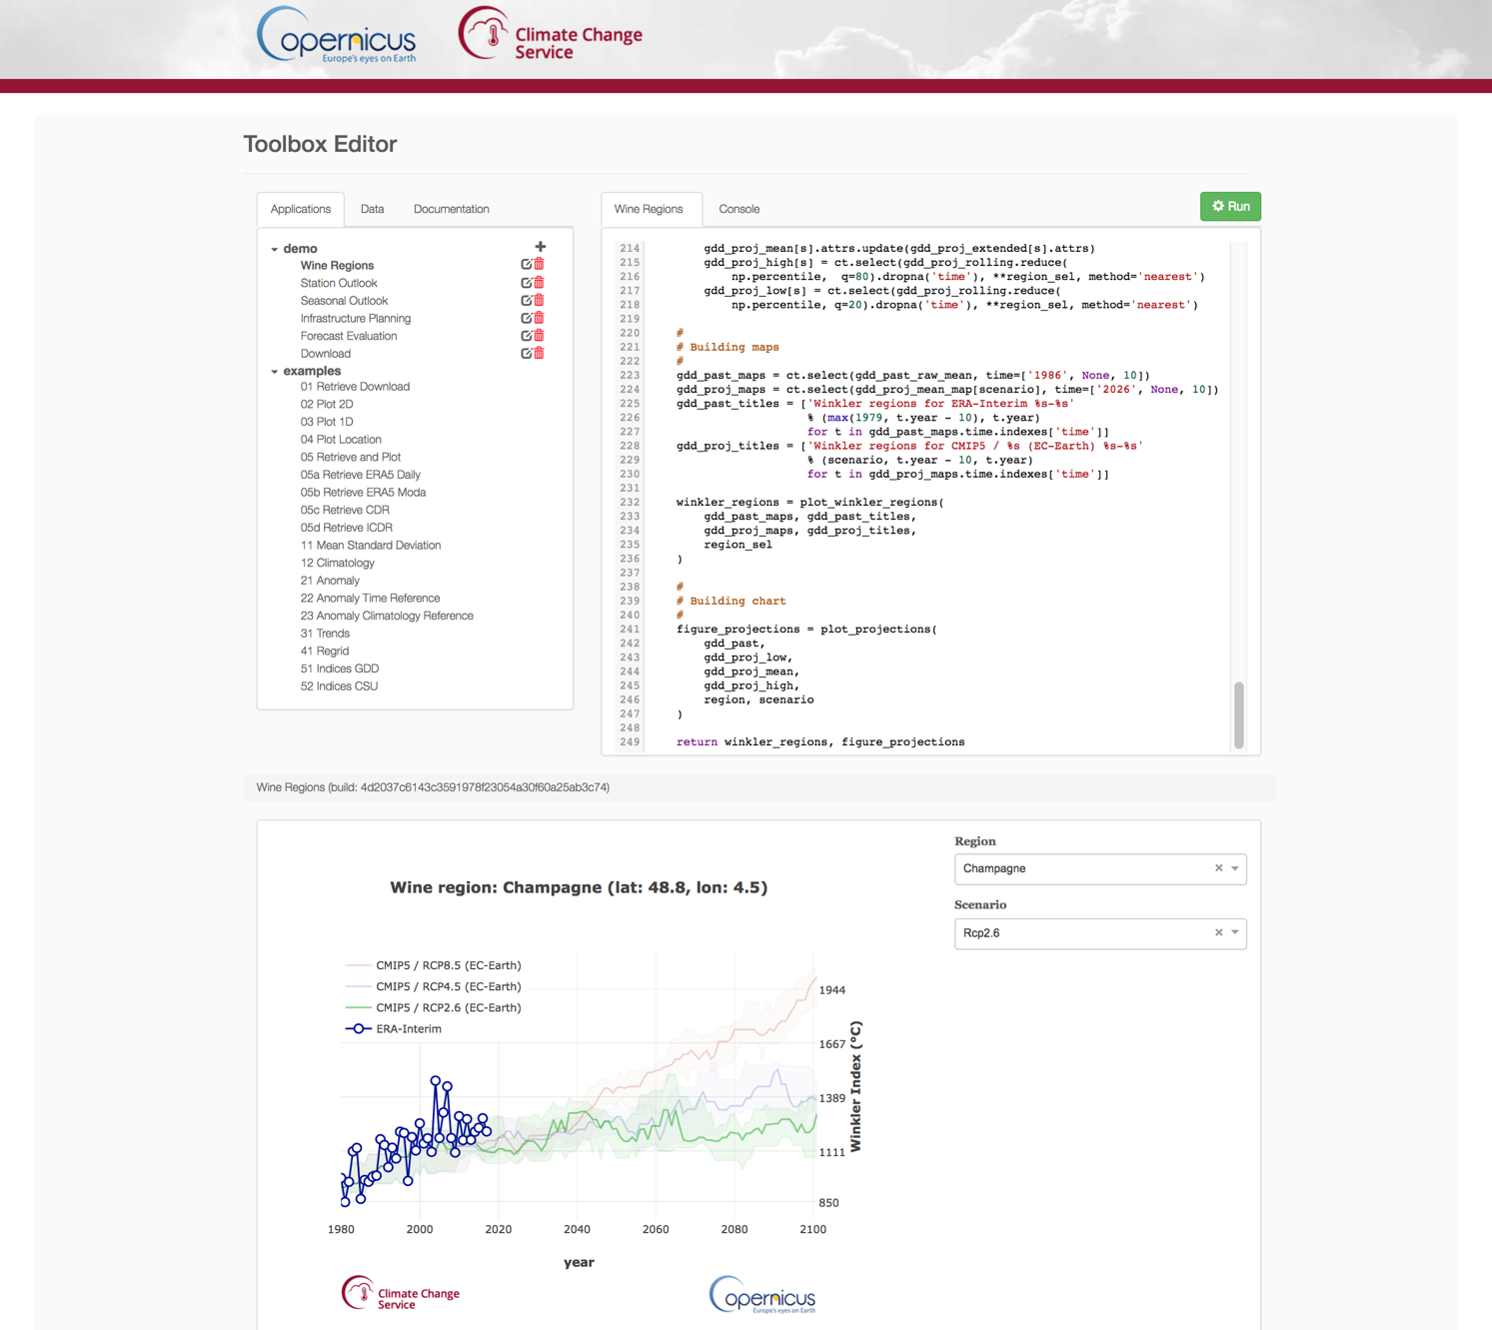
Online application development with python

Slide 20
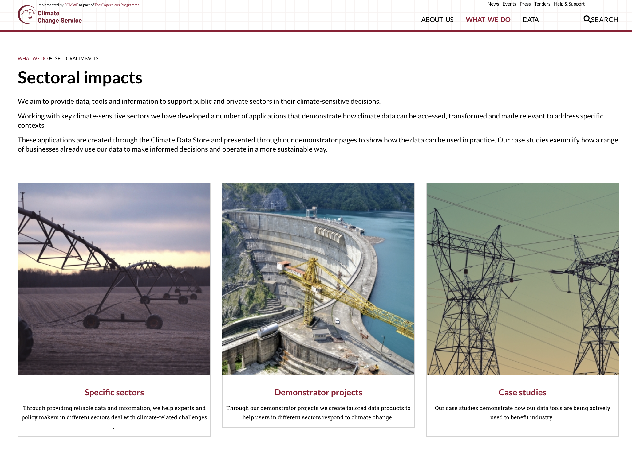
Demonstrating sectoral applications on the CDS
Several contracts issued for developing sectoral applications on the CDS
Drives development of CDS data content and toolbox functionality
Demonstrates best practices to stimulate new use cases of CDS data and tools

Slide 21
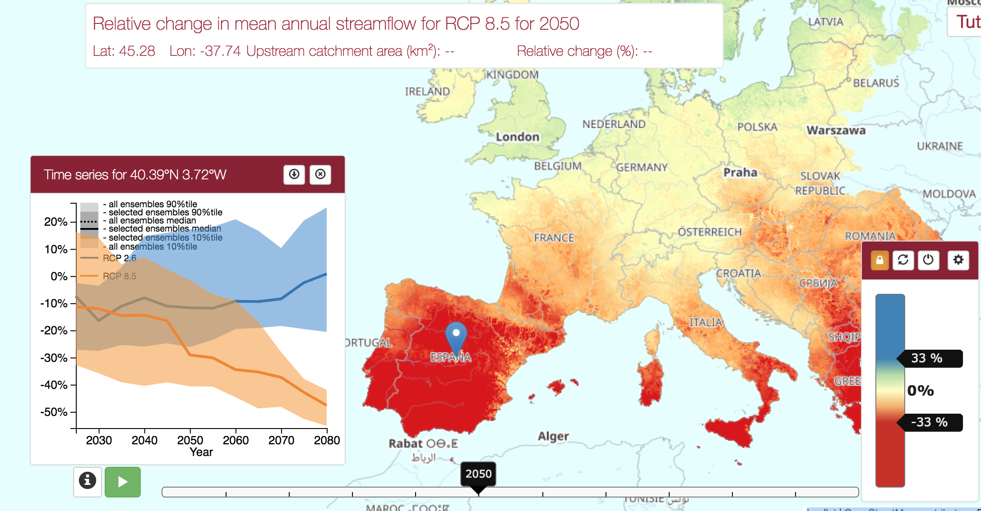
Example: Climate change and water availability

Slide 22
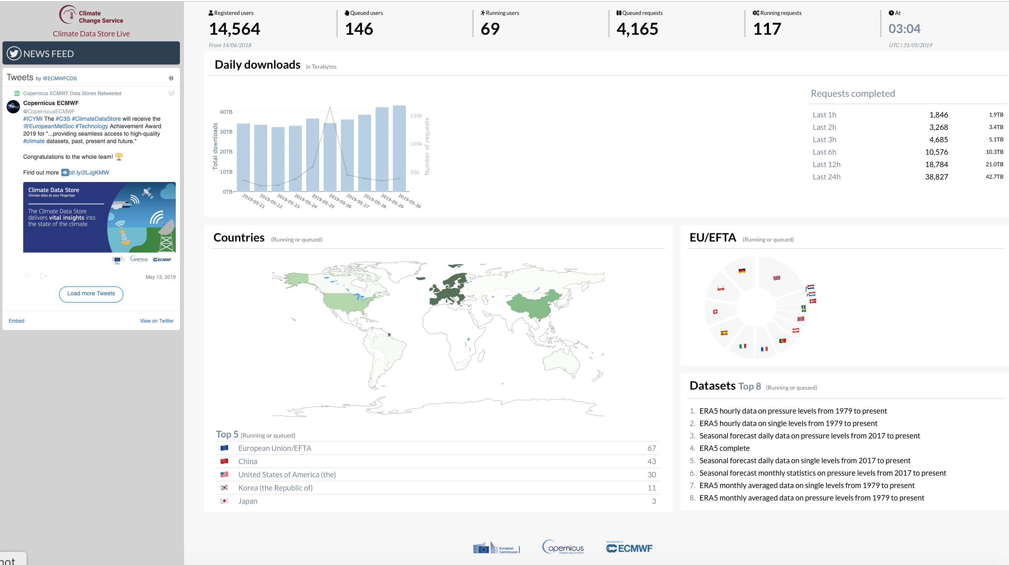
cds.climate.copernicus.eu/live/

Slide 23
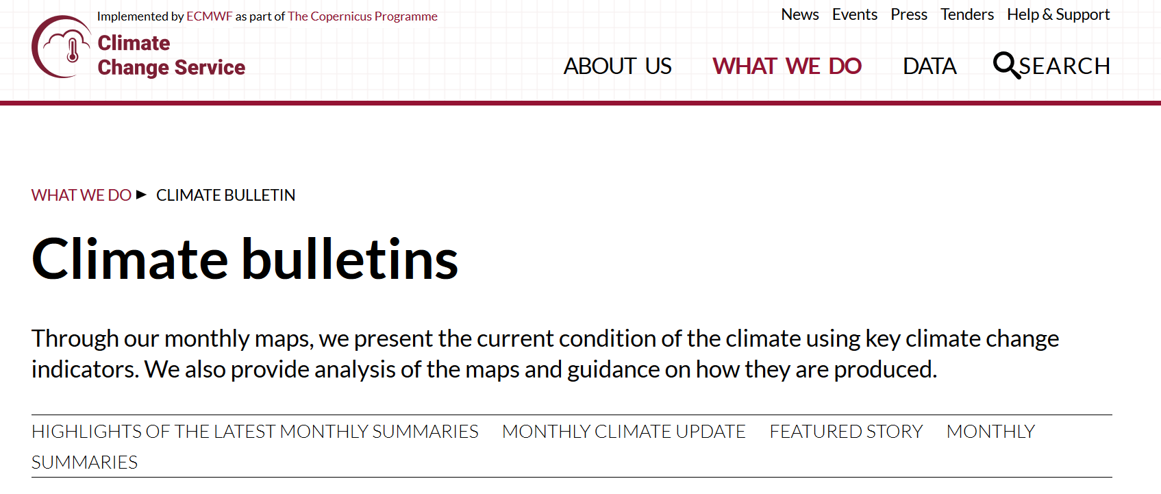
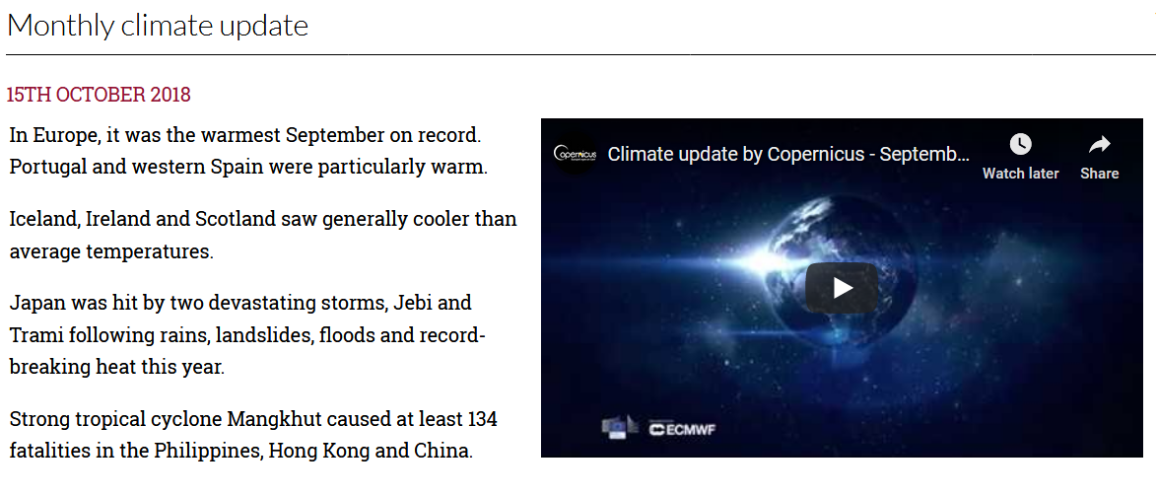
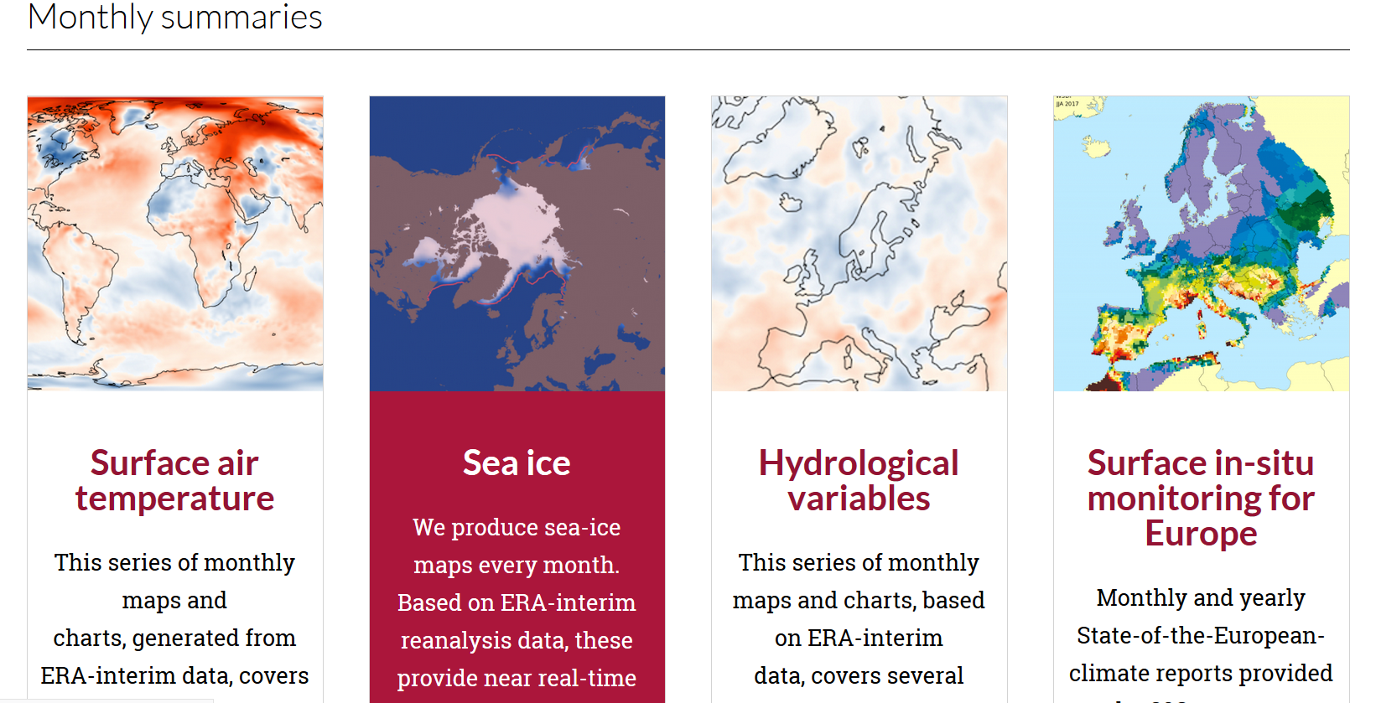
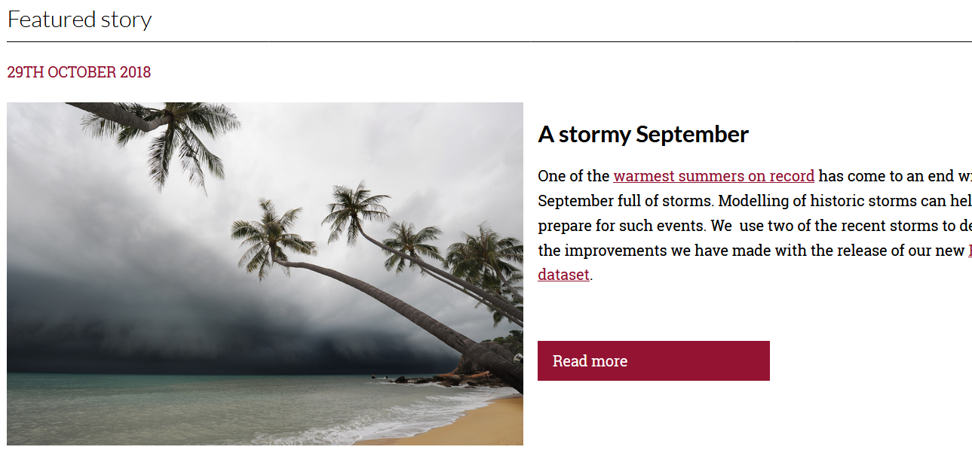
climate.copernicus.eu/climate-bulletins

Slide 24
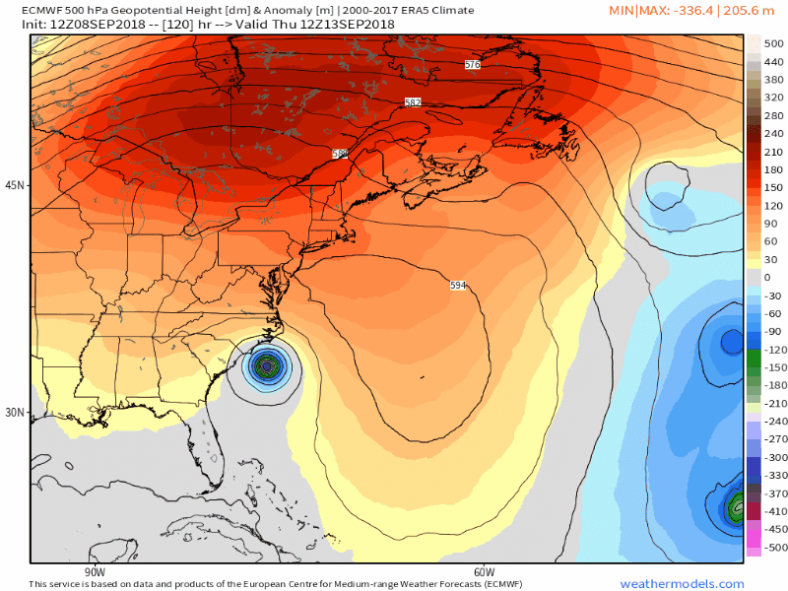

CDS next steps
Sample applications included with all datasets
An open Application Program Interface for all CDS data and tools
Ability to share data, applications and knowledge among users
Comprehensive Quality Assurance information and user guidance

Slide 25
Before…
Soon on the CDS: In situ climate observations
Observations are fundamental to everything we do. C3S is developing:
C3S Data Rescue Service
Global Land and Marine Observations Database
Global Upper-air Observations Database
The aim is to locate, collect, merge, quality-check, and organise all meteorological in situ observations ever made… and vastly improve access and usability.
To be launched in stages during 2019.
Notes:
Consistency:
In terms of appearance
In terms of dataset names and metadata
In terms of variables and units
In terms of download methods (select and click, api)
This is a big deal and requires a lot of work to get right

Slide 26
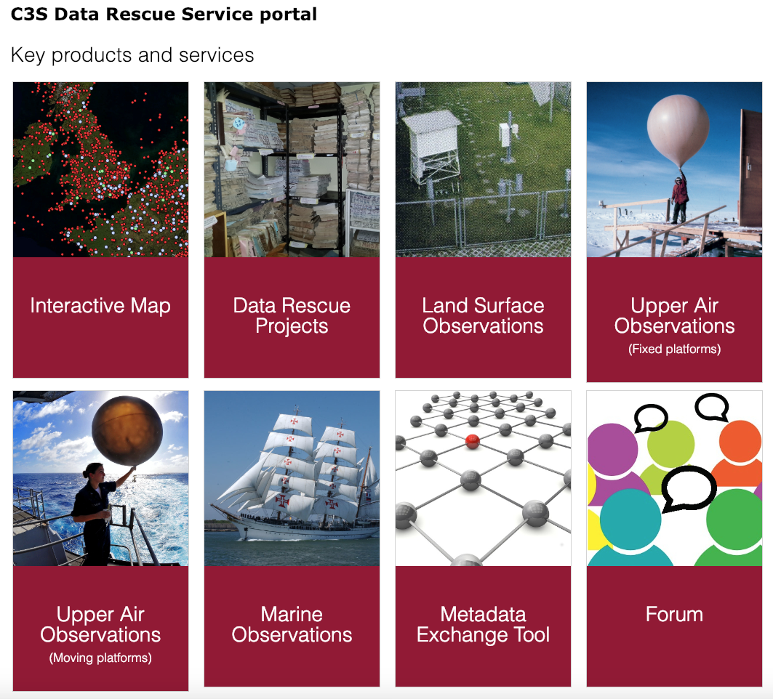
Before…
C3S Data Rescue Service
Coordination and support for climate data rescue projects
Registry and tools to locate related projects and data
Synchronized with WMO I-DARE
Tools for digitization, quality control, homogenization
Facility for submitting digitized data to international repositories
Notes:
Consistency:
In terms of appearance
In terms of dataset names and metadata
In terms of variables and units
In terms of download methods (select and click, api)
This is a big deal and requires a lot of work to get right

Slide 27
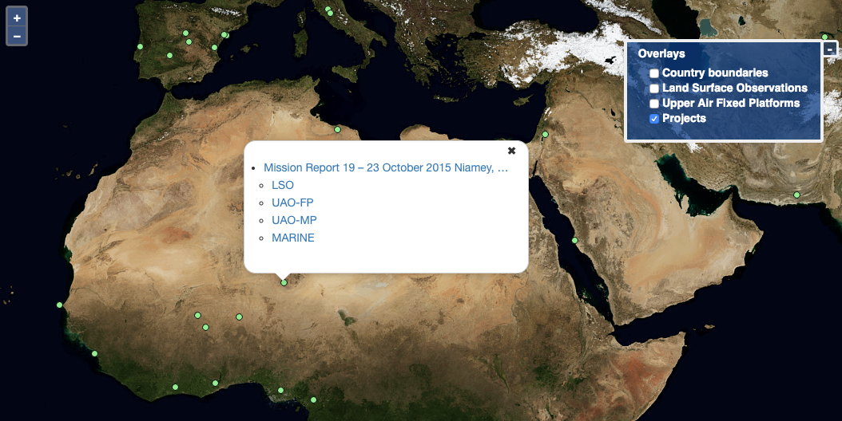
Before…
C3S Data Rescue Service
Coordination and support for climate data rescue projects
Registry and tools to locate related projects and data
Synchronized with WMO I-DARE
Tools for digitization, quality control, homogenization
Facility for submitting digitized data to international repositories
Notes:
Consistency:
In terms of appearance
In terms of dataset names and metadata
In terms of variables and units
In terms of download methods (select and click, api)
This is a big deal and requires a lot of work to get right

Slide 28
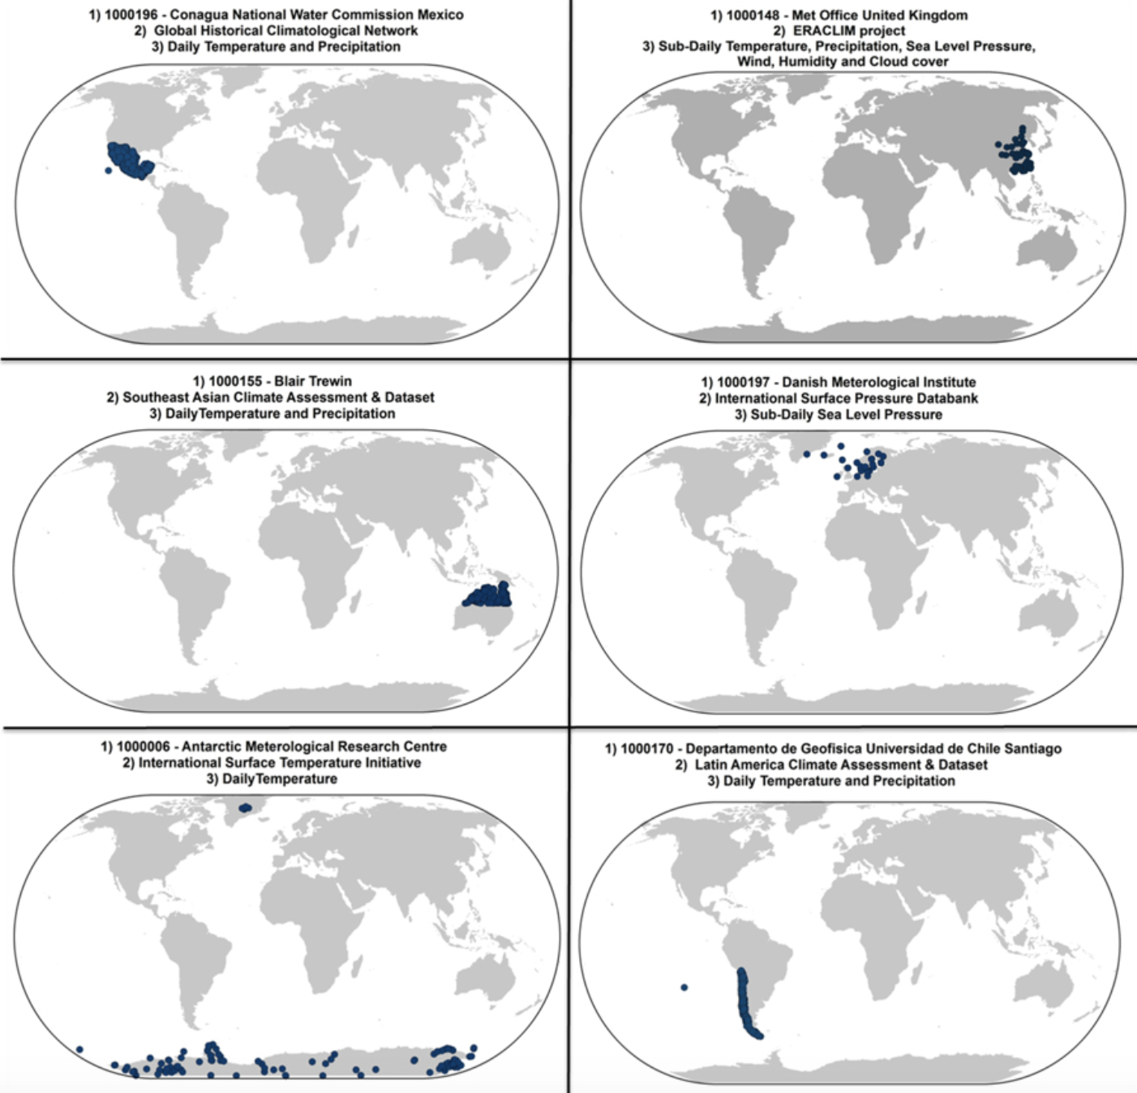
Global Land and Marine Observations Database
Collect, merge and harmonise all sub-daily, daily and monthly observations in a single data model
Ensure compliance with WMO metadata standards (e.g. WIGOS station IDs)
Strong collaboration with NOAA/NCEI
Land: mining and merging >300 sources of station data
Marine: Modernisation and improved quality control based on ICOADS

Slide 29
Some food for thought…
There are many similarities between JCSDA and C3S:
  Our goal is to turn research into services
  Everything we do is based on user requirements
  The work is highly collaborative
  We openly share knowledge, data and tools
  We enable new (unforeseen?) applications

Slide 30
Some food for thought…
There are many similarities between JCSDA and C3S:
  Our goal is to turn research into services
  Everything we do is based on user requirements
  The work is highly collaborative
  We openly share knowledge, data and tools
  We enable new (unforeseen?) applications
Can we use the CDS concept to create an app store for observations?
  Catalogue of observations for NWP and reanalysis
  Selection, QA, packaging and delivery
  Data from reference networks and campaigns
  Tools for QC, data selection, statistics, visualization
  Applications e.g. assessment against reanalysis data

