Slide 1

Impact of Assimilating Adaptively Thinned AIRS Cloud-Cleared Radiances in the GEOS
Erica McGrath-Spangler^{1,2}, Oreste Reale^{1,2}, Manisha Ganeshan^{1,2},
Will McCarty¹, and Ron Gelaro¹
¹NASA GSFC
²GESTAR/USRA

Slide 2
Outline
Short summary of work on AIRS published in 2018: Impact of adaptively thinned AIRS cloud-cleared radiances (CCRs) on TCs and global skill with GEOS 3DVAR (2014 TC season, from Sep 1st to Nov 10th )
Impact of AIRS CCRs on the analyzed temperature structure over the Arctic region
Adaptive thinning strategy tested on other sensors (CrIS and IASI)
New experiments with the Hybrid 4DEnVar GEOS system (2017 TC season)

Slide 3
Part 1 Adaptive Thinning
Clear-sky infrared satellite observations are uniformly thinned globally prior to assimilation to reduce computational cost and the incidence of horizontal error correlation
Liu and Rabier (2003), in a theoretical framework, found that “increased observation density with uncorrelated errors always increases the analysis accuracy”; however, “an increase in observation density degrades both the analysis and forecast if the error correlation between adjacent observations is greater than a certain threshold”
Several studies have shown that adaptive thinning (with fewer observations in slowly evolving inactive areas, and more observations within rapidly evolving features characterized by steep gradients) could substantially improve both the analysis and the forecasts (e.g. Ochotta et al., 2005, Lazarus et al., 2010). However, “a suboptimal analysis is often a necessary choice because of the difficulty and cost” (Bondarenko 2007).
A very simple TC-centered adaptive thinning approach, assimilating additional observations in a moving domain activated by Tropical Cyclone tracks, is presented

Slide 4
Two major findings
Published in August 2018, article summarizing the improvements obtained by assimilating adaptively thinned AIRS cloud-cleared radiances over homogeneously thinned clear-sky radiances.
Reale, O., E. McGrath-Spangler, W. McCarty, D. Holdaway, R, Gelaro, 2018: Impact of adaptively thinned AIRS cloud-cleared radiances on tropical cyclone representation in a global data assimilation and forecast system. Weather and Forecasting, 33, 908-931.
Assimilation of cloud-cleared AIRS radiances is a substantial improvement relative to clear-sky because the areas affected by clouds are meteorologically more active. However, CCRs must be thinned more aggressively because of higher information content
Assimilating more data around TCs (small scale, strong gradients and rapid evolution) and less globally, improves TC structure and intensity forecast, without damaging global skill.
Notes:
Mention higher likelihood of error correlation when using CCRs

Slide 5
Experiments setup
GEOS, version 5.13, using 3DVar data assimilation of all operational observations, simulating boreal fall 2014, differing only on AIRS data types or thinning
60 daily 10-day forecasts initialized at 00Z starting Sep 10th until Nov 10th
OPS: Clear-sky AIRS radiances, version used quasi-operationally by the GMAO
RAD: Clear-sky AIRS radiances, equivalent to OPS except with the vortex relocator turned off
CLD3: Cloud-cleared AIRS radiances, globally assimilated at about ¼ of clear sky density
SThin2_CLD: Cloud-cleared AIRS radiances, adaptively thinned with lower global density, but higher density surrounding TCs using a moving `TC’ domain that is activated with TC-vital or Best Track information
SThin2CLD_SThin2CrIS_SThin2IASI: Cloud-cleared AIRS radiances AND clear-sky CrIS and IASI radiances assimilated using adaptive thinning, a comprehensive thinning approach for ALL hyperspectral infrared radiances

Slide 6
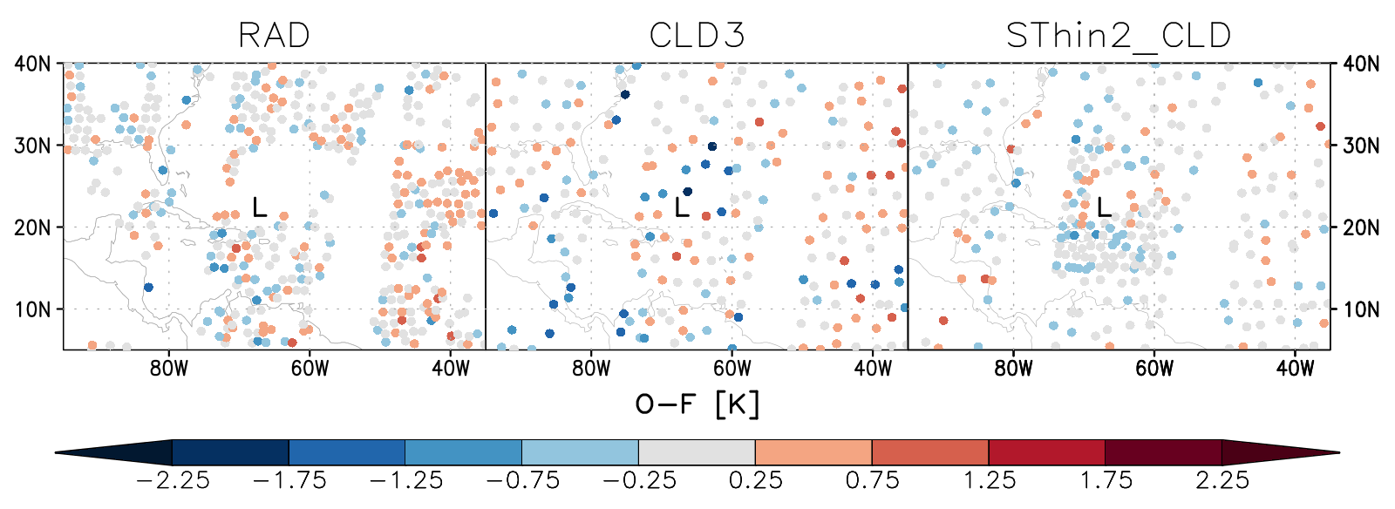
Density of AIRS coverage around Hurricane Gonzalo (2014)
Notes:
Perhaps skip ?

Slide 7
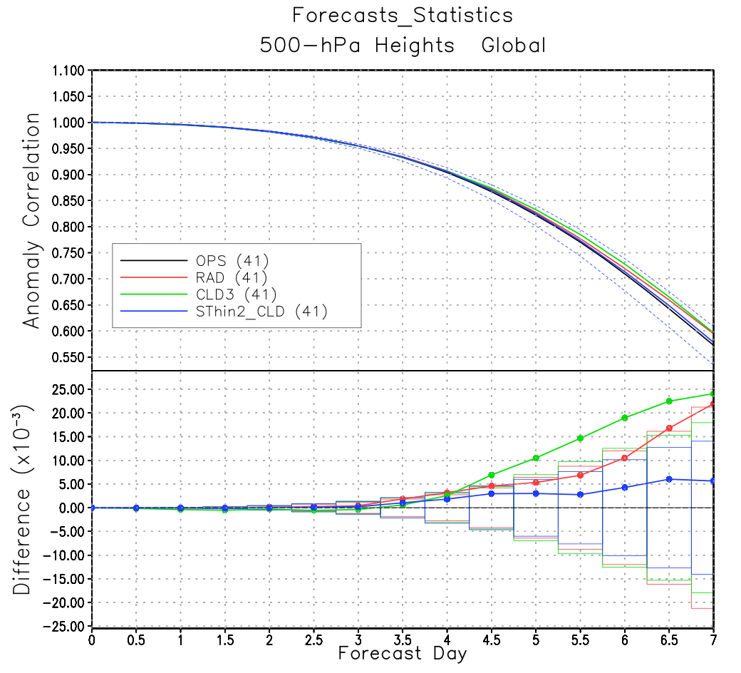
Global 500 hPa height anomaly correlation
Reference = OPS

Slide 8
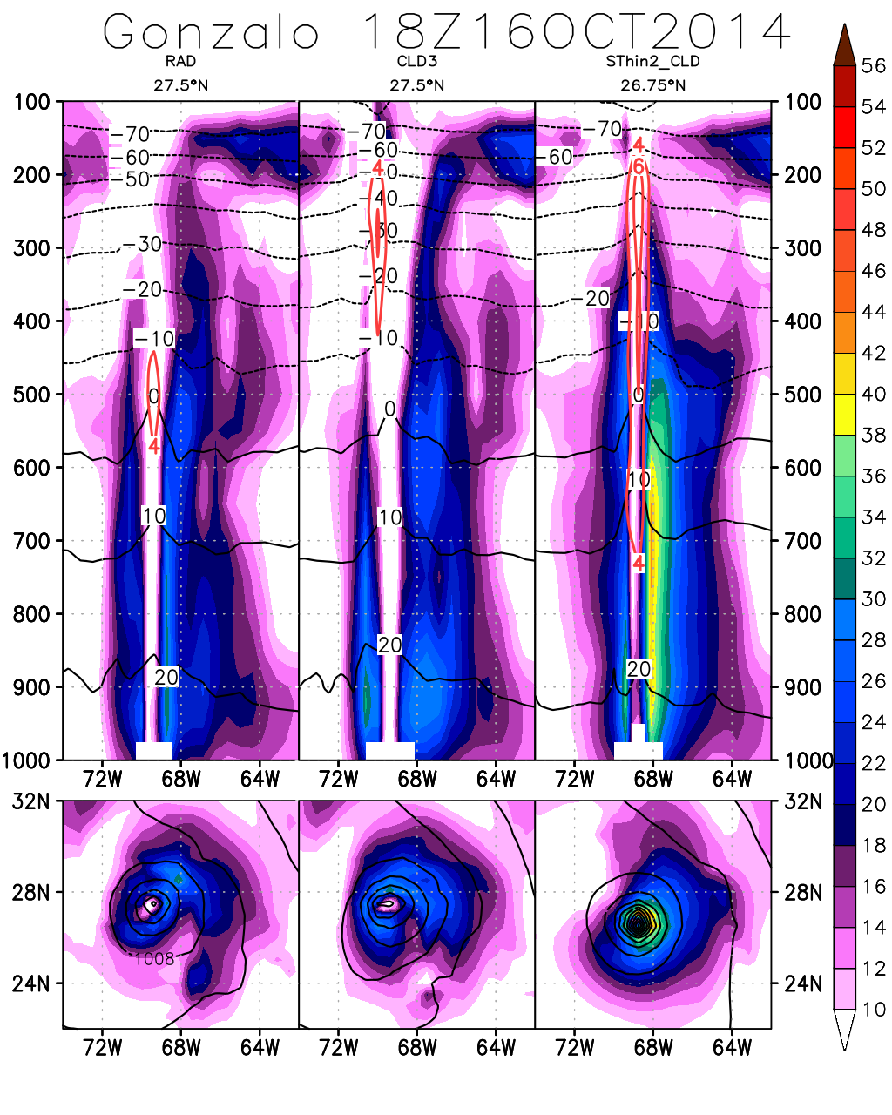
Operational, clear-sky
Cloud-cleared, low density
Cloud-cleared, Adaptive thinning
H. Gonzalo (2014)
Vertical cross section: Wind magnitude (shaded), Temperature (°C, black), Temp. Anomaly (°C, red)
850 hPa winds (shaded), slp (contours)
Homogenously thinned cloud-cleared radiances (CLD3) improve the global skill but not TC structure
Adaptively thinned cloud-cleared radiances produce large improvements in vertical and horizontal TC structure, without degrading the global skill
Specifically: more compact scale, stronger wind speeds, lower minimum pressure, stronger warm core
Limits: only TCs with good AIRS coverage were affected; TCs with very short lifespans were difficult to improve
Notes:
Adaptive thinning is COMPROMISE between improved global skill and improved TC representation

Slide 9
Part 2: Impact of cloud-cleared AIRS radiances on temperature structure in the Arctic
Aside from the impact on convectively driven cyclones worldwide (including Polar Lows), based on an improved representation of their thermal structure, assimilation of AIRS CCRs produces also another very different impact on a regional scale.
The Arctic region is extremely data scarce. Low-level stratus clouds limit the assimilation of clear-sky radiances. The analyzed thermal structure of the low-troposphere is very sensitive to the assimilation of AIRS CCRs
Notes:
Need to transition with motivation

Slide 10
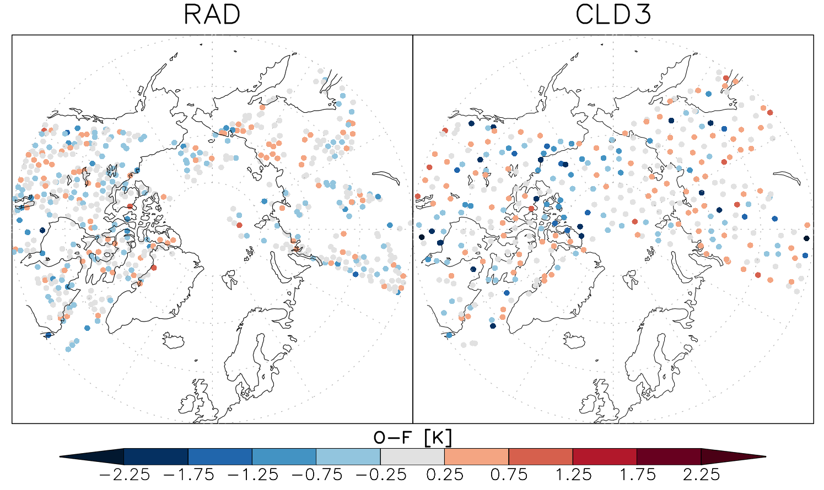
Clear-sky vs cloud-cleared coverage
Clear-Sky
Cloud-Cleared
Notes:
Data void areas
Point out continents, Clear-sky coverage is much sparser due to presence of clouds, homogeneous coverage of cloud-cleared experiment
Clear-sky contains more overall data because higher density, but also more heterogeneous coverage

Slide 11
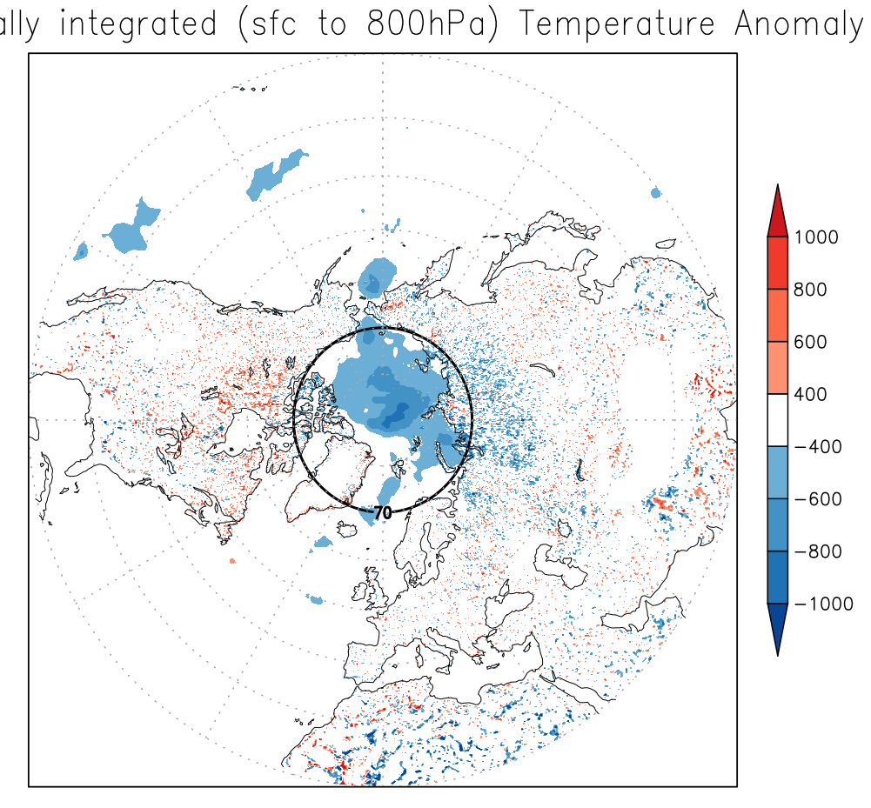
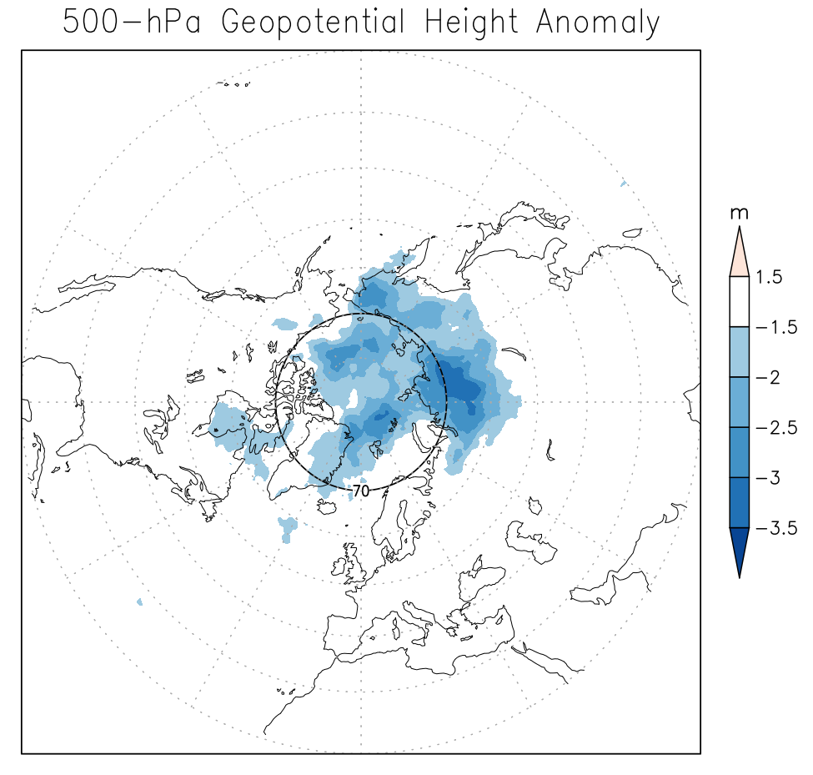
Vertically Integrated Temperature Anomaly
500-hPa Geopotential Height Anomaly
K∙kg∙m⁻²
m
Cloud-cleared minus clear-sky vertically integrated (sfc to 800-hPa) temperature and 500-hPa geopotential height anomalies in a two month-long analysis
Large, spatially coherent temperature anomaly over Arctic induces negative mid- and upper-tropospheric geopotential height anomalies due to hydrostatic adjustment
Notes:
Anomaly consistent with sea ice

Slide 12
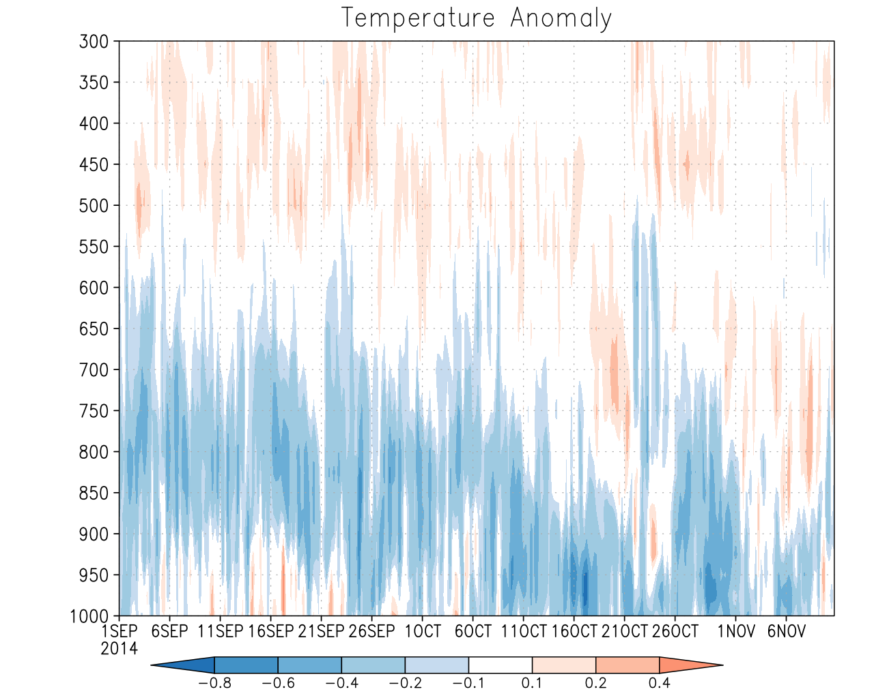
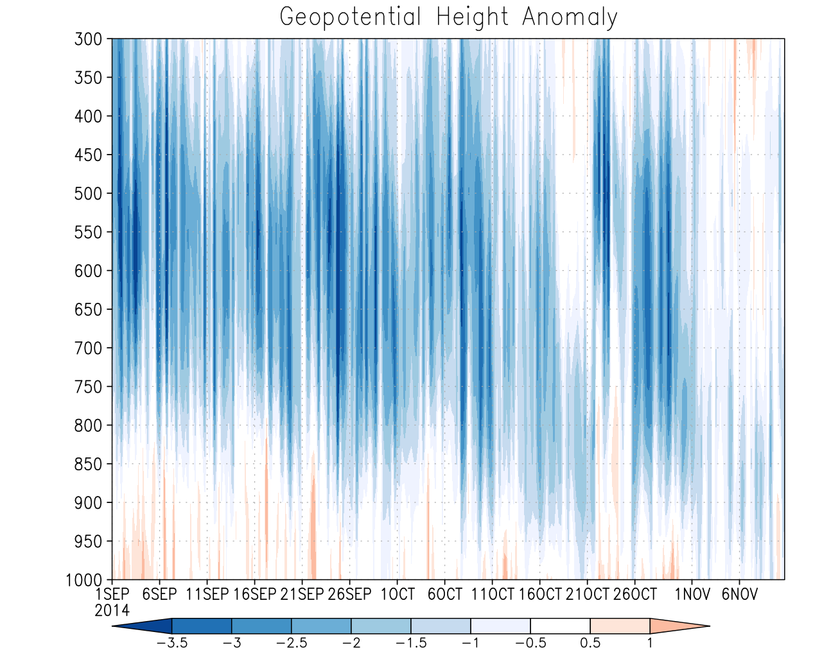
Temperature Anomaly
Geopotential Height Anomaly
K
m
Time series (Sep1st – Nov 10th) of cloud-cleared minus clear-sky anomalies averaged 70ºN – 90ºN
Persistent low-tropospheric cooling induced by assimilation of cloud-clear radiances over large area (over 15 million sq. km) lowers mid-troposphere geopotential height field
The anomaly propagates into a small average improvement in forecast skill over the northern hemisphere, originating from a few individual forecasts in which the difference in skill between CLD3 and RAD is very large.
Notes:
Over 1.5x the size of the United States, Physically consistent
By assimilating only clear-sky AIRS radiances, discard observations in cloudy regions that are associated with colder temperatures so biasing system warm, due to hydrostatic adjustment, this shifts the geopotential height field

Slide 13
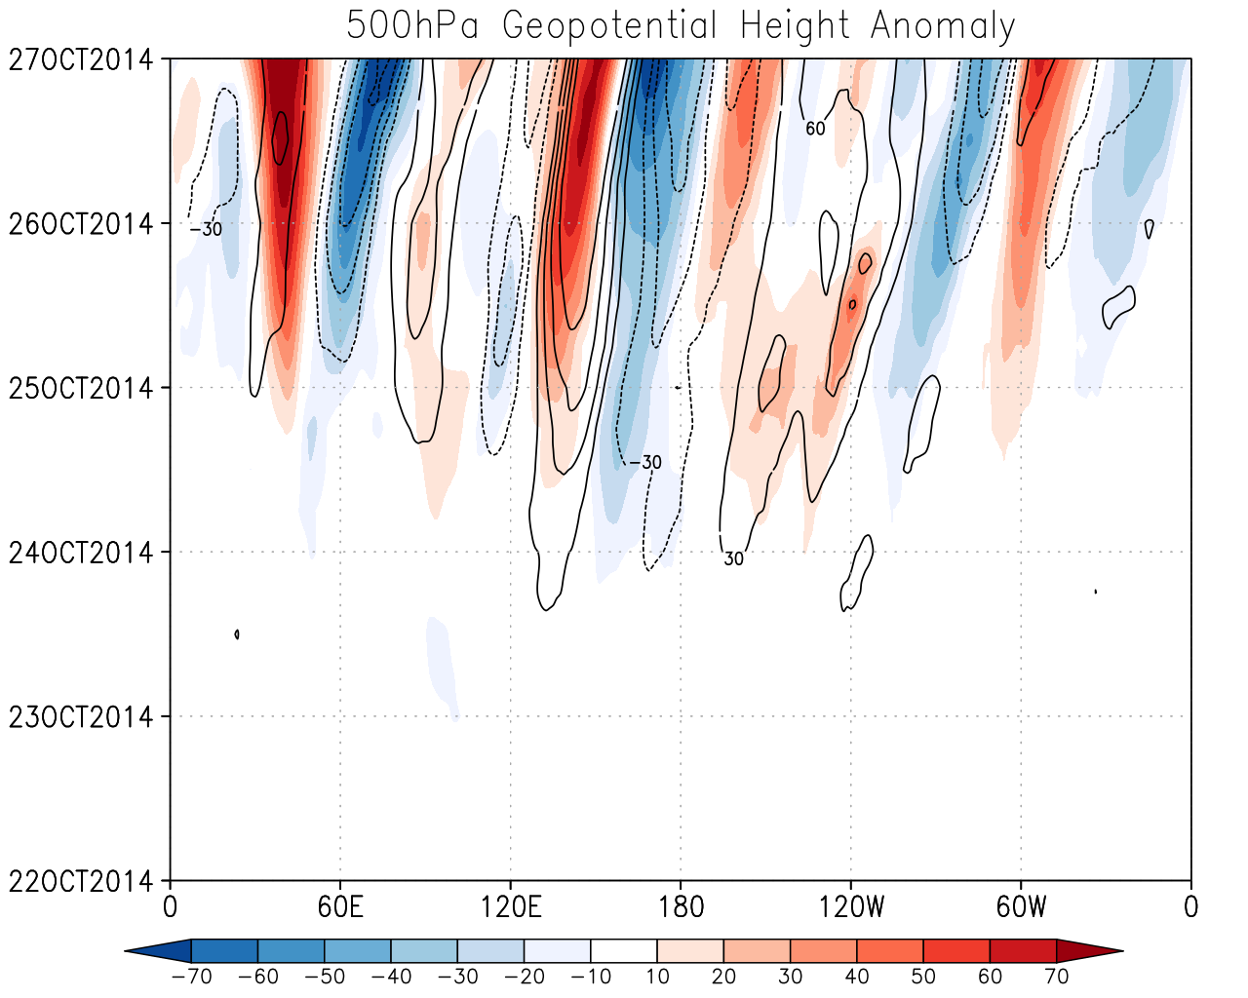
Geopotential Height Anomaly
Hovmöller diagram with 500 hPa geopotential height anomaly averaged from 40ºN – 80ºN
Shaded: cloud-cleared forecast minus clear-sky forecast
Contour: NCEP analysis minus clear-sky forecast
Anomalies grow with time and travel with westerly mid-latitude waves
Changes induced by cloud-clearing attempt to correct the forecast in the direction of the verifying analysis
Initialized: 00Z 22 Oct 2014, 5 day forecast
m
Notes:
Individual events can have quite large differences

Slide 14
Part 3: Impact of a comprehensive adaptive thinning strategy for all IR sensors together
Assimilation of low density AIRS CCRs brings a substantial improvement in global skill but negligible impact on TC structure
Adaptively thinned AIRS CCRs bring a strong improvement on structure of many TCs, without damage to Global Skill
Cloud-cleared CrIS and IASI are not yet available
However, when the adaptive thinning strategy is simultaneously applied to all hyperspectral sensors together (Cloud-cleared AIRS and clear-sky CrIS and IASI) global and TC representation both improve substantially; even more TCs are positively affected

Slide 15
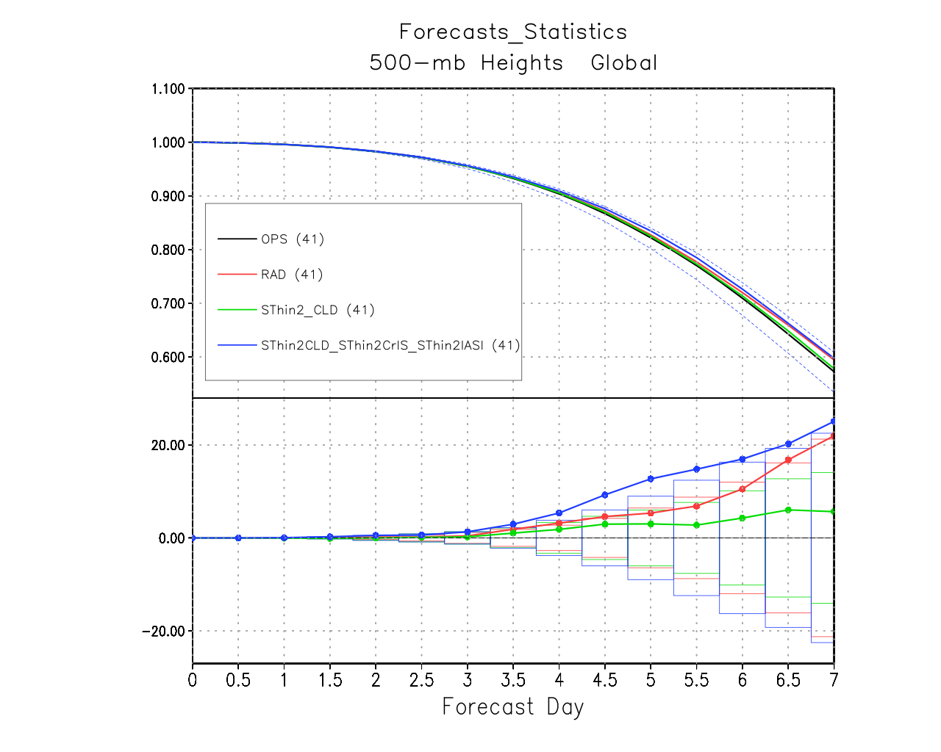
Global 500 hPa height anomaly correlation
A comprehensive, adaptive thinning approach for all hyperspectral infrared sensors, using cloud-cleared AIRS radiances, results in a statistically significant improvement in global forecast skill
Reference = OPS
Reference = OPS

Slide 16
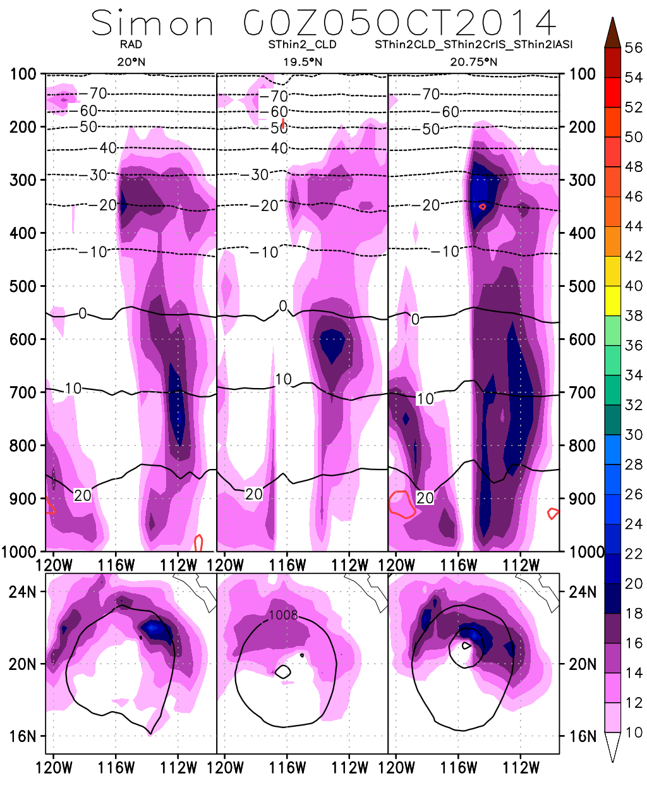
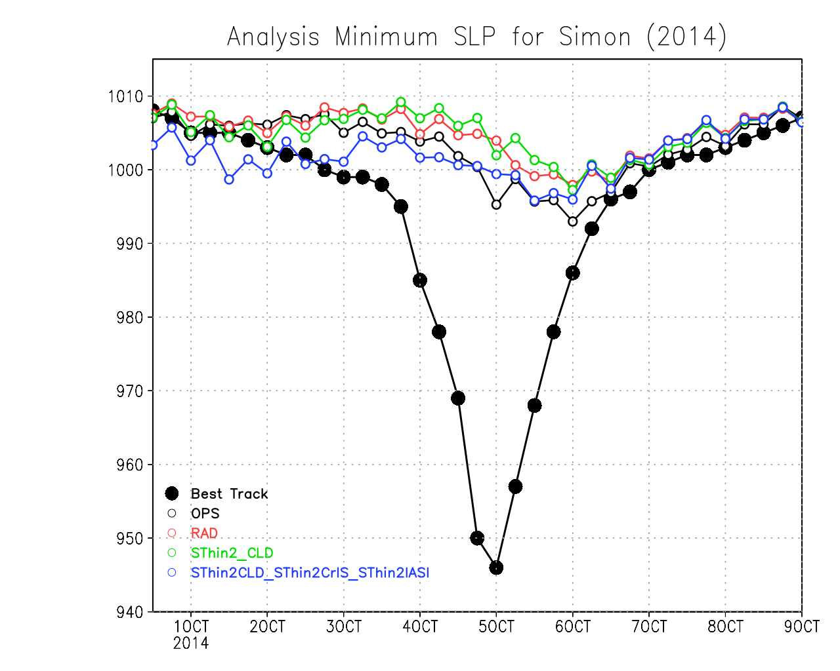
H. Simon (2014)
East Pacific
Vertical cross section
Wind magnitude (shaded)
Temperature
(°C, black)
Temp. Anomaly (°C, red)
50hPa
Impossibly difficult TC:
extremely small,
rapid deepening and
rapid dissipation
850 hPa winds (shaded)
slp (contours)
Notes:
Slp dropped from ~1000hPa to 945hPa and back up again in 2 days

Slide 17
Part 4: Hybrid 4DEnVar experiments and results
GEOS, version 5.17 experiments, using hybrid 4DEnVar data assimilation, simulating boreal late summer – early fall 2017
80 daily 10-day forecasts initialized at 00Z from July 31st to October 19th
RAD: Clear-sky AIRS radiances, as used operationally
CLD3: Cloud-cleared AIRS radiances, globally assimilated at a lower density (~1/3 of RAD)
CLD3 shows an improvement in global forecast skill after day 6

Slide 18
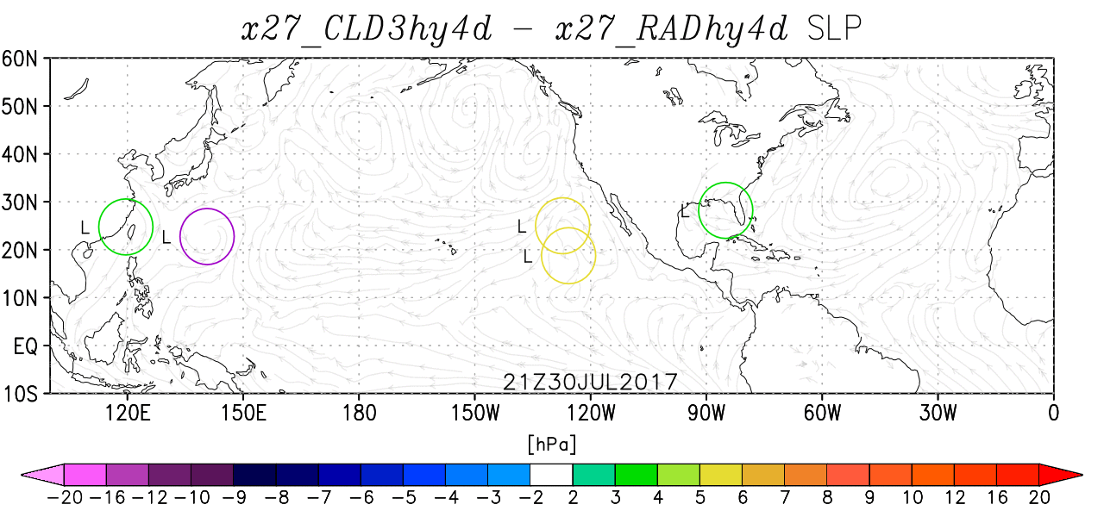
Impact of assimilating cloud-cleared against clear-sky radiances on the analyzed SLP

Slide 19
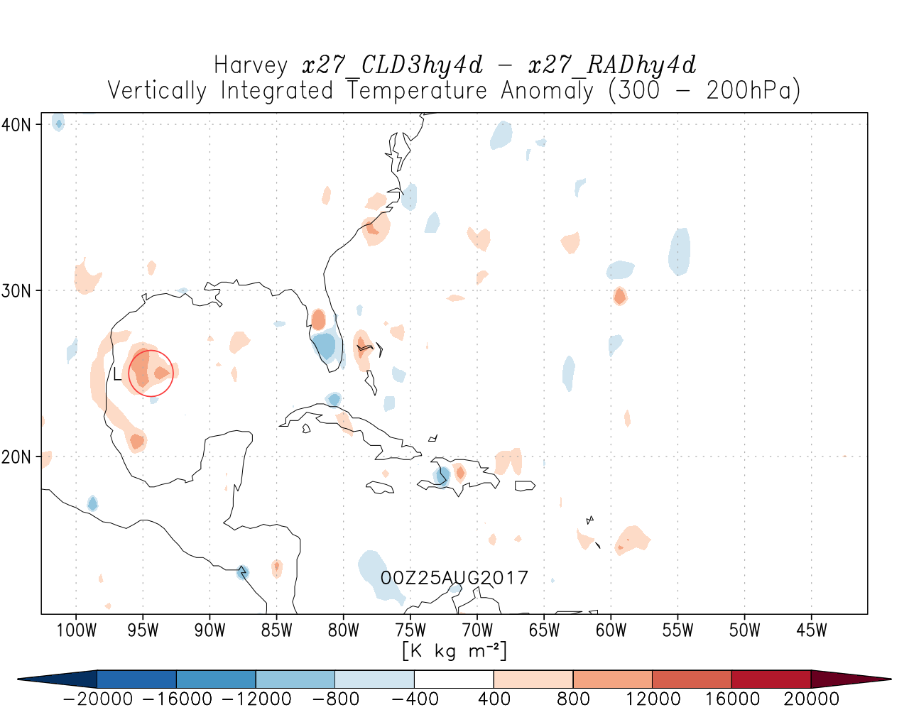
H. Harvey (2017) Cloud-cleared minus Clear-sky Vertically Integrated Temperature Anomaly (300 to 200 hPa)

Slide 20
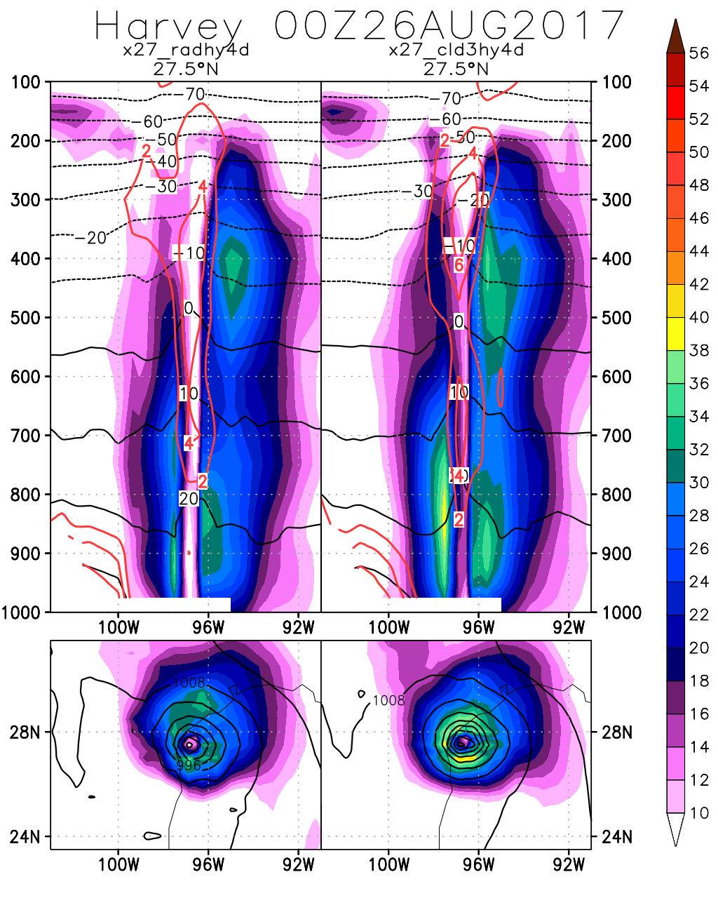
Clear-sky AIRS
Cloud-cleared AIRS
H. Harvey (2017)
Vertical cross section: Wind magnitude (shaded), Temperature (°C, black), Temp. Anomaly (°C, red)
850 hPa winds (shaded), slp (contours)
Increased warm core structure, stronger wind speeds and lower sea level pressure and an overall improvement in vertical and horizontal structure result from assimilation of cloud-cleared AIRS radiances assimilated at low global resolution
Both track and intensity forecast improve (not shown)

Slide 21
Conclusions
Previous work has shown the strong positive impact of assimilating adaptively thinned AIRS cloud-cleared radiances (CCRs) on TC representation, with no loss of global skill
More recent findings show that the increase in mid-latitude forecast skill is caused by a strong sensitivity of the Arctic region to assimilation of AIRS CCRs.
A comprehensive thinning approach (which adaptively thins all hyperspectral infrared radiances together) results in improved global forecast skill and better TC representation than when applied to AIRS radiances alone
Ongoing experiments with the newer Hybrid 4DEnVar data assimilation system continue to show the strong sensitivity of TC representation to assimilation of CCRs and appear very promising
Future work will involve assimilation of CrIS CCR and further exploring the sensitivity to adaptive thinning in the Hybrid 4DEnVar system

Slide 22
References
Bondarenko, V., T. Ochotta, and D. Sauple, 2007: The interaction between model resolution, observation resolution and observation density in data assimilation: a two-dimensional study. 87th AMS Annual Meeting, January 13-18, 2007, San Antonio, Texas, [Available online at https://ams.confex.com/ams/87ANNUAL/techprogram/paper_117655.htm]
Chahine, M. T., and Coauthors, 2006: AIRS: Improving weather forecasting and providing new data on greenhouse gases. Bull. Amer. Meteor. Soc., 87, 911–926, doi:10.1175/BAMS-87-7-911.
Lazarus, S. M., 799 M. E. Splitt, M. D. Lueken, and B. T. Zavodsky, 2010: Evaluation of data reduction algorithms for real-time analysis. Wea. Forecasting, 25, 837-851.
Le Marshall, J., and co-authors, 2006: Improving global analysis and forecasting with AIRS. Bull. Am. Meteorol. Soc., 87, 891–894, doi:10.1175/BAMS-87-7-891.
Liu, Z.-Q. and Rabier, F., 2002: The interaction between model resolution, observation resolution and observation density in data assimilation: A one-dimensional study. Q.J.R. Meteorol. Soc., 128, 1367–1386.
Ochotta, T., C. Cebhardt, D. Saupe, and W. Wergen, 2005: Adaptive thinning of atmospheric observations in data assimilation with vector quantization and filtering methods. Q. J. R. Meteorol. Soc., 131, 3427-3437.

Slide 23
Acknowledgements
Thanks to: Dr. Tsengdar Lee for current support through grant 80NSSC18K0927 ”Using AIRS and CrIS data to understand processes affecting TC structure in a Global Data Assimilation and Forecasting Framework (2018-2021)” (PI: Dr. O. Reale) Dr. Ramesh Kakar for past support through previous grants NNX11AK05G and NNX14AK19G “Using AIRS Data to Understand Processes Affecting Tropical Cyclone Structure and Extreme Precipitation in a Global Data Assimilation and Forecasting Framework”(2011-2014, 2014-2018), PI: O. Reale
Dr. Chris Barnet for his leadership on the development of cloud-cleared radiance algorithms. Dr. Tsengdar Lee for generous allocations of NASA High End Computing resources (NCCS) AIRS team at JPL and the Sounder Research Team at NASA GSFC GES DISC for their outstanding service to the community

Slide 24
AIRS-related articles published by this team Reale, O., J. Susskind, R. Rosenberg, E. Brin, E. Liu, L. P. Riishojgaard, J. Terry, J. C. Jusem, 2008: Improving forecast skill by assimilation of quality-controlled AIRS temperature retrievals under partially cloudy conditions. Geophysical Research Letters, 35, L08809, doi:10.1029/2007GL033002. Reale, O., W. K. Lau, J. Susskind, E. Brin, E. Liu, L. P. Riishojgaard, M. Fuentes, R. Rosenberg, 2009: AIRS Impact on the Analysis and Forecast Track of Tropical Cyclone Nargis in a global data assimilation and forecasting system. Geophysical Research Letters, 36, L06812, doi:10.1029/2008GL037122. Reale, O., W. K. Lau, K.-M. Kim, E. Brin, 2009: Atlantic tropical cyclogenetic processes during SOP-3 NAMMA in the GEOS-5 global data assimilation and forecast system. Journal of the Atmospheric Sciences, 66, 3563-3578. Reale, O., K. M. Lau, J. Susskind, and R. Rosenberg, 2012: AIRS impact on analysis and forecast of an extreme rainfall event (Indus River Valley, Pakistan, 2010) with a global data assimilation and forecast system, J. Geophys. Res., 117, D08103, doi:10.1029/2011JD017093. Reale, O., E. McGrath-Spangler, W. McCarty, D. Holdaway, R, Gelaro, 2018: Impact of adaptively thinned AIRS cloud-cleared radiances on tropical cyclone representation in a global data assimilation and forecast system. Weather and Forecasting, 33, 908-931.

Slide 25
Additional Slides

Slide 26
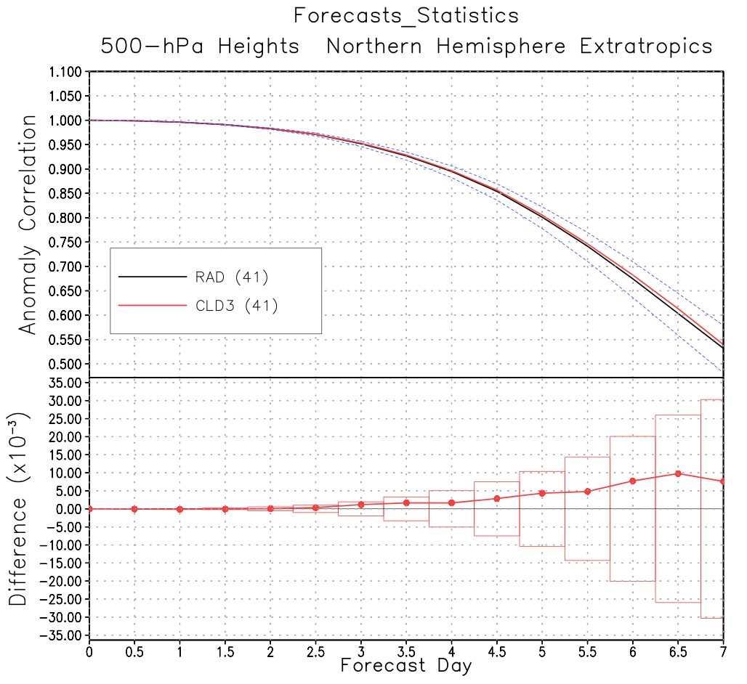
NHE Forecast Skill
5-day forecast
Notes:
Put a circle and state that the slight improvement comes from isolated forecasts in which CLD3 is much better than RAD

Slide 27
5 day forecast geopotential height anomalies
All valid 00Z 27 Oct. 2014.
Left: Cloud-cleared forecast minus clear-sky forecast
Right: NCEP operational analysis minus clear-sky forecast
Similar to Hovmöller, shows assimilation of cloud-cleared radiances reduces error growth in the forecast.
Initialized: 00Z 22 Oct 2014
m

Slide 28
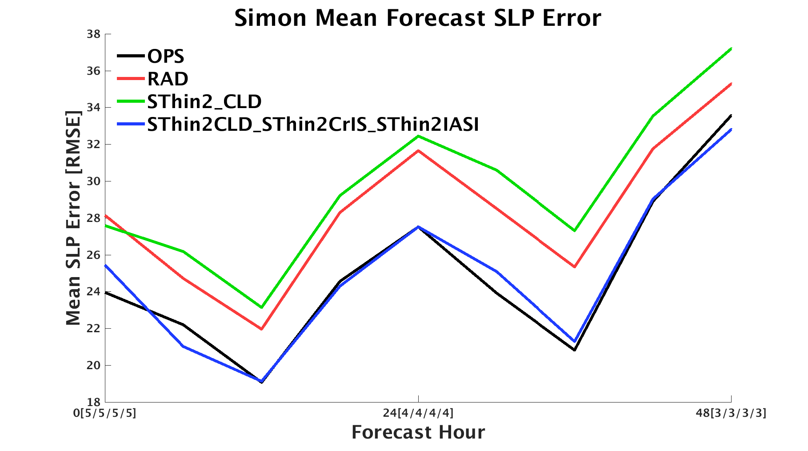
H. Simon intensity forecast
Intensity forecast for this difficult storm is identical to the one obtained with vortex relocator
Notes:
IR data can replace the vortex relocator!

Slide 29
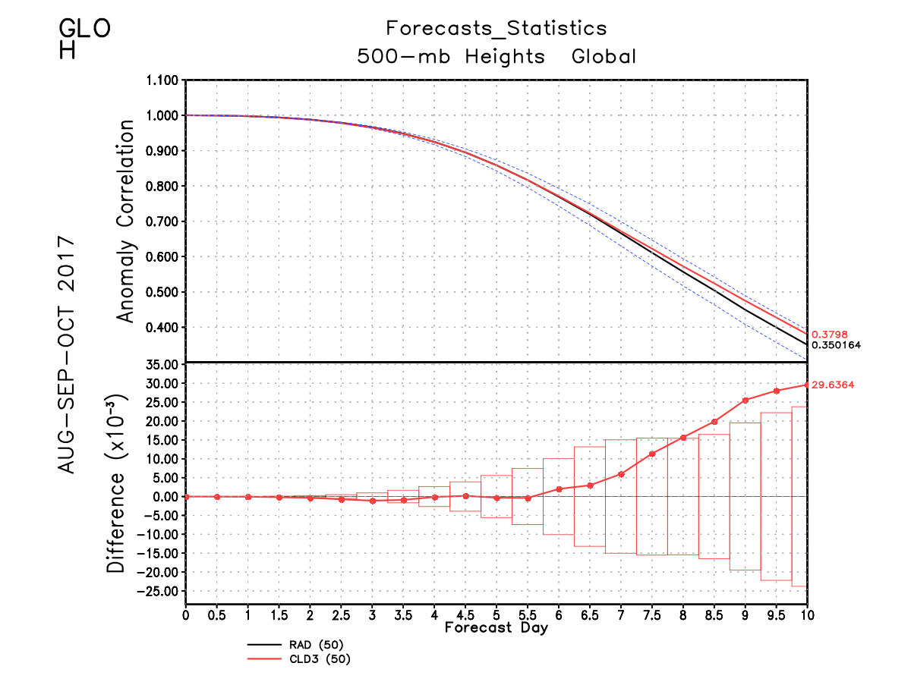
Assimilation of cloud-cleared AIRS radiances, more aggressively thinned, does not degrade the global forecast skill and produces an improvement after 6 days

Slide 30
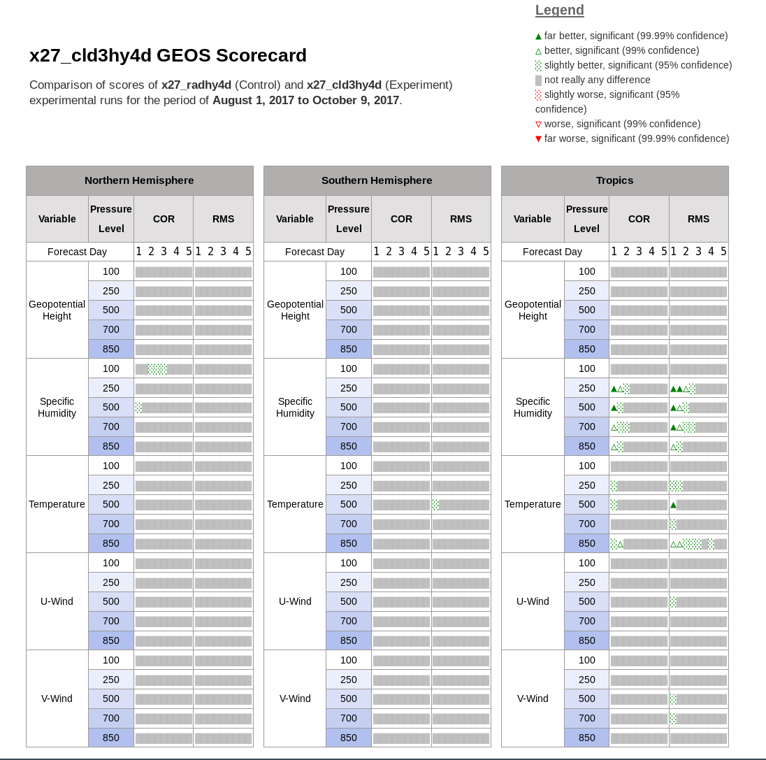

Slide 31
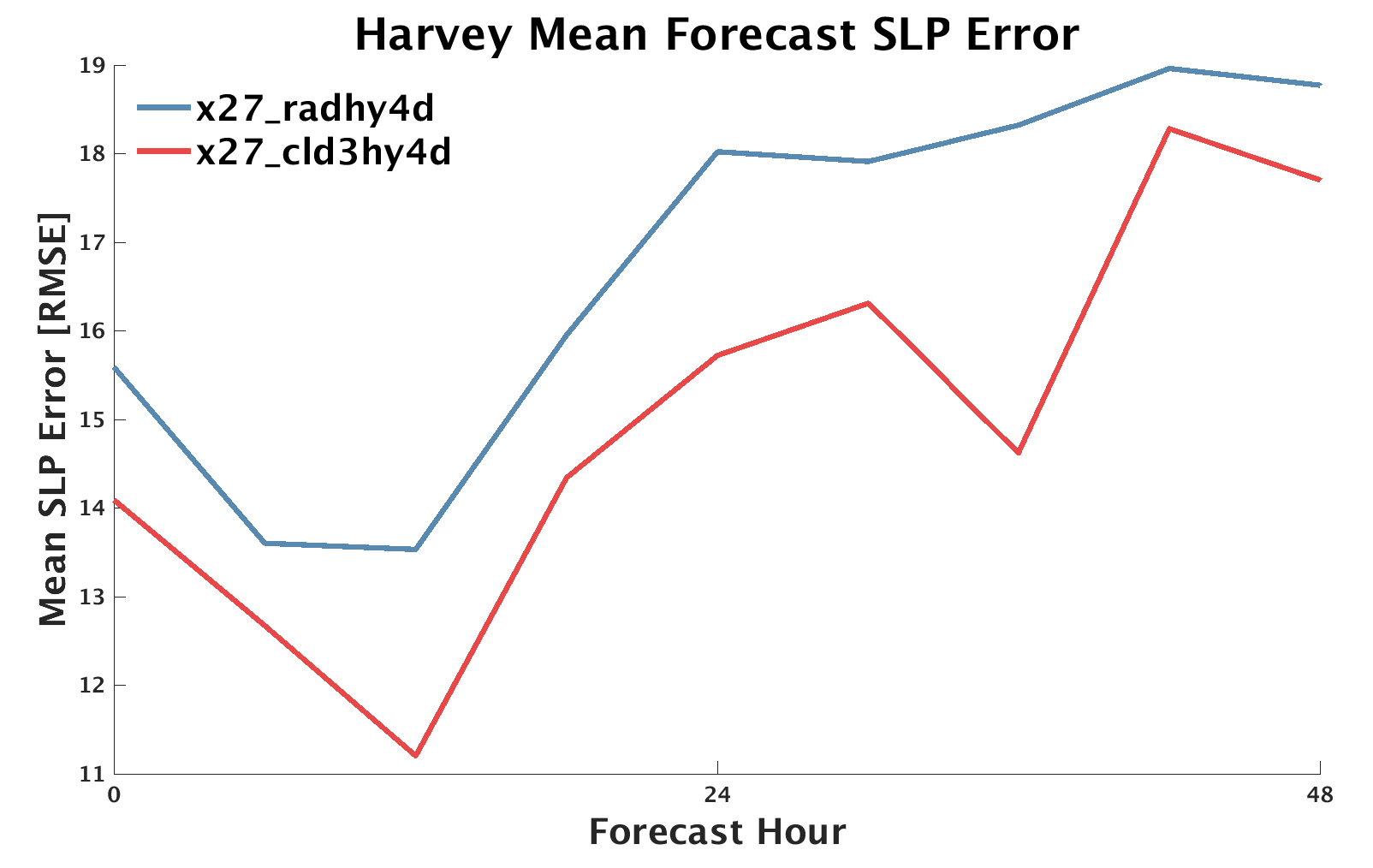
Clear-sky
Cloud-cleared
Assimilation of cloud-cleared AIRS radiances, even at a reduced density, have the capability to improve TC forecast intensity

Slide 32
Investigating Polar, Arctic, and Antarctic Lows
Based on positive results obtained for TCs, we explore the sensitivity of Polar Lows (PLs) to the adaptive thinning methodology
Unlike TCs, polar lows are generally not tracked in real time on a global scale (i.e., there is no TC vital-like information for PLs)
This limits the operational applicability of the methodology as of now
Adaptive thinning experiments are attempted to investigate whether the methodology could be applicable
SThinPL_CLD: ‘PL domains’ (in which higher density AIRS cloud-cleared radiances are used around PLs) are constructed as TC domains, but based on satellite information (AMSU-B) only
Results are promising and show strong sensitivity to assimilation of additional data in proximity to the storms
Notes:
Polar lows are extremely small and elusive, vertically aligned convective storms that resemble TCs, but form at high latitudes
(perhaps take out the PL stuff)

Slide 33
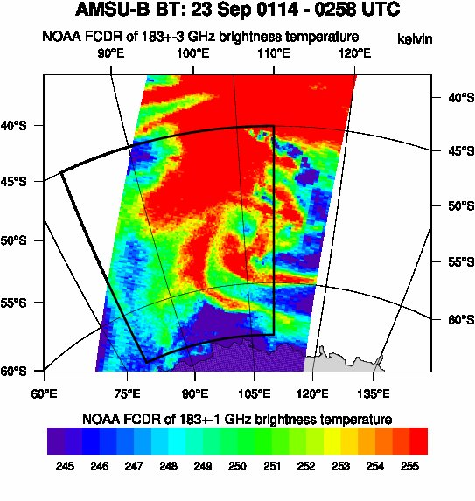
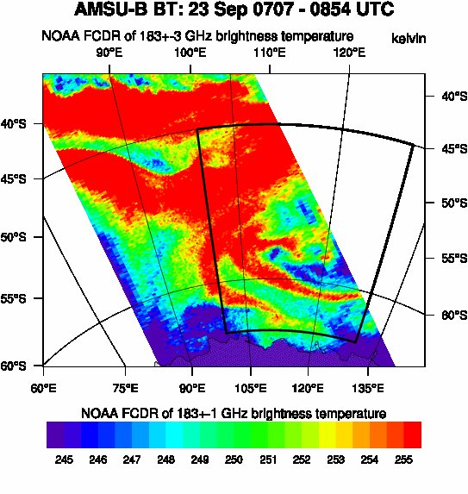
Satellite detection of polar low on 23 Sep. 2014

Slide 34
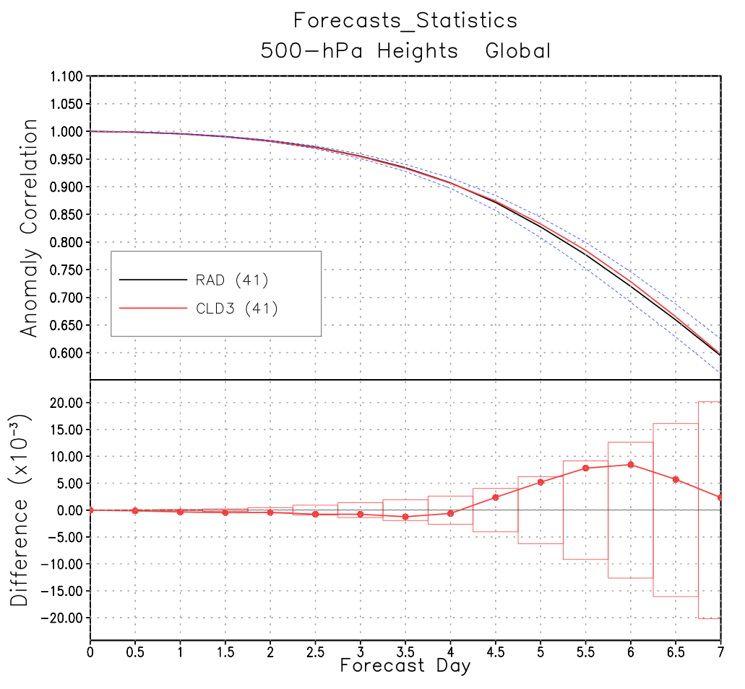
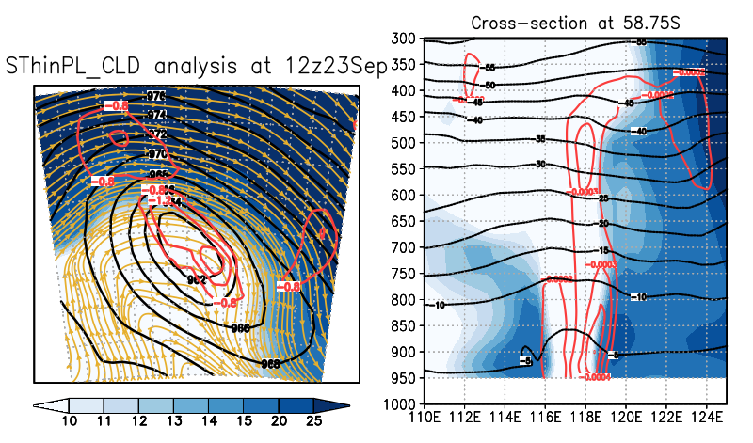
Horiz.: 300hPa winds (shaded),
Vert. Integ. vorticity (red),
slp (black)
Vert: Winds (shaded), vorticity (red), temperature (black)
Maximum vertically integrated cyclonic vorticity and a vertically aligned eye-like feature occur when adaptively thinned AIRS CCRs are used around a polar low
Notes:
CLD3, while able to improve global skill, could not improve convective systems300hPa winds (shaded),
vertically integrated vorticity (red),
slp (black)

