Slide 1
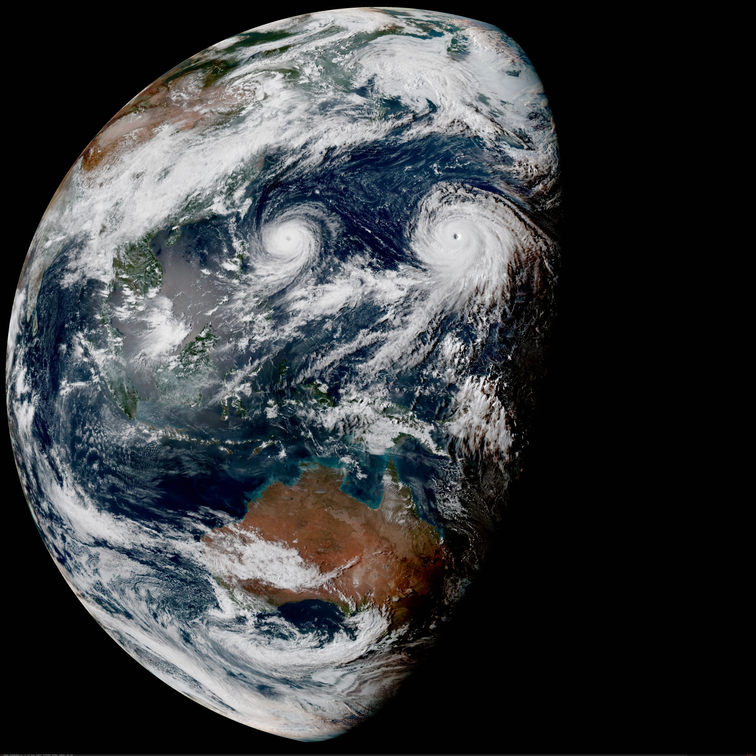

Impact of Observing Systems Project Overview
JCSDA IOS Team:
F. Vandenberghe, S. Dutta. D. Hahn, H. Zhang, H. Shao
Contributors:
R. Langland, B. Ruston, R. Mahajan, A. El Akkraoui, C. Schwartz, B. Menetrier, G. Bolmier and the JEDI team
JCSDA Science Workshop, Washington DC, May 29-31, 2019
Notes:
IOS objectives:
- An infrastructure that permits the agencies to conduct “what if” scenarios to evaluate the degradation or lost of an instrument or a full satellite in a timely manner;
- FSOI diagnostic tools that enable the agencies to monitor in real-time the relative contributions of each of the assimilated observing platforms on the forecast skills;
- Automated and adaptive algorithms for processing satellite observations with the objective of optimizing their impact on forecast.

Slide 2
2018 IOS Tasks
IOS-1: Toward Near-Real-Time FSOI Capability and inter-comparison
IOS-2: Improved Assessment of Observation Impact
IOS-3: Impact-based Adaptive Observation Processing

Slide 3
2018 IOS Tasks
IOS-4: Evaluate and Advance GNSSRO Data Assimilation, assist Transition to Operations (common with NIO)

Slide 4
Impact of Observing Systems Project Overview
IOS-1: Toward Near-Real-Time FSOI Capability and inter-comparison
IOS-2: Improved Assessment of Observation Impact
IOS-3: Impact-based Adaptive Observation Processing
1 cycle, 80 members, 30hr forecast at full resolution (T574/T1534):
~ 560 core*hours & ~2 Tb disk
Multiply by 3.09 to convert in Discover Standard Billing Units (~1600 SBU)
E-FSOI must be updated to NEMS GSI/GFS

Slide 5
IOS WEB Interface: Status
A prototype of WEB interface is up and running at ios.jcsda.org
All data from the Dec.-Jan 2015 EMC, NASA, NRL, JMA, UK Met-Office and Meteo-France inter-comparison experiments available for visualization
Daily NRL and NASA FSOI diagnostics files are pulled and processed in real-time on Amazon Web Services (AWS)
IOS-1:Toward Near-Real-Time FSOI Capability and inter-comparison

Slide 6
IOS WEB Interface: Example
ios.jcsda.org
IOS-1:Toward Near-Real-Time FSOI Capability and inter-comparison

Slide 7
IOS WEB Interface: Coming Work
Improve speed and robustness
Work with US Air Force to add their FSOI data
Engage JMA, UK Met-Office, Meteo-France & ECMWF
IOS-1:Toward Near-Real-Time FSOI Capability and inter-comparison

Slide 8
Impact of Observing Systems Project Overview
IOS-1: Toward Near-Real-Time FSOI Capability and inter-comparison
IOS-2: Improved Assessment of Observation Impact
IOS-3: Impact-based Adaptive Observation Processing
1 cycle, 80 members, 30hr forecast at full resolution (T574/T1534):
~ 560 core*hours & ~2 Tb disk
Multiply by 3.09 to convert in Discover Standard Billing Units (~1600 SBU)
E-FSOI must be updated to NEMS GSI/GFS

Slide 9
Improved IOS: On-going Work
Develop FV3 FSOI capabilities in JEDI
Account for clouds in FSOI error metrics
IOS-2: Improved Assessment of Observation Impact

Slide 10
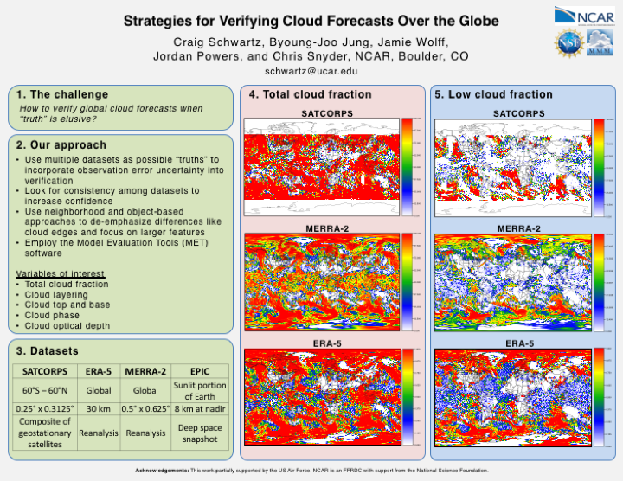
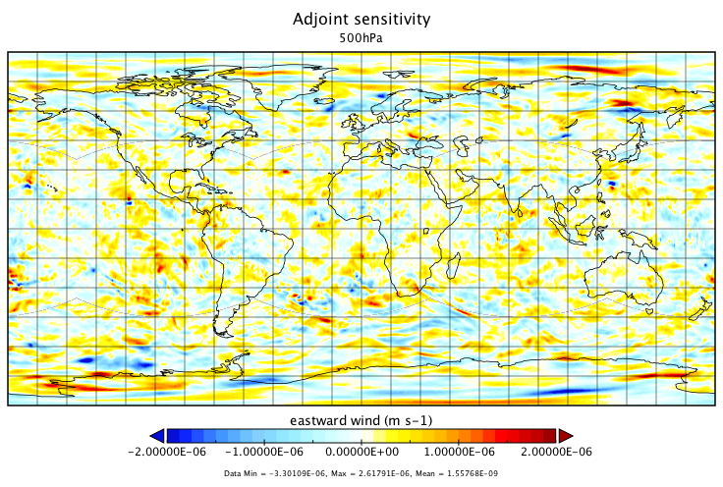
FV3 FSOI capabilities
GSI
operational analysis
OBS & BKG
JEDI analysis
FV3 forecast
Cost function J for error reduction &adjoint
Ritz Pairs
Trajectories
Obs impact
JEDI analysis
adjoint
FV3 forecast
adjoint
C. Schwartz poster
JEDI
D. Holdaway presentation
IOS-2: Improved Assessment of Observation Impact

Slide 11
E-FSOI: Time localization
wind field and temperature correlation 00hr/00hr forecast
wind field and temperature correlation 00hr/06hr forecast
IOS-2: Improved Assessment of Observation Impact

Slide 12
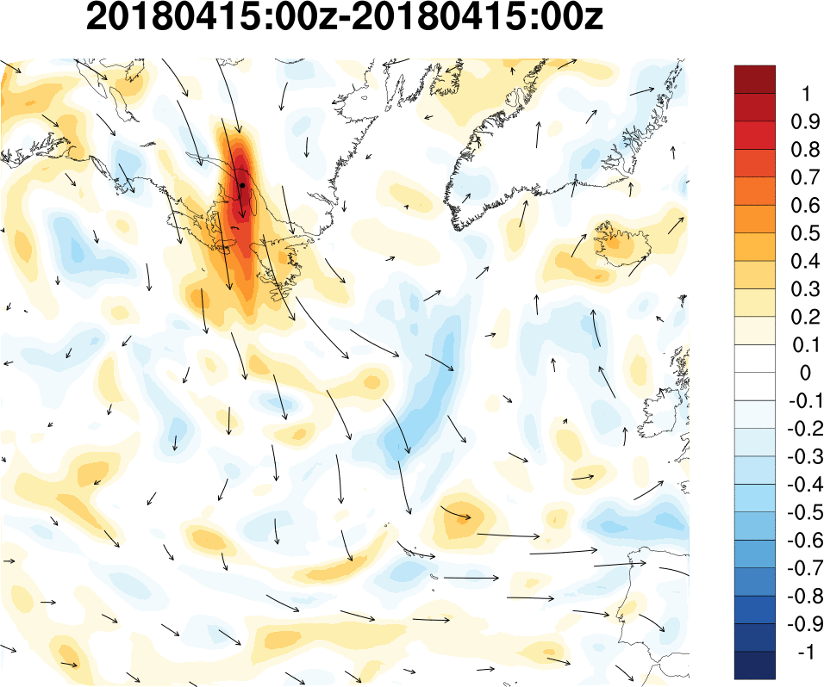
Temperature Time Correlation at 250hPa
time
correlation
at this point
IOS-2: Improved Assessment of Observation Impact
FV3-GEOS 0.5º 32-members
Notes:
Temperature component time correlations at 250hPa (model level 43) Colors represent the correlation between the temperature component valid at the given location and corresponding time (1,2,3,.., 6hrs) and the temperature component valid at t = 0hr at location 65.3oW, 49.3oS (indicated by the black dot).
Since the sampling noise on covariance is inversely proportional to the size of the ensemble, a larger ensemble could partially alleviate the problem, but at a higher computational cost.

Slide 13
Impact of Observing Systems Project Review
IOS-1: Toward Near-Real-Time FSOI Capability and inter-comparison
IOS-2: Improved Assessment of Observation Impact
IOS-3: Impact-based Adaptive Observation Processing
1 cycle, 80 members, 30hr forecast at full resolution (T574/T1534):
~ 560 core*hours & ~2 Tb disk
Multiply by 3.09 to convert in Discover Standard Billing Units (~1600 SBU)
E-FSOI must be updated to NEMS GSI/GFS

Slide 14
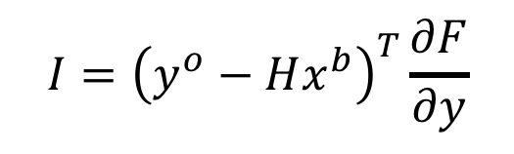
IOS-3: Impact-based Adaptive Observation Processing
Seek for the radiance bias correction that maximizes FSOI:
Use Machine Learning to compute bias correction coefficients (MLBC)
Do not limit the number of predictors. (big data)
$$I={\left(y^{o}−Hx^{b}\right)}^{T}\frac{∂F}{∂y}$$
impact
innovation
sensitivity
Can Forecast Sensitivity to Observations be predicted?

Slide 15
FSOI Machine Learning
Software: TenserFlow on Amazon
Data: Dec 2014, Jan 2015 & Feb 2015
Focus initially on AMSU
Training: Dec 1 – Feb 14
Prediction: Feb 14 - 28
Predictors: all FV3 first guess variables:
2D: Topography geopotential, Surface temperature, Fraction-of-land, Fraction-of-land-ice, Fraction-of-lake, Fraction-of-ocean, Fraction-of-ocean-ice, Surface Pressure. 3D: Pressure Thickness, Zonal Wind, Meridional wind, Virtual Temperature, Specific Humidity, ozone, Mass Fraction Cloud Ice Water, Mass Fraction Cloud Liquid Water.
IOS-3: Impact-based adaptive observation processing

Slide 16
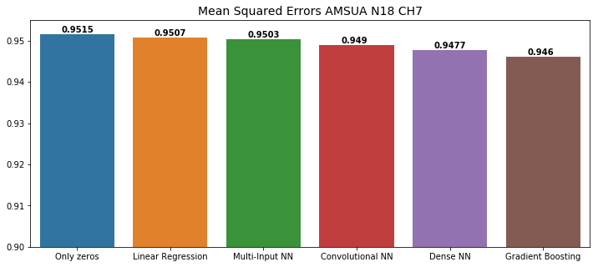
IOS3: Machine Learning Results
for GMAO Dec-Jan-Feb 2015 sensitivity AMSU N18 channel 7
IOS-3: Impact-based adaptive observation processing

Slide 17
Impact of Observing Systems Project Overview
IOS-4: Evaluate and Advance GNSSRO Data Assimilation, assist Transition to Operations (common with NIO)

Slide 18
GNSSRO UFOs developments & new platforms evaluation
Port GNSSRO operators (GSI NBAM, ROMSAF ROPP 1D/2D) in JEDI (H. Zhang’s presentation)
Evaluate GNSSRO new platforms: Kompsat-5, Megha-Tropiques, PAZ & MetOp-C (S. Sutta’s poster)
Evaluate NOAA Commercial Weather Data Products (CWDP)
IOS-4/NIO-4: Evaluate and Advance GNSSRO

Slide 19
GNSSRO new platforms evaluation
S. Dutta’s poster
IOS-4/NIO-4: Evaluate and Advance GNSSRO

Slide 20
Impact of Observing Systems Project Overview
Plan for 2019:
Extend FSOI inter-comparisons (with USAF & NRL)
Implement Cloud-based metrics (with USAF/NCAR and NRL)
Finalize FSOI Adjoint capability (with NASA)
Advance FSOI Ensemble capability (with NASA and NOAA)
Revisit Machine Learning (with NRL)
Complete CWDP evaluation (with NOAA/STAR)

Slide 21
Additional Slides

Slide 22
Forecast Sensitivity to Observations Impact (FSOI)
Fcst Error
observations assimilated
Langland and Baker (2004)
Time
-6 h
0 h
+24 h
Adjoint-derived (single outer-loop) observation impact
Ensemble-derived observation impact
Notes:
Build the illustration in a few steps, click by click....

